Slide 1
The (Long Awaited) ECHO and GCMD Merge
Dana Shum
1/7/2016
The material is based upon work supported by the National Aeronautics and Space Administration under Contract Number NNG15HZ39C

Slide 2
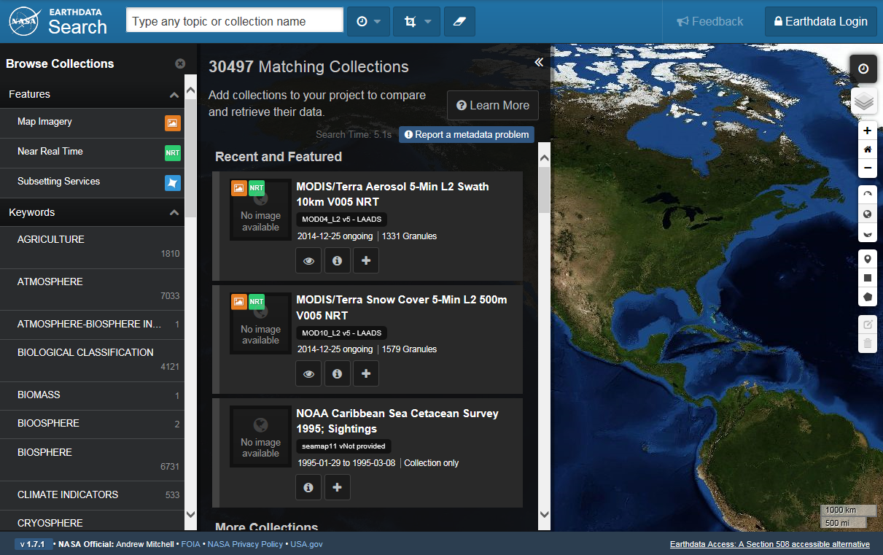
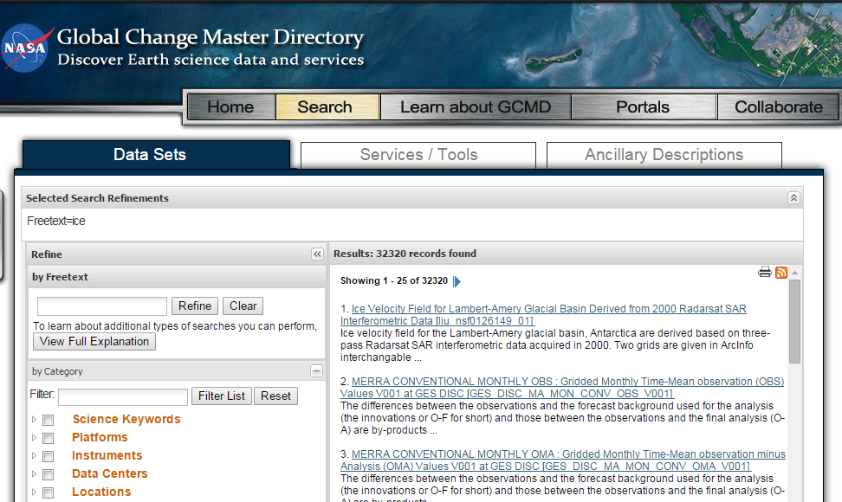
Lots of Work, Inconsistent Results!
Help! We’re exhausted
Data Providers
ECHO
GCMD
2660 != 32320
Help! I’m confused
User

Slide 4
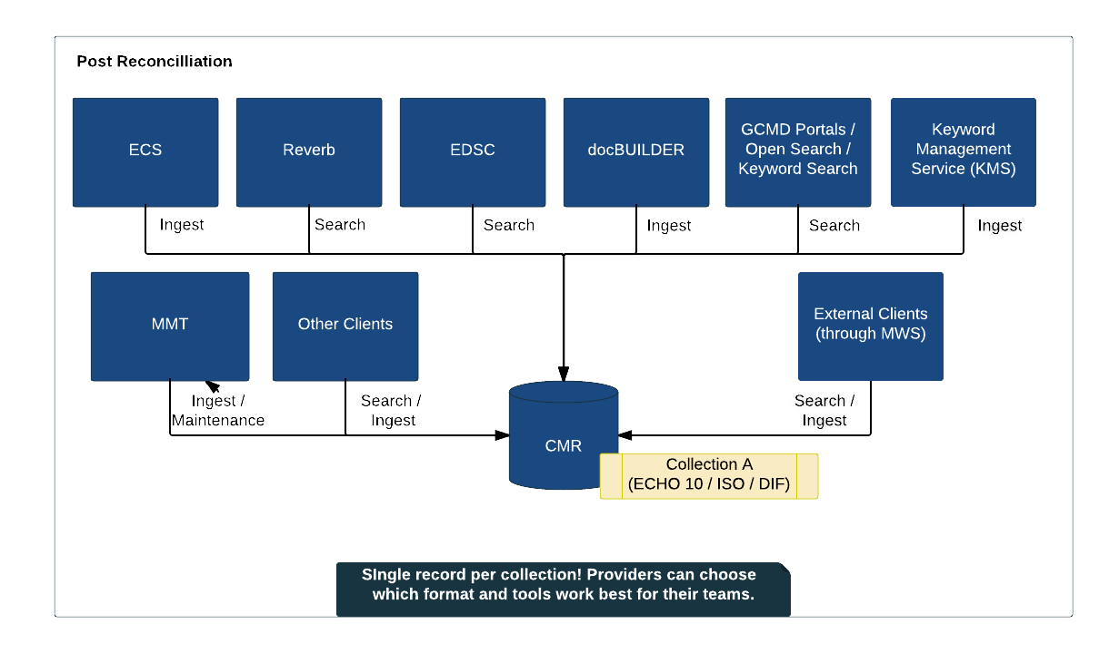
Feb 8th!

Slide 5
Less Work, Consistent Results!
What should we do with our free time?
Data Providers
CMR
32320
32320 = 32320
Good! The world makes sense again
User

Slide 6
And More Benefits…
All clients are now able to see IDN data
All clients benefit from tagging capability
All clients benefit from Hierarchical facet responses
GCMD clients benefit from the CMR speed (sub-second search)
All metadata benefits from translation services and revision history services
All clients benefit from validation with KMS keywords
All metadata benefits from additional curation
New more flexible JSON query language

Slide 7
How Did We Do That?
System Integration
Stop requirements paralysis, set the devs free
Prioritize, prioritize, prioritize
Show progress weekly
Data Integration
Meet one on one with each provider
Provide custom analysis of holdings as often as needed
Monthly tag-ups with all providers to allow them to learn from each other
Be flexible
Prioritize, prioritize, prioritize

Slide 8
This material is based upon work supported by the National Aeronautics and Space Administration under Contract Number NNG15HZ39C.

