Slide 1
Earthdata Search and Global OpenSearch
ESIP Winter Meeting 2016
Doug Newman (NASA Earthdata – Raytheon)
Andrew Mitchell (NASA Earthdata)
The material is based upon work supported by the National Aeronautics and Space Administration under Contract Number NNG15HZ39C

Slide 2
Where are the ‘best’ data about a local phenomena?
At the local agency corresponding to that phenomena
Notes:
I spoke at length about this use case in the Summer ESIP meeting.
If I am interested in the Sea Surface Temperature of the Indian Ocean it seems logical to assume that the best data for that would reside in an Indian agency as they should have the most interest in that area.

Slide 3
No puppies…
Notes:
I’ve been a bit alarmed at the amount of references to puppies in our conferences. I wanted to use something I felt more demonstrative of what we are doing. People of all stripes coming together to do good but hard work in a communal environment.
But I didn’t think Soviet-Era propaganda posters would get passed Corporate. Oh well…

Slide 4
How do I discovery that local data?
Go to the local provider?
Use the tools we already know?
Notes:
But I digress… Accepting the ‘local is good’ argument how do I go about discovering their data?
Do I go straight to the source or do I use the federated tools that I know about? Earthdata Search? CMR? Reverb? Etc.

Slide 5
No Kittens…
Notes:
That’s the last one I promise

Slide 6
Discovering local data in 2015
We could go to the ‘source’ but that presents problems
We had some great tools providing fast and sophisticated access to a vast amount of data. But some data was not available using those tools
I showed you a ‘Third Way’
CWICSmart + IDN OpenSearch + CWIC
Notes:
How it was in 2015
Going to the ‘source’ of the data you are interested in becomes problematic if you have many sources. In some cases, even a singular source can be difficult to exploit if you don’t ‘know your way around’
Earthdata Search and Reverb, coupled with CMR, provided fast and sophisticated access to all of the NASA’S EOSDIS holdings. That was over 260 million granules.
But if the data you are interested in wasn’t resident in an EOSDIS provider then you needed to look elsewhere.
I told you about CWICSmart, a proof-of-concept client that leveraged the IDN OpenSearch API and the CWIC server for collection and granule discovery for a large number of non-US agencies like ISRO, INPE and EUMETSAT.

Slide 7
Discovering local data in 2016
Earthdata Search now allows you to discover collections whose granule inventories are not resident in CMR but are accessible through CWIC
Notes:
It’s 2106 and I’m going to revise what I said about Earthdata Search.
You can now find CWIC-enabled collections via Earthdata Search!

Slide 8
Let’s find some data

Slide 9
Indian ocean surface temperature
I find the local agency using Google - ‘Indian Space Research Organization’
I search Earthdata Search with ‘sea surface temperature isro’
I get INSAT-3D Imager Level-2B Sea Surface Temperature
I get KALPANA-1 VHRR Level-2B Sea Surface Temperature
☺☺☺
Notes:
Here is the same use case I used in the Summer ESIP meeting. In the Summer I demonstrated that such a use case was fruitless in Earthdata Search. That is no longer the case.
Smiley faces!

Slide 10
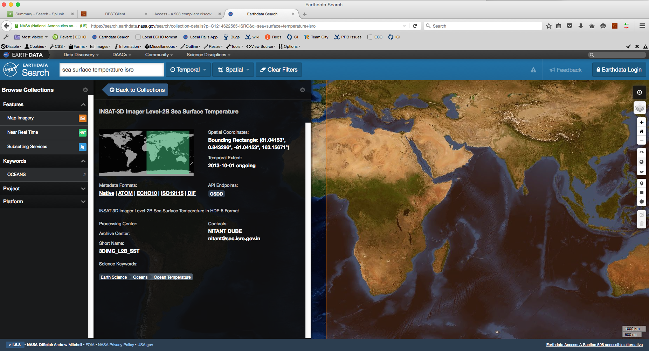
ISRO collections in Earthdata Search
Notes:
Here it is. I can search for ‘search surface temperature isro’ and find a collection from the ISRO data provider. Not NASA, Not USGS. Not NOAA.

Slide 11
This data came from
INDIA!
Notes:
ISRO. India.
That is really awesome.

Slide 12
Isn’t that awesome?
Notes:
I think so.

Slide 13
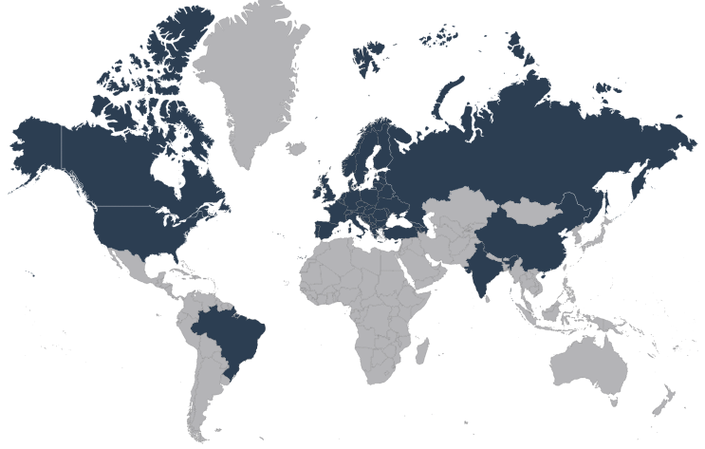
The pros – agency coverage
Notes:
NASA, USGS, NOAA, INPE, EUMETSAT, ESA, ISRO, CCMEO
In the near-term AOE and ROSCOSMOS
In the not so near term - Australia

Slide 14
The cons
No granule level search. Talk to us in a month or so…
Few search query terms across the board
Probably not as fast
Direct download not always available
Download process is not as sophisticated as CMR
Bottom line: your user experience will not be as rich when working with non-CMR granule inventories.
Notes:
No granule search yet. Give us a couple of sprints
Your search capabilities for CWIC collections will not be as rich as CMR-resident granule inventories
They won’t be as fast either.
Download capabilities will vary from provider to provider and utilize their own registration process. Like NASA they need to know who and how many are downloading their data too. Which is fair.
The wealth of options and ease of use presented to you for CMR data download (subsetting, reformatting through a uniform interface). You will have to leave the earthdata environment to do this

Slide 15
We are building a better world through…
Global Search @
https://search.earthdata.nasa.gov
Notes:
‘We are building a better world through…’ well maybe not but it may help…
CWIC allows Earthdata Search to get collection level metadata from a large number of agencies. Soon you will be able to discover and download data at a granule level through those agencies too
So it’s not just Global OpenSearch anymore. It’s GLOBAL SEARCH

Slide 16
Questions?
Notes:
Thank you very much

Slide 17
This material is based upon work supported by the National Aeronautics and Space Administration under Contract Number NNG15HZ39C.

