Slide 1
NGAP: Compliance as a Service in the Public Cloud
Andrew Pawloski – andrew@element84.com
Brett McLaughlin – brett@element84.com
Dan Pilone – dan@element84.com
Marc Huffnagle – marc@element84.com
Peter Plofchan – peter.g.plofchan@raytheon.com

Slide 2
Traditional Application Hosting
Notes:
Data centers are never actually this sexy

Slide 3
Traditional Application Hosting
Estimate magnitude
Order/install hardware
Manage on premises until hardware EOL

Slide 4
The cloud is a bit different..
Notes:
This is the view of your data center when you’re in the cloud
(That’s a poorly executed slide. You’re looking at an “ec2 describe” command listing our infrastructure)

Slide 5
The cloud is a bit different..
Unlimited* virtual machines
Hosts are created/disposed frequently
IP addresses change
Instance storage clears
Shared trust model
Hardware
Managed software services
*Not really, but enough capacity for us to think of it this way

Slide 6
With natural “wins” of its own
Iteration is faster
Resources procured via API calls
Pay for what you use
Leverage provider’s economy of scales
Scaling is easy, automatable
Vertical/horizontal
High availability is trivial
Managed load balancer services
Notes:
How do we leverage these wins in a way that meets the security and compliance standards

Slide 7
NGAP pitch statements & Goals

Slide 8
NGAP in 10 seconds
NGAP* is a cloud platform for Earthdata applications. It offers scalable, highly-available deployments in a NASA-sanctioned, control-compliant environment.
*NGAP=Next Generation Application Platform
Notes:
A NASA-sanctioned, controls-compliant

Slide 9
NGAP in 60 seconds
NGAP’s intent is to handle much of the undifferentiated heavy lifting that application teams must go through to get up and running with an application or experiment. By maintaining a common underlying platform and leveraging certain advantages of the cloud, it allows developers and application owners to rapidly deploy their projects in a NASA-compliant environment.

Slide 10
NGAP in one second
$ ngap-deploy hello-world hello-world.tar
TO
https://hello-world.earthdata.nasa.gov
Notes:
NASA.GOV domain name – secure, sanctioned NASA environment

Slide 11
1,000 Foot Overview
NGAP Base AMI
(Secure)
- ESDIS “blessed” component
ECC
(Code testing, tracking, deployment)
NGAP Builder
(Creates “slug” from ECC-hosted codebases)
App Source Code
NGAP-compliant AMI
(Application)
NGAP-compliant AMI
(Application)
NGAP-compliant AMI
(Application)
NGAP Services
(Monitoring, Logging, Security, Autoscaling, Billing, etc.)
Usable cloud “platform”
OCIO GP-MCE* (AWS Reseller)
*General Purpose Managed Compute Environment

Slide 12
NGAP Architecture

Slide 13
NGAP Applications
12-Factor (http://12factor.net/)
Externalized state, configuration
Interacts with services via port binding
No distinction between local/remote services
Disposable
Fast startup / graceful shut down
Logging via STDOUT and STDERR
Let process manager handle log stream

Slide 14
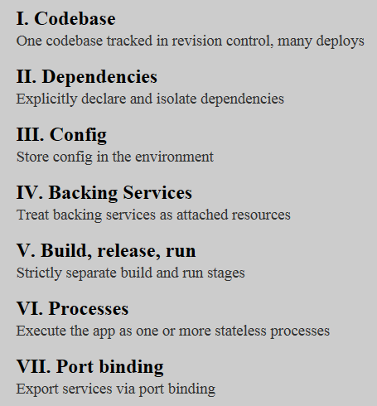
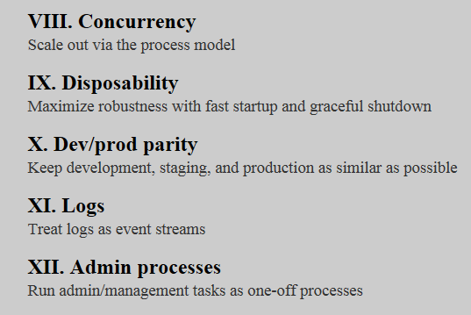
Twelve-Factor App methodology
https://12factor.net

Slide 15
NGAP Components
API Nodes
Serve NGAP platform requests
Deploys applications
Maintains system state
Routers
Directs traffic from ELB to application nodes
Enable wildcard DNS for NGAP platform
App Nodes
Notes:
Platform requests – deploying applications, reporting statuses, changing environment variables

Slide 16
App Hosting Architecture
*.ngap.earthdata.nasa.gov
Balances between routers. High-availability entry point
Elastic Load Balancer
Nginx
Routes to all hosts
Router
Router
Host
Host
Host
Host
Hardened RedHat AMI
App 1
App 1
App 2
App 1
App 2
Availability Zone
Availability Zone
Amazon RDS
NGAP Hosted Apps

Slide 17
NGAP Platform
platform.ngap.earthdata.nasa.gov
*.ngap.earthdata.nasa.gov
Self-Service Console
Elastic Load Balancer
Log Aggregation
Router
Router
Monitoring
Host
Host
Host
Host
App 1
App 1
App 2
App 1
App 2
Backups
Availability Zone
Availability Zone
NGAP Platform
Amazon RDS
NGAP Hosted Apps

Slide 18
NGAP App Deployment

Slide 19
1. Build Slug
Bamboo
platform.ngap.earthdata.nasa.gov
*.ngap.earthdata.nasa.gov
Language Buildpacks
Git repo
Elastic Load Balancer
Slug Builder
Router
Router
Artifact
Metadata
Application Slugs
Application Settings
Availability Zone
Availability Zone
NGAP Platform
Amazon RDS
NGAP Hosted Apps

Slide 20
2. Start Instance(s)
Bamboo
platform.ngap.earthdata.nasa.gov
*.ngap.earthdata.nasa.gov
Git repo
Elastic Load Balancer
Slug Builder
Router
Router
Artifact
Metadata
Host
Host
Application Slugs
Application Settings
Availability Zone
Availability Zone
NGAP Platform
Amazon RDS
NGAP Hosted Apps

Slide 21
3. Fetch slug from S3
Bamboo
platform.ngap.earthdata.nasa.gov
*.ngap.earthdata.nasa.gov
Git repo
Elastic Load Balancer
Slug Builder
Router
Router
Artifact
Host
Host
Application Slugs
Availability Zone
Availability Zone
NGAP Platform
Amazon RDS
NGAP Hosted Apps

Slide 22
4. Start slug
Bamboo
platform.ngap.earthdata.nasa.gov
*.ngap.earthdata.nasa.gov
Git repo
Elastic Load Balancer
Slug Builder
Router
Router
Artifact
Metadata
Host
Host
App 1
App 1
Application Slugs
Application Settings
Availability Zone
Availability Zone
NGAP Platform
Amazon RDS
NGAP Hosted Apps

Slide 23
5. Update routers
Bamboo
platform.ngap.earthdata.nasa.gov
*.ngap.earthdata.nasa.gov
Git repo
Elastic Load Balancer
Slug Builder
Router
Router
Artifact
Metadata
Host
Host
App 1
App 1
Application Slugs
Application Settings
Availability Zone
Availability Zone
NGAP Platform
Amazon RDS
NGAP Hosted Apps

Slide 24
NGAP Services

Slide 25
NGAP Services
System maintenance
Hardened images, Updates
Logging
Platform Elasticsearch/Logstash/Kibana
Offsite Splunk forwarding
Monitoring
Nagios
CloudWatch

Slide 26
NGAP Services (cont’d)
SSL/TLS
Highly Available Deployments
Application Maintenance Mode
Ingress/Egress Firewall
Database infrastructure*
ACLs, encryption
Backups/Disaster Recovery
Notes:
* DBI is really RDS. We provide instances using a compliant configuration (access control, encryption, etc)

Slide 27
1,000 Foot Overview
NGAP Base AMI
(Secure)
- ESDIS “blessed” component
ECC
(Code testing, tracking, deployment)
NGAP Builder
(Creates “slug” from ECC-hosted codebases)
App Source Code
NGAP-compliant AMI
(Application)
NGAP-compliant AMI
(Application)
NGAP-compliant AMI
(Application)
NGAP Services
(Monitoring, Logging, Security, Autoscaling, Billing, etc.)
Usable cloud “platform”
OCIO GP-MCE* (AWS Reseller)
*General Purpose Managed Compute Environment

Slide 28
NGAP: Compliance as a Service in the Public Cloud
Andrew Pawloski – andrew@element84.com
Brett McLaughlin – brett@element84.com
Dan Pilone – dan@element84.com
Marc Huffnagle – marc@element84.com
Peter Plofchan – peter.g.plofchan@raytheon.com

Slide 29
This material is based upon work supported by the National Aeronautics and Space Administration under Contract Number NNG15HZ39C.

