Slide 1
Send2NCEI:
Fostering Producer-Archive Propinquity..
Kenneth S. Casey, PhD
Deputy Director, Data Stewardship Division
John Relph
Technical Development Team Lead, Software Engineering Branch, Data Stewardship Division
Notes:
Propinquity: the state of being close to someone or something; proximity

Slide 2
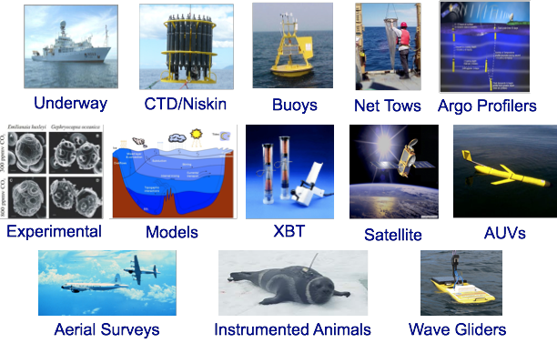
The NODC Mission - 2014
“… organized for the purpose of acquiring, compiling, processing and preserving oceanographic data for ready retrieval”

Slide 3
The NCEI Mission - 2015
6: National Services and Intl. Leadership
NCEI Levels of Stewardship
5: Authoritative Records
4: Derived Products
3: Scientific Improvements
2: Enhanced Access and Basic Quality Assurance
Focus
here
today
1: Long Term Preservation and Basic Access
“… responsible for preserving, monitoring, assessing, and providing access to the Nation’s treasure of environmental data and information.”

Slide 4
Open Archive InfoSys (OAIS)
Reminder!
Common Services
PRODUCERS
CONSUMERS
Preservation Planning
Data Management
Ingest
Access
Queries/Results
SIP
Descriptive Info
Archival Storage
DIP
AIP
AIP
AIP
Administration
MANAGEMENT
DIP/SIP = Dissemination/Submission Information Package

Slide 5
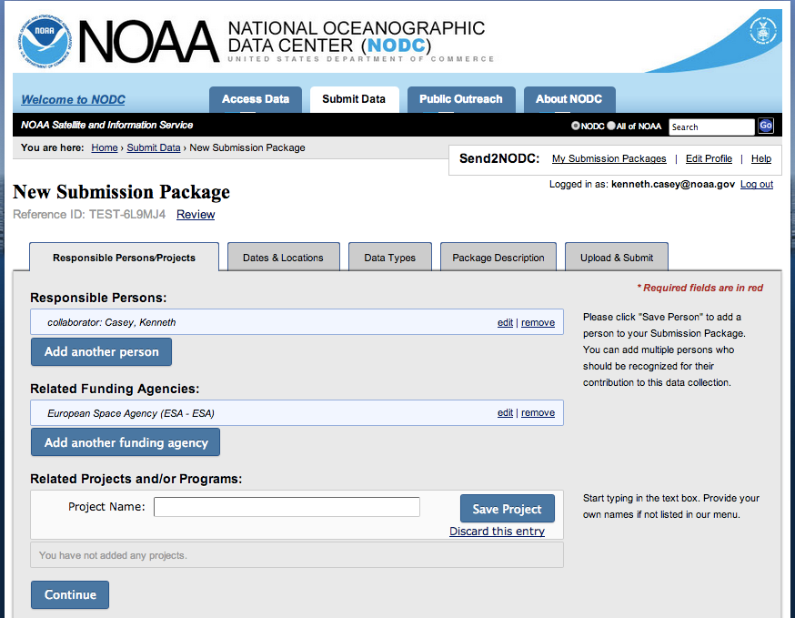
Ingest - Two Primary Methods
Common Services
Automation
PRODUCERS
CONSUMERS
Preservation Planning
Data Management
Ingest
Access
Queries/Results
SIP
Descriptive Info
Archival Storage
DIP
AIP
AIP
AIP
Send2NCEI.
Administration
MANAGEMENT

Slide 6
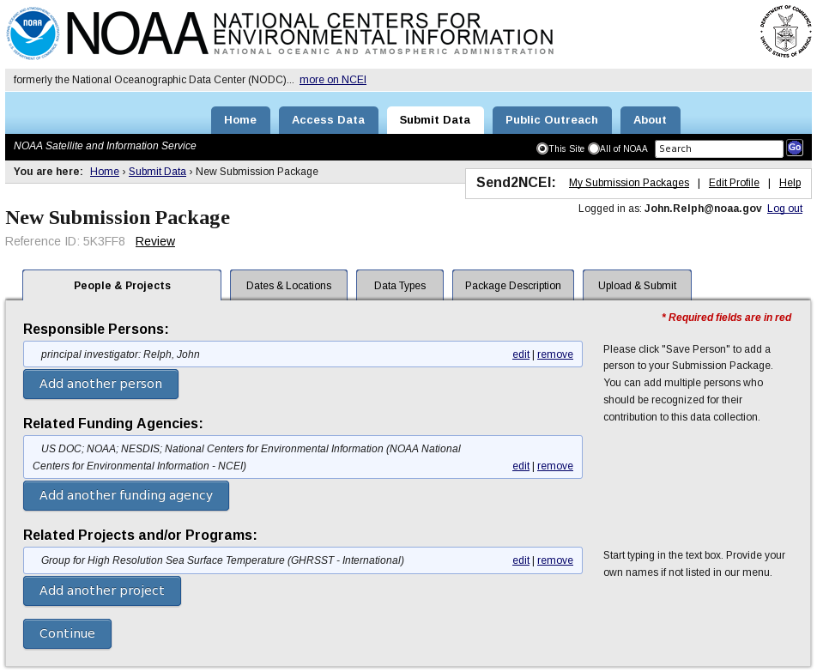
Send2NCEI
A Producer-friendly interface for collecting metadata and uploading data files to the Archive as a well-formed SIP, and...
An internal set of services for inserting the well-formed SIP into the existing Archive workflow
Intended for “one-off” submissions
Notes:
To understand where Send2NODC fits in… need to understand (at a high level, not necessarily at the detailed level), the NODC archive workflow...

Slide 7
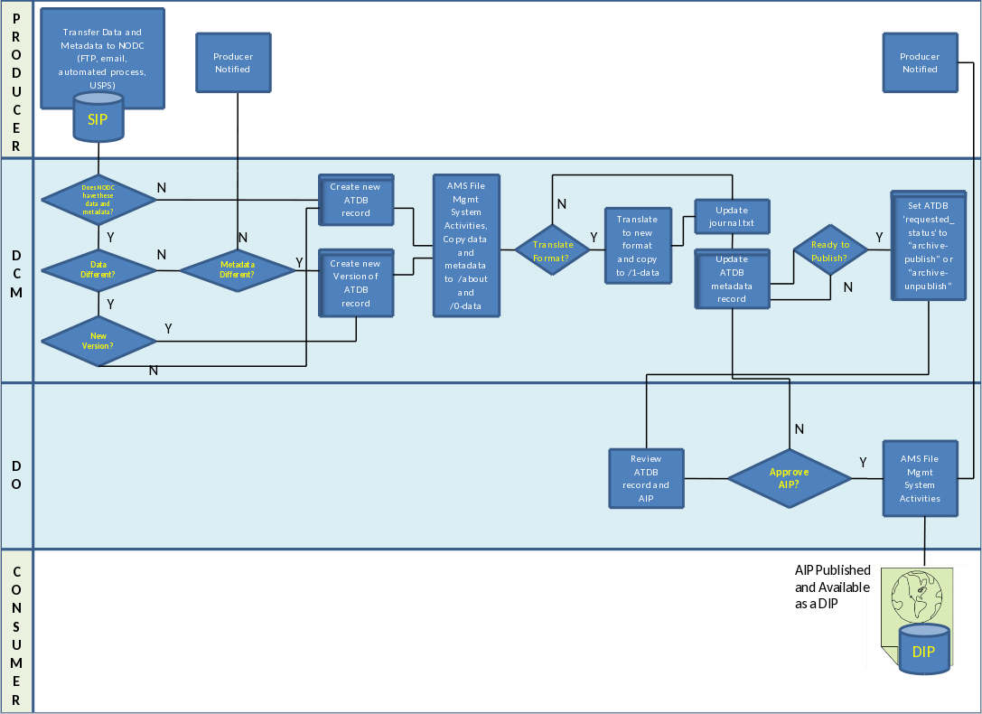
Archive “Swim Lanes”
Producers
Data Content Managers and Data Officers
Consumers
Data Content Managers (DCMs) do the bulk of the archive workflow. Data Officers (DOs) assign the submissions to DCMs, and provide an independent final review.
Notes:
This approach has great strengths: Our archive process is agnostic to both the structure and the content of the SIP. It can transmitted by any means (carrier pigeon? sure, why not?), the metadata can take any format (structured or otherwise), and the file format can vary (widely!). In other words, we have designed our system to be as easy as possible on the Producer, who has of course already done a lot of work to collect the data..

Slide 8
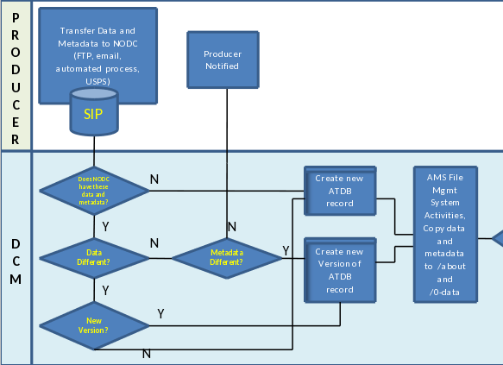
Archive “Swim Lanes”
Making it simple here...
… makes it harder here*
* and some things, like file integrity checks, are basically impossible
Notes:
But these strengths can also be a weakness. The SIP between the Producer swim lane and the Data Content Manager (DCM) lane is currently highly heterogeneous in every aspect: transmission method (ftp, email, etc.), the metadata "format" (readme file, email content, etc.), and the file format. This heterogeneity can create an additional burden on our DCMs, and it is harder to capture the kind of information that we really want (instead of just the minimums) in a structured way. NODC netCDF templates are already attacking the file format problem, and Send2NODC attacks the other two problems, thereby more rapidly advancing the DCM through his or her swim lane.

Slide 9
Send2NCEI
Addresses two of the three SIP heterogeneity problems*
unstructured/missing metadata
variable transmission
Enforces structure while still attempting to keep it simple and easy for the Producer
Improves overall quality and integrity
Reduces the DCM level of effort (and to a lesser extent, the DO’s)
* The third, varying file formats, is being addressed by the NODC netCDF templates
10

Slide 10
Send2NCEI Producer UI Flow
Create new account
new submitter
Login
forgot password
Retrieve password
existing
Edit Account Profile
My Submission Packages
Change password
Track Submitted
Create New
Edit Current
View Archived
1. People & Projects
2. Dates & Locations
3. Data Types
4. Package Description
5. Upload & Submit
Store Metadata
Store Data
Send Confirmation Email, Update Tables
11

Slide 11
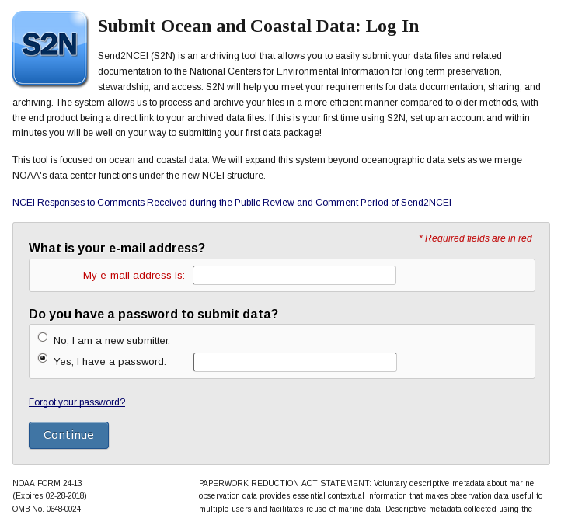
Login
Login or create account (< 3 minutes)
Meets numerous federal requirements (password complexity and recovery, “fine print” legalese, etc.)
Introduces user interaction model

Slide 12
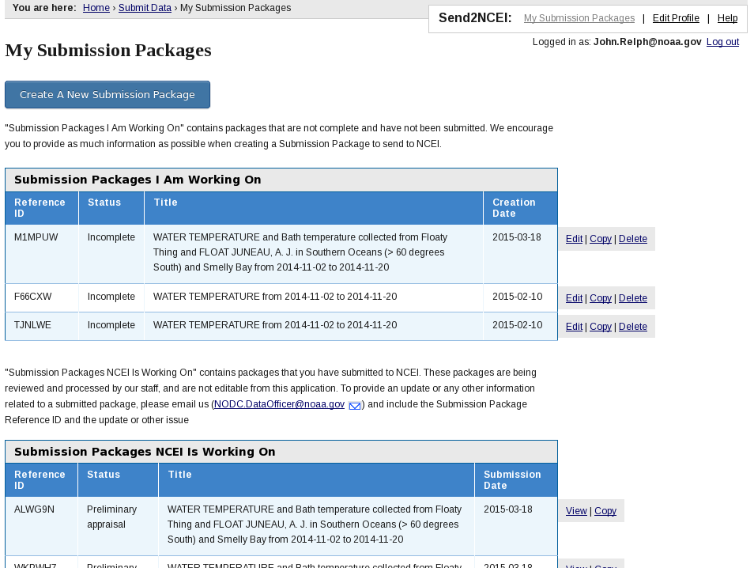
My Submission Packages
“Control Panel”
Establishes user presence “in app”
Create new packages
Edit/delete active packages
View submitted packages
Link to archived packages

Slide 13
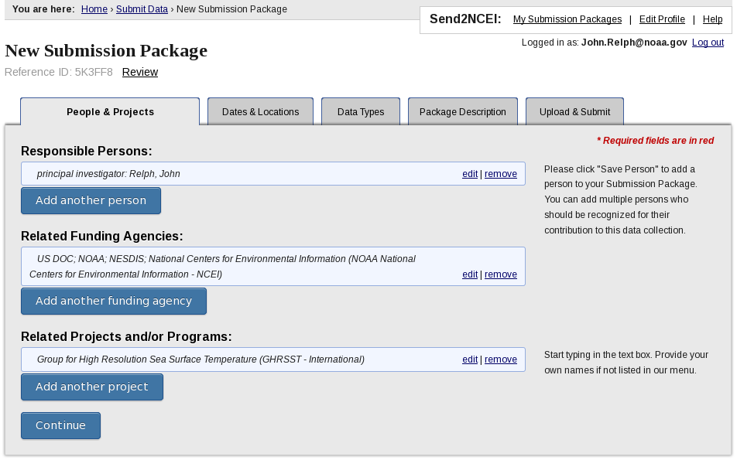
1. People & Projects
Well defined user interaction model (autocomplete, instant validation, repeating entries, etc.)
Multiple persons, multiple ISO roles
Projects
Funding Agencies

Slide 14
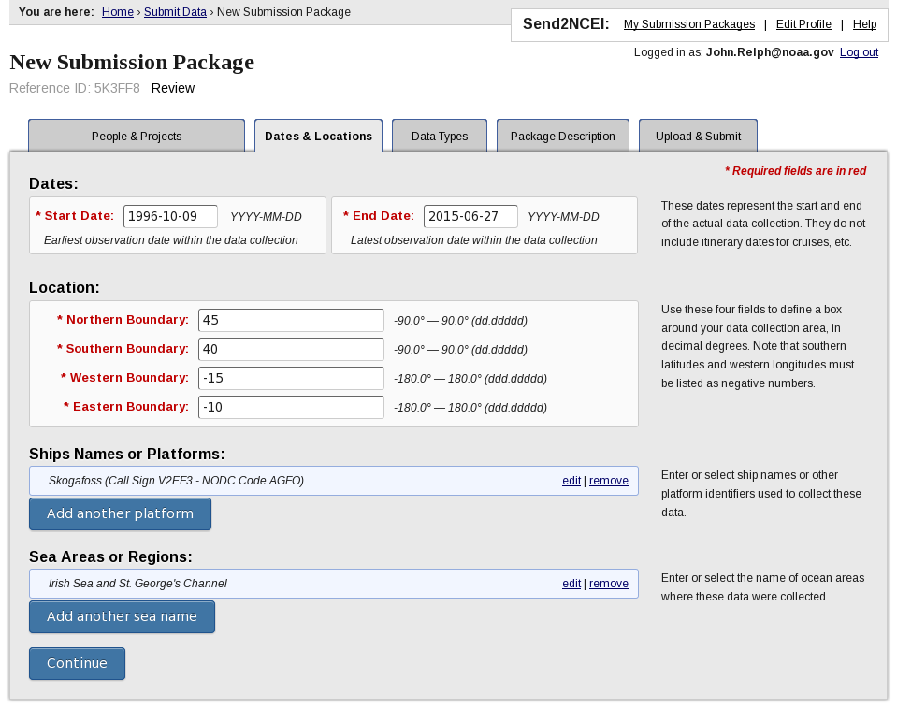
2. Dates & Locations
Dates
Locations
Platforms
Sea Areas/Regions

Slide 15
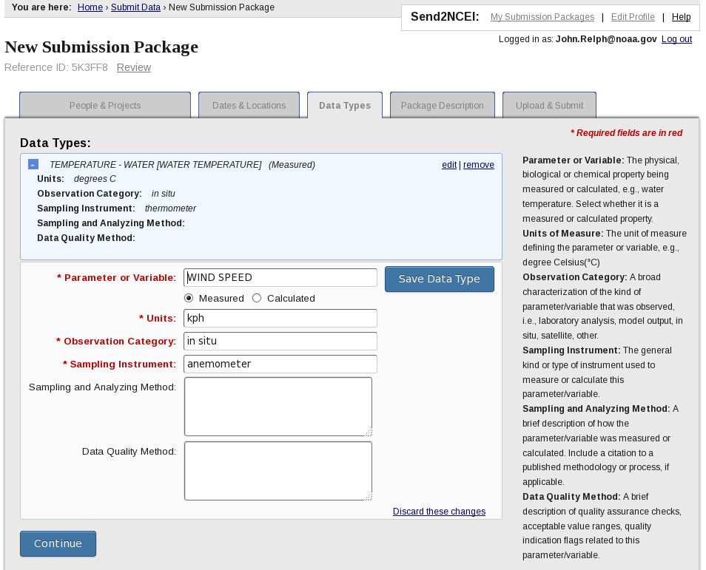
3. Data Types
Variables
Units (UDUNITS)
Instrument
Observation category
Can include methods and data quality info

Slide 16
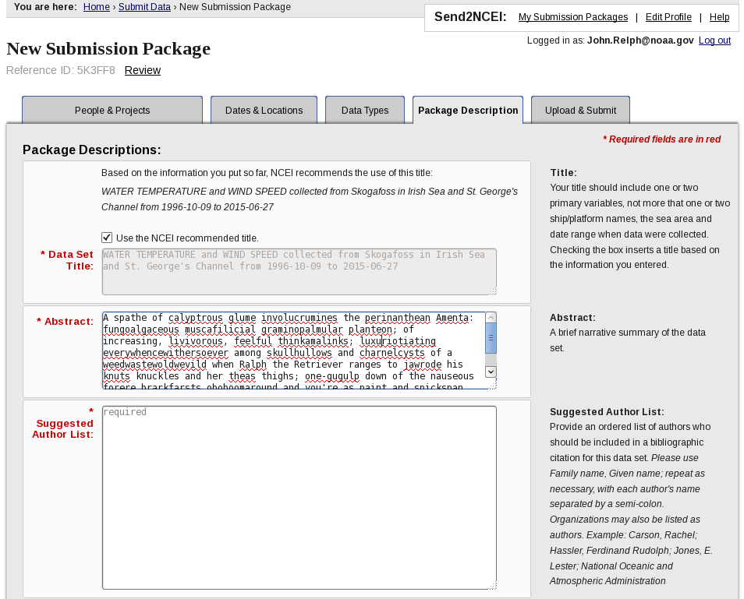
4. Package Description
Title (optionally auto-generated)
Abstract
Authorship List for DOIs
Purpose
References

Slide 17
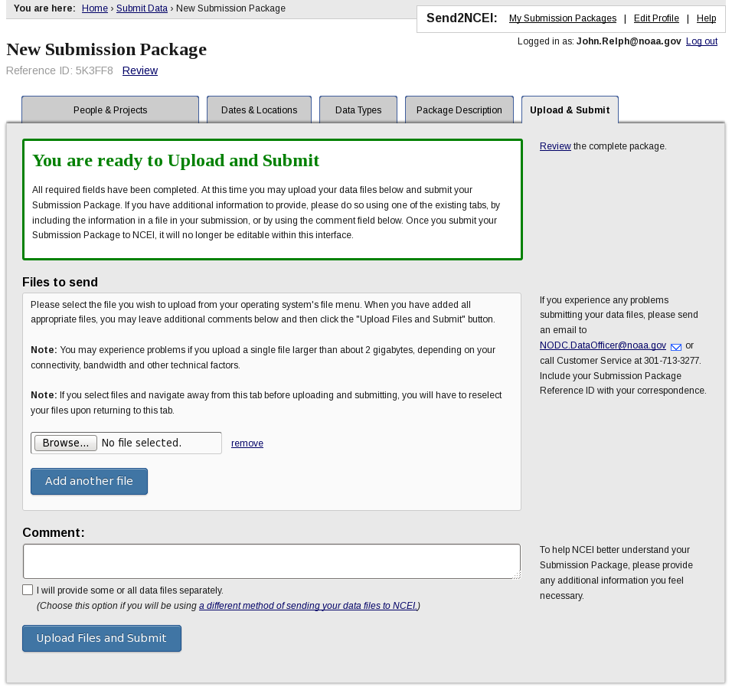
5. Upload & Submit
Upload files
Can separately provide some or all files if needed
Comment on overall package
Validate package prior to upload/submit
Newbies averaged less than 20 minutes!

Slide 18
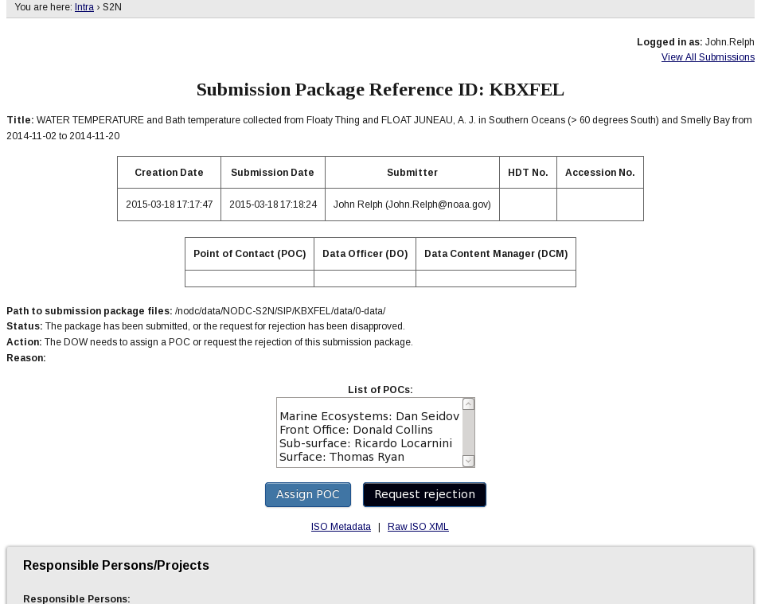
Send2NCEI Internal UI
Initial Appraisal by Data Officer of the Week (DOW)
S2N creates Help Desk Ticket (HDT)
HDT links to package metadata
DOW appraises and selects appropriate Unit/Team
Unit POC/DO assigns Data Content Manager (DCM)
Retrieve password
Change password
Send Confirmation Email, Update Tables
View Archived
forgot password
1. Responsible Persons/Projects
XML + data
Edit Current
existing
2. Dates & Locations
My Submission Packages
Store Data
Login
3. Measured Parameters
4. Package Description
5. Upload & Submit
Create New
new submitter
Create new account
Track Submitted
Store Metadata
Edit Account Profile

Slide 19
Send2NCEI Internal Process
Initial Appraisal By Data Officer of the Week (DOW)
S2N creates Help Desk Ticket (HDT)
HDT links to package metadata
DOW appraises and selects appropriate Unit/Team
Unit POC/DO assigns Data Content Manager (DCM)
S2N Stages Data and Metadata for DCM
AIP created in ingest area
Data and Producer’s ISO XML copied to accession
ATDB Brief Access Record pre-populated
HDT updated and DCM notified to begin work
Producer emailed and My Submission Packages updated
Normal Archive Procedures Followed
DCM reviews and interacts with Producer as needed
DCM requests “archive-published” status from DO
DO reviews and approves, or iterates
Producer emailed and My Submission Packages updated

Slide 20
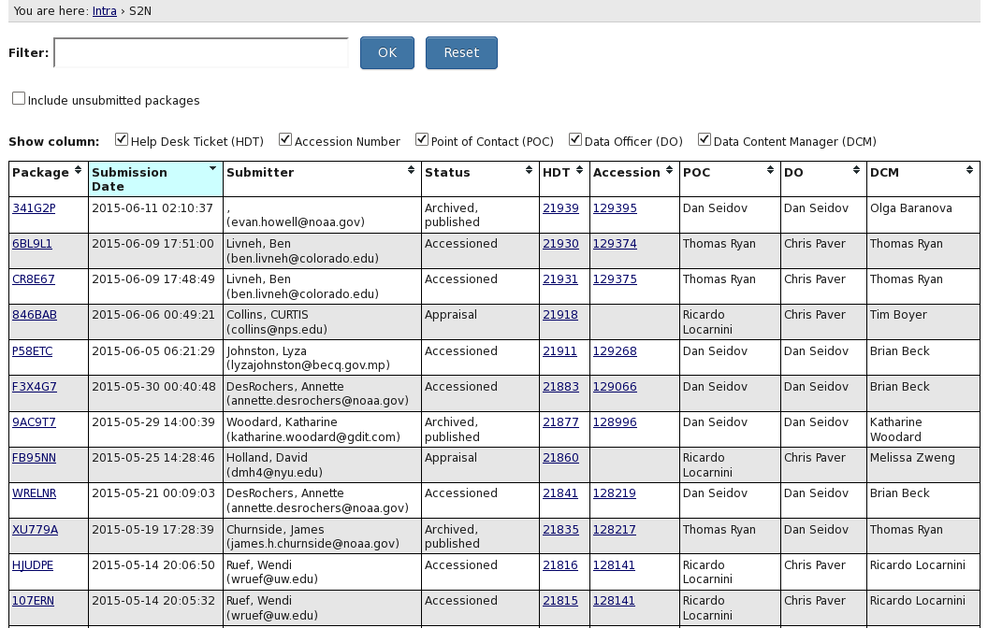
Send2NCEI Internal UI

Slide 21
Magic Happens Here!
Initial Appraisal by Data Officer of the Week (DOW)
S2N creates Help Desk Ticket (HDT)
HDT links to package metadata
DOW appraises and selects appropriate Unit/Team
Unit POC/DO assigns Data Content Manager (DCM)
Retrieve password
Change password
Send Confirmation Email, Update Tables
View Archived
forgot password
1. Responsible Persons/Projects
XML + data
Edit Current
existing
2. Dates & Locations
My Submission Packages
Store Data
Login
3. Measured Parameters
4. Package Description
5. Upload & Submit
Create New
new submitter
Create new account
Track Submitted
Store Metadata
Edit Account Profile
Notes:
I don’t like this slide, I think I’m gonna delete it, and instead just go to the next one, which needs a new title, something like Flexible and Extendable.

Slide 22
What Magic?
Human web interface only loosely coupled to backend processing
All sorts of extensibility is possible
Program-specific “tabs” could require additional metadata
Other machine systems could bypass web interface entirely
Web interface could be used to establish new collection level record for a future automated data stream
Pre-populate fields from an ISO record or a netCDF file
Other/additional vocabularies can be included in auto-complete fields...

Slide 23
Send2NCEI Status
Paperwork Reduction Act approval granted
Public comments collected and responses published
Released on April 22, 2015: https://www.nodc.noaa.gov/s2n/
Integrate into NCEI Archive workflow
Integrate into ATRAC?

Slide 25
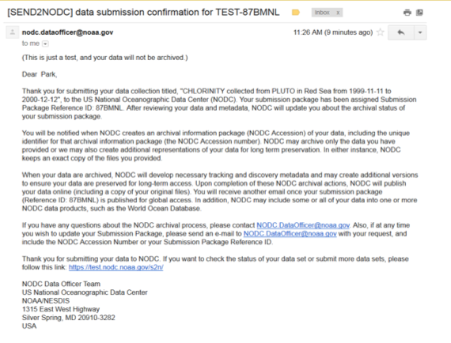
Producer Confirmation Email

Slide 26
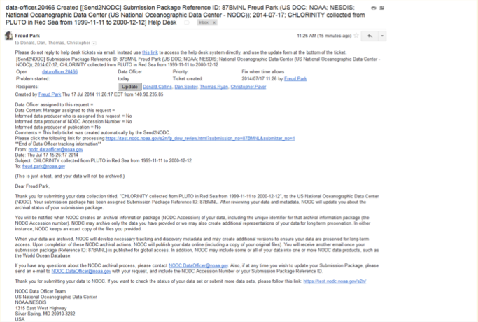
Help Desk Ticket

