Slide 1
ORNL DAAC Semi-Automated Data Ingest Process
Daine Wright (wrightdm@ornl.gov)
Suresh Vannan, Tammy Beaty, Bob Cook, Yaxing Wei, Ranjeet Deverakonda, Harold Shanafield
ESIP Summer Meeting 2015
July 15 2015
http://daac.ornl.gov
https://twitter.com/ORNLDAAC
https://www.facebook.com/OakRidgeDAAC

Slide 2
Ingest “Semi-automation” Why did we do this?
Provide the ability to track a data set from acceptance to publication
Automate steps that can be automated to improve efficiencies and reduce redundancy
Provide a centralized system to manage the various aspects of ingest
Data Files
Documentation
Code
Communications internal and external
Update legacy ingest infrastructure

Slide 3
Key Components
An archival interest form, that identifies an investigator’s data set for archival
Data Provider Questions (DPQ): On-line form that serves as the basis for a metadata record.
DAAC Ingest Dashboard (DID) and Ingest Kit: Data file management system, including PI upload and movement to archive area
Semi-automated QA evaluation
DAAC Online Metadata Editor (DAACOME): Metadata Editor that is capable of producing the data set documentation
Seamless publication

Slide 4
Archival Interest Form
Archival Interest Form

Slide 5
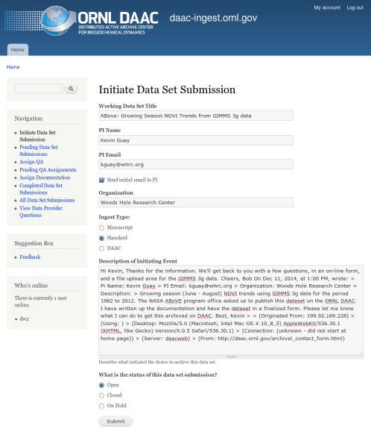
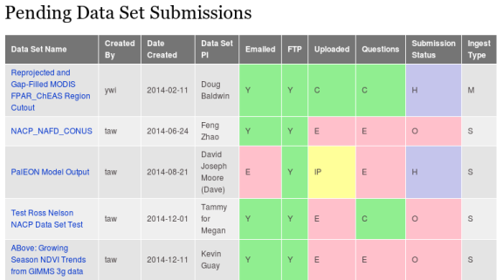
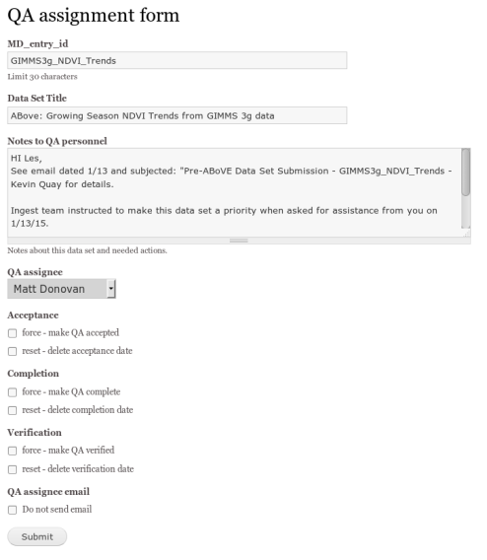
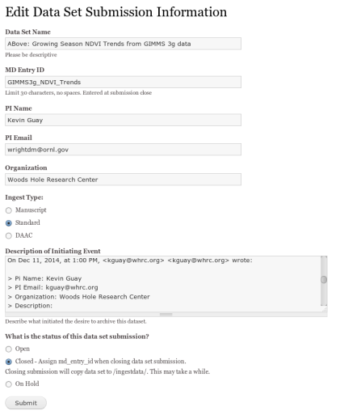
DAAC-Ingest Dashboard (DID)
Format: custom Drupal (php) module with MySQL schema
Adds links to navigation menu
Initiates data set submission
Emails data provider with instruction for data provider questions and data upload
Monitors data upload and data provider questions progress
Assigns QA, emails assignees and coordinator
Assign Documentation, emails assignee and coordinator
Displays the life cycle of a data set submission with completion dates for simplified reporting
Includes DAAC-ingest database schema
https://git.earthdata.nasa.gov/projects/DAACSUB/repos/daac-ingest-automation-dashboard

Slide 6
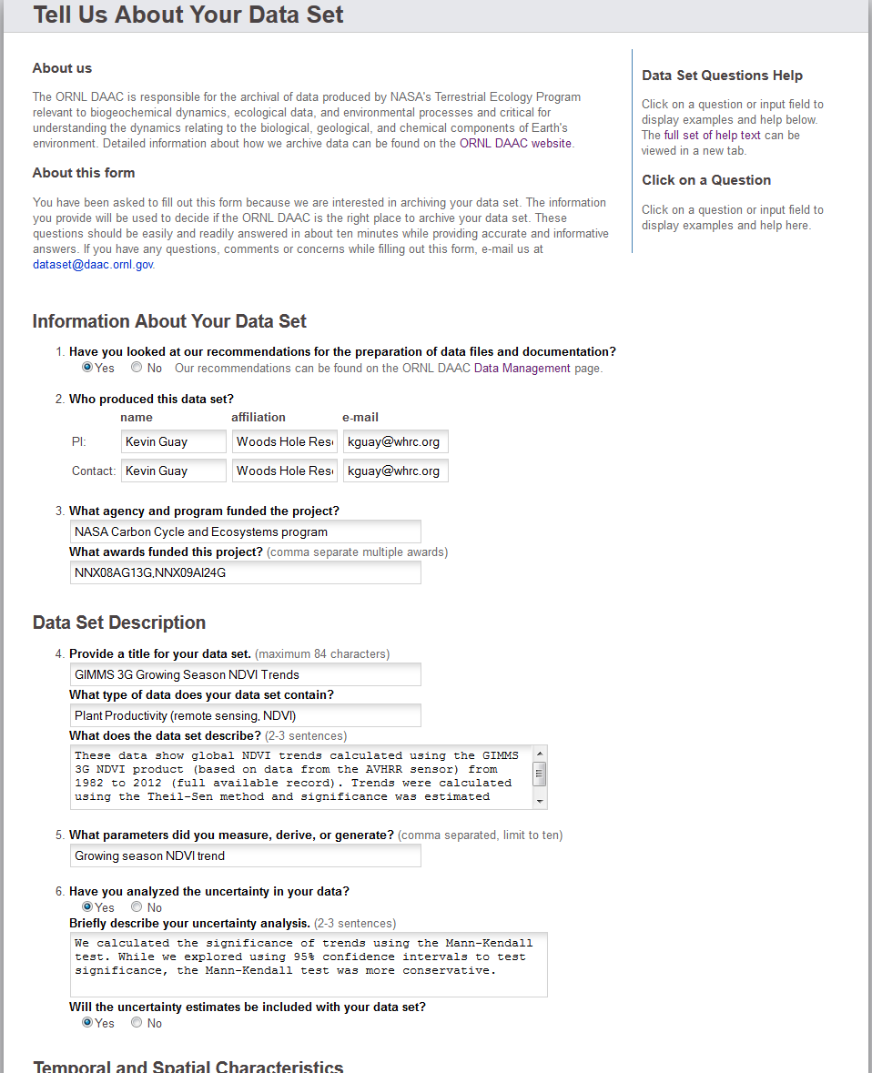
Data Provider Questions (DPQ)
Language: Perl / HTML / JavaScript / MySQL
Answers should be readily available
Form should only take about 20 minutes to complete
Gathers preliminary metadata on data sets
Travels with data set throughout archival process
https://git.earthdata.nasa.gov/projects/DAACSUB/repos/data-provider-questions

Slide 7
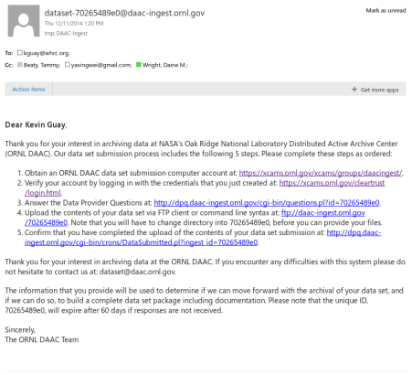
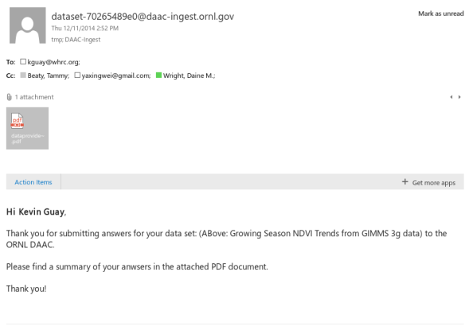
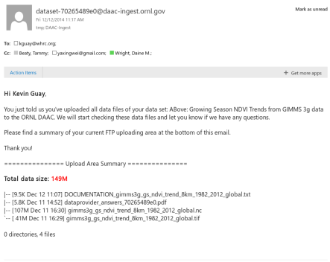
Ingest Kit
Language: Perl
Records emails between data provider and DAAC
Monitors data upload area
Copies files from upload area to storage and QA area
Collects granule level metadata
Backs up MySQL database
https://git.earthdata.nasa.gov/projects/DAACSUB/repos/ingest-kit

Slide 8
DAAC Ingest Automation Swimlanes
Interest
Submission
QA
Documentation
Publication
DP
Archival Interest Form
Create ORNL XCAMS account
Answer Data Provider Questions
Upload
data
Confirm Submission
DP
DAAC Appropriate?
IC
Initiate data set submission
Send initial email to DP
Monitor submission
Verify Data Set completeness
Assign QA staff member
Collect initial metadata
Verify QA and distribution package
Assign Documentation Coordinator
Publish Data Set
IC
Email DP with appropriate alternate archives
QA
Perform QA for granule data & metadata
Iterate with DP/DL/IC
QA
DP
Data Provider
IC
Ingest Coordinator
Create/Edit Metadata
Output
landing page
and guide doc
Assemble Metadata in database
DL
QA
DL
Quality Assurance
DL
Documentation Lead
DS
Scientific Review / Approval DSP
DS
DS
DAAC Scientist

Slide 9
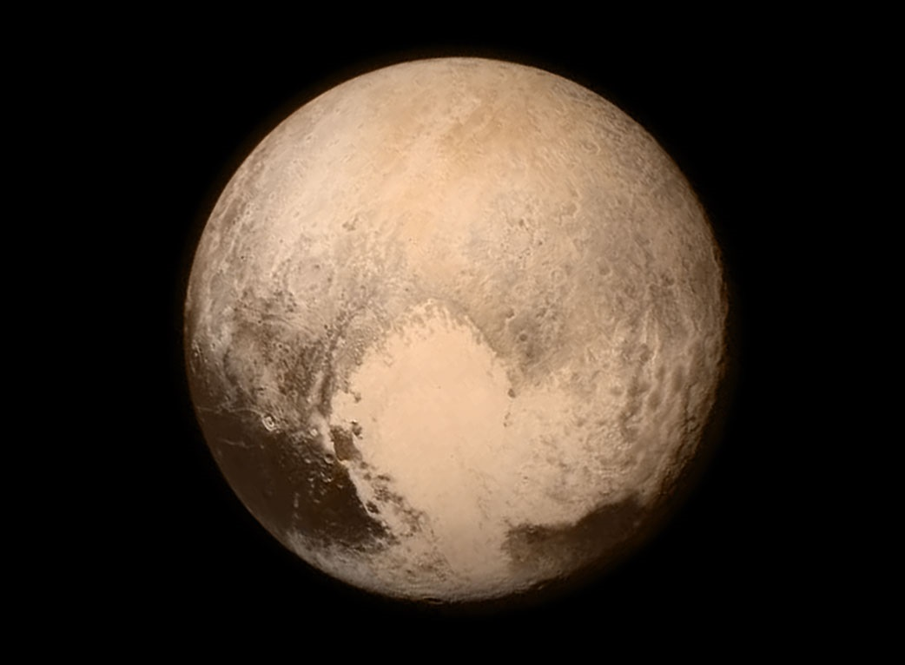
Questions?
Daine Wright (wrightdm@ornl.gov)
http://daac.ornl.gov
https://git.earthdata.nasa.gov/projects/DAACSUB/

Slide 10
Initiate data set submission
Initiate Data Set Submission

Slide 11
Send initial email to DP

Slide 12
Answer Data Provider Questions
Answer Data Provider Questions

Slide 13
Answer Data Provider Questions
Answer Data Provider Questions

Slide 14
Upload
data
FTP upload area

Slide 15
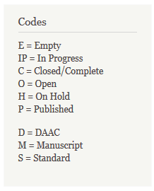
Monitor Submission
Pending Data Set Submissions

Slide 16
Close Submission

Slide 17
Assign QA staff member
Assign QA Staff Member

Slide 18
Assign QA staff member
View QA Assignment

Slide 19
Granule-Level Metadata Template
Field_Name,Field_Description,Required_Raster,Example_Raster,Required_Tabular,Example_Tabular
id,unique identifier for this file. UUID is recommended.,Y,76df854b-7aac-4a8f-a12d-80cf0be3b679,Y,09edaf50-5ba9-11e4-8ed6-0800200c9a66
filename,file name with extension,Y,climate6190_DTR.nc4,Y,air_sea_d-pco2_5d_1995.csv
title,human-readable title for this file,Y,CRU05 0.5 Degree 1961-1990 Mean Monthly Climatology: Diurnal Temperature Range,Y,"ISLSCP II Air-Sea Carbon Dioxide Gas Exchange, 1995, pco2"
file_type,raster/vector/tabular,Y,raster,Y,tabular
file_format,file format,Y,netCDF4,Y,CSV
srs,name for the file's spatial reference system,Y,"Geographic Lat/Lon, Lambert Conformal Conic, Sinusoidal, …",Y,Geographic Lat/Lon
srs_wkt,file's spatial reference system in OGC Well Known Text (WKT) format,N,"GEOGCS[""WGS 84"",DATUM[""WGS_1984"",SPHEROID[""WGS 84"",6378137,298.257223563,AUTHORITY[""EPSG"",""7030""]],AUTHORITY[""EPSG"",""6326""]],PRIMEM[""Greenwich"",0,AUTHORITY[""EPSG"",""8901""]],UNIT[""degree"",0.01745329251994328,AUTHORITY[""EPSG"",""9122""]],AUTHORITY[""EPSG"",""4326""]]",N,
M
Collect initial granule metadata

Slide 20
Monitor QA
Pending QA Assignments

Slide 21
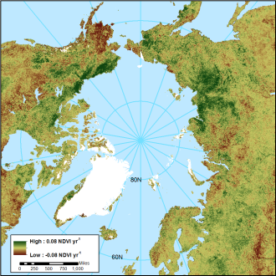
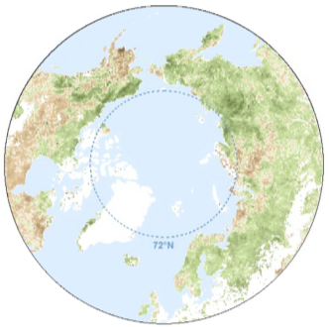
Perform QA for granule data & metadata
NDVI Growing Season Trends 1982-2012
Issue: A netCDF was provided but it was not described in the documentation. It also was not CF compliant.
Resolution: The PI had to be contacted and he explained that the netCDF was provided as an accessory file to a multiband geotiff that contained identical information. Since the data was not multidimensional the geotiff was chosen for archival.
Issue: The data in the provided geotiff did not exactly match the data shown in a similar figure in the research paper.
Resolution: The PI had to be contacted. He explained that the geotiff he provided had been updated since the paper’s publishing.
Issue: According to the research paper, yearly growing season NDVI data was produced but this data was not submitted to the DAAC.
Resolution: A request for this data was submitted to the PI and he produced geotiffs for each year. The DAAC staff created a netCDF that incorporated all of the geotiff data as well as a time dimension.

Slide 22
Assign Documentation Coordinator
Assign Documentation Coordinator

Slide 23
Assign Documentation Coordinator

Slide 24
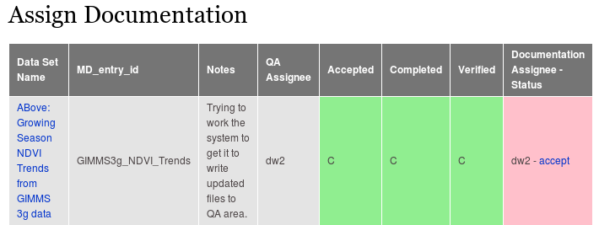
Monitor Documentation
Pending Documentation Assignments

Slide 25
Create/Edit Metadata
DAAC Online Metadata Editor (DAACOME)

Slide 26
Output landing page and guide doc
DAACOME Guide Doc

Slide 27
Scientific Review / Approval DSP

Slide 28
Monitor Submissions
Pending Documentation Assignments

Slide 29
Monitor Submissions
Pending Documentation Assignments

Slide 30
Published Data Set
Data Set Landing Page
Guide Documentation

Slide 31
Published Data Set
Data Set Landing Page
Guide Documentation

Slide 32
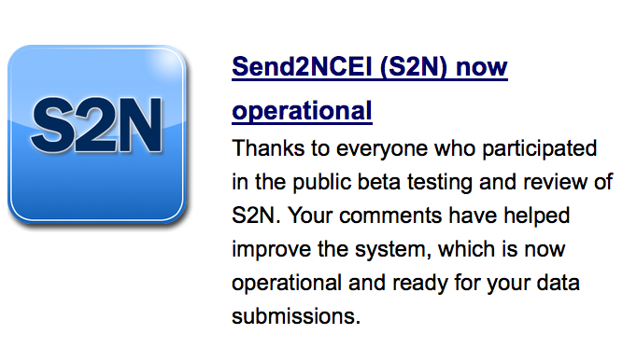
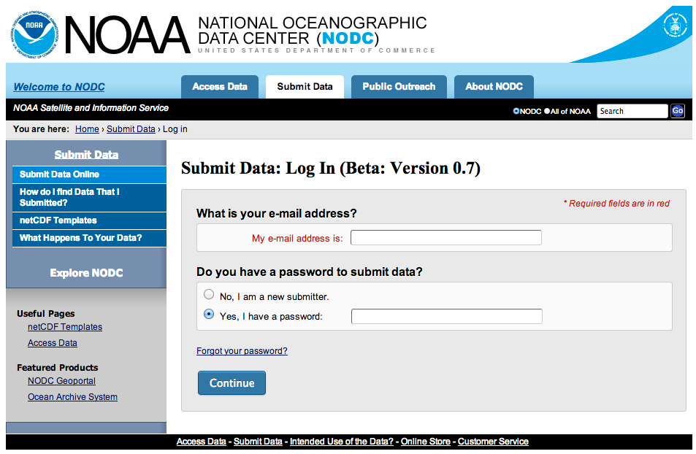
Ongoing discussions with NODC on
Approaches
Possible collaborations
Best Practices
https://www.nodc.noaa.gov/s2n/

