Slide 1
Augmented Reality Markup Language 2.0 Manil Maskey Information Technology & Systems Center University of Alabama in Huntsville Martin Lechner Wikitude ESIP Summer Meeting 2012

Slide 2
Introduction
Augmented Reality
Semantic Context
ARML 1.0
Why?
Allow Distribution of AR content on multiple AR platforms and Applications

Slide 3
Scope
Target mobile, mainly geo-location based AR applications
Comprises of many different fields
WebGL, Computer Vision, etc.
Why not KML?
KML built for map-based applications
Not flexible enough to bridge the gap between map and AR based (geo-)applications when defining the presentation of POIs and allowing tie-ins from other AR-relevant topics, such as visual tracking
KML also lacks the possibility of allowing dynamic components, such as JavaScript, to interact with the AR objects.

Slide 4
Scope..Example
ARML 2.0 could allow the specification of a reference image for a particular POI + a visual representation of the POI in case the reference image is detected in the video stream
However, ARML 2.0 will not specify how the tracking should be done and what algorithms should be used to detect the reference image, this is supposed to be done in a group focusing on WebGL.

Slide 5
Stakeholders
Analyze who is part of an AR ecosystem and why,
Which stakeholder is influenced by a standards discussion.
How the stakeholders could benefit from a new standard

Slide 6
StakeHolders (Content)
Content Producers: Create content for multiple occasions, not just for delivering the content to an AR application. Real life examples include travel book writers or tourist bureaus.
Content Publishers: Receive content from the Content Producer and specifically publish the content to an AR application. Examples include publishing agencies specialized in mobile publishing.

Slide 7
Stakeholders (Software)
AR Software Developers:
Develop software/app
Receive content from the Content Publisher
Device Platform Providers:
Provide the platform the AR Software Developer is using to build the AR application
Operating systems and development platforms.
Provide the interface between the software and hardware. Google (Android), Apple (iOS), Nokia (Symbian)…
Software Publisher:
Make the AR Software available to the market. AR Software Developer delivers the software to the Software Publisher.
Mobile stakeholder is typically represented by Android Market, App Store, Ovi Store, App World etc.
It could also be a webpage advertising the AR for download

Slide 8
Stakeholders (Hardware/End User)
Hardware Enablers:
Manufacture hardware necessary to build AR applications, including chipsets, sensors, cameras, network, battery etc.
Essentially, the Device Platform Provider builds the platform on top of the hardware.
Examples include Qualcomm, Nokia, HTC etc.
End Users:
Download the application from the Software Publisher
Provide feedback

Slide 9
Architecture
Generic AR software architecture:
6 subsystems
Application Tracking Interaction Presentation Context
World Model

Slide 10
Architecture (Client)
Tracking:
Observe one or multiple properties in the real world Typically done via sensor evaluation
Aggregation
Make accessible to the application
Interaction:
Subsystem that takes care of user interaction.
Presentation:
Subsystem deals with rendering - visual, audio, haptic etc
Data Filtering:
The client needs to filter data based on real- time knowledge gathered constantly on the client (location, camera video stream etc.), before they are presented in the application.

Slide 11
Architecture (Server)
World Model:
Describes the world around the user and stores information about the virtual objects and their presentations.
Search Engine:
Queries data based on certain query parameters sent by the client

Slide 12
Proposed Standardizable Components

Slide 13
Related AR Technologies and Standards
Geospatial: GML GeoJSON
3D:
Web Technologies:
And much more ...

Slide 14
Example Issue
3D Models in Augmented Reality
Many proprietary formats (game engines etc.)
obj
md2, md5
3ds
...
A couple of standardized formats
COLLADA, X3D
3D is complex!
Different ways to
define the model
define animations
define textures/shaders/materials

Slide 15
Result
Developer Frustration
Incomplete AR Content
User Frustration
Troublesome 3D Format Conversion
Solution: Interoperability between AR and 3D community!

Slide 16
Starting Point
KML for POI geometries (+ any other geo data format which can be used as input, such as GeoJSON, GeoRSS or GML)
ARML 1.0
KARML and ARGON
CityGML
X3D, COLLADA
WebGL
JavaScript
HTML and JavaScript as a reference architecture, supporting declarative and dynamic/interactive components.

Slide 17
ARML 2.0 SWG
30+ members join founding six
ARML 1.0 used as a non-standardized AR data format
ARML 2.0 Standards Working Group founded within the OGC, 6 founding members
Finalization and signed-off
ARML 2.0 standard
2010
2011
2012
2013
ARML 2.0 proposed to respond to new needs in AR
First (internal) Draft of ARML 2.0 spec, membership increases to 47
members
http://www.opengeospatial.org/projects/groups/arml2.0swg

Slide 18
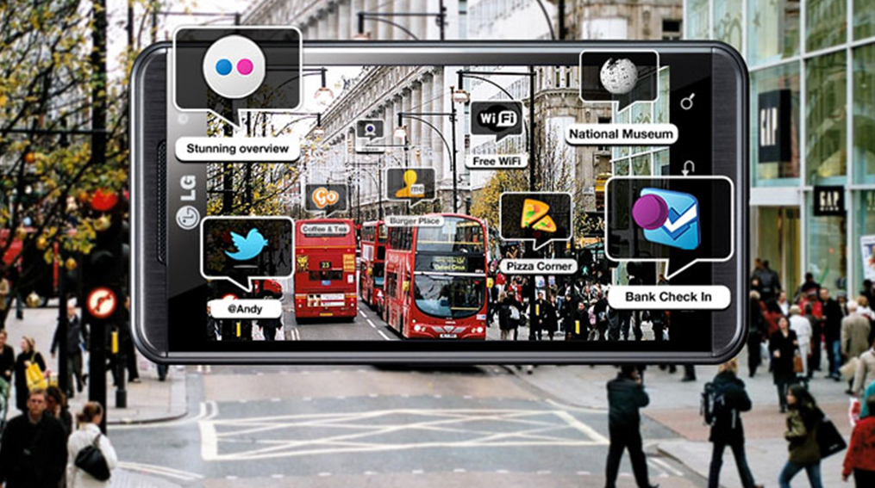
Mobile App Prototype

Slide 19
Contact
Manil Maskey
Information Technology & Systems Center
University of Alabama in Huntsville
mmaskey@itsc.uah.edu

