Slide 1
Using unmanned aircraft to provide near real-time updates of biomass, forest structure and land use in the Western Amazon
A new look at an old problem
Max Messinger

Slide 2
Notes:
40,000 from 195
Forest conservation is a big part
Now we have to figure out how to turn words into actions

Slide 3
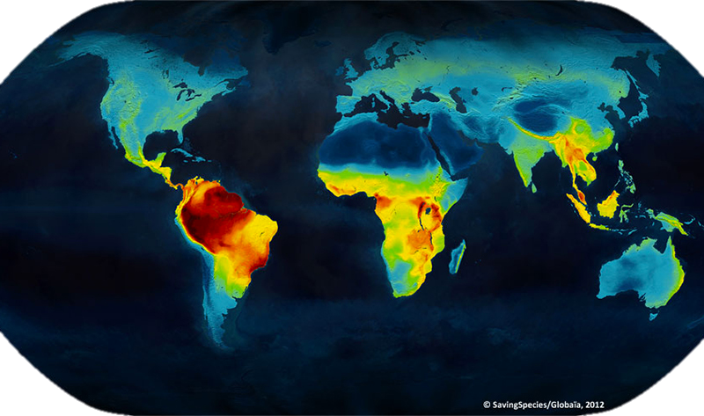
Notes:
In addition to carbon, there is extreme biodiversity (this is vertebrates)
Over 1,000 bird sp, 10,000 trees

Slide 4
University of Maryland
Notes:
Deforestation is expanding, accelerating in Amazon
Still a lot of forest left in the Amazon, biggest tropical wilderness on Earth
What you really have a hard time seeing here is the extensive fragmentation that goes on

Slide 5
Finer and Novoa 2015
Notes:
So now Peru, where we see that fragmentation
This is CLASlite
All color is deforestation
But we don’t know the cause

Slide 6
Notes:
Governance is another issue
Size of SC
Much protected area, much reserved for responsible land use
Timber, agriculture, reforestation, agroforestry, tourism
Wild East
Peru is having a very hard time governing this space with their limited resources

Slide 7
The Problem
Massive forest loss from gold mining and other drivers
Fine-scale activity makes monitoring with space-borne sensors difficult
CLASlite provides deforestation detection but provides no information about cause
Manned aircraft are too expensive for frequent monitoring
Notes:
*** Reforestation is critical*** We often focus on deforestation but these mines are typically abandoned after only a few years of activity

Slide 8
Goals
Carbon conservation and management
Develop an effective method for frequent and accurate forest carbon estimation in a variety of forest types
Develop an integrated system to rapidly detect forest disturbance, quantify its impacts, and conduct long-term monitoring

Slide 9
Notes:
Current state of the art, amazing tool, tens of millions of $$

Slide 10
Deacon Airborne Observatory
Notes:
Our answer
Fully autonomous
Comparatively fast, long range, able to cover a lot of ground (250 ha/flight)

Slide 11
The Process
Collect Imagery
Structure-from-Motion
Create Canopy Model
Calculate Canopy-Height
Model Aboveground Carbon

Slide 13
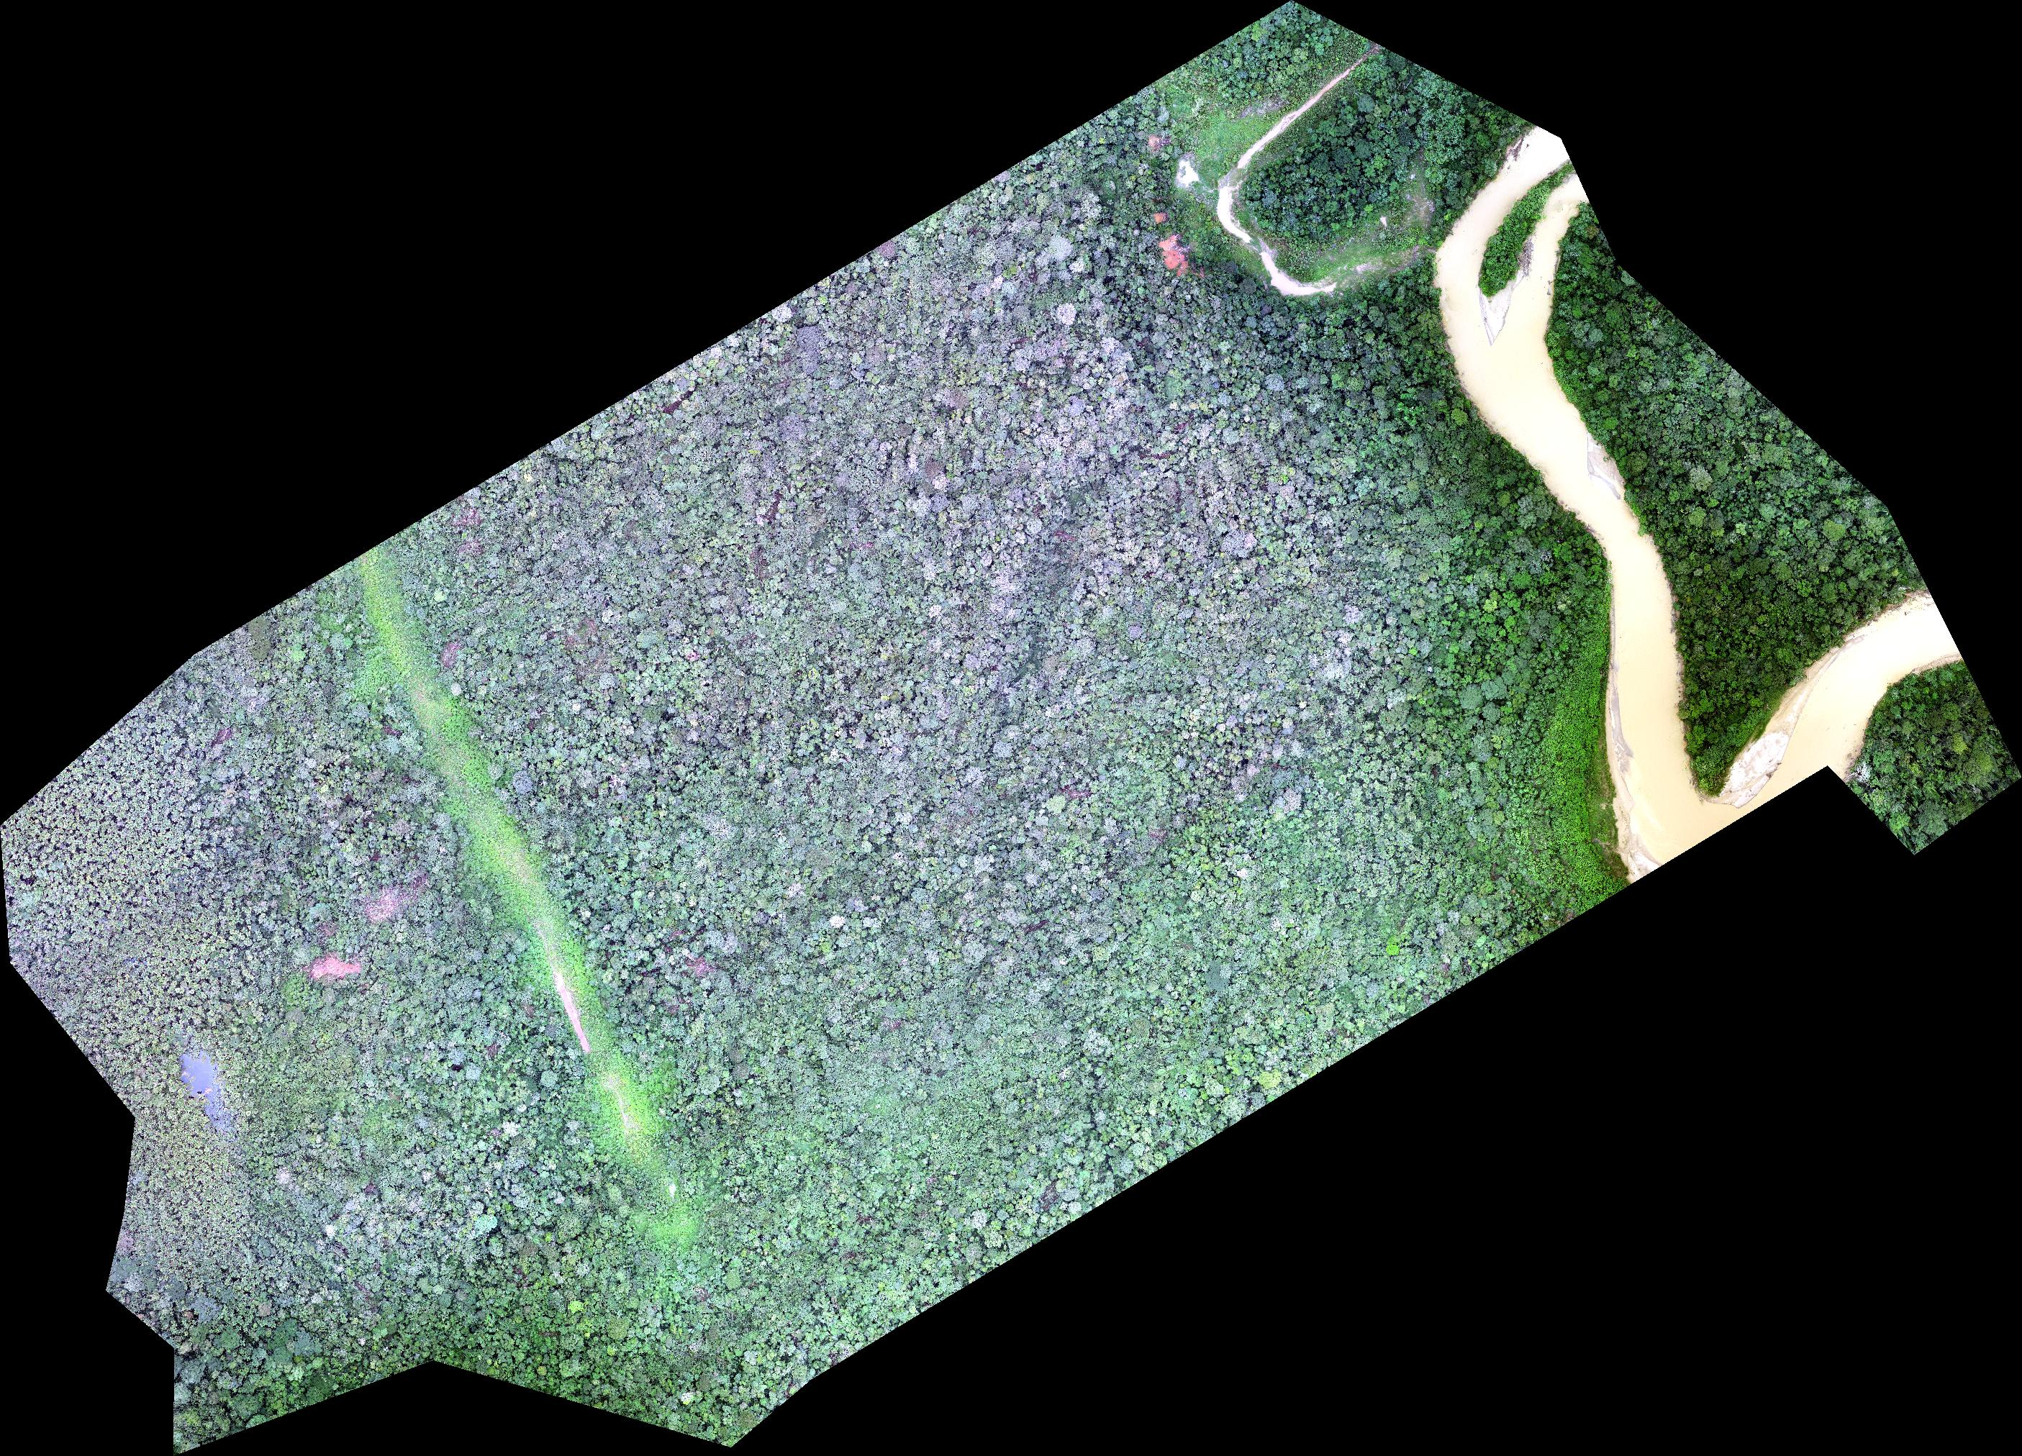

Slide 14
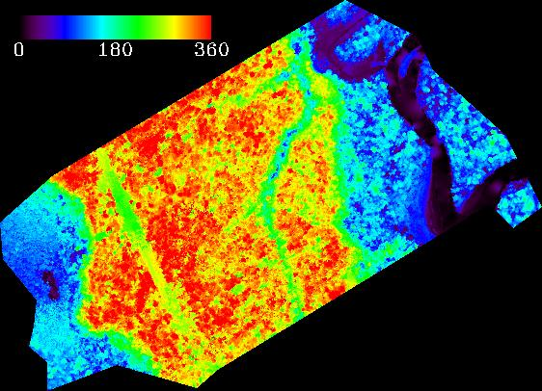
250
360

Slide 15
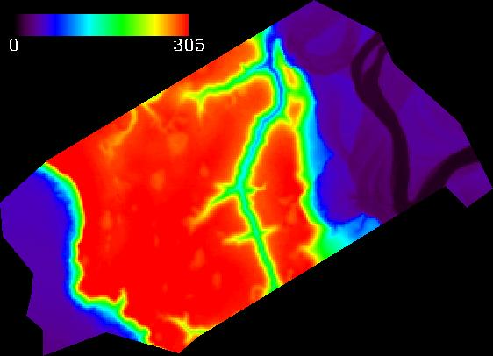
250
305

Slide 16
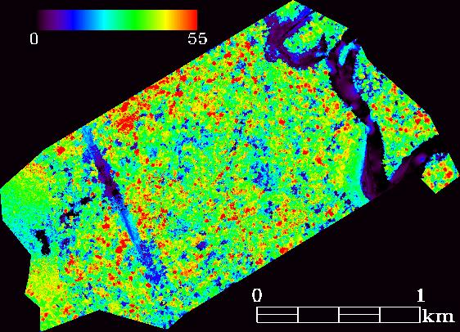
0
55

Slide 17
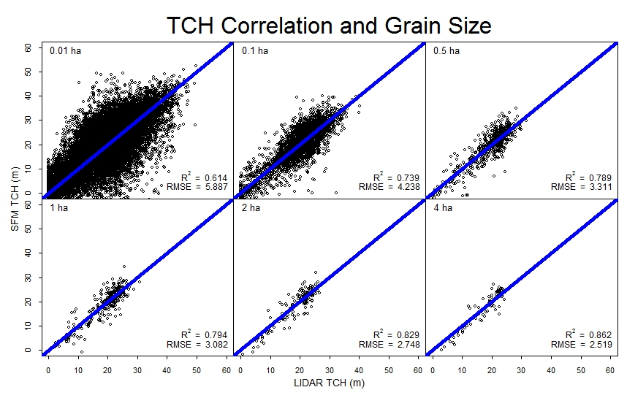

Slide 18
Aboveground Carbon (Mg C ha⁻¹)
Canopy Height (m)
Asner and Mascaro 2014

Slide 19
Aboveground Carbon Model
$$EACD=a{TCH}^{b1}{BA}^{b2}{ρ_{BA}}^{b3}$$
$$EACD$$ | Aboveground carbon
$$TCH$$ | Canopy height
$$BA$$ | Regional mean basal area
$$ρ_{BA}$$ | Basal-area weighted wood density
$a$, $b1$, $b2$, $b3$ | Coefficients (Estimated by Asner and Mascaro 2014)

Slide 20
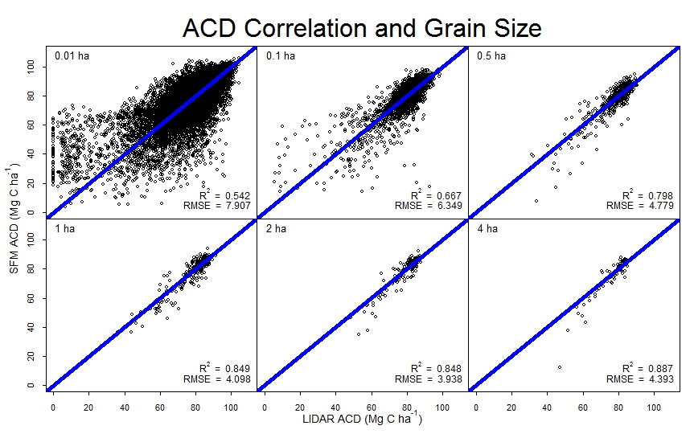

Slide 21
Goals
Carbon conservation and management
Develop an effective method for frequent and accurate forest carbon estimation in a variety of forest types
Develop an integrated system to rapidly detect forest disturbance, quantify its impacts, and conduct long-term monitoring

Slide 22
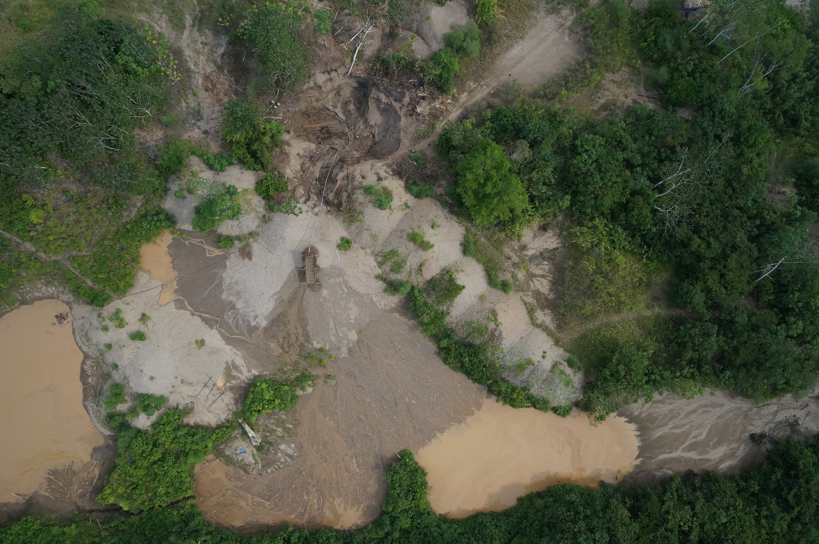
Notes:
And we got a lot of imagery like this.
Here is a scene with old mining at the bottom (you can see vegetation growing on the tailing piles) and
***inside this circle we see current mining

Slide 23
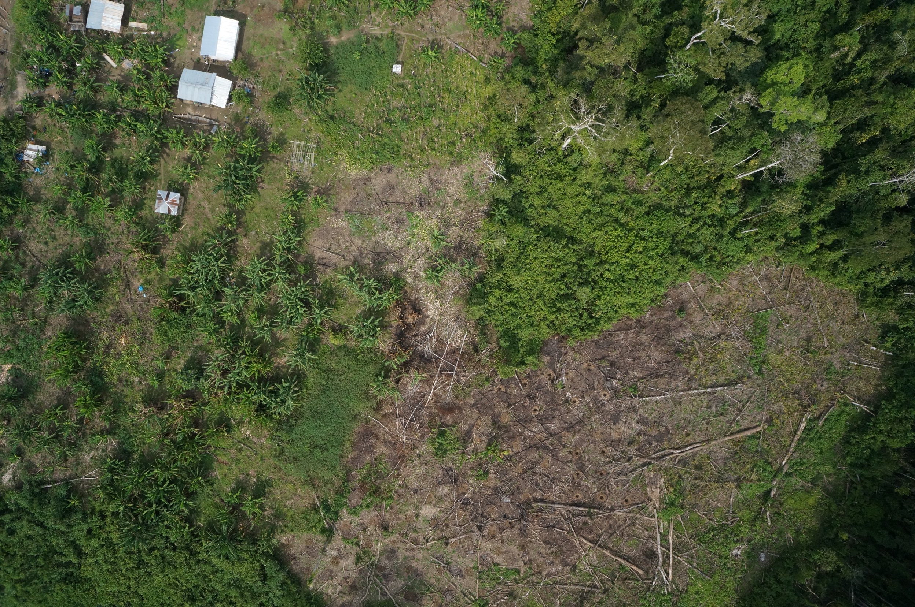
Notes:
But we also got stuff like this, a newly cleared field by a small settlement. Differentiating between these is important, as while they are both deforestation they have very different impacts on the environment.
We are working to integrate the aircraft into the routine monitoring framework in this area by building local capacity to operate them

Slide 24
Long-Term Forest Monitoring
Carbon baseline
Estimate of lost carbon
Database of disturbance
Estimation of forest recover and carbon accumulation through time

Slide 25
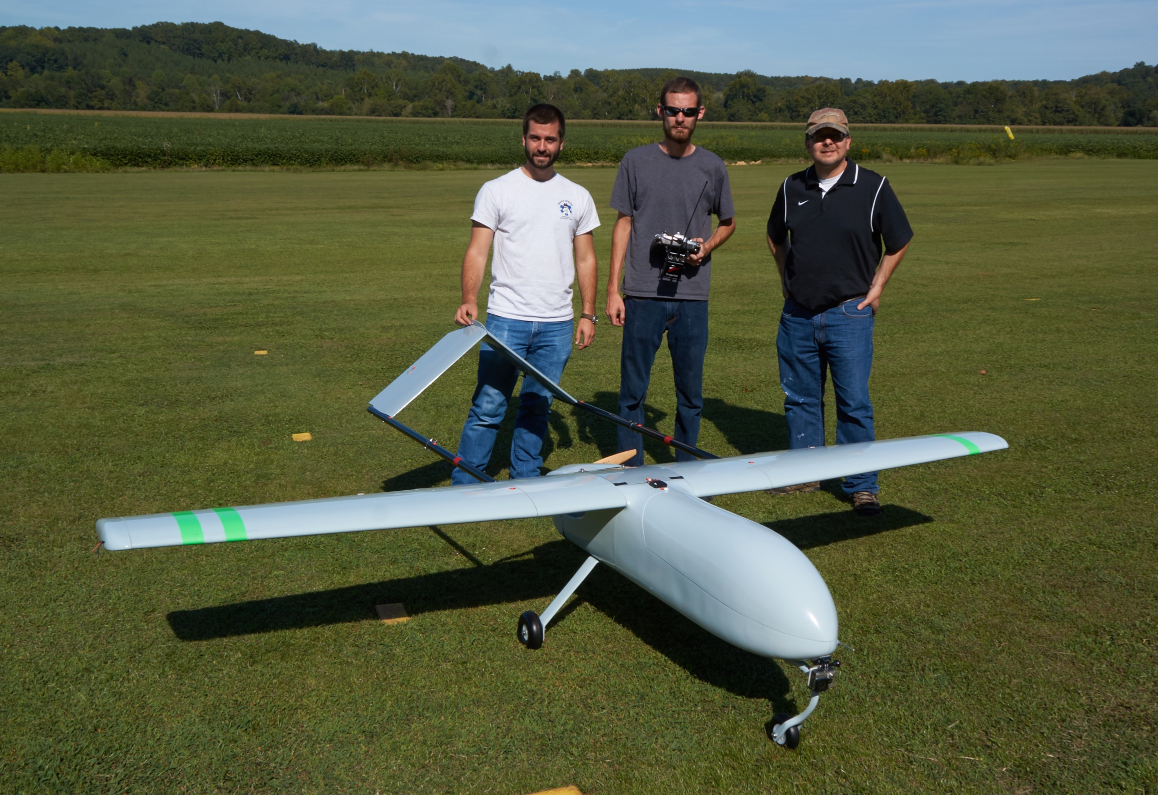
Notes:
This is our newest aircraft, a gas powered, 3m wingspan plane which will hopefully provide us 5 hours of flight time at 120km/h and the ability to carry much heavier payloads, i.e. LIDAR, hyperspec, etc

Slide 26
Going to Scale
Data Challenges:
Storage: ~200 GB/day generation, 4 days/week operation, ~40 TB/year
Processing: Demand will be ~10-15 TFLOPS
Distribution: Need to deliver data products in near real-time
The Kicker:
Intermittent power availability
Low-bandwidth and intermittent networking

Slide 27
Conclusions
Better information about carbon cycling, especially in novel disturbance regimes
High-frequency updates about the location, size, and nature of forest disturbance
Better informed governance
Low cost forest carbon monitoring for the forestry and payment-for-ecosystem-services market

Slide 28
Conclusions
Future directions:
Integrate into existing conservation, governance, and commercial forest monitoring networks
Develop a better understanding of the behavior of post-mining succession
Determine usability of space-borne RADAR (SRTM) as a replacement for LIDAR terrain model
Determine usability of space-borne RADAR (i.e. PALSAR-2) for forest disturbance detection
Streamlining/automating workflows

Slide 29
Made possible by:
The Sabin Family Foundation
The Winston-Salem Foundation

Slide 30
Acknowledgments
Advisor: Miles Silman
Committee: Bill Smith
Michael Anderson
Paul Pauca
Team SUAS: Marcus Wright
Tim King
Billy Nicholson
Nella Hendley
Matt Gray
Team ACCA: Carlos Castañeda
Carlos Quispe
Silman Lab: Rachel Hillyer
William Farfan
Noah Yavit
Karina Garcia
Collaborators: Greg Asner and lab
Matt Finer
Sidney Novoa

Slide 31
Questions?
max@linnaero.com

