Slide 1
Co-location Satellite, Model, and Ground Data
Arif Albayrak
GES-DISC NASA

Slide 2
Outline
Introduction
Important Aspects by Examples
Co-location Types
Current Prototype Development
Conclusion

Slide 3
Introduction
Worked on:
AOD bias correction using ML.
Data analysis (ACOS, Aqua/TRMM, OCO-2, GPM)
Precipitation interpolation (TRMM)
Notes:
Some of the examples

Slide 4
Important Aspects
Precision/Resolution

Slide 5
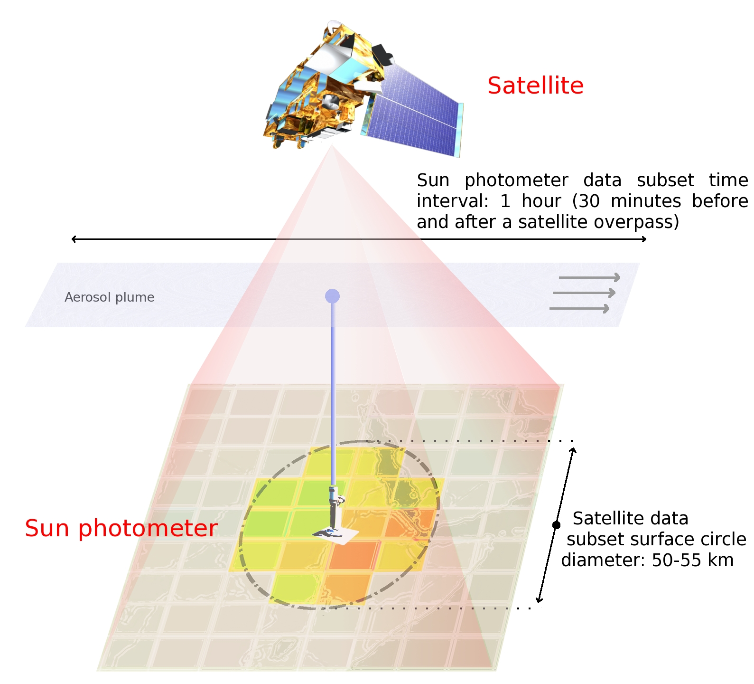
Important Aspects
Precision/Resolution
Notes:
Similarly, statistics for ground-based temporal observations in a particular location are derived from measurements taken within 30 minutes of each satellite overpass over this location.

Slide 6
Important Aspects
Statistics for region of interest
Total number of pixels;
Number of valid pixels;
Value of the central pixel;
Mean;
Median;
Mode;
Standard deviation;
Slope of a plane (for a spatial subset) or line (for a temporal subset) fitted to the subset;
Azimuth (direction) of the slope of the plane; and
Multiple Correlation Coefficient (for a spatial subset) or Linear Correlation Coefficient (for a temporal subset)
Notes:
AOD estimation

Slide 7
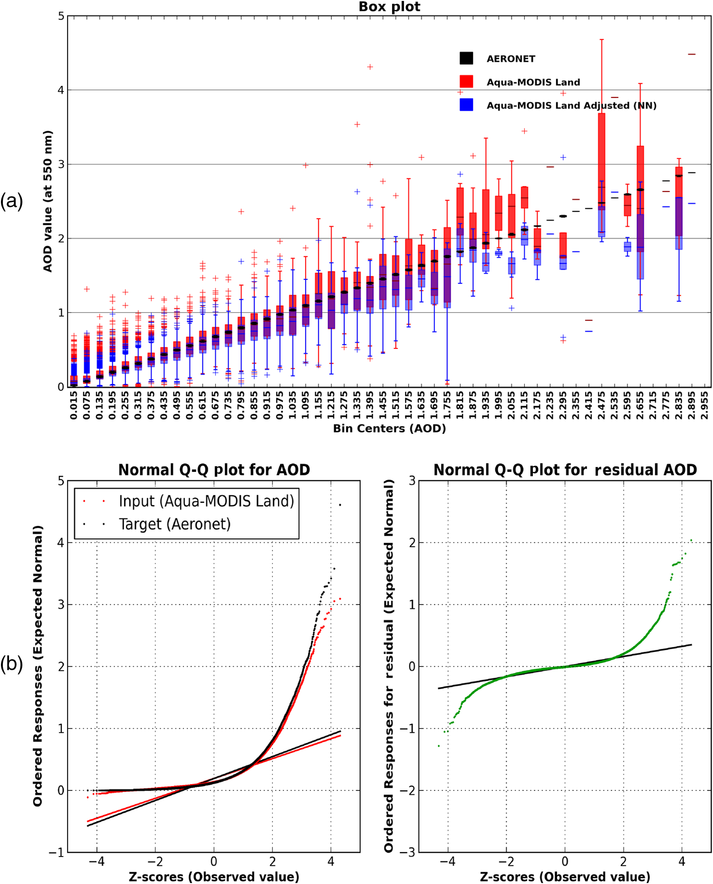
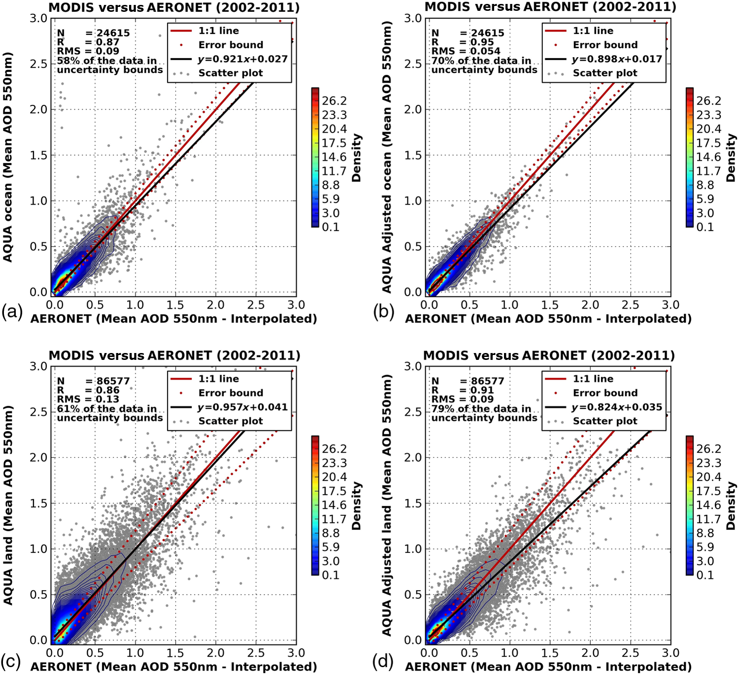
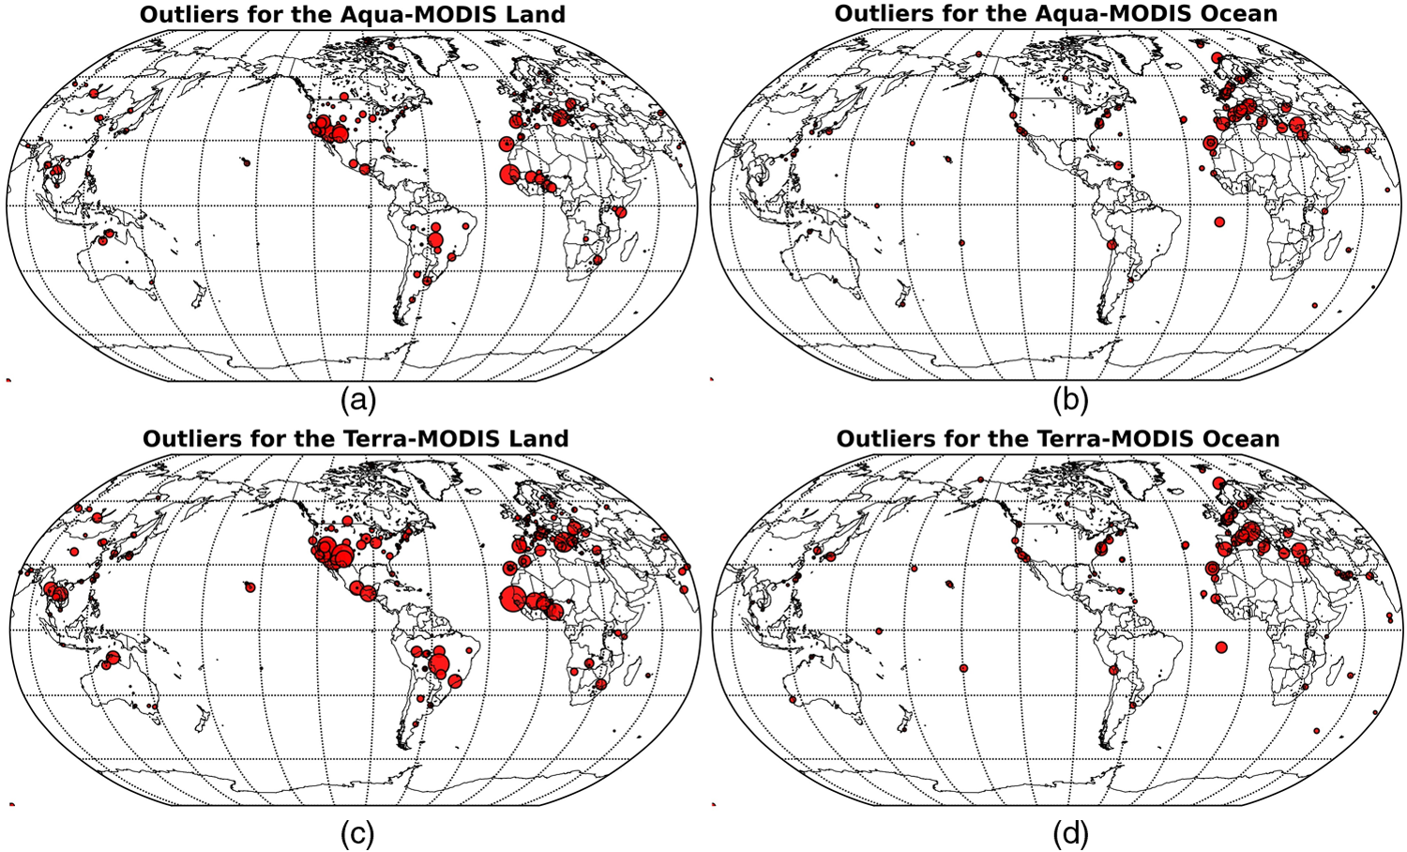
Results

Slide 8
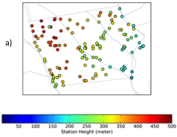
Multi-Station Problem
Estimating Rainfall for INDEX-BASED Agricultural Insurance.
Notes:
Filling the gaps in africa

Slide 9
Multi-Station Problem
Estimating Rainfall for INDEX-BASED Agricultural Insurance.
Notes:
Spatial and Temporal are not only co-location types
Contextual as well

Slide 10
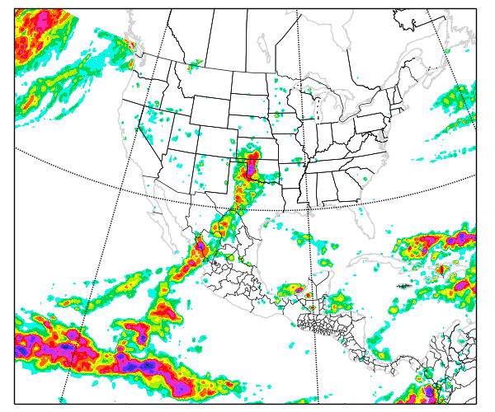
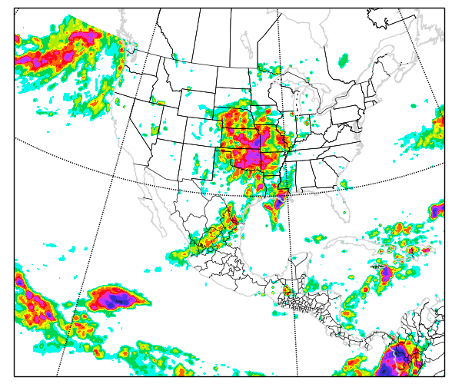
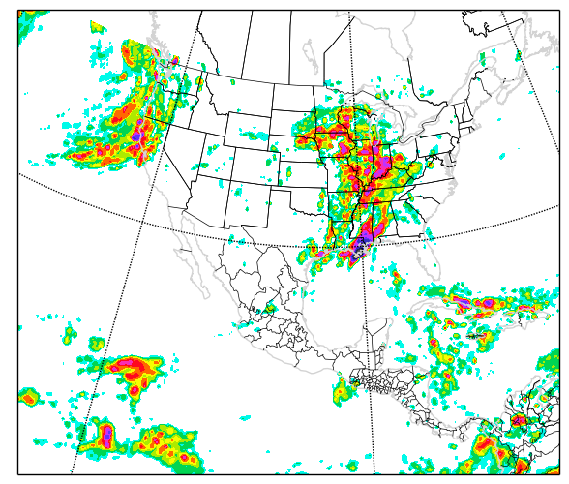
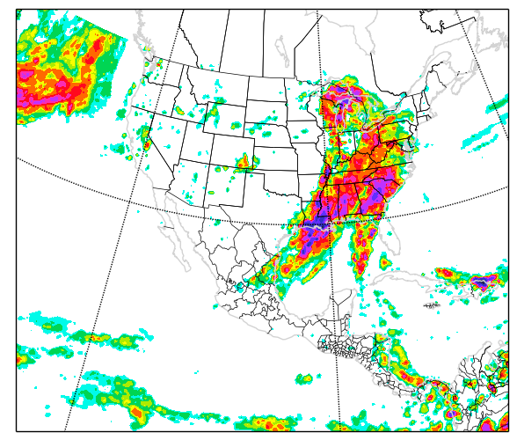
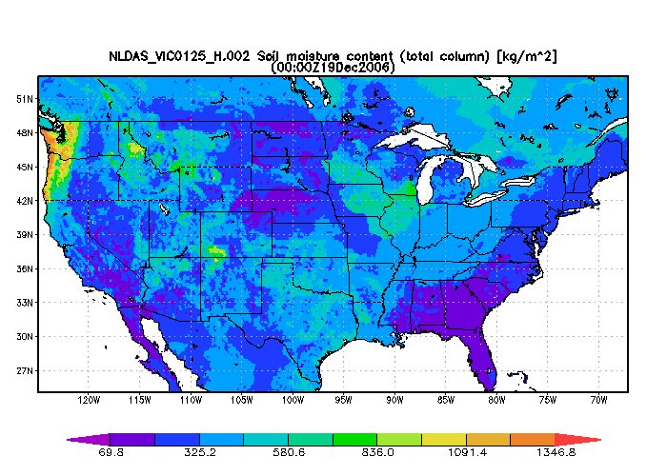
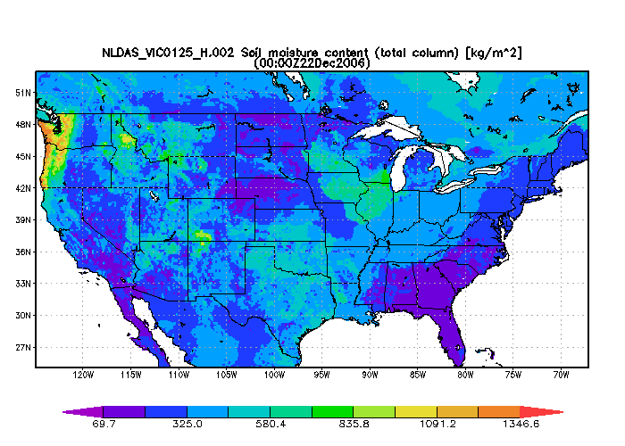
Multi-Station Problem Gridded Data (TRMM, NLDAS)
2006-12-19
2006-12-20
2006-12-21
2006-12-22
Notes:
1- More Details
2- Statistics
3- Patterns in specific area (Rain local versus global) Contextual co-location

Slide 11
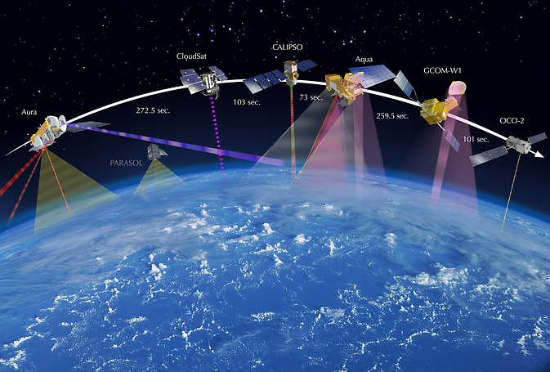
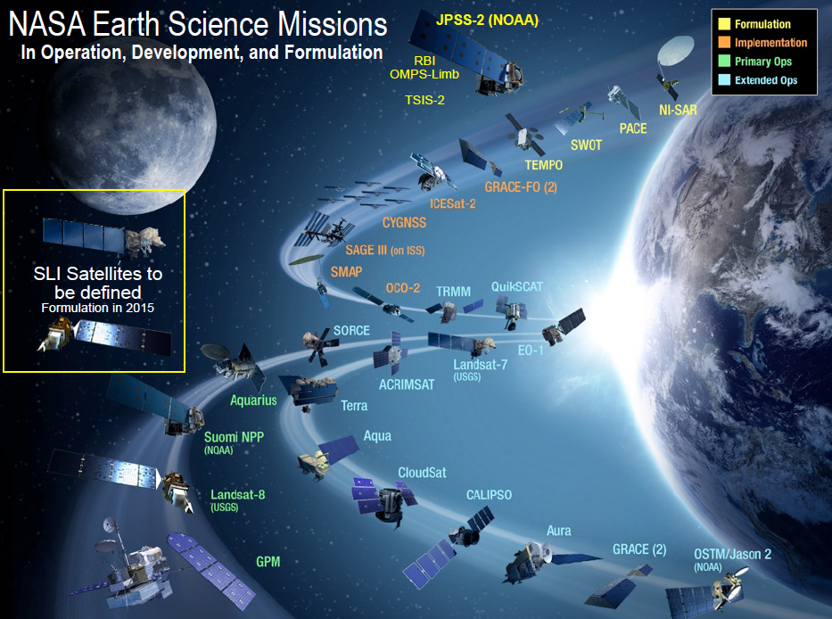
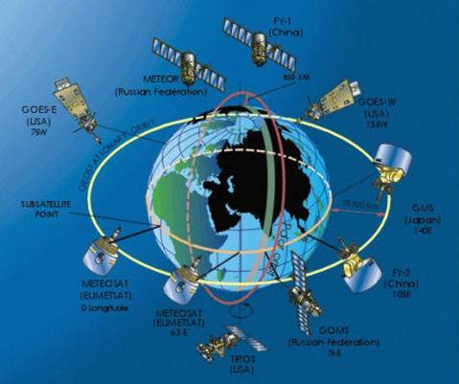
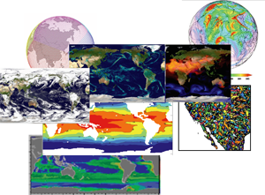
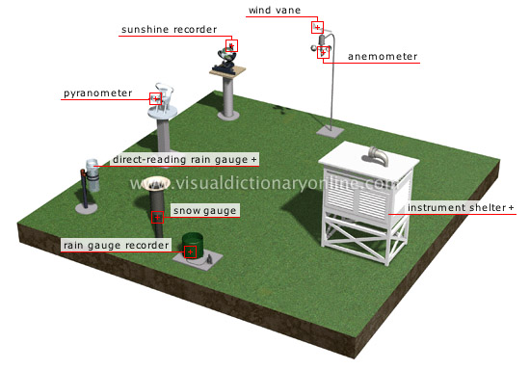
Multi Sensor/Model Data

Slide 12
A-Train

Slide 13
Bigger Picture for Satellites

Slide 14
Geo-Satellites

Slide 15
Re-Analysis Data

Slide 16
Station Data

Slide 17
Data Comes in Different Shapes
GRID

Slide 18
Data Comes in Different Shapes
SWATH
GRID

Slide 19
Data Comes in Different Shapes
SWATH
GRID
POINT

Slide 20
Data Comes in Different Shapes
SWATH
GRID
POINT

Slide 21
Co-location Types in Consideration
Acknowledgement to AIST Proposal Group

Slide 22
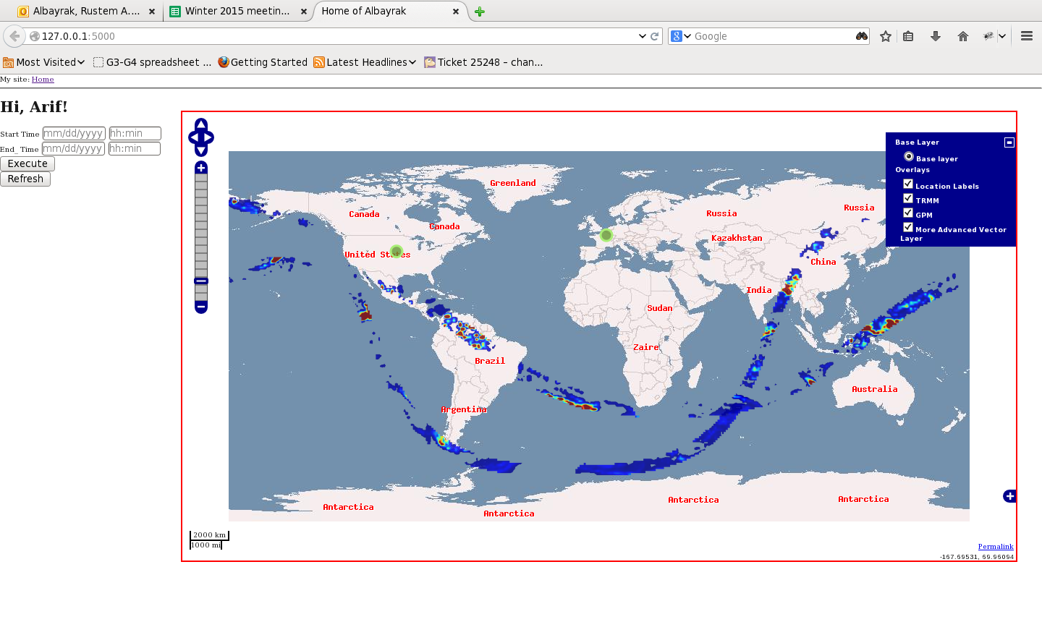
Co-located Data on the Fly Arif Albayrak, Bill Teng, (Gilberto Vincente)
Notes:
polygones

Slide 23
Conclusion
3 Co-location Types; Spatial, Temporal, Contextual, are Summarized.
Software Efforts are described.
Work currently continues.

Slide 24
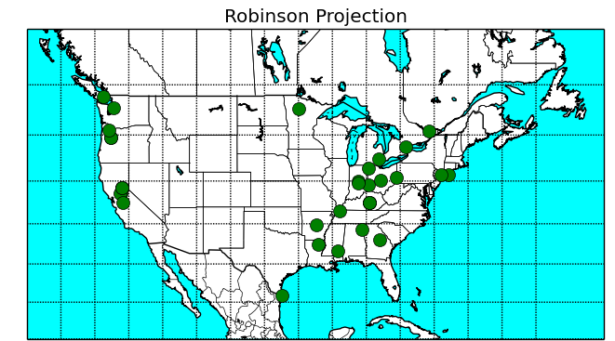
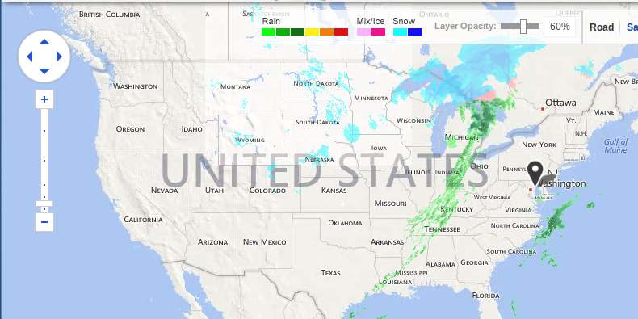
Twitter Message Analysis Maya Albayrak

