Slide 1
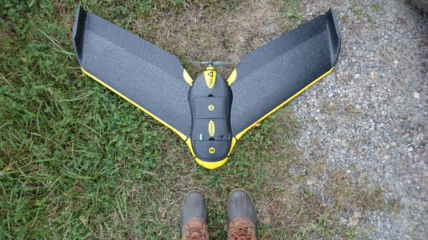
Monitoring
Agricultural Emissions
Lindsay Barbieri @barbieriiv
Notes:
Quickly!
Raise hands use drones ever
Raise hands use drones in science

Slide 2
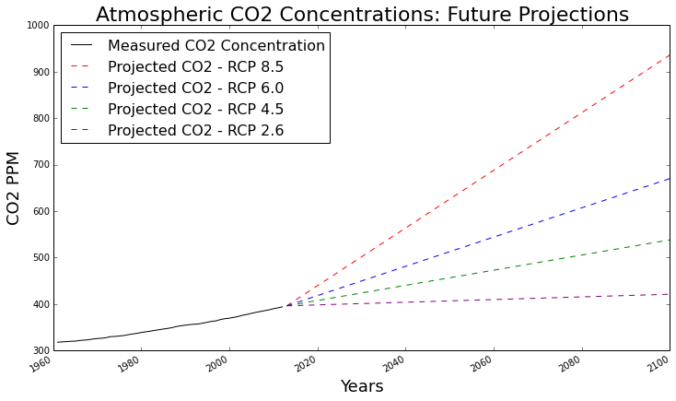
Atmospheric Carbon Dioxide Levels: Measured and Projected

Slide 3
Atmospheric Carbon Dioxide Levels: Measured and Projected
measured

Slide 4
Atmospheric Carbon Dioxide Levels: Measured and Projected
measured

Slide 5
Atmospheric Carbon Dioxide Levels: Measured and Projected
Mitigation
Strategies!
measured

Slide 6
Notes:
Sensors:
Cameras - Imagery (in many spectral bands - like traditional remote sensing techniques)
From this imagery you can get point cloud data (similar to LiDAR) - elevation / topographic
GHG Sensors, Heat Sensors...anything small enough to put on a drone!

Slide 7
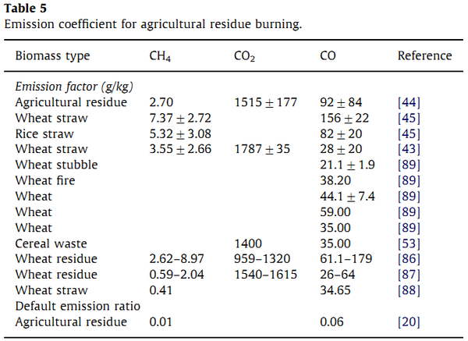
agricultural activity x emissions factor =
greenhouse gas estimations!
Notes:
Sensors:
Cameras - Imagery (in many spectral bands - like traditional remote sensing techniques)
From this imagery you can get point cloud data (similar to LiDAR) - elevation / topographic
GHG Sensors, Heat Sensors...anything small enough to put on a drone!

Slide 8
Global Challenges
Field Level Knowledge
Notes:
Lots of ways to talk methods, operations, software, data collection etc…
BUT thought we’d outline the big picture of drone use we’re familiar with in stories

Slide 9
Global Challenges
Field Level Knowledge
DRONES
Notes:
Lots of ways to talk methods, operations, software, data collection etc…
BUT thought we’d outline the big picture of drone use we’re familiar with in stories

Slide 10
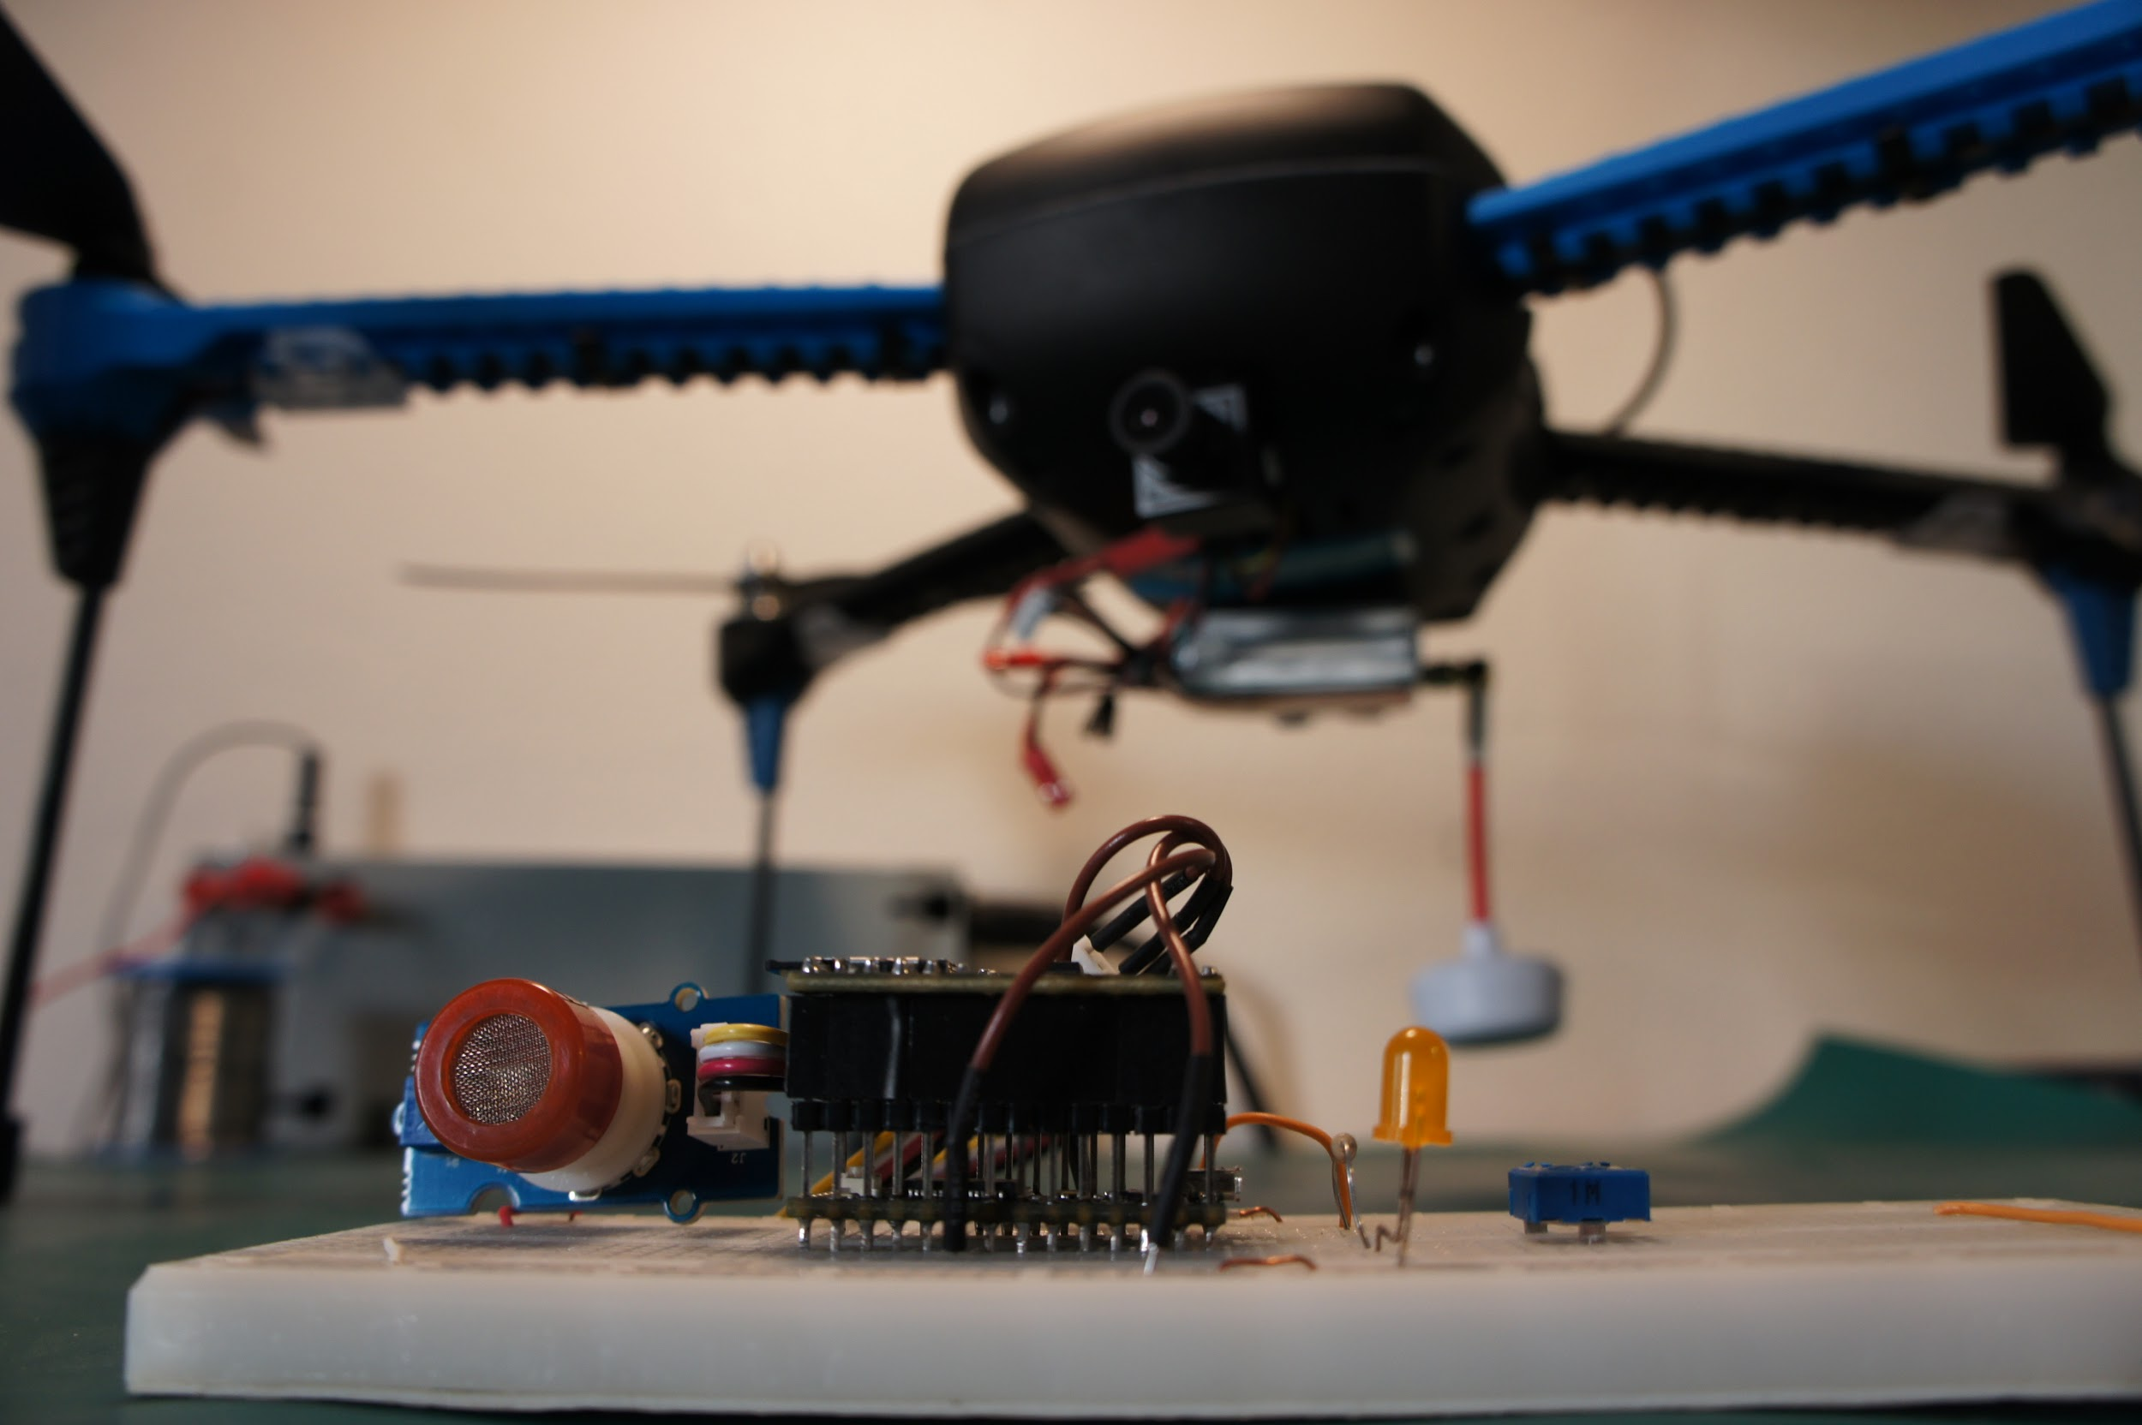
Notes:
Sensors:
Cameras - Imagery (in many spectral bands - like traditional remote sensing techniques)
From this imagery you can get point cloud data (similar to LiDAR) - elevation / topographic
GHG Sensors, Heat Sensors...anything small enough to put on a drone!

Slide 11
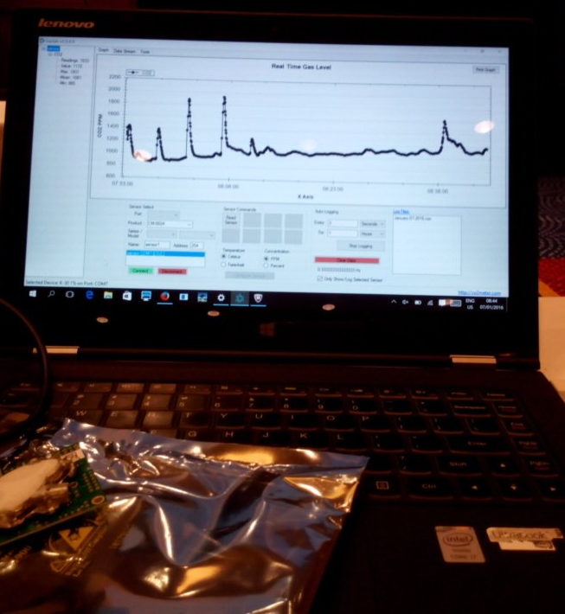
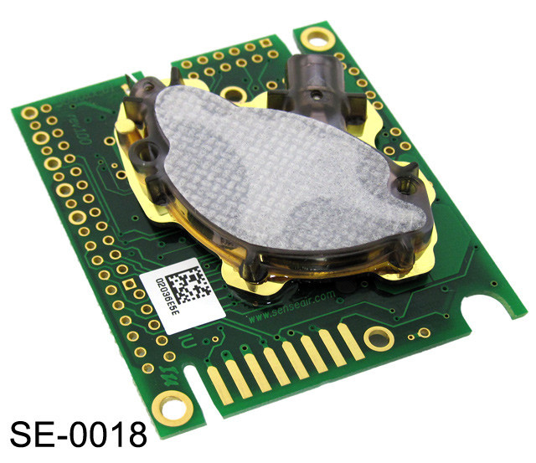
CO2 Meter
FUNding
Friday
Notes:
Sensors:
Cameras - Imagery (in many spectral bands - like traditional remote sensing techniques)
From this imagery you can get point cloud data (similar to LiDAR) - elevation / topographic
GHG Sensors, Heat Sensors...anything small enough to put on a drone!

Slide 12
The Data: Monitoring of Two Hay Fields, Shelburne Farms
Edge of Field Station
Field 1
Non Aerated
“Conventional”
Field 2
Aerated
“Best Management Practice (BMP)”
Air Temperature
Precipitation
Water quality and field runoff
* sampled every 15 minutes
Notes:
mitigation is important… and becoming more of a theme in the scientific literature (search for “agriculture” and “climate”) -- take out CGIAR

Slide 13
The Data: Monitoring of Two Hay Fields, Shelburne Farms
Edge of Field Station
Field 1
Non Aerated
“Conventional”
Field 2
Aerated
“Best Management Practice (BMP)”
Air Temperature
Precipitation
Water quality and field runoff
* sampled every 15 minutes
Static Chambers
Soil Gas Flux
Soil Temperature
Soil Moisture
* sampled ~once a week
June - October 2015
Notes:
mitigation is important… and becoming more of a theme in the scientific literature (search for “agriculture” and “climate”) -- take out CGIAR

Slide 14
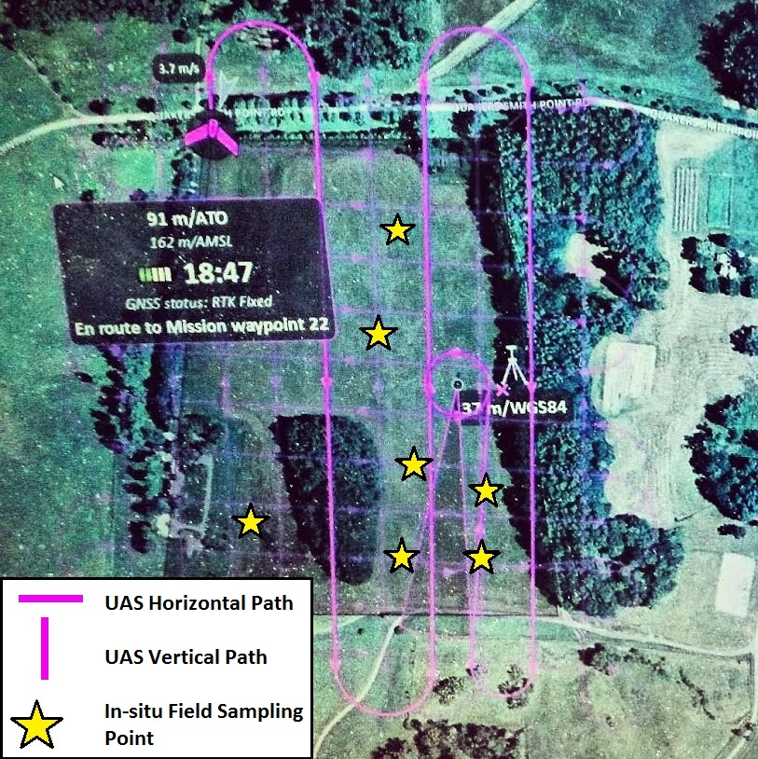
The Data: Monitoring of Two Hay Fields, Shelburne Farms
Hay Fields
(Shelburne Farms)
Unmanned Aerial Systems
Edge of Field Station
Field 1
Non Aerated
“Conventional”
Field 2
Aerated
“Best Management Practice (BMP)”
Air Temperature
Precipitation
Water quality and field runoff
* sampled every 15 minutes
Two flight days =
8 mosaiced images
True Color Imagery
Near Infrared Composite
Point Cloud
Digital Surface Models (DSM)
Normalized Difference Vegetation Index (NDVI)
Static Chambers
Soil Gas Flux
Soil Temperature
Soil Moisture
* sampled ~once a week
June - October 2015
Notes:
mitigation is important… and becoming more of a theme in the scientific literature (search for “agriculture” and “climate”) -- take out CGIAR

Slide 15
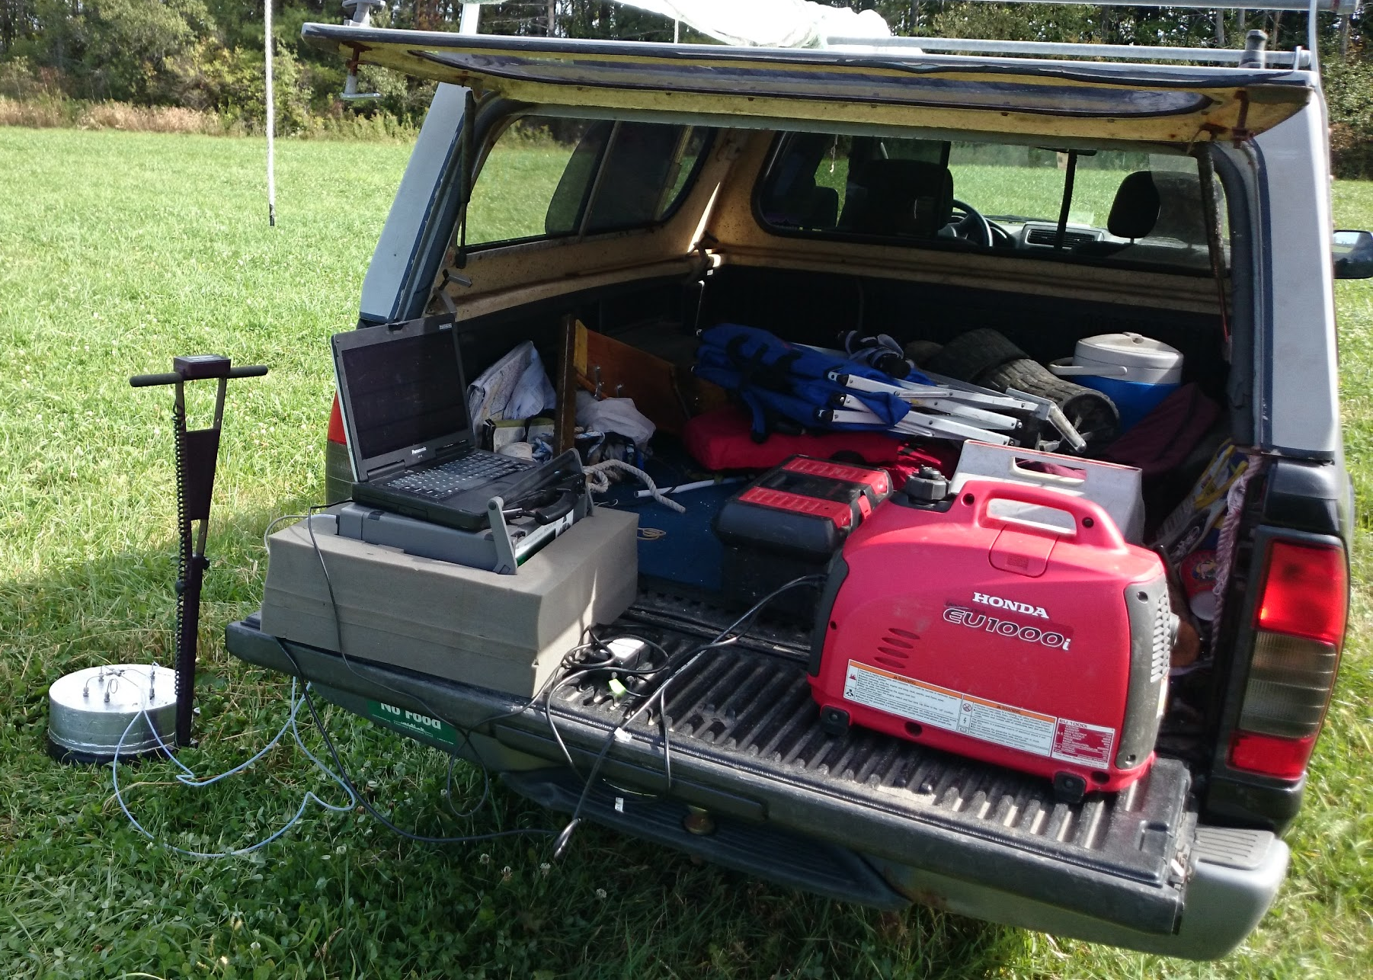
All Day Sampling Is Fun… but...
Notes:
AG
field scale (15 minutes per chamber, 4 ch per field, 4 field…) field work costs in time, work, and equipment (that isn’t easily movable)

Slide 16
TIME CONSUMING
EXPENSIVE
All Day Sampling Is Fun… but...
Notes:
AG
field scale (15 minutes per chamber, 4 ch per field, 4 field…) field work costs in time, work, and equipment (that isn’t easily movable)

Slide 17
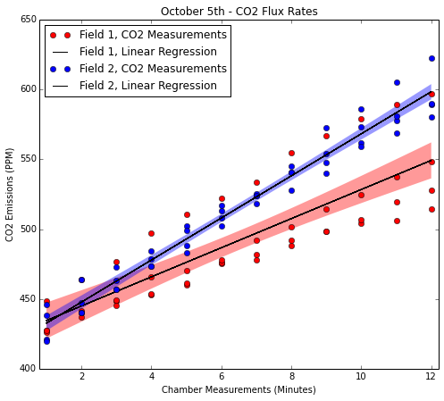
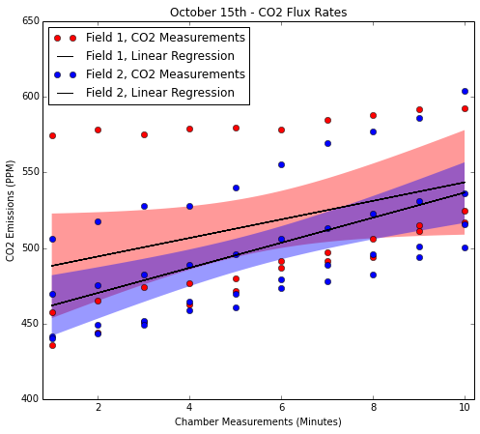
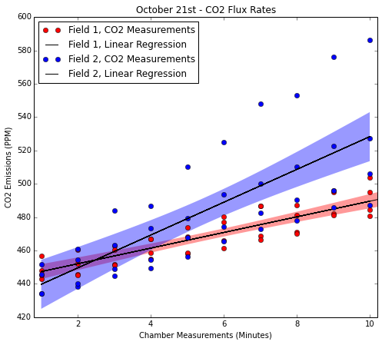
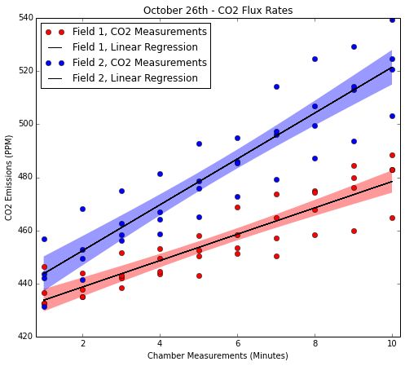
Linear Regression with 95% CI
October 5th
October 15th
Field 2: Mitigation
CO2 Measurements
Field 1: Conventional
CO2 Measurements
October 21st
October 26th
Notes:
A lot of exploration here… and more teasing apart to do, but really I am interested in this from a remote sensing perspective...possible techniques to scale up.

Slide 18
Linear Regression with 95% CI
October 5th
October 15th
Field 2: Mitigation
CO2 Measurements
Field 1: Conventional
CO2 Measurements
October 21st
October 26th
Post Manure-Spreading
Notes:
A lot of exploration here… and more teasing apart to do, but really I am interested in this from a remote sensing perspective...possible techniques to scale up.

Slide 19
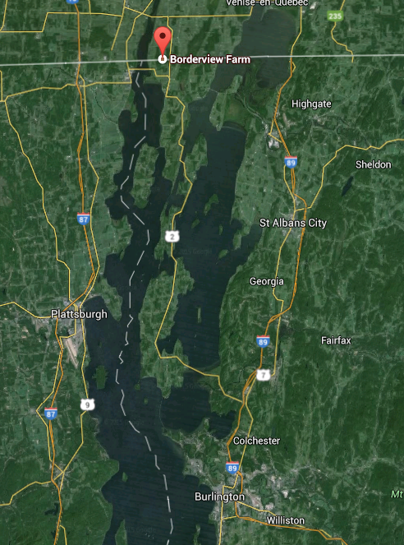
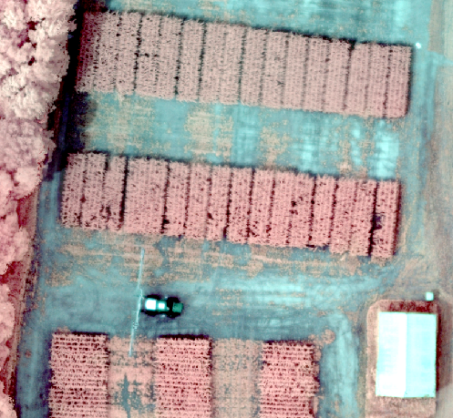

Slide 20
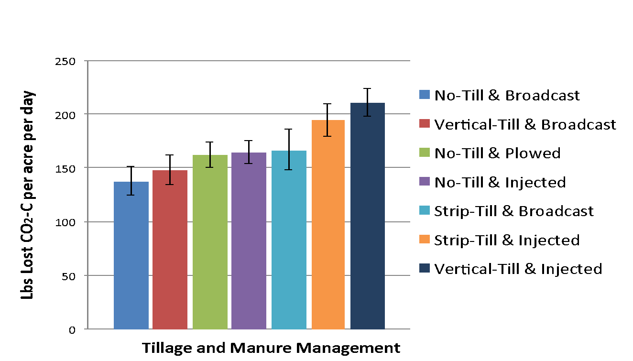
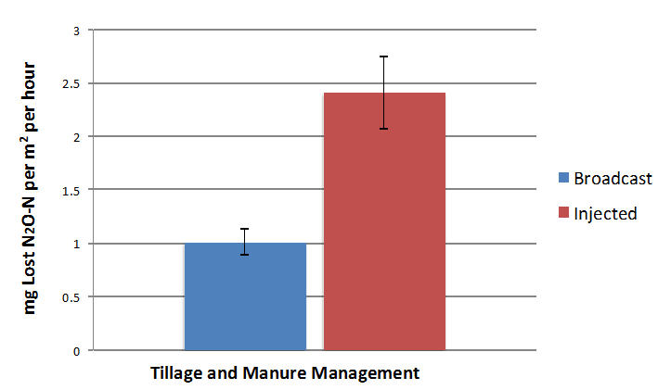
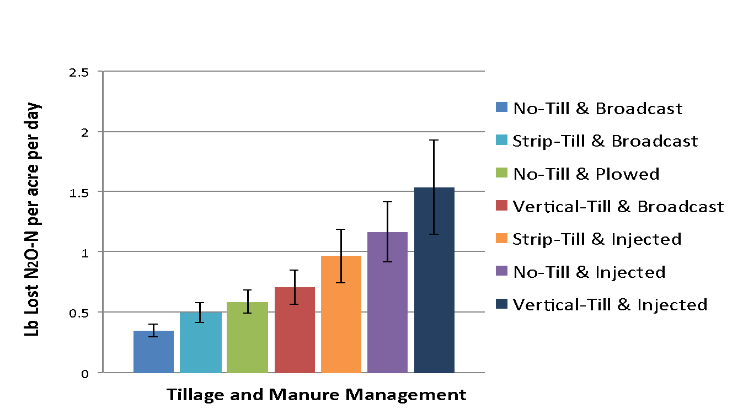

Slide 21
“Mitigation” Not Straightforward...

Slide 22
“Mitigation” Not Straightforward...

Slide 23
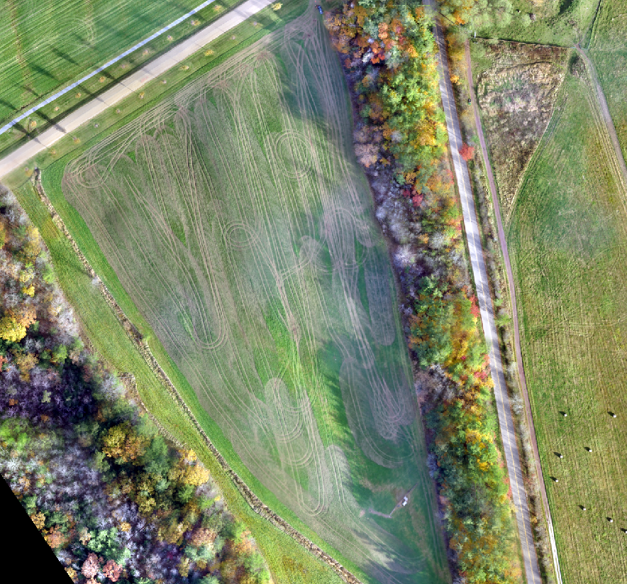
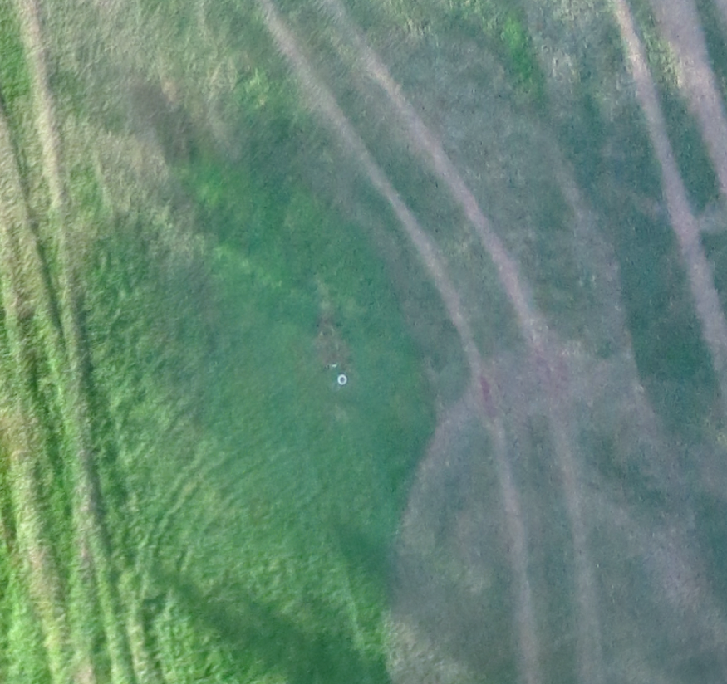
20 Minutes per Chamber...
Notes:
field work costs in time, work, and equipment (that isn’t easily movable)

Slide 24
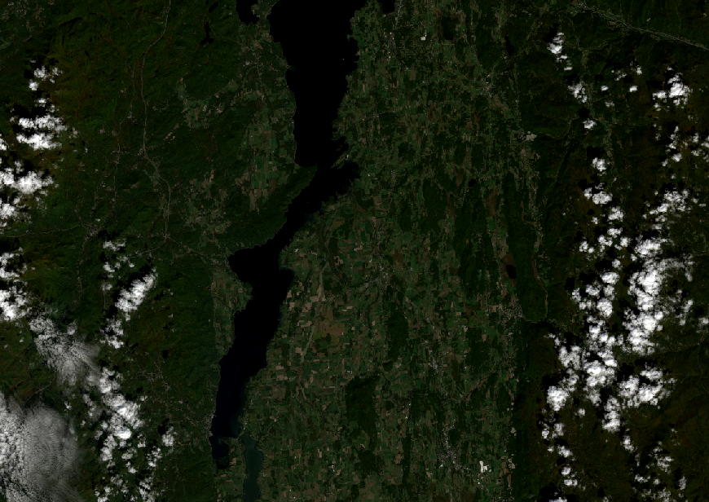
Ag
Champlain Valley, Vermont & New York
Landsat 2014
Notes:
field work costs in time, work, and equipment (that isn’t easily movable)

Slide 25
Drone Flight Plan
Notes:
field work costs in time, work, and equipment (that isn’t easily movable)

Slide 26
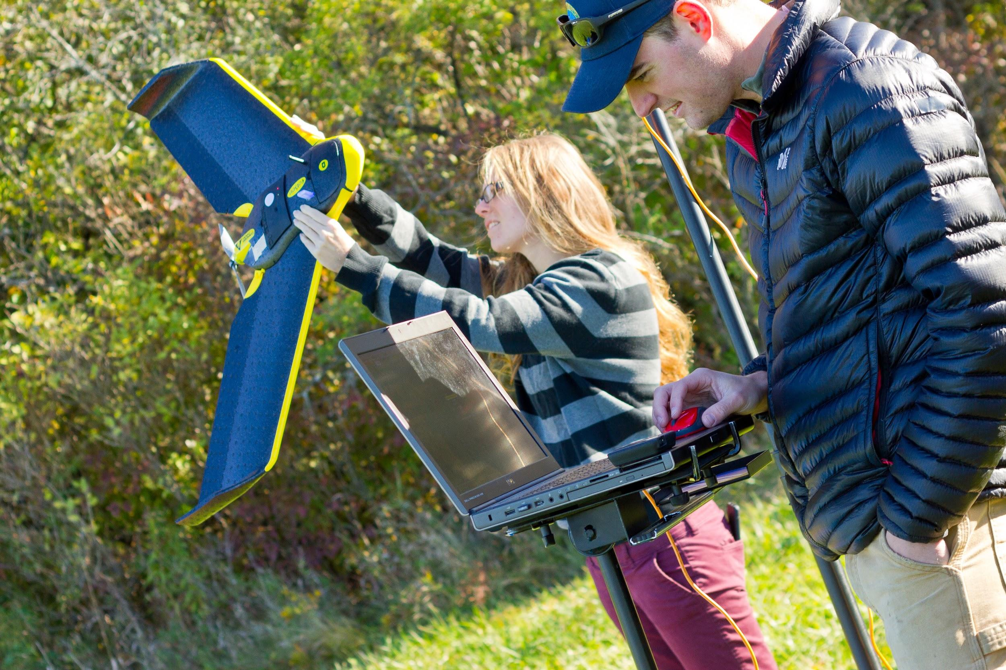
photography: Joshua Brown, UVM

Slide 27
photography: Joshua Brown, UVM

Slide 28
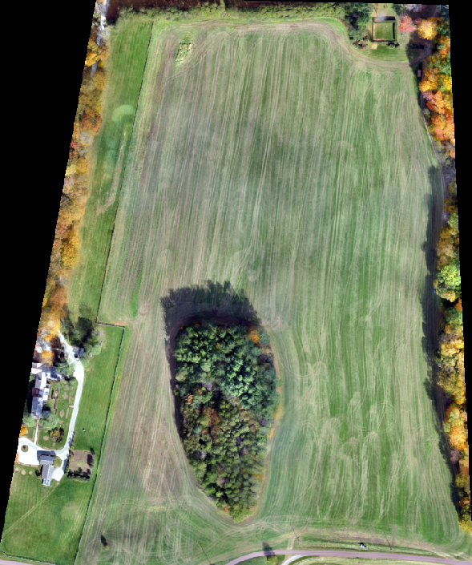
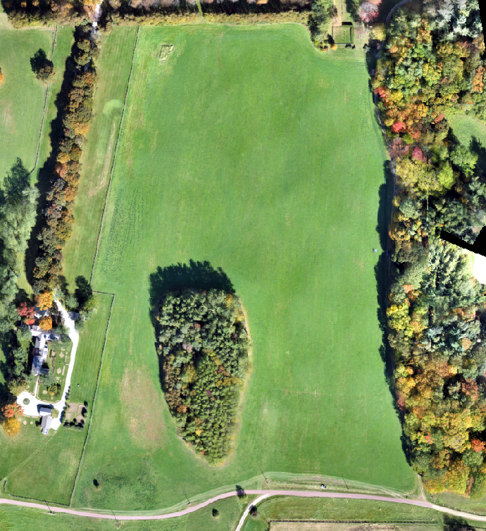
October 15th
October 26th
October 15th
October 26th
Notes:
timing - manure on / off… uas imagery vs landsat imagery

Slide 29
October 15th
October 26th
Notes:
timing - manure on / off… uas imagery vs landsat imagery

Slide 30
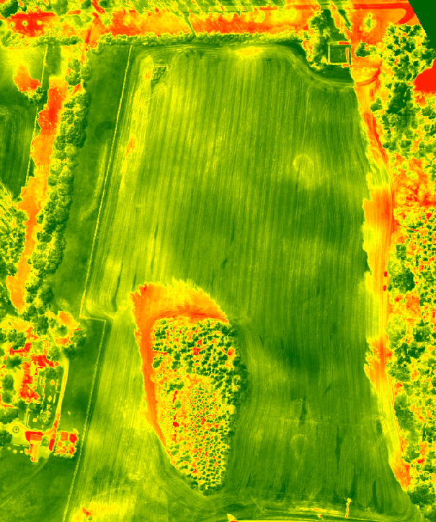
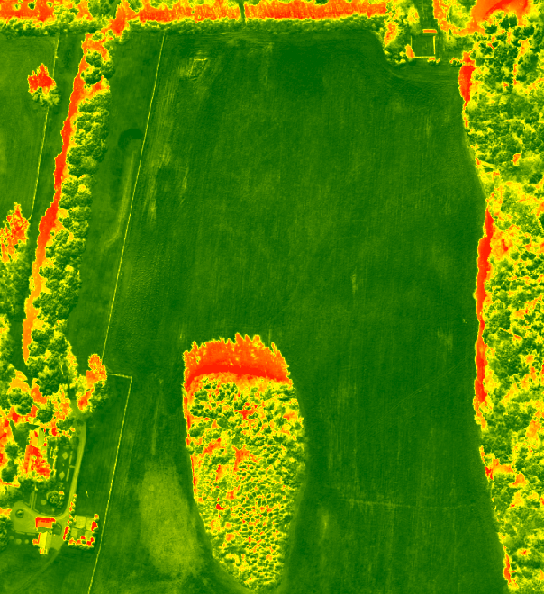
October 15th
October 26th
October 15th
October 26th
Notes:
timing - manure on / off… uas imagery vs landsat imagery

Slide 31
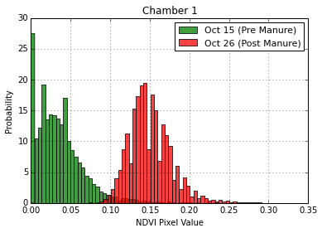
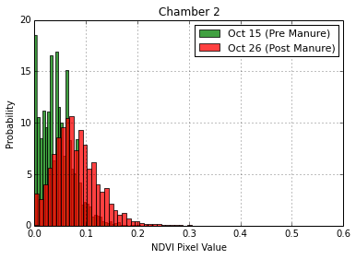
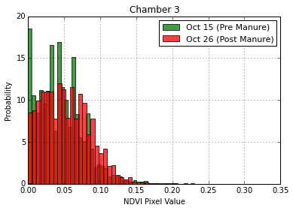
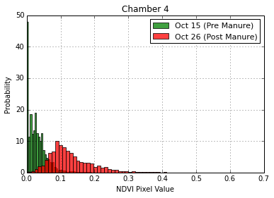
KS Test
P Value:
0.0
KS Test:
KS Test
P Value:
0.0
KS Test
P Value:
2.8946314925221446e-117
KS Test
P Value:
0.0
Notes:
timing - manure on / off… uas imagery vs landsat imagery

Slide 32
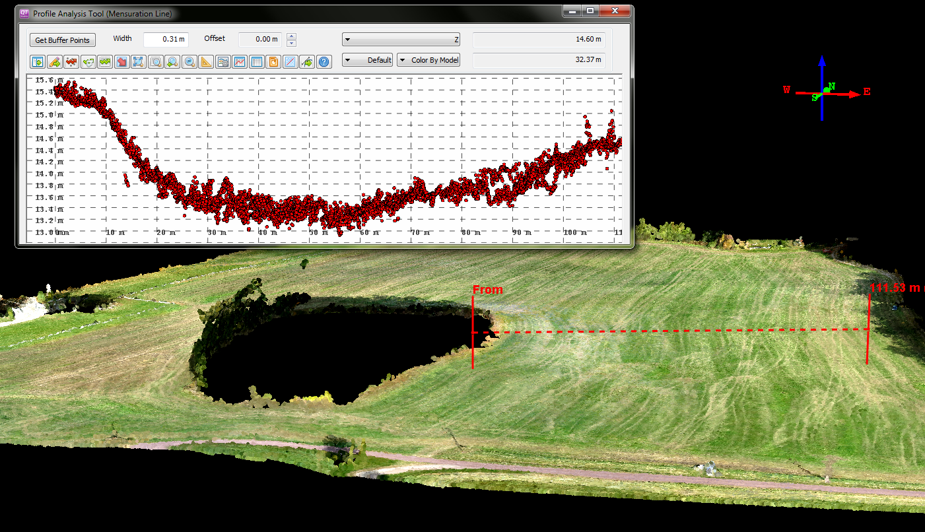
Notes:
maximum:
11/4/1927
13,600 flow cubic ft per second
~14 ft stage area with

Slide 33
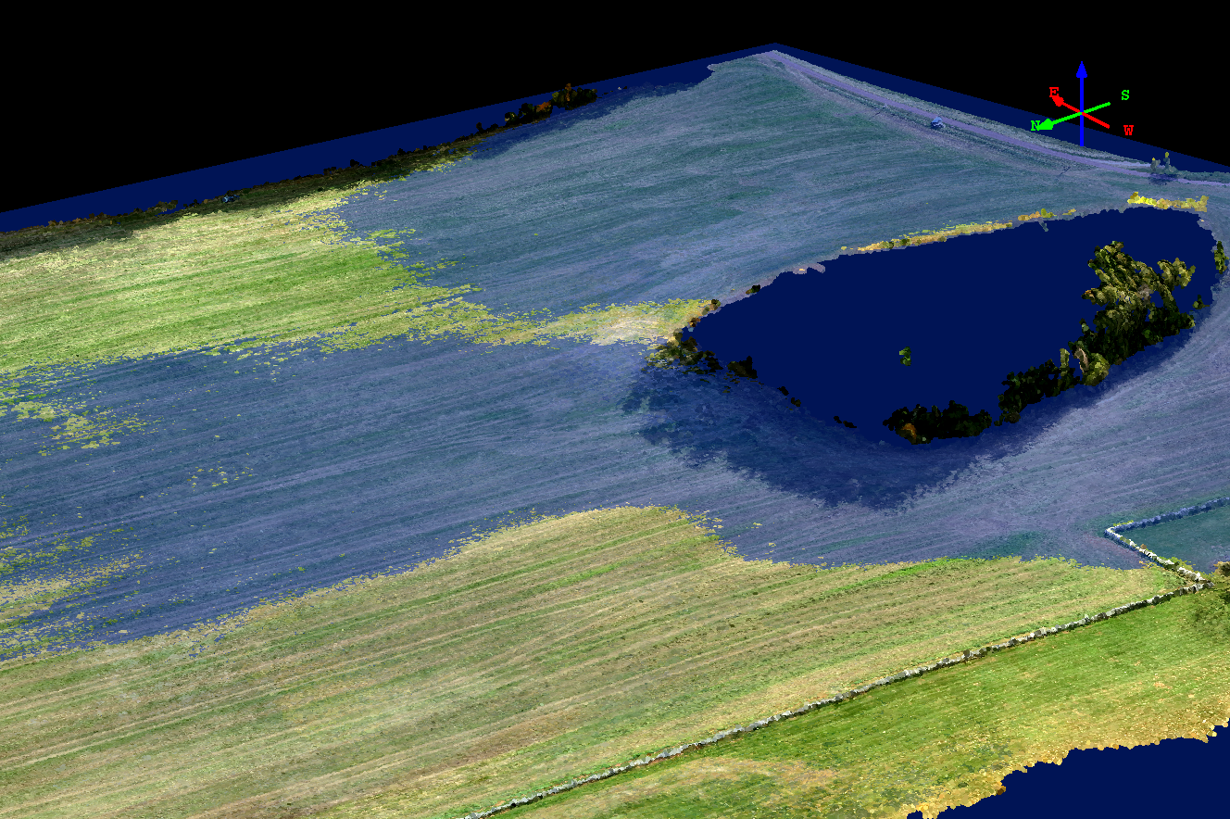
Notes:
maximum:
11/4/1927
13,600 flow cubic ft per second
~14 ft stage area with

Slide 34
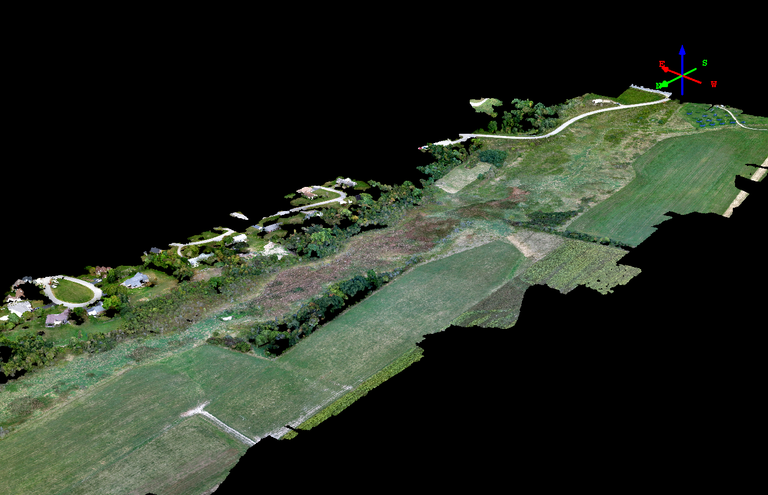
Neighborhoods
Agricultural Fields
Notes:
maximum:
11/4/1927
13,600 flow cubic ft per second
~14 ft stage area with

Slide 35
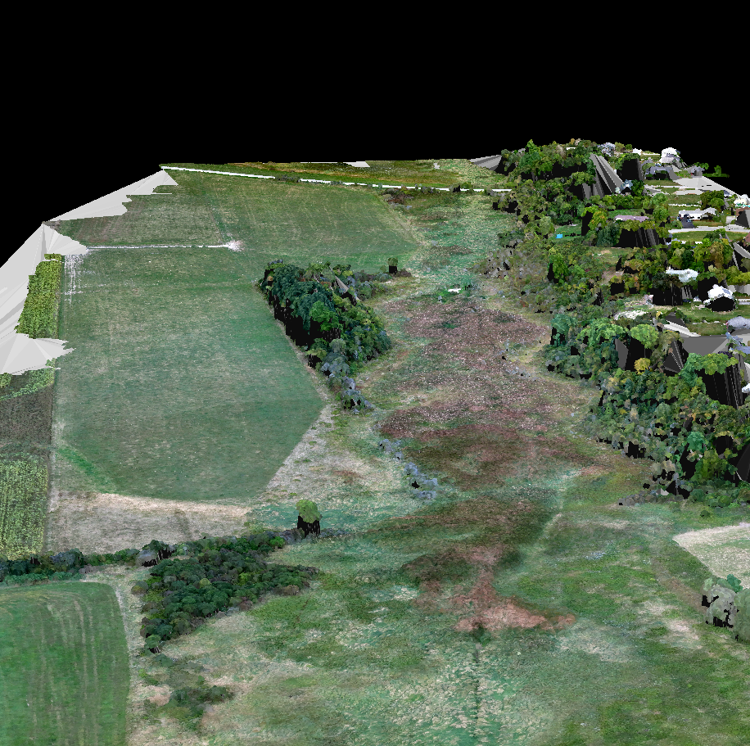
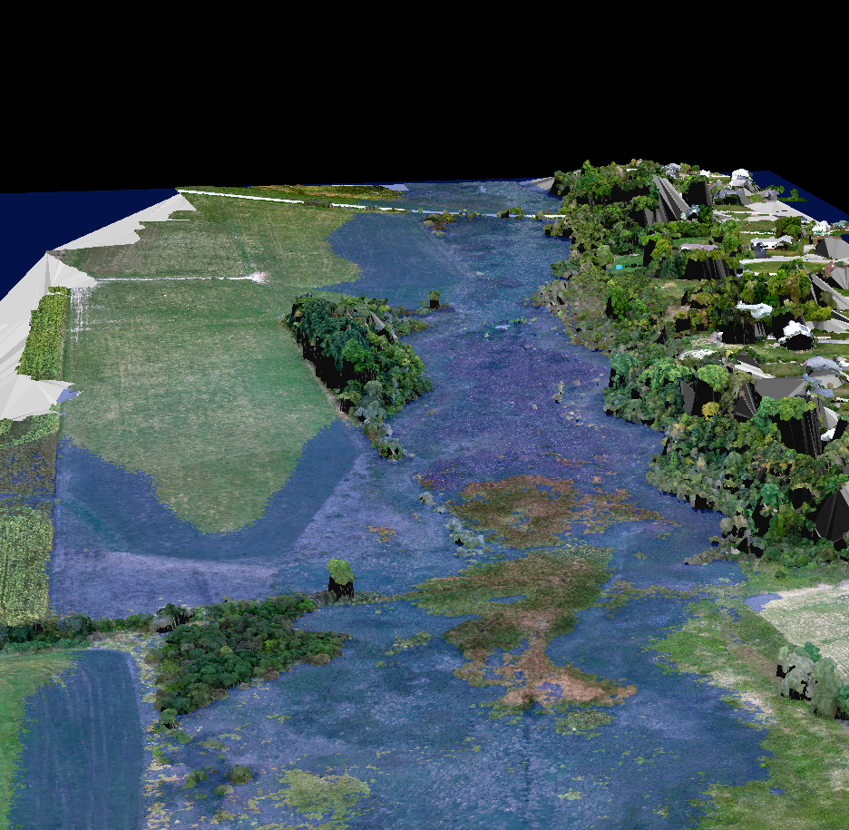
3D Model
Flood Analysis
Agricultural Fields
Neighborhoods
Agricultural Fields
Neighborhoods
Flood Analysis
Simulating a Otter Creek flood of maximum from 1927:
13,600 cfs, 14ft stage area
Notes:
maximum:
11/4/1927
13,600 flow cubic ft per second
~14 ft stage area with

Slide 36
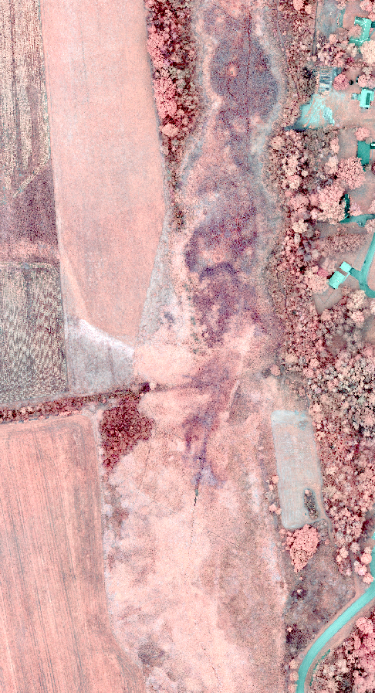
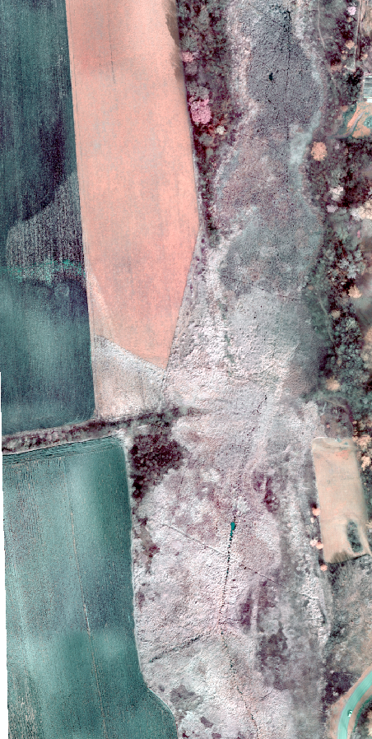
September
October

Slide 37
Lindsay Barbieri
@barbieriiv
The University of Vermont
Rubenstein School of Environment and Natural Resources
Gund Institute for Ecological Economics
Spatial Analysis Lab
ESIP Student Fellow:
Agriculture and Climate Cluster
Data Analytics Cluster

