Slide 1


NOAA Administrative Order 212-15:
Management of Environmental and
Geospatial Data and Information
The Case for Data Stewardship – Agency Requirements
Jeff Arnfield
NOAA’s National Climatic Data Center
Version 1.0
February 2013
Copyright 2013 Jeff Arnfield
Notes:
Introduction: Slide 1
This is the Federation of Earth Science Information Partners Data Management for Scientists Short Course, Section: The Case for Data Stewardship – Agency Requirements; Module: NOAA Administrative Order 212-15: Management of Environmental and Geospatial Data and Information.
This training module is part of the Federation of Earth Science Information Partners (or ESIP Federation's) Data Management for Scientists Short Course. The subject of this module is " NOAA Administrative Order 212-15: Management of Environmental and Geospatial Data and Information". The module was authored by Jeff Arnfield from NOAA’s National Climatic Data Center. Besides the ESIP Federation, sponsors of this Data Management for Scientists Short Course are the Data Conservancy and the United States National Oceanic and Atmospheric Administration (NOAA).

Slide 2
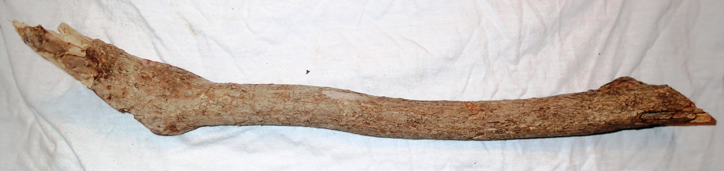

Data Management: the NOAA approach
NOAA, like many other agencies, has its own requirements and directives that augment higher level data management mandates
NOAA offices, contractors, partners and researchers receiving NOAA funding must manage environmental
data in compliance with NOAA’s requirements and directives
NOAA’s Environmental Data Management Committee (EDMC) provides implementation guidance for NOAA's environmental data management strategy, access to directives and other resources
Notes:
Slide 2: Data Management: the NOAA approach
NOAA, like many other agencies, has its own set of requirements and directives that augment broader Federal level data management mandates. Ah, but how to achieve compliance?
As with most orders, there is the inevitable “stick:” anyone receiving NOAA funding -- its own offices and employees as well as contractors, partners and outside researchers – must manage resulting environmental data in compliance with NOAA’s requirements and directives.
To assist data managers in understanding and meeting those requirements, there is also a bit of carrot: NOAA’s Environmental Data Management Committee, or EDMC, provides access to the directives and various supporting resources, including implementation guidance. NOAA’s National Data Centers provide additional guidance for data submitted for archiving.

Slide 3
NOAA Administrative Order 212-15
Management of Environmental and Geospatial Data and Information (NAO 212-15)
  “…provides high-level direction that guides… environmental data and information management throughout NOAA.”
  Simple: “Environmental data will be visible, accessible and independently understandable to users…”
  Comprehensive: “… applies to all NOAA environmental data and to the personnel and organizations that manage these data…”
  Holistic: “Management of NOAA environmental data will be based upon an end-to-end data management lifecycle”
  Extensible: Procedural directives will provide further guidance, and “approved Procedural Directives inherit the requirements and authority of this policy.”
Notes:
Slide 3: NOAA Administrative Order 212-15
NOAA’s high-level Environmental Data Management (EDM) requirements are laid out in NOAA Administrative Order 212-15, entitled “Management of Environmental and Geospatial Data and Information .“ Because details often change as standards and technologies evolve, 212-15 ensures long-term relevance by focusing on the big picture. Rather than delving deeply into details, it instead uses broad brush strokes to define a simple, comprehensive, holistic and extensible vision for effective environmental data and information management.
Simple? Well, “Environmental data will be visible, accessible and independently understandable to users” is brief, concise and clearly conveys the goals. Think of it as NOAA’s Prime Directive for managing its environmental data.
Sometimes it is unclear exactly to whom a requirement applies. The phrase “applies to all NOAA environmental data and to the personnel and organizations that manage these data” makes it quite clear that this means you!
“Management of NOAA environmental data will be based upon an end-to-end data management lifecycle” makes it clear that data management is not merely a box to check off, but rather a process spanning the entire project or program.
By delegating specific implementation standards and details to separate Procedural Directives, NOAA 212-15 ensures that specific requirements and guidelines can be modified as needed, with no need to change the Prime Directive!

Slide 4


Directives dealing with devilish details
Do my data need to be archived?
  NOAA Procedure For Scientific Records Appraisal
  and Archive Approval: Guide for Data Managers
Who should have access to my data?
  NOAA Data Sharing Policy for Grants and
  Cooperative Agreements
Is my data management plan adequate?
  NOAA Data Management Planning Directive
What documentation is necessary?
  NOAA Documentation Directive
Notes:
Slide 4: Directives dealing with devilish details
There are more specific directives to help you with other questions that you might have. For instance, you might ask: Who should have access to my data? To answer that question, you can go to the NOAA Data Sharing Policy for Grants and Cooperative Agreements.
The NOAA Data Management Planning Directive can provide guidance on whether your data management plan is adequate.
The NOAA Documentation Directive can tell you what documentation is necessary for your project.

Slide 5

Do my data need to be archived?
NOAA Procedure For Scientific Records Appraisal and Archive Approval: Guide for Data Managers (Sept 2008)
  Applies to scientific records defined in NOAA Information Quality Guidelines (2006) :
    Original Data
    Synthesized Products
    Warnings, Forecasts, and Advisories
    Experimental Products
  Defines processes for evaluating and archiving scientific records
    Identify
    Appraise
    Decide
    Implement
Notes:
Slide 5: Do my data need to be archived?
Obviously, data management principles apply to all data. NOAA has a separate guide to help determine whether your data should reside in a formal archive, such as one of its National Data Centers. It’s called the NOAA Procedure for Scientific Records Appraisal and Archive Approval: Guide for Data Managers. The guidelines in this Procedure apply to scientific records, and define processes for evaluating and archiving those records.

Slide 6
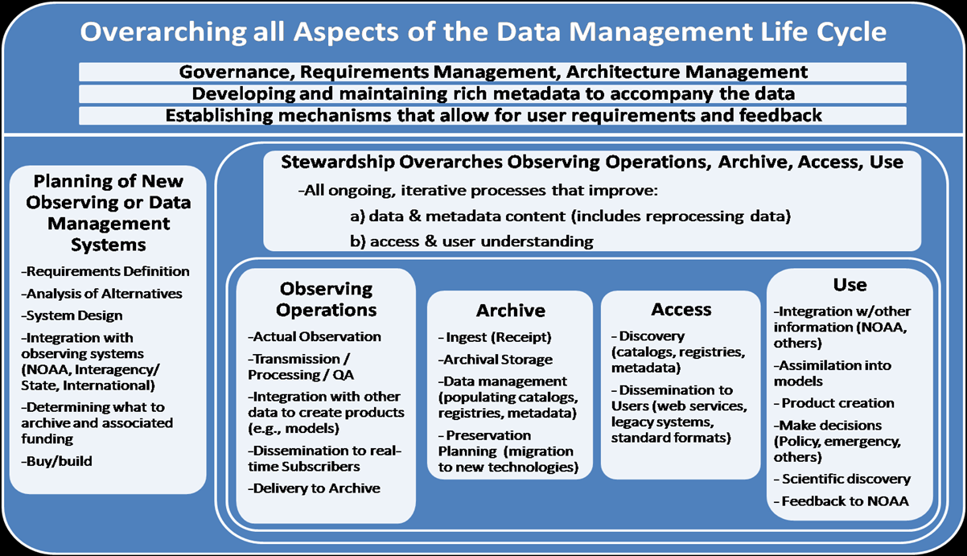
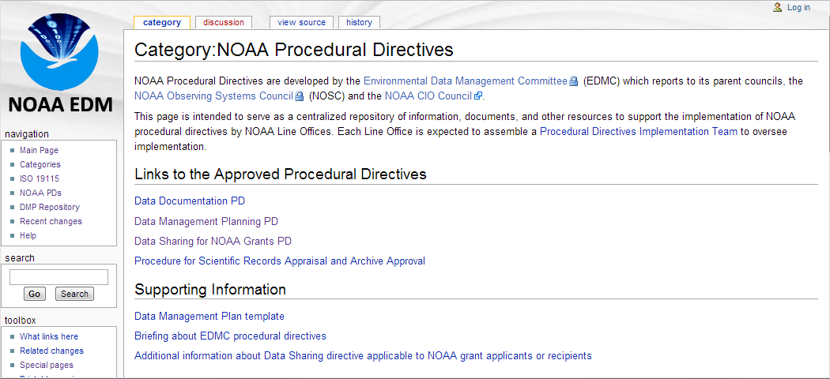
Environmental Data Management Committee
The EDMC’s goal is to enable NOAA to maximize the value of its environmental data assets through sound and coordinated data management practices
NOAA’s EDM wiki provides access to NOAA directives and supporting resources
Notes:
Slide 6: Environmental Data Management Committee
As is probably clear by now, environmental data management is an end-to-end process that includes acquisition, quality control, validation, reprocessing, storage, retrieval, dissemination and long-term preservation activities. The EDMC’s goal is to enable NOAA to maximize the value of its environmental data assets through sound and coordinated data management practices. To guide and support data managers in their tasks, NOAA’s EDM wiki provides links to NOAA’s approved procedural directives and to additional information and resources.

Slide 7
Resources
NOAA Environmental Data Management Committee site
  https://www.nosc.noaa.gov/EDMC/
NOAA Environmental Data Management (EDM) wiki
  https://geo-ide.noaa.gov/wiki/index.php?title=Main_Page
NOAA records management site
  http://www.corporateservices.noaa.gov/audit/records_management/
Notes:
Slide 7: Resources
We’ve included some additional resources that you might find helpful should you need more information about some of the topics we’ve covered in this module.

Slide 8
References
NOAA Information Quality Guidelines http://www.cio.noaa.gov/Policy_Programs/IQ_Guidelines_110606.html
NOAA Administrative Order 212-15 http://www.corporateservices.noaa.gov/ames/administrative_orders/chapter_212/212-15.html
NOAA Data Sharing Policy for Grants and Cooperative Agreements https://www.nosc.noaa.gov/EDMC/PD.DSP.php
NOAA Data Management Planning Directive https://www.nosc.noaa.gov/EDMC/PD.DMP.php
NOAA Data Documentation Directive https://www.nosc.noaa.gov/EDMC/PD.DD.php
NOAA Procedure For Scientific Records Appraisal and Archive Approval: Guide for Data Managers https://www.nosc.noaa.gov/EDMC/documents/NOAA_Procedure_document_final_12-16-1.pdf
Notes:
Slide 8: References
Within this module, we've made reference to published sources that we think you may want to review when you want more information about NOAA’s policies and guidelines related to data management.

Slide 9
Other Relevant Modules
The Case for Data Stewardship: Agency Requirements
The Case for Data Stewardship - Agency Requirements: NSF Data Management Plans
The Case for Data Stewardship - Agency Requirements: NASA Science Data Policy
Local Data Management – Advertising Your Data: Agency Requirements for Submitting Metadata
Data Management Plans: Elements of a Data Management Plan
Notes:
Slide 9: Other Relevant Modules
The modules of the ESIP Data Management for Scientists Short Course have been designed to complement and supplement each other. In light of this plan, we think you may find the following modules relevant as you seek to gain a better understanding of the topics covered in this module:
For both a broader view and more specifics on agency requirements for managing your data, see:
The Case for Data Stewardship: Agency Requirements
The Case for Data Stewardship -- Agency Requirements: NSF Data Management Plans
The Case for Data Stewardship -- Agency Requirements: NASA Science Data Policy
Local Data Management – Advertising Your Data: Agency Requirements for Submitting Metadata
Data Management Plans: Elements of a Data Management Plan.

Slide 10
Recommended Citations
Arnfield, J. 2013. “The Case for Data Stewardship – Agency Requirements; NOAA Administrative Order 212-15: Management of Environmental and Geospatial Data and Information.” In Data Management for Scientists Short Course, edited by Ruth Duerr and Nancy J. Hoebelheinrich, Federation of Earth Science Information Partners: ESIP Commons. doi:10.7269/P3KK98PW
Copyright 2013 Jeff Arnfield
Notes:
Slide 10: Recommended Citation
This module is available under a Creative Commons Attribution 3.0 license that allows you to share and adapt the work as long as you cite the work according to the citation provided.
Thank you very much for your interest in the ESIP Federation’s Data Management for Scientists Short Course.

