Slide 1


Agency Requirements:
NSF Data Management Plans
The Case for Data Stewardship
Ruth Duerr
National Snow and Ice Data Center
Version 1.0
November 2012
Copyright 2012 Ruth Duerr
Notes:
Slide 1: Introduction:
This is the Federation of Earth Science Information Partners Data Management for Scientists Short Course, Section: The Case for Data Stewardship – Agency Requirements; Module: NSF Data Management Plans.
This training module is part of the Federation of Earth Science Information Partners (or ESIP Federation's) Data Management for Scientists Short Course. The subject of this module is "NSF Data Management Plans". The module was authored by Ruth Duerr from the National Snow and Ice Data Center in Boulder, Colorado. Besides the ESIP Federation, sponsors of this Data Management for Scientists Short Course are the Data Conservancy and the United States National Oceanic and Atmospheric Administration (NOAA).

Slide 2
Overview
All proposals to NSF must be accompanied by a data management plan
  Plans must be no longer than 2 pages
  Plans should be responsive to NSF’s policy on the dissemination and sharing of research results (see NSF Award and Administration Guide)
  NSF’s Fastlane system will not accept proposals without this supplementary document
Individual directorates may have directorate specific guidance
Individual solicitations may have program specific guidance
Notes:
Slide 2: Overview
If you’ve done any proposal writing for the National Science Foundation (NSF), you know that NSF now requires that all proposals be accompanied by a data management plan that can be no longer than two pages. The data management plans are expected to respond to NSF’s existing policy on the dissemination and sharing of research results. You can find a description of this policy in the NSF Award and Administration Guide to which we provide a link later in this module. In addition, we should note that the NSF’s proposal submission system, Fastlane, will not accept a proposal that does not have a data management plan attached as a supplementary document.
Individual directorates may have specific guidance for data management plans. For example, the Ocean Sciences Division specifies that data be available within two years after acquisition. Specifications for some individual directorates may provide a list of places where you must archive your data and what you should do if none of the archives in the list can take your data. They may also have additional requirements for both annual and final reporting beyond the general case requirements from NSF. In addition, individual solicitations may have program specific guidelines to which you need to pay attention.

Slide 3
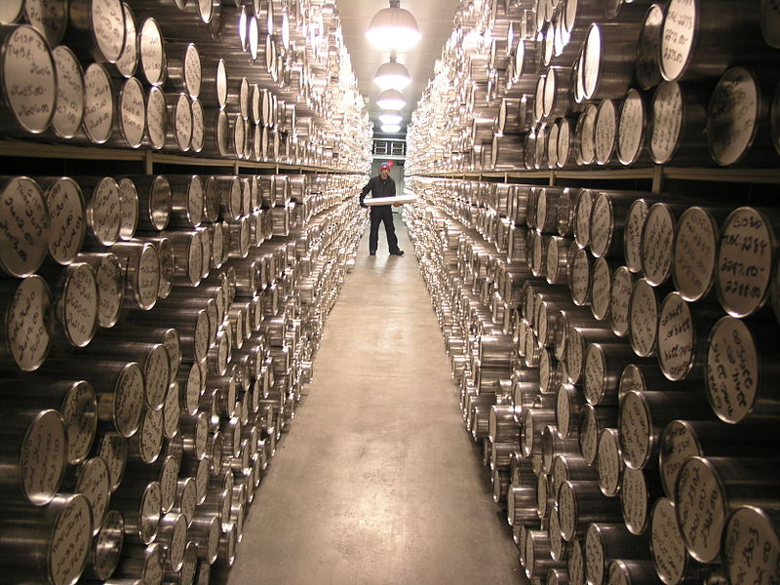
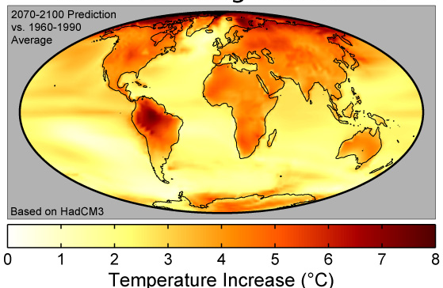

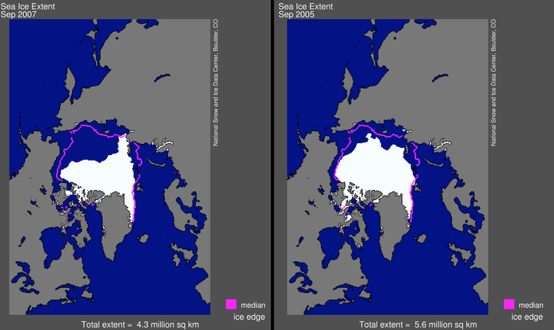
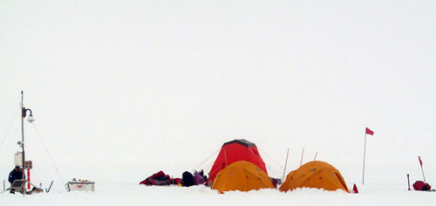
NSF’s Definition of Data
The NSF definition of data is very broad - you may be surprised at what is included!
Obviously
Data!
Photo credit: Erik Cravens, National Ice Core Laboratory, 2006
samples
Photo credit: Robert A. Rohde, Global Warming Art, 2007
Model output
Photo credit: DynV, Open Clip Art Library, 2006
experiment data
Photo credit: National Snow and Ice Data Center, 2006
“in-situ” data
remote sensing data
Notes:
Slide 3: NSF’s Definition of Data (What is Obviously Data)
NSF’s definition of data is very, very broad; you might be surprised at what is included. Some formats are straight forward. For example, computer models that produce data as an output are obviously data. A prediction of temperature rise due to global warming is considered data, as is field instrumentation or any sort of in-situ data gathering. Also obvious are lab descriptions about how snow crystals are made, for example. Collections of physical objects in the field such as ice cores, biological samples, geological samples, or water samples are considered data as well as remote sensing data such as the imagery and other data from the Advanced Very High Resolution Radiometer or A-V-H-R-R instrument on board several space crafts. All of these examples are obviously data and should be covered by the data management plans that NSF requires.

Slide 4


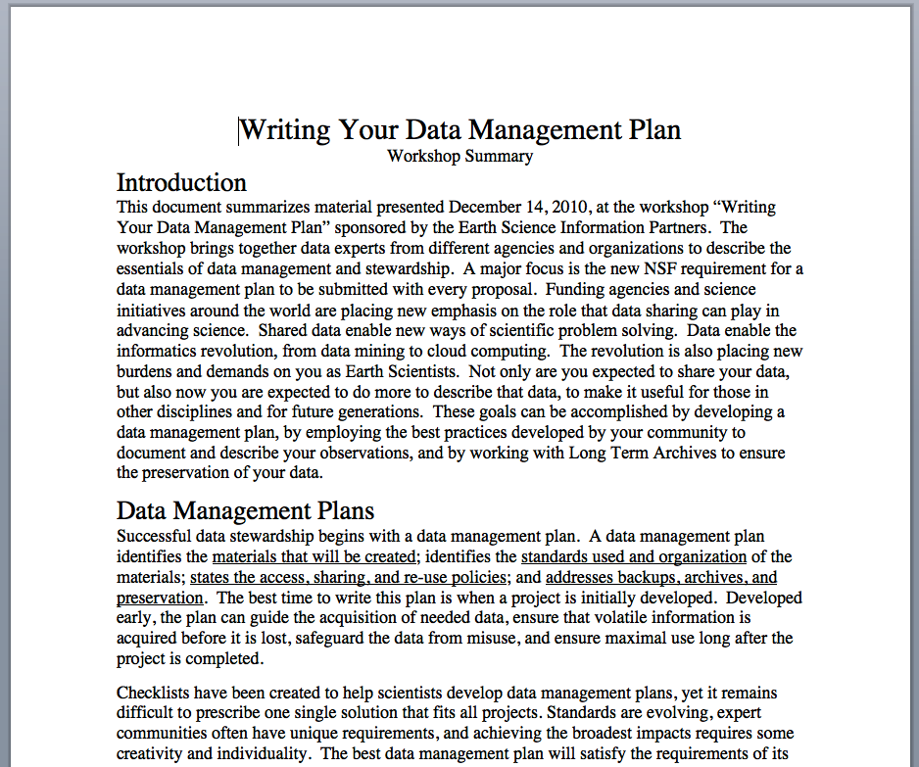
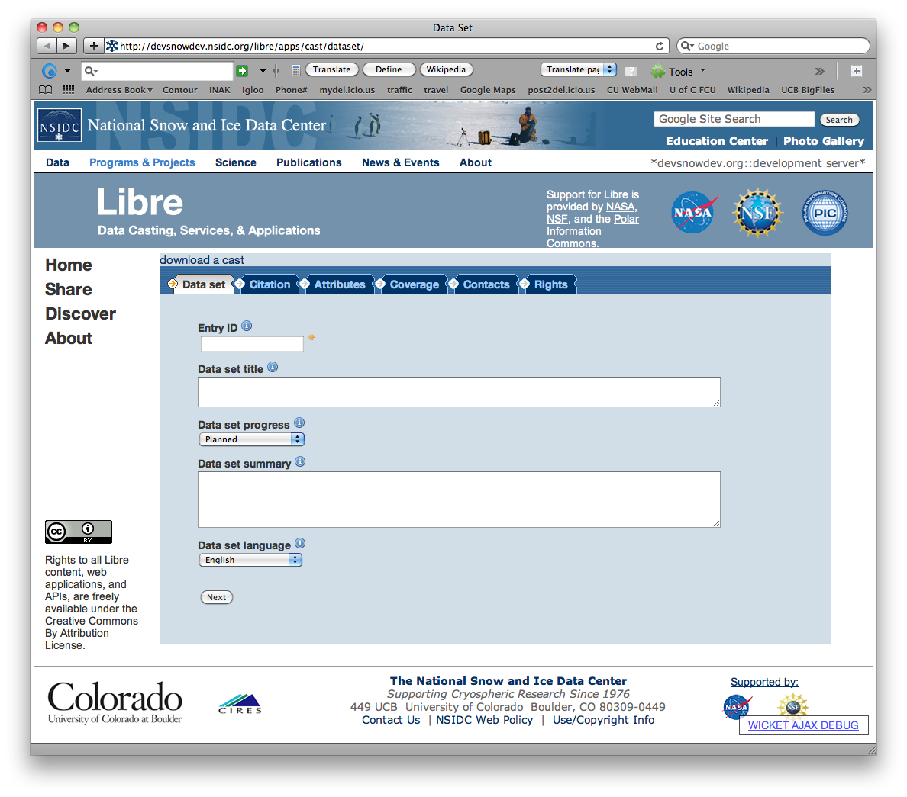
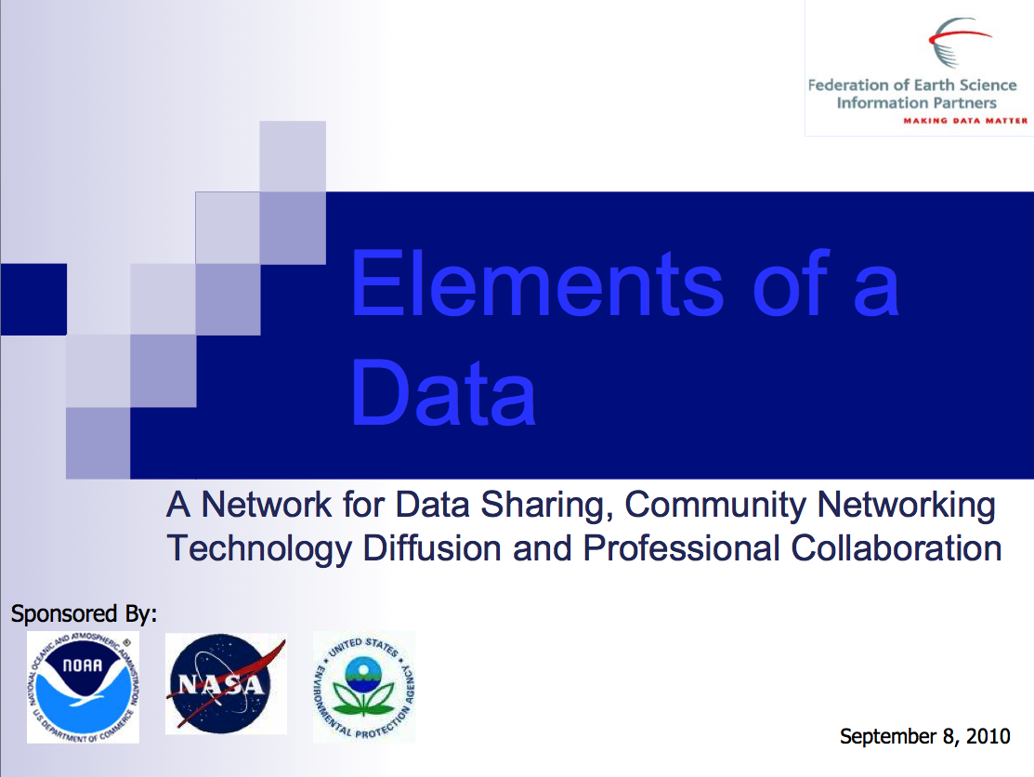
NSF’s Definition of Data
Not so
obviously
Data??
Blueprints
Photo credit: Franklin Jones, Wikimedia Commons, 2005
Photo credit: National Snow and Ice Data Center, 2012
Course Materials
Software
Notes:
Slide 4: NSF’s Definition of Data (what is not so obviously Data??)
Other kinds of research outputs might be considered data too. For example, if you are building a facility or an instrument, you may very well be expected to provide access to the blueprints and plans that you use while building that facility or instrument. Course or curricula materials might also be considered data such as training documents, videos, Powerpoint presentations, or white papers. If you are creating software as an output of research that is being done, there may be a requirement to make the software publicly available, just as more traditional research results might be. The example on this slide shows a screen shot of software that provides a web form for an investigator to fill out. From the information on the form, investigators can easily advertise the existence of their data sets in a machine discoverable way by placing links on their website. The software that was created for this task needed to be made publicly available and was placed on github.

Slide 5
NSF policy on dissemination and sharing
Investigators must promptly publish all significant findings
Investigators are expected to share primary data, samples, etc. created or gathered
  Privacy or sensitive information concerns need to be taken into account
  Exceptions to open sharing may be granted on request to your program officer
Sharing of software or other inventions created as a result of your research is encouraged and some programs may require it
Notes:
Slide 5: NSF policy on dissemination and sharing
The NSF policy on dissemination and sharing has been in place for many years but in many cases has not been consistently enforced. The new requirement for a data management plan is probably the first step along the path toward enforcement. In any case, the policy calls for investigators to promptly publish all significant findings. What “promptly” means varies by discipline as you might expect, but typically is within a year or two. What you are expected to share are your primary data and any samples created or gathered as we discussed previously. NSF does understand that ethical or legal reasons may prohibit you from fully sharing everything that you are producing. For these situations, a mechanism exists to grant exceptions to open sharing, i.e., a request to your program officer. As we mentioned, you are typically expected to share software or other inventions that you create and in some cases, the expectation may be a requirement.

Slide 6
General guidance from NSF on plan content
Description of materials produced as a part of the project
Metadata and data standards and formats to be used
Access and sharing policies
Policies for re-use, re-distribution, and creation of derived products
Plan for preserving materials and access to them
Notes:
Slide 6: General guidance from NSF on plan content
So what should be in this data management plan? Basically, the data management plan should describe the who, what, when, where, and why of your project. In other words, you should answer questions like the following: What materials are you producing and how are you creating them? In what format are the data going to be stored? What standards are you using for the data itself and for the metadata associated with that data? How are you planning to share your data and allow others to access them? If others will be reusing your data, what are your policies related to that reuse? Are they allowed to redistribute the data? Can they create derived products? What are the policies you want to establish for those activities? Finally, how are you planning to make your data available after your project is finished? In other words, what data are going to be preserved, by what means, and how are people going to access them after the project is completed?

Slide 7
Resources
NSF Data Policy
  NSF. 2011. “Award and Administration Guide.” http://www.nsf.gov/pubs/policydocs/pappguide/nsf11001/aag_6.jsp#VID4.
NSF Data Management Plan Requirement
  NSF. 2013. “Grant Proposal Guide, Chapter II.C.2.j.” http://www.nsf.gov/pubs/policydocs/pappguide/nsf13001/gpg_2.jsp#IIC2j.
NSF Directorates with specific guidance
  NSF. 2011. “Dissemination and Sharing of Research Results.” http://www.nsf.gov/bfa/dias/policy/dmp.jsp.
Notes:
Slide 7: Resources
On the next two slides, you will find a linked listing of some additional resources you might find helpful should you need more information about
NSF data management planning requirements, including links to the official NSF documentation on this slide.

Slide 8
Additional Resources
The California Digital Library in conjunction with a number of partners maintains an on-line Data Management Plan creation tool
  DMPTool: https://dmp.cdlib.org.
The Data Conservancy has a questionnaire that is a useful guide for generating an data management plan at
  http://dataconservancy.org/education/data-management-planning/.
The NSF funded DataOne project has a data base of data management best practices at
  http://www.dataone.org/best-practices.
The UK Digital Curation Centre houses a wealth of material on data management at
  http://www.dcc.ac.uk/resources
Notes:
Slide 8: Additional Resources
A wide variety of universities and other organizations have materials that can help you figure how to write a data management plan. For example, the California Digital Library has an online data management planning tool that you can use with some institution-specific requirements for data management. The Data Conservancy has a questionnaire that is a useful guide for generating a data management plan. The NSF funded DataONE project has a database of data management best practices for your use. In the United Kingdom, the Digital Curation Centre also has a wealth of material on data management.

Slide 9
Other Relevant Modules
For more information about how data management planning can help you, see
  Data Management Plans: Why Do a Data Management Plan?
For more information about what to put in your data management plan, see
  Data Management Plans: Elements of a Data Management Plan
For a discussion of agency requirements for publishing metadata about your data, see
  Local Data Management - Advertising Your Data: Agency Requirements
Notes:
Slide 9: Other Relevant Modules
The modules of the ESIP Data Management for Scientists Short Course have been designed to complement and supplement each other. In light of this plan, we think you may find the following modules relevant to you as you seek to gain a better understanding of how to generate data management plans:
For more information about why data management planning can, in general, help you become a more effective and efficient researcher, see the module called Data Management Plans: Why Do a Data Management Plan?
See Data Management Plans: Elements of a Data Management Plan for more information about what to include in your plan.
The Local Data Management – Advertising Your Data: Agency Requirements module will give you more information about what some U.S. Federal agencies are requiring for submitting metadata about your data.

Slide 10
Recommended Citations
Duerr R. 2012. “The Case for Data Stewardship – Agency Requirements: NSF Data Management Plans.” In Data Management for Scientists Short Course, edited by Ruth Duerr and Nancy J. Hoebelheinrich, Federation of Earth Science Information Partners: ESIP Commons. doi:10.7269/P3GT5K3Z
Copyright 2012 Ruth Duerr.
Notes:
Slide 10: Recommended Citation
This module is available under a Creative Commons Attribution 3.0 license that allows you to share and adapt the work as long as you cite the work according to the citation provided.
Thank you very much for your interest in the ESIP Federation’s Data Management for Scientists Short Course.

