Slide 1
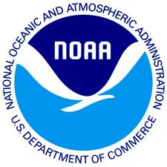
The Case for Data Stewardship: Preserving the Scientific Record
Section:
The Case for Data Stewardship
Matthew Mayernik
National Center for Atmospheric Research
Version 1.0
September 2012
Copyright 2012 Matthew Mayernik.
Notes:
Introduction:
This is the Federation of Earth Science Information Partners Data Management for Scientists Short Course, Section: The Case for Data Stewardship, Module: Preserving the scientific record.
Slide 1: Title: The Case for Data Stewardship: Preserving the scientific record.
This training module is part of the Federation of Earth Science Information Partners (or ESIP Federation's) Data Management for Scientists Short Course. The subject of this module is "Preserving the scientific record". The module was authored by Matthew Mayernik from the National Center for Atmospheric Research. Besides the ESIP Federation, sponsors of this Data Management for Scientists Short Course are the Data Conservancy and the United States National Oceanic and Atmospheric Administration (NOAA).

Slide 2
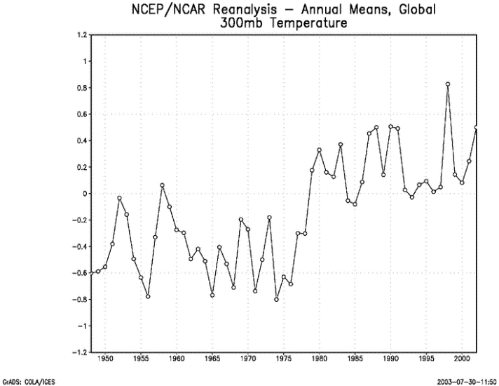
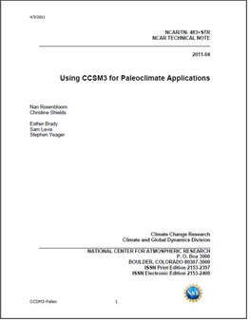
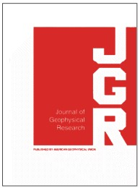
The Scientific Record
The scientific record is an aggregation of
scientific journals
conference presentations and proceedings
technical reports and pre-prints
the underlying data, software, and other evidence to support published findings
This aggregation is highly distributed across
Libraries
Archives
Museums
Data Centers
Academic publishers
Investigator web sites
Notes:
Slide 2: The Scientific Record
In this module, we will be talking about what the scientific record is, why it’s important, and why and how preservation of this kind of data is important.
So, what is a “scientific record”? A scientific record is an aggregation of lots of different types of research products that includes scientific journals, conference presentations and proceedings, other grey literature like technical reports and pre-prints, and also the underlying data software and other research products that support all of the published findings.
As you might imagine, the types of materials listed are widely distributed across a number of different information and data curation institutions. These institutions (including libraries and archives) typically manage published literature, personal papers and other resources. Others such as museums manage specimens and other physical objects, while data centers hold data. Academic publishers for the most part, archive articles since libraries now, often lease the articles rather than purchase them in physical journals. Investigative or research project websites are also considered to contain pertinent parts of the scientific record.

Slide 3
Purpose of the Scientific Record
Communicating findings, hypotheses, and insights from one person to another, across space and time
Organizing scientific communities
establishing common nomenclature and terminology
connecting related work
developing disciplines
Documenting, managing, and resolving controversies and disagreements
Establishing precedence for ideas and results
Offering evidence for the quality and significance of scientific work through bibliometrics
Notes:
Slide 3: Purpose of the Scientific Record
The purposes of the scientific record are multiple.
- First, the scientific record can facilitate the communication of findings, hypotheses and insights from one person to another across space and time. As an example, think about the fact that we can go back to articles that were written 100 or more years ago to see how particular people thought about scientific issues at that time.
- A second purpose for a scientific record is organizing scientific communities. By means of the scientific record, communities establish common nomenclature and terminologies. By looking back at the scientific record, you can see how particular terms and methods grow in importance over time. Another way in which the scientific record organizes communities is by making connections among related works. Most visibly, connections are made by means of the bibliographic citation mechanism, but textual references and other kinds of links also connect related works. As nomenclature is established and related work is connected, scientific disciplines develop over time. In this way, the scientific record is a strong indicator for and a documentation of the development of a discipline.
- A third purpose is for documenting, managing and resolving controversies and disagreements. The record of discussion is how particular ideas or methods become accepted as the correct or the most appropriate way of explaining something or studying something. A standard part of scientific discourse includes disagreements about explanations for a particular phenomenon or controversial explanations for how some particular phenomena happen. The scientific record documents these controversies and how they were ultimately resolved.
- A fourth purpose is establishing precedence for ideas and results. The establishment of who was responsible for ultimately resolving a particular controversy by proposing a method or by producing a very significant finding is a very important contribution of the scientific record.
- A fifth & final purpose for the scientific record is to offer evidence for the quality and significance of scientific work. By means of bibliometric studies, citations are counted and analyzed to understand how the number of citations for a particular work grows over time. Other evidence of quality & significance of scientific work is found by network analysis of authorship and co-authorship and the ways that authorship impacts or is impacted by other people’s work.

Slide 4
Challenges to the Scientific Record - 1
Increasing complexity of experiments and data cause the linkages between evidence and writings to become more complex and elusive
Data sets are often extractions or compilations of other data sets
Tracking the provenance of digital resources is very difficult
Example* – computation-based scientific research
Many data sets are now created through computational methods
Different software packages (or custom-built code) might also be used to access, analyze, deposit, format, compile, and/or filter data.
Metadata required to execute scientific software, including the libraries, compilers, operating system, and hardware description, might be orders of magnitude larger than the software itself.
* Example based on Stodden, Mitchell, & LeVeque, 2012.
Notes:
Slide 4: Challenges to the Scientific Record – 1
Now that scientific work is very well established in the digital world, there are some factors about it that are becoming more important because they challenge the way that the scientific record is preserved.
The first challenge is the increasing complexity of experiments and data as a result of the use of digital tools. The increased complexity causes the linkages between evidence and writing to become more complex, elusive and difficult to track.
A couple of examples can illustrate this point:
- First, data sets, particularly digital data sets are often extractions or compilations of other data sets. Data sets are combined from multiple sources. Or, one large data set may be distributed in various ways, so that people can pull up particular parts of it and do analyses on that.
With digital resources this practice is very common, but it presents a real challenge to data preservation. Tracking how extractions, compilations, filters and processes all work together is very difficult. Currently, there are a number of initiatives to develop models for tracking provenance or lineage of digital resources, but those are still in the beginning stages and have not yet been widely deployed in a standardized way.
In the computation based research that we’ve been discussing, there are other aspects that are important to consider. Data are often accessed, analyzed, deposited, formatted, compiled or filtered through computational methods. In many cases, all these different processes use different software packages or different custom built code. One analysis could go through many steps, may involve many types of software, and result in many different data sets that are derived in different ways.
In addition to the data and the software themselves, the metadata required to document all of the software might include the libraries of codes, compilers and in some cases even the operating system or hardware description itself. The size of this metadata might actually be larger than the software that is used for a particular process, thus adding to the complexity of what needs to be preserved. This is very important, particularly in climate modeling, where the codes are very complex and also have very tight dependencies on hardware and operating system details.

Slide 5
Challenges to the Scientific Record - 2
Increasing rate of the growth of the literature and data
Disciplines and sub-specialties branch and evolve continuously
Example* – Most schools of Meteorology have been renamed in the past few decades. New names include:
Atmospheric and Ocean Sciences
Earth and Atmospheric Sciences
Geological and Atmospheric Sciences
Earth, Ocean, and Atmospheric Sciences
Environmental Sciences
Earth, Atmospheric, and Planetary Sciences
Tools and practices that help manage literature are either non-existent or just beginning for data
Specialized journals
Citations
Indices
Controlled vocabularies and taxonomies
* Example from Ramamurthy, 2012.
Notes:
Slide 5: Challenges to the Scientific Record – 2
The second challenge to the scientific record is the rate at which collections of literature and data are growing, i.e., an ever increasing rate. This rate of growth is manifested in a number of different ways. One is the way that scientific disciplines have branched and evolved continuously into sub-specialties. For example, there used to be many schools of meteorology around the United States, but in the past few decades many of them have been renamed. Now there are only a couple of schools of meteorology in the US, but a lot of other schools that are related but also totally different, such as Atmospheric and Ocean Sciences. This phenomenon indicates how different priorities have taken root in different communities, and is reflected in the way that particular areas of literature are put together and evolve over time.
The second component to this challenge is the lack of tools and practices that can help manage data. Within the analog literature world, for papers and conference proceedings for example, there are many tools and practices that libraries and other organizations have developed to help manage all those resources and keep them together. In the case of digital data, those tools and practices don’t relate or are really just starting to be developed. For example, specialized data journals and even citations for data are just now taking off. Indices of both data journals and citations to data are at the very beginning stages of existence. There are many controlled vocabularies and taxonomies for data sets, but they are often separate from each other and not well connected.

Slide 6
Preservation of the Scientific Record
Tenets of the scientific record
That scientific products are trustworthy
That scientific products enable results to be reproducible and/or transparent
Preserving the scientific record: Data considerations
Are data stored in a trustworthy institutional setting?
Are data documented in a way that ensures understandability, reproducibility, and transparency over time?
Notes:
Slide 6: Preservation of the Scientific Record
As we explained, in conclusion, preservation of the scientific record is very important and very challenging. There are a couple of tenets of particular importance to keep in mind about preserving the scientific record.
- First, that scientific products are preserved in such a way that the data are trustworthy, and
- Second, that the products enable the research results to be reproducible and/or transparent. It’s important to say AND - OR transparent because not all scientific studies are reproducible. For example, observational data that were collected at a particular time and place cannot be truly reproduced. You cannot go back and re-collect data from last year. You can use the same methods and you can go to the same place, but you obviously cannot go back to what you observed last year. So the important thing for observational data is to have a transparent data set that indicates how, where and through what processes the data were collected.
A couple of considerations related to preservation of your data then are:
- Are your data stored in a trustworthy institutional setting? It’s important for data to be supported by institutions and organizations, not just by an individual. Individuals have many other responsibilities and can’t be trusted to make sure that data continues to live over time.
- Is there good documentation that ensures understandability, reproducibility and transparency over time? From the point of fact that preserving the Scientific Record is potentially a multi-century process, there has to be documentation ensuring that multiple generations of people can understand a data product.

Slide 7
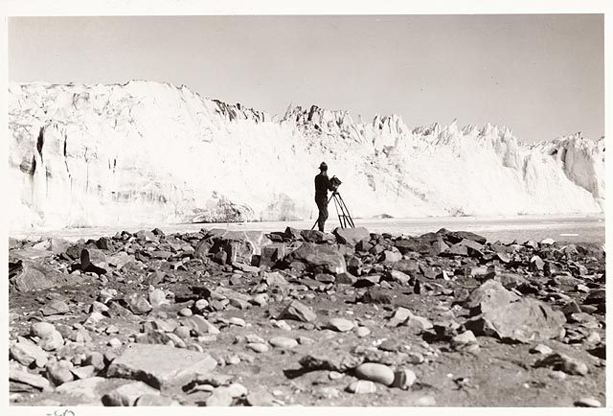
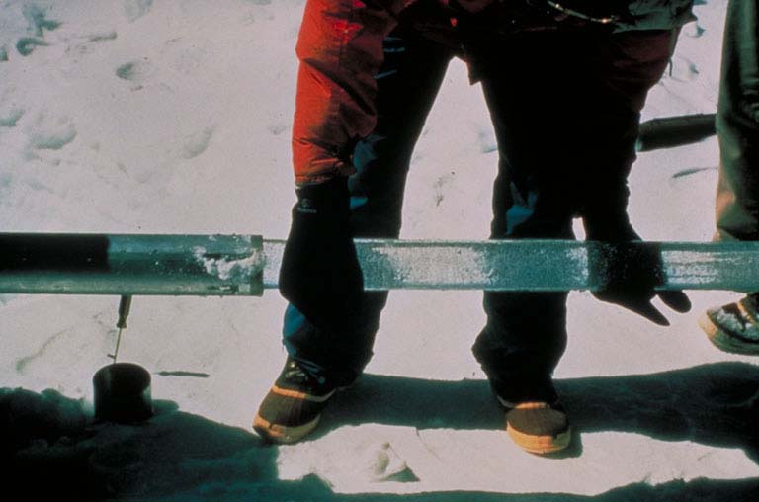
Other Preservation Modules
Establishing relationships with archives
Preserving a record of environmental change
Case studies
National Snow & Ice Data Center Glacier Photos
Arctic Temperature Variability Data
Image: Field, William Osgood. 1931 Columbia Glacier: From the Glacier Photograph Collection. Boulder, Colorado USA: National Snow and Ice Data Center/World Data Center for Glaciology. Digital media.
http://nsidc.org/cgi-bin/gpd_deliver_jpg.pl?columbia1931090612
Image from: http://www.ncdc.noaa.gov/paleo/about-collage.html
Notes:
Slide 7: Other Preservation Modules
There are a few other modules in the ESIP Federation Data Management for Scientists Short Course that are relevant for the concepts we’ve discussed briefly in the module that talk about how to establish relationships with archives, why and how preserving a record of environmental change is important, and a couple of case studies looking at management of glacier photos, and of Arctic temperature variability data.

Slide 8
References
Hanson, B., A. Sugden, and B. Alberts. 2011. “Making data maximally available.” Science 331(6018): 649. http://dx.doi.org/10.1126/science.1203354
Lynch, C. 2009. “Jim Gray’s Fourth Paradigm and the Construction of the Scientific Record.” In The Fourth Paradigm: Data-Intensive Scientific Discovery, edited by T. Hey, S. Tansley, & K. Tolle,137-146. Redmond, WA: Microsoft. http://research.microsoft.com/en-us/collaboration/fourthparadigm/4th_paradigm_book_part4_lynch.pdf
Ramamurthy, M. 2012. "Data Management: Progress, Opportunities and Challenges." Presentation at 2012 Unidata Users Workshop, 12 June 2012, Boulder, CO. http://www.unidata.ucar.edu/events/2012UsersWorkshop/#schedule
Stodden, V., I. Mitchell, R. LeVeque. 2012. "Reproducible Research for Scientific Computing: Tools and Strategies for Changing the Culture," Computing in Science and Engineering 14(4): 13-17. http://doi.ieeecomputersociety.org/10.1109/MCSE.2012.38
Uhlir, P.F. and P. Schröder. 2007. “Open data for global science.” Data Science Journal 6. https://www.jstage.jst.go.jp/article/dsj/6/0/6_0_OD36/_pdf
Notes:
Slide 8: References
Within this module, we've made reference to a number of published information sources that we think you may want to review when you want more in-depth information. The most relevant references are listed here.

Slide 9
Resources
Data Journals
Earth System Science Data - http://www.earth-system-science-data.net/
Geoscience Data Journal - http://www.geosciencedata.com
Data Citations
Earth Science Information Partners (ESIP) - Interagency Data Stewardship/Citations/provider guidelines http://wiki.esipfed.org/index.php/Interagency_Data_Stewardship/Citations/provider_guidelines
DataCite – http://datacite.org
Thomson Reuters Data Citation Index (announced) - http://thomsonreuters.com/content/press_room/science/686112
Controlled vocabularies and taxonomies
Global Change Master Directory - http://gcmd.nasa.gov/
NetCDF Climate and Forecast (CF) Metadata Convention - http://cf-pcmdi.llnl.gov/
Open Geospatial Consorium - Observations and Measurements http://www.opengeospatial.org/standards/om
Semantic Web for Earth and Environmental Terminology (SWEET) http://sweet.jpl.nasa.gov/ontology/
Notes:
Slide 9: Resources
On this slide, you will find a linked listing of some additional resources you might find helpful should you need more information about some of the areas we’ve covered briefly in this module. For example, there are some data journals that are now starting to come online such as Earth System Science Data which has been around for a few years. Geosciences Data Journal is starting up in late 2012. Guidelines for the creation of data citations are starting to come out. In addition, there are many controlled vocabularies and taxonomies relevant to Earth Science communities that may be useful for different purposes.

Slide 10
Other Relevant Modules
Modules about data management plans
Data Management Plans: Why Do a Data Management Plan
Data Management Plans: Elements of a Plan
Modules about documentation and metadata
Local Data Management: Introduction to Metadata and Metadata standards
Local Data Management: Recording Provenance and Context
Modules about preservation strategies
Preservation Strategies: Options for Archiving Your Data
Preservation Strategies: Emerging Standards For Preservation
Case for Data Stewardship – Preserving the Scientific Record
Establishing Relationships with Archives
Preserving a Record of Environmental Change
Case Study 1 – NSIDC Glacier Photos
Case Study 2 – Arctic Temperature Variability Data
Notes:
Slide 10: Other Relevant Modules.
The modules of the ESIP Data Management for Scientists Short Course have been designed to complement and supplement each other. In light of this plan, we think you might find the following, related modules relevant to you as you gain a better understanding of data management:
For more information about the data management plans that are used to document your efforts to preserve the scientific record, see Data Management Plans: Why Do a Data Management Plan, and Data Management Plans: Elements of a Plan.
More information about documentation and metadata about your data can be found in the modules entitled Local Data Management: Introduction to Metadata and Metadata Standards, and Local Data Management: Recording Provenance and Context.
If you want to know more about preservation strategies for your data, see the Preservation Strategies: Options for Archiving Your Data, and Preservation Strategies: Emerging Standards for Preservation modules.
Finally, as previously mentioned, the modules within the Case for Data Stewardship – Preserving the Scientific Record section will more fully discuss the concepts touched upon in this module.

Slide 11
Recommended Citations
Mayernik, M. 2012. “The Case for Data Stewardship: Preserving the Scientific Record.” In Data Management for Scientists Short Course, edited by Ruth Duerr and Nancy J. Hoebelheinrich, Federation of Earth Science Information Partners: ESIP Commons. doi:10.7269/P3PK0D3F
Copyright 2012 Matthew Mayernik.
Notes:
Slide 11: Recommended Citation
This module is available under a Creative Commons Attribution 3.0 license that allows you to share and adapt the work as long as you cite the work according to the citation provided.
Thank you very much for your interest in the ESIP Federation’s Data Management for Scientists Short Course.

