Slide 1
British Library
Wordy Data
Chris Jenkins, INSTAAR Univ Colorado Boulder

Slide 2
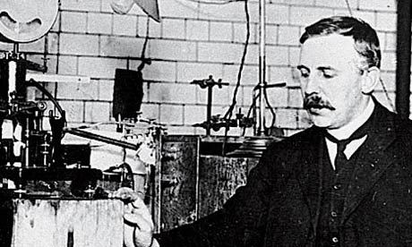
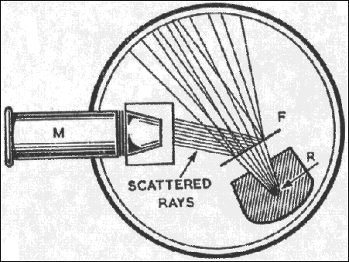
“That which is not measurable is not science”
Rutherford and/or Kelvin
Assuming that the central charge is 100e. it can be calculated that the value of b for an ® particle of velocity 2.09×109 cms. per second is about 3.4×10−12cm. In this calculation b is supposed to be very small compared with R. Since R is supposed to be of the order of the radius of the atom, viz. 10−8 cm., it is obvious that the ® particle before being turned back penetrates so close to the central charge, that the field due to the uniform distribution of negative electricity may be neglected.
Digital Commons

Slide 3
Word Data: can’t do without it …
Digital Commons
NOAA

Slide 4
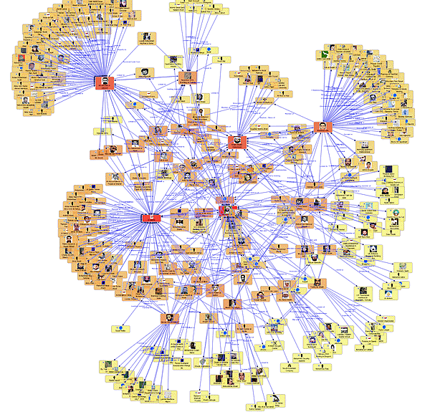
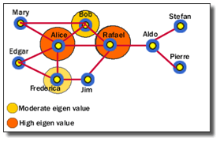
Measureable ?
http://www.fmsasg.com
http://www.fmsasg.com

Slide 5
The Trouble with Corpus
Universal Pictures

Slide 6
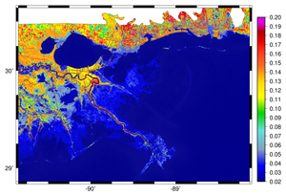
“Show me the science !”
Data discovery
Crosswalks
Parameters
Process-pathways
http://www.environment-agency.gov.uk

