Slide 1
Common Metadata Repository (CMR)
Update and Near Term Plans – ESIP Winter 2014
Dan Pilone (dan@element84.com)

Slide 2
In a world where metadata matters…

Slide 3
URS
GIBS
EMS
EOSDIS Discovery Tools
DAACs
Near Real Time (LANCE)
???
CMR

Slide 4
Seriously? Another catalog?

Slide 5
No.

Slide 6
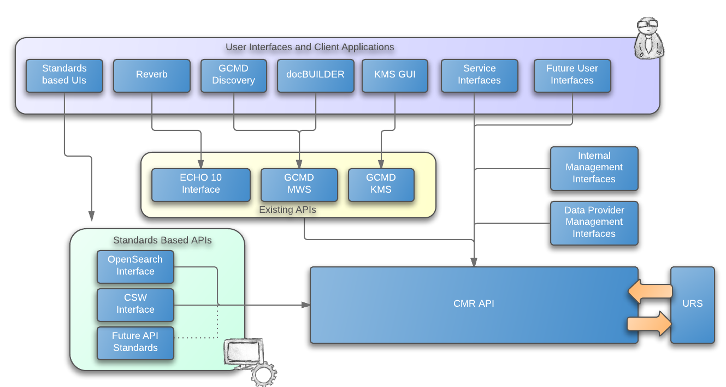
Notes:
Search APIs

Slide 7
So why are we doing this?

Slide 8
Emphasis on Metadata Quality

Slide 10
Reconciliation Progress and Plans
DIF support added to ECHO
GCMD is programmatically monitoring ECHO for new Collections and Updates
Assessment and correlation between ECHO and GCMD holdings has started
Initial pass will associate ECHO 10 Collections with GCMD DIFs
Science Coordinators will assess differences between associated records and work from easiest to hardest with providers

Slide 11
Handling Metadata Changes
Science Coordinator will work with Data Providers to make changes at Metadata source
CMR will support pluggable Ingest Adapters to allow in-line updates to ingested metadata if needed
Science Coordinator can make updates to metadata on behalf of providers when approved by owner

Slide 12
Initial Metadata Targets
LANCE (NRT)
MEaSUREs
MODAPS

Slide 13
Emphasis on Performance

Slide 14
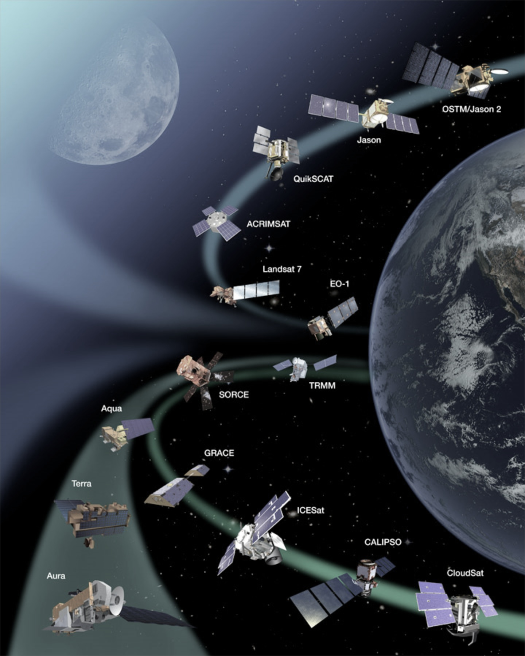
Current Holdings
Collections: ~4k + ~24k
Granules: ~140M
Growth:
Current
500k+ granules/week
Future
~1 million granules/day during MODIS Collection 6 Reprocessing
As of 12/18/2013

Slide 15
Client breakdown for a week in Oct 2013

Slide 16
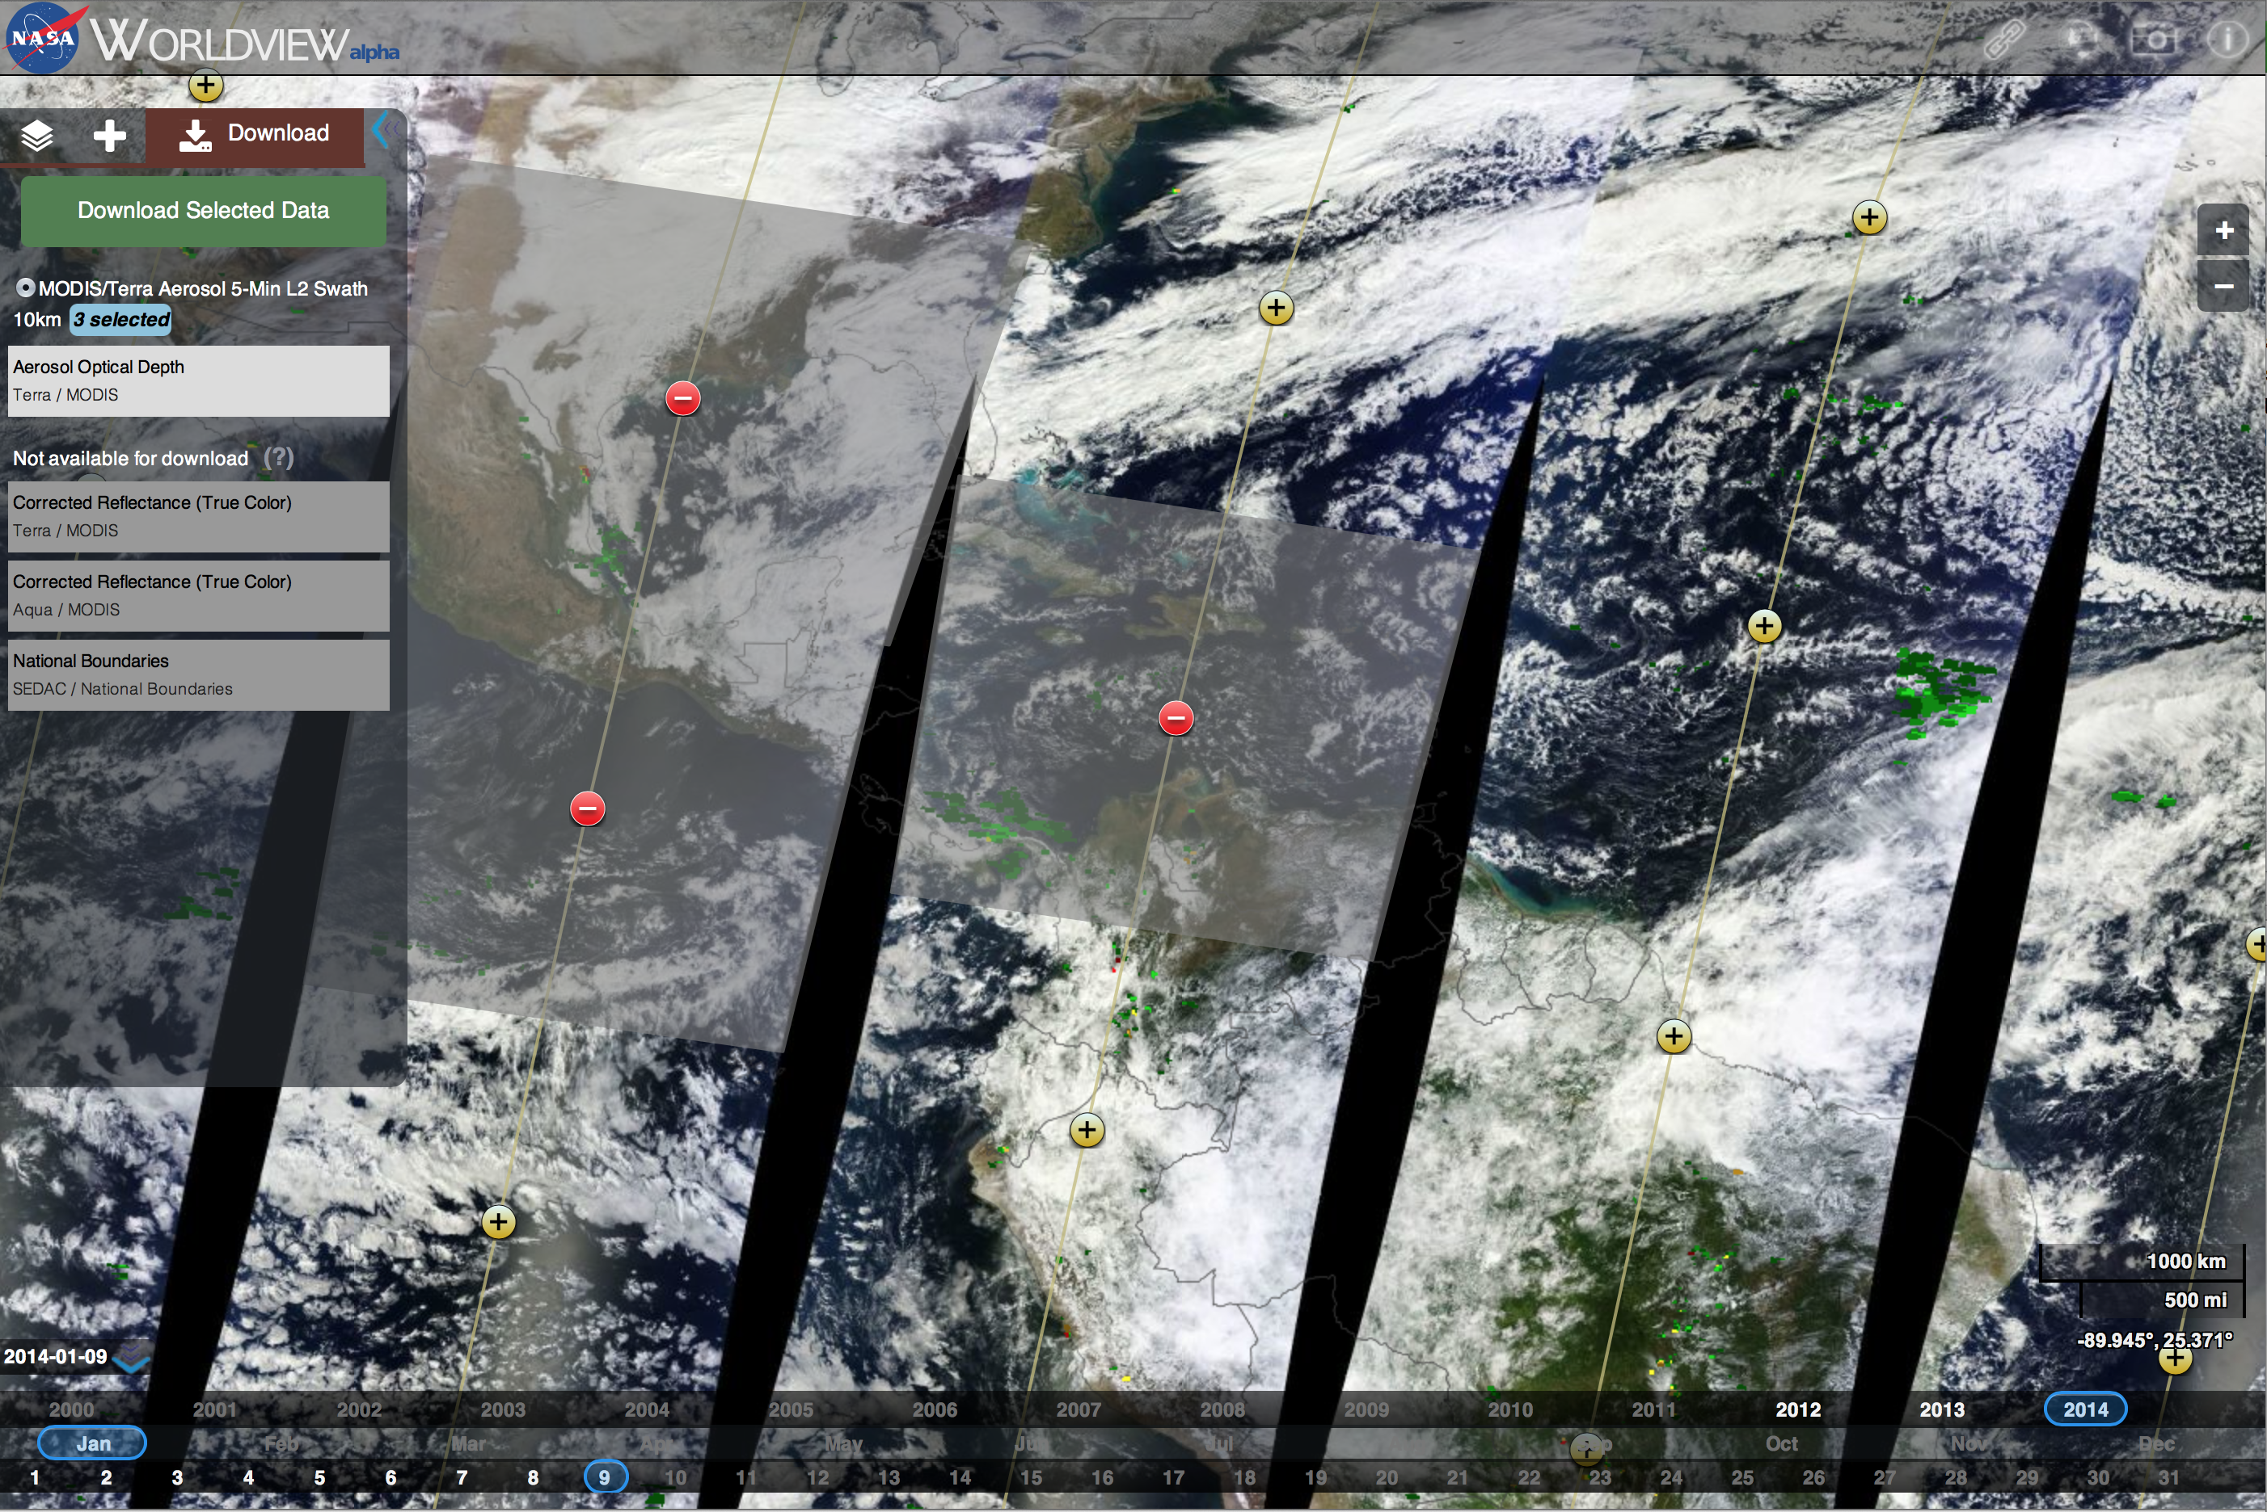

Slide 17
CMR Transition
CMR will build on ECHO and GCMD capabilities
Initial requirements based on MASI and MASII studies
Updated requirements effort starting soon
Early work to focus on search performance
ECHO components progressively replaced with CMR components

Slide 18
Metadata Concept Support

Slide 19
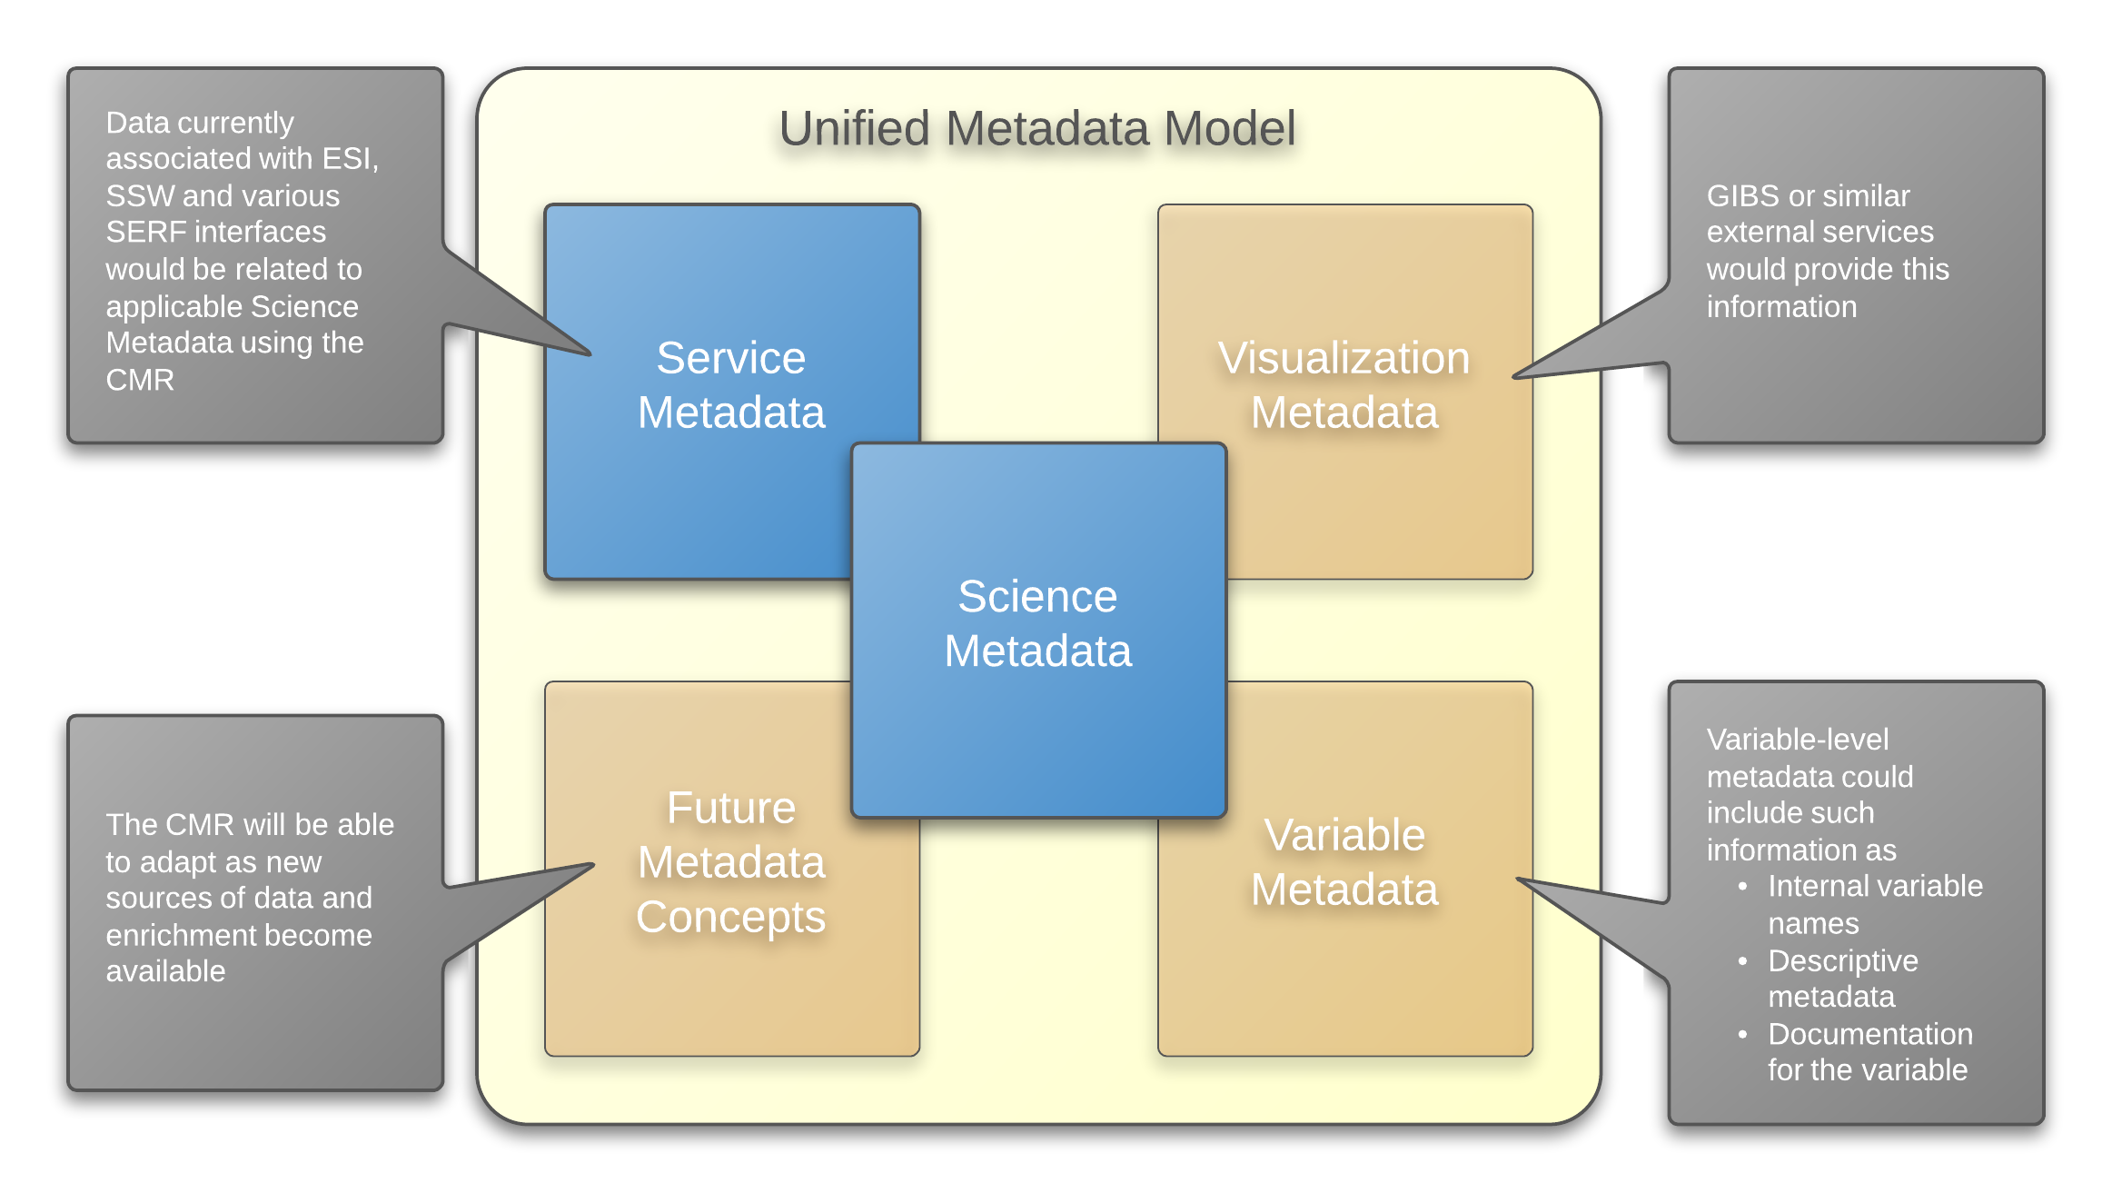
Extensibility
Notes:
Metadata Concept support

Slide 20
1
2
ECHO 10
GCMD DIF
EMS
UMM
ISO19115
Ingest Adapter
Visualization
Documentation
Services
Parameters
3
Notes:
Unification of responses

Slide 21
How Will This Affect Me?
http://store.metmuseum.org/content/ebiz/themetstore/invt/80010981/80010981_01_l.jpg

Slide 22
Metadata Providers
Streamlined Processes, More Engagement
You won’t have to reconcile multiple systems
Most systems will continue to work
ECHO FTP ingest going away
Current formats will continue to function
You will need to be engaged in the adaptation process
You will need to support controlled vocabularies
You will have a voice through the Technical Committee
Notes:
ECHO FTP ingest going away

Slide 23
Client Developers
More Metadata, Better Quality
Richer, higher quality metadata will be available
Existing APIs will be supported
Standards-compliant APIs will be available
Metadata will be available in an ISO19115 compliant format

Slide 24
End Users
More Metadata, Better Quality
Richer, higher quality metadata will be available
Unified view of EOSDIS holdings
Easier access through a variety of clients, data casting, etc
Metadata will be available in an ISO19115 compliant format

Slide 25
Questions?

