Slide 1
Streamlining Metadata with Common Metadata Repository (CMR)
ESIP Summer 2014
Copyright © 2014 Raytheon Company. All Rights Reserved

Slide 2
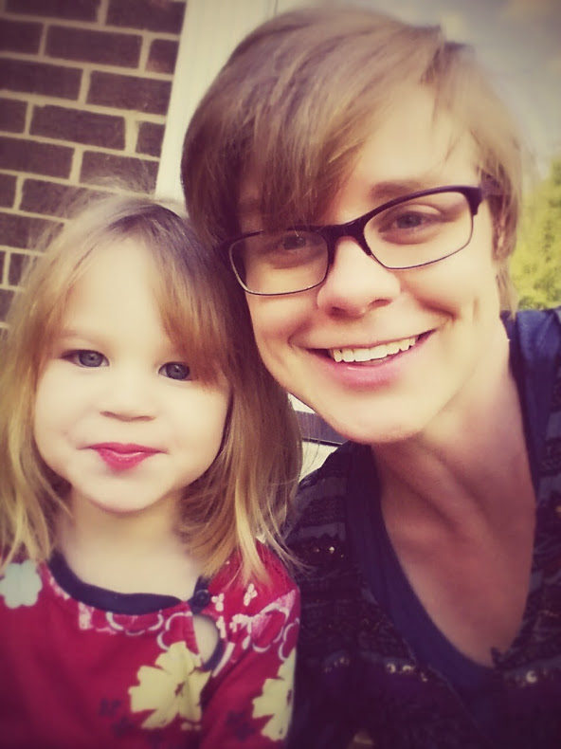
Session Speakers
Katie Baynes – Raytheon
Dan Pilone – Element84
Tyler Stevens – Wyle
Expanding Metadata Capabilities
CMR Overview
Building the CMR
General Question & Answer
Reconciliation Process
Metadata Quality & Validation Service
Unified Metadata Model (UMM) for Collections
Notes:
CMR Overview Katie 15 minutes
Building the CMR Dan 20 minutes
Expanding Metadata Capabilities Katie 10 minutes
Unified Metadata Model for Collections (UMM-C) Tyler 10 minutes
Reconciliation Process Tyler 10 minutes
Metadata Quality/Validation Service Tyler 10 minutes
General Question & Answer All 15 minutes

Slide 3
CMR Overview
ESIP Summer 2014

Slide 4
What is the CMR?
Common Metadata Repository
A single source of unified, high-quality, and reliable Earth Science metadata
A high performance ingest and search architecture for submission and discovery of all Earth Observing System Data and Information System (EOSDIS) metadata
A metadata lifecycle that helps evolve metadata standards to ensure ‘richness’ and models new concepts proposed by stakeholders

Slide 5
CMR Key Benefits
Single, authoritative source of EOSDIS metadata
Single ingest and search architecture
UMM and Metadata Concepts
Metadata Quality Assurance Workflow
Sub-second Search Capability
High Availability

Slide 6
Multiple Metadata Concepts
Unified Metadata Model
(UMM)
Science Metadata
Services Metadata
Parameter Metadata
Visualization Metadata
Future Metadata Concepts
Meta-Metadata
(Collections and Granules)

Slide 7
Metadata Quality Assurance
©iStock.com/BrianAJackson

Slide 8
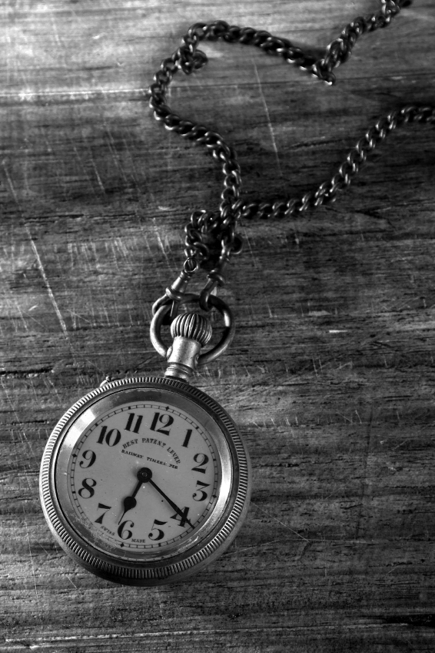
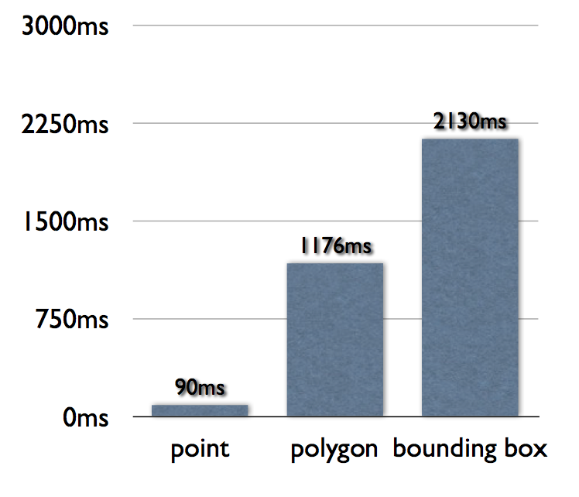
Sub-second Search
Examining performance
Format Translations
Spatial search
ElasticSearch indexing
Caching
Parallelization
©iStock.com/AOosthuizen
Notes:
The number of shards for the amount of data in ECHO is too small.
In addition, there's a whole slew of other things we found will increase elasticsearch query performance. Elasticsearch scales really well if you design your indexes properly. We can throw hardware at the problem in terms of more machines and more or faster I/O and it will speed up individual queries and allow us to handle more queries.

Slide 9
Standards-Based & Backward Compatible Formats/APIs
Project Open Data “Common Core”
Atom
JSON
ISO 19115
DIF
ECHO10
OpenSearch
Catalog Services for the Web (CSW)
ECHO REST
Global Change Master Directory MWS/KMS

Slide 10
Building the CMR
ESIP Summer 2014

Slide 11
Pillars of the CMR
Performance
Extensibility
Metadata Quality

Slide 12
CMR Performance

Slide 13
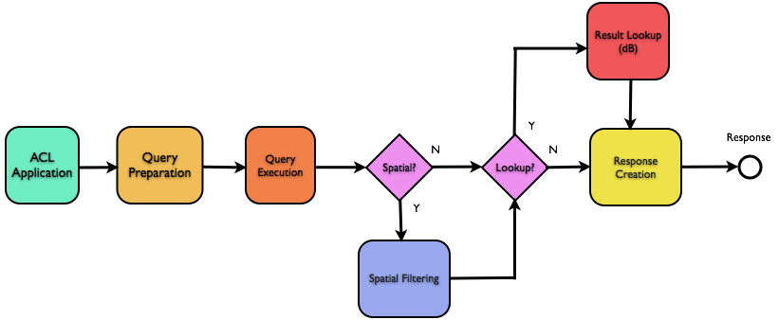
ECHO Search Flow

Slide 14
ECHO Query Execution
ECHO Granule Id Queries: 100 ms
Other Queries: 2321 ms
Spatial Queries: 3800 ms

Slide 15
Spatial Filtering in Oracle

Slide 16
ECHO Result Lookup
Lookup 2000 granules: 5s
2.5 ms/g

Slide 17
ECHO Response Format Frequency
No DB lookup needed

Slide 18
How Many Items?
63% request only 1 granule
85% request 500 or fewer

Slide 19
ECHO Response Creation
16s
12s
Time for
500 granules
1s

Slide 20
How the CMR achieves its performance

Slide 21
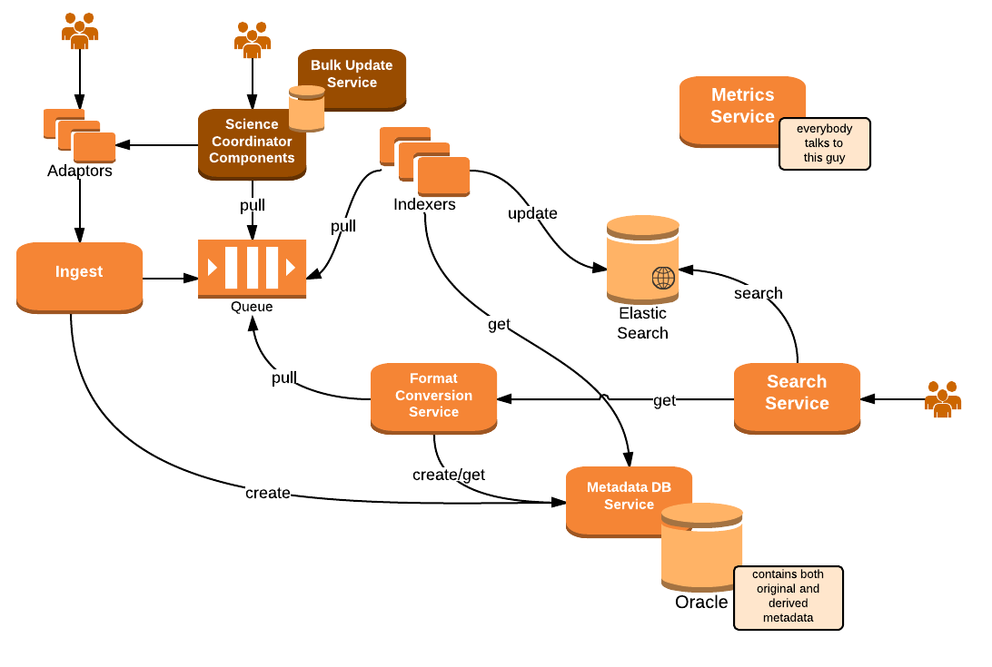
Micro-service Based Architecture

Slide 22
Test Query-Only Performance

Slide 23
Query Execution Improvements
More machines
Increase I/O
Condition Ordering
Decrease Index Size
and more…

Slide 24
Retrieving Results
Use Elastic Search directly for Atom XML and JSON
JDBC and Oracle Tweaks
Faster XML Libraries
Cache converted dialects
Parallelization

Slide 25
CMR Extensibility

Slide 26
Concept Commonalities
Dialects
UMM
Single Model for each Concept
With a set of fields
Validation Rules
Dialect & UMM Mappings
Behaviors
Ingest, Search, Validation

Slide 27
Concept Differences
Scale
1000s to 100s of millions
Relationships
Dialects and UMM

Slide 28
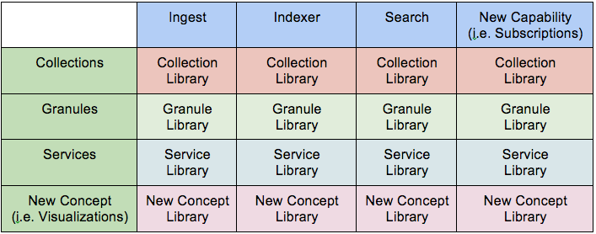
Capabilities as Applications
Concepts as Libraries

Slide 29
Expanding Metadata Capabilities
ESIP Summer 2014

Slide 30
Multiple Metadata Concepts
Science Metadata
Services Metadata
Parameter Metadata
Visualization Metadata
Future Metadata Concepts
Meta-Metadata
(Collections and Granules)
Notes:
Looking for stakeholders and use cases
Plug for EDSC and segue to metadata lifecycle and quality

Slide 31
Collections (UMM-C)
UMM-C
GCMD DIF Model
ECHO10 Collection Model
ESDIS Metrics Model
(more on this later)

Slide 32
Unified Metadata Model
ECHO 10
GCMD DIF
EMS
Ingest Adapter
UMM
ISO19115
Atom
JSON
…
UMM-C
ECHO 10
UMM-G
Visualization
Parameters/Variables
UMM-V
UMM-P
…
Future Concepts
UMM-?

Slide 33
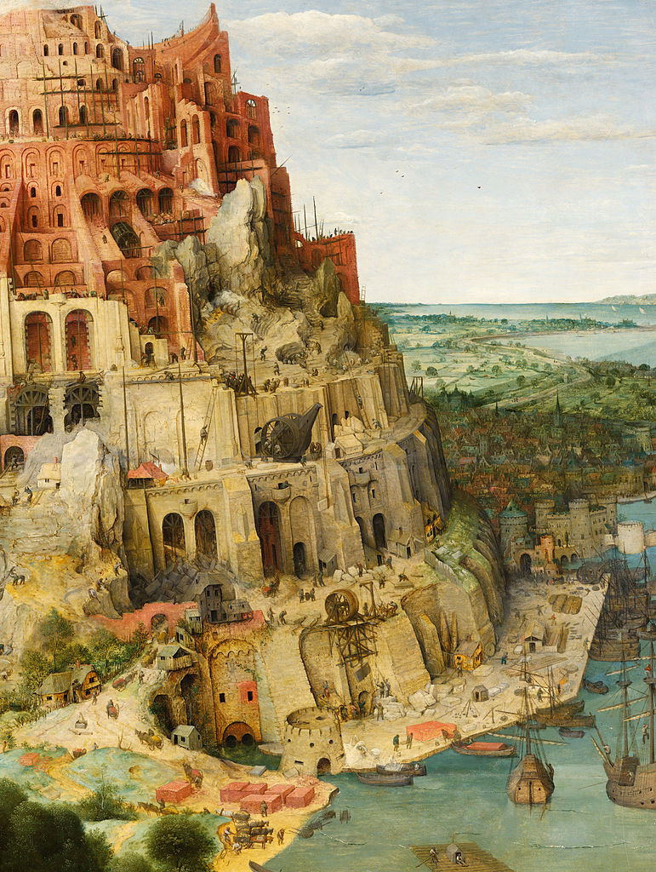
Targeted Concepts
Granules
Parameters
Services
Visualization
Documentation
Meta-Metadata
http://creativecommons.org/publicdomain/mark/1.0/

Slide 34
Process for adopting UMM concepts
Proposal of new concept
Stakeholder Interviews
Surveying Existing Implementations
Developing Use Cases
Defining Fields
Defining Relationships
Identifying Subsystem Interactions
Tailoring Lifecycle
ESO review

Slide 35
UMM Lifecycle to Evolve Metadata
Stakeholder Requests Change to UMM
Change Request Reviewed
Changes Submitted to ESO
ESO Review
UMM Updates Made
New Revision of UMM Published
(more on this later)

Slide 36
UMM-C: Unified Metadata Model for Collections
ESIP Summer 2014

Slide 37
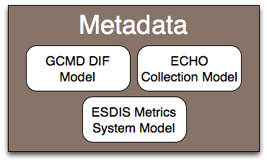
UMM-C Introduction
The Unified Metadata Model for Collection Metadata (UMM-C) brings together the existing EOSDIS metadata models into a single unified metadata model for use within the CMR.
Notes:
The UMM is based on merging existing GCMD, ECHO, and EMS metadata models into a single unified metadata model for use within the Central Metadata Repository (CMR).

Slide 38
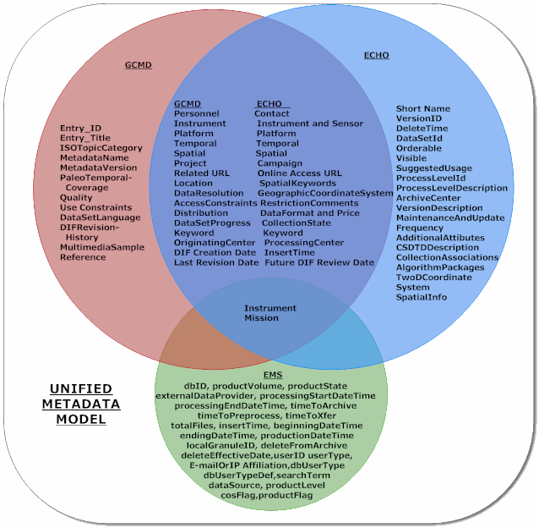
A More Detailed Look at the Fields

Slide 39
UMM-C Required and Recommended Fields (V.1.0 Beta)
Required (15)
Entry ID
Entry Title
Summary
Science Keywords
Platform
Platform/Instrument
Temporal Coverage
Spatial Coverage
Project
Organization
Related URL
Metadata Standard Name
Metadata Standard Version
Metadata Creation Date
Product
Highly Recommended (5)
Ancillary Keyword
Platform/Instrument/Sensor
Spatial Coverage/TwoD Coordinate System
Extended Metadata
Product Specific Attribute
Recommended (18)
Collection Citation
ISO Topic Category
Paleo Temporal
Temporal Keyword
Collection Progress
Spatial Keyword
Spatial Info
Quality
Access Constraints
Use Constraints
Distribution
Publication/Reference
Parent Association
Metadata Association
Metadata Revision History
Dataset Language

Slide 40
Process and Study Documents
UMM-C Crosswalk Study Document
Discusses mapping and analysis of each model, including similarities, differences, and recommendations.
UMM-C Crosswalk Spreadsheet
Detailed mapping between DIF, ECHO, EMS.
UMM-C Field Constraints
Detailed field constraints information for each concept.

Slide 41
ESDIS Standards Office (ESO) Review
Stakeholders are currently reviewing the UMM-C crosswalk document.
https://wiki.earthdata.nasa.gov/display/ESO/UMM-C+Review
Reviewers were asked to consider
Correctness of required and recommended sets of fields
Precision of the mappings
Completeness of the mappings
Correctness and utility of the fields which are mapped to controlled vocabularies
Impact of the UMM-C on metadata providers

Slide 42
UMM Lifecycle (Document Currently in Draft)
The objective of the UMM Life Cycle document is to highlight the steps/processes involved in making additions, changes, or deletions to the Unified Metadata Model (UMM).
Stakeholder Requests Change to UMM
Change Request Reviewed
Changes Submitted to ESO
ESO Review
UMM Updates Made
New Revision of UMM Published

Slide 43
Reconciliation Process
ESIP Summer 2014

Slide 44
Metadata Reconciliation Approach for Collection Metadata
Reconciliation Goal: Develop a high quality single metadata record for each EOSDIS data product.
Work with providers to achieve a single metadata record for EOSDIS collections.
Work with provider to identify appropriate metadata format (DIF or ECHO) for a given record based on information that must be represented, system constraints from the metadata provider, or other external factors.
Identify “discovery” records where a single discovery record represents a consolidation and common attributes across multiple versions of Collection level records.

Slide 45
Reconciliation Process
Link
Link metadata records (DIF and ECHO) by ID.
Triage
Assign a Merge Plan (Merge, No Merge, Other)
Identify Parent/Child Links (1 to many)
Merge (If necessary)
Metadata Format Preference (DIF or ECHO) using decision table
Review and obtain DAAC acceptance
Merge into a single collection record (DIF or ECHO)
Edit/QA
Ingest
Modify record to include values for UMM-C fields
Modify record to facilitate collection/granule linkage (if needed)
Fix inconsistent product identifiers
Ingest reconciled records into CMR
Validate against UMM-C

Slide 46
Adapter APIs
A sub-system of the "CMR ingest system“ that is designed to "adapt" metadata to the CMR based on provider requirements. The adapter API is intended to be used by both metadata providers (AKA YOU) and the CMR.
How adapters will help with reconciliation.
Map keywords to GCMD science keywords.
Standardize platform names to the GCMD/EMS set.
Insert EMS tags based on metadata rules.
Standardize formatting issues specific to providers and CMR.
Handle complex translation of ISO records specific to a provider.
Enable bulk changing of metadata at load time.
Replace HTML with markup recognized by the CMR (Markdown).

Slide 47
Metadata Quality Validation Process
ESIP Summer 2014

Slide 48
Metadata Quality In the CMR
To be useful to a broad range of Earth Science applications, metadata must be of high quality, complete, and consistent.
The CMR will incorporate both science coordinator and machine metadata assessment features to ensure high quality metadata.
During ingest, automated metadata validation will occur giving providers insight into how to make their data more discoverable or usable by users.
Science Coordinators and providers will review metadata that fails validation or lacks required information and help made make metadata more consistent and complete.

Slide 49
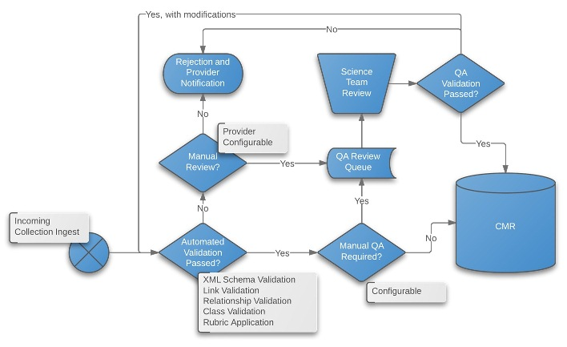
Metadata Quality Assurance Workflow

Slide 50
Developing a QA Validation Service API
Providers will be able to use an API to validate their metadata before ingest into the CMR.
Validate metadata against a common set of rules in order to ensure UMM compliance.
Required Fields
Validity of URLs
Completeness of Fields
DOI Linkages
Syntax
Validate metadata against a provider set of requirements in order to ensure higher quality metadata.

Slide 51
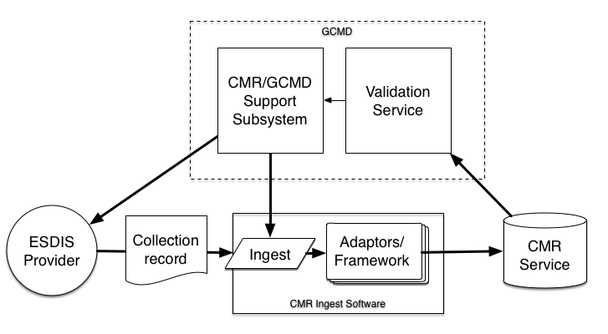
Proposed Validation API Architecture
EOSDIS

Slide 52
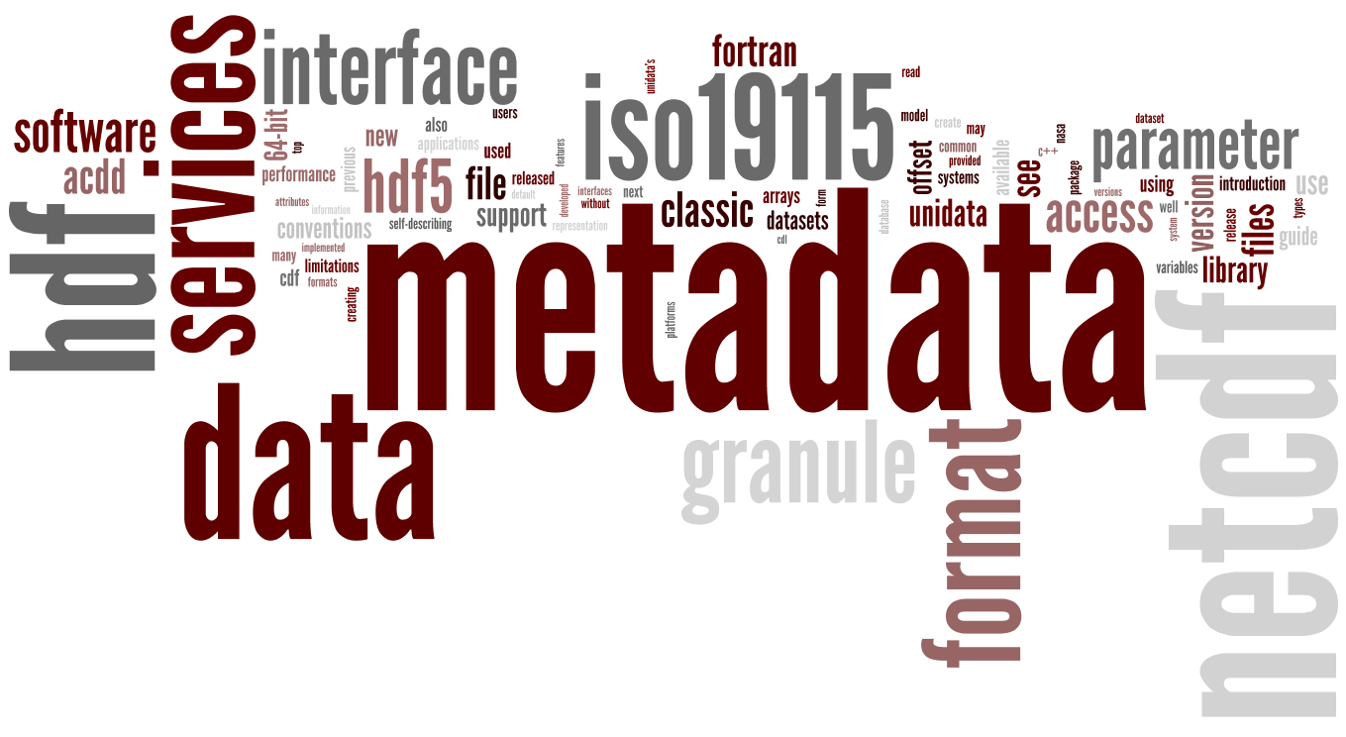
Made with wurdle.com
We want your input.
(on a variety of topics)

Slide 53
Questions
support@earthdata.nasa.gov
ESIP Summer 2014

Slide 54
Questions and Answers
What is the CMR?
The CommonMetadata Repository (CMR) catalogues all data and service metadata records for the EOSDIS system. These metadata records are registered, modified, discovered, and accessed through programmatic interfaces leveraging standard protocols and APIs.
Will the CMR have a Metadata UI similar to docBUILDER?
Yes! The CMR Metadata UI will provide similar capabilities to docBUILDER and is intended to make the creation and maintenance of high quality metadata as simple as possible.
Will data providers need to make changes to their current metadata?
As part of the transition to the CMR metadata will be reviewed and reconciled between ECHO, GCMD, and EMS versions. The CMR Team will aid in this transition and help to consolidate duplicate metadata entries down to a single record. If approved changes can’t be made by the provider, CMR Ingest adapters can provide a temporary mechanism to update metadata during Ingest.
If I’m happy with our current metadata can I submit a single record to the CMR and stop submitting to multiple systems now?
Yes, but please coordinate the transition with the CMR Support team.

Slide 55
Questions and Answers
Does it matter which metadata format (ECHO10, DIF, ISO19115) I chose for my metadata?
Depending on your metadata needs (granules vs. no granules, publication citations, etc.) one format may be a more natural fit than another, however, the CMR is capable of converting records between formats based on the end user request. The CMR team can help you select the right format based on your specific needs and existing system.
Will records I submit as DIFs be available in Reverb, Earthdata Search Client, etc? Will records I submit as ECHO10 be available in GCMD?
Yes! EOSDIS metadata submitted to CMR will be available in any CMR client, including GCMD. Non-EOSDIS metadata may be excluded by a particular client based on the scope of that client’s data usage.
Will I be able to continue to work with the GCMD Science Team to help author / maintain my metadata?
Yes! The GCMD Science team will continue to provide outstanding data provider support and ensure metadata quality. The GCMD Science team has full access to the metadata management and maintenance tools and can provide assistance in developing your metadata or simply providing metadata review after initial submission.

