Slide 1
Why Create a Data Management Plan?
Data Management Plans
Ruth Duerr
National Snow and Ice Data Center
Version 1.0
February 2013
Copyright 2013 Ruth Duerr
Notes:
Introduction: Slide 1
This is the Federation of Earth Science Information Partners Data Management for Scientists Short Course, Section: Data Management Plans; Module: Why Create a Data Management Plan?
This training module is part of the Federation of Earth Science Information Partners (or ESIP Federation's) Data Management for Scientists Short Course. The subject of this module is "Why Create a Data Management Plan?" The module was authored by Ruth Duerr from the National Snow and Ice Data Center at the University of Colorado in Boulder. Besides the ESIP Federation, sponsors of this Data Management for Scientists Short Course are the Data Conservancy and the United States National Oceanic and Atmospheric Administration (NOAA).

Slide 2
Overview
Data Management Plans: Why Create a Data Management Plan?; Version 1.0, February 2013
What is a Data Management Plan?
The top 3 reasons why you should create one:
To make your research easier and cheaper
To enhance your reputation
Because many funding agencies require it
Notes:
Slide 2: Overview
In this module, we’ll very briefly review what a Data Management Plan is, followed by a discussion of our top three reasons for creating a data management plan. These reasons are:
First, that proper data management planning should make your work easier and possibly even cheaper than if you had handled your data in an ad-hoc fashion throughout your project;
Second, handling your data properly and documenting them well, can actually improve your standing with your users and with your colleagues, most importantly, and
Last and perhaps least, because your funding agency says that you must.
Hopefully, by the end of this module you will become convinced that while funding agency requirements may be the stick making you create data management plans now, creation of the plans has actually been in your best interest all along.

Slide 3
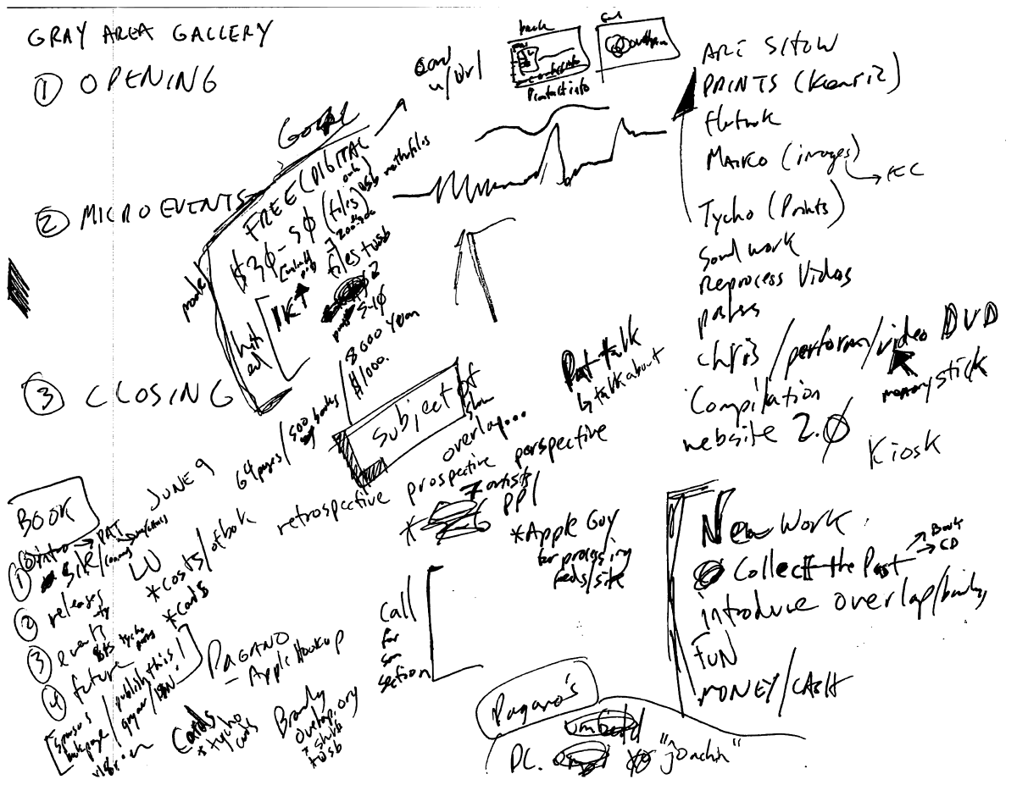
What is a Data Management Plan?
Data Management Plans: Why Create a Data Management Plan?; Version 1.0, February 2013
A document describing what you are going to do with your data both during your project and after it is over
Image by Jon Phillips, Open Clip Art Library 3/29/2010
Notes:
Slide 3: What is a Data Management Plan? A Data Management Plan is simply a document describing what you are going to do with your data both during your project and after the project is over; hopefully, your document will be a bit more legible than the plan illustrated on this slide!
As with any planning activity, the important thing to remember is that plans can and should change over the course of a project as the situation changes. A data management plan that exists solely at the time a proposal is written and is never updated will probably be worthless. Certainly, it is unlikely to reflect reality.

Slide 4
Making Your Research Easier and Cheaper
Data Management Plans: Why Create a Data Management Plan?; Version 1.0, February 2013
The 5 P’s matter!
Prior Planning Prevents Poor Performance!
Notes:
Slide 4: Making Your Research Easier and Cheaper: The 5 P’s Matter
We hope to convince you that data management planning will make your research easier and cheaper. But first, have you ever heard of the 5 P’s? Perhaps you’ve heard of them as the 6 P’s or maybe 7? In any large project, whether building a house, preparing for an extensive field campaign or nearly any kind of complex or time-consuming activity, the 5 P’s matter! Simply put, Prior Planning Prevents Poor Performance!

Slide 5
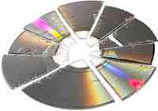
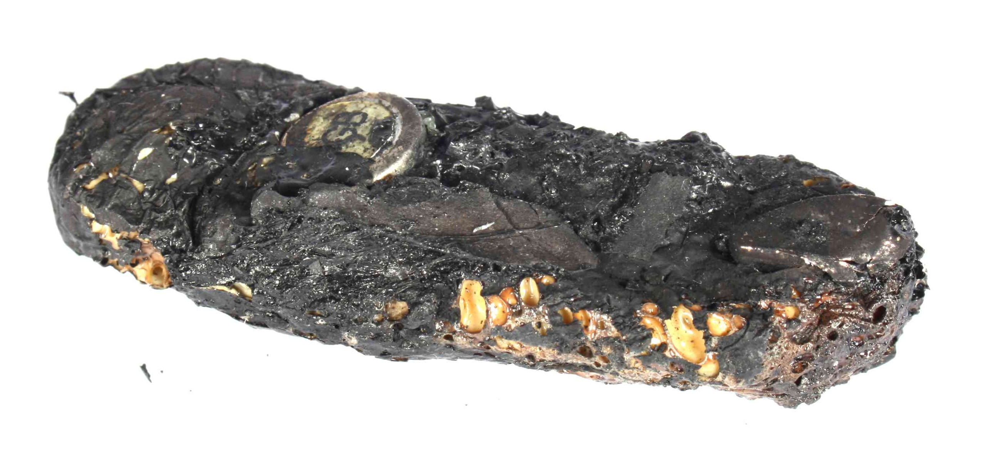
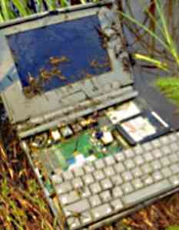
Making Your Research Easier and Cheaper
Data Management Plans: Why Create a Data Management Plan?; Version 1.0, February 2013
Accidents do happen!
Notes:
Slide 5: Making Your Research Easier and Cheaper: Accidents do happen! Accidents do happen:
CD’s and DVD’s really can break
Fire, floods, earthquakes, hurricanes or other natural disasters really can destroy your memory sticks or other hardware
You really might drop that laptop on a field trip (in this case into a swamp)
And who hasn’t had their personal computer decide to fry itself, often for no apparent reason?
What would be the impact of an event like this on your project?
There are companies out there that make good money recovering data from situations like these, but they aren’t cheap and they can’t always recover everything. If you’ve thought about data protection in advance, or thought about having multiple copies of your data on different kinds of media in many places so that no single event can destroy your work, these kinds of events don’t have to be a tragedy.

Slide 6
Don't you think it would be more efficient
Data Management Plans: Why Create a Data Management Plan?; Version 1.0, February 2013
If you didn't have to remember
the name of that file?
and the directory where you put it?
the units those measurements were taken in?
which sample site was which?
etc.
Notes:
Slide 6: Don’t you think it would be more efficient
On the topic of efficiency, don’t you think it would be more efficient if you didn’t have to remember:
The name of that file, the one that had the correct calibration details, the one you based your conclusions on?
Exactly where you put it?
What units those measurements were in?
Which sample site was which?
Any of the myriad of details needed to really understand the meaning of your data?

Slide 7
Making Your Research Easier and Cheaper
Data Management Plans: Why Create a Data Management Plan?; Version 1.0, February 2013
Write it down!
Notes:
Slide 7: Making Your Research Easier and Cheaper
Do you have a perfect memory? Who does? Even if you remember something extremely well today, odds are that in a few years you are not likely to remember the details of whatever project you were working on way back then. But you probably are going to want to use and understand your data for many years. So… if it is important, plan to… Write it down!

Slide 8
Poor data practice results in loss of information
Data Management Plans: Why Create a Data Management Plan?; Version 1.0, February 2013
Time of publication
Specific details
General details
Retirement or
career change
Information Content
Accident
Death
Time
(Michener et al. 1997)
Notes:
Slide 8: Poor data practice results in loss of information The diagram on this slide comes from a paper by Bill Michener written in 1997. The paper talks about the fact that the time at which you know and understand most about your project’s data is right at the time of publication. Then slowly or more rapidly due to time and life events, what you know about the data declines to zero eventually.
That same diagram seems to hold true for details about any proposed project. You will have spent considerable time and energy thinking through the details when writing your proposal. Doesn’t it just make sense to document those details thoroughly when writing your proposal? If you had, you wouldn’t have to reinvent all of those details when the proposal is actually funded.
This fact also holds true during your project. For example, the Cold Land Processes Field Experiment, a very large multi-investigator, extended duration project, found a 15% improvement in the amount and quality of the data taken by simply having the data that was acquired daily checked daily for quality control by someone other than the person who took the measurements. If they had waited even a few days after acquisition, the problems found and corrected right then, on-the-spot, may well have been impossible to correct.

Slide 9
Enhancing Your Reputation
Data Management Plans: Why Create a Data Management Plan?; Version 1.0, February 2013
Sloppy, unorganized and undocumented data is hard to share
What does sloppy, unorganized, and not well documented data say about the rest of your work?
What if you get hit by a bus?
Your data may well be your most important legacy!
Notes:
Slide 9: Enhancing your reputation Another reason that data management planning is in your best interest is because it can enhance your reputation:
There are increasing calls these days for you to share your data. The arguments for sharing include ethical arguments about publicly funded research needing to be available to those who funded it, studies that show economic benefits to open data, and arguments about the scientific process itself. Yet sloppy, unorganized and undocumented data is hard to share. Either you will have to answer lots of questions by any user, or the number of users will be small. Also, there is always the risk of misuse. By contrast, well-documented, clean and organized data may lead to new collaboration and funding opportunities.
On another note, what are people going to think about the rest of your work if your data are messy? Is that good for your reputation?
Lastly, what if you get hit by a bus? Particularly in the Earth sciences where data lost is often impossible to re-create, your data may well be your most important legacy!

Slide 10
Many funding agencies require data management plans
Data Management Plans: Why Create a Data Management Plan?; Version 1.0, February 2013
NSF now requires a two page data management plan submitted with every proposal
NASA Earth Sciences requires a data management plan for its Earth science missions, projects, grants and cooperative agreements.
NOAA and USGS also require data management plans.
NIH requires that projects with budgets greater than $500k/yr include a data sharing plan in their proposals.
Notes:
Slide 10: Many funding agencies require data management plans If you’re still not convinced by either of those two arguments, keep in mind that many, if not all, funding agencies now require you to create data management plans:
You probably know that the National Science Foundation, NSF, requires a 2 page data management plan to be included with every proposal. As a matter of fact, the NSF FastLane system won’t even accept a proposal without one; but
You may not be aware that NASA, NOAA, and USGS all require data management plans for their grant funded work; and
Even the National Institutes of Health, NIH, requires that large projects produce a data sharing plan.
Hopefully, we’ve convinced you that data management planning can save you time and money and enhance your reputation in your field. If not, odds are that you are going to have to do it anyway since most funding agencies require it.

Slide 11
References
Data Management Plans: Why Create a Data Management Plan?; Version 1.0, February 2013
Michener, W.K., J.W. Brunt, J.J. Helly, T.B. Kirchner, and S. G. Stafford. 1997. “Nongeospatial metadata for the ecological sciences.” Ecological Applications 7(1):330-342.
Notes:
Slide 11: References
Within this module, we've made reference to this published source that we think you may want to review when you want more information about the reasons to create data management plans.

Slide 12
Resources
Data Management Plans: Why Create a Data Management Plan?; Version 1.0, Reviewed September 2012
NSF Guidance: http://www.nsf.gov/bfa/dias/policy/dmp.jsp
NASA Data Policy: http://science1.nasa.gov/earth-science/earth-science-data/data-information-policy/
NOAA Administrative Order 212-15: http://www.corporateservices.noaa.gov/ames/administrative_orders/chapter_212/212-15.html
USGS National Climate Change and Wildlife Science Center guidance: https://nccwsc.usgs.gov/?q=content/data-policies-and-guidance
NIH Data Sharing Policy and Implementation Guidance: http://grants1.nih.gov/grants/policy/data_sharing/data_sharing_guidance.htm
Notes:
Slide 12: Resources We’ve included some additional resources that you might find helpful should you need more information about some of the topics we’ve covered in this module.

Slide 13
Other Relevant Modules
The Case for Data Stewardship section
For more details on why Data Management is important
Data Management Plan: Elements of a Data Management Plan
For a high level overview of the content of a Data Management Plan
Data Management Plan - Elements of a Data Management Plan: Identify Materials to be Created
Data Management Plan - Elements of a Data Management Plan: Organization and Standards
Find out more about specific elements of a typical data management plan
Notes:
Slide 13: Other Relevant Modules The modules of the ESIP Data Management for Scientists Short Course have been designed to complement and supplement each other. In light of this plan, we think you may find the following modules relevant as you seek to gain a better understanding of what should be included in a data management plan:
The Case for Data Stewardship section
Data Management Plans: Elements of a Data Management Plan
Data Management Plans - Elements of a Data Management Plan : Identifying Materials to be Created
Data Management Plans: Elements of a Data Management Plan: Organization and Standards

Slide 14
Recommended Citations
Duerr, R. 2013. “Data Management Plans: Why Create a Data Management Plan?” In Data Management for Scientists Short Course, edited by Ruth Duerr and Nancy J. Hoebelheinrich, Federation of Earth Science Information Partners: ESIP Commons. doi:10.7269/P3FT8HZ5
Copyright 2013 Ruth Duerr
Notes:
Slide 14: Recommended Citation This module is available under a Creative Commons Attribution 3.0 license that allows you to share and adapt the work as long as you cite the work according to the citation provided.
Thank you very much for your interest in the ESIP Federation’s Data Management for Scientists Short Course.

