Slide 1

Presentation for Lawrence
Chris: Do you know how to paste Gilberto’s sample presentation format into this Google Presentation?
Steve: See if this works. (GV)
Earth Science Data Analytics Cluster
Steve Kempler, Moderator
July 20, 2016
ESIP Federation Meeting
Durham, NC

Slide 2
Session Focus
Session Focus:
The ESDA Cluster (for new participants)
What we have accomplished
A ‘Student of Data Analytics’ Point of View – Lindsay Barbieri
Where do we go from here

Slide 3
Obligatory Background Information
Earth Science Data Analytics (ESDA) Cluster Goal:
To understand where, when, and how ESDA is used in science and applications research through speakers and use cases, and determine what Federation Partners can do to further advance technical solutions that address ESDA needs. Then do it.
Ultimate Goal:
To Glean Knowledge about Earth from All Available Data and Information

Slide 4
Motivation
Increasing Amounts of Heterogeneous Datasets being made available to advance science research
… and a lot of people/directives are addressing it
Thus, it is not necessarily about Big Data, itself.
It is about the ability to examine large amounts of data of a variety of types to uncover hidden patterns, unknown correlations and other useful information.
That is:
To glean knowledge from data and information

Slide 5
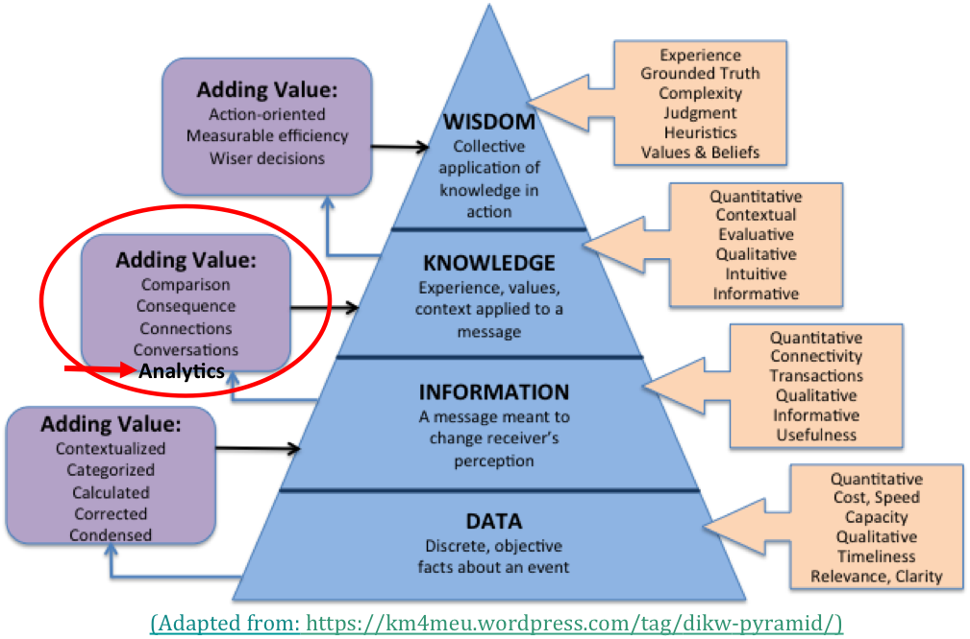
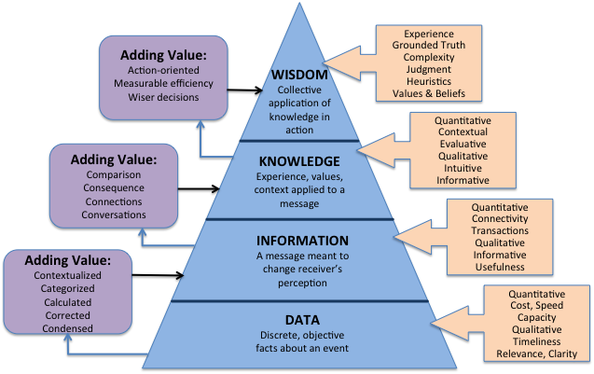
(Adapted from: https://km4meu.wordpress.com/tag/dikw-pyramid/)
(Adapted from: https://km4meu.wordpress.com/tag/dikw-pyramid/)

Slide 6
ESDA Cluster – What we have done
24 Telecons
8 face-to-face sessions
16 ‘guest’ presentations
Created the ESDA specific use case template
Gathered 18 use Cases
Defined Earth Science Data Analytics - Adopted by ESIP
Specified 3 types of ESDA definition types
Defined 10 Earth science data analytics goals - Adopted by ESIP
Drafted ESDA Tools/Techniques requirements analysis
  Gathered and described known tools/techniques
  Associated ESDA techniques with goals for each type of analytics
Presented our work at AGU

Slide 7
ESIP’s Earth Science Data Analytics Definition
The process of examining, preparing, reducing, and analyzing large amounts of spatial (multi-dimensional), temporal, or spectral data using a variety of data types to uncover patterns, correlations and other information, to better understand our Earth.
This encompasses:
Data Preparation – Preparing heterogeneous data so that they can be jointly analyzed
Data Reduction – Correcting, ordering and simplifying data in support of analytic objectives
Data Analysis – Applying techniques/methods to derive results

Slide 8
ESIP’s Earth Science Data Analytics Goals
To calibrate data
To validate data (note it does not have to be via data intercomparison)
To assess data quality
To perform coarse data preparation (e.g., subsetting data, mining data, transforming data, recovering data)
To intercompare datasets (i.e., any data intercomparison; Could be used to better define validation/quality)
To tease out information from data
To glean knowledge from data and information
To forecast/predict/model phenomena (i.e., Special kind of conclusion)
To derive conclusions (i.e., that do not easily fall into another type)
To derive new analytics tools

Slide 9
Data Analytics Goals
Why is it important to identify Data Analytics Goals?
To better identify key needs that tools/techniques can be developed to address.
Basically, once we can categorize different goals of Data Analytics, we can better associate existing and future Data Analytics tools and techniques that will help solve particular problems.

Slide 10
Our Sources
In addition to research, and from other organizational activities (IEEE, RDA, NIST, etc.):
Use cases (18)
Tools, techniques, and integrated systems – web/article extractions
“The Field Guide to DATA SCIENCE”, Booz/Allen/Hamilton, 2015
AGUs
  Analytics Session: “Geophysical Science Data Analytics Use Case Scenarios” (12 Posters)
  Other Big Data/Analytics oriented sessions
  Science posters to better understand research methodologies
Us: Our thinking about it

Slide 11
  Use Cases (gathered so far) Mapped to ESDA Goals
 | Earth Science Data Analaytics Goals
Use Cases | 1 | 2 | 3 | 4 | 5 | 6 | 7 | 8 | 9 | 10
1 MERRA Analytics Services: Climate Analytics-as-a-Service |  |  |  |  |  |  |  |  |  | √
2 MUSTANG QA: Ability to detect seismic instrumentation problems |  |  | √ | √ |  |  |  | √
3 Inter-calibrations among datasets | √ | √ |  |  | √
4 Inter-comparisons between multiple model or data products |  |  |  |  | √
5 Sampling Total Precipitable Water Vapor using AIRS and MERRA |  | √ |  |  | √
6 Using Earth Observations to Understand and Predict Infectious Diseases |  |  |  |  |  |  |  | √ | √
7 CREATE-IP - Collaborative REAnalysis Technical Environment - Intercomparison Project |  |  |  |  | √
8 The GSSTF Project (MEaSUREs-2006) |  |  |  |  |  | √
9 Science- and Event-based Advanced Data Service Framework at GES DISC |  |  |  |  | √ |  |  |  |  | √
10 Risk analysis for environmental issues |  |  |  |  |  |  |  | √
11 Aerosol Characterization |  |  |  |  | √ |  |  |  | √
12 Creating One Great Precipitation Data Set From Many Good Ones |  |  |  |  |  | √
13 Reconstructing Sea Ice Extent from Early Nimbus Satellites | √ |  |  | √
14 DOE-BER AmeriFlux and FLUXNET Networks * |  |  |  |  |  | √ |  |  | √
15 DOE-BER Subsurface Biogeochemistry Scientific Focus Area * |  |  |  |  |  |  |  | √
16 Climate Studies using the Community Earth System Model at DOE’s NERSC center * |  |  |  |  |  |  |  | √ | √ | √
17 Radar Data Analysis for CReSIS * |  |  |  |  |  | √
18 UAVSAR Data Processing, Data Product Delivery, and Data Service * |  |  |  |  |  | √
* - Borrowed, with permission, from NIST Big Data Use Case Submissions [http://bigdatawg.nist.gov/usecases.php]

Slide 12
Earth Science Data Analytics
Exemplary Tools, Techniques, Integrated Systems
Types of Analytics | Tools | Techniques |  | Integrated Systems
 | • R, SAS, Python, Java, C++ | • Statistics functions | • Factor Analysis
 | • SPSS, MATLAB, Minitab | • Machine Learning | • Principal Component Analysis
 | • CPLEX, GAMS, Gauss | • Data Mining | • Neural Networks | • EarthServer (http://www.earthserver.eu)
• Data Preparation | • Tableau, Spotfire | • Natural Language Processing | • Bayesian Techniques | • NASA Earth Exchange (https://nex.nasa.gov/nex/)
• Data Reduction | • VBA, Excel, MySQL | • Linear/Non-linear Regression | • Text Analytics | • EDEN (http://cda.ornl.gov/projects/eden/#)
• Data Analysis | • Javascript, Perl, PHP | • Logical Regression | • Graph Analytics | • EARTHDATA (https://earthdata.nasa.gov)
 | • Open Source Databases | • Time Series Models | • Visual Analytics | • Giovanni (http://giovanni.gsfc.nasa.gov/giovanni/)
 | • PIO, NCL, Parallel NetCDF | • Clustering | • Map Reduce
 | • AWS, Cloud Solutions, Hadoop | • Decision Tree
 | • MPI, GIS, ROI-PAC, GDAL
Compiled from: http://practicalanalytics.co/predictive-analytics-101/ and http://cda.ornl.gov/research.shtml

Slide 13
We Began Describing Identified
Tools/Techniques/Integrated Systems
TOOLS
Anaconda | Initailly Anaconda was a distirubtion of
AWS | Amazon Web Services (AWS), is a collection of cloud computing services that make up the on-demand computing platform offered by Amazon.com
C++ | C++ is a general-purpose programming language. It has imperative, object-oriented and generic programming features, while also providing facilities for low-level memory manipulation.
CPLEX | IBM ILOG CPLEX Optimization Studio (often informally referred to simply as CPLEX) is an optimization software package.
Excel | A spreadsheet program created by Microsoft that enables data analysis and visualization. It includes VBA.
TECHNIQUES
Aggregation | The compiling of information from databases with intent to prepare combined datasets
Anomaly Detection | The identification of items, events or observations which do not conform to an expected pattern
Bias Correction | Bias correction methods are often applied for systematic statistical deviations from observational data. They generally adjust the long-term mean by adding the average difference between the simulated and observed data over the historical period to the simulated data, or by applying an associated multiplicative correction factor. In addition, differences between the variance of the simulated and observed data are often corrected.
Bayesian Techniques | Bayesian analysis, a method of statistical inference that allows one to combine prior information about a population parameter with evidence from information contained in a sample to guide the statistical inference process. Bayesian Synthesis.
Bivariant Regression | The simplest form of regression is bivariate regression, in which one variable is the outcome and one is the predictor.
Classification | The problem of identifying to which of a set of categories (sub-populations) a new observation belongs

Slide 14
“The Field Guide to DATA SCIENCE”
Booz/Allen/Hamilton, 2015
Data Science:
Describe
  Processing
    Filtering, Imputation, Dimensionality Reduction, Normalization/Transformation
  Aggregation
  Enrichment
Discover
  Clustering
  Regression
  Hypothesis Testing
Predict
  Regression
  Recommendation
Advise
  Local reasoning
  Optimization
  Simulation

Slide 15
“The Field Guide to DATA SCIENCE”
Booz/Allen/Hamilton, 2015
For each of the most indented item, data analytics techniques are provided based on specific situations… e.g. ….:
Describe
  Processing
    Filtering, Imputation, Dimensionality Reduction, Normalization/Transformation e.g., Outlier Removal, Random Sampling, K-means clustering, Fast Fourier Transformation
  Aggregation e.g., Distribution Fitting
  Enrichment e.g., Annotation
  Discover … and so on
  Clustering
  Regression
  Hypothesis Testing
Predict
  Regression
  Recommendation
Advise
  Local reasoning
  Optimization
  Simulation

Slide 16
At the AGU …
Visited science posters to better understand research methodologies. Aka analytics used:
Looked for presentations that discussed the co-analysis of multiple datasets
Looked for presentations that described methodology techniques employed
‘Scanned’ 100’s of posters, identifying presentations (and through discussion with authors) that provide sought after information
  31 Atmospheric Science research projects identified
  12 Hydrology Science research projects identified
  (Don’t read into the numbers, this is just as far as II got)
Science research methodology techniques being used …
– how many? Conclusions? Techniques tools used? Relevant presentations

Slide 17
Analyzing our Information
Defining Techniques
TECHNIQUES
Aggregation | The compiling of information from databases with intent to prepare combined datasets
Anomaly Detection | The identification of items, events or observations which do not conform to an expected pattern
Bias Correction | Bias correction methods are often applied for systematic statistical deviations from observational data. They generally adjust the long-term mean by adding the average difference between the simulated and observed data over the historical period to the simulated data, or by applying an associated multiplicative correction factor. In addition, differences between the variance of the simulated and observed data are often corrected.
Bayesian Techniques | Bayesian analysis, a method of statistical inference that allows one to combine prior information about a population parameter with evidence from information contained in a sample to guide the statistical inference process. Bayesian Synthesis.
Bivariant Regression | The simplest form of regression is bivariate regression, in which one variable is the outcome and one is the predictor.
Classification | The problem of identifying to which of a set of categories (sub-populations) a new observation belongs
Clustering; Hierarchical Clustering | An approach to organize objects into a classification and can be accomplished utilizing various methods, including statical techniques.
Constrained Variational Analysis | A field of mathematical analysis that deals with maximizing or minimizing functionals, which are mappings from a set of functions to the real numbers
Coordinate Transformation | Put data into a different coordinate system
Correlation Analysis/Regression Analysis | Correlation and regression analysis are related in the sense that both deal with relationships among variables. The correlation coefficient is a measure of linear association between two variables. Correlation computes the value of the Pearson correlation coefficient, r. Its value ranges from -1 to +1.
Data Fusion | The process of integration of multiple data and knowledge representing the same real-world object into a consistent, accurate, and useful representation.
Data Mining | Data mining, an interdisciplinary subfield of computer science, is the computational process of discovering patterns in large data sets (“big data”) involving methods at the intersection of artificial intelligence, machine learning, statistics, and database systems. The overall goal of the data mining process is to extract information from a data set and transform it into an understandable structure for further use.

Slide 18
Analyzing our Information
Defining Techniques
TECHNIQUES
Factor Analysis | Factor analysis is a statistical method used to describe variability among observed, correlated variables in terms of a potentially lower number of unobserved variables called factors.
Filtering | A class of signal processing, the defining feature of filters being the complete or partial suppression of some aspect of the signal
Format Conversion | Change the representation of data so to be more usable when analyzing
Forward Modeling | The technique of determining what a given sensor would measure in a given formation and environment by applying a set of theoretical equations for the sensor response
Fourier Analysis | A method of defining periodic waveforms in terms of trigonometric functions
Gaussian Distribution | A continuous function which approximates the exact binomial distribution of events
Grid Search | Systematic search across discrete parameter values
Imputation | The process of replacing missing data with substituted values
Inverse Modeling | Derive a physical property model given a set of observations.
Linear/Non-linear Regression | In statistics, linear regression is an approach for modeling the relationship between a scalar dependent variable Y (e.g., a sounding temperature) and one or more explanatory variables (or independent variables) denoted X, (or X1, X2...) (e.g., the satellite retrieved temperature(s)). The case of one explanatory variable is called simple linear regression. In statistics, nonlinear regression is a form of regression analysis in which observational data (e.g., Y) are modeled by a function which is a nonlinear combination of the model parameters (e.g., aX + bX2 +….) and depends on one or more independent variables (e.g., X or X1, X2,….). The data are fitted by a method of successive approximations.
Machine Learning | Machine learning is a subfield of computer science that evolved from the study of pattern recognition and computational learning theory in artificial intelligence. Machine learning explores the study and construction of algorithms that can learn from and make predictions on data. Supervised. Unsupervised.
Model Simulations | A simulation generally refers to a computerized version of the model which is run over time to study the implications of the defined interactions
Monte Carlo method | Any method which solves a problem by generating suitable random numbers and observing that fraction of the numbers obeying some property or properties. The method is useful for obtaining numerical solutions to problems which are too complicated to solve analytically.

Slide 19
Analyzing our Information
Defining Techniques
TECHNIQUES
Multi-variate time series analysis | Multivariate time series analysis is used when one wants to model and explain the interactions and co-movements among a group of time series variables
Neural Networks | A computing system made up of a number of simple, highly interconnected processing elements, which process information by their dynamic state response to external inputs.
Noise Analysis | Typically performed using FFT and Signal Processing techniques, the goal is to determine the level of signal versus noise present in the data recorded as well as assess the inherent noise of the recording system. This is measured either as a ratio or as a power spectrum within the dynamic range of the instrument.
Outlier Removal | Method for identifying and removing noise or artifacts from data
Pattern Recognition | The recognition of patterns and regularities in data
Poisson Regression | A form of regression analysis used to model count data and contingency tables. Poisson regression assumes the response variable Y has a Poisson distribution, and assumes the logarithm of its expected value can be modeled by a linear combination of unknown parameters
Principal Component Analysis | Principal component analysis (PCA) is a statistical procedure that uses an orthogonal transformation to convert a set of observations of possibly correlated variables into a set of values of linearly uncorrelated variables called principal components
Ratios | A relationship between two numbers indicating how many times the first number contains the second
Sensitivity Analysis | Testing individual parameters in an analytic to observe the magnitude of the effect
Smoothing; Exponential Smoothing | An approximating function that attempts to capture important patterns in the data, while leaving out noise or other fine-scale structures/rapid phenomena. Gaussian Smoothing - the result of blurring an image by a Gaussian function; a low pass filter
Spatial Interpolation | Refers to the process of estimating the unknown data values for specific locations using the known data values for other points.
Spectral Analysis | the determination of the constitution or condition of bodies and substances by means of the spectra they produce
Temporal Trend Analysis | Analysis of observations as they change over time to predict future observations
Text Analytics | Text analytics is the process of analyzing unstructured text, extracting relevant information, and transforming it into useful intelligence
Visual Analytics | Visual analytics is a form of inquiry in which data that provides insight into solving a problem is displayed in an interactive, graphical manner.

Slide 20
Analyzing our Information
Describing Tools
TOOLS
Anaconda | Initailly Anaconda was a distirubtion of
AWS | Amazon Web Services (AWS), is a collection of cloud computing services that make up the on-demand computing platform offered by Amazon.com
C++ | C++ is a general-purpose programming language. It has imperative, object-oriented and generic programming features, while also providing facilities for low-level memory manipulation.
CPLEX | IBM ILOG CPLEX Optimization Studio (often informally referred to simply as CPLEX) is an optimization software package.
Excel | A spreadsheet program created by Microsoft that enables data analysis and visualization. It includes VBA.
GAMS | GAMS is a high-level modeling system for mathematical optimization. General Additive Models allow for the extention of a simple linear model to various linear and non-linear functions across multiple predictors, depending on their conditional distribution, within the framework of a single model. In other words, in a multivariate analysis with multiple predictors and a single responce variable, if the conditional distrubute of the one predictor variable in relation to the responce variable is linear then a linear function will be applied, while if the conditional distribution of another predictor may be polynomial and so a polynomial function will be applied. The inherent strength of General Additive Models is this ability to incorporate multiple basis functions (e.g. linear, polynomial, piecewise constants, etc.) into a single model. A GAM can be run in R utilizing the lm function.
GDAL | Geospatial Data Abstraction Library (GDAL) is a computer software library for reading and writing raster and vector geospatial data formats, and is released under the permissive X/MIT style free software license by the Open Source Geospatial Foundation.
GIS | A geographic information system is a system designed to capture, store, manipulate, analyze, manage, and present all types of spatial or geographical data.
Hadoop | Apache Hadoop is an open-source software framework written in Java for distributed storage and distributed processing of very large data sets on computer clusters built from commodity hardware

Slide 21
Analyzing our Information
Describing Tools
TOOLS
Java | Java is a general-purpose computer programming language that is concurrent, class-based, object-oriented,[13] and specifically designed to have as few implementation dependencies as possible.
Javascript | A high level interpreted language used by most websites and browsers.
MATLAB | MATLAB is a multi-paradigm numerical computing environment and fourth-generation programming language. A proprietary programming language developed by MathWorks, MATLAB allows matrix manipulations, plotting of functions and data, implementation of algorithms, creation of user interfaces, and interfacing with programs written in other languages, including C, C++, Java, Fortran and Python.
Minitab | Minitab is a statistics package developed at the Pennsylvania State University
MySQL | MySQL is an open-source relational database management system (RDBMS);
Open Source Databases | http://webresourcesdepot.com/25-alternative-open-source-databases-engines/
Parallel NetCDF | Parallel NetCDF is a library providing high-performance parallel I/O while still maintaining file-format compatibility with Unidata's NetCDF, specifically the formats of CDF-1 and CDF-2.
Perl | A high level interpreted scripting language frequently used on UNIX computers. It is frequently used to wrap other programs together.
PHP | A scripting language designed for web development. It can be used to create CGI (Common Gateway Interface) executable for web pages.
PostgreSQL | PostgresSQL is an open-source relational database management system (RDBMS);
Python | Python is a widely used general-purpose, high-level programming language. Its design philosophy emphasizes code readability, and its syntax allows programmers to express concepts in fewer lines of code than would be possible in languages such as C++ or Java. The language provides constructs intended to enable clear programs on both a small and large scale. (Wikipedia)

Slide 22
Analyzing our Information
Describing Tools
TOOLS
Python Packages | Anaconda - provides an enterprise-ready data analytics platform that empowers companies to adopt a modern open data science analytics architecture. With Python at its core, Anaconda allows you to explore and deploy analytic apps that solve challenging problems. Processing multi-workload data analytics – from batch through interactive to real-time. (continuum.io) scipy numpy pandas obspy
R | Currently R & Python are vying to be the dominant programming language of data science. Both are high-level languages as mentioned above. Where Python was developed from within the computer science community R was developed by the statistical community. Thus, while R has traditionally been used for statistical analytics Python has been used for more for traditional programming purposes. However, with the ever growing additions of the added libraries, or packages, to the programming langauges they continue to extend beyond their original intended purpose and move into each others space. http://www.kdnuggets.com/2015/05/r-vs-python-data-science.html
ROI-PAC | ROI-PAC is a software package created by the Jet Propulsion Laboratory division of NASA and CalTech for processing SAR images to create InSAR images, named interferograms
SAS | SAS (Statistical Analysis System) is a software suite developed by SAS Institute for advanced analytics, multivariate analyses, business intelligence, data management, and predictive analytics. SAS was developed at North Carolina State University from 1966 until 1976, when SAS Institute was incorporated. (Wikipedia)
Spark | Apache Spark is an open source cluster computing framework. Spark provides an interface for programming entire clusters with implicit data parallelism and fault-tolerance. (wikipedia)
Spotfire | A tool that enables data mining and visualization of very large data sets. Similar to Excel but apparently easier to use for large data sets.
SPSS | SPSS Statistics is a software package used for statistical analysis.
Tableau | A tool that enables data visualization using a drag and drop interface.
VBA | (Visual Basic for Applications) An implementation of Visual Basic that enables user defined functions and interaction with Windows API and libraries.

Slide 23
Analyzing our Information
Associating Techniques with ESDA Types
Data Preparation | Data Reduction | Data Analysis
Aggregation
 | Anomaly Detection
Bias Correction |  | Bias Correction
 |  | Bayesian Techniques
 |  | Bivariant Regression
Classification | Classification | Classification
Clustering; Heirarchical Clustering | Clustering; Heirarchical Clustering | Clustering; Heirarchical Clustering
 |  | Constrained Variational Analysis
Coordinate Transformation
 |  | Correlation Analysis/Regression Analysis
 |  | Data Fusion
Data Mining | Data Mining | Data Mining
 |  | Factor Analysis
Filtering | Filtering | Filtering
Format Conversion
 |  | Forward Modeling
 |  | Fourier Analysis
 |  | Gaussian Distribution
Imputation |  | Imputation
 |  | Inverse Modeling

Slide 24
Analyzing our Information
Associating Techniques with ESDA Types
Data Preparation | Data Reduction | Data Analysis
 |  | Linear/Non-linear Regression
 | Machine Learning | Machine Learning
 |  | Model Simulations
 |  | Monte Carlo method
 |  | Multi-variate time series analysis
 | Neural Networks | Neural Networks
 |  | Noise Analysis
Outlier Removal | Outlier Removal | Outlier Removal
 |  | Pattern Recognition
 |  | Poisson Regression
 |  | Principal Component Analysis
 |  | Ratios
 |  | Sensitivity Analysis
Smoothing; Exponential Smoothing | Smoothing; Exponential Smoothing | Smoothing; Exponential Smoothing
Spatial Interpolation |  | Spatial Interpolation
 |  | Spectral Analysis
 |  | Temporal Trend Analysis
 |  | Visual Analytics

Slide 25
Analyzing our Information
Associating Techniques with ESDA Goal - Draft
ESDA Goals | Data Preparation | Data Reduction | Data Analysis
 | ESDA Techniques | ESDA Techniques | ESDA Techniques
Technique may be needed for all goals -> | Coordinate Transformation, Filtering, Format Conversion, Outlier Removal, Spatial Interpolation | Anomaly Detection, Outlier Removal, Smoothing; Exponential Smoothing | Outlier Removal, Visual Analytics
1.To calibrate data | Aggregation, Bias Correction | Filtering | Filtering, Sensitivity Analysis
2.To validate data (note it does not have to be via data intercomparison) | Aggregation, Bias Correction | Filtering, Machine Learning | Correlation Analysis/Regression Analysis, Factor Analysis, Filtering, Linear/Non-linear Regression, Noise Analysis, Pattern Recognition, Sensitivity Analysis, Smoothing; Exponential Smoothing
3.To assess data quality | Bias Correction | Filtering | Bias Correction, Bivariant Regression, Filtering, Linear/Non-linear Regression, Noise Analysis, Ratios, Sensitivity Analysis, Smoothing; Exponential Smoothing
4.To perform coarse data preparation (e.g., subsetting data, mining data, transforming data, recovering data) | Classification, Clustering; Heirarchical Clustering, Smoothing; Exponential Smoothing | Classification, Clustering; Heirarchical Clustering, Data Mining, Filtering

Slide 26
Analyzing our Information
Associating Techniques with ESDA Goal - Draft
ESDA Goals | Data Preparation | Data Reduction | Data Analysis
 | ESDA Techniques | ESDA Techniques | ESDA Techniques
5.To intercompare datasets (i.e., any data intercomparison; Could be used to better define validation/quality) | Aggregation, Bias Correction, Classification, Clustering; Heirarchical Clustering, Data Mining, Imputation | Classification, Clustering; Heirarchical Clustering, Data Mining, Filtering | Bias Correction, Bayesian Techniques, Bivariant Regression, Classification, Clustering; Heirarchical Clustering, Constrained Variational Analysis, Correlation Analysis/Regression Analysis, Data Mining, Filtering, Forward Modeling, Linear/Non-linear Regression, Machine Learning, Multi-variate time series analysis, Smoothing; Exponential Smoothing
6.To tease out information from data | Bias Correction, Classification, Clustering; Heirarchical Clustering, Data Mining, Imputation, Smoothing; Exponential Smoothing | Classification, Clustering; Heirarchical Clustering, Data Mining, Filtering, Machine Learning, Neural Networks | Any or All
7.To glean knowledge from data and information | Bias Correction, Classification, Clustering; Heirarchical Clustering, Data Mining, Smoothing; Exponential Smoothing | Classification, Clustering; Heirarchical Clustering, Data Mining, Filtering, Machine Learning, Neural Networks | Any or All

Slide 27
Analyzing our Information
Associating Techniques with ESDA Goal - Draft
ESDA Goals | Data Preparation | Data Reduction | Data Analysis
 | ESDA Techniques | ESDA Techniques | ESDA Techniques
8.To forecast/predict/model phenomena (i.e., Special kind of conclusion) | Bias Correction, Classification, Clustering; Heirarchical Clustering, Imputation, Smoothing; Exponential Smoothing | Classification, Clustering; Heirarchical Clustering, Data Mining, Filtering, Machine Learning, Neural Networks | Bias Correction, Bias Correction, Bayesian Techniques, Bivariant Regression, Correlation Analysis/Regression Analysis, Factor Analysis, Forward Modeling, Inverse Modeling, Machine Learning, Model Simulations, Multi-variate time series analysis, Outlier Removal, Pattern Recognition, Poisson Regression, Sensitivity Analysis, Temporal Trend Analysis
9.To derive conclusions (i.e., that do not easily fall into another type) | Any or All | Any or All | Any or All
10.To derive new analytics tools | Any or All | Any or All | Any or All

Slide 28
A ‘Student of Data Analytics’ Point of View
– Lindsay Barbieri, Ph.D. Student

Slide 29
What’s next?
Validate our work
  Are there other ESDA Tools and Techniques that we need to add?
  Are our techniques to ESDA types correct?
  Are our techniques to ESDA goals correct?
Acquire additional Use Cases
Map Tools to Techniques? (but need to validate first)
  This should uncover missing tools (gaps)
How should we do this? Approach?
What else should we be doing to facilitate ESDA?
What can we do to ensure the student’s point of view gets reflected in future ESDA tool development?
What can we do to ensure students are being taught the best skills to perform ESDA or be a Data Science?

Slide 30
Thank you

Slide 31
BACKUP

Slide 32
NIST Big Data Definitions and Taxonomies, V 0.9
National Institute of Standards and Technology (NIST) Big Data Working Group (NBD-WG)
February, 2014, http://bigdatawg.nist.gov/show_InputDoc.php, M0142
Big Data consists of extensive datasets, primarily in the characteristics of volume, velocity and/or variety, that require a scalable architecture for efficient storage, manipulation, and analysis.

Slide 33
Open Geospatial Consortium (OGC)
Big Data Working Group
http://external.opengeospatial.org/twiki_public/BigDataDwg/WebHome
“Big Data” is an umbrella term coined by Doug McLaney and IBM several years ago to denote data posing problems, summarized as the four Vs:
Volume – the sheer size of “data at rest”
Velocity – the speed of new data arriving (“data at move”)
Variety – the manifold different
Veracity – trustworthiness and issues of provenance

Slide 34
IEEE BigData 2014
http://cci.drexel.edu/bigdata/bigdata2014/callforpaper.htm
… in any aspect of Big Data with emphasis on 5Vs (Volume, Velocity, Variety, Value and Veracity) relevant to variety of data (scientific and engineering, social, …) that contribute to the Big Data challenges
Ruth adds:
Visibility

Slide 35
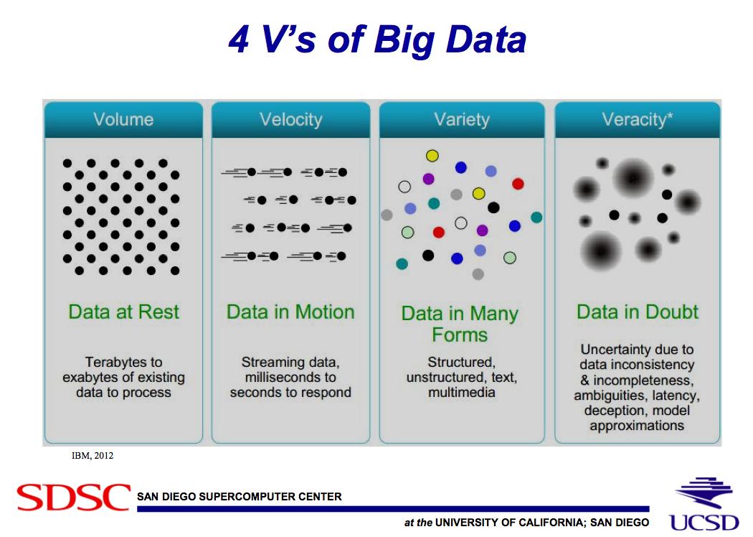
From: Demystifying Data Science
(Natasha Balac , accessible via: http://bigdatawg.nist.gov/show_InputDoc.php, M0169)

Slide 36
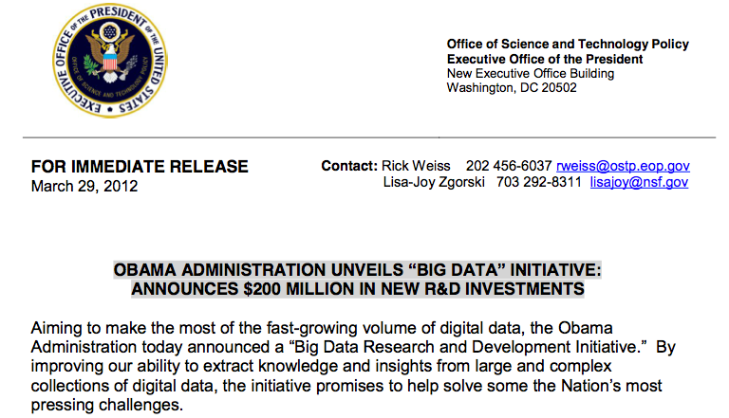
So, Why does Big Data Have Everybody’s Attention?
This is an encourager:
(http://www.whitehouse.gov/sites/default/files/microsites/ostp/big_data_press_release_final_2.pdf)

Slide 37
  Data Scientist in the context of analytics
Data Scientist
A data scientist possesses a combination of analytic, machine learning, data mining and statistical skills as well as experience with algorithms and statistical skills as well as experience with algorithms and coding. Perhaps the most important skill a data scientist possesses, however, is the ability to explain the significance of data in a way that can be easily understood by others. (Source: http://searchbusinessanalytics.techtarget.com/definition/Data-scientist)
Rising alongside the relatively new technology of big data is the new job title data scientist. While not tied exclusively to big data projects, the data scientist role does complement them because of the increased breadth and depth of data being examined, as compared to traditional roles. (Source: http://www-01.ibm.com/software/data/infosphere/data-scientist/)

Slide 38
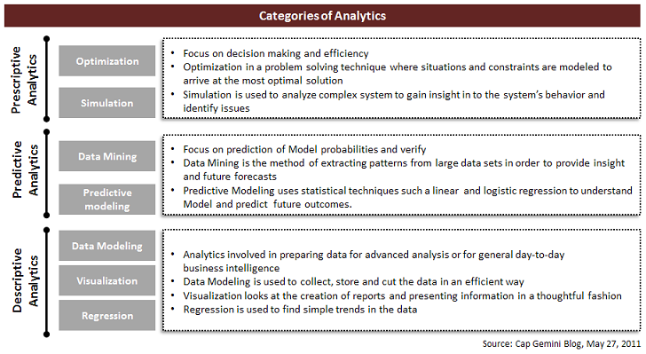
Analytics
(http://steinvox.com/blog/big-data-and-analytics-the-analytics-value-chain/)

Slide 39
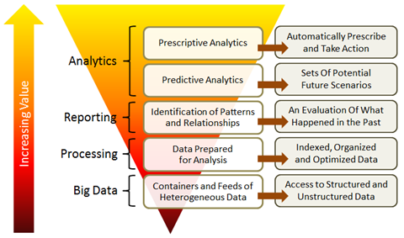
Another look at Analytics
(http://steinvox.com/blog/big-data-and-analytics-the-analytics-value-chain/)

Slide 40
2014 IEEE International Conference on Big Data (IEEE BigData 2014) | What V's do the call for papers
Call for papers in the following (consolidated) areas: | address:
 | Volume | Velocity | Variety | Veracity
1. Big Data Science and Foundations
a. Novel Theoretical Models for Big Data | √ | √ | √ | √
b. New Computational Models for Big Data | √ | √
c. Data and Information Quality for Big Data | √ |  |  | √
d. New Data Standards |  |  | √ | √
2. Big Data Infrastructure
a. High Performance/Parallel/Cloud/Grid/Stream Computing for Big Data | √ | √
b. Autonomic Computing and Cyber-infrastructure, System Architectures, Design and Deployment | √ | √
c. Programming Models, Techniques, and Environments for Cluster, Cloud, and Grid Computing to Support Big Data | √
d. Big Data Open Platforms | √ | √
e. New Programming Models and Software Systems for Big Data beyond Hadoop/MapReduce, STORM | √ |  | √

Slide 41
2014 IEEE International Conference on Big Data (IEEE BigData 2014) | What V's do the call for papers
Call for papers in the following (consolidated) areas: | address:
 | Volume | Velocity | Variety | Veracity
3. Big Data Management
a. Algorithms, Architectures, and Systems for Big Data Web Search and Mining of variety of data. |  | √ | √ | √
b. Algorithms, Architectures, and Systems for Big Data Distributed Search | √ | √ | √
c. Data Acquisition, Integration, Cleaning, and Best Practices |  |  | √ | √
d. Visualization Analytics for Big Data |  |  | √ | √
e. Computational Modeling and Data Integration | √ |  | √
f. Large-scale Recommendation Systems and Social Media Systems |  |  | √ | √
g. Cloud/Grid/Stream (Semantic-based) Data Mining and Pre-processing- Big Velocity Data |  | √ | √ | √
h. Multimedia and Multi-structured Data- Big Variety Data |  |  | √

Slide 42
A 2011 McKinsey report suggests suitable technologies include...
(http://www.mckinsey.com/insights/business_technology/big_data_the_next_frontier_for_innovation)
…A/B testing, association rule learning, classification, cluster analysis, crowdsourcing, data fusion and integration, ensemble learning, genetic algorithms, machine learning, natural language processing, neural networks, pattern recognition, anomaly detection, predictive modelling, regression, sentiment analysis, signal processing, supervised and unsupervised learning, simulation, time series analysis and visualisation.

Slide 43

Analytics Master's Degrees Programs

Slide 44
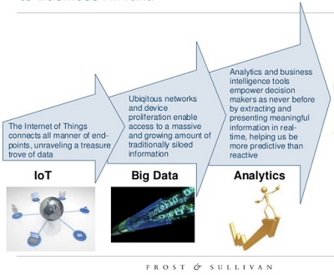



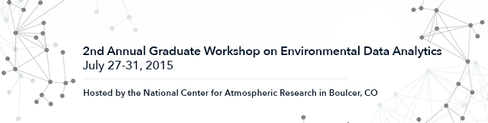

Deriving Earth Science Data Analytics Requirements
Goal oriented Earth Science Data Analytics (ESDA)
reveal requirements for needed data
analytics tools/techniques
Earth Science Data Analytics: Definition
The process of examining, preparing, reducing, and analyzing
large amounts of spatial (multi-dimensional), temporal, or spectral data
using a variety of data types to uncover patterns, correlations and other information,
to better understand our Earth.
Motivation
How can we maximize the usability of large heterogeneous datasets to glean knowledge out of the data?
Methodology
Categorize/Analyze ESDA use cases; derive data analytics requirements; associate tools/techniques;
perform gap analysis
Data Preparation
Data Reduction
Data Analysis
To validate data
Earth Science Data Analytics: Goals
To perform coarse data preparation
To glean knowledge
To derive conclusions
To calibrate data
To assess data quality
To intercompare datasets
To tease out information
To forecast/predict/model
To derive new analytics tools
Earth Science Data Analytics: Initial Requirements
Ingest from various sources; Homogenize data; Visualization; Sampling; Gridding
Access large datasets; High speed processing; Subsetting, mining, machine learning
Looking for
Community
input
Data exploration; Filter, mine, fuse, interpolate data; Manage custom code
Homogenize data; Intercomparison statistics; Pattern recognition
Seek heterogeneous data relationships; Ingest from various sources; Image processing
Ingest from various sources; High speed processing; Math functions
Access large datasets; Assess erroneous data; Detect data anomalies
Data exploration; Neural networks; Math/Stat modeling; Near Real Time data
Access very large datasets; homogenize data; visualization
Earth Science Data Analytics: Exemplary Tools, Techniques, Integrated Systems
Types of Analytics | Tools | Techniques |  | Integrated Systems
 | • R, SAS, Python, Java, C++ | • Statistics functions | • Factor Analysis
 | • SPSS, MATLAB, Minitab | • Machine Learning | • Principal Component Analysis
 | • CPLEX, GAMS, Gauss | • Data Mining | • Neural Networks | • EarthServer (http://www.earthserver.eu)
• Data Preparation | • Tableau, Spotfire | • Natural Language Processing | • Bayesian Techniques | • NASA Earth Exchange (https://nex.nasa.gov/nex/)
• Data Reduction | • VBA, Excel, MySQL | • Linear/Non-linear Regression | • Text Analytics | • EDEN (http://cda.ornl.gov/projects/eden/#)
• Data Analysis | • Javascript, Perl, PHP | • Logical Regression | • Graph Analytics | • EARTHDATA (https://earthdata.nasa.gov)
 | • Open Source Databases | • Time Series Models | • Visual Analytics | • Giovanni (http://giovanni.gsfc.nasa.gov/giovanni/)
 | • PIO, NCL, Parallel NetCDF | • Clustering | • Map Reduce
 | • AWS, Cloud Solutions, Hadoop | • Decision Tree
 | • MPI, GIS, ROI-PAC, GDAL
Compiled from: http://practicalanalytics.co/predictive-analytics-101/ and http://cda.ornl.gov/research.shtml
Earth Science Data Analytics:
Enabling Organizations
The good news…
Earth Science Data Analytics: Preparing for the Future
Earth Science Data Analytics: Looking Ahead
• Complete Gap Analysis between ESDA requirements and current tools/technologies
• Continue to evolve tools/techniques to address growing scope of the ‘Internet of Things’
Central England NERC Training Alliance
Big data analysis to fuel environmental
research at Reading University
… offering degrees in Data Science
… summer school on Big Data Analytics
… online master’s degree in data analytics
* Thanks to the work of the Earth Science Information Partners (ESIP) Federation, Earth Science Data Analytics (ESDA) Cluster

Slide 45
Deriving Earth Science Data Analytics Requirements

