Slide 1



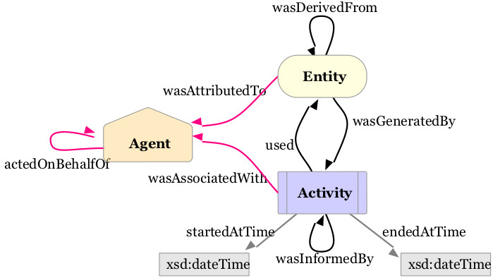
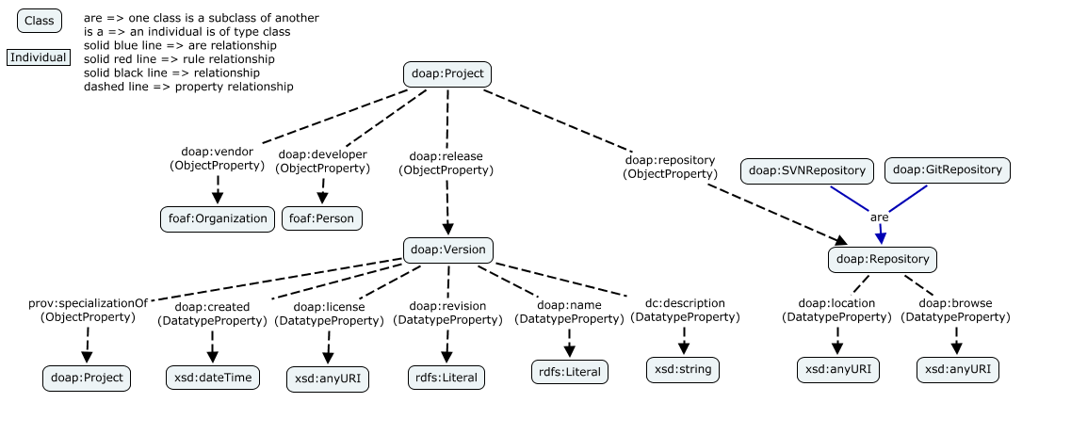
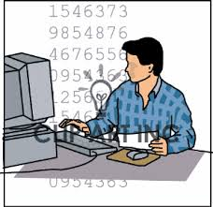

ESIP Winter 2014
W3C PROV-O Recommendation
DOAP – Description of a Project Ontology
DOAP provides us with the ability to represent software, software projects, releases of software, licensing information, where to download releases, where to find information about the software, and so on.
Provenance Capture in Data Access
And Data Manipulation Software
Patrick West^{1 (westp@rpi.edu)}, Peter Fox^{1(pfox@cs.rpi.edu)},
Deborah L. McGuinness^{1 (dlm@cs.rpi.edu)},
James Gallagher^{2(jgallagher@opendap.org)},
Dan Holloway^{2(d.holloway@opendap.org)},
Nathan Potter^{2(ndp@opendap.org)}
(¹Tetherless World Constellation, Rensselaer Polytechnic Institute Troy, NY, United States)
(²OPeNDAP.org, Saunderstown, RI, United States)
Abstract
Need: to trace back the origins of data products,
whether images or charts in a report, data obtained from a sensor on an instrument, a generated dataset referenced in a research paper, in government reports on the environment, or in a publication or poster presentation.
Yet: most software applications that perform data access and manipulation keep only limited history of the data, i.e. the provenance.
Scenario: There is a figure in a report showing multiple graphs and plots related to global climate, the report is being drafted for a government agency.
The graphs and plots are generated using an algorithm from an iPython Notebook, where the algorithm pulls data from four data sets from that portal.
That data is aggregated together over the time dimension, constrained to a few parameters, accessed using a particular piece of data access software, and converted from one datatype to another datatype (1)
Today we’re lucky to get a blob of text under the figure that might say a couple things about the figure with a reference to a publication that was written a few years ago.
Thus: Data citation, data publishing information, licensing information, and provenance are all lacking in the derived data products.
What we really want:
Trace the figure all the way back to the original datasets,
have access to data integration and manipulation processes,
See information about the researchers, the project, the agency funding, the award, and the organizations collaborating on the project.
OPeNDAP Hyrax Processing
Example DOAP Document
Link to Science Domain
We show here how we can link to a specific science domain
Ontologies, such as VSTO, and other tools, such as ToolMatch
<http://opendap.tw.rpi.edu/instances/software/BES>
a doap:Project, prov:Entity;
doap:name "OPeNDAP Back-End Server (BES)";
doap:developer <http://tw.rpi.edu/instances/PatrickWest>;
doap:developer <http://tw.rpi.edu/instances/DanHalloway>;
doap:developer <http://tw.rpi.edu/instances/James_Gallagher>;
doap:developer <http://tw.rpi.edu/instances/NathanPotter>;
doap:homepage <http://opendap.org/download/hyrax?q=BES_software>;
doap:vendor <http://tw.rpi.edu/instances/OPeNDAP>;
doap:repository <http://opendap.tw.rpi.edu/instances/Repository>;
doap:bug-database <http://scm.opendap.org/trac/>;
doap:release <http://opendap.tw.rpi.edu/instances/software/BES/3.12.0>;
doap:description "BES is a high-performance back-end server software framework that allows data providers more flexibility in providing end users views of their data.";
doap:license <http://opendap.tw.rpi.edu/instances/License>;
.
<http://opendap.tw.rpi.edu/instances/software/BES/3.12.0>
a doap:Version, prov:Entity;
prov:specializationOf
<http://opendap.tw.rpi.edu/instances/software/BES>;
doap:name "BES-3.12.0";
doap:revision "3.12.0";
doap:download-page <http://opendap.org/download/hyrax/1.9>;
doap:repository <http://scm.opendap.org/svn/tags/bes/3.12.0>;
doap:license <http://opendap.tw.rpi.edu/instances/License>;
doap:created 2013-08-27;
.
<http://opendap.tw.rpi.edu/instances/Repository>
a doap:SVNRepository;
doap:location <http://scm.opendap.org/svn/>
doap:browse <http://scm.opendap.org/svn/>
.
<http://opendap.tw.rpi.edu/instances/License>
dc:description "This software is distributed under the GNU Lesser General Public License <http://www.gnu.org/licenses/gpl.html>";
doap:name "GNU LESSER GENERAL PUBLIC LICENSE";
rdfs:seeAlso <http://www.gnu.org/licenses/gpl.html>;
.
<http://opendap.tw.rpi.edu/id/opendap/D9IH6677D3I6HDIHD36IHDI7DH>
# The hash above is: HASH(config file, BES version that read it)
a prov:Agent;
prov:wasDerivedFrom
<http://opendap.tw.rpi.edu/instances/software/hdf5_handler/2.1.1>,
<http://opendap.tw.rpi.edu/instances/software/BES/3.12.0>,
<http://opendap.tw.rpi.edu/instances/software/ncml_module/1.2.2/>,
<http://opendap.tw.rpi.edu/instances/software/fileout_netcdf/1.2.1>;
.
prov:wasDerivedFrom :config_file_hash;
# b/c BES set it up:
prov:wasAttributedTo <http://scm.opendap.org/svn/tags/bes/3.9.2>;
.
:dds_of_reading a prov:Entity;
dcterms:format opendap:DataDDS;
prov:wasGeneratedBy [
a prov:Activity;
prov:used <http://test.opendap.org/dap/data/h5/monday.h5> [
a vsto:Dataset, prov:Entity, toolmatch:DataCollection;
toolmatch:hasAccessURL <http://test.opendap.org/dap/data/h5/monday.h5>;
];
prov:used <http://test.opendap.org/dap/data/h5/tuesday.h5> [
a vsto:Dataset, prov:Entity, toolmatch:DataCollection;
toolmatch:hasAccessURL <http://test.opendap.org/dap/data/h5/monday.h5>;
];
prov:wasAssociatedWith <opendapi:software/hdf5_handler/2.1.1>;
];
.
:constrained_dds a prov:Entity;
dcterms:format opendap:DataDDS;
prov:wasGeneratedBy [
a prov:Activity;
prov:used :dds_of_reading;
prov:wasAssociatedWith <opendapi:software/BES/3.12.0>;
];
.
:aggregated_dds a prov:Entity;
dcterms:format opendap:DataDDS;
prov:wasGeneratedBy [
a prov:Activity;
prov:used :constrained_dds;
prov:wasAssociatedWith <opendapi:software/ncml_module/1.2.2>;
];
.
:result a foaf:Document;
nfo:fileName "thursday.h5";
dcterms:format netcdf;
prov:wasGeneratedBy [
a prov:Activity;
prov:used :aggregated_dds;
prov:wasAssociatedWith <opendapi:software/fileout_netcdf/1.2.1>;
];
.
Requests processing
Scientific Data
Gets back response
Provenance included in header
Ping-back service in header
Input Requested
We’d love your feedback and your input. Specifically, your thoughts on:
The model. Using PROV-O, DOAP
The use of provenance and ping-back in the response header
Would you like to review the model/design/technology infrastructure
Would you like to collaborate on this project?
Any other questions, comments, suggestions are welcome!
How to provide feedback:
Scan the QR code to the left. This will take you to a page with more information and information on how you can contribute.
Or email westp@rpi.edu with your questions, comments, suggestions.
Provenance Store
Provides ping-back information
OPeNDAP Hyrax Response
Poster QRCode
200 OK
S: Link: <http://opendap.tw.rpi.edu/instances/result/provenance>;
rel="http://www.w3.org/ns/prov#has_provenance"
S: Link: <http://opendap.tw.rpi.edu/instances/result/pingback>;
rel="http://www.w3.org/ns/prov#pingback"
Acknowledgments:
Stephan Zednik and Tim Lebo – Tetherless World Constellation
Current Proposal
Future Work
Glossary:
DAP – OPeNDAP Data Access Protocol
DOAP – Description of a Project (https://github.com/edumbill/doap/wiki)
FOAF - Friend of a Friend (http://www.foaf-project.org/)
OWL – Web Ontology Language (http://www.w3.org/2002/07/owl#)
OPeNDAP - Open-source Project for a Network Data Access Protocol (http://opendap.org)
PROV-O – Provenance Ontology, W3C recommendation (http://www.w3.org/TR/prov-o/)
RDFs – Resource Description Framework Schema (http://www.w3.org/2000/01/rdf-schema#)
RPI/TWC – Rensselaer Polytechnic Institute / Tetherless World Constellation (http://tw.rpi.edu)
Where it came from
The request that was made of the data access server.
The source data set(s)
Any data set(s) that the resulting data product is derived from
Processing that happened
Any software that did any sort of processing against the data and any intermediate data
The software version
This will vary for different servers (it might be one number or a list or numbers), but in the end it is one or more of the tried and true x.y.z version numbers along with names.
How to cite the dataset in a publication
Nominally a DOI or instructions.
Licensing information/restrictions
URL reference to a license.
Modeling
In this presentation we’ve given a glimpse of the information modeling and ontology development we feel is necessary to complete this project. Need to finalize and review the model.
Coding
There will be coding to be done in the server software, in this case OPeNDAP BES. Creating the provenance trace, ability to add license and citation information, and creating the ping-back services.
Providing Services
In addition to provenance trace access, provide a prov:pingback service so that users can tell the data providers what they’ve done with the data (citation in a report or publication, for example)

