Slide 1
National Geospatial Platform
Jerry Johnston
Department of the Interior
January 6, 2016

Slide 2
The US National Spatial Data Infrastructure
Executive Order 12906 (1994) calls for the establishment of the National Spatial Data Infrastructure (NSDI)
Defined as the “technologies, policies and people necessary to promote sharing of geospatial data throughout all levels of government, the private and non-profit sectors, and the academic community”
Goals include reducing duplication and costs, while making more geographic information available to the public and partners in government and the private sector
Standards development and registries (Geospatial One Stop, Data.gov) followed…
Tens of thousands of datasets registered to shared catalogs

Slide 3
What problems still need to be solved?
The role of government in the geospatial ecosystem has changed
Use of geospatial data and maps in the public sector is pervasive – need to focus on driving towards better access to and understanding of the right information
Some significant challenges to address:
Inability to surface the right data or the right map in search results
Past approaches have not allowed for significant collaboration among partners in the NSDI or users of data/services/maps
Making sure it all “works” when you need it to (e.g., service quality)

Slide 4
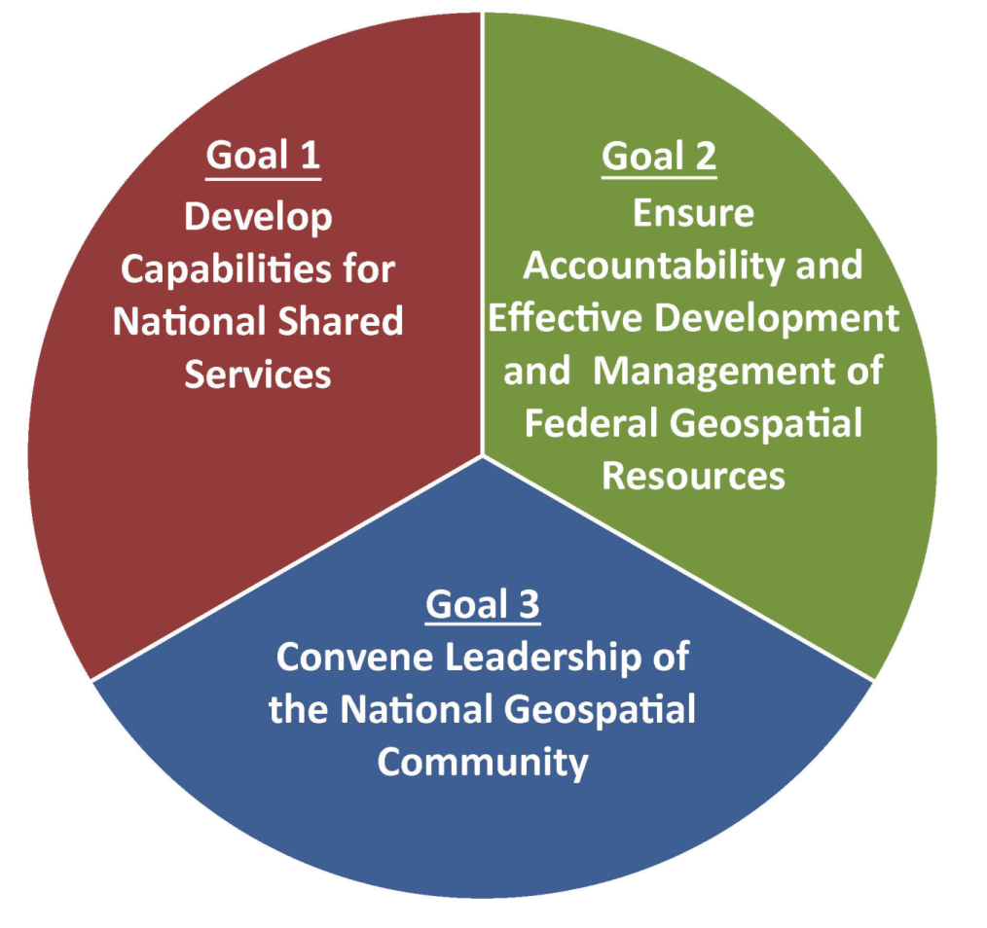
NSDI Strategic Plan Goals
NSDI Strategic Plan Includes:
3 Strategic Goals
9 Objectives
29 Actions

Slide 5
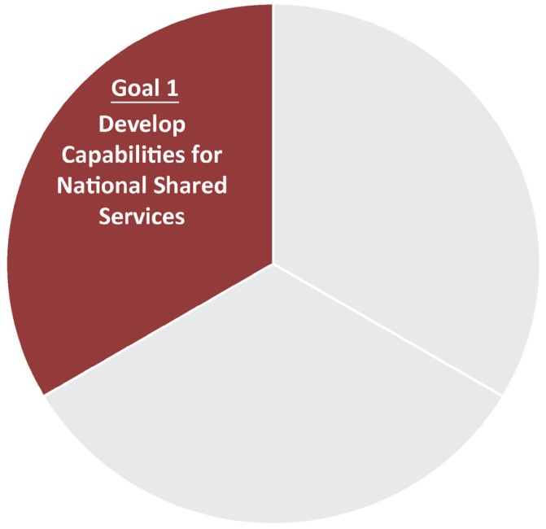
NSDI Strategic Goal #1
STRATEGIC GOAL 1:
Develop Capabilities for National
Shared Services
Objective 1.1. Develop geospatial interoperability reference architecture
Objective 1.2. Establish the Geospatial Platform as the Federal geospatial
data, services, and applications Web-based service environment
Objective 1.3. Expand the use of cloud computing
Objective 1.4. Promote the use of geospatial multiagency acquisition
vehicles for interagency and intergovernmental purchases

Slide 6
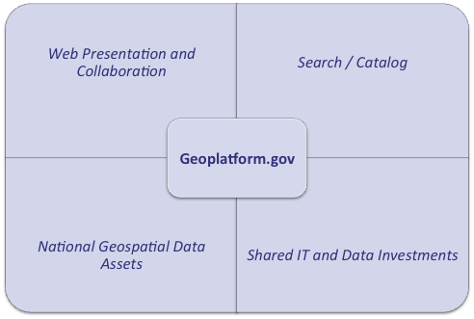
Geospatial Platform Components

Slide 7
Geoplatform.gov – What’s New
A complete redesign and redeployment of Geoplatform.gov and its underlying capabilities
Hosted in a commercial cloud environment (Amazon Web Services)
Greatly increased capabilities and performance
Fall 2015 “Preview” Release: http://preview.geoplatform.us
New home page / web design
New Web Map Viewer with integrated service quality measures
Improved capabilities for map gallery creation and sharing
Expanded performance and portfolio measurement tools

Slide 8
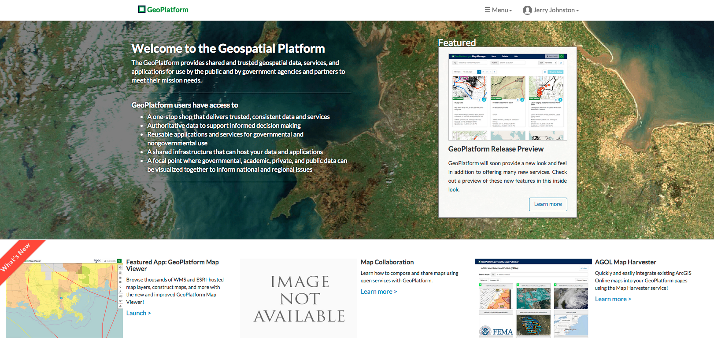
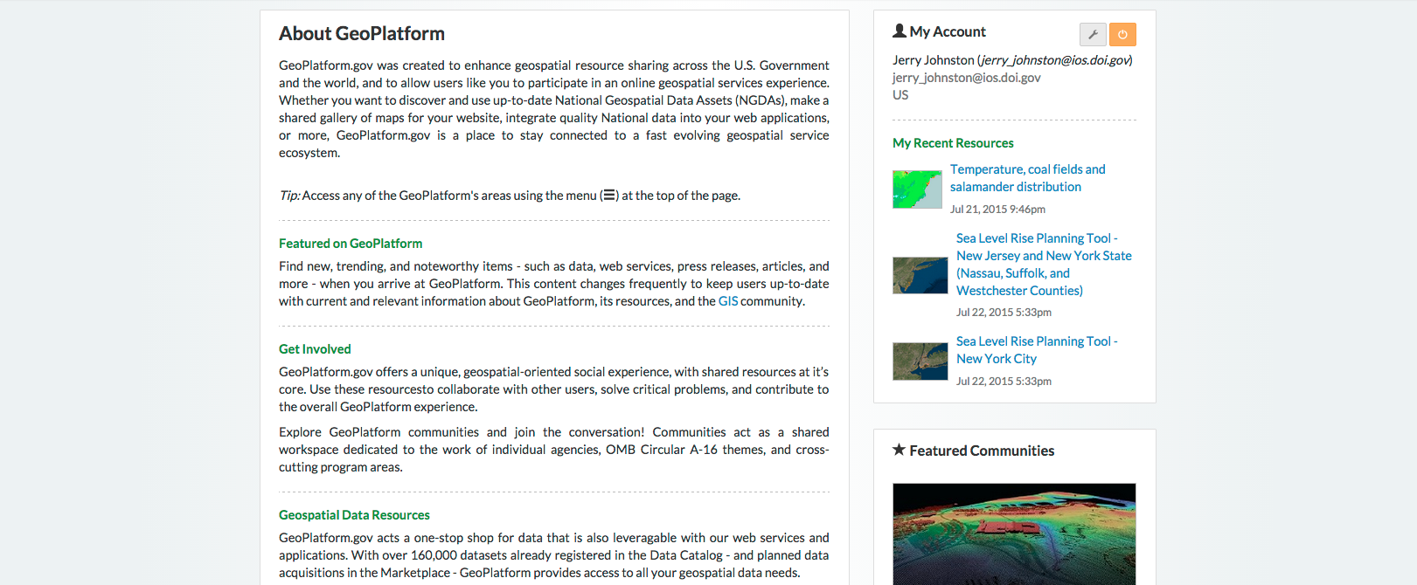

Slide 9
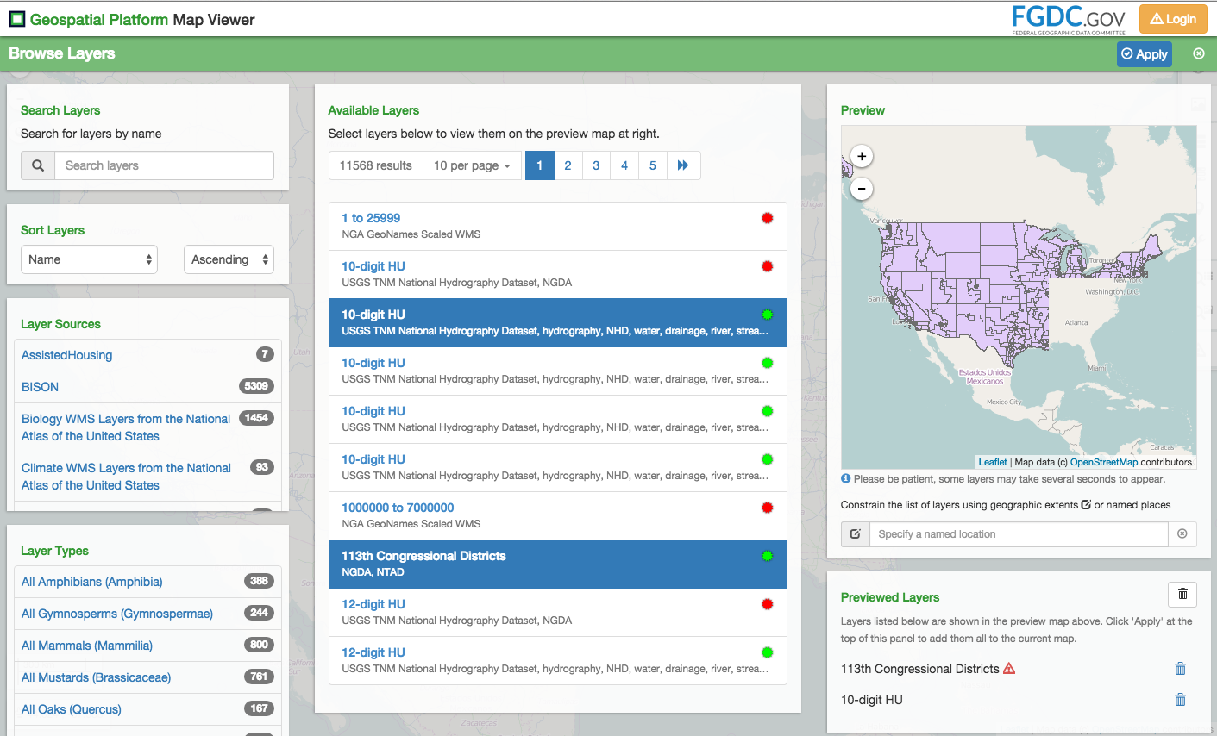

Slide 10
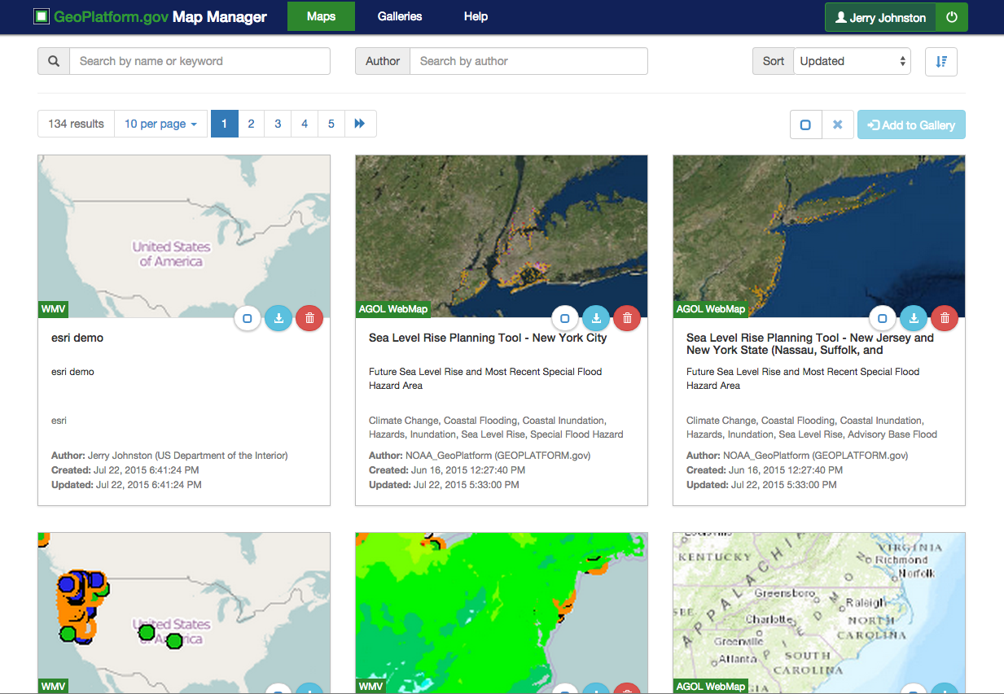

Slide 11
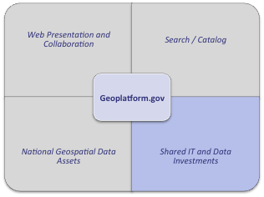
Geospatial Platform – Shared Investments
Common data / application hosting infrastructure to enable agencies to save time and money
Leveraging ArcGIS Online
Using commercial cloud computing services to build out additional shared hosting infrastructure for the benefit of FGDC partners
Developing shared IT security documentation for the common hosting environment – leveraging DOI Foundational Cloud Hosting Contract and existing relationship with Esri

Slide 12
Discussion

