Slide 1
Experiences Accessing Federal Data
Janet Fredericks
2014 ESIP Summer Meeting (July 8, 2014)

Slide 2
http://www.whoi.edu/mvco
Local information indicated a coastal breach occurred …. Using data from the coastal observatory, we seek to tell a story.
Satellite data could help us identify the timing of the breach so we can focus our analysis of the data around the time of the event and compare conditions to other similar events that affected no such breach.

Slide 3
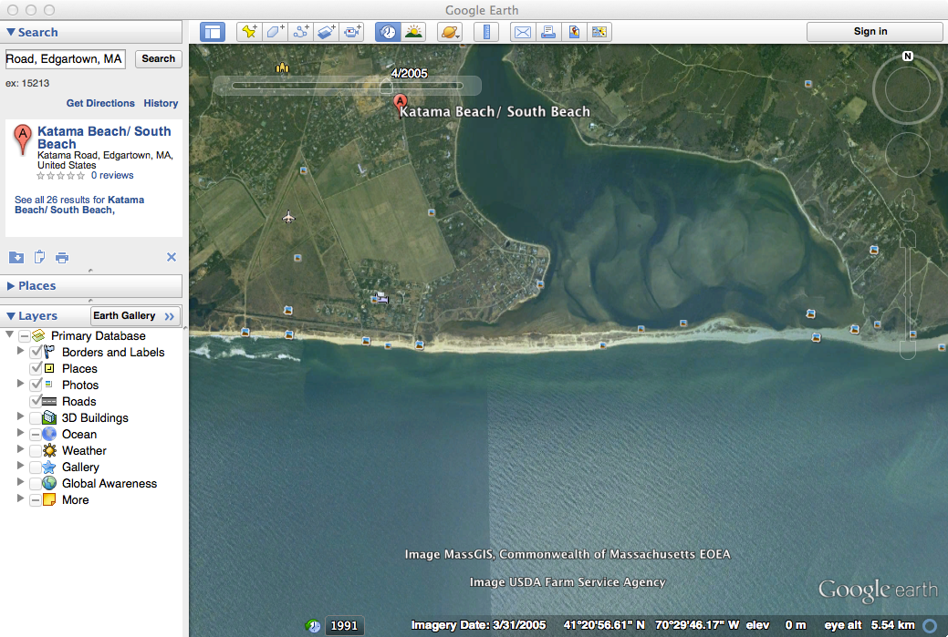

Slide 4
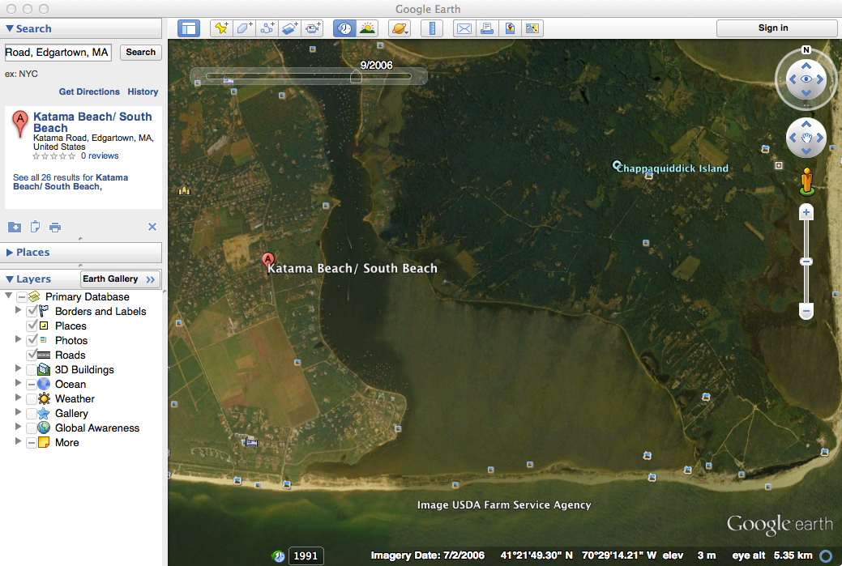

Slide 5
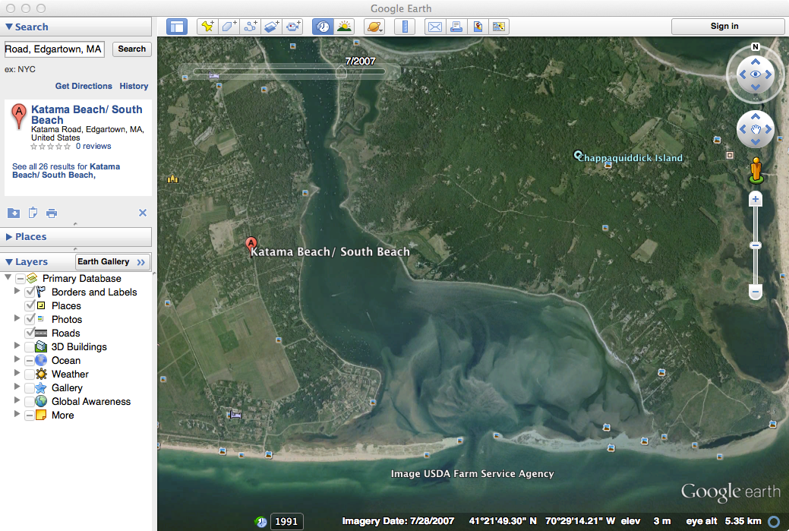

Slide 6
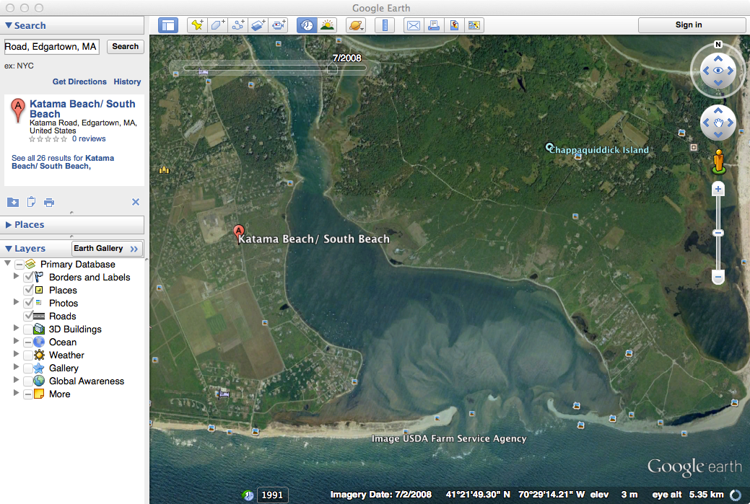

Slide 7
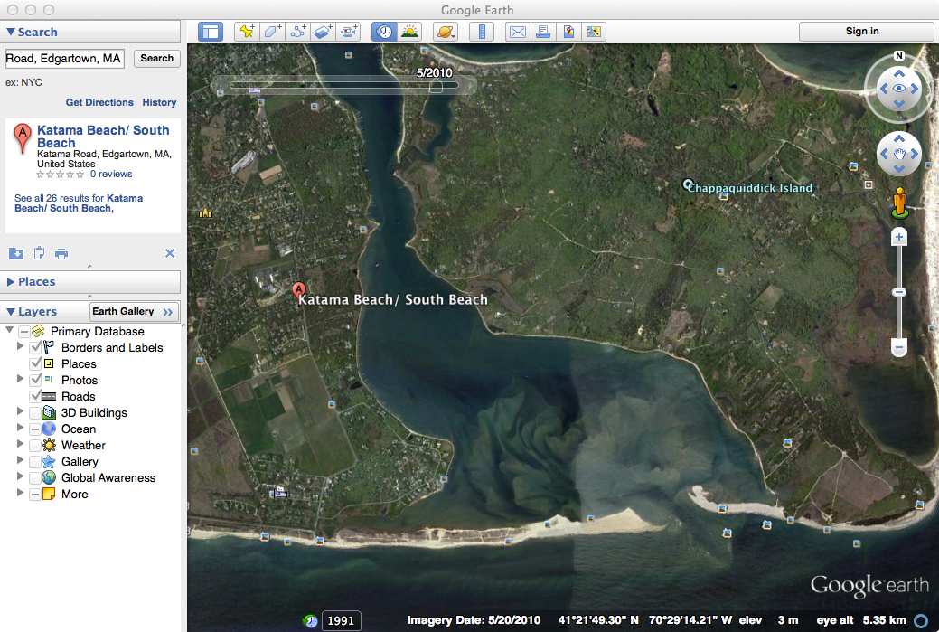

Slide 8
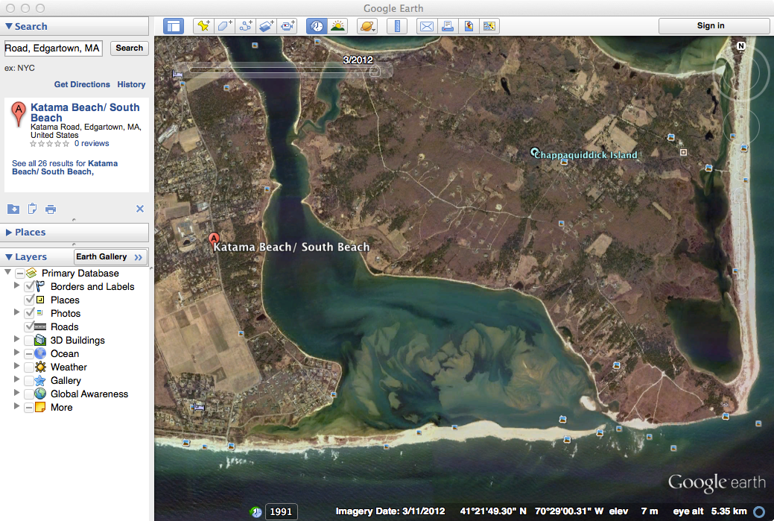

Slide 9
What happened between July 2006 and July 2007?
Went to look for satellite images

Slide 10
The google search

Slide 11
Data.gov

Slide 12
Search on data.gov

Slide 13
OK – am I there? No, have to upgrade

Slide 14
OK – there’s data and I see it (not sure of the resolution, but found images my month/year)

Slide 15
Earth Explorer Image (LS7)
2007 Day 091 (4/1/2007)

Slide 16
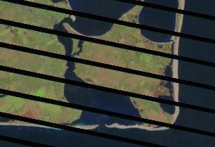
Earth Explorer Image (LS7)
2007 Day 123 (5/3/2007)

Slide 18
*** Another User Experience ***
Study of the features on the MidAtlantic continental shelf
Spacing; orientation
Changing in time
Issues (besides discovery):
Blocks are square and area of interests follows the diagonal of the Mid-Atlantic coastline.
Requires accessing multiple files (NorthEast and then MidAtlantic) then conflating, etc
Verbal communication (needed to contact colleagues)
No reference to time … data set was a collection over unknown time with different data sets gathered at disparate time. Cannot identify sampling dates.

Slide 19
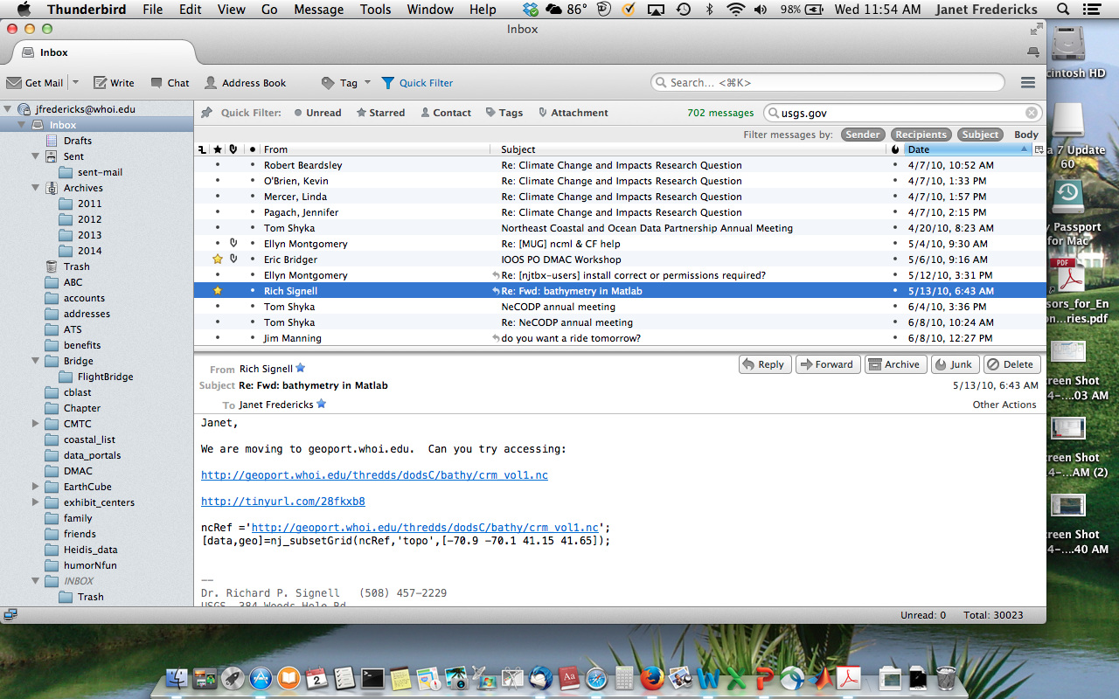

Slide 20
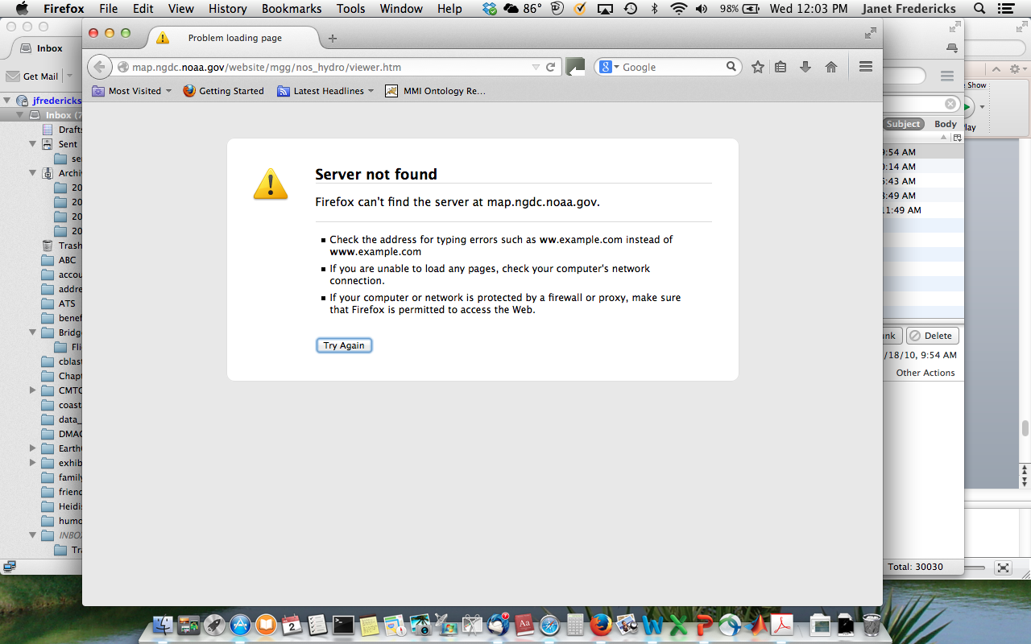
Reproducing work – what worked in 2010 doesn’t work

Slide 21
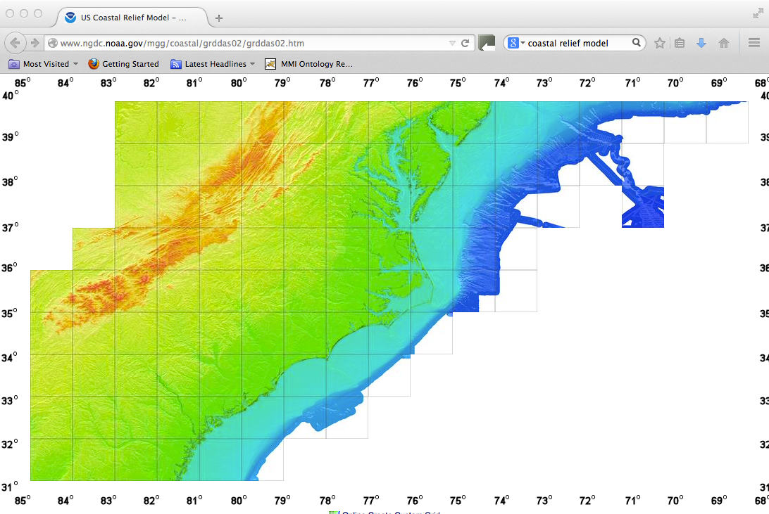

Slide 22
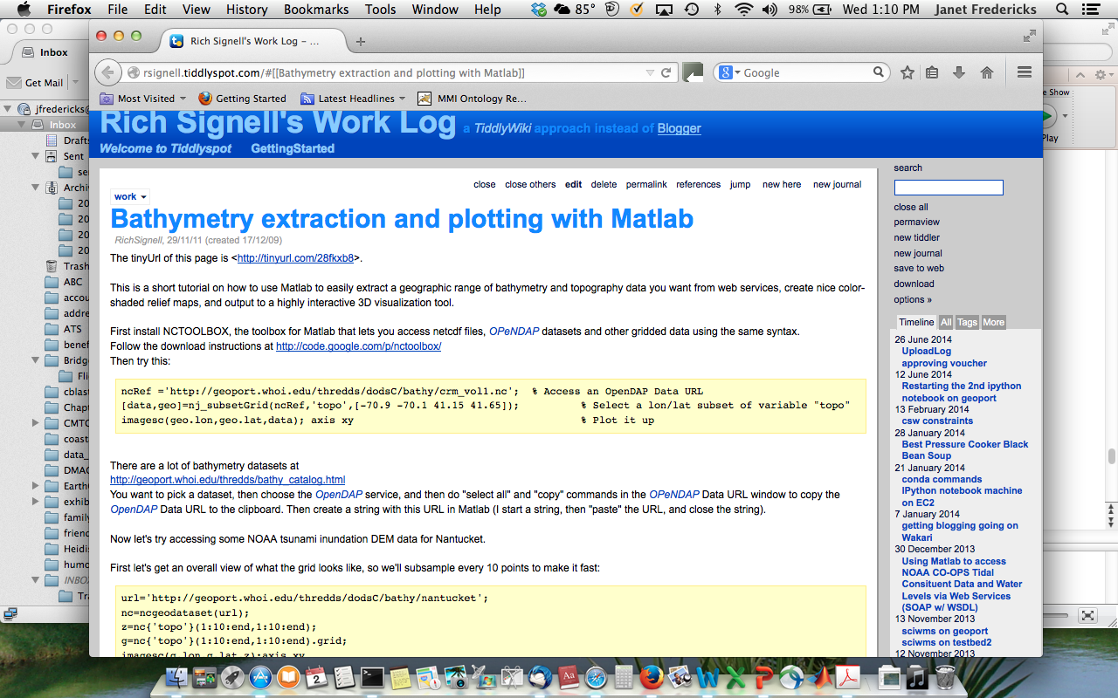

Slide 23
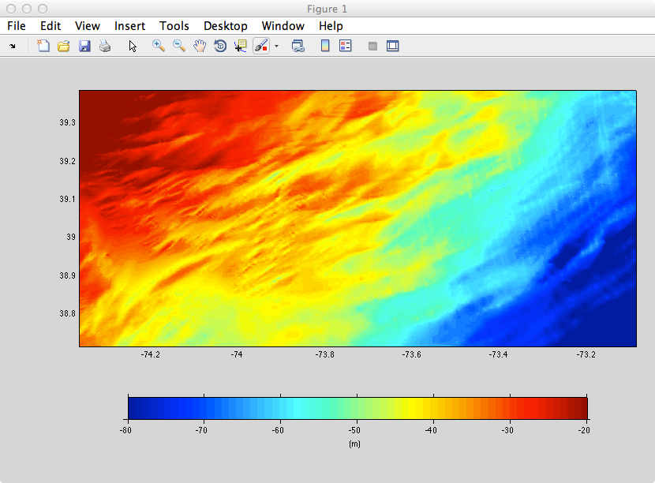

Slide 24
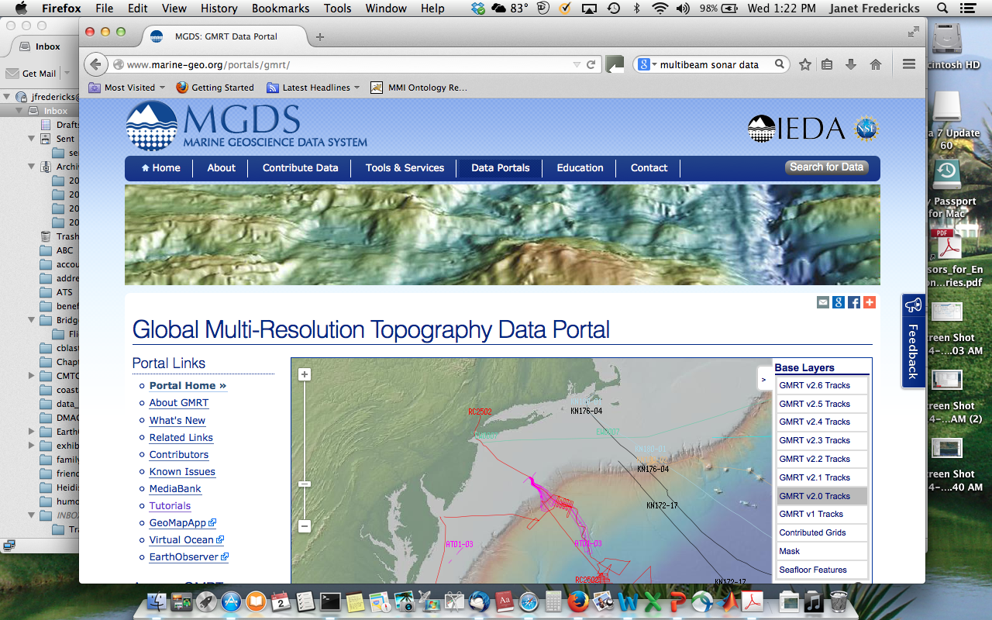

Slide 25
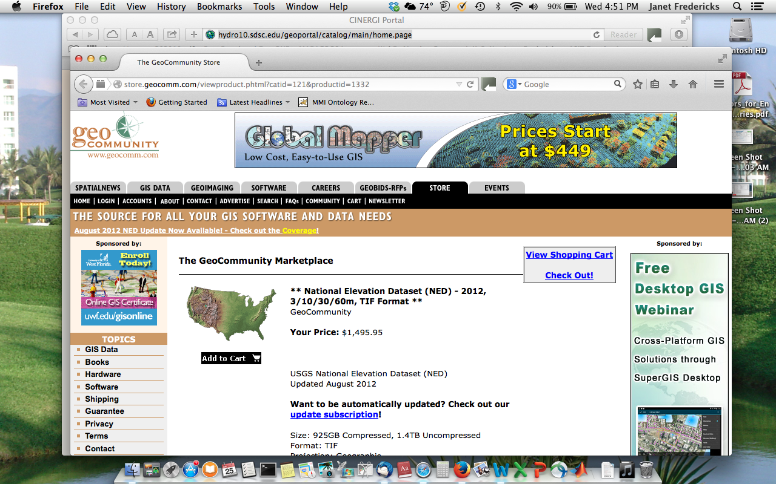

Slide 26
How can we find and access what we need and only what is needed?
What do I want? Bathymetry, seafloor topography, data (as opposed to map)
One Query (Discovery and Selection)
Search by geospatial limits
Further Limit by distance from a feature –
e.g., 100km east of Atlantic Coast of the United States
OR
Identify feature: Eastern U.S. continental shelf
Request supplemental metadata –
e.g., time of observation so we can identify changes
Return a single file for each data set available (not multiple files due to geographic boundaries of the data source) and provide tools that can be used to merge the data sets
Scripting interface for documenting access methods and processing

