Slide 1




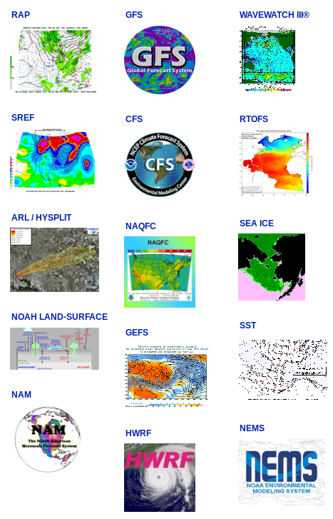
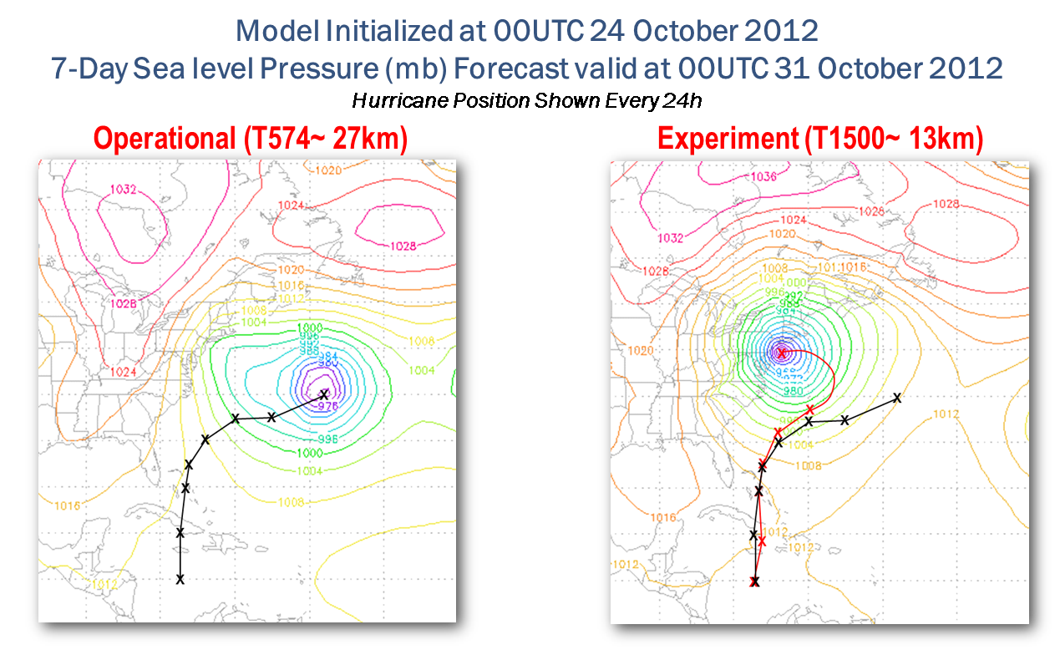
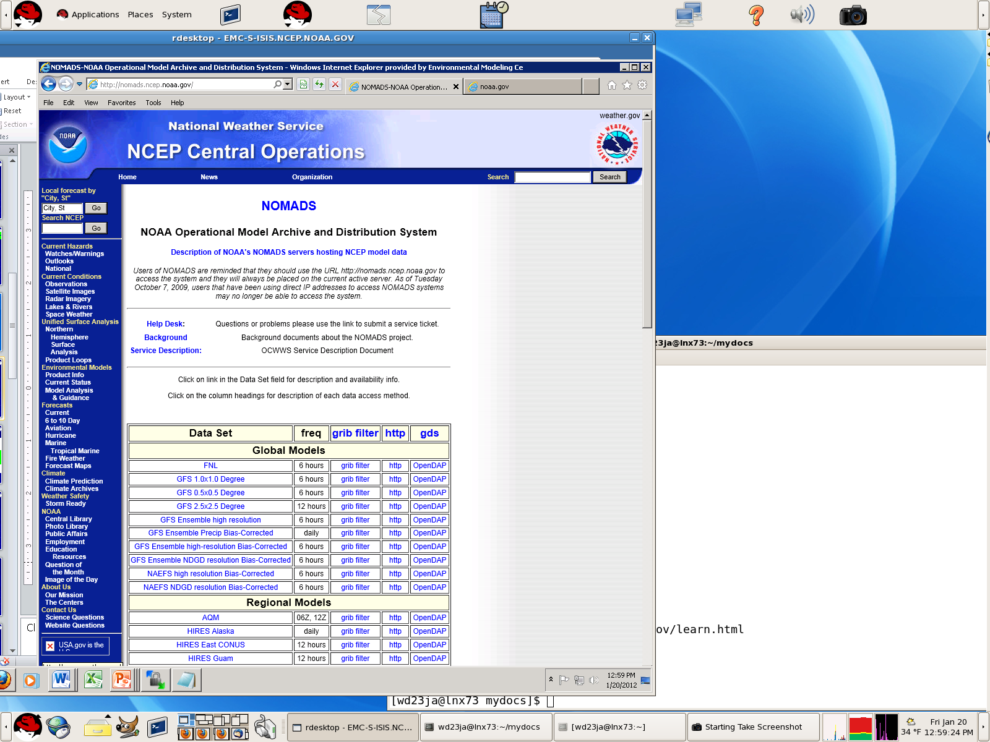
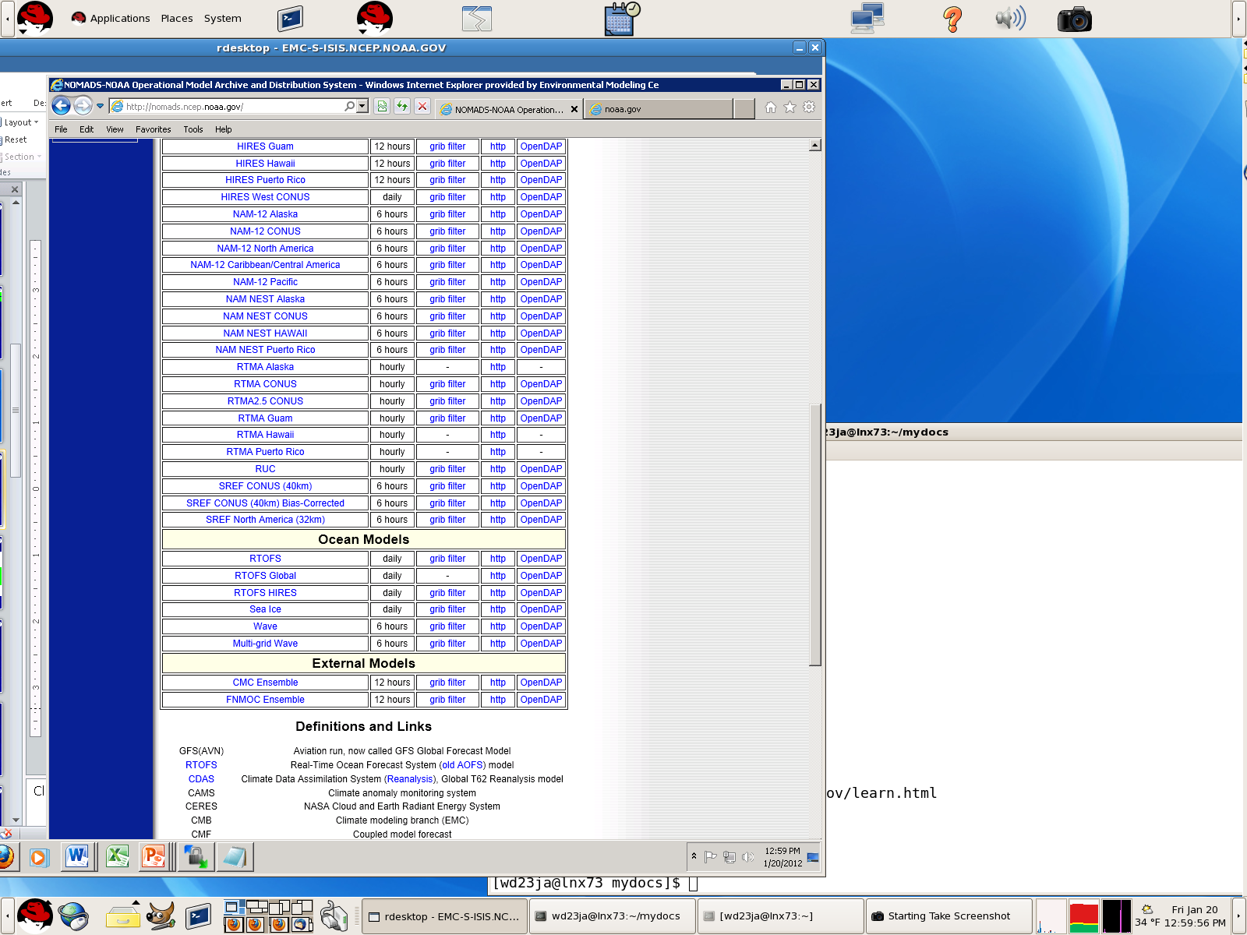
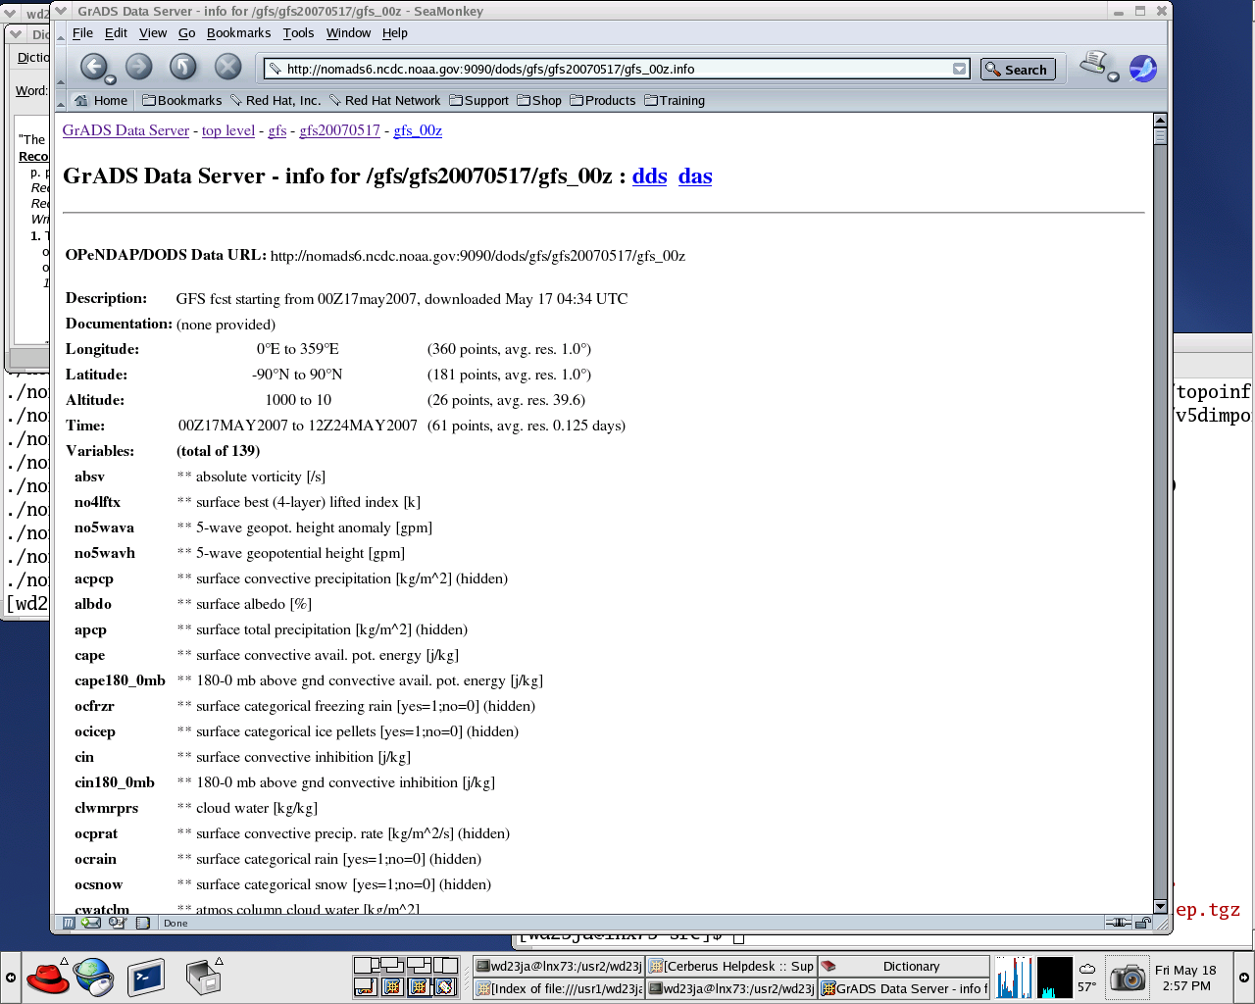

NOAA Weather Model Output Data for Decision Support Systems, Including Aggregation of Ensembles
ESIP Winter Meeting,
January 6-8, 2015, Washington D.C.
Earth Science and Data in Support of …
Climate, Energy, Water Nexus.
UPoster
Jordan C. Alpert
Glenn Rutledge
NOAA/NWS/NCEP/Environmental Modeling Center,
NOAA Center Weather and Climate Prediction ,
College Park, Maryland 20740
Climate Services Division, National Climate Data Center
151 Patton Avenue, Asheville NC 28801
“It Slices, It Dices, and Area Subsets”
Want Data for Decision Support?
Use Server Aggregated Data Sets
The NWS/NCEP Environmental Modeling Center Want Operational Real Time Model Grid Data?
Model output datasets at National Centers are formatted as Gridded Binary (GRIB) and in a few cases NETCDF files. NOMADS services are format independent using Grads Data Server GDS/OPeNDAP services and NOMADS also includes applications to repackage Grib data sets:
Using http queries, a URL request extracts data from the GDS server: An example using GEFS aggregated global ensemble data set from a NOMADS OPeNDAP/GDS constrained query is below:
EMC is responsible for the enhancements, transitions-to-operations, and maintenance of more than 20 numerical prediction systems comprising NCEP's operational production suite.
NOMADS real-time services are supported by NOAA/NCEP, available at http://nomads.ncep.noaa.gov/. This server provides all the real time weather service model output data.
Access to NCEP's operational data sets as they are being generated for up to a month in the past for some data sets (we still call this real time).
24x7 monitoring and data flow by NCEP staff and backup server to insure high availability for time critical access.
Long-term archives (many years) for some data sets is at National Climatic Data Center (NCDC): http://nomads.ncdc.noaa.gov/
“Gribfilter” streams data from our server to yours. A web page interface filter
is in place to allow the user, for any model run, to select files by forecast time,
(when you want only a section of a huge data file rather than transferring the
entire file) by region, vertical level(s), for any of the model’s variables. One selects
the files to "slice and dice" the needed data set, and users customize
their own data flow, receiving a re-packaged GRIB file streamed to the user workstation or the “URL commands” for program scripting. For details see: http://www.cpc.ncep.noaa.gov/products/wesley/scripting_grib_filter.html
The resulting repackaged GRIB file is streamed to the users work station or the “Show the URL only for web programming” check box provides a custom URL address and keywords to download the repackaged dataset if used as the object of a non-interactive web download command such as wget or cURL. These can be used in a user script in virtually any language and placed in a cron scheduler for user custom high availability data flow.
http://nomads.ncep.noaa.gov:9090/dods/gens/gens20090501/gep_all_00z.ascii?tmpprs[0:20][0:21][1:1][129:129][243:243]
Notice the 5-Dimensional query for each variable (6-D data cube!), for temperature (tmpprs):
i^{th} Ensemble component [0:20] Lists all 20 Ensemble components plus control at, Forecast times [0:21] IC and every 6-hour interval to 5-days is indicated, Vertical levels [1:1] 975Mb indicated, and [0:0] would mean 1000mb, Latitude, [129:129] is measured from SP (0) to NP (for a 1x1 degree grid) Longitude, [243:243] Beginning at the 0 meridian – we show BWI airport
The ordering of the square bracketed values constrain the query, otherwise the entire dimension contents are returned: [Ens1:Ens2][Fcst1:Fcst2][Lev1:Lev2][Lat1:Lat2][Lon1:Lon2]
The “gep_all_00z” is the entry point to the 21 ensemble components, each with a realization of forecasts out to 384-hours.
Units and other information are represented in the metadata descriptor file, at the above address when ascii? Is changed to .info. A stride is also possible as [start:stride:finish] using colon separated values.
Normally constrained queries are composed by high level languages MATLAB and IDL on the commercial side and GrADS as a freeware example, in response to user functional commands. But one can compose these by hand or users can construct their own script and query the server with non-interactive web download commands like wget an cURL. Here is an example:
Ensemble probability tool: A web based client application that can be used to provide threshold information to the user. The program obtains the Global Ensemble Forecast information matrix from the server as described above from 400 separate binary packed GRIB2 files, and returns the information to the user as a probability display. A user then determines a proper threshold of their defined weather event. See demo at http://nomads.ncdc.noaa.gov/EnsProb/
Users can determine their threshold (to tolerate false alarms) for a weather event alert, that is sent to email and cell phone (SMS) text-message when the threshold is met in a similar application http://nomads-cloud.net/cgi-bin/ensprob_wb4.pl.
The returned URL for this application will repeat the alert process, that is, sending user notification only if the threshold criteria is met, otherwise no action is taken, so the user may repeat the command in cron or a scheduler and be assured of the latest forecast cycle (4X/day).
Prediction is what makes EMC unique!
“http/fast/partial” ftp protocol allows "random access" GRIB file transfer using server side metadata description index files and a downloadable perl program that supports ftp random access. NOMADS servers keep a metadata file for this purpose for all datasets. The index file metadata is accessed by a get inventory information script and a random-access program using cURL. Both are freely available, widely used, and work on many platforms. Called “http/fast/partial ftp” commands are easily scripted/automated and placed into a cron job. For examples and downloads see http://www.cpc.ncep.noaa.gov/products/wesley/fast_downloading_grib.html http://www.cpc.ncep.noaa.gov/products/wesley/wgrib2/index.html
(0)
Global Forecast System (GFS), Global Spectral Model
(2)
What is NOMADS?
“ftp” File transfer protocol service, Yes., NOMADS does this too
NOAA’s Operational Model Archive Distribution System
Want Data Values From Format Independent URL Queries?
NOMADS is a distributed data service for format independent access to climate, ocean and weather model output grid data.
Weather service real time model output at the Web Operations Center has moved to the NOAA Center for Weather and Climate Prediction (NCWCP) data center
At Weather Forecast Office’s, Regional Centers, University and Institutional research, NOAA often effort is wasted on data receipt and format issues with not enough infrastructure to collaborate.
There is a need for Climate and Weather model output data to make decisions to preserve life, property and commerce.
Applications to Slice, Dice and Area subset model output packed binary grid data sets across the complex dimensions of the NOAA Operational model output matrix
GDS/OPeNDAP*: combines both GrADS, the Grid Analysis and Display System, a freeware client (from COLA**) and GrADS Data Server, to provide subsetting and analysis services across the internet. Underneath GDS is OPeNDAP data networking that makes local data accessible to remote locations. The server unpacks the model output data in response to user queries so server data values can appear to the user or client application as a local file! NOMADS serves data. Display is done by the user (client)
Use URL queries to request or extract data from the GDS/OPeNDAP server
(4)
All NOMADS holdings have a Metadata description that is man or machine readable
An Example: The OPeNDAP/GDS constrained query for the Aggregated Global Ensemble data set (GEFS)
SUMMARY AND FUTURE WORK
Data location
Description
Dimensions & Extent
Variables, Units…
Geo-spatial
For an ensemble data set, an additional metadata line in the dimensions and extent would read “Ensemble:1 to 21 (21 points) Variables” indicating the 21 GEFS ensemble component forecasts aggregated over the separate files.
What are Ensembles?
Aggregation of data sets is the key for users to obtain the data they need to make time critical decisions for their own projects.
NCEP global ensemble forecasts are constructed from many (~20) GFS model integrations by slightly changing the initial conditions.
Each of the GEFS ensemble forecast components are in separate binary (GRIB2) files from initial condition (f00) time to 16 days (f384) in the future.
Probability estimates can be defined simply as the percentage of forecasts that satisfy a specified weather event (hits)over the total sample space (the total number of components).
GDS/OPeNDAP servers are an efficient way for users and web or cell phone application programs to get real time model output data on demand.
Operational Conventional and non-conventional Observations need to be served in a similar way to grid fields.
THREDDS Data Server is under testing at NCWCP
http://nomads.ncep.noaa.gov (Data)
http://nomads.ncdc.noaa.gov (Archives)
NOMADS successful at satisfying NWS Strategic Goals
Improve Weather, Climate and Water Decisions Services,
Improve sector-relevant information in support of economic productivity,
Enable environmental forecast services supporting healthy communities and ecosystems
(1)
Aggregation means all the ensemble component files representing each realization of all the separate forecast files appear as if they were one dataset with one entry point without any duplication of the data.
*GrADS Data Server: http://www.iges.org/grads/gds/index.html
**Center for Ocean-Land-Atmosphere Studies: http://www.iges.org/grads/
(5)
(3)

