Slide 1
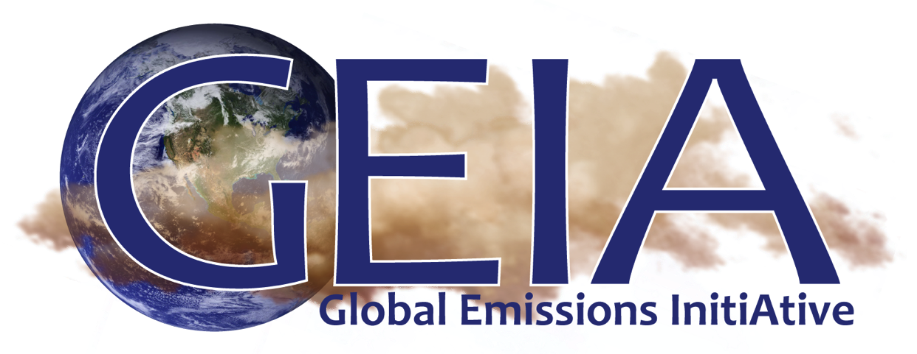
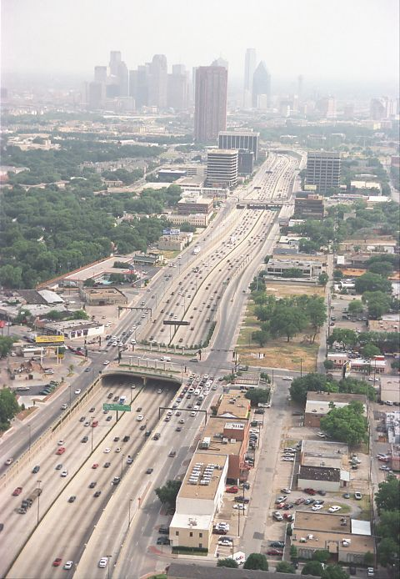
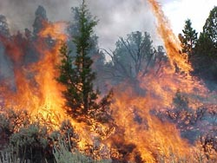
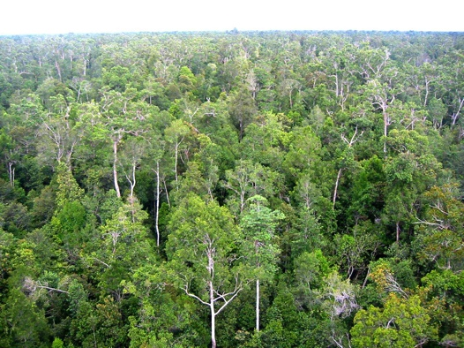
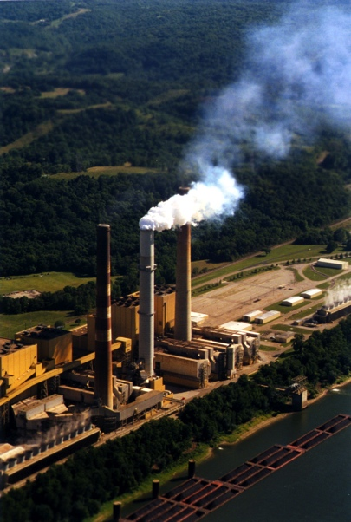
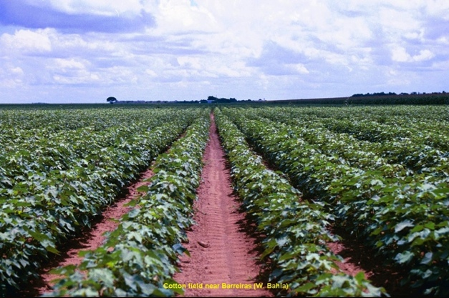
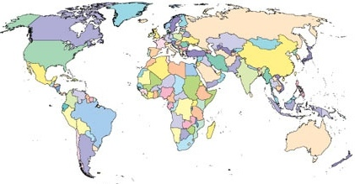
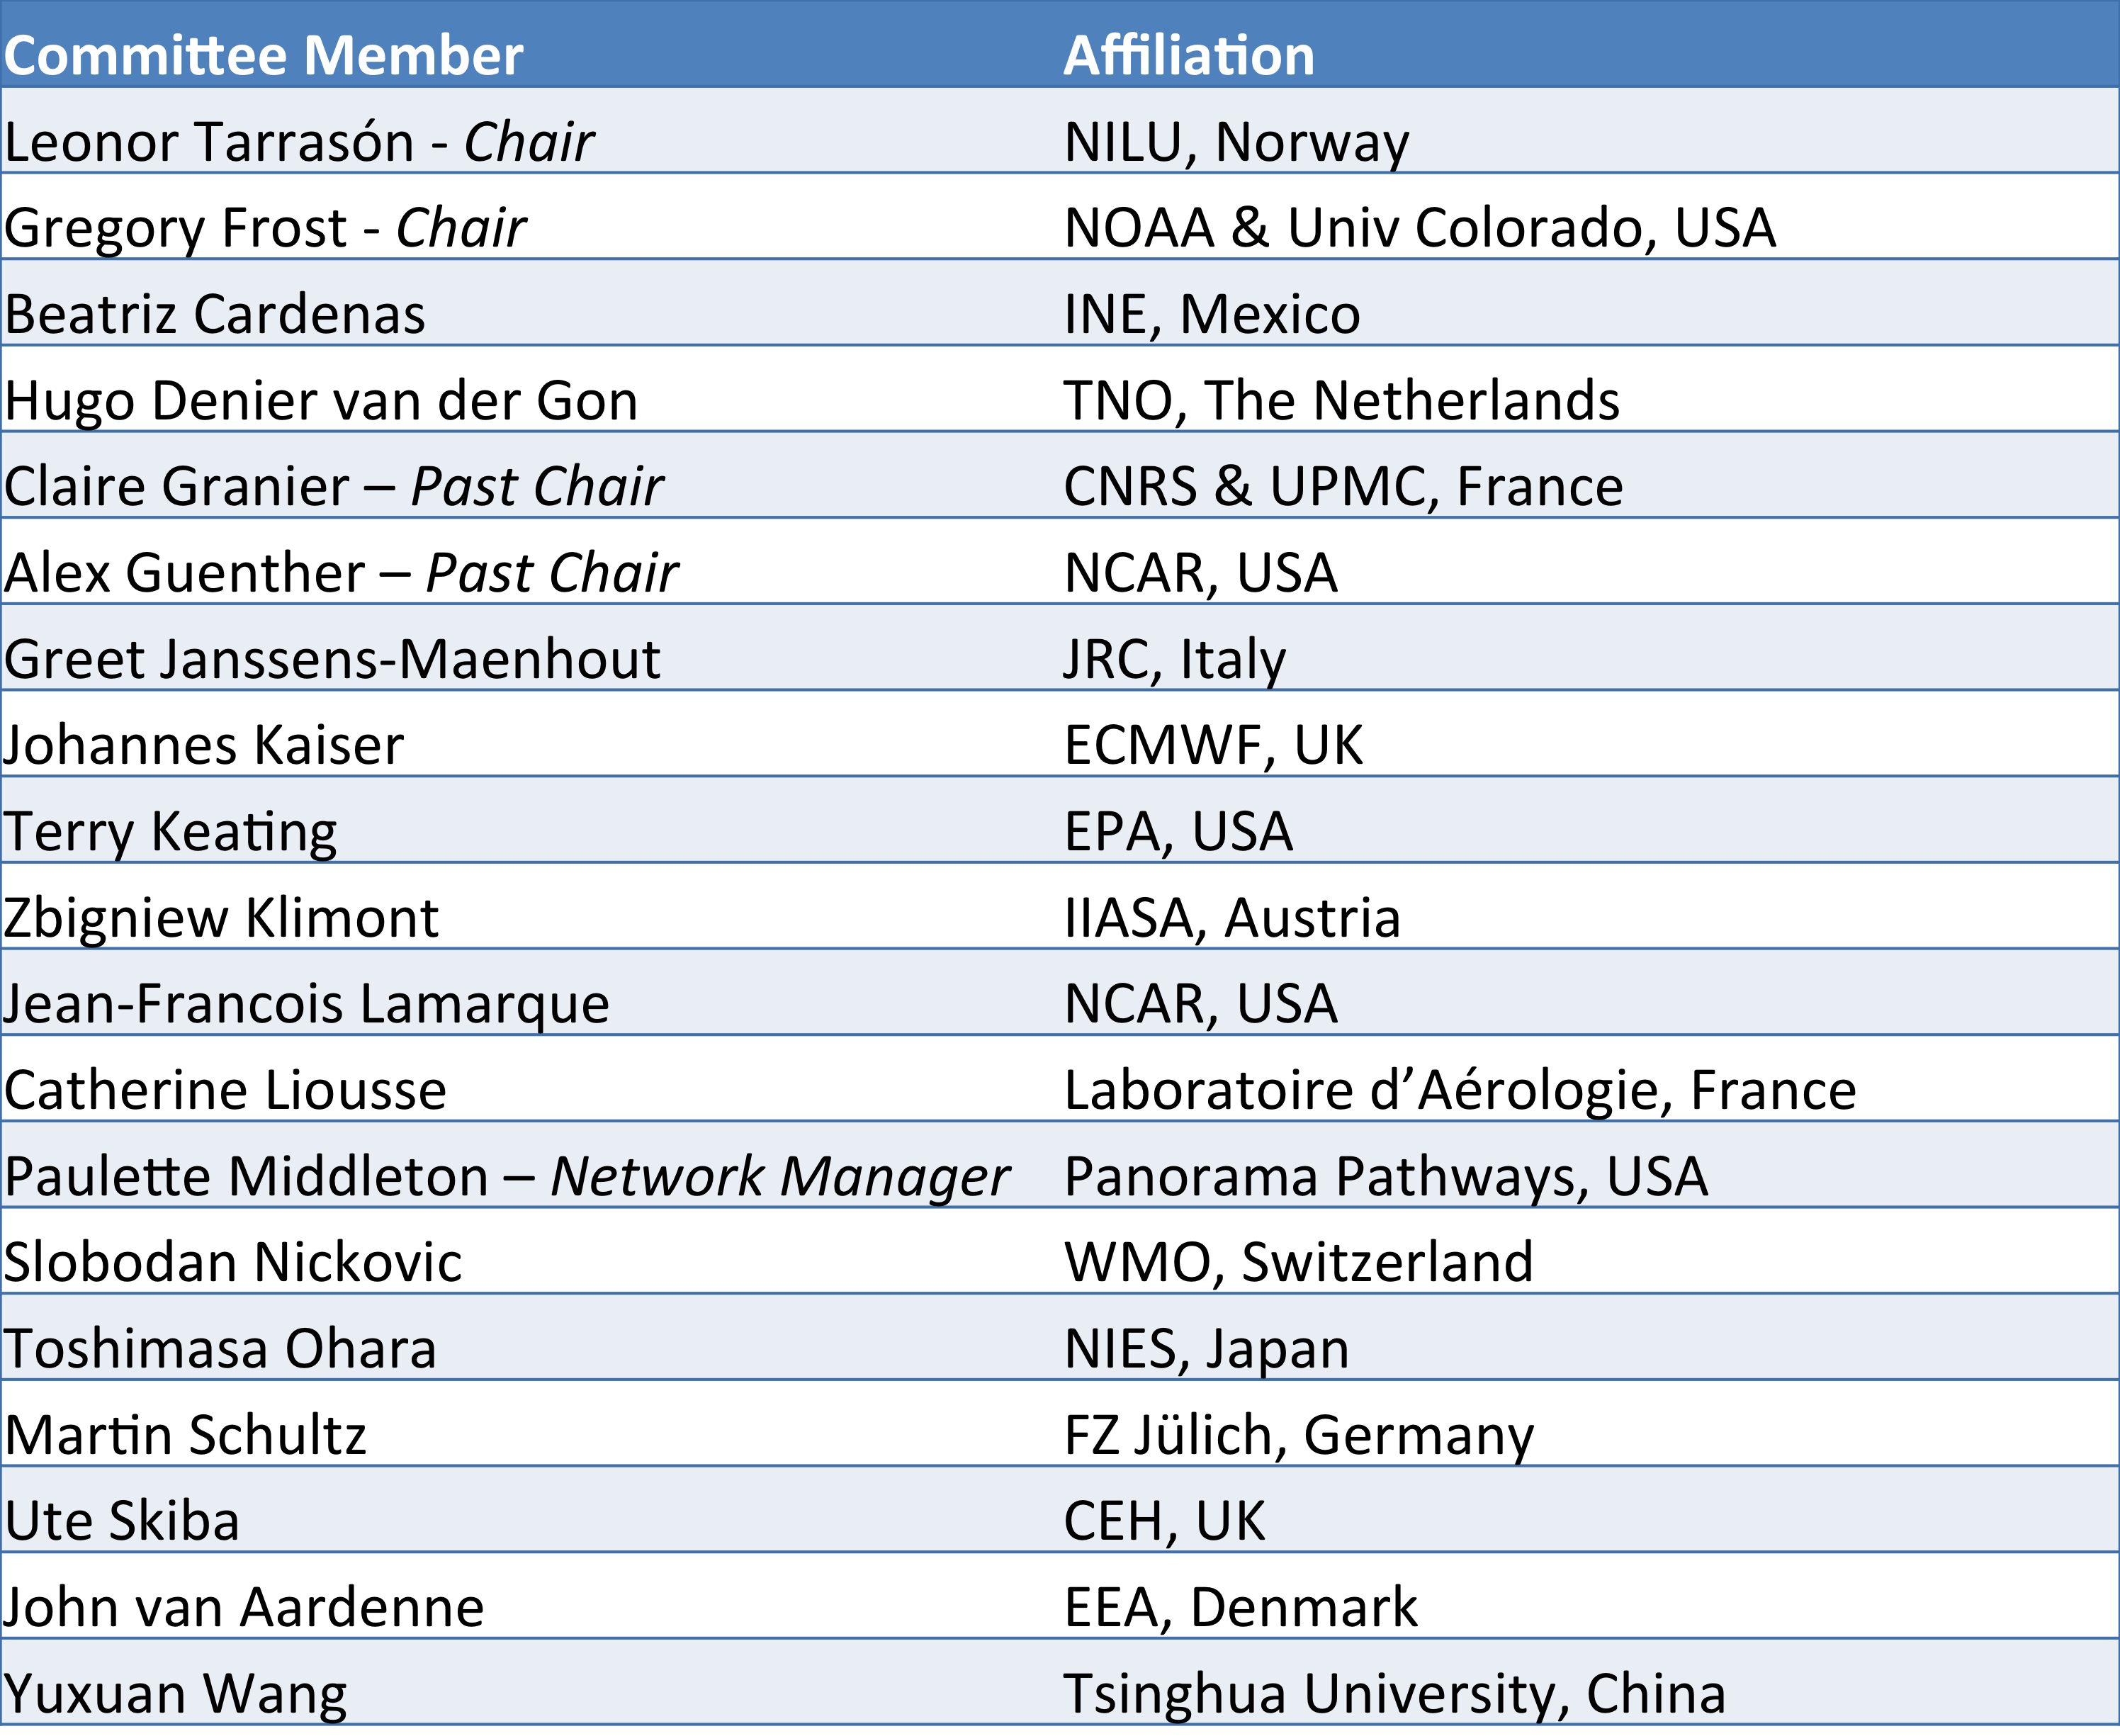
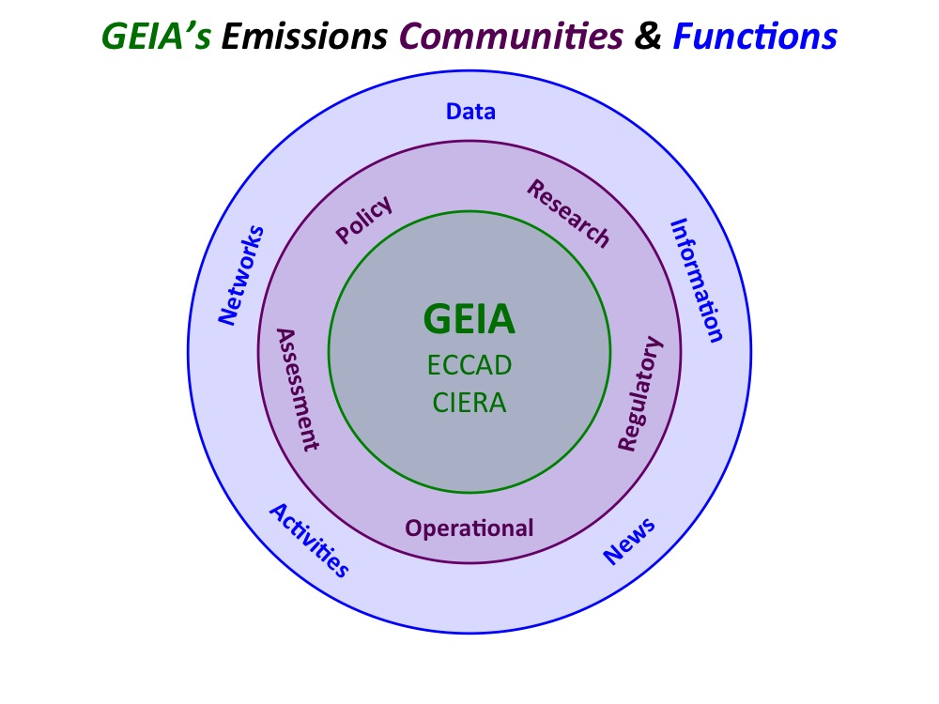
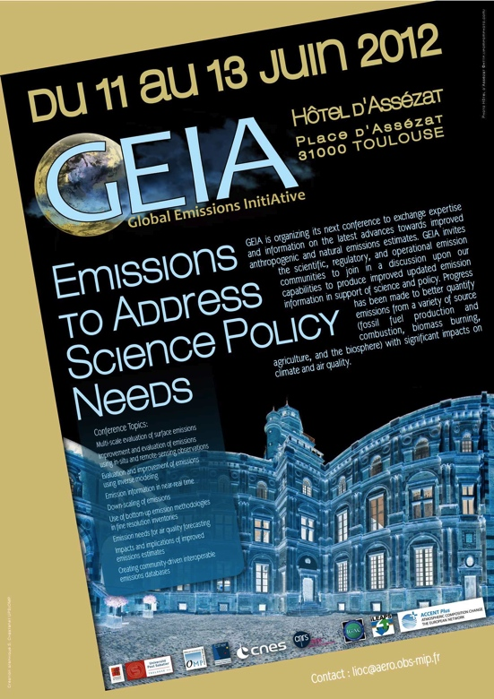
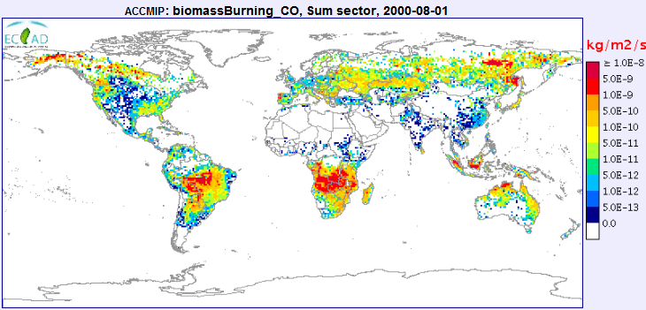
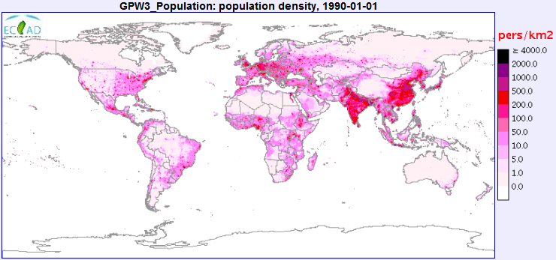
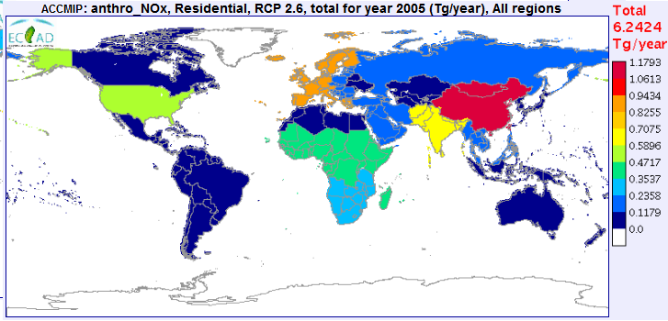
Addressing Science and Policy Needs with Community Emissions Efforts
Gregory J. Frost⁽¹⁾, Leonor Tarrasón⁽²⁾, Claire Granier^{(1,3,4)}, and Paulette Middleton⁽⁵⁾
(1) ESRL/NOAA & CIRES/Univ. Colorado, Boulder, Colorado, USA (2) Norwegian Institute for Air Research (NILU), Kjeller, Norway
(3) LATMOS-IPSL, CNRS/INSU, Univ. Pierre et Marie Curie, Paris, France
(4) Max Planck Institute for Meteorology, Hamburg, Germany
(5) Panorama Pathways, Boulder, Colorado, USA
Email addresses:
gregory.frost@colorado.edu
Paulette@PanoramaPathways.net
claire.granier@latmos.ipsl.fr
leonor.tarrason@nilu.no
Abstract
Motivation
Emissions Information Challenges
The Global Emissions InitiAtive (GEIA, http://www.geiacenter.org/), a joint IGAC/iLEAPS/AIMES initiative of the International Geosphere-Biosphere Programme, has served as a forum for the exchange of expertise and information on emissions for more than two decades, providing a solid scientific foundation for atmospheric chemistry research. GEIA’s interactive emissions data portal, ECCAD (Emissions of chemical Compounds & Compilation of Ancillary Data, http://pole-ether.fr/eccad), provides consistent access to emission inventories and ancillary data with easy-to-use tools for analysis and visualization. CIERA (Community Initiative for Emissions Research & Applications, http://ciera-air.org/) is a GEIA community project to develop interoperability in emissions datasets and tools and to support evaluations of inventories. GEIA’s vision is to help build a bridge between environmental science and policy, by bringing together people, data, and tools to create and communicate the highest quality information about emissions.
Actions and decisions about the atmosphere focus on emissions
Many emissions data requirements are common to air quality and climate research, regulation, & policy
Transparency
Consistency
Accuracy
Timeliness
Uncertainty
At the same time, there are many issues and needs associated with emissions data
High quality emission information is needed to calculate past, present, and future atmospheric composition, to assess impacts on air quality and climate, and to take action and make choices about pollution controls. Emissions are tools not only of science and environmental policy, but also of economics, foreign policy, and international diplomacy.
Need to broaden accessibility and improve quality of emissions data while maximizing sparse resources
Complexity
Spatial/temporal scales
Source types
Interdisciplinary
Development
Inconsistencies
Timeliness
Traceability
Analysis
Evaluations
Uncertainties
Impacts
Communication
Data access and sharing
Literature access
Producer – user feedbacks
G. J. Frost, et al. (2012) New Directions: Toward a Community Emissions Approach, Atmospheric Environment, 51, 333–334
GEIA, the Global Emissions InitiAtive
http://www.geiacenter.org/
GEIA’s Ongoing Activities
GEIA’s strong foundation for future emissions work
GEIA Vision: The Science – Policy Bridge
Founded in 1990 to quantify anthropogenic emissions & natural exchanges of trace gases & aerosols and to facilitate the use of this information by the research, assessment, & policy communities
Provides consistent access to global & regional emission inventories
Maintains worldwide network of emissions developers & users
Organizes meetings & schools for emissions community
Facilitates emissions data evaluations & state-of-the-science summaries
Helps meet emissions needs of international scientific projects
Support: NASA, IGAC, NOAA
GEIA Network
Science
Policy
Emissions
GEIA’s vision is to help build a bridge between environmental science and policy, by bringing together people, data, and tools to create and communicate the highest quality information about emissions.
GEIA Steering Committee 2012-2014
1300 data developers and users worldwide
15th GEIA Conference
11-13 June 2012, Toulouse, France
The Conference brought together GEIA’s global network of emissions information developers & users representing 25 countries.
The latest emissions research efforts were shared in 90+ presentations on evaluation & improvement of energy sector, traffic sector, fire and natural emissions, creating community interoperable emissions databases, and impacts & implications of improved emissions estimates.
Emission information capabilities and needs were discussed in an interactive Town Hall and Steering Committee meeting.
Conference proceedings available at http://www.geiacenter.org/
Next GEIA Conference: June 2014, Boulder, Colorado
ECCAD
Emissions of chemical Compounds & Compilation of Ancillary Data
http://ciera-air.org/
http://pole-ether.fr/eccad
CIERA
Community Initiative for Emissions Research and Applications
Major GEIA Future Activities*
Analysis
Translate new emissions challenges into emissions databases
Establish virtual clearinghouse of emissions evaluation strategies
Facilitate project-based work to improve emissions information
Access
Implement interoperability for emissions datasets and tools
Expand datasets available through GEIA portals
Community
Reach out to the emissions community
Facilitate stronger relationships between science & policy
Build emissions information capacity worldwide
GEIA’s interactive emissions data portal
GEIA’s emissions collaboration space
Provides consistent access to GEIA’s emission inventories and ancillary data with easy-to-use tools for analysis and visualization
Contributes to EU science & forecasting projects
Support: French National Center for Space Studies (CNES)
PIs: Claire Granier, Cathy Liousse
Developing interoperability between inventories, observations and models
Designing emissions metadata
Facilitating emissions analysis & evaluation
Communicating emissions information
Leveraging developments from information technology community
Support: EPA, NOAA, ESIP, Northrop Grumman
Point of Contact: Greg Frost
Technical Development: Ann Keane, Stefan Falke, Ed Fialkowski
Distributed Emissions Data System
Inventories, observations, model output
Emissions Inventories
Web standards for exchanging data
*The GEIA Steering Committee is formulating GEIA’s long-term vision and strategy, guided by input from the GEIA Communities, and built on a strong foundation of ongoing GEIA-ECCAD-CIERA & related work. This will be articulated in an upcoming New Directions article in Atmospheric Environment.
Relational database provides consistent access to many global & regional inventories
Tools that visualize, analyze data
Get Involved with GEIA
Ancillary Data
Conceptual model for interoperability of datasets & tools
Access to ancillary data used to construct emissions inventories: population, vegetation, & fire data
Partners in Interoperability Development
Use and contribute datasets, tools, and policy-relevant information available through GEIA portals.
Join GEIA working groups and propose new ones.
Contribute to GEIA outreach, communication and strategic planning.
For more information, contact a GEIA representative at the email addresses listed at the top of the poster.
Communities of Practice
Interactive Graphical Tools
http://www.esipfed.org/
http://wiki.esipfed.org/index.php/GEO_AQ_CoP
Online maps, time series, and data analysis
Rudy Husar et al.
http://datafed.net
Development Nodes
Martin Schultz et al.
http://ogc-interface.icg.kfa-juelich.de:50080

