Slide 1
OPULS
Town Hall
Thursday @ 3:30

Slide 2
OPeNDAP
Unidata
NOAA

Slide 3
Notes:
What is the OPULS project? When you read the project summary, one thing stands out: OPULS is about data.
OPULS is: “OPeNDAP Unidata Linked Servers” project
It’s goals are to “embrace data provision, via Web-based servers, as well as data access via browsers and applications, the latter being valuable underpinning for data analysis, data visualization and even data synthesis (creating new data by merging or otherwise adding value to existing data). These capabilities serve large communities of scientists, educators and…” the private sector.

Slide 4
data analysis
&
synthesis

Slide 5
data
web
&
your input

Slide 6
data model
DAP4
web services

Slide 8
Neutral
Specific
Domain

Slide 9
Neutral
Specific
Domain

Slide 10
interoperability

Slide 11
layers

Slide 12
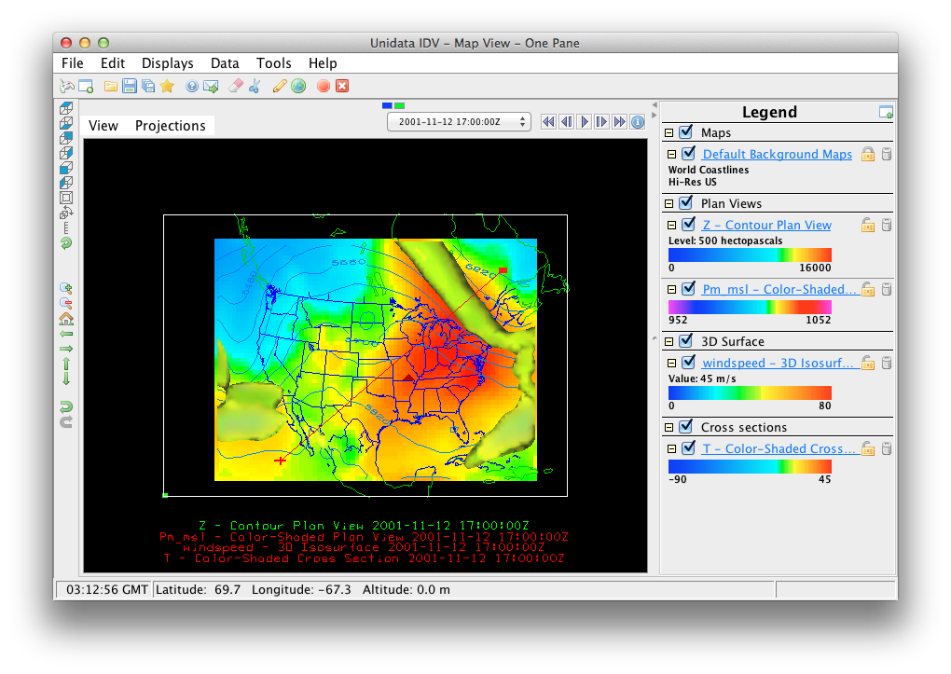

Slide 13
catalog
search
subscription

Slide 14
web services
ecosystem

Slide 15
server processing
(functions)

Slide 16
standardization
=
utility

Slide 17
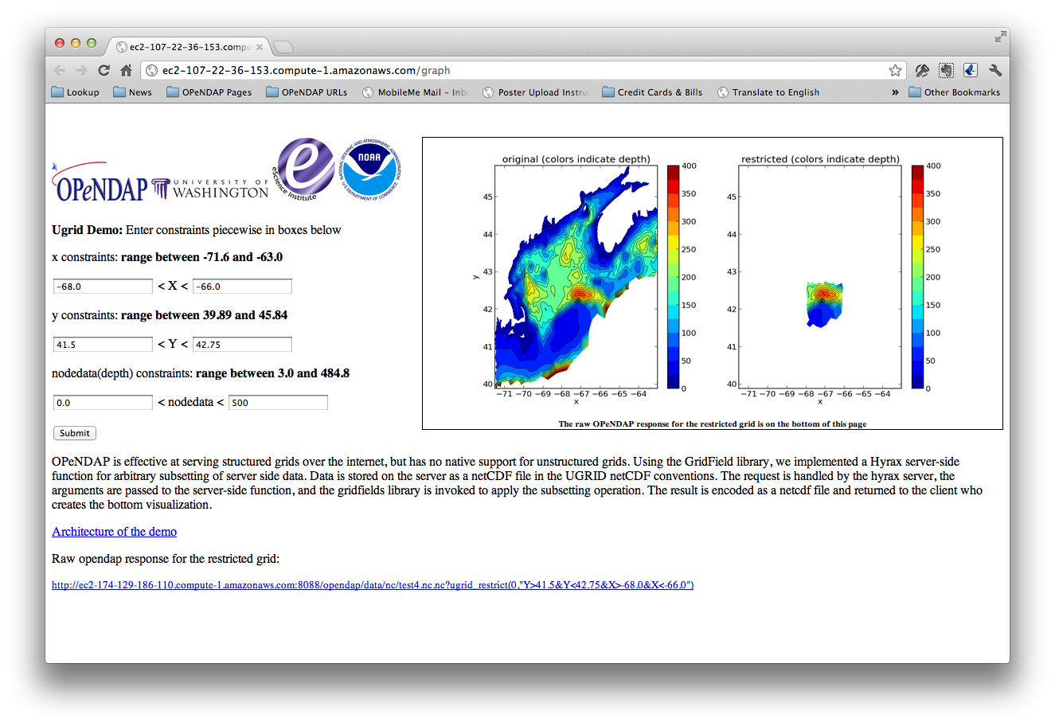

Slide 18
Notes:
In OPULS we are seeking community input for both web services and server processing functions. We want to know what should be part of the DAP4 protocol suite based on your experience.

Slide 19
Notes:
In OPULS we are seeking community input for both web services and server processing functions. We want to know what should be part of the DAP4 protocol suite based on your experience.

Slide 20
Town Hall
Rm 227
Thursday @ 3:30

