Slide 1
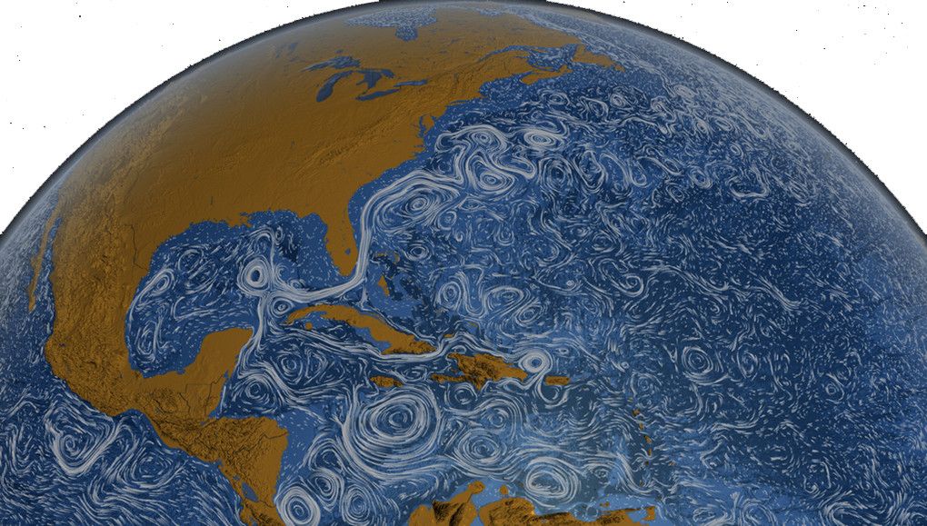
Using NASA Resources to Promote Climate Literacy
Dana Haine, MS
UNC-Chapel Hill Institute for the Environment
Principal Investigator, NC CLIMATE Fellows Program
A NASA Innovations in Climate Education Program

Slide 2
Next Generation Science Standards DCI: Global Climate Change
Though the magnitudes of human impacts are greater than they have ever been, so too are human abilities to model, predict, and manage current and future impacts.
Through computer simulations and other studies, important discoveries are still being made about how the ocean, the atmosphere, and the biosphere interact and are modified in response to human activities.

Slide 3
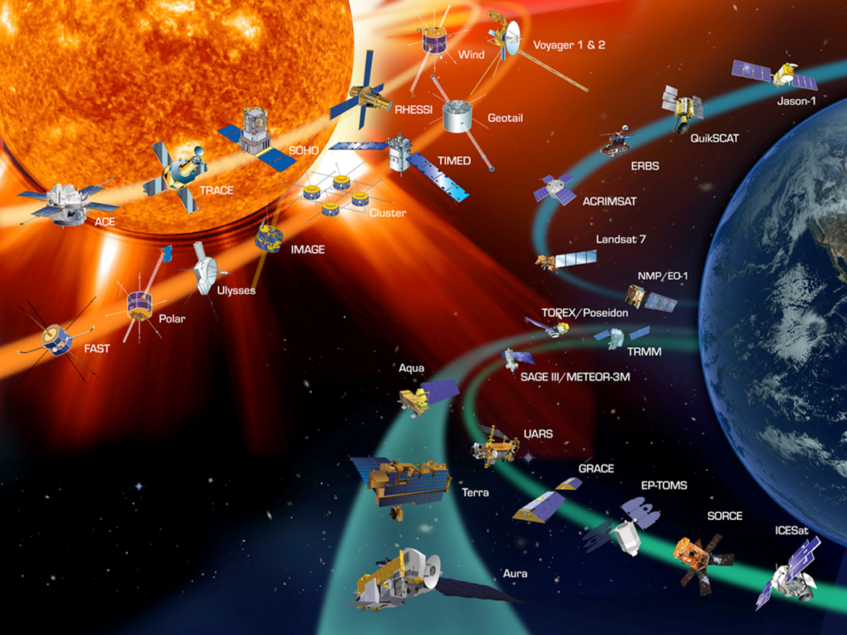
NASA Satellites in Orbit
http://climate.nasa.gov
Notes:
NASA currently has more than a dozen Earth science spacecraft/instruments in orbit studying all aspects of the Earth system (oceans, land, atmosphere, biosphere, cyrosphere), with several more planned for launch in the next few years. The OCO-2 was launched on July 2nd.

Slide 4
NASA: Orbiting Carbon Observatory Launched July 2, 2014
Will take more than 100,000 measurements of carbon dioxide in the Earth's atmosphere every day
Will provide the precision, resolution, and coverage needed to characterize CO₂ sources and sinks on regional scales
Will quantify CO₂ variability over the seasonal cycles year after year
"For society to better manage carbon dioxide levels in our atmosphere, we need to be able to measure the natural source and sink processes.”
-David Crisp, OCO-2 science team leader at NASA's Jet Propulsion Laboratory

Slide 5
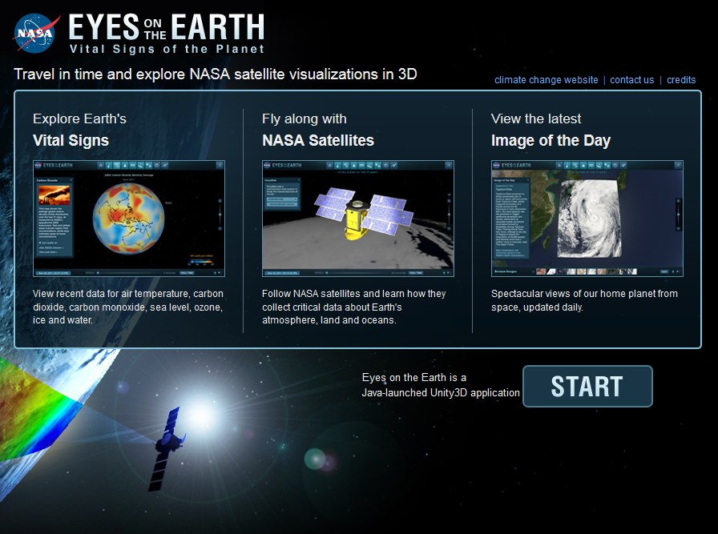
NASA’s Eyes on the Earth
http://eyes.jpl.nasa.gov/earth/

Slide 6
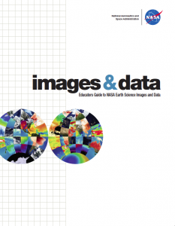
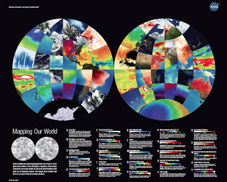
Educators Guide to NASA Earth Science Images and Data
http://nasaesw.strategies.org/wp-content/uploads/2013/08/EducGuide_508Fin.pdf

Slide 7
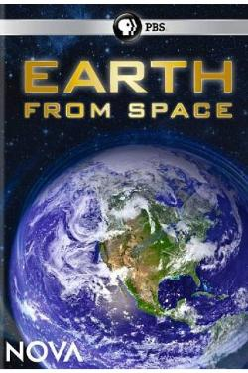
Produced in extensive consultation with NASA scientists, this 2 hour special reveals a spectacular new space-based vision of our planet.
http://www.pbs.org/wgbh/nova/space/earth-from-space.html

Slide 8
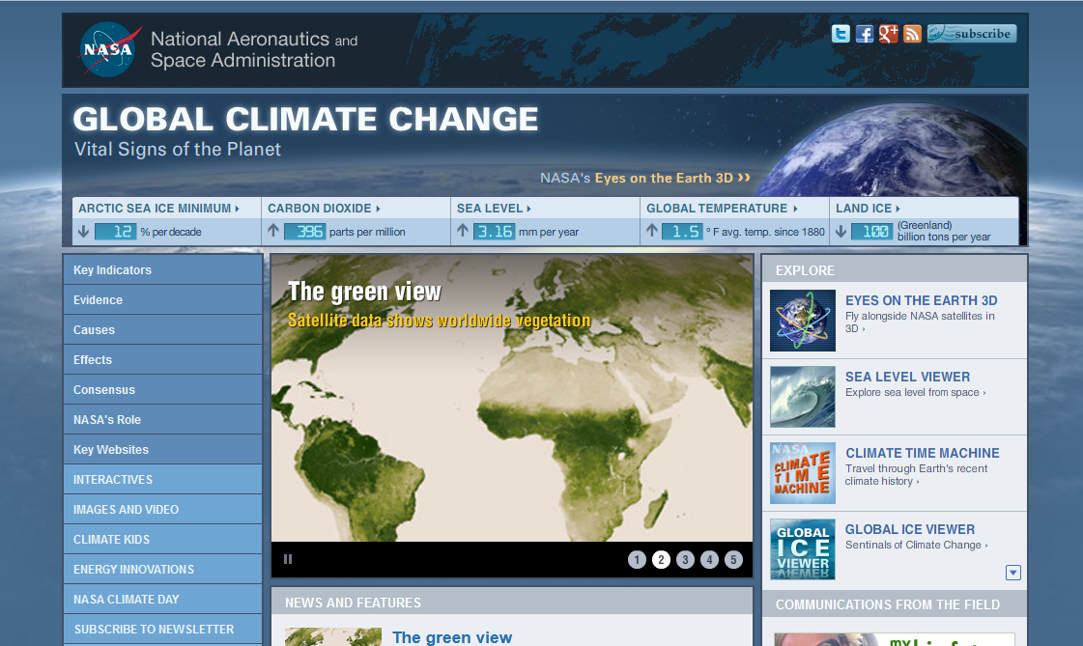
climate.nasa.gov/

Slide 9
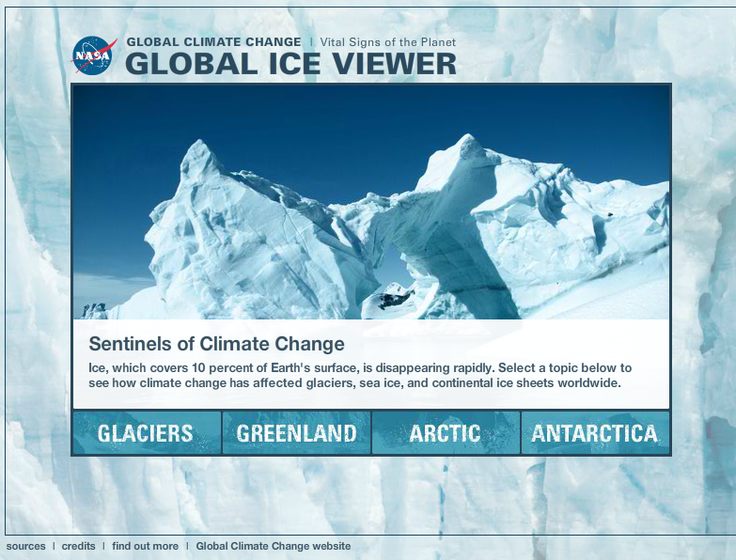
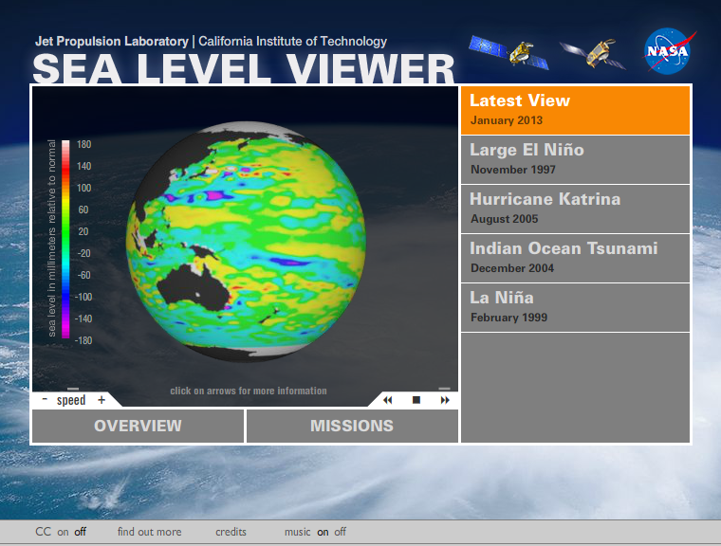
NASA Climate
Interactives

Slide 10
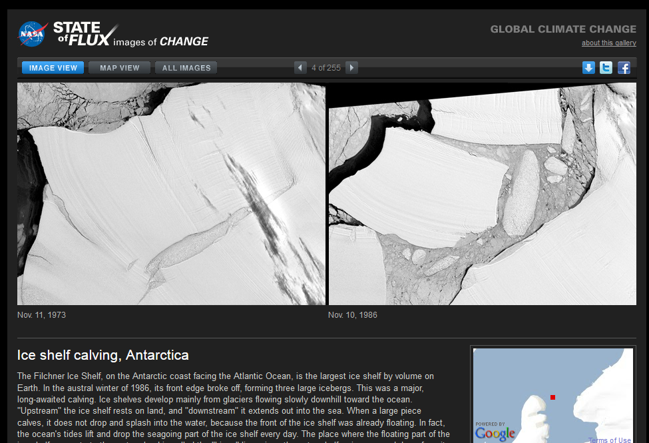
NASA’s Images of Change
http://climate.nasa.gov/state_of_flux

Slide 11
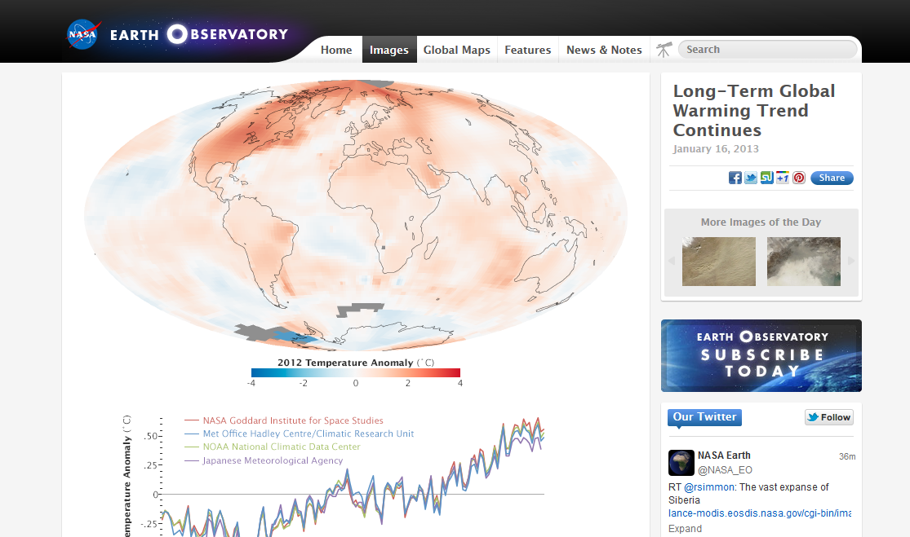
NASA’s Earth Observatory
http://earthobservatory.nasa.gov/

Slide 12
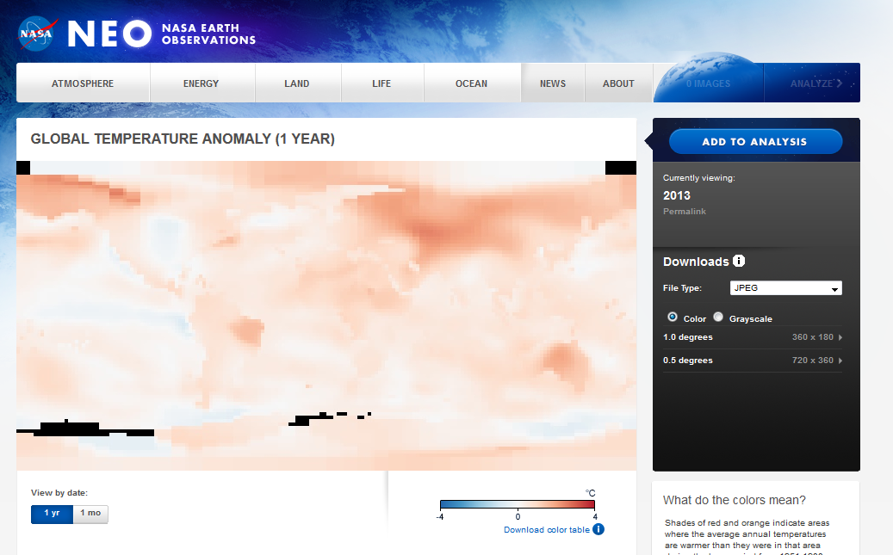
NASA Earth Observations
http://neo.sci.gsfc.nasa.gov/

Slide 13
Climate Essentials Multimedia Gallery
http://svs.gsfc.nasa.gov/Gallery/ClimateEssentials.html

Slide 14
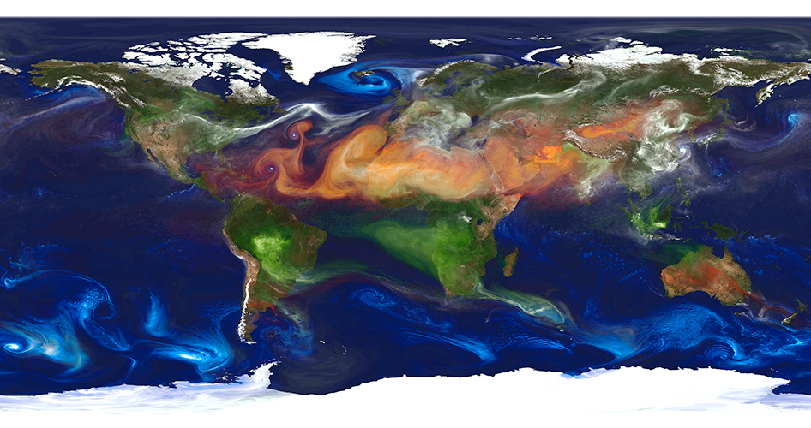
NASA’s Paint by Particle
http://svs.gsfc.nasa.gov/vis/a010000/a010900/a010977/

Slide 15
Data Enhanced Investigations for Climate Change Education
http://gdata1.sci.gsfc.nasa.gov/daac-bin/G3/gui.cgi?instance_id=DICCE-G_Basic

Slide 16
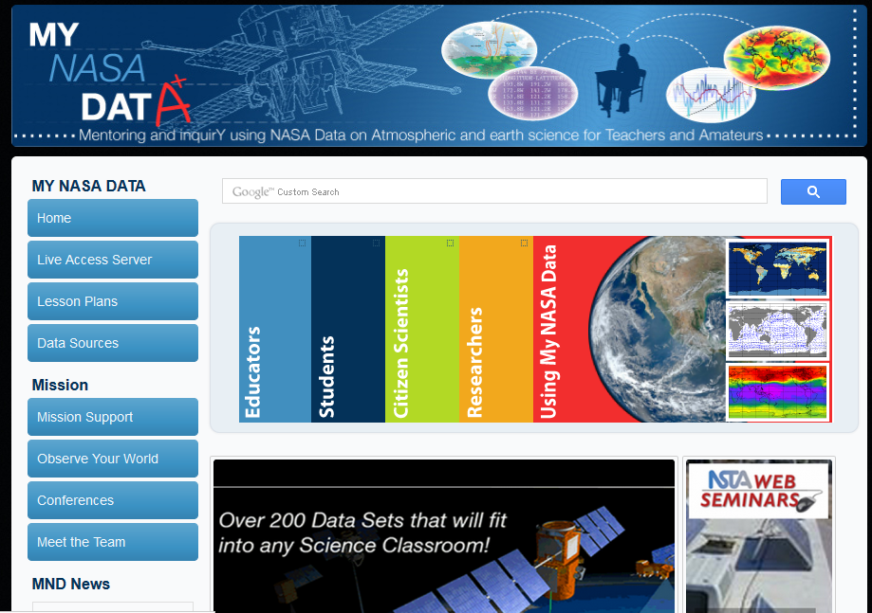
My NASA DATA
http://mynasadata.larc.nasa.gov/

Slide 17
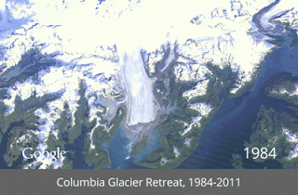
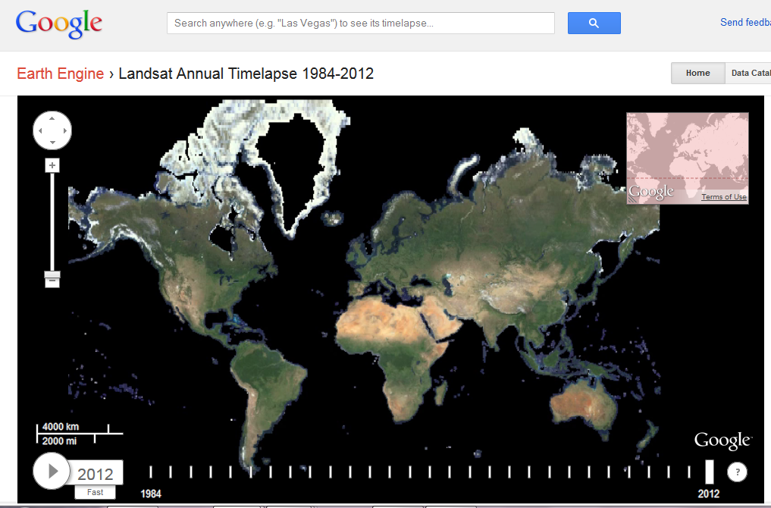
Timelapse powered by Google Earth Engine
http://world.time.com/timelapse/

Slide 18
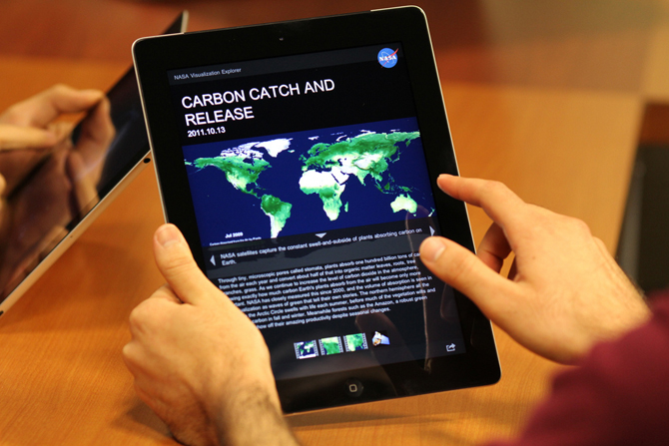
NASA Apps

Slide 19
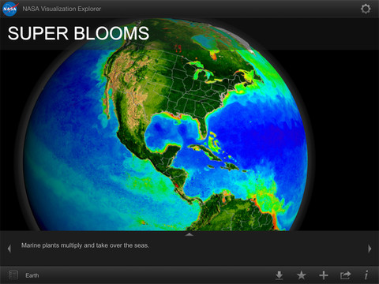
NASA’s Visualization Explorer

Slide 20
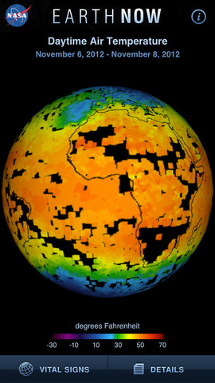
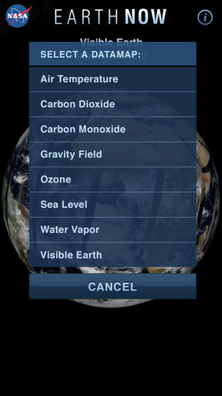
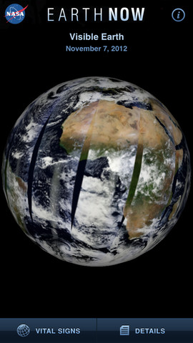
NASA’s Earth Now

Slide 21
Thank you!
Dana Haine, MS
UNC Institute for the Environment
Principal Investigator, NC CLIMATE Fellows
A NASA Innovations in Climate Education Program
dhaine@unc.edu
(919) 843-5735

