Slide 1

National Aeronautics and Space Administration
NASA Satellite data to compare your DRONE/UVA data to.
www.nasa.gov
Notes:
The beginning of the lesson

Slide 2

What is MY NASA DATA?
Get students studying and analyzing real science.
Enable K-12 teachers and students, as well as citizen scientists, to explore the large volumes of data that NASA collects about the Earth from space.
Students use scientific inquiry and math skills as they access and display microsets of the Earth System.
http://mynasadata.larc.nasa.gov

Slide 3
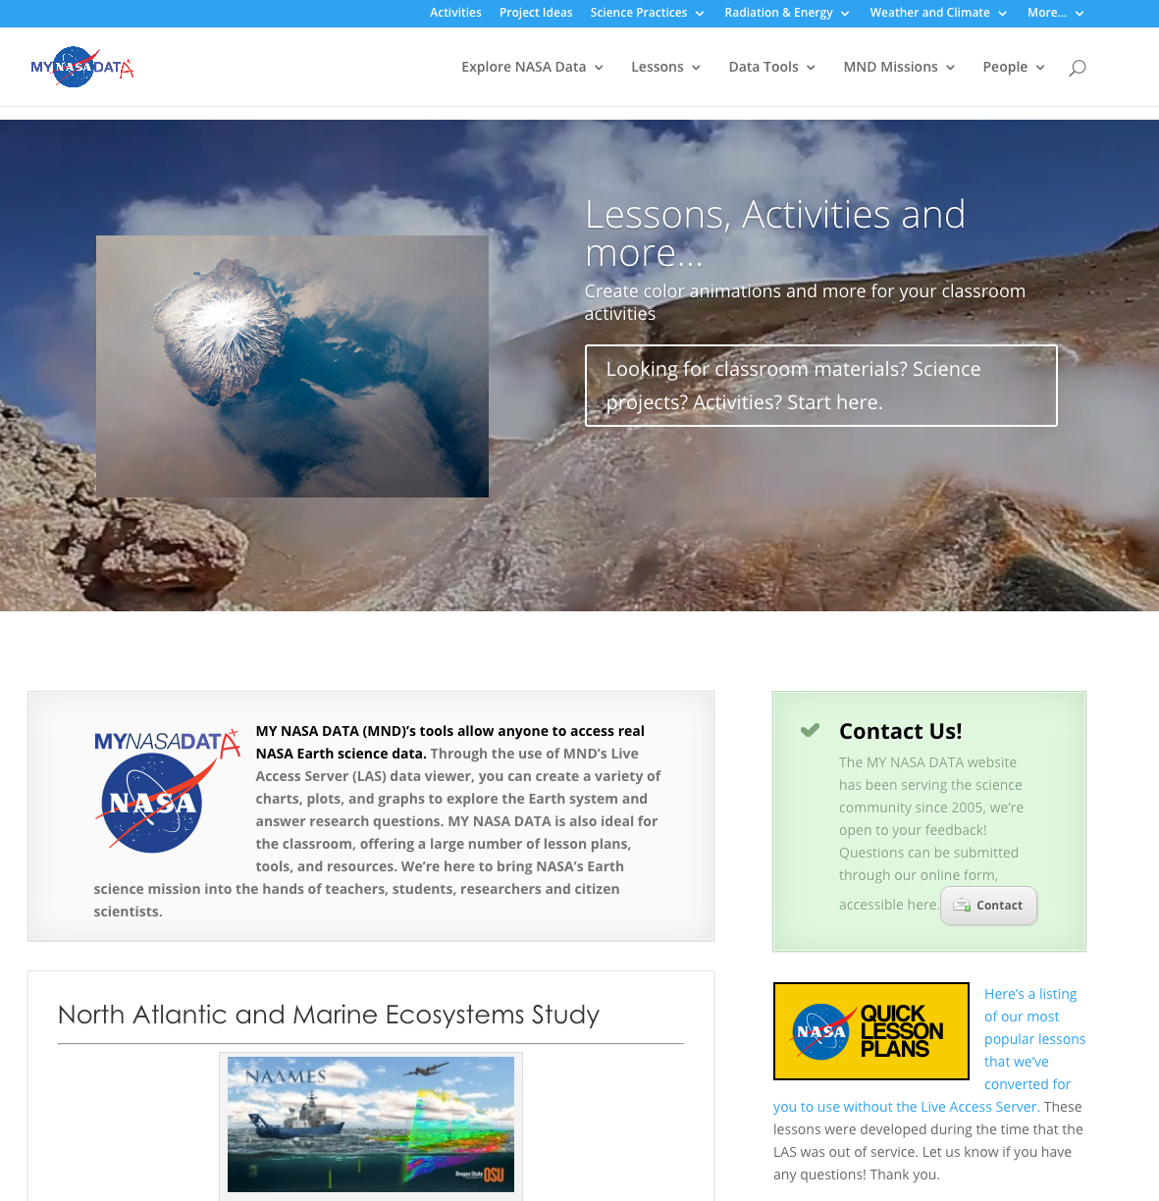

Slide 4
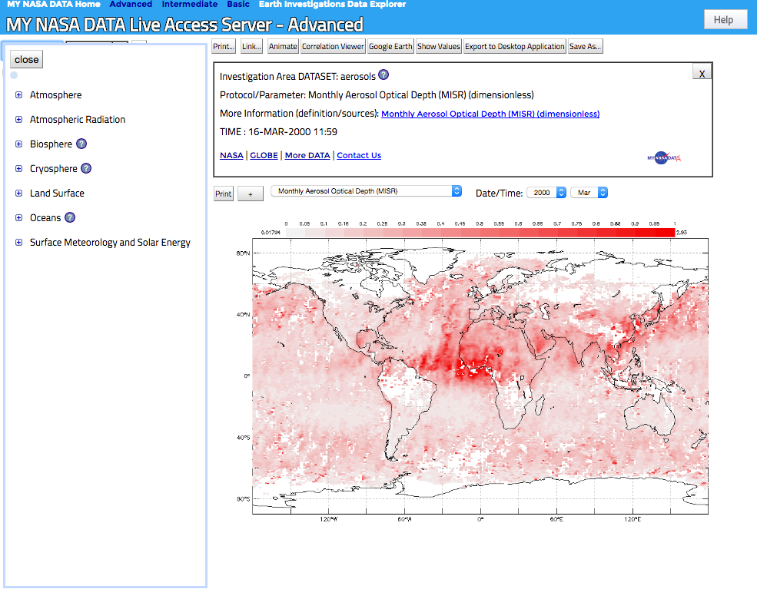
Color Maps: Default Plot option
Live Access Server: Choose Data Set

Slide 5
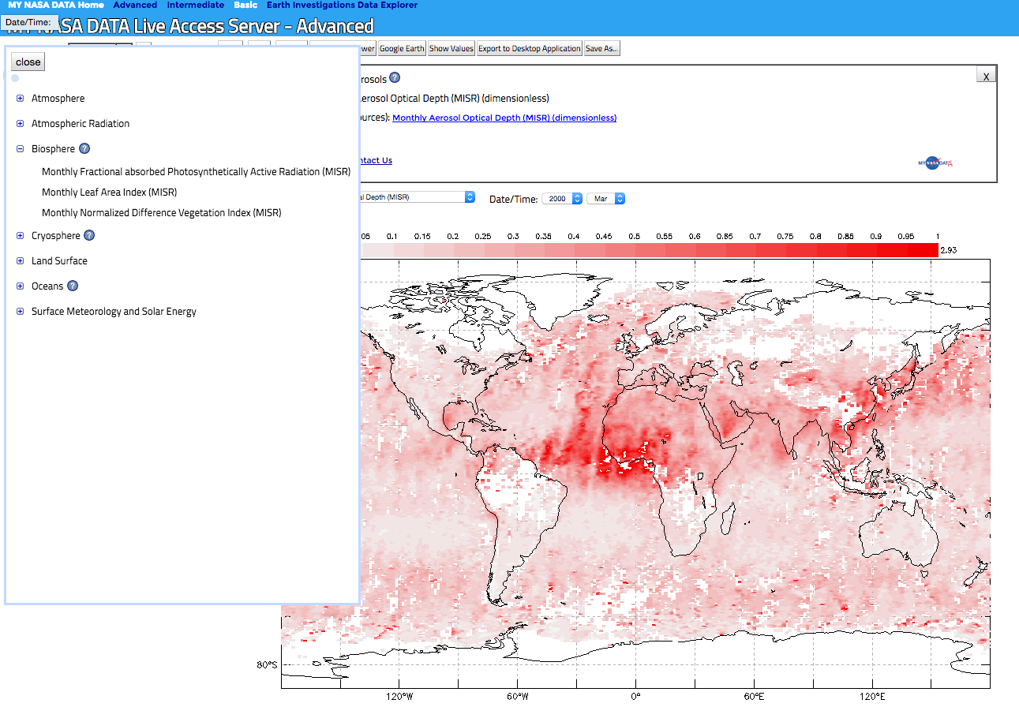
Choosing a Dataset

Slide 6
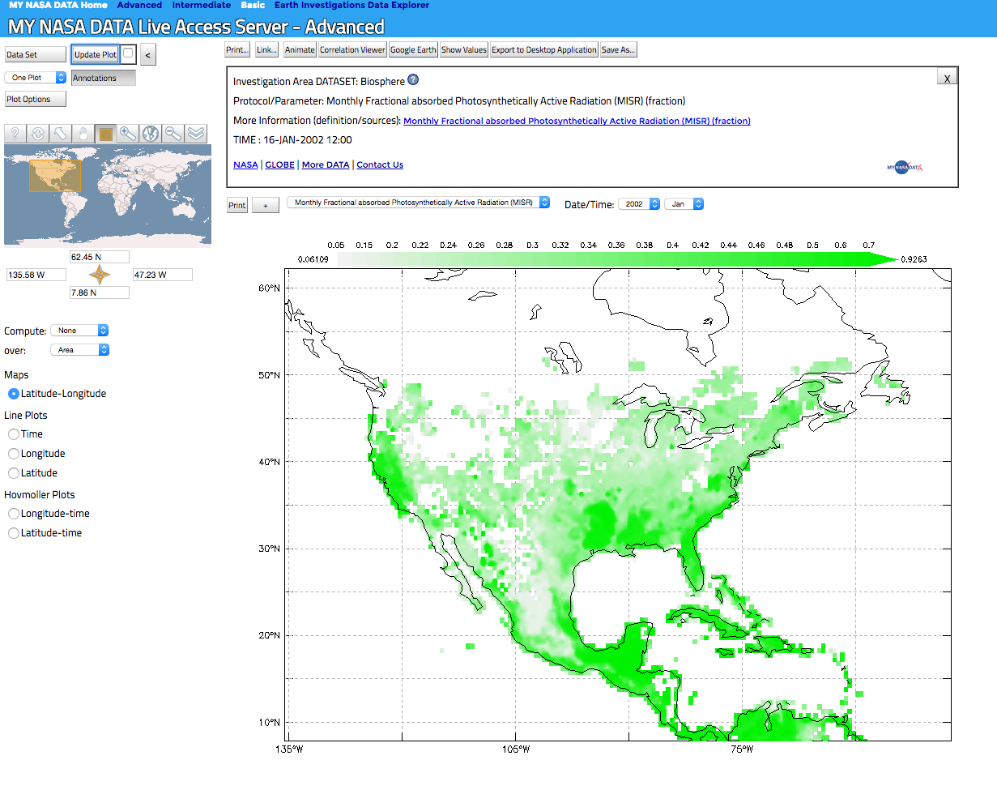
The Dataset that you are looking for.
Notes:
Here is what the procedures would look like in the actual lesson:
Part I: Use the Live Access Server to make daily data maps of SST for the Gulf of Mexico during and after the passage of Hurricane Rita. An example data map is provided above.
1. Click on the lesson link for the Live Access Server.
2. Click on Oceans, Daily Sea Surface Temperature (GHRSST). Click Next.
3. Enter the following coordinates in the compass rose fields below the navigation map, top-37.97N, right-60.47W, bottom- 1.41N, left-106.87W.
4. Select a date above the main map during or after the week of Rita. Click Update Plot in the upper left-hand corner.
5. Repeat for several consecutive days. Save or print your results.
6. Choose a day of interest and make note of the coordinates along the track of Rita where lowered SST is observed.

Slide 7
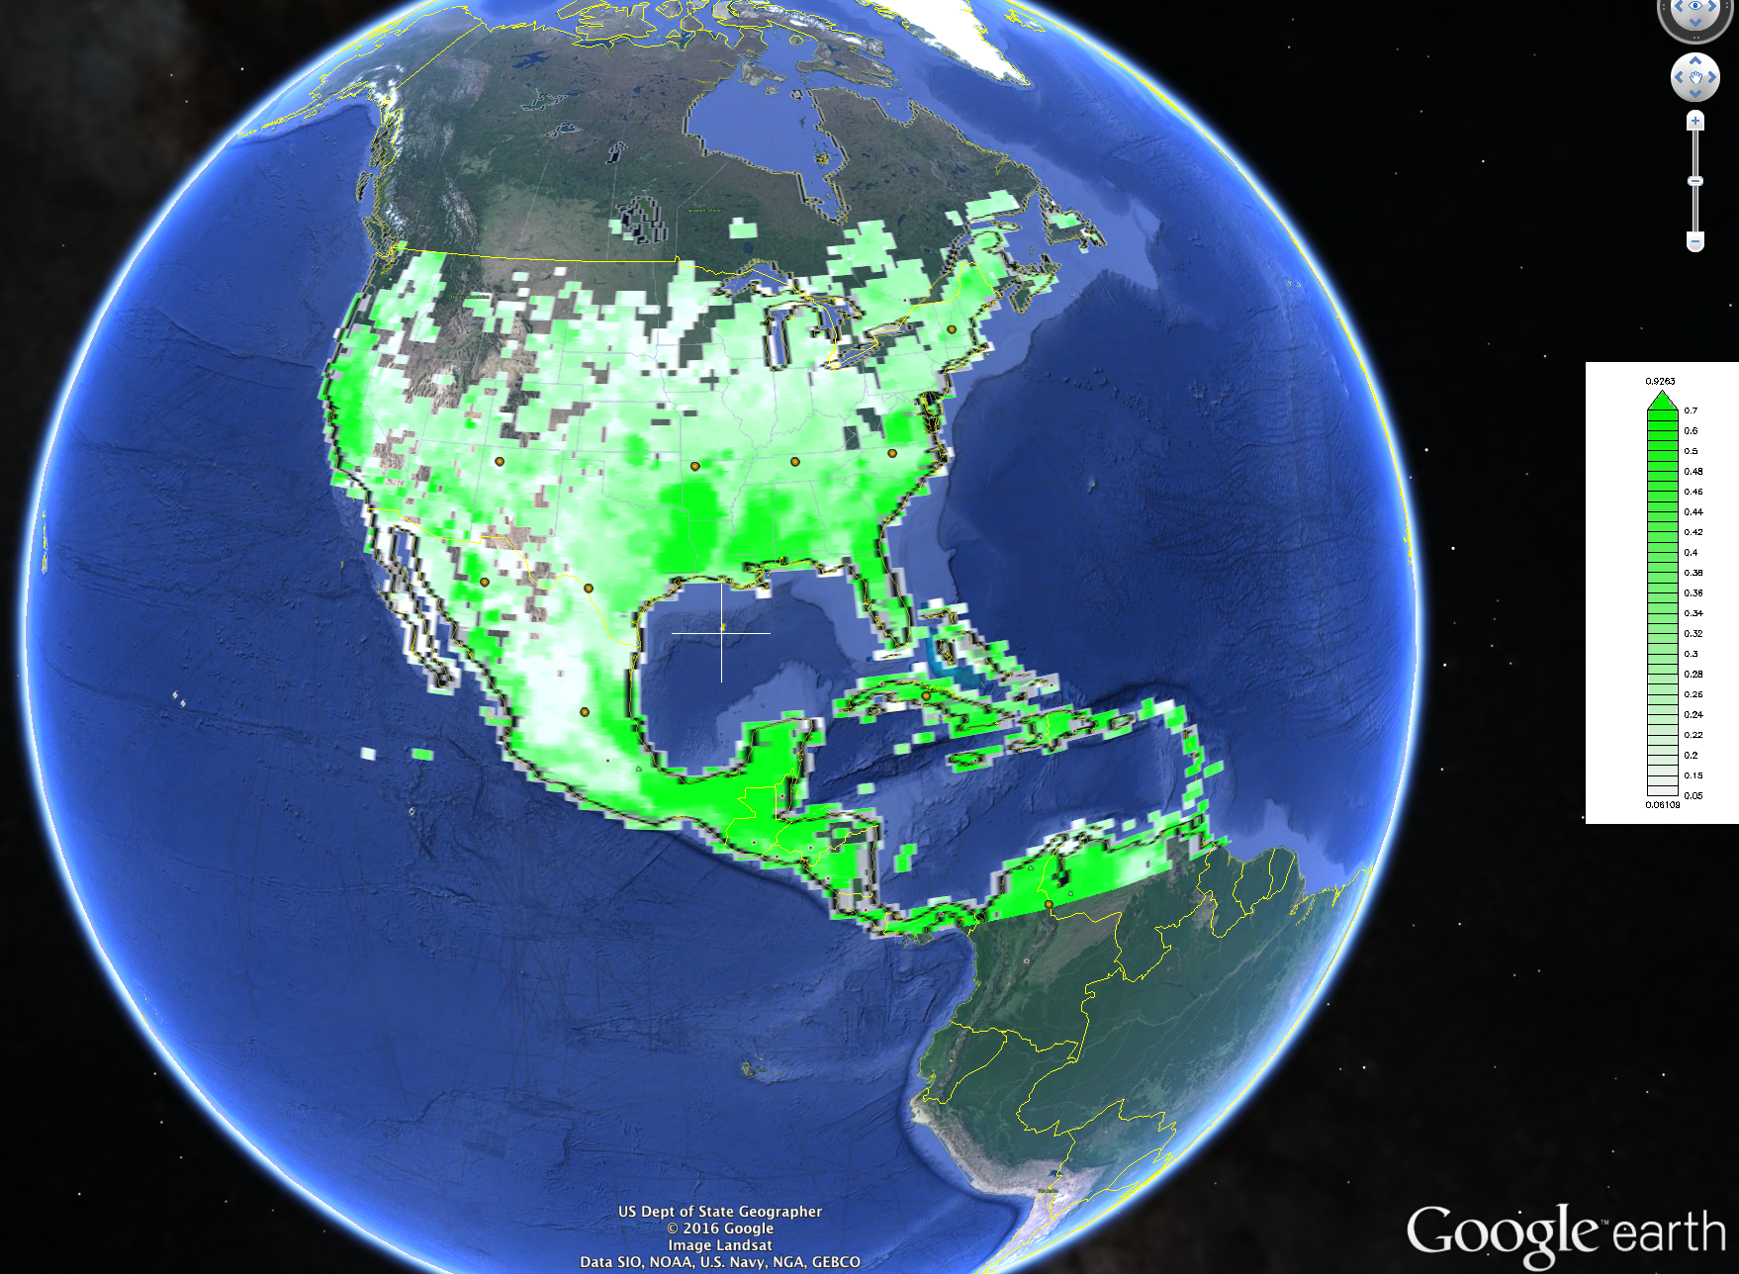

Slide 8
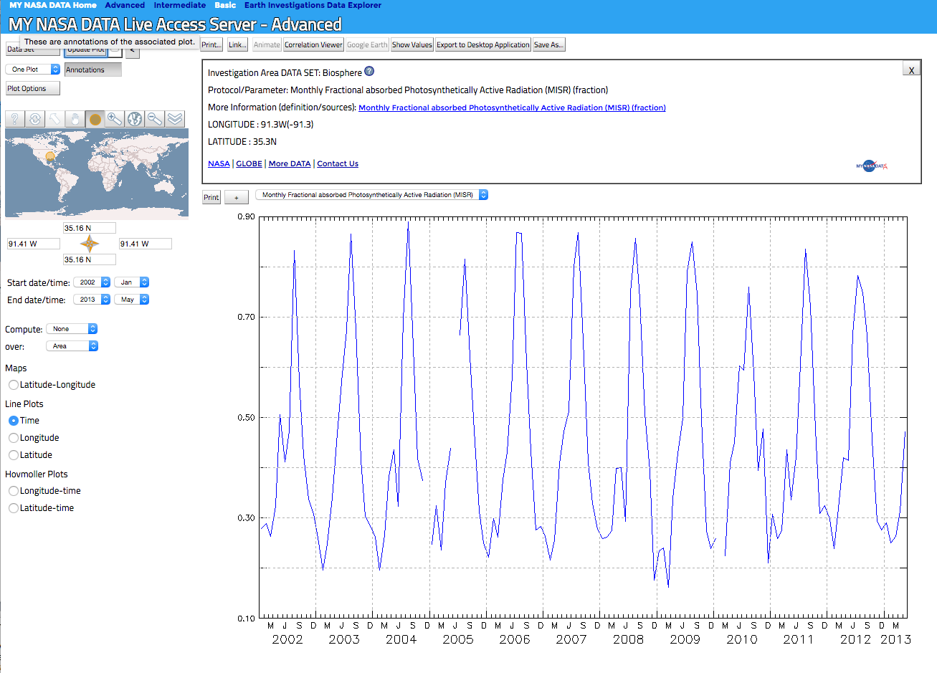
Now making it a line plot
Notes:
Can correlate your images to the seasons

Slide 9
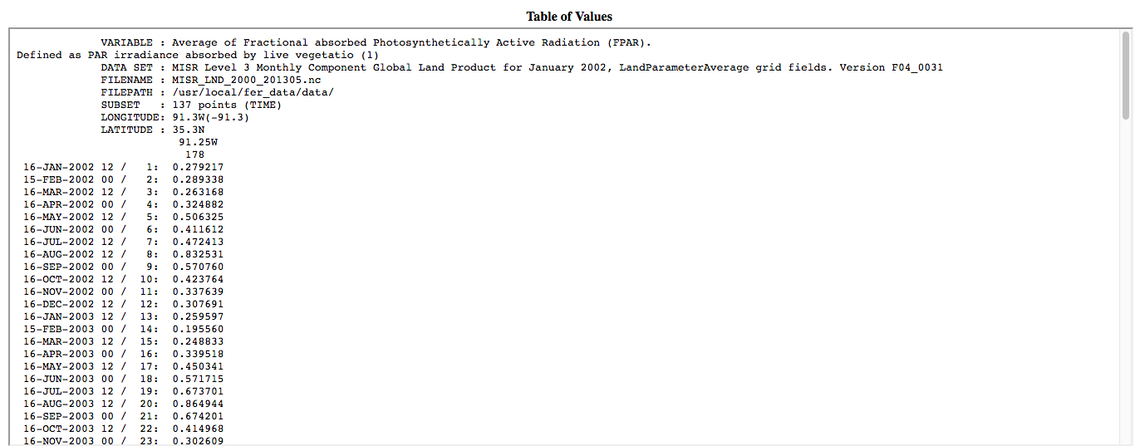
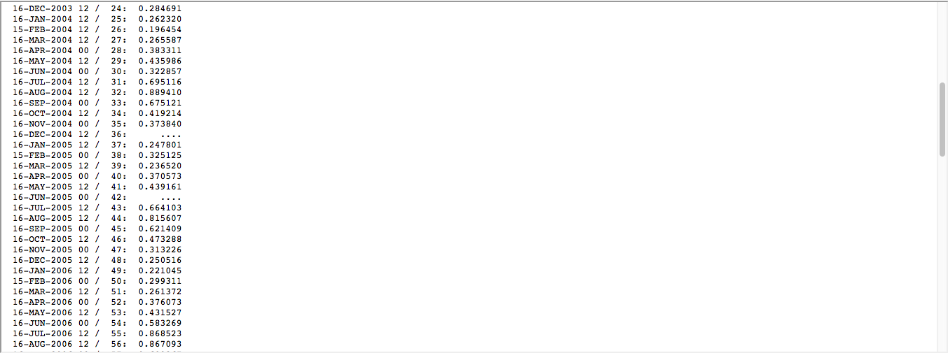

Slide 10

+
=
Limitless Place Based
Learning Opportunities

