Slide 1

Globus Genomics – Science as a Service for large scale NGS analysis
Ravi Madduri
madduri@anl.gov
Joint work with Paul Davé, Lukasz Lacinski, Alex Rodriguez, Dinanath Sulakhe, Ryan Chard and Ian Foster

Slide 2
Who We Are
Globus Genomics is developed, operated, and supported by researchers, developers, and bioinformaticians at the Computation Institute – University of Chicago/Argonne National Lab
We are a non-profit organization building solutions for non-profit researchers
Our goal is to support the advancement of science by bringing together our strengths and capabilities to help meet the unique needs of researchers and research institutions

Slide 3
90% of cancer patients carry a mutation that may be responsive to a known drug
Mark Rubin, Weill Cornell Medical College and NewYork-Presbyterian Hospital in New York in Nature, April, 2015

Slide 4

Trying to find a single causative gene for diseases with a complex genetic background is like looking for the proverbial needle in a haystack
– Nancy Cox
(Vanderbilt)
Notes:
http://sciencelife.uchospitals.edu/2013/10/28/testing-a-whole-haystack-to-find-more-needles/

Slide 5
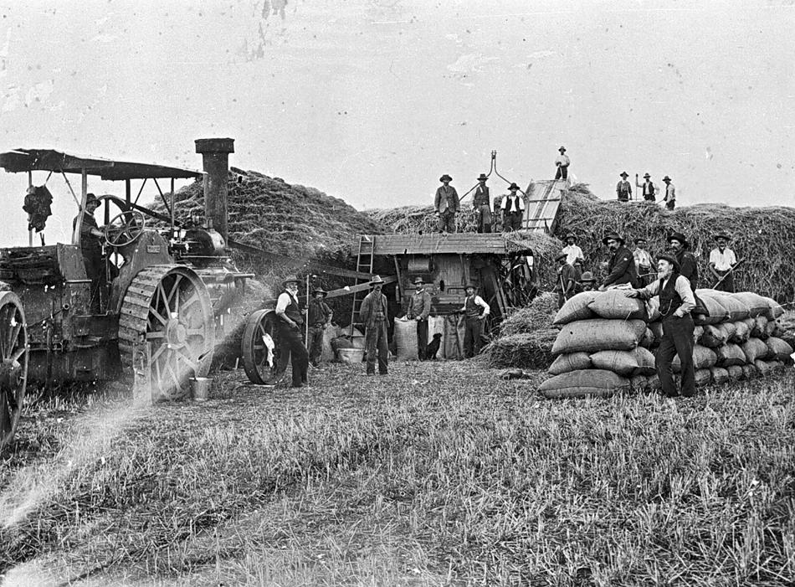
How do we accelerate discovery without requiring that every lab acquire a haystack-sorting machine?
Clayton & Shuttleworth thresher, 1910: Museum Victoria, Australia
Notes:
http://museumvictoria.com.au/collections/items/772499/negative-threshing-team-with-aveling-porter-traction-engine-bagging-grain-building-a-haystack-miners-rest-victoria-1910

Slide 6



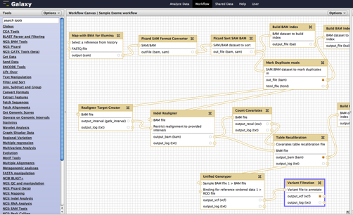


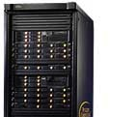
Our answer: Globus Genomics
Galaxy-based workflow management
Globus Genomics
Public
Data
Globus integrated within Galaxy
Web-based UI
Drag-Drop workflow creations
Easily modify workflows with new tools
FTP, SCP, others
Globus Online Endpoints
Fastq
Ref Genome
FTP, SCP, HTTP
Globus provides for
High-performance
Fault-tolerant
Secure
file transfer between
all data-endpoints
Galaxy
Data Libraries
Sequencing Centers
Sequencing Centers
Picard
Storage
FTP, SCP
SCP
Research Lab
Alignment
Analytical tools are automatically run on the scalable compute resources when possible
Seq Center
Local Cluster/
Cloud
GATK
Variant Calling
Globus Genomics on Amazon EC2
Data management
Data analysis
Notes:
Our goal is to operationalize key capabilities so researchers can depend on them. Think of Gmail for science..

Slide 7
Our Science Stack
Galaxy
  Interactive execution
  Creation, Execution, Sharing, Discovering Workflows
Globus
  Data management
  Identity Management
AWS
  HTCondor, Chef, EC2, EBS, S3, SNS
  Spot, Route 53, Cloud Formation
SaaS
PaaS
IaaS

Slide 8
Key Technical Bits
HTCondor
Computational Profiles for various analysis tools
Elastic Spot instance provisioner
Chef
Nagios + Munin
Support

Slide 9

Cox lab, UChicago
134 samples and 4 workflows
4 TB data
2200 core hours in 6 days
Notes:
We built this pipeline to create high quality variants using multiple genotyping algorithms

Slide 10
Olopade lab, UChicago
A profile of inherited predisposition to breast cancer among Nigerian women
Y. Zheng, T. Walsh, F. Yoshimatsu, M. Lee, S. Gulsuner,
S. Casadei, A. Rodriguez, T. Ogundiran, C. Babalola,
O. Ojengbede, D. Sighoko, R. Madduri, M.-C. King, O. Olopade
200 targeted exomes
200 GB data
76,920 core hours in 1.25 days
Notes:
http://abstracts.ashg.org/cgi-bin/2014/ashg14s.pl?author=madduri&sort=ptimes&sbutton=Detail&absno=140122328&sid=84013

Slide 11
Innovation Center for Biomedical Informatics - Georgetown
A case study for high throughput analysis of NGS data for translational research using Globus Genomics
D. Sulakhe, A. Rodriguez, K. Bhuvaneshwar, Y. Gusev,
R. Madduri, L. Lacinski, U. Dave, I. Foster, S. Madhavan
78 exomes from lung cancer study
2 TB data
125,936 core hours in 1.7 days
Notes:
http://abstracts.ashg.org/cgi-bin/2014/ashg14s.pl?author=madduri&sort=ptimes&sbutton=Detail&absno=140121535&sid=84013

Slide 12
















Other Globus Genomics users
Nagarajan Lab
Dobyns
Lab
Cox Lab
Volchenboum Lab
Olopade Lab

Slide 13
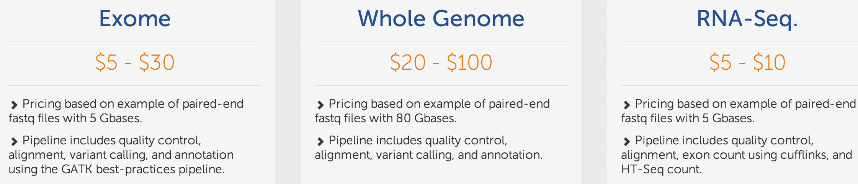
Costs are remarkably low
Pricing includes
  Estimated compute
  Storage (one month)
  Globus Genomics platform usage
  Support

Slide 14
Globus Genomics – Making it routine to find needles in NGS haystacks
www.globus.org/genomics

Slide 15
Other Examples of
Science as a Service
PDACS - Portal for data analysis services for cosmological simulations
CVRG Galaxy – Large-scale ECG Data Analysis
Globus Proteomics
eMatter – Material Science Simulations
FACE-IT - Framework to Advance Climate, Economic, and Impact Investigations with Information Technology (usefaceit.org)

Slide 16
More information on Globus Genomics:www.globus.org/genomics
More information on Globus: www.globus.org

Slide 17




Our work is supported by:
U.S. DEPARTMENT OF
ENERGY

Slide 18
Thank you!
@madduri

