Slide 1
Making Geoscience Data Accessible and Usable in Education
Tamara Shapiro Ledley
TERC, Cambridge MA

Slide 2
The Earth Exploration Toolbook (EET)
http://serc.carleton.edu/eet
The EET is a collection of computer based activities that feature Earth science datasets and data analysis tools.
EET chapters provide step-by-step instructions for accessing and analyzing data to explore issues or concepts in Earth system science.
44 EET chapters
Ledley et al, Science, 2011

Slide 3
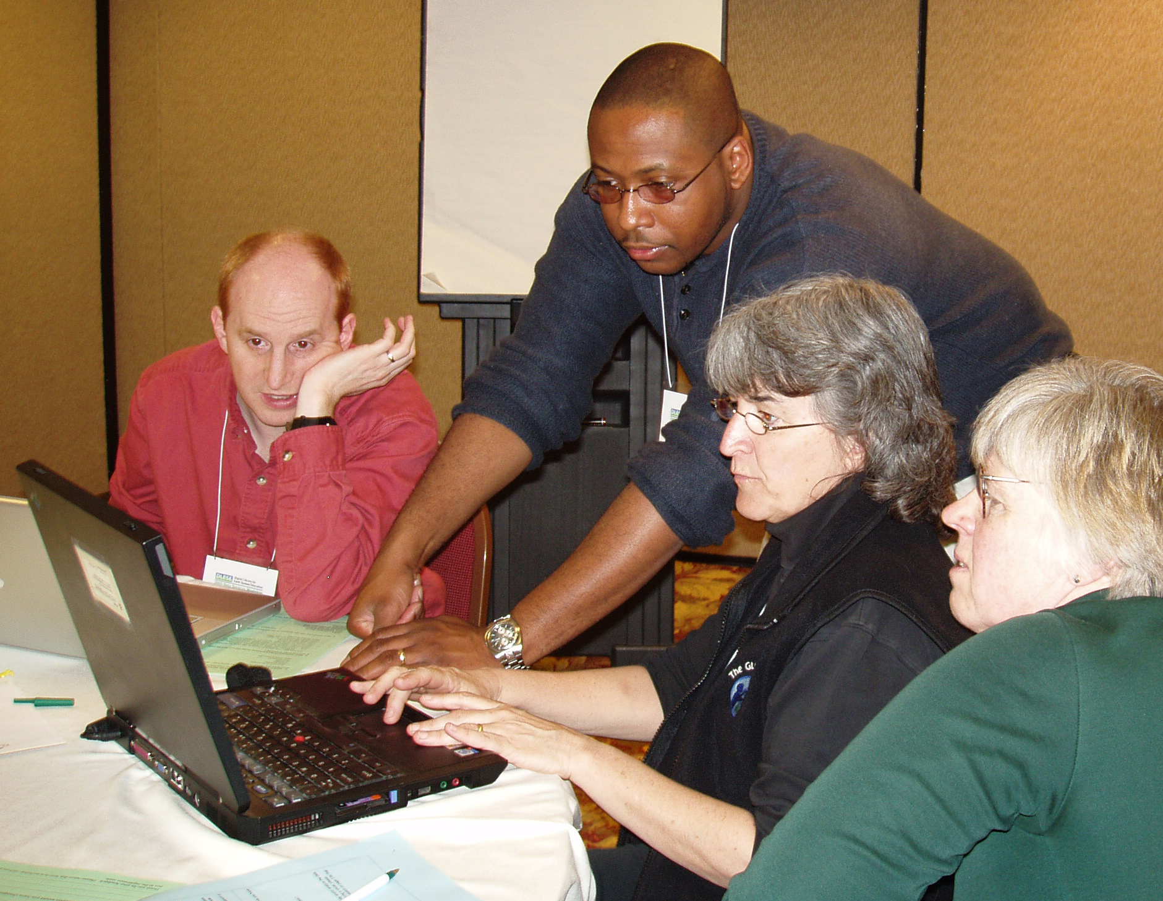
Model for Building Effective EET Chapters
Bridge the gap between the technical and educational communities concerning “data resources”
Facilitate the interaction of the scientific and educational communities in order to assure that Earth system
science datasets and tools
are accessible and usable by educators
are used in the development of Earth system science educational modules
are available through digital libraries (NSDL, DLESE, CLEAN…)
Ledley et al, Journal of Geoscience Education, 2012

Slide 4
AccessData Teams
Team of 5-6 people with the following expertise
Data Provider – knows the data and how to get it
Tool Specialist – knows tool that can be used to analyze data
Scientist – knows scientific context/importance/relevance of the data
Curriculum Developer – will complete the development of the EET chapter after workshop
Educator – teacher or undergraduate faculty
Key
All are treated as equals with different expertise to bring to the table
All commit to attending all breakout sessions – 2.5 days

Slide 5
AccessData Teams
6 AccessData Workshops 2004-2009
- 240 participants
- Average 10 teams per workshop
Primary and Secondary Role as Self Reported by AccessData Workshop Participants 2006-2009
Educators/Curriculum Developers – 81 Scientists/Data Providers/Tool Specialists – 79

Slide 6
Value of Workshop

Slide 7
Taber et al, Journal of Geoscience Education, 2012

Slide 8
Taber et al, Journal of Geoscience Education, 2012

Slide 9
AccessData Longitudinal Impacts Survey
Data Specialists: How has your participation in the workshop(s) impacted how you think about and put in practice providing data to educators and students (e.g., data products, formats, metadata, searchability, interfaces)?
Access has to be simple, downloads minimal size and there should be a way to quickly verify that you have the data you want before you download. Participated in 3 of 6 workshops
It has changed how we document our software, how we implement middleware (THREDDS, RAMADDA) and what meta-data schemas to adopt and support, what formats to use and make available for data transfer, storage, and visualization. How to aid in discovery (data mining) as well as discovery based learning. Participated in 4 of 6 workshops
240 Participants in 6 workshops from 2004-2009; 55 responded to survey – 23%

Slide 10
Review Criteria for Data Sets
Curriculum Developers can find and use the appropriate data easily
Curriculum Developers can ascertain data quality and the impact of data quality on their conclusions
Data are provided in ways that facilitate their manipulation through a variety of tools
Data site supports, through these tools, data manipulation to answer questions through comparisons with other online or student collected data and/or visualizations
Ledley et al, Eos, 2008

Slide 11
DataSheets Educationally Relevant Metadata Standards for Data Sets
Title : Author : Web address : Organization Archiving Data : Graphic Representation of Data
Description of the data - geospatial and temporal extent
Use and relevance of the data - data’s importance
How the data might be used in teaching – content and skills
How to explore the data
How the data were collected – limitations & sources of error
Scientific and educational references/resources that use the data
Ledley et al, Eos, 2008

Slide 12
DataSheets
View DataSheet Collection
http://serc.carleton.edu/usingdata/browse_sheets.html
DataSheet Examples
Exploring Sea Ice Data from Satellites - http://serc.carleton.edu/usingdata/datasheets/seaicedata.html
Exploring Forest Extent, Composition and C Storage Using UG Forest Inventory and Analysis Data and Report http://serc.carleton.edu/usingdata/datasheets/forest_ECC
Exploring Temperature Change Caused by Greenhouse Gas Increases Using the EdGCM Climate Modeling Suitehttp://serc.carleton.edu/usingdata/datasheets/EnvisioningClimateChange.html

Slide 13
EET Utilization Metrics
Since Jan 1, 2007 as of July 6, 2014 (7.5 yrs)
529,775 Sessions, Pageviews 1,536,995
Visit Duration: 3-10 minutes – 36,525 sessions, 265,377 pageviews
10-30 minutes – 31,565 sessions, 295,304 pageviews
>30 minutes - 13,161 sessions, 231,671 pageviews
• Page Depth: 5-9 pages – 47,964 sessions, 311,478 pageviews
10-14 pages – 16,123 sessions, 187,283 pageviews
15-19 pages – 7,120 sessions, 119,163 pageviews
20+ pages – 8,950 sessions, 286,176 pageviews
370,874 New Visitors
158,901 Returning Visitors
Average Time on Sites for Returning Visitors – 5.35 min
Average Pages/Visit for Returning Visitors – 4.20
Visit the EET – http://serc.carleton.edu/eet

Slide 14
References and Contact Information
Ledley, T.S., A. Prakash, C.A. Manduca, and S. Fox, Recommendations for Making Geoscience Data Accessible and Usable in Education, EOS, v89, n32, p291, (DOI: 10.1029/2008EO2003), August 5, 2008, http://www.agu.org/journals/eo/eo0832/2008EO320003.pdf#anchor.
Ledley, T.S, L. Dahlman, C. McAuliffe, N. Haddad, M. Taber, B. Domenico, S. Lynds, M. Grogan, Making Earth Science Data Accessible and Usable in Education, Science, vol 333 no. 6051 pp1838-1839, DOI: 10.1126/science.1199348, http://www.sciencemag.org/content/333/6051/1838.summary, September 30, 2011.
Ledley, T.S, M.R. Taber, S. Lynds, B. Domenico, L. Dahlman, A Model for Enabling an Effective Outcome-Oriented Communication Between the Scientific and Educational Communities, Journal of Geoscience Education, v.60, no. 3, pp 257-267, doi: 10.5408/11-234.1, http://nagt-jge.org/doi/abs/10.5408/11-234.1, August 2012.
Taber, M.R., T.S. Ledley, S. Lynds, B. Domenico, L. Dahlman, Geoscience Data for Educational Use: Recommendations from Scientific/Technical and Educational Communities, Journal of Geoscience Education, v 60, no. 3, pp249-256, doi: 10.5408/12-297.1, http://nagt-jge.org/doi/abs/10.5408/12-297.1, August 2012.
Tamara Shapiro Ledley Tamara_Ledley@terc.edu 617-873-9658

