Slide 1
Developing Mobile Apps for Drupal Sites Manil Maskey Information Technology & Systems Center University of Alabama in Huntsville mmaskey@itsc.uah.edu ESIP Summer Meeting 2012

Slide 2
Agenda
Mobile Trend
Mobile Capabilities
Approaches
Strategies/Solutions for Drupal based Mobile Apps
Service Module
Use Case/Implementation

Slide 3
Big Trend
Mobile is Exploding
One Million Users
America Online - 9 years
Facebook – 9 months
Draw Something – 9 days
Mobile phones will overtake PCs as the most common Web access devices worldwide next year.
source: mashable.com

Slide 4
Mobile Penetration
Facebook: 2x more usage than Desktop
Twitter Mobile: 50% of total active users, 40% of all tweets
Adoption within Drupal Community 40+ results (search mobile modules)
Source: CISCO

Slide 5
Mobile Extends your Capabilities
Multi-Touch & Gesture Input
Precise Location Detection
Accelerometer
Orientation & Digital Compass
Audio Input from Mic / Output to Speaker
Video & Image Capture
Push: Real-Time “Instant” Notifications
Bluetooth: Connect Devices to Others
Proximity: Closeness to Physical Objects
Light/Dark Environment Awareness
Haptic Feedback
RFID Readers, QR Readers, NFC

Slide 6
Drupal as a Multiplatform CMS
Drupal already targets desktops, tablets, mobile devices
Flexible content model & templating engine
Advantages:
One content store (node) for all platforms
Available Tools
Mobile Tools Module
Context Module
Services Module

Slide 7
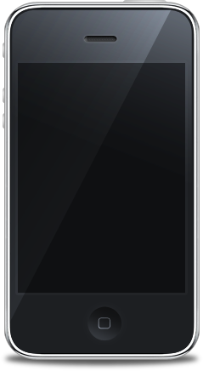
Native App vs. Mobile Website
CSS
HTML
JavaScript
Drupal Supports both Approaches

Slide 8
Implementation Solutions
Strategy
Technologies
Dedicated App
iOS/Android/Services
Optimize reach by cross Platform Native App
Titanium/PhoneGap/ Services
Browser based webapp for high end devices
HTML5/CSS3/Drupal
Browser based webapp all devices
XHTML/Drupal

Slide 9
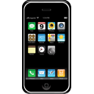
Mobile App with Drupal Backend
Database
Core
Contrib
Drupal Services

Slide 10
Services Module
Allow third party sites to communicate with Drupal using multiple protocols
Allow sites to expose data and allow updates
Extensible (Service Logs)
What comes with core services?
Servers
Resources
Authentication

Slide 11
Resources
Key concept in services
They are what allows you to …
File Resource
User Resource
Node Resource
CRUD
Index
Action

Slide 12
Authentication
Session based
Simple
Using drupal users directly
Login resource provides session information
All following requests provide session as header cookie

Slide 13
Other Mobile Modules
Theme switching modules: These modules detect if a mobile device is accessing the sites, and loads a mobile theme for the mobile devices See .mobi_loader, Accessibility, Mobit, Mobile Theme, Mobile Devices
Redirection modules: these modules redirect the mobile user to a mobile url.
Mobile theming: these modules (or themes) provide a mobile friendly version of the site. See .mobi theme, iUI, bluemobi (with accessibility), Mobile
SMS modules: some modules are targeted towards an integration with SMS gateways. See SMS framework
Mobile publishing: modules helping getting content on your site originating from a mobile phone. See Mobile Media Blog and dotgo
Mobile payments: modules enabling paying from a mobile device. See Mobillcash

Slide 14
Use Case
Upload a crowdsourced data to an existing drupal site
Upload picture taken from mobile device
Geolocate
Add title and description

Slide 15
Create a Content Type for Crowd Sourced Data
Drupal content type for a crowd sourced data
Citizen Observation

Slide 16
Configure Service Module

Slide 17
Configure Resources

Slide 18
Mobile Client
Titanium/Appcelerator

Slide 19
File Upload
Returns file id
Use file id to associate the file with a node

Slide 20
Create Node (Citizen Observation Type)
Parameters:
Cookie for authentication
File id for uploaded file
Lat/Lon using device GPS/Wifi
Title/Desc

Slide 21
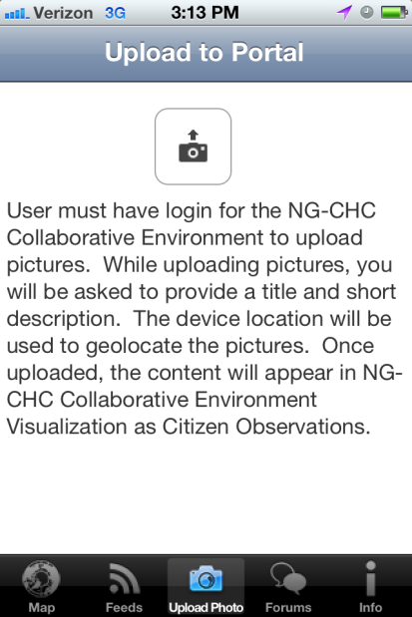
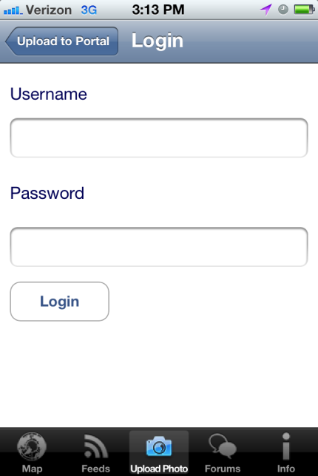
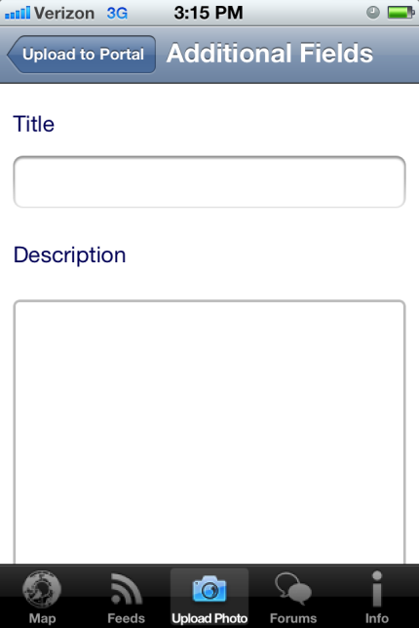
iPhone App

Slide 22
In Drupal
In Drupal Content Page
In Drupal GIS Module

Slide 23
Resources
Drupal RWD: Adaptivetheme & Omega
http://www.mobilephoneemulator.com/
http://voipdrupal.org
http://drupanium.org/

Slide 24
Contact
Manil Maskey
Information Technology & Systems Center
University of Alabama in Huntsville
mmaskey@itsc.uah.edu

