Slide 1
Data Citation Implementation for VecNet Transmission Simulator
Institution: Vector-Borne Disease Network (VecNet),
https://www.vecnet.org/ Presenter: Natalie K. Meyers
Useful Data citation of Transmission Simulator experiments & output data requires reproducibility, visualization, data identification, description, provenance, and metadata.
^{1.}James Cook University, michelle.barker1@jc.edu.au ; ^{2.} University of Notre Dame, dbrower@nd.edu ; ^{3.} University of Notre Dame, natalie.meyers@nd.edu
R. Farlow Consulting, LLC

Slide 2
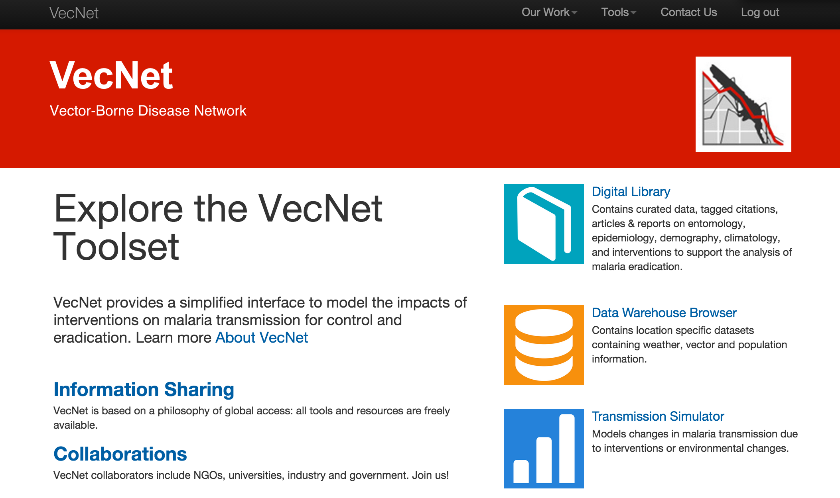

Slide 3
VecNet Use Case
Scenario: VecNet Transmission Simulator: - Domain: Vector Disease Modeling, Purpose: for malaria eradication.
VecNet Transmission Simulator users can access and run two vector disease models thru Vecnet’s Transmission Simulator: Institute for Disease Modeling’s Epidemiological Modeling (EMOD ) software or Swiss Tropical and Public Health Institute’s OpenMalaria software.

Slide 4
VecNet Audience of Users
Individuals and groups who want to use software models to explore combinations of vector and drug based malaria interventions to determine the optimal mix for use in specific geographic areas but may not have the compute or analyst resources to do so on their own
New product developers(chemical companies, drug developers) to refine target product profiles and
Policy makers and funders who can use modeled data to make better decisions about where to spend resources
Vector disease model developers and users who want to democratize access to their models and/or input/output data

Slide 5
Rate of change
- Data Characteristics as of 12/15/2014:
Number of Experiments: 943 Number of Runs: 1937 Number of Executions: 45281 Number of Replications: 33458 Number of Users: 110 Number of Rows of Simulation Data: 1634960000.0 Total Size of the Database(GB): 229.724580936
The following are the [weekly] changes between the previous measurement and today: Increase in Number of Experiments: 29 Increase in Number of Runs: 52 Increase in Number of Executions: 126 Increase in Number of Replications: 126 Increase in Number of Users: 2 Increase in Rows of Simulation Data: 49100000.0 Increase in Total Rows of Data: 196390000.0 Increase in Overall Size of Database (GB): 6.67205047607 The above states are calculated for a time interval of: 6 days, 23:59:59.674404 The time period was from 2014-12-08 08:00:01.890540 to 2014-12-15 08:00:01.564958

Slide 6
File Types & TimeStamping
- Type: what type(s) of data are part of the use case? How is the data stored: SQL/RDBMS for some input data and results data, XML, JSON, binary input files for climate and demography) - Versioning of software and some input data is in place, output data is timestamped. Rows, files, and modifications are timestamped

Slide 7
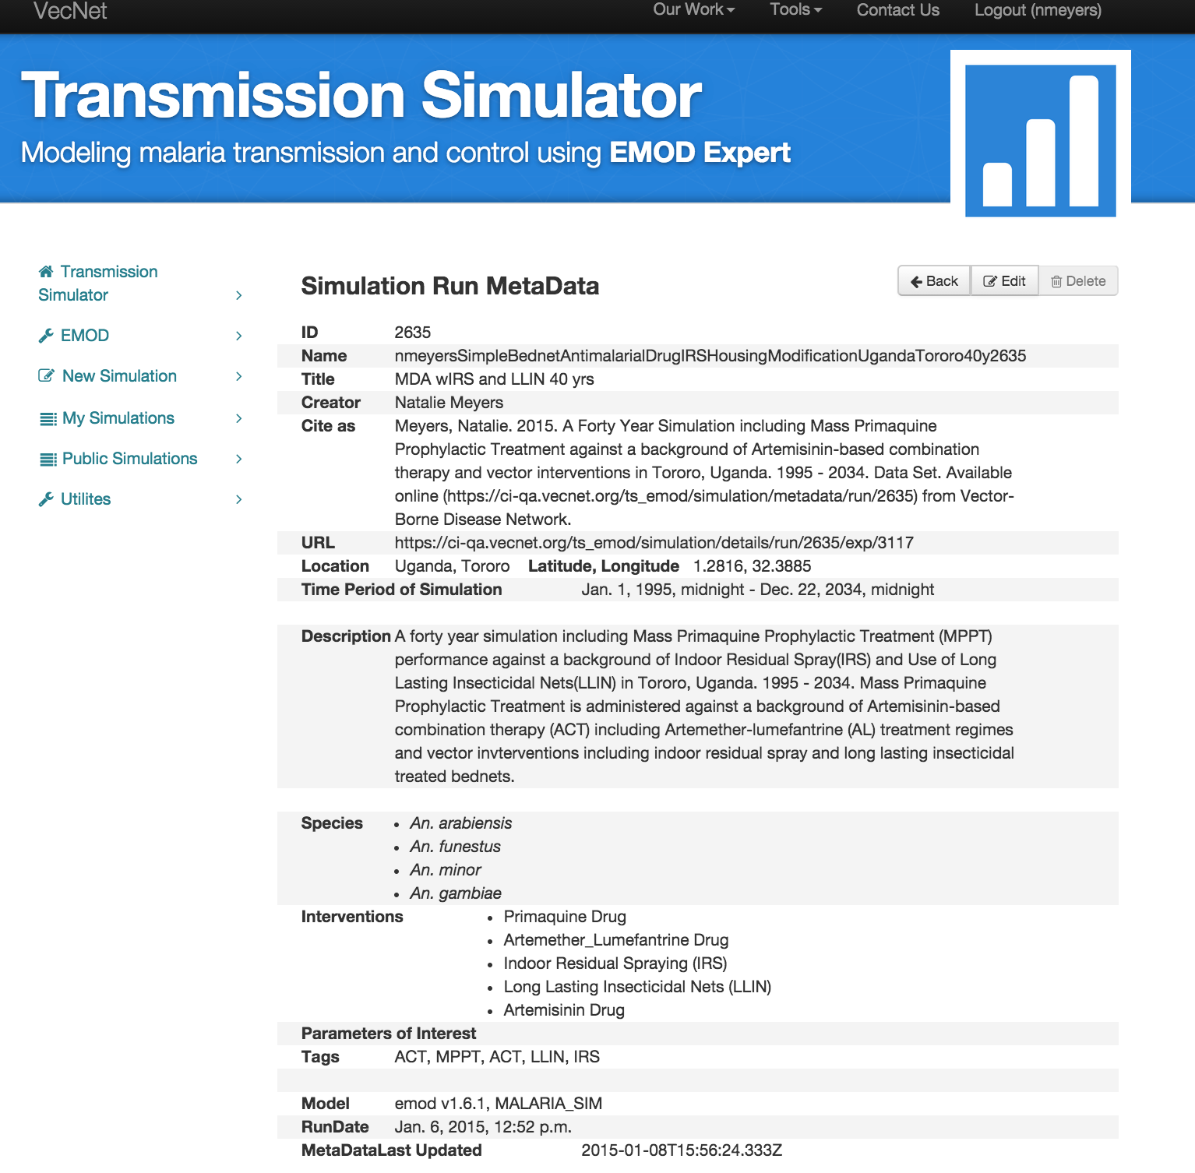
Public View of Metadata
Notes:
Data citation features with metadata view and edit features are under development in Vector-Borne Disease Network’s UI.

Slide 8
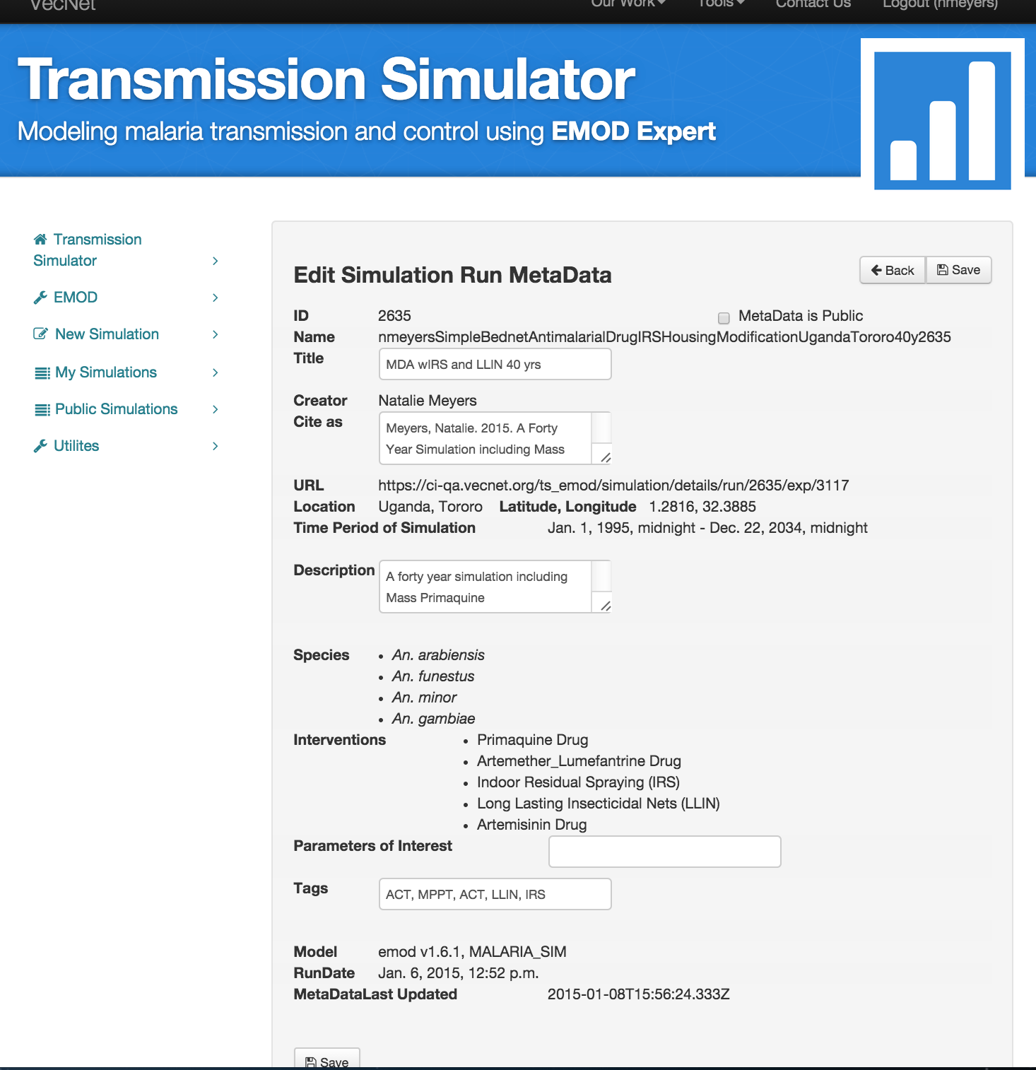
Edit View of Metadata
Notes:
We will be adding Metadata edit on simulations as well as runs, and there may be a need to do it for sweeps.

Slide 9
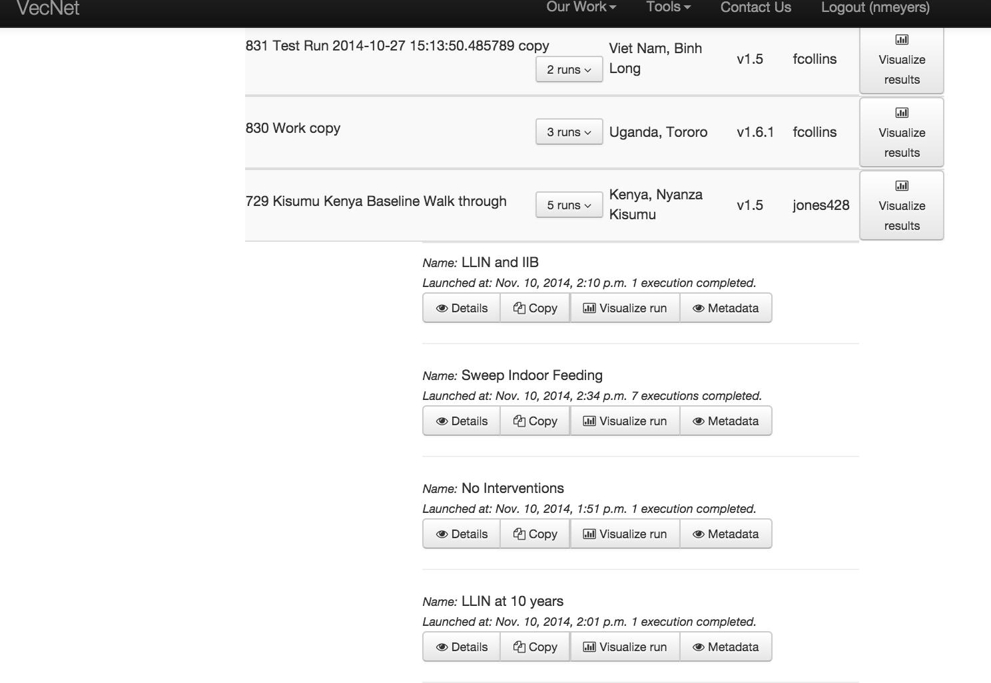
Citing Simulations & Runs
Notes:
We’ve currently implemented Data Citation & metadata edit for runs, will expand feature to Simulations and perhaps enhance for sweeps.

Slide 10
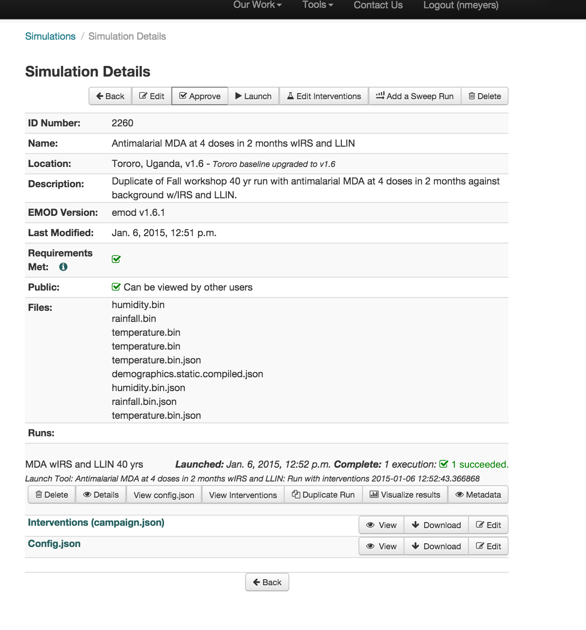
Simulations & Runs
Demography and Weather files (processed weather station or processed earth observation or processed forecast data) have metadata in the Digital
Library (spatial and temporal coverage, source etc) - these files will be linked to that metadata.
Notes:
At simulation level, from a citation users and/or a process can add a sweep, go to a run, once inside a run, duplicate that run, visualize results, edit and execute.

Slide 11
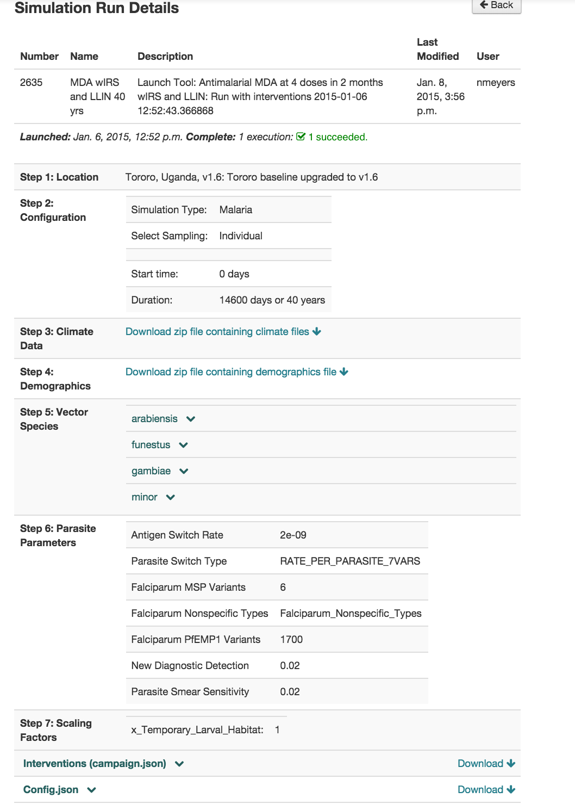
Notes:
At Run level we have input files, scaling factors, results etc . You can “copy” a run.

Slide 12
Summary of Required Metadata
Title/Name(Include any/all if applicable.)
Name of results dataset
Name of Run(s) that produced results output.
Name of simulation(aka experiment/scenario) that umbrellas the runs that produced the results.
Identifier(s): All citations must have a unique identifier for ea results data set and any associated data containers
Creator(s): UserID and/or Username(s), and Personal Name(s) w/link to an affiliation or contact information.
Abstract or Description: A brief synopsis of the simulation and/or results data that another researcher can review quickly to see the relevance of the simulation and/or results.
Dates and Timestamps:
Date timestamp for the results data
created and last modified date timestamps for the related input files
start and end date(s) of the time period covered by the simulation
Location: If the data relates to a physical location, the spatial coverage should be named and documented.
for a point/single node location the lat/long coordinates in decimal degrees
Model Specific Fields:
Model Name: name of model used to create results (e.g. OpenMalaria, EMOD)
Model Version: version number of model executed to generate results (e.g. for EMOD data from: dim_dtk_version)
Model Variation: variation name (if any) eg for EMOD: Generic_Sim, Vector_Sim, Malaria_Sim, MalariaSim, for OpenMalaria: the Modelvariant
File Access Information:
The location of the data(DOI/URL or filesystem location)
Any note on how a researcher can access the content if not a URL or DOI

Slide 13
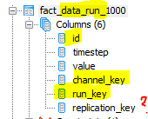
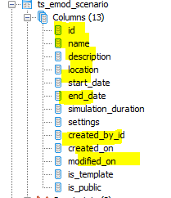
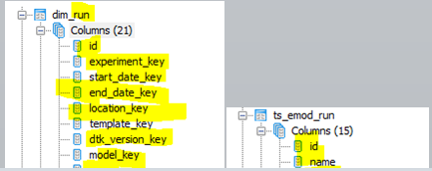
Transmission Simulator IDs
VecNet TS IDs -Identifier(s) : Unique identifier(s) used to identify the data. Any TS Results Data citation must have a unique identifier for each results data set and any associated data containers or visualizations.
ID of results dataset (mandatory)
ID of the Run(s) that produced results output. (Mandatory)
ID of the simulation(aka experiment/scenario) that umbrellas the runs that produced the results.
Notes:
What PIDs for each level?
DOIs, ARKS, etc.

Slide 14
Title aka Name
Title aka Name(Include any/all of below if applicable.)
Name of results dataset (mandatory)
Name/ID of Run(s) that produced results output(mandatory).
Name/ID of simulation(aka experiment/scenario) that umbrellas the runs that produced the results.
Recommend auto-labelling and/or auto-naming to aid find-ability/sorting by concatenating an abbreviation of the location, dominant vector species, username.
Notes:
One of our PIs requested auto-name feature so we could get informative unique naming for each run to make sorting, viewing etc more user-friendly. We implemented as:
Name (autogenerated)
Title (user entered)

Slide 15
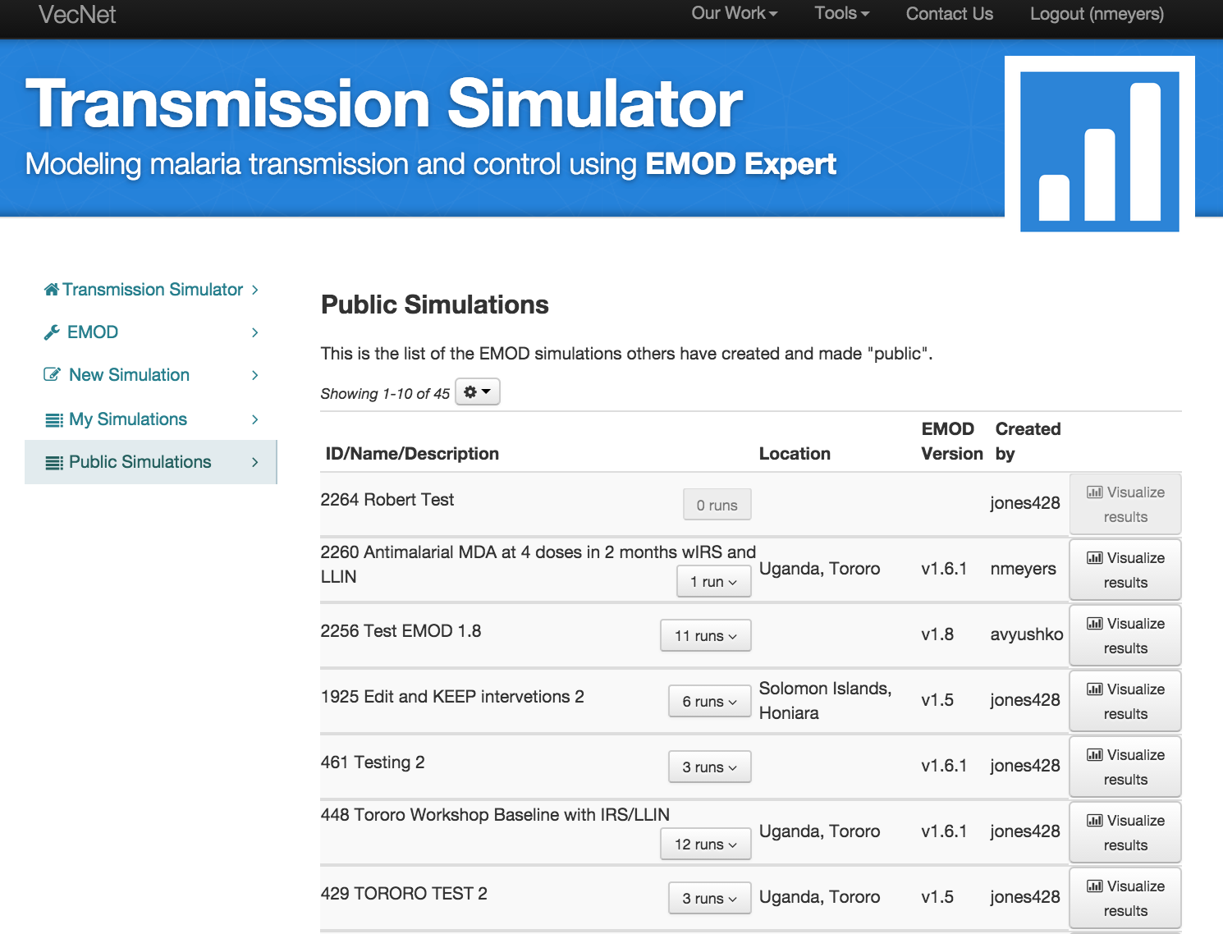
Issues w User Entered Titles
Notes:
User entered titles can be problematic bcs:
Repetitive – non-unique
Uninformative – Not very descriptive
User doesn’t have enough info at beginning of a simulation to informatively name a simulation – These can be updated afterward, but often aren’t
Autonaming can aid sorting by creating uniqueness
Autonaming can aid simulation owners by pre-populating name with important parameter values

Slide 16
Some auto-naming examples
AutoName | NamingConvention
fcollins8302014-10-2715:13:50 | Username+ID+DateTimeStamp
fcollins830UgandaTororo | Username+ID+Location(ifany)
TB830AnFarBougainville | Userinitials+ID+species+location(ifany)
AnFarBougainvilleTB830 | Species+Location(ifany)+UserInitials+ID
buileduy830DuyKenya30y | Username+ID+UserLabel+Species+Location
buileduy1287Jan012002-Apr112002KenyaNyanza Kisumu | Username+ID+startTime+EndTime+Location(Ifany)

Slide 17
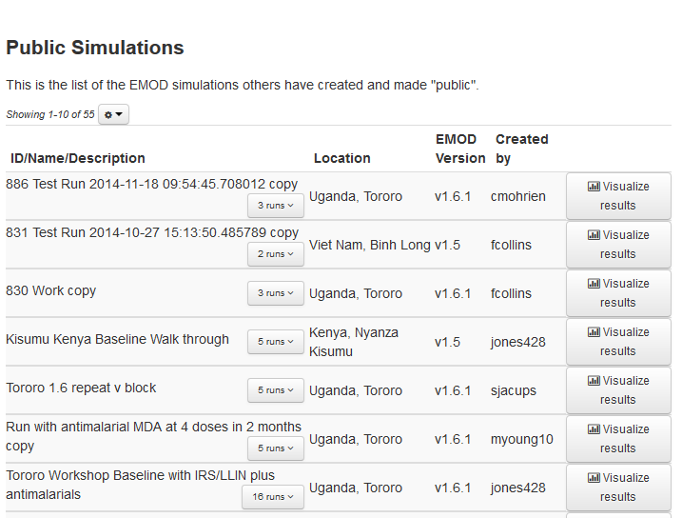
Names/Labels aid Sorting and findablity

Slide 18
Naming Conventions Known Issues
User Entered labels tend to repeat (mysim, test, copy, etc)
Autonaming and use of naming conventions can aid sorting and findability
All the metadata doesn’t have to be compounded into the name – keeping it separate helps users filter and sort
Notes:
We initially implemented as:
“userID+intervention1Intervention2Intervention3etc+location+durationofsim+RunID.
Will update as:
“userIDRunID-Intervention1-Intervention2-Intervention3-Intervention4-Location-Duration
Problems – length of string, some simulations do not have Interventions or Locations (baselines w/out intervention), OpenMalaria Simulations with no specific location(just demographic).

Slide 19
Description
Description aka Abstract or Notes -A notes field for user entered information .
Abstract/Description of simulation(aka experiment/scenario) that umbrellas the runs that produced the results.
User entered label or description of Run(s) that produced results output(helps users differentiate btwn runs).
User entered description of a results dataset (allows creators to emphasize findings in results)
Abstract/Description is Mandatory at Scenario level for “published” data, optional at other levels (runs, sweeps, results).
Notes:
This is currently user entered.

Slide 20
Model Specific Metadata
Model Specific:
Model Name: name of model used to create results (OpenMalaria, EMOD)
Model Version: version number of model executed to generate results (for EMOD could be data from: dim_dtk_version, for OM? )
Model Variation (if any) : variation name (for EMOD: Generic_Sim, Vector_Sim, Malaria_Sim, MalariaSim; for OpenMalaria: use the Model variant name)

Slide 21
Creator Metadata
The UserID and/or Username(s) of the person who created the scenario, run or results files (Required)
Personal Name(s) (Required for published data– can be an exposed part of user profile and/or LDAP record)
Contact information (Required for published data, could be optional til then) (in the form of an organizational affiliation and/or email address for the user that created the data – can be an exposed part of user profile and/or LDAP record)
Add’l Contributor(s): Names and addresses of additional individuals that contributed to parameterization and/or modification of the input files .
Notes:
We implemented as:
If we have username and affiliation:
FirstName Lastname, Organization
If we do not know Org
First Name Lastname
If we don’t know User’s firstname or lastname
Username
If User was “admin”
Then populate as:
CRC Developers, Notre Dame

Slide 22
Date/Timestamps
start and end date of the time period covered by the simulation (required)
Start and end date of intervention campaigns covered by the simulation (optional) could be autogenerated and tags associated w/Campaign files and/or results files
datetimestamp of the run and/or results (required)
created and last modified dates for the related input files (best practice)
created and last modified dates for visualizations of results (best practice).
Notes:
We implemented as:
Time period covered by simulation: Jan 01, 2010 midnight - Dec 31, 2034 midnight (displayed from start date and calculated date of end of duration)
Run date as : Jan 6, 2015 12:55 PM (from date time stamp of job execution)
Metadata created and/or last updated as date-timestamp 2015-05-26T15:56:24:333Z

Slide 23
Location Metadata
If the data relates to an explicit physical location, the spatial coverage should be named and documented.
Location Name (required) - should be what was used in the simulation config file and should be authority controlled thru a picklist or the vecnet db/datawarehouse
Spatial Coverage (best practice) For a single node location aka point data – describe coverage as lat/long coordinates in decimal degrees , for a bounded area provide a link to the users’ boundary selection from admin districts, boundaries, or use coordinates of a bounding box that contains the area).
Notes:
Location name is autopopulated from simulation config file
Spatial coverage is autogenerated as a centroid lat/long of boundary shape file affiliated w/ location name
Known issue –populating spatial coverage with point as autogenerated centroid may offset display on map from actual study site’s exact point location – may need to rethink this one ?

Slide 24
Access Information
The location of the data (required)
URI/URL
DOI (DOI: digital object identifiers could be assigned to “published” results sets and/or their “published” companion input files).
Notes/Instructions for how a researcher can access the content if no URI/DOI
Declare any access restrictions on sharing (Global, VecNet Only, workgroup members, or private)
Any use/re-use restrictions(all rights reserved, creative commons, etc) (optional)
Notes:
Currently as URI/URL
Want to add feature for user to request/get a DOI when “make metadata public” is clicked and/or “publish metadata” via EZID

Slide 25
Additional Metadata that aids sorting and finding simulations of interest
Species names - As parameterized in input/config files of simulation (could be auto-generated w species tags attached to simulation and results records )
Intervention Names – As parameterized in the input files (could be auto-generated w intervention tags attached to simulation and results records )
Tags: Keywords or short phrases that label or describe the content of the simulation or results data. In adding these, think of how you would search for the materials.
Parameter of Interest:
Subject: MeSH subjects (optional) NLM subject headings that describe the subject or content of the simulation or results data. In adding these, think of how you would search for the simulation or tag the results in published articles .
Notes:
Species names are autopopulated to metadata record from config file
Intervention names are autopopulated to metadata record from campaign file
Tags are user entered
Parameter of interest is user entered
Subject is not implemented yet

Slide 26
Add’l Metadata Under consideration for Results Data citation
Methodology: An descriptive notes field where the researcher can describe how the simulation was conceived, any data validation and/or model fitting, quality assurance of the input data, etc.
Sources: Citations for any sources that were used during the project. (who authored the input files if different than the simulation user, or journal/digital library citations for why certain parameter values were chosen)
File Structure: Description of the Organization of the data and/or companion input file(s)
List of File Names: Linked List all of the input and output data files/URIs associated with the simulation, including the file extensions.
File Versions: Include a Date/time stamp for input/output files/URIs, and use a separate identifier for each version.
File Formats: A summary of the Format(s) of the data and any software that is required to read the file formats of the input or output files including the version. (Example: XML, JSON, csv, binary)
DataDictionary: Link to definition of parameters and/or output channels that are present in the input and output files
Variable List: List of active/parameterized variables in the data files, when applicable.
Code Lists: Explanation of codes or abbreviations used in the file names, variables of the data, or the project over all that will help the user understand the project. (Example: 999 indicates a missing value in the data)
Checksums: (If any) Can be used to test if a file has changed over time. If present, this aids in the long term preservation of the data and helps make it secure by making alterations in the file trackable by creators and users who download and re-use the files.
Notes:
Known issues:
Right now have to go to “details” via click through URL to see all input data files etc
Already a notes field in addition to the description/abstract field has been requested

