Slide 1
From Collection to Granule in
Data Discovery
NOAA/NODC
Jan 08, 2014

Slide 2
Table of Contents
Collections and Granules
Rich information in the ISO metadata
Different ways of granule level discovery
Linking collection level discovery to granule level discovery

Slide 3
Collections and Granules

Slide 4
Collections and Granules
From the Open Archival Information System Reference Model (OAIS-RM):
Archival Information Package (AIP): An Information Package, consisting of the Content Information and the associated Preservation Description Information (PDI), which is preserved within an OAIS.
Archival Information Collection (AIC): An Archival Information Package whose Content Information is an aggregation of other Archival Information Packages.
In NODC terms, an accession is an AIP, and a collection is an AIC, which consists of one or more accessions. When a collection is sufficiently large, we define searchable granules within that collection. Sometimes the searchable granule is an accession, sometimes it is a file, and sometimes it is a part of a file…. Ideally, we would define that searchable granule based on an understanding of user discovery and access patterns. In reality, we make our best guess and have to operate within limited resources.

Slide 5
Collections and Granules
From a functional perspective:
Collections are the minimum citable unit, akin to a journal article
Granules are the minimum searchable unit, akin to a word in the article
Depending on the situation, an accession can be a collection, a part of an collection, or a granule.
We don’t currently enable granule-level discovery for all collections since many collections contain very few granules.
Collection level
Searchable/Citable Collection
Accession level
Searchable Granule
File/sub file level

Slide 6
Collections and Granules Example
As an example, there are currently 60 GHRSST collections archived at NODC. Each of them consists of hundreds to thousands of accessions, each of which holds between one and a few hundred individual data files. Users want to find and access the individual data files, and don’t really care much about the accessioning strategy we have implemented for these collections (all the data for a given collection per day go into one accession).
Collection level
Searchable/Citable Collection
File level
Searchable Granule
The user defines the level they want to search and we provide the services.

Slide 7
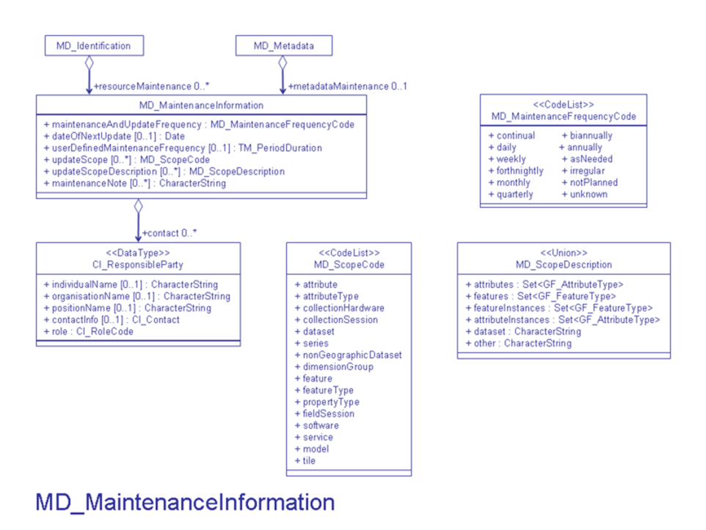
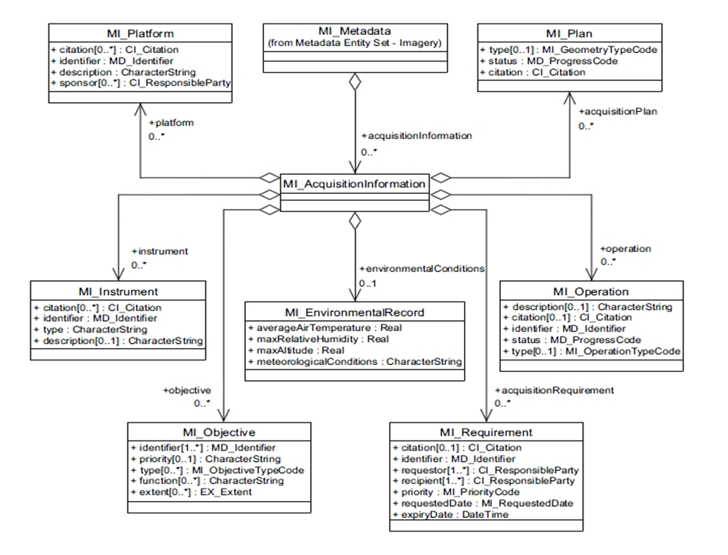
Rich Information In the ISO Metadata

Slide 8
Collection level:
Use NODC ISO metadata template
The metadata for collection level discovery follows the best practice of ISO 19115-2 template, with
Citation information
A place holder for future DOI information
NODC vocabulary keywords entries
GCMD Keywords section
ISO topic categories
Multiple data access links
Browse graphic URLs
Following these best practices facilitates effective discovery.

Slide 9
Rich information in the ISO metadata
An automatic workflow has been set up to create collection level and accession level ISO standard metadata directly from the archive data system. The ISO metadata follows a standard template we released recently as well. Another automatic workflow was set up for the granule metadata creation.
Collection level
ISO metadata is created directly from the archive system
Collection level geoportal
Accession level
File level
ISO metadata is created based on both the data file and the collection level metadata
Granule level geoportal

Slide 10
Different Ways of Granule Level Discovery

Slide 11
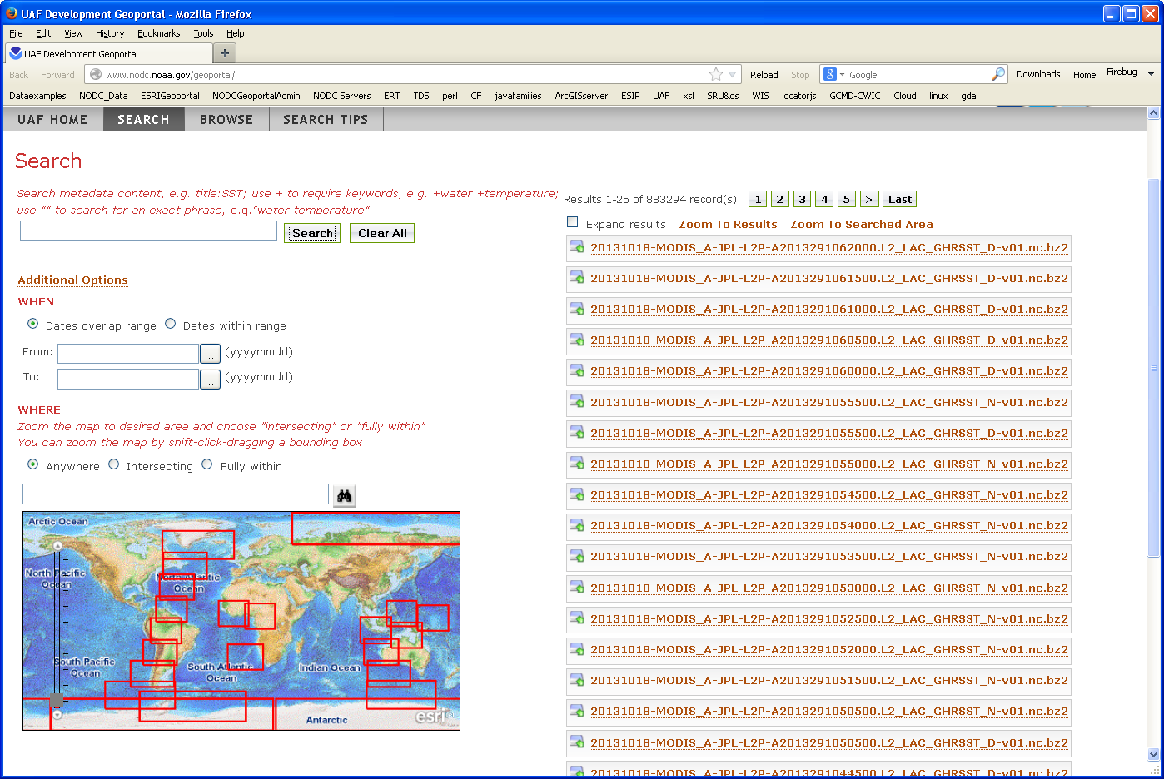
Different ways of granule level discovery
Search directly from the Granule level Geoportal
www.nodc.noaa.gov/geoportal/

Slide 12
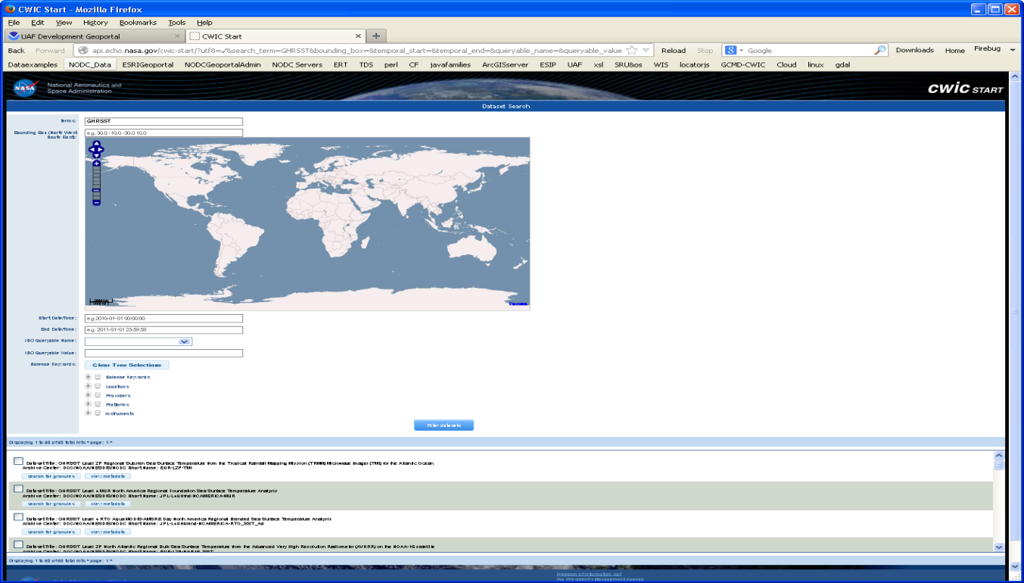
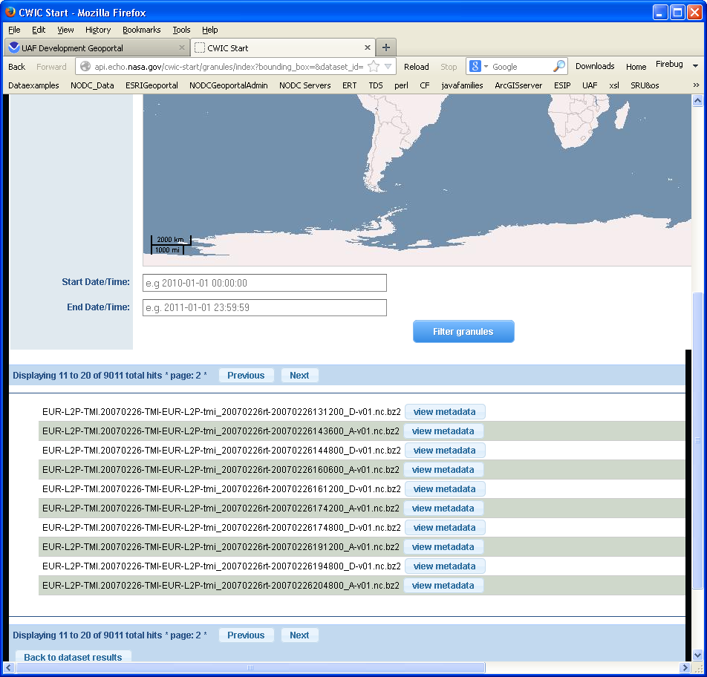
Different ways of granule level discovery
Search through the CSW from the NODC Granule level Geoportal
http://www.nodc.noaa.gov/geoportal/csw/discovery?Request=GetCapabilities&Service=CSW&Version=2.0.2
CWIC Start Portal
Similar to CSW, OpenSearch, JSON, RSS feed are also available for the granular discovery

Slide 13
Linking collections to granule
The collection discovery is linked to the granule level discovery through the REST URL from geoportal by searching gmd:fileIdentifier or gmd:Identifier
The URL is constructed using a search query which links to the discovery page of the granule level geoportal
This URL is added to the collection level metadata which is discovered through the collection level geoportal

Slide 14
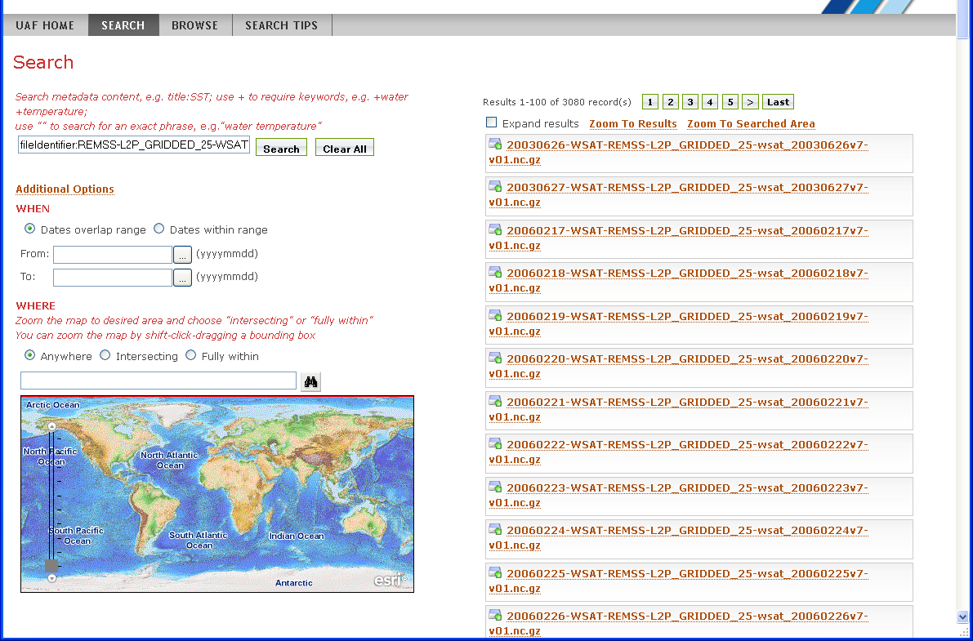
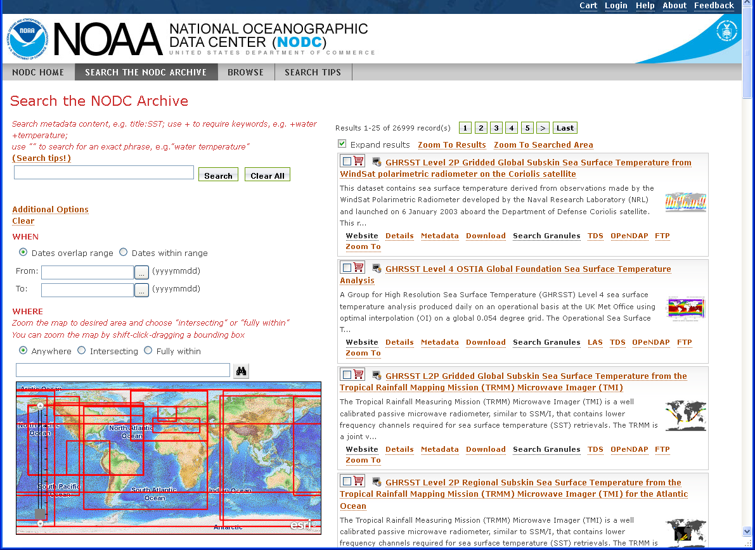
Collections to file level granule

Slide 15
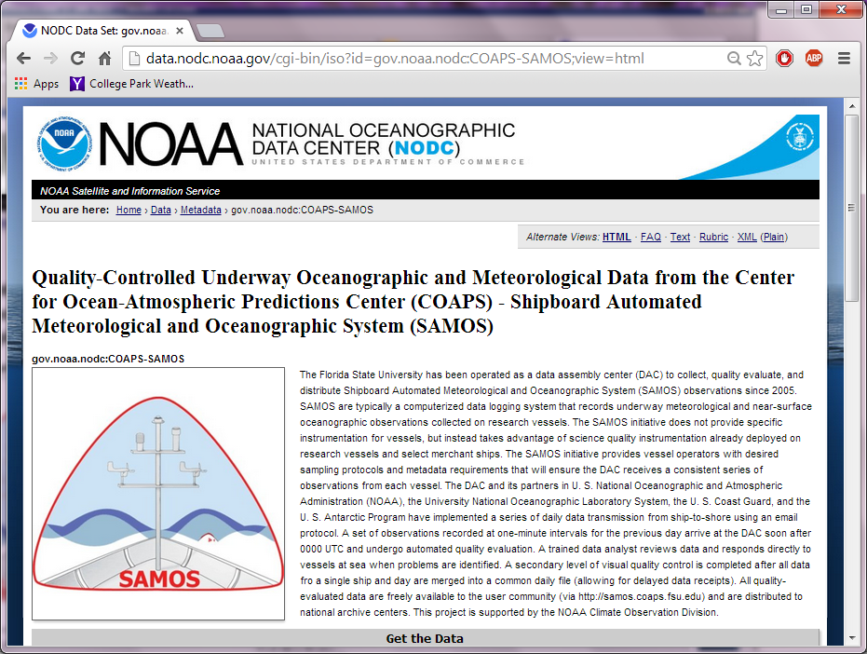
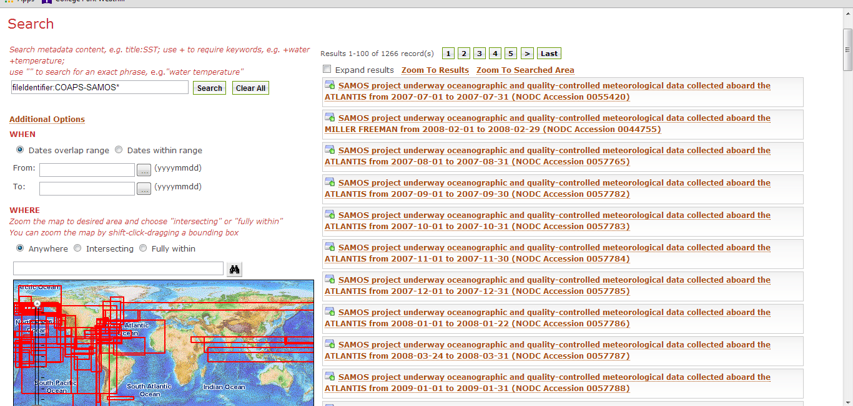
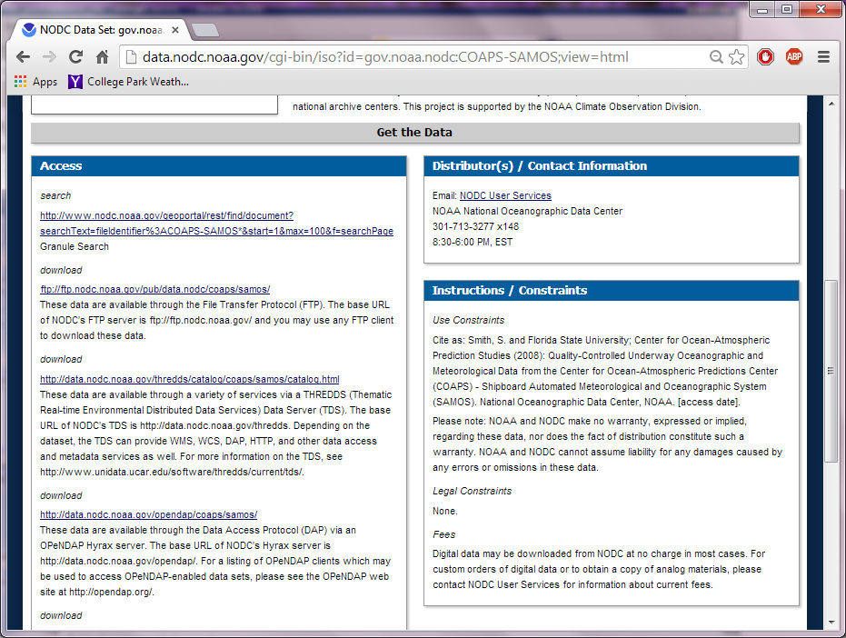
Collections to accession level granule

Slide 16
Questions?
Kenneth.casey@noaa.gov
Yuanjie.li@noaa.gov

Slide 17
Granule level:
Data + the collection level metadata
Combine the collection level metadata information with granule level metadata
Example data sets – GHRSST granule level metadata
GHRSST granule metadata NODC keywords & other required information for discovery
GHRSST granule data
Modified ncISO xslt
GHRSST granule metadata
Index into geoportal
GHRSST collection level metadata from JPL
Add NODC keywords & resolution info
GHRSST collection level metadata
GHRSST granule level geoportal server
Notes:
NODC has built up a tool for the work flow, which applies not only to GHRSST granule level metadata updates, but also to any other granule level metadata. In cases of other NODC granule level metadata updates with collection level metadata, we just replace “GHRSST cocllection level metadata from JPL” to “NODC collection level metadata from ATDB”.

