Slide 1
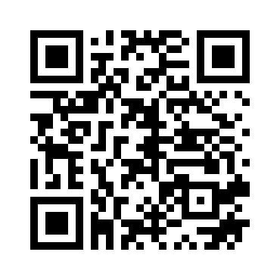
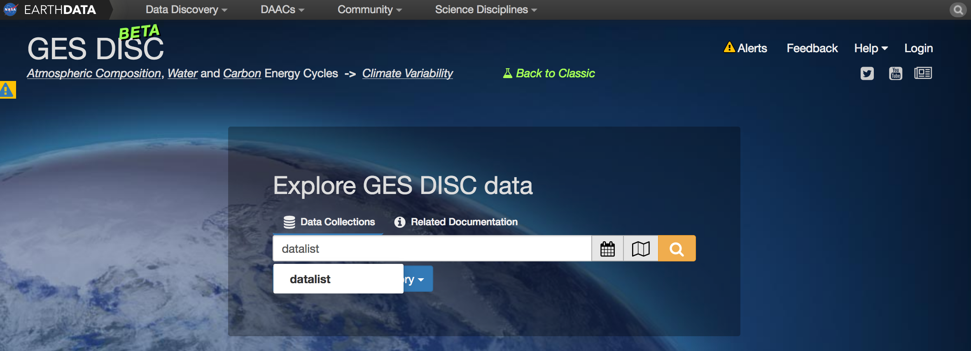
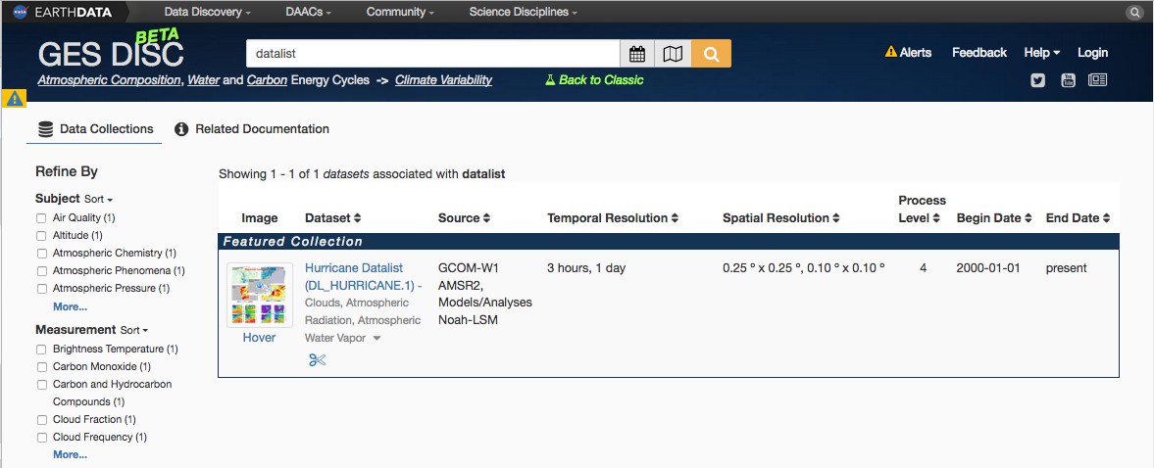
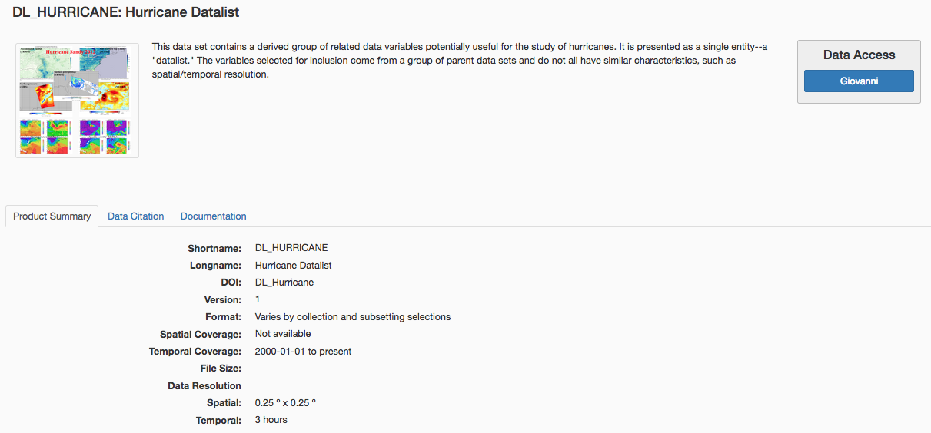
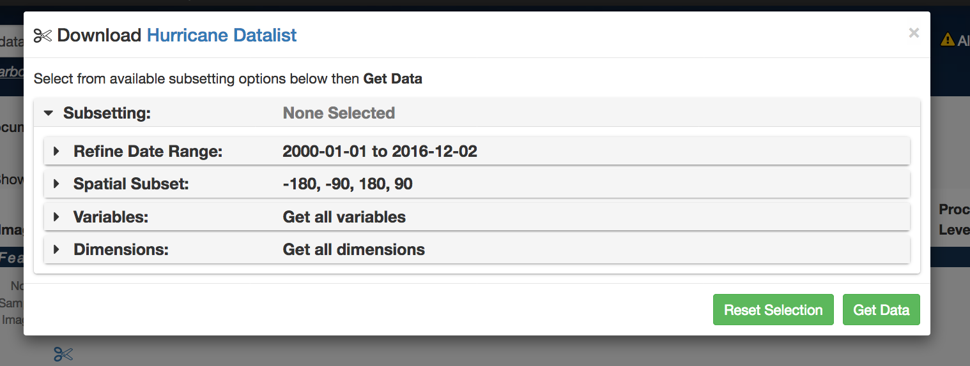
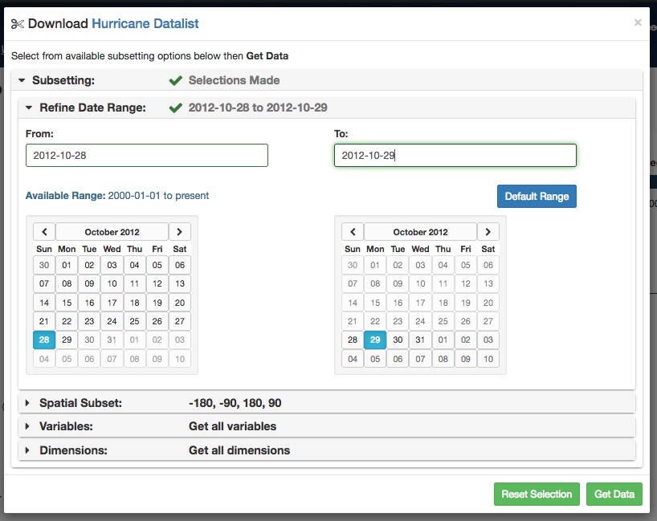
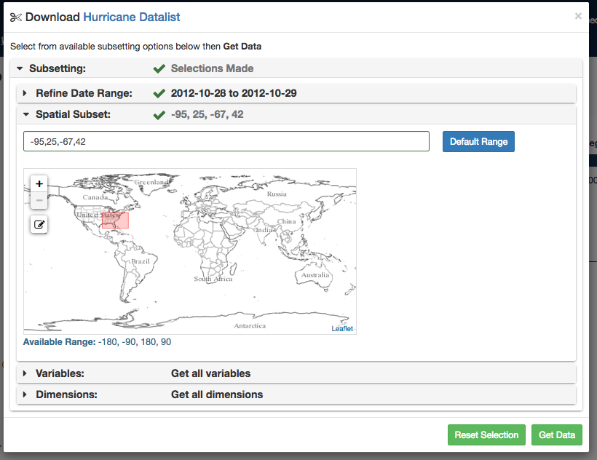
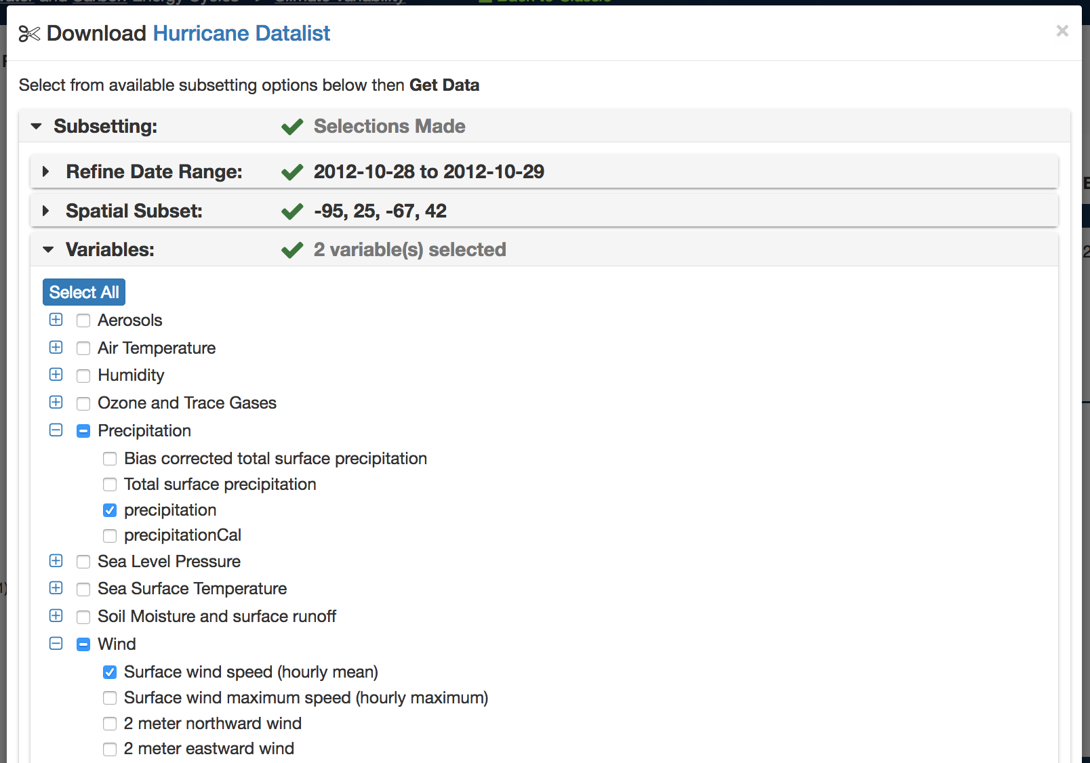
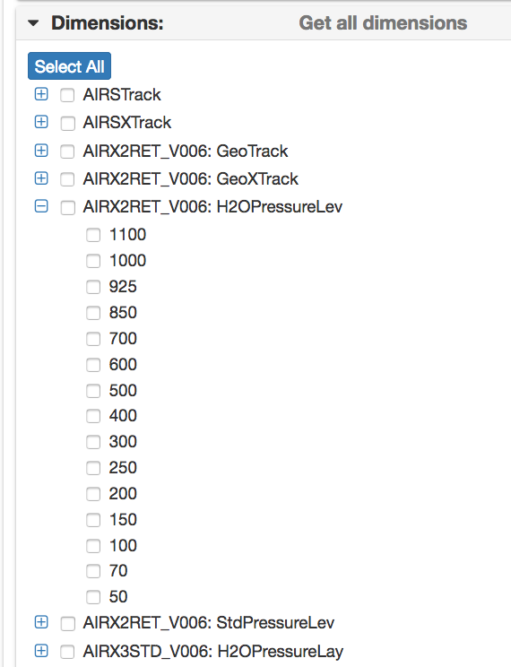
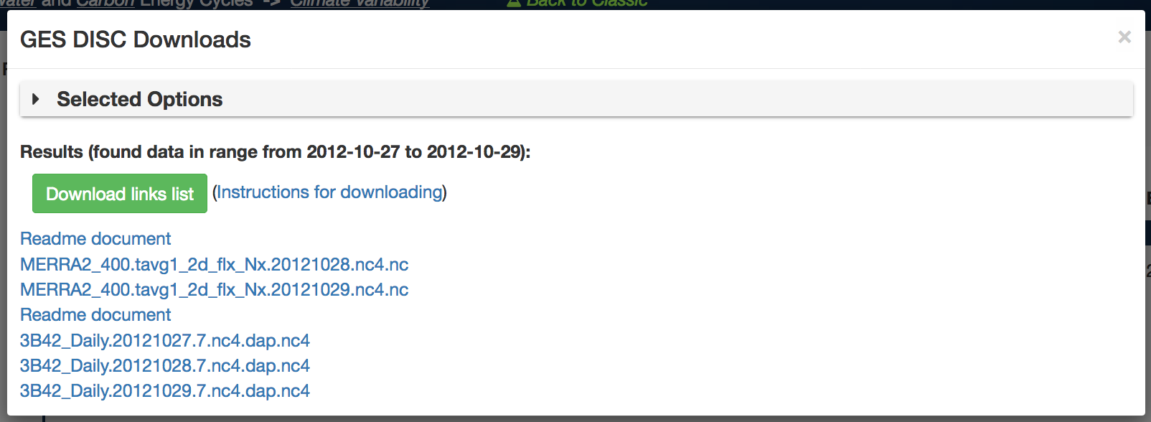
New GES DISC Services
Shortening the Path in Science Data Discovery
NASA/Goddard EARTH SCIENCES DATA and INFORMATION SERVICES CENTER (GES DISC)
Angela Li¹, Chung-Lin Shie^{1, 2}, Maksym Petrenko^{1,3 ,} Mahabaleshwa Hegde^{1,3}, William Teng^{1,3}, Zhong Liu^{1,3}, Keith Bryant^{1,3}, Suhung Shen^{1,4}, Thomas Hearty^{1,3}, Jennifer Wei^{1,3}, and Long Pham¹
Abstract
Search, Access and Download
Architecture
The Current GES DISC available services only allow user to select variables from a single dataset at a time and too many variables from a dataset are displayed, choice is hard.
At American Geophysical Union(AGU) 2016 Fall Meeting, Goddard Earth Sciences Data Information Services Center (GES DISC) unveiled a new service: Datalist. A Datalist is a collection of predefined or user-defined data variables from one or more archived datasets. Our science support team curated predefined datalist and provided value to the user community. Imagine some novice user wants to study hurricane and typed in “hurricane” in the search box. The first item in the search result is GES DISC provided Hurricane Datalist. It contains scientists recommended variables from multiple datasets like TRMM, GPM, MERRA, etc. Datalist uses the same architecture as that of our new website, which also provides one-stop shopping for data, metadata, citation, documentation, visualization and other available services.
We implemented Datalist with new GES DISC web architecture, one single web page that unified all user interfaces. From that webpage, users can find data by either type in keyword, or browse by category. It also provides user with a sophisticated integrated data and services package, including metadata, citation, documentation, visualization, and data-specific services, all available from one-stop shopping.
GES DISC’s new web architecture unifies user interfaces
Datalist is implemented with same architecture
Curator using DIF Editor to add datalist metadata into Mongo DB
GES DISC Homepage
Key in “datalist” here!
Hurricane Datalist Hyperlink
GES DISC User Interface
Context (space, time, data, keywords...)
Datalist Landing Page
Visualization
Subsetting
Information
Visualization
Subset
Search
Data Citation
Data
Documentation
Web Page
AngularJS
Content View
Temporal Subset
Spatial Subset
User Actions
JSON WSP
request
JSON WSP
response
Legacy
Service
wrappers
OPeNDAP
SSW
Giovanni
JSON WSP
Node.js
Web Server,
Built-in services
DIF Connector
Query
JS Objects
CMR,
Legacy metadata
Metadata
Mongo DB
Database
Challenges
Datalist
metadata
DIF Editor
Natural phenomenon study requires multiple datasets and multiple variables
Newcomers to Earth science don’t know where to start
Current GES DISC available services
Only allow user to select variables from a single dataset at a time
Too many variables from a dataset are displayed, choice is hard
Selecting
Data Variables
Selecting
Data Dimensions
Coming in 2017
precipitation selected
Datalist Curator’s tool Spring
A-Train Datalist Early Spring
User-defined datalist Summer
Sharable datalist Summer
Datalist for event Fall
Smart datalist TBD
wind speed selected
Solution
One Stop
Data Download !
Authors
GES DISC’s new Datalist service
A Datalist is a collection of predefined or user-defined data variables from one or more archived datasets
Value-add service
Subject Area Experts are the Curators of the datalist
Selected
Data Variables
MERRA2
wind speed
¹ NASA Goddard Space Flight Center
² University of Maryland, Baltimore County
³ ADNET Systems Inc.
⁴ George Mason University
TRMM precipitation

