Slide 1
Preserving the Scientific Record: Case Study 1 – National Snow & Ice Data Center (NSIDC) Glacier Photos
Section:
The Case for Data Stewardship
Matthew Mayernik
National Center for Atmospheric Research
Version 1.0
October 2012
Copyright 2012 Matthew Mayernik.
Notes:
Introduction:
This is the Federation of Earth Science Information Partners Data Management for Scientists Short Course, Section: The Case for Data Stewardship - Preserving the Scientific Record, Module: Case Study 1 – National Snow & Ice Data Center (NSIDC) Glacier Photos.
Slide 1: Title: The Case for Data Stewardship - Preserving the Scientific Record: Case Study 1 – National Snow & Ice Data Center (NSIDC) Glacier Photos.
This training module is part of the Federation of Earth Science Information Partners (or ESIP Federation's) Data Management for Scientists Short Course. The subject of this module is “Case Study 1 – National Snow & Ice Data Center (NSIDC) Glacier Photos". The module was authored by Matthew Mayernik from the National Center for Atmospheric Research. Besides the ESIP Federation, sponsors of this Data Management for Scientists Short Course are the Data Conservancy and the United States National Oceanic and Atmospheric Administration (NOAA).

Slide 2
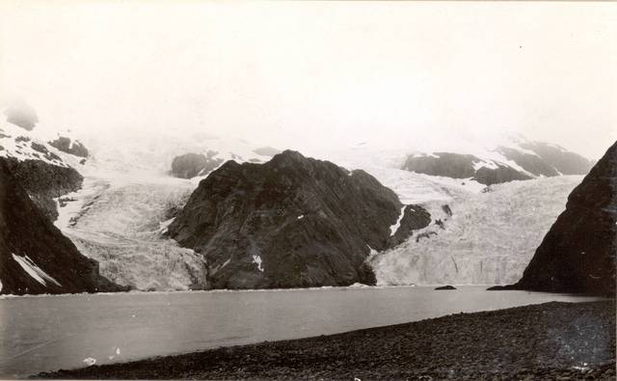
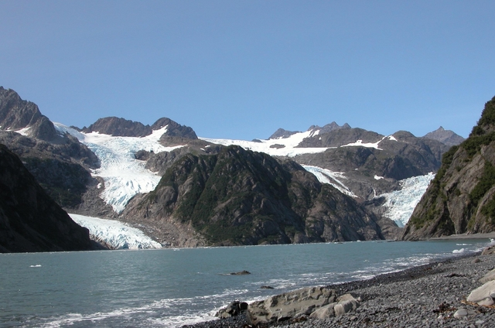
Overview
Glacier photos provide vivid demonstrations of climate change and can be used in photogrammetric studies to determine how the physical properties of glaciers (e.g. mass and extent) change over time
1909¹
2004²
1. Grant, Ulysses Sherman. 1909. Holgate Glacier: http://nsidc.org/cgi-bin/gpd_deliver_jpg.pl?holgate1909072401
2. Molnia, Bruce F. 2004. Holgate Glacier: http://nsidc.org/cgi-bin/gpd_deliver_jpg.pl?holgate2004081301
From the Glacier Photograph Collection. Boulder, Colorado USA:
National Snow and Ice Data Center/World Data Center for Glaciology. Digital Media.
Notes:
Slide 2: Overview
We have chosen the NSIDC Glacier Photo Collection as a case study to illustrate the importance of preserving the scientific record because from a big picture perspective, the glacier photos in this collection are very valuable for demonstrating climate change. The two pictures of the Holgate Glacier on this slide have been taken almost 100 years apart. As you see, there is dramatic difference in the extent of ice and distribution of the glacier on this particular mountain location.
These types of pictures can be very useful for photogrammetric studies intent on determining how glacier properties change over time in terms of ice mass, for instance, as well as extent and thickness of the ice.

Slide 3
NSIDC Glacier Photo Collection
NSIDC curates and provides online access to more than 13,000 glacier photographs
Photos from 130+ photographers, U.S. government, military, and scientific agencies
Photographs date from the mid 1800s to the present
Collection has been growing since 1950’s
Full analog archive contains more than 15,000 glacier photograph prints, ~100,000 glacier images on microfilm, and many slides and negatives
Digitization was a partnership with the National Oceanic and Atmospheric Administration (NOAA) Climate Database Modernization Program, National Climatic Data Center (NCDC), and private industry
Notes:
Slide 3: NSIDC Glacier Photo Collection
The National Snow and Ice Data Center has an extensive collection of glacier photos. About 13,000 of the photos are available online through the NSIDC website.
The complete extent of that collection is quite large, as there are photos from over 130 photographers, both individual artists and those representing the United States government, the U.S. military and particular scientific agencies.
The photos in the collection date back over 150 years to the mid-1800s. The collection was first put together in the 1950s and has been growing ever since. The 13,000 photos available online are actually a subset of a much larger analog collection that’s housed at the NSIDC in Boulder, Colorado. The complete collection is comprised of 15,000 photographic prints as well as about 100,000 glacier images on microfilm, slides and other kinds of negatives. The photos that are online were digitized through a partnership with the National Oceanic and Atmospheric Administration’s Climate Database Modernization Program, the National Climatic Data Center, and some private companies.

Slide 4
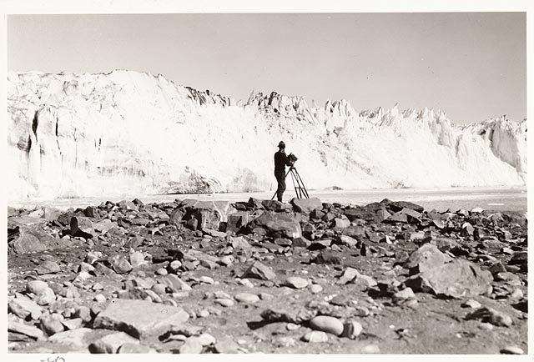
NSIDC Glacier Photo Documentation - 1
Documentation for discovery
Background information
Spatial and temporal coverage
Collection organization
Location, science, and other topical keywords
How to cite the collection (and individual images)
References and related publications
Image: Field, William Osgood. 1931 Columbia Glacier: From the Glacier Photograph Collection. Boulder, Colorado USA: National Snow and Ice Data Center/World Data Center for Glaciology. Digital media.
http://nsidc.org/cgi-bin/gpd_deliver_jpg.pl?columbia1931090612
Notes:
Slide 4: NSIDC Glacier Photo Documentation – 1 of 2
In addition to the photos themselves, the collection includes very extensive documentation of different types. We will discuss two types of documentation that are important for the Glacier Photo Collection. The first type of documentation is for discovery, that is, information about the collection that is necessary and useful to enable people to find particular photos within a large collection of many thousands of photos.
Discovery documentation may include background information on a picture, such as where it came from, who the photographer was, and when it was taken. Spatial and temporal coverage – the timeframe in which a picture or a particular set of pictures was taken and where they located, is obviously very important to know in order to evaluate change over time. People like to know how the collection itself is organized, so that they know whether and how to browse or search to find images of a group in which they might be interested.
Other important pieces of information useful for discovery are descriptive keywords. Keywords describing location, areas of science, and topics covered by the photos can give people ideas about how to find images. NSIDC includes citation information about the collection so that people can provide attribution or make a reference to their use of the collection. Also included as documentation about the collection are reference books and other related publications that use or reference the photos. These kinds of publications can be very helpful when people are trying to find particular images.

Slide 5
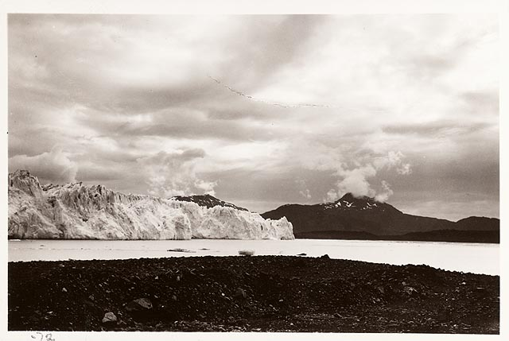
NSIDC Glacier Photo Documentation - 2
Documentation for long-term curation
Contact information
Background information
Formats and file sizes
File naming conventions
Error sources and quality assessment
Collection organization
Access mechanisms
Acknowledgments
Image: Field, William Osgood. 1931 Columbia Glacier: From the Glacier Photograph Collection. Boulder, Colorado USA: National Snow and Ice Data Center/World Data Center for Glaciology. Digital media.
http://nsidc.org/cgi-bin/gpd_deliver_jpg.pl?columbia1931090101
Notes:
Slide 5: NSIDC Glacier Photo Documentation – 2 of 2
In addition to discovery documentation, NSIDC provides information that aids in the curation of their collections over the long term to make sure that they continue to be usable. Long-term curation data includes contact information in case there is anybody else within NSIDC or outside who knows about a collection and could provide important contextual knowledge. Besides the background information that has already been discussed, statements about formats and file sizes are very important as digital images are migrated to new image formats. Descriptions of file naming conventions help in identifying particular images and their associated digital files. Knowledge about sources of error and assessment of quality are useful for some data sets. We’ve mentioned that a description of organizing principles for a collection is important for discovery, but it is also useful knowledge as an archive maintains photos in a collection over time. So also are explanations about how collection resources are accessed and whether any acknowledgments about the collection must be made over time.

Slide 6
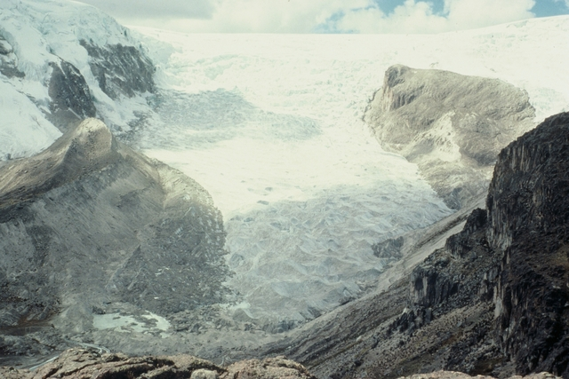
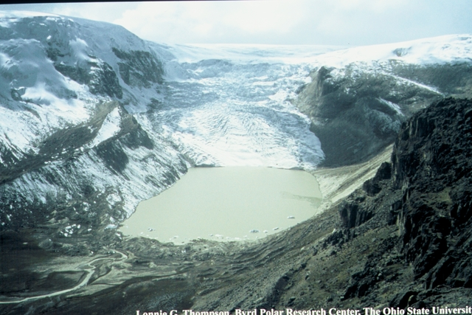
Conclusion
These photos are an invaluable scientific resource.
NSIDC’s active curation makes this collection available to scientific and public communities for research and policy uses
1978¹
2004²
1. http://nsidc.org/cgi-bin/gpd_deliver_jpg.pl?qorikalis1978070001
2. http://nsidc.org/cgi-bin/gpd_deliver_jpg.pl?qorikalis2004070001
Qori Kalis Glacier in Peru: From the Glacier Photograph Collection. Boulder, Colorado USA:
National Snow and Ice Data Center/World Data Center for Glaciology. Digital media.
Both photos by: Lonnie G. Thompson, Byrd Polar Research Center, the Ohio State University
Notes:
Slide 6: Conclusion
We’ve illustrated how the kinds of photos that are contained in the NSIDC Glacier Photo Collection, such as the two photos in this slide, are extremely valuable as a scientific resource for assessing change over time of particular glaciers in the Arctic, Antarctic and other locations around the world. By active curation, the National Snow & Ice Data Center makes this collection available to the scientific community but also to the public for research and policy uses.

Slide 7
References
Additional Information:
Beitler, J. The Dry Valleys of Antarctica: Data for Big Science. Data Conservancy press release, June 28, 2011. http://dataconservancy.org/the-dry-valleys-of-antarctica-data-for-big-science/
Molnia, B.F. 2010. Repeat photography of Alaskan glaciers and landscapes from ground-based photo stations and airborne platforms. In R.H. Webb, D.E. Boyer, R.M. Turner (eds.), Repeat Photography: Methods and Applications in the Natural Sciences, Washington, DC : Island Press, (pp. 59-76).
Notes:
Slide 7: References
Within this module, we've made reference to a number of published information sources that we think you may want to review when you want more in-depth information. The most relevant references are listed here.

Slide 8
Resources
Links:
NSIDC Glacier Photo Collection Home Page: http://nsidc.org/data/glacier_photo/
NSIDC Glacier Photo Collection Documentation: http://nsidc.org/data/docs/noaa/g00472_glacier_photos/index.html
Photogrammetry:
http://en.wikipedia.org/wiki/Photogrammetry
Notes:
Slide 8: Resources
On this slide, you will find a linked listing of some additional resources you might find helpful should you need more information about some of the areas we’ve covered briefly in this module.

Slide 9
Other Relevant Modules
For more discussion of why data preservation is important, see:
The Case For Data Stewardship: Preserving the Scientific Record
Preservation strategies: Options for archiving your data
For data management recommendations, see:
Local Data Management: Managing Your Data
Local Data Management: Creating documentation and metadata
Local Data Management: Working with your archive organization
Responsible Data Use: Citation and Credit
Notes:
Slide 9: Other Relevant Modules.
The modules of the ESIP Data Management for Scientists Short Course have been designed to complement and supplement each other. In light of this plan, we think you might find the following, related modules relevant to you as you gain a better understanding of data management:
If you want to know more about why data preservation is important, see The Case for Data Stewardship: Preserving the Scientific Record, and Preservation Strategies: Options for archiving your data.
For more information about how to manage your data, see Local Data Management: Managing your data, Local Data Management: Creating documentation and metadata, Local Data Management: Working with your archive organization, and Responsible Data Use: Citation and credit.

Slide 10
Recommended Citations
Mayernik, M. 2012. “The Case for Data Stewardship - Preserving the Scientific Record: Case Study 1 – National Snow and Ice Data Center (NSIDC) Glacier Photos.” In Data Management for Scientists Short Course, edited by Ruth Duerr and Nancy J. Hoebelheinrich, Federation of Earth Science Information Partners: ESIP Commons. doi:10.7269/P3Z31WJ3
Copyright 2012 Matthew Mayernik.
Notes:
Slide 10: Recommended Citation
This module is available under a Creative Commons Attribution 3.0 license that allows you to share and adapt the work as long as you cite the work according to the citation provided.
Thank you very much for your interest in the ESIP Federation’s Data Management for Scientists Short Course.

