Slide 1
Citation and Credit
Section:
Responsible Data Use
Matthew Mayernik
National Center for Atmospheric Research
Version 1.0
February 2013
Copyright 2013 Matthew Mayernik.
Notes:
Introduction: Slide 1
This is the Federation of Earth Science Information Partners Data Management for Scientists Short Course, Section: Responsible Data Use; Module: Citation and Credit.
This training module is part of the Federation of Earth Science Information Partners (or ESIP Federation's) Data Management for Scientists Short Course. The subject of this module is "Citation and Credit". The module was authored by Matthew Mayernik from the National Center for Atmospheric Research. Besides the ESIP Federation, sponsors of this Data Management for Scientists Short Course are the Data Conservancy and the United States National Oceanic and Atmospheric Administration (NOAA).

Slide 2
Overview
Citation and professional credit
Data Citation & its relation to traditional publication citation
How credit is related to citation
The importance of data citation and credit
Notes:
Slide 2: Overview In this module we are going to talk about issues related to citation, specifically data citation, about receiving credit for research work done with scientific data, how these two concepts are related to each other, and why they are especially important today.

Slide 3
Growing Visibility of Data Citations
2009 AGU position statement:
“The scientific community should recognize the professional value of such [data] activities by endorsing the concept of publication of data, to be credited and cited like the products of any other scientific activity, and encouraging peer-review of such publications.”
2009 AMS Ad Hoc Committee on Data Stewardship Prospectus:
AMS should “[d]evelop a plan for citing data referenced in publications and preserving data links for the long term.”
Notes:
Slide 3: Growing Visibility of Data Citations The topic of data citation is becoming very widely discussed in a lot of different venues from government agencies to individual research organizations as shown by the example quotes found on this slide. The first quote is taken from the American Geophysical Union 2009 Position Statement that states, “The scientific community should recognize the professional value of such data activities by endorsing the concept of publication of data, to be credited and cited like the products of any other scientific activity and encouraging peer-review of such publications.” This statement indicates the value of citing data as a publication.
The second quote comes from the American Meteorological Society’s committee on Data Stewardship which was a proposed committee in 2009 and is now a fully adopted committee in AMS. This quote indicates how important this issue is in scientific communities by stating that the AMS should develop a plan for citing data referenced in publications and preserving data links for the long term. Later in this module, we’ll discuss some other efforts that have been going on since 2009.

Slide 4
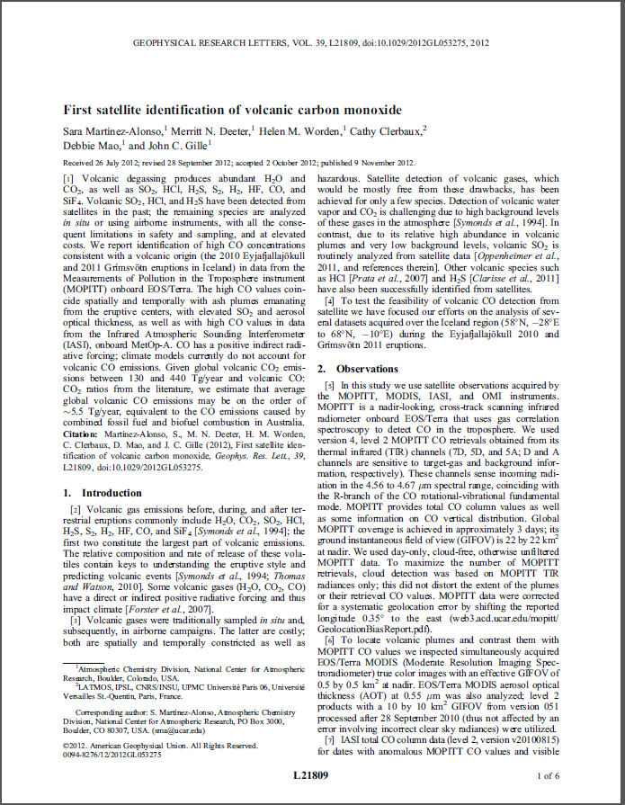
Purpose of Data Citations
Connect publications to their underlying data
Give scientists and data centers credit for producing and curating data sets
Understand how data are used
Track the products that derive from data
Facilitate data and science transparency and reproducibility
Notes:
Slide 4: Purpose of Data Citations The main purpose of data citation is to connect publications to the data underlying their content by means of the well-known citation mechanism which is already understood and instituted in the scientific communication process.
Adding a citation to the data set or sets that you use in researching an article or other publication is very similar to citing another article that you use in your research and adding it to the reference list of your publication. The connection through the citation provides a direct link from the data to the publication.
The second purpose for data citations is to link to the data sets in order to help scientists and data centers get credit for producing and curating data sets. At this point, the work required to create and manage data, and to provide access to data is often not rewarded in the same ways as producing other kinds of scientific products even though data work is obviously central to scientific activity.
Other purposes for data citation are related to the understanding of data use. A citation can illustrate very directly how a data set was used in a particular publication. Some other ways of tracking data use such as download counts from websites or other kind of metrics don’t say much about what products were created using a certain data set; a citation makes the statement of use explicit. In that way, a citation can also help track what products lead to and derive from other data sets. This connection can be desirable by illustrating how certain data sets were used or produced in many publications. Of course, the connection can also be less desirable when a dataset is found to be faulty or have particular problems; in these cases, however, it is still important to be able to identify and notify people who used that data set.
Ultimately, the underlying purpose is to facilitate transparency and reproducibility of data and the science using that data.

Slide 5
How are Data Citations different from Publication Citations?
Differences in citing data vs. publications
Data sets are extremely variable in structure, representation schemes, and access mechanisms, unlike traditional scholarly publications.
Data sets are often highly dynamic, changing or growing regularly, whereas scholarly articles do not change once published
Data sets are often hierarchical composites of data and metadata files, software, and other related documents.
Authorship is a problematic notion in relation to data sets, particularly in distributed and collaborative work.
Notes:
Slide 5: How are Data Citations different from publication citations? There are a couple of differences between data citations and publication citations that really have to do with characteristics of data sets versus data found in a typical academic article. The first difference is that data sets can be extremely variable in structure, in representation schemes found in data set documentation, and in access mechanisms. Typically, this is not the case with scholarly publications. There are differences between journals in terms of how articles look, but typically, an article in one journal is very similar in structure and form to one in another journal. In addition, the ways that articles in different journals are described and catalogued are quite similar. Again, this is not quite true for data sets.
A second difference lies in the fact that data sets are often very dynamic. They can change or grow on a continuous or discontinuous basis while scholarly articles typically don’t change once published. Even when problems are identified in a published article, notice appears in separate published articles that indicate the problem article has been withdrawn or has a problem. The original article is almost never changed which is a big difference in how data citations and publication citations can work.
A third difference is that data sets are often hierarchical, composite objects that may have many data files associated with them. A single data set may include data files, metadata files, software files and other related documents as files. By contrast, an article in a traditional publication is usually a single document especially with the current practice of sharing articles as a single PDF file that doesn’t change.
A final difference is that authorship of data sets can be a very difficult and problematic notion in contrast to a traditionally published article. Particularly with distributed or collaborative work, lots of different people contribute to the creation of a data set, and a typical data set doesn’t declare a primary author. Bu contrast, in a typical published article, authorship is much more explicitly identified. As data citation initiatives progress, it is more common to establish the author or authors of data sets for purposes of citation, but at this point, authorship may be established after the fact as opposed to when the data set is first posted.

Slide 6
Data Citation Initiatives
Many research centers are beginning to assign actionable web identifiers to data (such as DOIs, ARKs, and Handles).
Actionable identifiers uniquely locate resources that are available online
Actionable identifiers can potentially enable data use to be tracked more efficiently
Actionable identifiers facilitate data transparency and reproducibility by directly linking to the data that led to results
DataCite - an international consortium of libraries and research organizations that promote and provide registration services for DOIs and citations for data
Notes:
Slide 6: Data Citation Initiatives As we mentioned earlier, there are many initiatives to make data citations easier to create, and easier to find. For instance, research centers are beginning to assign actionable web identifiers to data sets such as Digital Object Identifiers (DOIs), Archival Resource Keys (ARKs), and Handles. What these identifiers do is establish unique identification for an object such as a data set, and also locate where that object is in the web environment. The web location is similar to an address on a street or on a building. The identifiers can also help track data use when it is consistently cited and included in a reference list.
Unlike standard identifiers, actionable identifiers directly link to the data or other resources and thereby facilitate use as well as create transparency, and enable results to be tracked to the original data.
DataCite is one of the most visible organizations in the data citation space. DataCite is an international consortium of libraries and research organizations that provides registration services for DOIs. DataCite has ongoing efforts to promote citations for data as well. We’ll talk more about DataCite a little later.

Slide 7
Data Citation Recommendations
ESIP Data Stewardship Committee recommendations
Required citation elements: Author. Release date. Title. Version. Archive/Distributor. Locator/Identifier. Access date and time.
Optional citation elements: Subset Used; Editor, Compiler, or other important role; Distributor, Associate Archive, or other Institutional Role; Data Within a Larger Work
Example citation in ESIP format:
Zwally, H.J., R. Schutz, C. Bentley, J. Bufton, T. Herring, J. Minster, J. Spinhirne, and R. Thomas. 2003. GLAS/ICESat L1A Global Altimetry Data V018, 15 October to 18 November 2003. National Snow and Ice Data Center. Data set accessed 2011-07-21 at doi:10.3334/NSIDC/gla01.
Notes:
Slide 7: Data Citation Recommendations
So, what should a data citation actually look like? This slide shows an excerpt from the Earth Science Information Partners’ Data Stewardship Committee recommendations centered around data citation. At the top are the Committee’s recommendation for data citation requirements including author, release date, title, version, archive/distributor, the identifier, and the access date and time. The second bullet indicates the number of optional citation elements identified by this committee that may be applicable to a particular data set or a particular repository. The slide also provides a good example of what a data citation would look like that shows all the required elements.
This recommendation is particularly useful for Earth Sciences data because of ESIP’s focus on Earth Science and the domain expertise of the Committee.

Slide 8
Other Data Citation Recommendations
International Polar Year policy
Data citations “should include the following elements as appropriate”:
Author or investigator, Publication date, Title, Dates used, Editor or compiler, Publication place, Publisher, Distributor or associate publisher, Distribution medium or location, Access date, Data within a larger work.
DataCite
Recommended minimum citation elements:
Creator. PublicationYear. Title. [Version]. Publisher. [ResourceType]. Identifier.
Notes:
Slide 8: Other Data Citations Recommendations On this slide, we’ve included data citation recommendations that are potentially relevant or usable in the Earth Science community from a few other organizations. The ESIP recommendations are derived from work that came out of the International Polar Year project which has a similar citation syntax as shown here and includes many of the same elements. The DataCite organization also provides a recommendation for a minimum number of elements that should be included in a data citation. The DataCite citation is much more sparse, but includes a lot of the same information. Each of these recommended citation formats might be useful for a different type of resource.

Slide 9
Conclusion
Work with your data center to:
Develop appropriate citations for your data
Assign identifiers to data
Find citations for existing data
Work with collaborators to:
Decide when data citations are appropriate
Provide each other with citation information for data
Work within your research institutions to:
Make citing data a regular practice in your labs/groups
Promote the value of data citations in tenure and promotion committees
Notes:
As we’ve discussed, there is a lot of activity going on that is based on data citation, particularly in the earth sciences community. Chances are your data center will be aware of this activity, so we recommend that you work with them, to assign identifiers to your data, to create appropriate citations for your data and to help you find citations for existing data.
Work with your collaborators to decide when data citations are appropriate to use or to assign. When sharing data with colleagues, you can provide each other with citation information that is appropriate for your data.
Finally, you can work to make citing data a regular practice in the labs and groups within your research organization. You can also promote the value of data citations by considering them when assigning professional rewards such as tenure, hiring, and promotion. Citations are a way to indicate the value of the data work that is often invisible and not rewarded.

Slide 10
References
American Geophysical Union. 2009. AGU Position Statement: The Importance of Long-term Preservation and Accessibility of Geophysical Data. http://www.agu.org/sci_pol/positions/geodata.shtml
American Meteorological Society. 2009. AMS Ad Hoc Committee on Data Stewardship Prospectus. http://www.unidata.ucar.edu/staff/mohan/Data%20Stewardship%20Prospectus.pdf
Ball, A. & M. Duke. 2011. “How to Cite Datasets and Link to Publications.” DCC How-to Guides. Edinburgh: Digital Curation Centre. http://www.dcc.ac.uk/resources/how-guides
Duerr, R., et al. 2011. “On the utility of identification schemes for digital earth science data: an assessment and recommendations.” Earth Science Informatics, 4(3): 1-22. http://dx.doi.org/10.1007/s12145-011-0083-6
Parsons, M.A. 2011. “Data Citation.” Presentation at GeoData 2011, Broomfield, CO, 3 March 2011. http://http://tw.rpi.edu/media/latest/ParsonsDataCitation.pdf
Parsons, M.A., R. Duerr, and J.-B. Minster. 2010. “Data Citation and Peer Review.” Eos Transactions, AGU 91(34): 297-298. http://dx.doi.org/10.1029/2010EO340001
Notes:
Slide 10: References Within this module, we've made reference to published sources that we think you may want to review when you want more information about citing data.

Slide 11
Resources
Federation of Earth Science Information Partners (ESIP). 2011. “Interagency Data Stewardship/Citations/provider guidelines.” http://wiki.esipfed.org/index.php/Interagency_Data_Stewardship/Citations/provider_guidelines
International Polar Year 2007-2008 Data Policy. 2008. Version 1.2. http://classic.ipy.org/Subcommittees/final_ipy_data_policy.pdf
DataCite. http://datacite.org
DataCite Metadata Search – a service for discovering data sets http://search.datacite.org/
Identifiers:
Digital Object Identifiers (DOIs) – http://www.doi.org/
Archival Resource Keys (ARKs) – https://wiki.ucop.edu/display/Curation/ARK
Handles - http://www.handle.net/
Notes:
Slide 11: Resources On this slide, you will find a linked listing of some additional resources you might find helpful should you need more information about the practice of data citation.

Slide 12
Other Relevant Modules
The Case for Data Stewardship – Agency Requirements section
Find out more about NSF, NASA and NOAA requirements for providing access to your data including the use of data citations
Local Data Management - Advertising Your Data section
Find out more about some options you might have for making your data and your work more well known
Local Data Management - Providing Access to Your Data section
Find out more about options you might have for providing access to your data, determining an audience for your data, and constraints you might need to have upon your data
Notes:
Slide 12: Other Relevant Modules The modules of the ESIP Data Management for Scientists Short Course have been designed to complement and supplement each other. In light of this plan, we think you may find the following modules relevant as you seek to gain a better understanding of data citation:
To find out more about NSF, NASA and NOAA requirements for providing access to your data including the use of data citations, see The Case for Data Stewardship – Agency Requirements section.
The Local Data Management - Advertising Your Data section will help you find out more about some options you might have for making your data and your work more well-known.
To find out more about options you might have for providing access to your data, determining an audience for your data, and constraints you might need to have upon your data, see the Local Data Management - Providing Access to Your Data section.

Slide 13
Recommended Citations
Mayernik, M. 2013. “Responsible Data Use: Citation and Credit.” In Data Management for Scientists Short Course, edited by Ruth Duerr and Nancy J. Hoebelheinrich, Federation of Earth Science Information Partners: ESIP Commons. doi:10.7269/P3QC01D5
Copyright 2013 Matthew Mayernik.
Notes:
Slide 13: Recommended Citation
This module is available under a Creative Commons Attribution 3.0 license that allows you to share and adapt the work as long as you cite the work according to the citation provided.
Thank you very much for your interest in the ESIP Federation’s Data Management for Scientists Short Course.

