Slide 1
Realize effortlessly feeding FVCOM and CRM with multisource earth observation data: two applications of CyberConnector
Presenter: Dr. Ziheng Sun
George Mason University
ESIP Winter Meeting, Washington D.C., USA
Jan 7, 2016

Slide 2
Content
Background
Objective
Methodology
Implementation
Experiment
Evaluation
Conclusion & Future work

Slide 3
Background
Huge volumes of Earth science data have been collected and archived.
Earth science modeling (ESM) is a major way to study the Earth system
EO data is the major part in ESM input files.

Slide 4
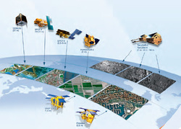
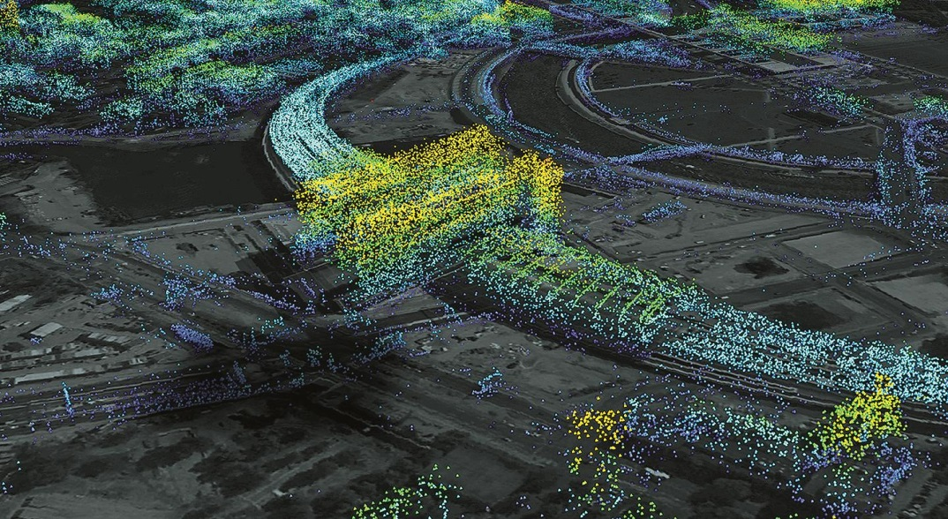
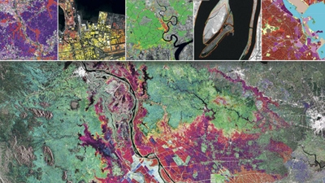
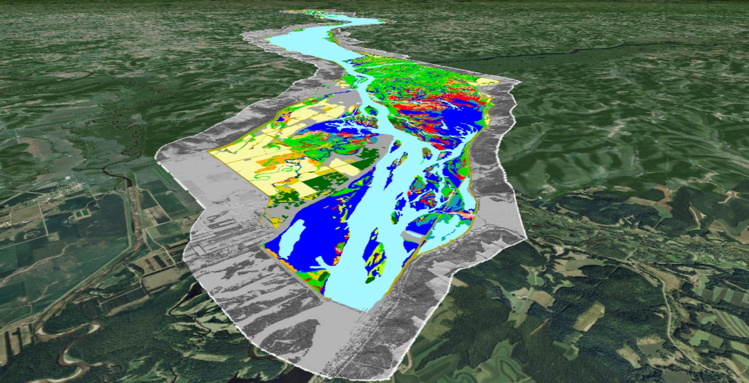
In-situ/Remote Sensing Sensor

Slide 5
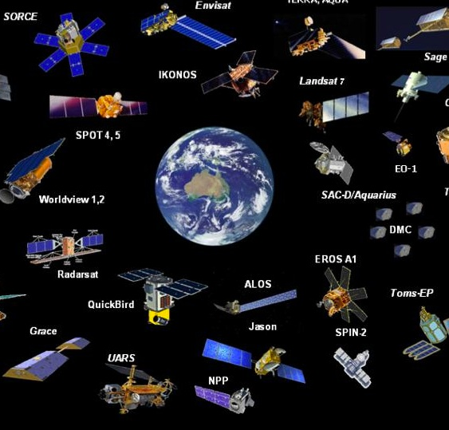
Satellite sensors

Slide 6
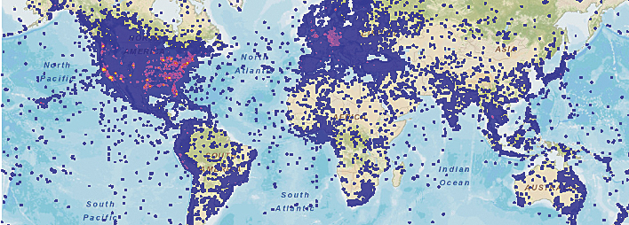
Huge Observation Dataset
The volume of earth observation data is increasing in a incredible speed..

Slide 7
Levels of Data Processing
Raw observation
Level 1
Level 2
Level 3
…
Model input
Model output (products)
Data Provenance
Data Transformation

Slide 8
Earth Science Modelers
Searching
Downloading
Reformating
Clipping
Reprojecting
Organizing
…..
usually spend more than 60% of their time to do the data preparation work..

Slide 9
What modelers need
ESMs need high-level geophysical products in a model-specific form as input.
Modelers generally create their own private input file formats for model processing conveniences.
Such products are normally NOT available directly from sensor measurements, but are derived from multi-sensor measurements and assimilated with data from other sources.

Slide 10
Reality
There is an obvious gap between earth observations and earth science models.
Temperature
Modeling
Cloud
Ocean
Flood
PM2.5
Climate
Weather
…
River Discharge
Water
Soil Moisture
Weather
Vegetation
Cloud
Wind
QuickBird
Salinity
WorldView
MODIS
Precipitation
EO
ESM

Slide 11
Four real scenarios in ESM
(1) The ESM-needed data product exists at a data source in the form exactly matching the ESM requirement.
(2) The ESM-needed data product exists at a data source but in a form different from the needed form (e.g. data format, projection, coverage or resolution).
(3) The ESM-needed data product does not exist in any one of the data sources but can be generated from low level data inputs through a set of processing steps.
(4) The ESM-required product does NOT exist in any data sources and can NOT be derived from existing data in the data sources.

Slide 12
Objective
We try to bridge the gap by building a web service based system – CyberConnector.
It is designed to realize effortlessly feeding ESM with multisource EO data.
Temperature
Modeling
Cloud
Ocean
Flood
PM2.5
Climate
Weather
…
River Discharge
Water
Soil Moisture
Weather
Vegetation
Cloud
Wind
QuickBird
Salinity
WorldView
MODIS
Precipitation
EO
ESM

Slide 13
Solution
Based on fine-grained existing interoperable web services (CSW, WMS, WCS, WFS, WPS, WCPS, SOS, SPS, WSDL, REST, etc.)
Take advantage of workflow technology
Gear up the related services in workflow according to data preparation processes
Execute the workflow automatically and return ESM-needed files to modelers

Slide 14
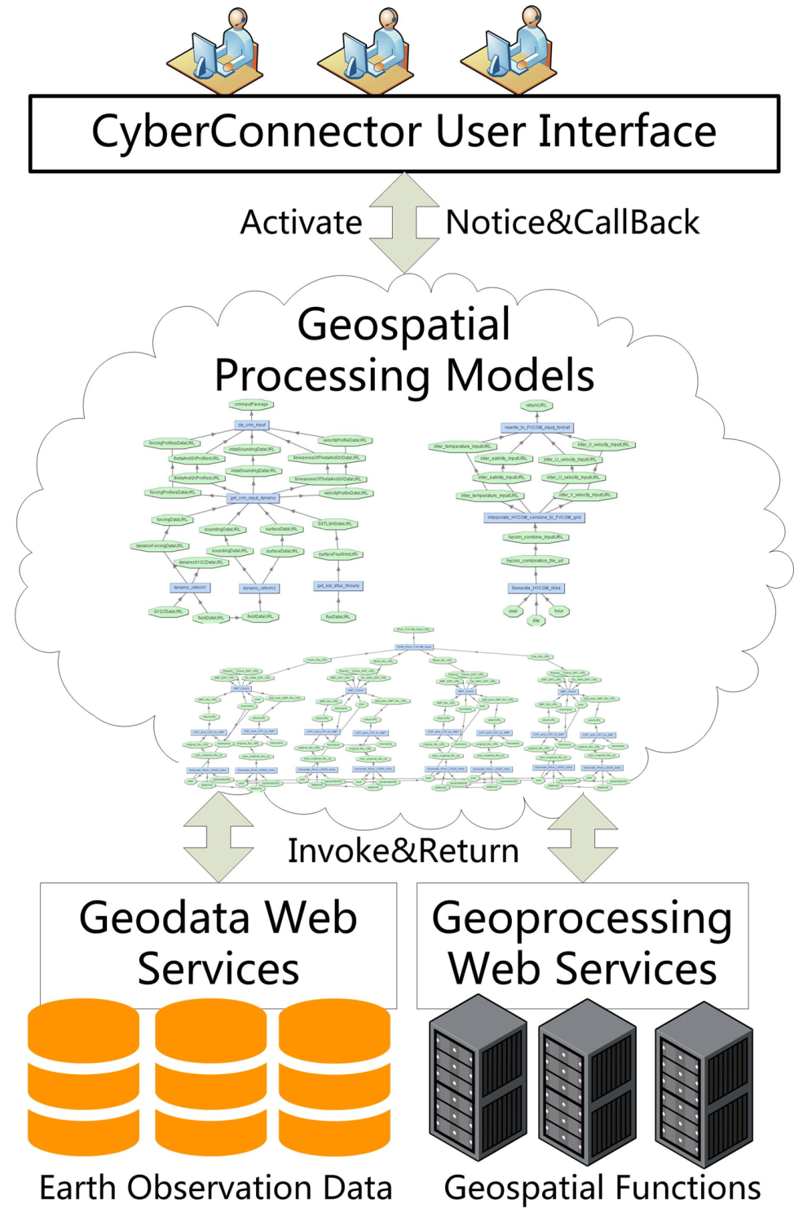
Precipitation
Temperature
Vegetation
River Discharge
Water
Soil Moisture
Weather
Cloud
Wind
QuickBird
Salinity
WorldView
MODIS
EO data
Model Ready Input File

Slide 15
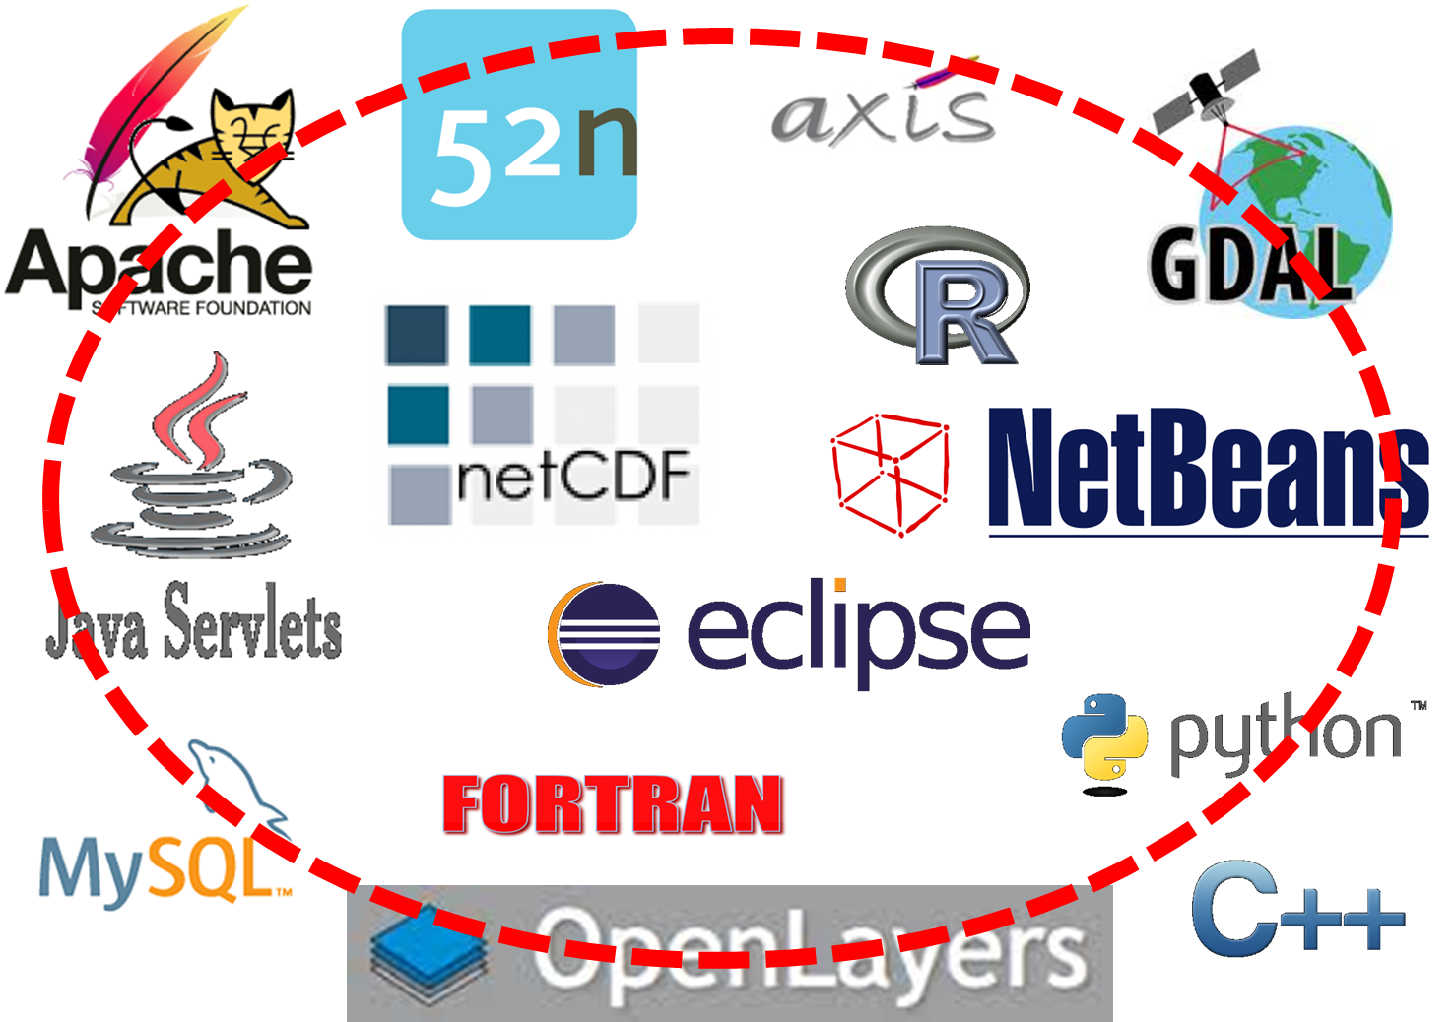
Implementation

Slide 16
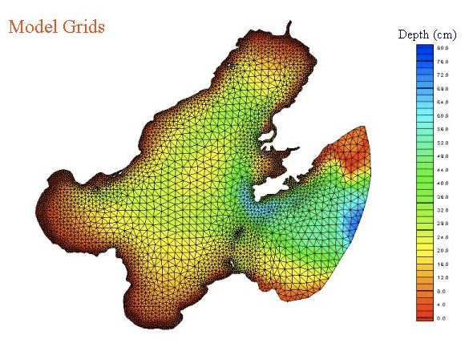
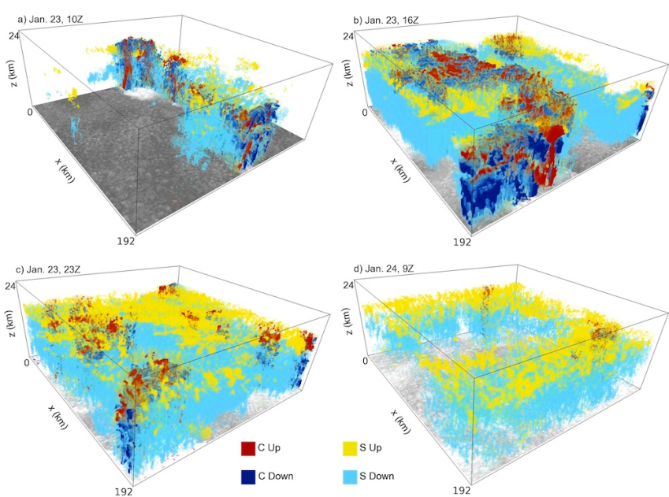
Experiment
Two models are tested on CyberConnector:
FVCOM (unstructured grid finite volume coastal ocean model)
CRM (cloud-resolving model)
Image from Chen
image from Fridlind

Slide 17
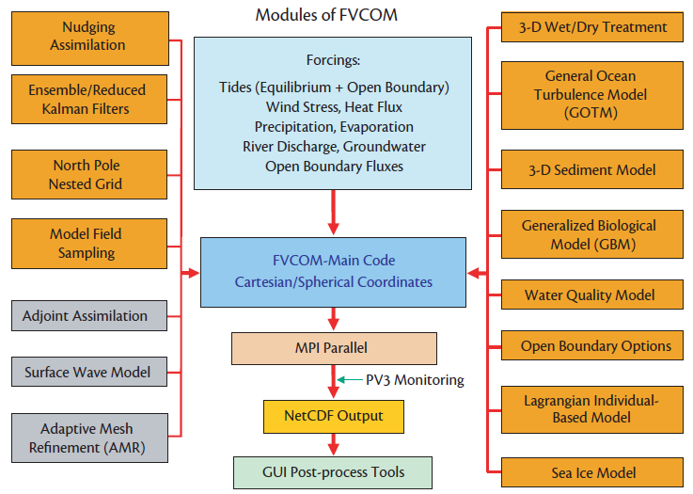
FVCOM

Slide 18
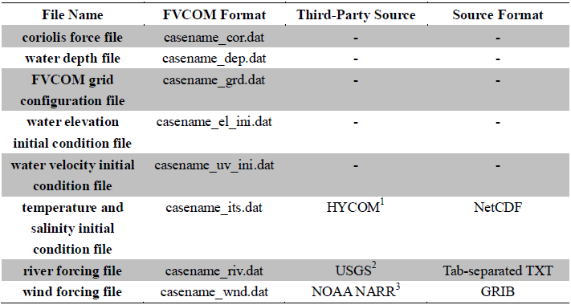
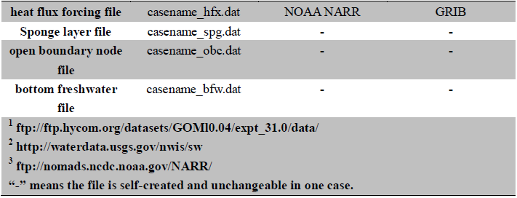
FVCOM Input Files

Slide 19
CRM
CRM provide a useful tool to simulate the response of convection and clouds to the large-scale forcing under different climate regimes in producing cloud, precipitation and radiative properties.
CRM’s common data source is Colorado State University array averaged products - DYNAMO.

Slide 20
CRM Input Files
http://johnson.atmos.colostate.edu/dynamo/products/array_averages/index.html

Slide 21
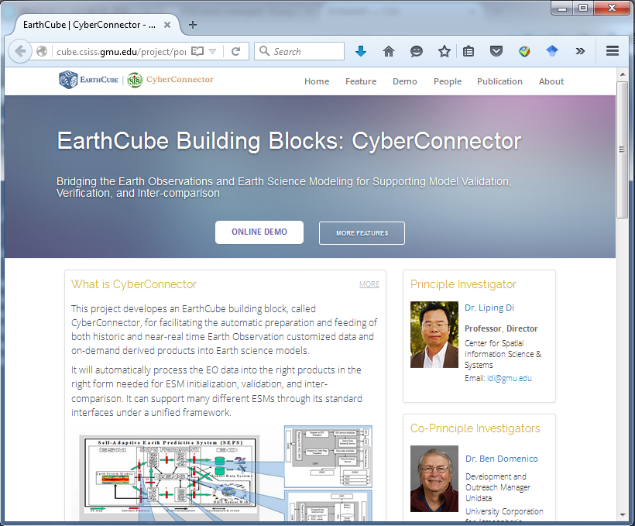
CyberConnector Portal

Slide 22
CyberConnector Testing Page

Slide 23
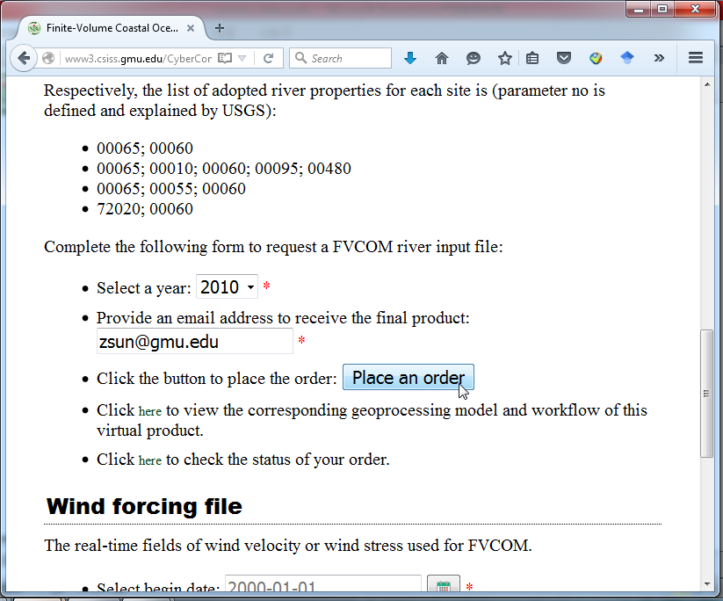
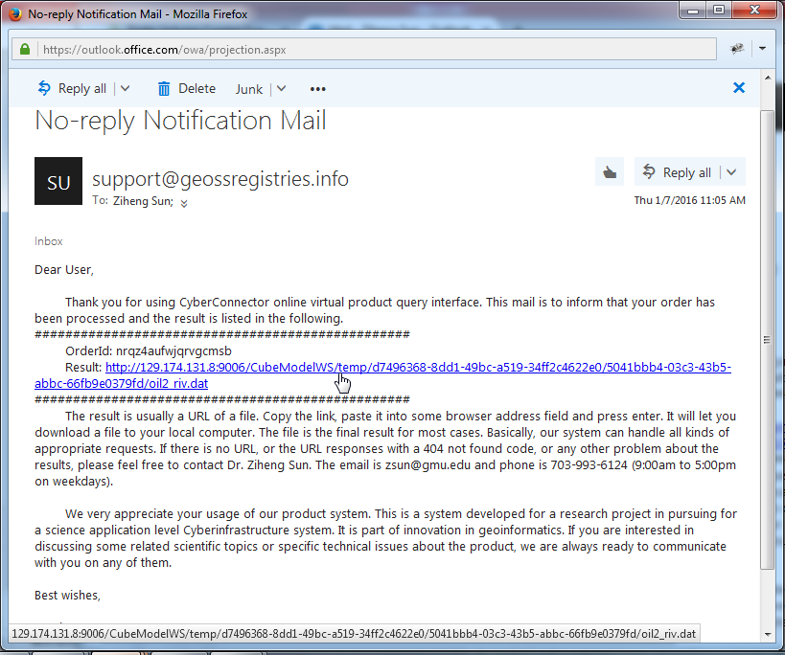
FVCOM Testing

Slide 24
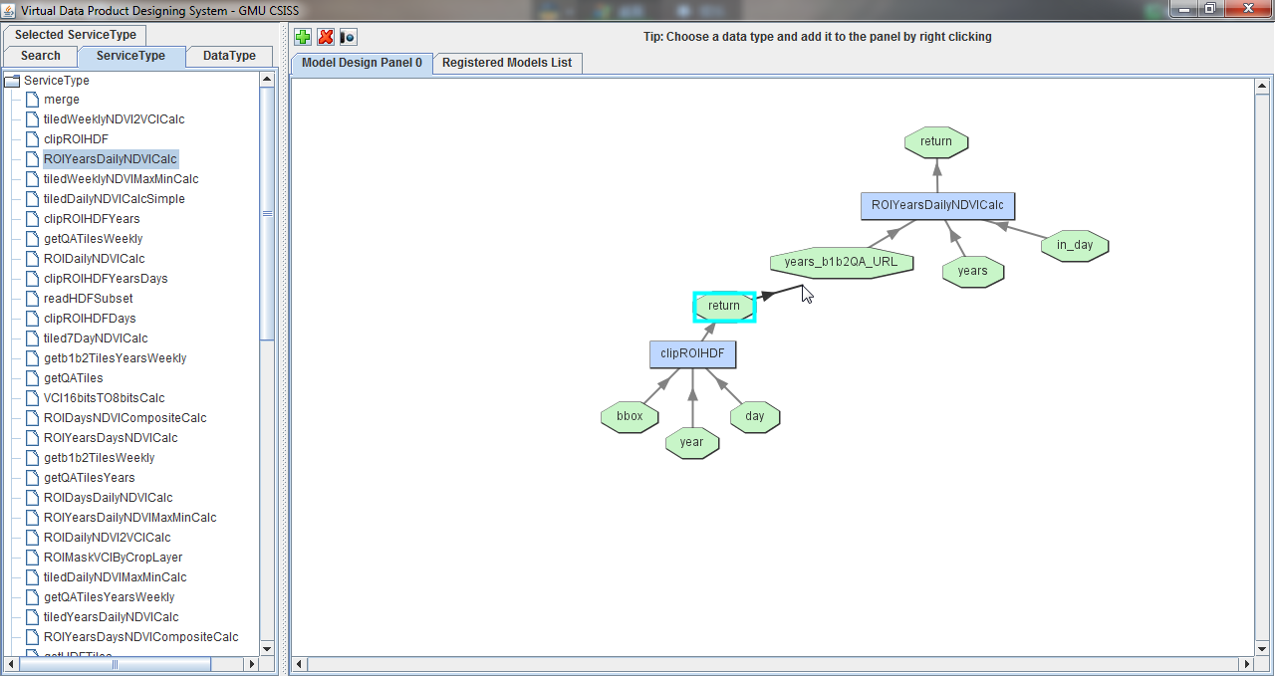
Flexibility
Modelers can build their own preprocessing workflow by using VDP designer

Slide 25
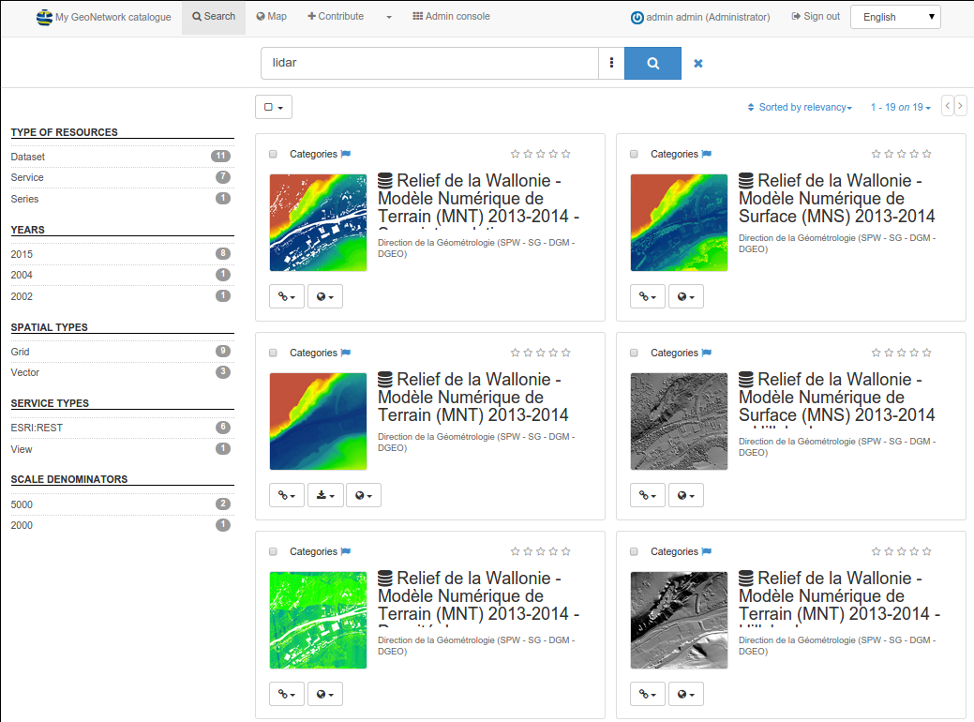
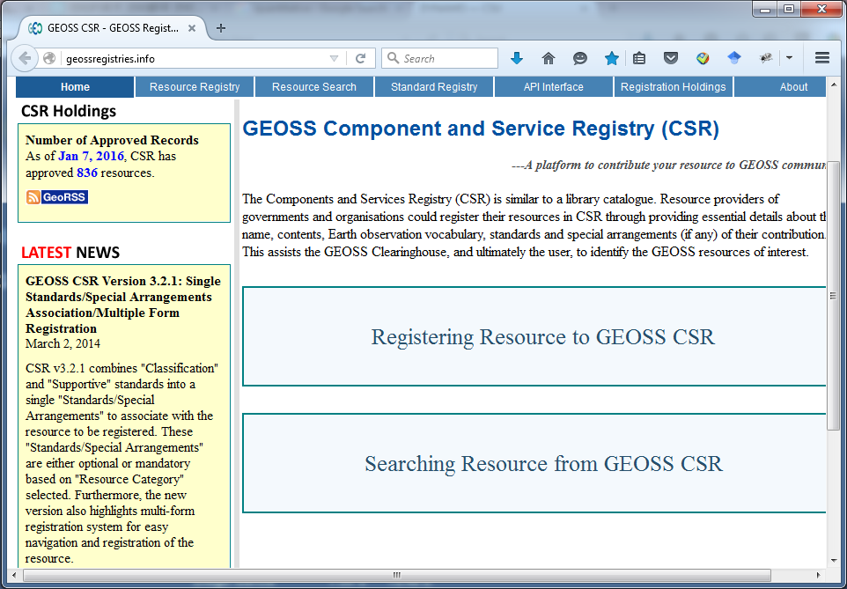
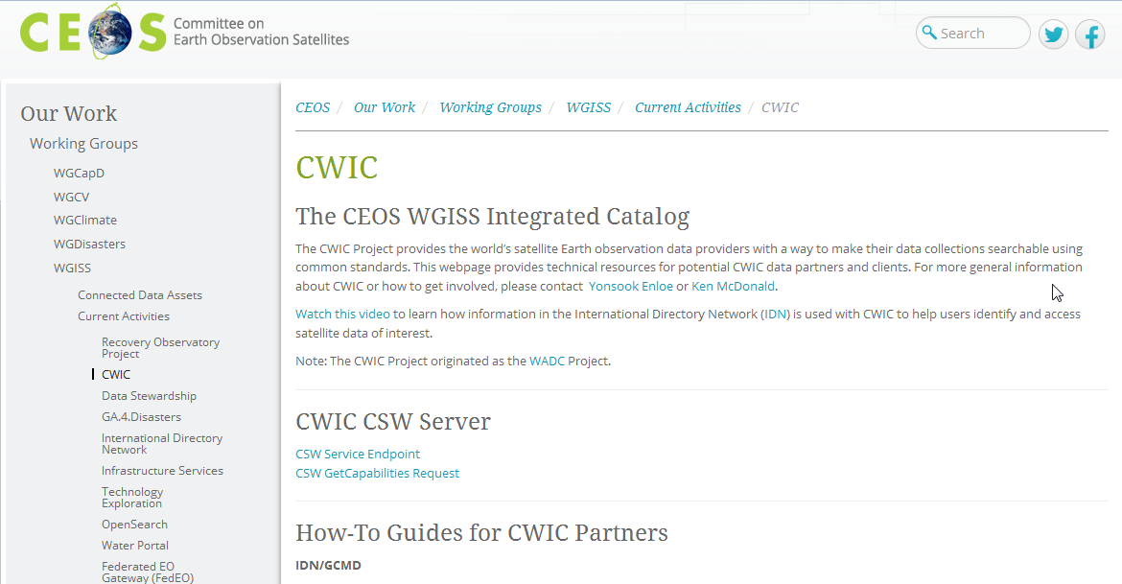
Scalability
Geonetwork
GEOSS CSR (Component and Service Registry)
CEOS CWIC
Geonetwork CSW is used to register web services and datasets.
Third-party repositories can also be used through standard interfaces.

Slide 26
Interoperability
Web services used in CyberConnector have to follow some interoperable interface standards such as OGC WCS, WMS, WFS, WPS, WCPS, SOS, SPS, WTMS, WSDL, REST, etc.
CyberConnector depends on interoperable resources.

Slide 27
General Evaluation
CyberConnector can save modelers at least half of the time they used to spend on input preparation work.
No human intervention during the data processing.
No monitoring is needed.
Back pushing notification mechanism (email) is applied.

Slide 28
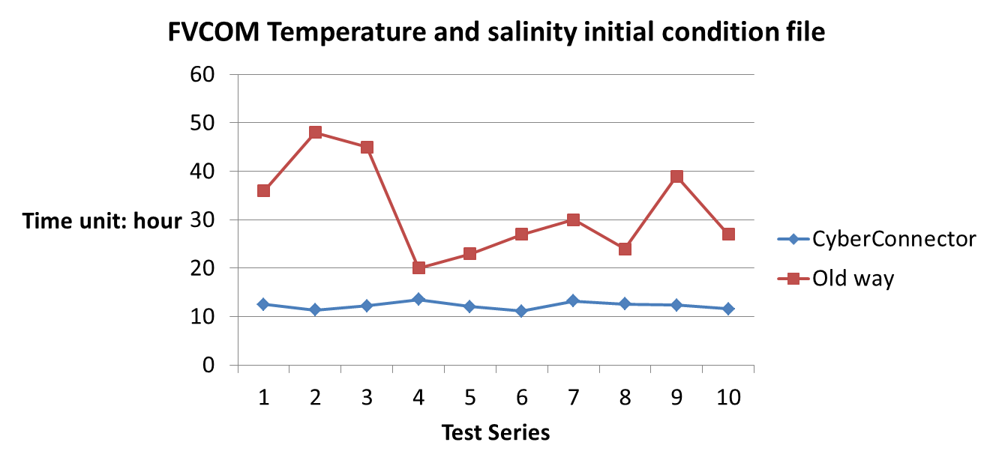
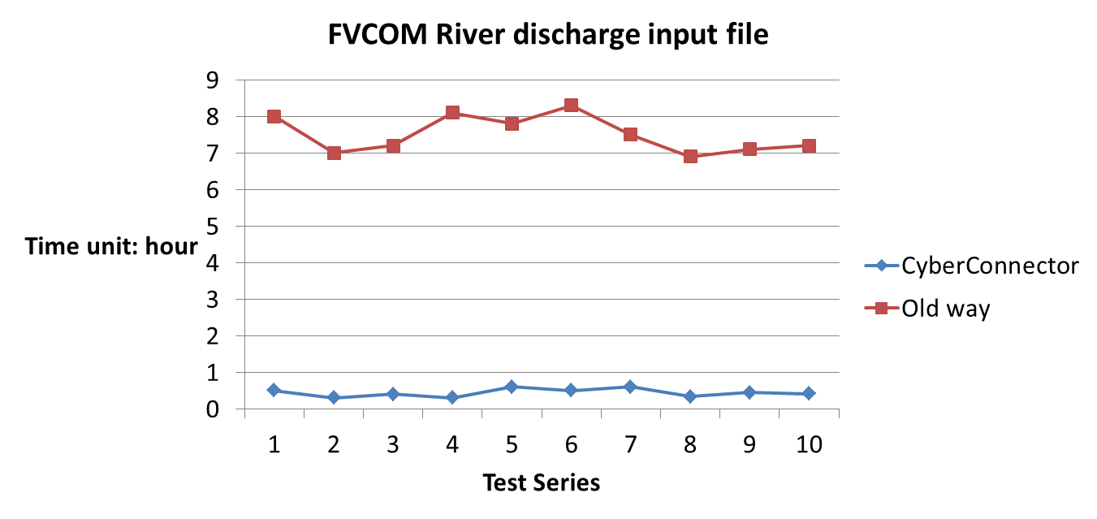
Quantitative evaluation

Slide 29
Conclusion & Future work
This study proposed a solution framework named CyberConnector to remove the barriers between EO data sources and ESMs.
We will involve the data and models from other disciplines such as Unidata (UCAR) and CMAQ to demo CyberConnector and benefit more and more modelers.

Slide 30
Thank you!
End

