Slide 1
Copyright and Data
Section:
Responsible Data Use
Matthew Mayernik
National Center for Atmospheric Research
Version 1.0
October 2012
Copyright 2012 Matthew Mayernik.
Notes:
Introduction:
This is the Federation of Earth Science Information Partners Data Management for Scientists Short Course, Section: Responsible Data Use, Module: Copyright and Data.
Slide 1: Title: Responsible Data Use: Copyright and Data.
This training module is part of the Federation of Earth Science Information Partners (or ESIP Federation's) Data Management for Scientists Short Course. The subject of this module is "Copyright and Data". The module was authored by Matthew Mayernik from the National Center for Atmospheric Research. Besides the ESIP Federation, sponsors of this Data Management for Scientists Short Course are the Data Conservancy and the United States National Oceanic and Atmospheric Administration (NOAA).

Slide 2
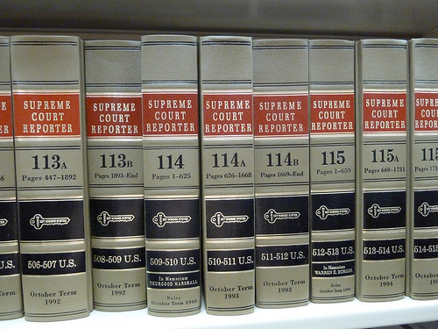
Overview
Copyright and data
What is copyrightable and what isn’t in the U.S.
Open copyright license options
Using copyrights (or waiving them)
Copyright and the public domain
Establishing non-legal norms of data access and use
Image: http://www.flickr.com/photos/j3net/6685161421/
Notes:
Slide 2: Overview
In this module, we will focus on copyright law and associated procedures related to data. We don’t often think about data as having intellectual properties as a book or a movie would, but there are some important intellectual property issues to understand about data, especially involving copyright.
We will first talk about what is and is not copyrightable in the United States with respect to data. Copyright laws can be vary greatly from country to country and jurisdiction to jurisdiction around the world, so we want to emphasize that our discussion in this module will focus upon copyright and data in the United States.
We will also talk about open copyright license options and how they apply to data, and how copyright can be used or deliberately waived, in order to make data more open and easier to access and use. We will also discuss how it’s possible to use non legal means for establishing community based norms to address some of these issues.

Slide 3
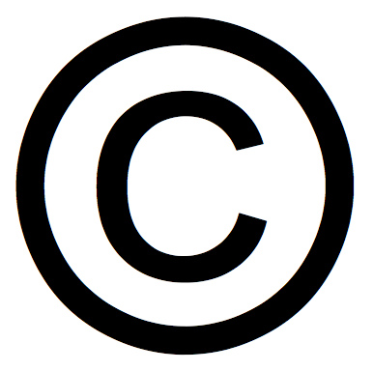
Copyright and Data
Not copyrightable in the U.S.
Facts: 2+2 = 4
Measurements: Temperature = 20 C
Copyrightable in the U.S.
Original selection and arrangement of data
Metadata: documentation and descriptions of data or processing steps
In the U.S., copyrights are assigned by default, i.e. without having to officially file for them.
Ex. lab notebooks or dissertations are copyrighted without researchers filing for them.
Through employment contracts and intellectual property agreements, copyrights for research products are often owned by employers (e.g. universities), not creators.
Image: http://www.flickr.com/photos/mikeblogs/3020966666/
Notes:
Slide 3: Copyright and Data
In the United States, there have been a number of legal decisions that have addressed copyright of data. Some of the results of those decisions have established that facts are not copyrightable in the US. For example, the fact that 2+2=4 is not copyrightable. In applying that principle to data, we can assume that individual facts or data points are not copyrightable. So for example, the idea that the temperature was measured at 20 degrees outside a building yesterday is a fact, and not copyrightable.
What is copyrightable in the U.S. however, is a new or original way to select and arrange data. The court case in which this was decided focused on the phone book, that is, whether somebody could copy all of the information in the phone book and make a rival phone book. The decision in this court case held that the information a phone book contains, including facts such as your name, address and phone number is not copyrightable; however, the original arrangement of all the sequential ordering is copyrightable. This rule also applies to data, meaning that the original selection and arrangement of data can be copyrighted.
In addition, the associated metadata, that is, the documentation and descriptions of data or about the processing used to collect data are copyrightable.
Another important consideration about copyright in the U.S. is that copyright is typically assigned by default, meaning that even if you haven’t officially filed for a copyright you will still have copyright on the materials you’ve created. For example, suppose you have notebooks from your lab that have been created in the process of doing your research. The lab notebooks have all your notes, and maybe even have some observations or values recorded. Those notebooks are copyrighted by default. In addition, printed materials like dissertations or research articles are copyrighted by default without you actually having to file for the copyright (unless you’ve signed publishing agreements that establish other copyright).
It is important to note, however, that copyright is not necessarily assigned to the people who have created the material, but rather to the organizations for which they work. Universities or other research agencies often have agreements that you must sign when you become an employee or contractor that say materials created while an employee must have copyright, or patents or other intellectual property assigned to the employing organization, such as the University. It’s important to be aware of when this might be the case for you.

Slide 4
Copyright license agreements for data
Through copyright law, license agreements exist for making data public:
Free/Open Licenses such as GNU General Public License (GPL)
Creative Commons licenses
Such copyright license agreements complicate data sharing and integration efforts
There is an amorphous line between what can and cannot be copyrighted within databases
Different license agreements have different usage requirements, e.g. querying across 10 databases may return results with 10 different usage license agreements
Notes:
Slide 4: Copyright license agreements for data
We’d now like to talk about some of the copyright license agreements that have been developed to make resources more publicly available, and more publicly useful.
In general, having copyright for a resource means that you have the exclusive rights to publish something, to make copies of it, to make public presentations and so on. If you have a copyright on your book, another person can’t publish another version of your book or make a copy of it without your permission.
In recent years, licenses have been created that allow more open use and reuse of intellectual resources. These kinds of licenses have become fairly common for open source software and for web available resources. The licenses are available openly, without needing to pay legal fees or other restrictions. Examples of this kind of license are the GNU General Public License (GNU GPL) and Creative Commons licenses. These licenses state that anybody using a resource subject to the license may make copies of the resource, republish it and its versions, and use it to produce new types of materials under certain conditions. The declared conditions might be for use with attribution given to the license holder or use for non-commercial uses only, for example.
We should note that when applying these types of licenses for use to data, they can often complicate data sharing and integration efforts. There are a number of reasons for this complication.
First as explained previously, there is often an amorphous line between what can and cannot be copyrighted. For example within a database, it may be very difficult to determine what is a data point, i.e., a fact, and what is an original organization or presentation of data - a copyrightable feature.
Secondly in modern computational science research, data is often brought together from lots of different sources, lots of different databases, and lots of different projects. If all of these different data sets or data sources have different usage requirements, then you might run into a situation where querying across ten databases may return results that have ten different usage licenses. Trying to meet all the requirements from these different license agreements can significantly complicate the way data is shared and brought together.

Slide 5
Using copyrights (or waiving them)
Possible ways to reduce copyright license complications:
Use the least restrictive open access licenses
Putting data in the public domain (waive all intellectual property rights)
Eliminates data use restrictions
Enables data integration
Encourages non-legal means for resolving problems
Scientific communities can develop norms as to how data should be made available, used, and attributed
Work with collaborators to ensure that the usage and attribution of others’ data meets with community accepted practices
Check with data centers for data use and attribution policies
Examples:
International Polar Year
Seismology data
Notes:
Slide 5: Using copyrights (or waiving them)
We’d like to suggest some approaches to using copyright or to waiving copyright to make data sharing easier and less restrictive.
The first approach is simply to use the least restrictive open access licenses for your data since they obviously put the least restriction on your users. The fewer the restrictions on use, the more data can be used and reused. Since there are a number of licenses of this kind, it’s important to look into the options for them and the conditions they offer. We’ve provided links to some of these licenses at the end of this module.
The second approach is to put your data into the public domain so that all intellectual property rights can be waived. Putting data into the public domain means that you explicitly designate that there are no restrictions on how data can be repurposed or integrated with other data.
One advantage of this approach is that it really encourages the resolution of problems around data sharing by using non-legal means. One effective non-legal method is to develop community-based norms for data sharing. A norm can be considered a set of expectations that are found in a particular community about how to behave properly. Some scientific communities have developed norms about how data can be made available, used and distributed that don’t involve the legal world, but instead rely upon community expectations for proper ways of behaving.
You can work with your collaborators to find out what their community accepted practices for data sharing are and ensure that they are being met. One way in which community practices for data sharing are expressed is in the data use and attribution policies of the data centers for particular disciplines or communities. We have a couple of examples to illustrate what we mean.

Slide 6
Norms of Appropriate Data Use
Ex. International Polar Year (IPY)
“The IPY Joint Committee requires that IPY data, including operational data delivered in real time, are made available fully, freely, openly, and on the shortest feasible timescale…equitable, non-discriminatory access to all data preferably free of cost, but some reasonable cost-recovery is acceptable.” (IPY Data Policy, 2008, pg. 3)
“[U]sers of IPY data must formally acknowledge data authors (contributors) and sources. Where possible, this acknowledgment should take the form of a formal citation, such as when citing a book or journal article.” (pg. 4)
Ex. Seismology Data
“For those programs in which selected principle [sp.] investigators have initial periods of exclusive data use, data should be made openly available as soon as possible, but no later than two (2) years after the data were collected.” (NSF Division of Earth Sciences, 2010, pg. 2)
“[Federation of Digital Seismograph Networks] Networks and Data Centers appreciate proper acknowledgment when anyone makes use of the data from their organizations.” (FDSN Services website: http://www.fdsn.org/services.htm)
Notes:
Slide 6: Norms of Appropriate Data Use
Our first example is the International Polar Year (IPY), a project two years in the making from 2007 – 2008. This project generated many studies about different aspects of the polar environment. The International Polar Year project has a policy that requires IPY data, including operational data, be made fully available, freely available, and openly available in the shortest feasible time frame. The policy calls for non-discriminatory access to IPY data, free of cost, unless cost recovery is necessary.
The IPY also has a norm about attribution. The policy states that users of IPY data must formally acknowledge data authors or contributors and the sources of the data. It further states that where possible the acknowledgement should take the form of a citation to a data set, just as one would cite a journal article.
Both aspects of the IPY policy encourage non-legal means of making data available and of acknowledging that those data sets are being used.
Our second example is from the research area of seismology. This example looks at two organizations devoted to organizing and providing access to seismic data: the Incorporated Research Institutions for Seismology (IRIS) and the International Federation of Digital Seismograph Network (FDSN).
Within seismology, there is an expectation of data sharing. This expectation is supported by a statement from the National Science Foundation’s Division of Earth Sciences that states for those programs in which investigators have initial periods of exclusive data use, data should be made openly available as soon as possible, but no later than two years after the data were collected.
From this statement, we can see that there is an expectation within this community that data will be openly available, but with some time constraints in order to meet community needs. Researchers have two years of exclusive use before making data available if they so choose. This policy statement once again represents a non-legal norm - a way of establishing open, accessible data sets through a process that meets community needs.
Turning to the International Federation of Digital Seismograph Network, in a policy statement on the FDSN website, this community expresses its appreciation of proper acknowledgement when anyone makes use of data from their organization. Making these public statements about open accessibility and proper acknowledgement are a normative way of ensuring that people can get credit for their work, have their rights and responsibilities protected, but also make data openly available as much as possible.

Slide 7
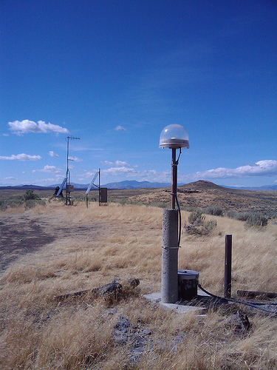
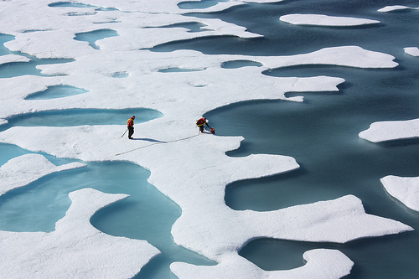
Conclusion
Copyright law has limited application to data
Data are not copyrightable directly
Other related research materials are copyrightable
Understand copyright options
Who has copyrights
Open licensing schemes
When public domain might be applicable
http://www.flickr.com/photos/gsfc/6151061573/ http://www.flickr.com/photos/inl/5988483935/
Notes:
Slide 7: Conclusion
We’ve talked about how there is some application of copyright law to data but in a limited and indirect way. Data themselves are not copyrightable directly but data organization can be copyrighted as well as the other associated research material, such as metadata, software and so on.
We’ve identified some key questions to ask yourself about the intellectual property issues associated with your data. Who has copyright on the data you have or are using; is it the investigator or the organization sponsoring the work that resulted in the data? What are some of the licensing schemes that make resources as openly available as possible? When are those licenses applicable to your data and when they are not? When might it be appropriate to make data freely available by placing it into the public domain and when not? As a responsible data creator and user, it’s important to understand the copyright options for your data.

Slide 8
References
Copyright and Data
Samuelson, P. 2001. “Digital Information, Digital Networks, and The Public Domain.” Conference on the Public Domain, Duke Law School. http://law.duke.edu/pd/papers/samuelson.pdf
Stodden, V. 2009. "The Legal Framework for Reproducible Scientific Research: Licensing and Copyright." Computing in Science & Engineering 11(1): 35-40. http://dx.doi.org/10.1109/MCSE.2009.19
Wilbanks, J. 2008. “Public domain, copyright licenses and the freedom to integrate science.” Journal of Science Communication 7(2). http://jcom.sissa.it/archive/07/02/Jcom0702%282008%29C01/Jcom0702%282008%29C04/Jcom0702%282008%29C04.pdf
Notes:
Within this module, we've made reference to published sources that we think you may want to review when you want more information about copyrighting data and about the public domain.

Slide 9
Resources
Copyright and Data
Copyright law of the United States. http://www.copyright.gov/title17/
Creative Commons Licenses. http://creativecommons.org/licenses/
Science Commons. “Protocol for Implementing Open Access Data.” http://sciencecommons.org/projects/publishing/open-access-data-protocol/
Cornell University. “Copyright Term and the Public Domain in the United States.” http://copyright.cornell.edu/resources/publicdomain.cfm
Polar Information Commons. “Appropriate behavior when contributing and using PIC data.”
http://www.polarcommons.org/ethics-and-norms-of-data-sharing.php
Notes:
Slide 9: Resources
On this slide, you will find a linked listing of some additional resources you might find helpful should you need more information about copyright licenses and legal definitions of public domain.

Slide 10
Other Relevant Modules
Local Data Management – Providing Access to Your Data:
Rights
Handling Sensitive Data
Preservation Strategies: Data Transfer and Submission Agreements
Responsible Data Use: Citation and Credit
Notes:
Slide 10: Other Relevant Modules
The modules of the ESIP Data Management for Scientists Short Course have been designed to complement and supplement each other. In light of this plan, we think you may find the following modules relevant to you as you seek to gain a better understanding of data management:
For more information about dealing with sensitive data or rights related to your data, see the Local Data Management – Providing Access to Your Data section and review the Rights and the Handling Sensitive Data modules.
For more information about how to declare the data accessibility facts about your data, see the Preservation Strategies: Data Transfer and Submission Agreements module.
For more information about how and why to create a citation and receive credit for your data, see the Responsible Data Use: Citation and Credit module.

Slide 11
Recommended Citations
Mayernik, M. 2012. “Responsible Data Use: Copyright and Data.” In Data Management for Scientists Short Course, edited by Ruth Duerr and Nancy J. Hoebelheinrich, Federation of Earth Science Information Partners: ESIP Commons. doi: 10.7269/P31V5BWP
Copyright 2012 Matthew Mayernik.
Notes:
Slide 11: Recommended Citation
This module is available under a Creative Commons Attribution 3.0 license that allows you to share and adapt the work as long as you cite the work according to the citation provided.
Thank you very much for your interest in the ESIP Federation’s Data Management for Scientists Short Course.

