Slide 1
Retrieving and Transforming ISO 19115 Metadata
ESIP Summer 2014

Slide 2
ESDIS Standards Office (ESO) Review
Gotchas
Retrieving ISO 19139 XML
via Reverb
via ECHO API
ECHO Catalog and ISO 19115 Metadata
Current Status
Notes:
CMR Overview Katie 15 minutes
Building the CMR Dan 20 minutes
Expanding Metadata Capabilities Katie 10 minutes
Unified Metadata Model for Collections (UMM-C) Tyler 10 minutes
Reconciliation Process Tyler 10 minutes
Metadata Quality/Validation Service Tyler 10 minutes
General Question & Answer All 15 minutes

Slide 3
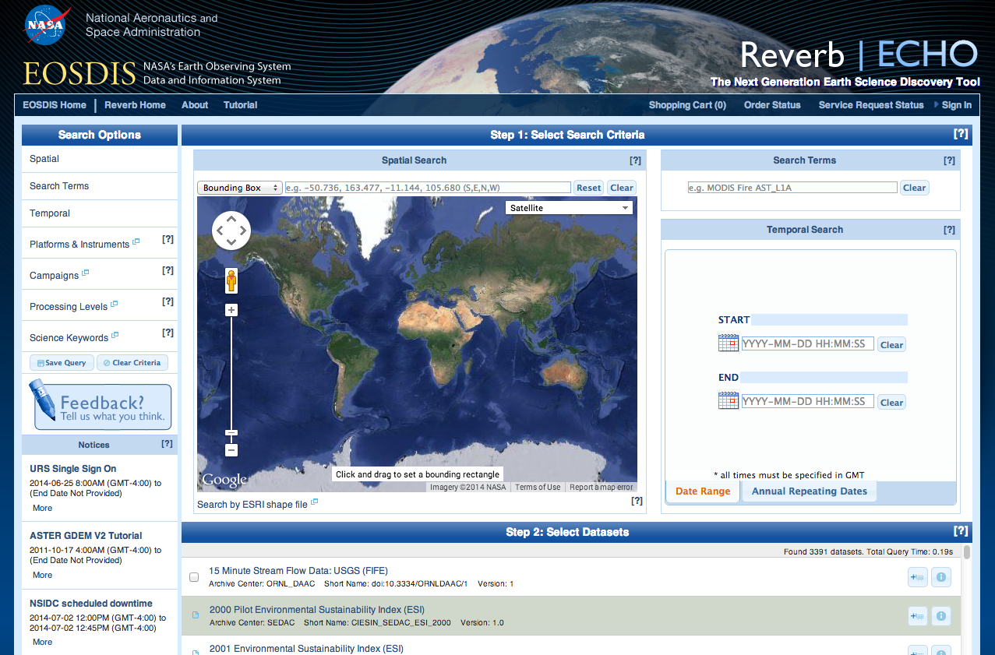
What is ECHO?
ECHO is a metadata catalog
NASA’s Earth Observing System Data and Information System (EOSDIS)
Collections: 3.9k
Granules: 160 million
Growing: 600k/week
REST API
Web Front End: Reverb
https://reverb.earthdata.nasa.gov

Slide 4
ECHO and ISO Current Status
Ingesting Metadata
ECHO has support for adding ISO 19115 directly to our catalog via the REST API
SMAP - testing underway
GRACE – translation underway

Slide 5
ECHO and ISO Current Status
Translating Content
Every collection and granule in ECHO can be exported as ISO 19115
ECHO10
NASA ISO
xslt

Slide 6
ECHO and ISO Future
Translating Use Cases
Discovery
Discovery
ECHO10
Use
Understanding
(Data Quality,
Lineage)
NASA ISO
xslt

Slide 7
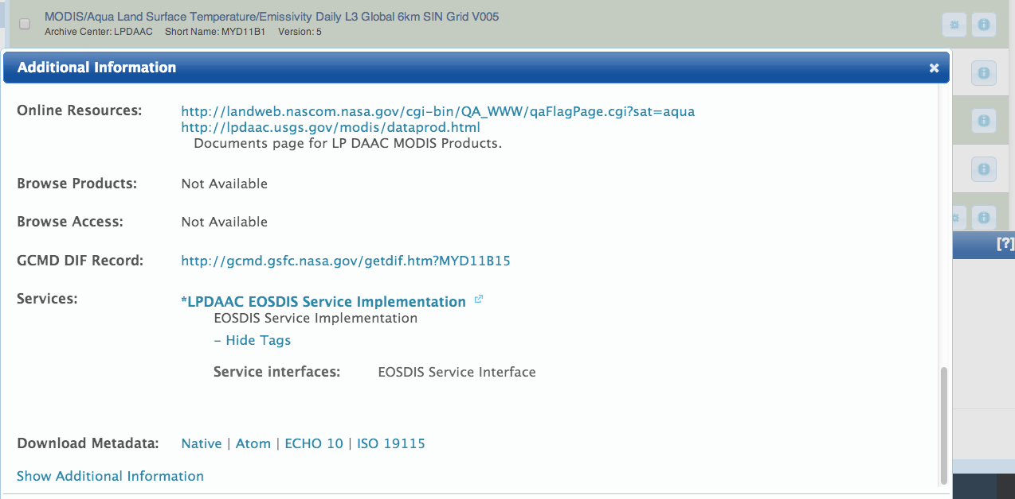
Retrieving ISO 19115 via Reverb
Go to Reverb
Search for Collection
Click Info Icon
Scroll to bottom of dialog.
Select ISO 19115

Slide 8
Retrieving ISO 19115 via ECHO API
ECHO has a REST(ish) API.
The format you want can be retrieved with a URL suffix
http://api.echo.nasa.gov/catalog-rest/echo_catalog/
│
├──datasets.iso19115?keyword=cryosphere
│
├──granules.iso19115?short_name=MYD11B1&updated_since=2014-07-03T10:00:00Z
│
├──datasets/{echo_collection_id}.iso19115
│
└──granules/{echo_collection_id}.iso19115

Slide 9
Retrieving ISO 19115 via ECHO API
More Info on ECHO’s REST API
(+ non-ISO 19115-specific examples)
https://api.echo.nasa.gov/catalog-rest/catalog-docs/index.html
https://wiki.earthdata.nasa.gov/display/echo/ECHO+REST+Search+Guide
https://github.com/dpilone/echo_technical_interchange
https://openclipart.org/image/300px/svg_to_png/185205/teacher-male.png

Slide 10
What Version of the Translation am I looking at?
There’s an XPath for that:
/gmi:MI_Metadata
│
└──/gmd:metadataMaintenance
│
└──/gmd:MD_MaintenanceInformation
│
└──/gmd:maintenanceNote
│
└──/gco:CharacterString
Translated from ECHO using ECHOToISO.xsl Version: 1.15 (Jan 27, 2014)

Slide 11
Can I look at the xslt?
Sure.
https://cdn.earthdata.nasa.gov/iso/
https://cdn.earthdata.nasa.gov/iso/resources/transforms/
(Plus, Ted is really good about version changes)
Newest Version is from June 6, but isn’t Operational in ECHO yet

Slide 12
ESO MENDS Review
ESO | Earth Science Data and Information System Standards Office
MENDS | Metadata Evolution for NASA Data Systems
MENDS Phases | Phase I: Recommendations Phase II: Crosswalk & Schema Development Phase III: Review and Revision

Slide 13
ESO MENDS Review
MENDS Phase III Goals:
Review & Revise ECHO to ISO 19115 mapping
Outputs:
Metadata Requirements Base Reference
XSL Transform and conventions
ECHO Crosswalk
XML Schema
Notes:
Metadata Requirements Base Reference
One of the earliest deliverables of phase III was an agreement on what metadata should be supplied by NASA missions going forward. The metadata requirements document is the best starting point for understanding the “top level” metadata included in the NASA Best Practices. All future NASA Earth Science missions will provide the metadata described in this document, so understanding it is a key component of reviewing MENDS phase III.
XSL Transform and conventions
The ECHO to ISO 19115 Transform is the primary reviewable artifact of MENDS phase III . The transforms convert ECHO-formatted metadata into ISO 19115 format. These transforms were implemented as a set of XSLT files and have been installed in a test version of ECHO. ECHO’s Reverb client, in that test version, can be used to exercise these transforms and view existing ECHO metadata in ISO format. Directions for finding and viewing the metadata are given below.
ECHO Crosswalk
The ECHO Crosswalk Spreadsheet lists each of the ECHO Collection and Granule metadata attributes and shows the absolute xpath to where the attribute is stored in the ISO 19115 XML Representation.
XML Schema
Most of the ECHO attributes mapped to equivalent attributes in the ISO model. For attributes that did not cleanly map to ISO, four strategies for mapping legacy attributes into ISO were used. One of these strategies was to extend the ISO XML format to include additional elements. A new schema, using the EOS namespace, was developed to describe NASA’s ISO extensions.

Slide 14
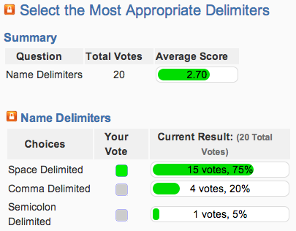
ESO MENDS Review
The Review and Voting Process
Facilitated via Teleconferences and a Wiki

Slide 15
ESO MENDS Review
Final Review Process
1: Science Experts/Previous MENDS Team
2: Data Center Staff with ISO Experience
3: Data Center Staff with little/no ISO Experience

Slide 16
Gotchas
Finding Errors/Gaps in the Source Metadata
“The two biggest issues I see for users is the format in which the metadata displays and the completeness and accuracy of the metadata.” – Deann Miller
“…range of horizontal tiles in the polar grid is 0-18, not 0-38. but I note it's 0-38 in the native metadata…” – Siri Jodha Kalsa
“…we identified a whole bunch of quality, consistency, and completeness problems with ECHO metadata during MENDS…” – Ted Habermann

Slide 17
Gotchas
Hierarchical Keywords (aka GCMD)
EARTH SCIENCE
│
└──LAND SURFACE
│
└──LAND TEMPERATURE
│
└──LAND SURFACE TEMPERATURE
becomes
EARTH SCIENCE&gt;LAND SURFACE&gt;LAND TEMPERATURE&gt;LAND SURFACE TEMPERATURE&gt;NONE&gt;NONE&gt;NONE

Slide 18
Gotchas
Translation Times
??
16s
12s
Time for
500 granules
1s
ISO 19115

Slide 19
Questions
support@earthdata.nasa.gov
ESIP Summer 2014

