Slide 1
SciSpark: Applying In-memory Distributed Computing to Large-Scale Climate Science & Analytics
Presentation at ESIP Federation
Authors: Rahul Palamuttam, Renato Marroquin, Brian D. Wilson, Chris Mattmann, Paul Ramirez, Kim Whitehall, Rishi Verma, Lewis McGibbney
This work is funded under NASA proposal number 14-AIST-14-0034, PI. Chris Mattmann

Slide 2
Outline
Motivation
Improved version 2 of RCMES using parallel computing
SciSpark Architecture
sRDD
N-Dimensional Arrays
Mesoscale Convective Systems
Science Algorithm: Grab ‘em, Tag ‘em, Graph ‘em (GTG)
Notebook Analytics Demo
Distributed GTG Algorithm (map-filter-reduce)
Performance Issues

Slide 4
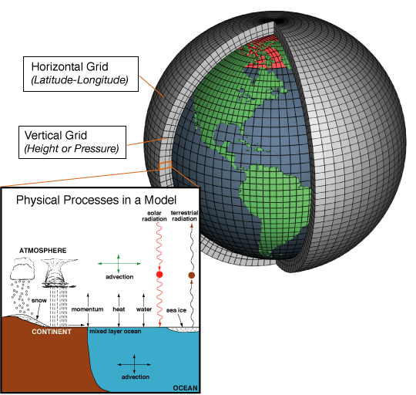
SciSpark Motivation
Climate and weather directly impacts all aspects of society
To understand average climate conditions, and extreme weather events, we need data from climate models and observations
These data are voluminous & heterogeneous - varying spatial and temporal resolutions in various scientific data formats
Provides important information for policy- and decision- makers, as well as for Earth science and climate change researchers
"AtmosphericModelSchematic" by NOAA - http://celebrating200years.noaa.gov/breakthroughs/climate_model/AtmosphericModelSchematic.png. Licensed under Public Domain via Commons - https://commons.wikimedia.org/wiki/File:AtmosphericModelSchematic.png#/media/File:AtmosphericModelSchematic.png
Notes:
Climate models are systems of differential equations based on the basic laws of physics, fluid motion, and chemistry. To “run” a model, scientists divide the planet into a 3-dimensional grid, apply the basic equations, and evaluate the results.
Model output is voluminous
Can’t compromise resolution in order to do computation
Need a powerful computation engine to deal with this problem
Model = representation of the climate. Code that represents the physical processes of the atmosphere - simulation.
Model computes temperature values
To evaluate the accuracy of these models we need to compare them to actual data
To do such voluminous comparisons without losing resolution and we need to do so very fast.
The important point/ segue :
How can we analyze such data?
What are the obstacles to dealing with voluminous and heterogenous files using current Big Data technologies?

Slide 5
SciSpark: an analytical engine for science data
I/O is major performance bottleneck
Reading voluminous hierarchical datasets
Batch processing limits interaction and exploration of scientific datasets
Regridding, interactive analytics, and variable clustering (min/max) over decadal datasets could benefit from in-memory testing
Spark Resilient distributed dataset (RDD)
Enables re-use of intermediate results
Replicated, distributed, and reconstructable (provenance)
In memory for fast interactivity
Notes:
Extending spark to create a scientific computation framework
Previous framerwoks like Hadoop have a major I/O bottleneck
The concept of an RDD helps us reuse intermediate results
Can we use MapReduce for atmospheric algorithms
Say the use case we will be demonstrating is the Search for Mesoscale Convective Complexes.
Reading heirarchical datasets from HDFS is difficult - there is a discrepancy between the logical and physical filesystem layout
Normally

Slide 6
Spark: In-Memory Map-Reduce

Slide 7
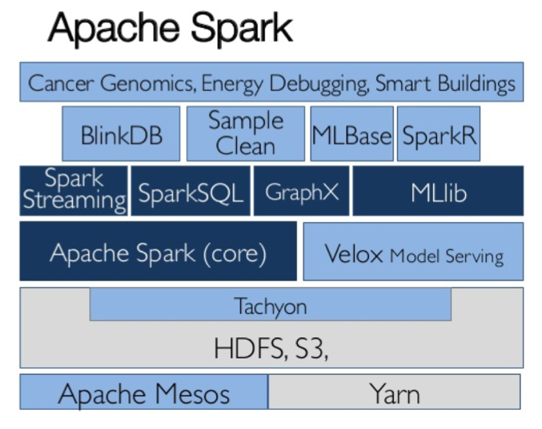
Ecosystem

Slide 8
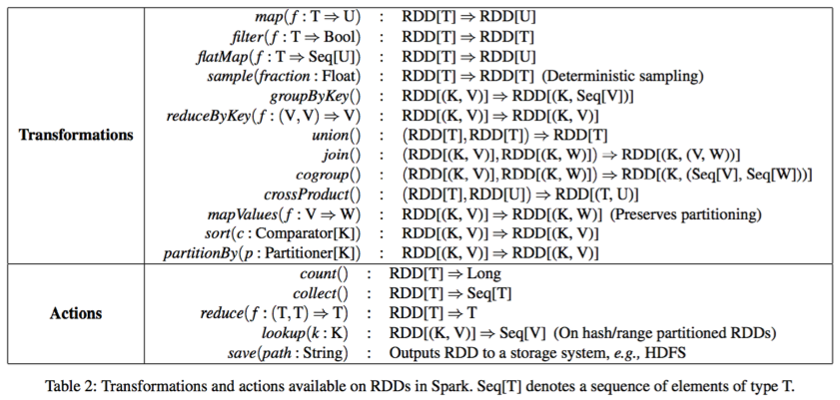
Spark Transformations & Actions

Slide 9
Envisioned architecture
Frontend
Backend
Notes:
How do we extend spark?
To achieve this goal, an initial ambitious software architecture
A scientific RDD was designed to load data from different formats, but also implement operations to help scientists on not having to re-implement such operations like regriding, or reshaping
** Explain the Layers of SciSpark -- Technology Slide**
This is what we initially envisioned.
Our internship had a two-fold goal:
we need implement a system capable of processing scientific data
implement an algorithm to prove our implementation
Our key insight in this proposal is that the lack of data reuse between these multi-stage processes and the repeated I/O is the root cause of performance bottlenecks and the resulting user’s frustrations
The RDD notion directly enables the reuse of array data across multi-stage operations and it ensures data can be replicated, distributed and easily reconstructed in different storage tiers, e.g., memory for fast interactivity, SSDs for near real time, and spinning disk for later operations
Motivation
** Expand Frontend **
D3 - promote interactive exploration of the dataset.
We want to do this in a notebook environment
Still basic viz, but it demonstrates how D3 can be leveraged for realtime/ intermediate visualization (and scientific exploration of what we capture)

Slide 10
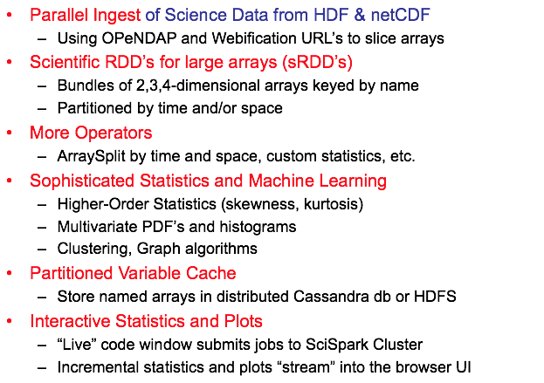
SciSpark Contributions

Slide 11
Three Challenges using Spark for Earth Science
Adapting Spark RDD to geospatial 2D & 3D (dense) arrays
sRDD, with loaders from netCDF & HDF files
sciTensor using ND4J or Breeze
Reworking complex science algorithms (like GTG) into Spark’s map-, filter-, and reduce- paradigm
Generate parallel work at expense of duplicating some data
Port or redevelop key algorithms from python/C to scala
Performance for bundles of dense arrays in Spark JVM
Large arrays in memory require large JVM heap
Garbage collection overheads
Notes:
What were the challenges we anticipated
Adapting the RDD to work well the geospatial data
heterogenous formatting
n-dimensionality
Reworking iterative science algorithms to fit the map reduce paradigm
The performance issues with JVM and it’s garbage collection latency
Spark is reliant on the JVM

Slide 12
Challenge 1: Getting scientific data in the engine

Slide 13
Science Data File Formats
network Common Data Form (netCDF) v. 3 & 4 and Hierarchical Data Format (HDF) v. 4 & 5
Heavily used by NASA, DOE, NOAA
Encapsulates (Scalars, vectors, Matrices)
Metadata (Summary info, data/time ranges, spatial ranges).
Custom readers/writers/APIs in many languages
Written in Fortran, C/C++, IDE, Python, Java
Notes:
** Specific Scientific Data
We specifically used netCDF and HDF formats netCDF HDF files
Need to worry about the logical and physical layout of the files across Hadoop Distributed Filesystem
Cannot read portions of the files, and instead must read all of the file when ingesting
The hierarchical nature and custom libraries introduces unique backend challenges for such a system
Specifically non-serializable library classes and I/O
**
Challenge 1: Unique file formats that encapsulate both
Many languages = Fortran, C/C++, IDE, Python, Java
With Spark these libraries introduce serializability issues

Slide 14
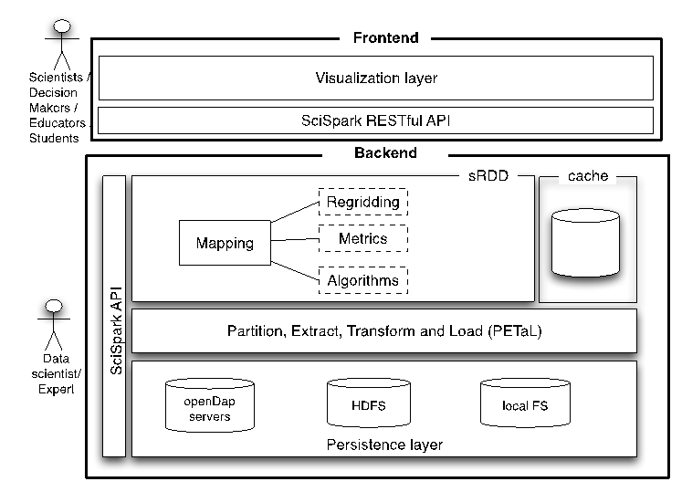
SciSpark current architecture
Implemented in Java/Scala environment
PETAL layer: flexibility for user to write their own loader and partitioner
Notes:
Needed to think about user and allow them to write their own loader and partitioner for ingesting data in SciSpark
We also sought to simplify the initial backend architecture
From initial backend architecture we realized that the concept was not going to work
We needed to redefine what it means to read data in multiple formats from multiple sources
How to materialize an RDD from such a source
What makes it an sRDD
The sRDD inherits functionality from the RDD
It is fundamentally different because :
loaders from multiple sources and scientific formats
closely tied with the matrix library.
Spark has wrappers around matrix libraries for linear algebra
However these libraries do not support loading N-Dimensional data
We decided to write this in Scala/ Java → Don’t need to explain this - only if somebody asks
scientific community are comfortable with using Python as their programing language for analysis, viz so why not use pyspark
PySpark - which is Spark’s python interface involves copying from JVM to daemon processes
Furthermore a collect operation in PySpark involves first writing the results to disk and then reading them.
however still open to future research for a python interface for SciSpark

Slide 15
SciSpark’s scientific RDD creation workflow
sRDD
sPartition 0
…..
sTensor
sTensor
. . .
Partition 0:
List[URI]
Partitioning function
sPartition 1
sTensors loaded only at compute time
Passes
sTensor
sTensor
. . .
1.URIs set
Load
function
. . .
Partition N:
List[URI]
sPartition 2
sTensor
sTensor
. . .
Notes:
To go a little more in depth into the workflow (abstracted away from the novice/ application end user, but available to the expert user):
The partition function takes the list of URI’s and chops it up into a bunch of smaller lists
Each partition gets 1 list.
These lists are pointers to where files are located.
This could be an HDFS path or an OpenDAP Rest API URL.
This may not be the best approach for OpenDAP - because this ends up throttling the server. We recognize is an area for future work.
After the partitions have been shipped around, we then call the loader function which loads the data
In CS terms this is the data instantiation step
Thus we are able to load data in parallel. This is better than first loading the data and the shipping the data around for computation.
-- Time Where you are on this slide if > 8 minutes then keep it quick - otherwise talk about the opendap issue

Slide 16
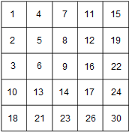
How the sRDD is represented to the scientist
sciTensor
a self-documented array
keeps a list of variable arrays
keeps metadata in a hashmap
users can query the hashmap and do matrix operations
sRDD
sciTensor
Metadata
Abstract Tensor
...
Partition 0
key
value
Gets
sciTensor
...
User
MapReduce
Algorithm
Partition 1
sciTensor
sciTensor
sciTensor
...
Notes:
TODO : update variable array hashmap
This is what the sRDD looks like.
There’s a large object called the sciTensor
a SciTensor is a self-documented array
It keeps a list of variable arrays
it keeps all it’s metadata in a hashmap, so users can also query the hashmap and also do matrix operations
b. Think of the sciTensor as an spark in-memory abstraction of a NetCDF or HDF file
2. Programming Interface
the scientist sees the sRDD.
Scientists will express their problem following the MapReduce paradigm

Slide 17
Matrix Libraries: N-dim in Spark
BREEZE
N-dimension arrays
Young project
Arrays contiguous in mem
2-dimension arrays
Established project
Arrays contiguous in mem
Notes:
how do we achieve n-dimensionality in spark
TODO : List Pro’s and cons
breeze is the defacto linear algebra library for scala
Native java arrays achieve N-dimensionality by nesting pointers - indirection causes latency
Breeze only supports upto 2 dimensions
The Apache Spark community supports linear algebra in spark by providing wrapper objects around Breeze matrices
ND4J by SkyMind IO is a new high performance matrix library that supports N dimensional arrays in java
Arrays are allocated contiguously in memory so it takes advantage of cache locality for elementwise operations
Still being heavily developed

Slide 18
Challenge 2: Scientific problems in MapReduce

Slide 19
SciSpark use case: Mesoscale Convective Systems
Mesoscale convectively driven weather systems that are generally associated with high precipitation events during short periods
Impacts: flash flooding, agricultural damage, infrastructure damage
300 – 400 MCCs occur globally, with 66% in the NH
Duration: ≈10 hrs
Analyzing them
Voluminous data - high spatial & temporal res -> (dense matrices)
Normally IDed manually
Notes:
Mesoscale - there is a range of values.
anything between 10 - 100,000 km square arrays
“ They are normally identified by infrared satellite imagery.
Scientists look at them manually.
Want to look at the highest resolution both in space and in time - vs sampling or averaging. Keeping all data vs Throwing data
If we take a look at this video - we see how a MCC forms. Speficially these smaller features combine to form this larger feature. This movement is what we want to track.
“
- Convective
- Clouds come as convective
- convective = thunderstorm
- Looking for clouds that have a very cold temperature with small embedded areas
Brightness temperature mean
Wanted to point out how different “temperature regions” join together to form one large region
How do we track the formation of these large atmospheric events through time?
Segue into Kim’s Grab em’ Tag em’ Graph em’ algorithm
At 2 seconds you see MCC
it’s circular
larger area
becomes a squall line - an inverted storm
previous images you saw cumulus clouds and organized convective systems
they combined into the MCC
eventually become a Squall line
Why do we want to identify MCC
High impactful events. They bring heavy rain in short period of time. ex. flash flooding
High winds
Thunderstorm
Precursor to other weather features
Some locations - they are the only source of rain fall
Voluminous data - high resolution -> (dense matrices) and short time periods.
The data is read in at a minimum of ever 10 minutes. At a maximum of every 10 hours.
features normally identified via manual methods, and the voluminous data make them difficult to study over a long period of time
current techniques involve reducing the resolution and or averaging - causes loss of accuracy

Slide 20
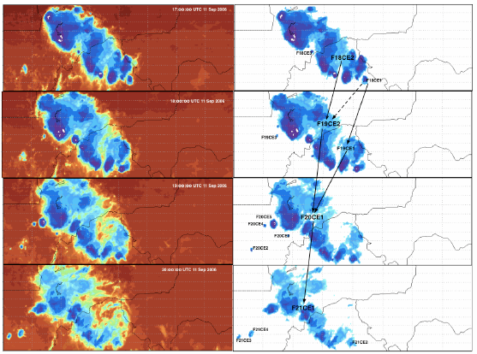
Sequential Grab ‘em, Tag ‘em, Graph ‘em (GTG)
T_{B} ≤ 241K & A ≥ 2400km²
time
Adapted from Whitehall et al. (2014)
Notes:
Limitations of the approach:
reading files sequentially to populate the array in step 1
entire array stored in memory
serial creation of the graph
because of the computation in efficiencies, the algorithm cannot handle the full dataset, high temporal resolutions (over longer periods) or long time periods
I was thinking of inserting a generated graph from an actual dataset
How are they identified?
data mining in infrared satellite data to identify contiguous regions where T_{B} ≤ 241K & A ≥ 2400km²
connect overlapping regions in consecutive times

Slide 21
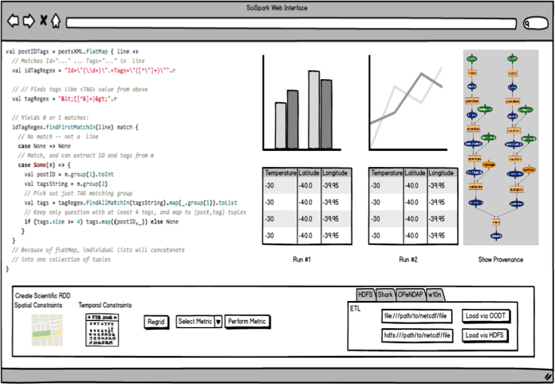
Proposed GUI: Live Code Notebook with Viz. Widgets

Slide 22
Notebook Analytics Demo - notebook connected to Spark Cluster - “live” code window for scala, python, sql - interactive plot widgets

Slide 23
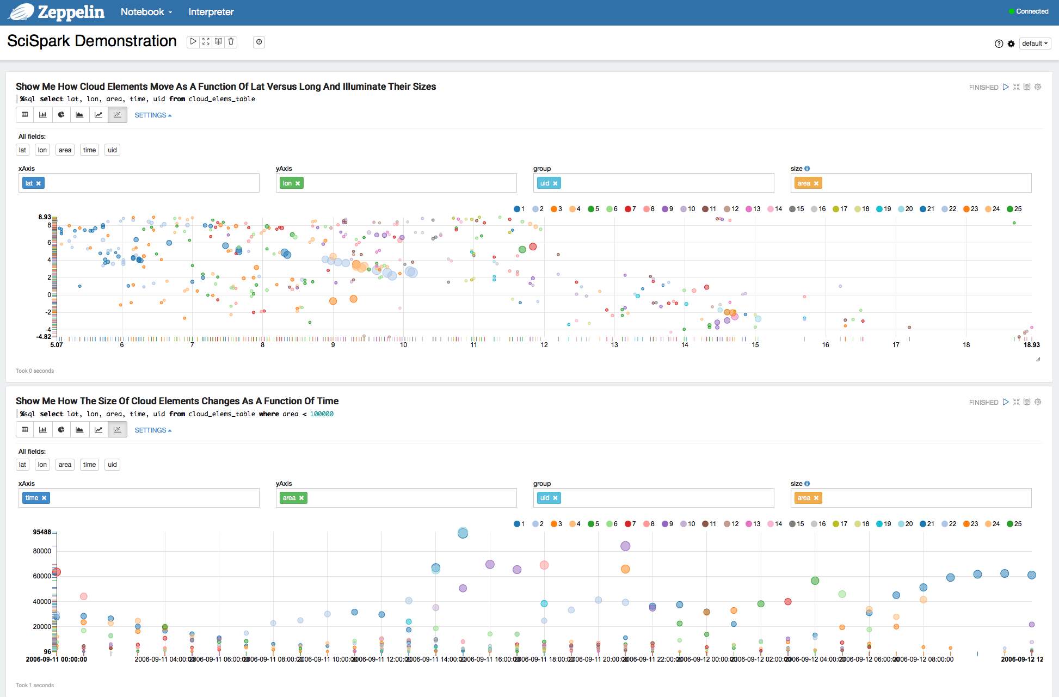

Slide 24
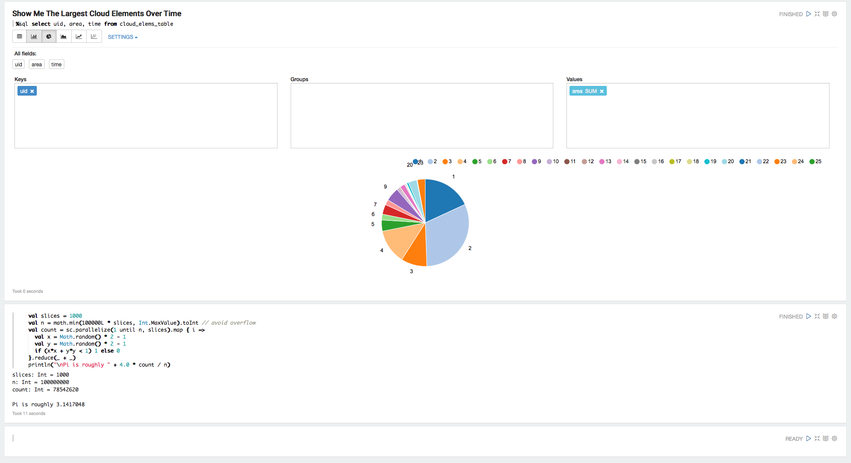

Slide 25
Distributed GTG implementation on SciSpark
sciTensor
0
2
2
2
2
2
2
2
2
2
2006/09/11 00:00
0
0
0
0
0
2006/09/11 00:00
0
0
0
0
0
0
0
0
0
0
0
0
0
0
0
0
0
0
0
1
2
2
0
1
2
2
1
2
2
0
0
0
2006/09/11 01:00
2
2
2006/09/11 01:00
2
2
2
2
9
0
9
0
0
9
2
2
9
2
2
2
2
0
0
0
0
0
0
0
0
0
0
Read Files
Find Cloud Elements
(Graph Vertices)
Find Overlapping Regions
Generate Edges
Notes:
Read MERG ← Merg is a grid of brightness temperature
Label Component
Find overlap
generate edges
extract vertices
Graph done ←- Where we are at
Iterative DFS
how to compute the pairs of sequential dates in a distributed manner? how to pair sequential dates ?
cartesian product over the dates which blew up the task space, we launched millions of unneeded
we realized that we were doing a cartesian product among the components which blew up our heap space
we achieved this by multiplying our data instead creating unneeded tasks

Slide 26
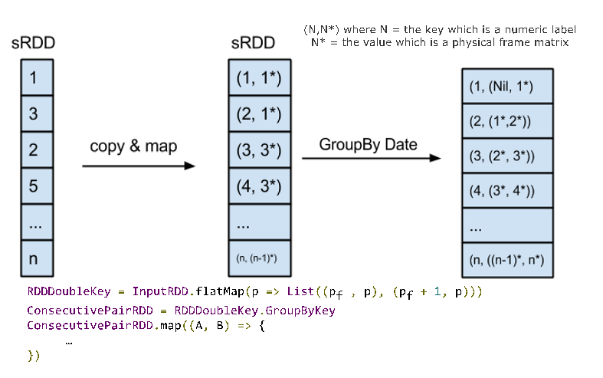
GroupBy Approach

Slide 27
Distributed GTG using MapReduce Paradigm
1: class Mapper
2: // a time-frame id represents the actual date/timestamp when the data was gathered.
3: method MAP(key frameId, sciTensor r)
4: EMIT(frameId, r)
5: // the (frameId + 1) operation outputs the next sequential frameID
6: EMIT(frameId + 1, r)
1: class Reducer
2: method Reduce(key frameId, sciTensors [r1, r2, . . .])
3: // Avoids using first and last frames
4: If sciTensors.length == 2 Then
5: // label the components inside each sciTensor
6: A_{L} = labelComponents(sciTensors[0])
7: B_{L} = labelComponents(sciTensors[1])
8: // outputs the edge found between those consecutives time-frames
9: EMIT (overlappingComponents(A_{L}, B_{L}))
10: EndIf
Notes:
“ In the mapper class we frame the time line
“ In the reducer class we implement the operations we want to do on each frame pair

Slide 28
Algorithmic Assessments of approaches
 | Sequential GTG | Distributed GTG
Level of Parallelism | 1 | p
Number of Tasks | 1 | k
Total Memory | O(n) | 2n = O(n)
Input Memory per task | O(n) | 2n/k = O(n/k)
Notes:
We tried different approached for the Distributed GTG
We found that we needed to copy our data in order to frame the problem
By copying we were able to improve our runtime by taking advantage of parallel work
Yes we copied the data - but the problem still scales linearly

Slide 29
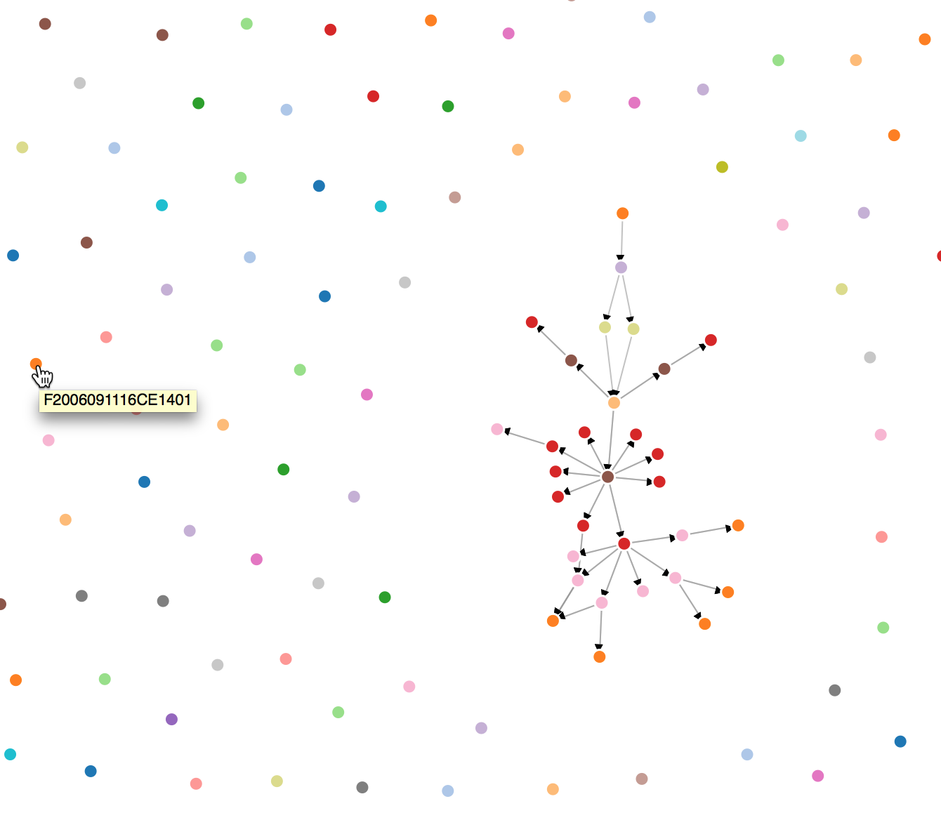
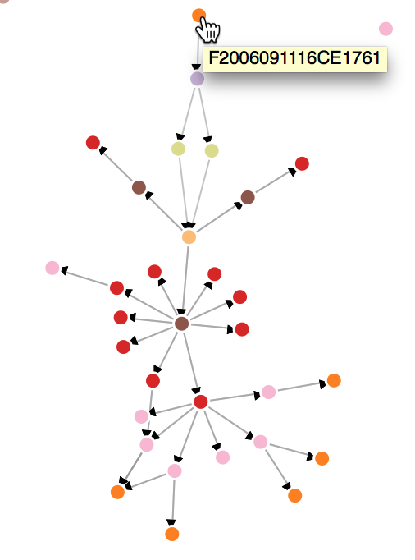
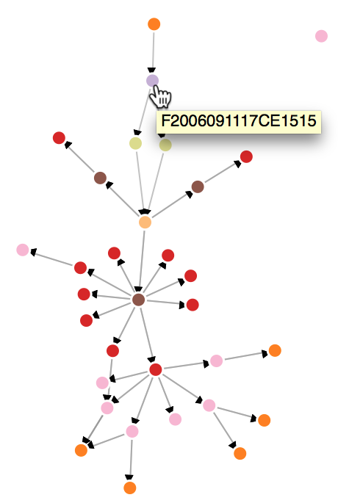
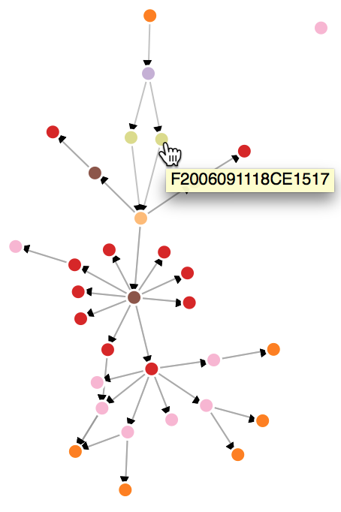
Results: D3 Visual of the graph
Drilling down on interesting graphs
Notes:
“Now we finished backend algorithm for DGTG we now look at frontend visualization of our results”
dots are coloured by time
Tested first parts of Dist-GTG with real data: hourly MERG data (raw arrays files of brightness temperature) 20060911_00:00 - 20060912_12:00. Spatial resolution: 4km x 4km, covering the globe between 60S and 60N → 4125 * 1238 matrix
isolated dots are cloud elements that were masked but aren’t connected with locations in subsequent frames
graphs indicate possible MCS regions that can develop further
notice the directionality of the graph and the complex structure e.g. at F2006091118 (bottom) : we see two CEs are connected to the node before splitting between the times - important meteorological observation!
“ 1. id cloud elements
2. mesoscale convective systems
3. can see weather futures - can see cloud elements splitting

Slide 30
Challenge 3: Performance issues

Slide 31
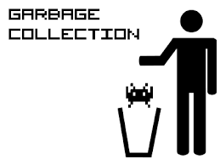
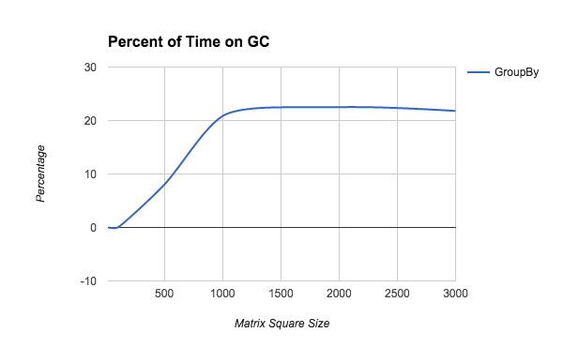
Garbage Collection (GC) Performance
Avoid unnecessary object creation
Avoid creating a lot of small objects
Avoid cartesian product!
Multiple data copies can be advantageous
Large JVM heap leads to large GC overhead
Notes:
You can try all sorts of garbage collection parameters
We tried the Concurrent GC, printing GC debug statements, and increasing younggen heapspace in the hopes that objects don’t move to old gen
However we realized that garbage collection happens for a reason! When we have too much garbage!
What we learned?
When doing big data - avoid object creation!
When using scala - avoid the tuple.
The tuple is an ordered-pair type of object. Constructing a tuple essentially takes two objects and puts them together into one object.
It’s usually a wasteful operation
and Most importantly - avoid cartesian products over any type of collections!
Yes it’s easy to use when you want to make types of pairings with your data
But this simply does not scale, with Big Data.

Slide 32
Accomplishments
sRDD architecture
built RDD to handle scientific data formats
Demonstrated functionality to read hierarchical data
Extend N-Dimensional Array operations
Provide common interface for both Breeze and ND4J
Support loading scientific data from multiple sources and formats
SciSpark use case: Distributed GTG
Generate a graph (nodes are cloud areas & edges are time) using SciSpark (run time 10 - 60 seconds)
Notes:
SciSpark prototype
sRDD architecture
read multidimensional data from NetCDF
We can read NetCDF from local filesystem or OpenDAP url’s
We can also read MERG brightness data off of HDFS and Tachyon

Slide 33
Next steps ..
Continuous evaluation of multi-dimensional array libraries
Improved results visualization
Complete GTG algorithm in SciSpark use case
How to traverse a graph to identify the features
Implementing other science cases in SciSpark
Parallel PDF Clustering
Higher-order statistics with rollups over week, month, season, etc.
Notes:
support for reading NetCDF from HDFS - a project in itself

Slide 34
Questions or comments?
Connect with us at: https://github.com/SciSpark
Contact us at: Chris Mattmann – Chris.A.Mattmann@jpl.nasa.gov
Brian Wilson – Brian.Wilson@jpl.nasa.gov

Slide 35
SciSpark use case: Mesoscale Convective Systems
The core problem: how to create the graph and how to traverse it to identify weather features in a distributed environment
Resources
Hourly infrared satellite data from the National Centers for Environmental Prediction / Climate Prediction Center (NCEP/CPC) 4 km Global (60N – 60S) Infrared Dataset dates is used
Our test are run on 4-node cluster, each node has 32 cores, 240 GB memory and 100 GB disk space.

