Slide 1
Building catalog-driven, web service-based applications with OpenSearch
ESIP Winter Meeting 2016
January 2016
Doug Newman (NASA Earthdata – Raytheon)
The material is based upon work supported by the National Aeronautics and Space Administration under Contract Number NNG15HZ39C

Slide 2
Agenda
What is OpenSearch?
Why you should I use it
How you can I use it
Notes:
If you are looking to architect a web service or application powered by Earthdata catalog-services then you have a variety of options. I’m going to make a case for OpenSearch. I’m going to tell you the what, why and how of OpenSearch in this presentation.

Slide 3
WHAT IS OPENSEARCH?

Slide 4
Definition
From www.opensearch.org
‘OpenSearch is a collection of simple formats for the sharing of search results’
Notes:
It is a standard, originally designed by Amazon to describe
search engine capabilities
their results
and navigation of those results.
This concept is ideal for catalog services and, as we will learn, critical to two-step catalog searching that is so fundamental to Earthdata discovery.

Slide 5
WHY SHOULD I USE IT?

Slide 6
APIs are simple
HTTP Request in
ATOM xml out
Client could be as simple as your browser

Slide 7
Standardized
HTTP
ATOM
Solid base standard
Well-defined extensions for the earth science domain
Notes:
This is all stuff that, as a web developer or even web-savvy scientist, you should already know about.
We use simple HTTP calls in a REST-like manner
We use the ATOM result format that provides a HATEOS (Hypermedia as the Engine of Application State), self-describing portrayal of results.
We all adhere to the base standard
We have developed extensions for the Earthdata discovery domain. Temporal, Spatial etc.
When I say ‘we’ I mean NASA, CWIC and a multitude of other organizations who provide an OpenSearch API to their catalog.

Slide 8
Self-describing
The OSDD describes your search API
The results describe how to,
Navigate
Drill down
Browse
Obtain metadata
Obtain data
Manipulate data (OPeNDAP)
Notes:
How to search – use the OpenSearch Descriptor document (OSDD) it completely describes the search interface.
URL templates and namespacing tells a client I can search using a a GEORSS bounding box or a dublin core temporal extent
Parameter extension for WKT polygon or a free text keyword search using elastic search standards
Navigate your result set using first, previous, next, last and up REST links that are navigable
Drill down using a ‘search’ link to an OSDD. Collection result? Here is how to search those granules! With a potentially different search API that is described by the OSDD
Browse – links described by a standard rel and type (how browsers know how to render images for example)
Same for metadata using rel and type
Same for data
OPeNDAP url standards (ESIP) instruct you how you can reproject of subset your data

Slide 9
Sources can be aggregated
All your sources are returning ATOM results
‘extensions’ don’t break the rules
Lowest common denominator search is what most people want
Keyword
Spatial
Temporal
Relevancy ranking gives some support to ranking results from multiple sources
Notes:
Aggregating results is easier when all your sources follow a common protocol and common standards
Even when different sources use different extensions the search api and results may still be useable to something only using the base standard.
Lowest common denominator search accounts for about 90% of queries according to ECHO metrics
Weak support for relevancy (one man’s relevant is another man’s irrelevant notwithstanding)
Aggregation can become very powerful when you have a lot of sources and those sources are diverse

Slide 10
Sources are legion
At each ESIP meeting I see more and more OpenSearch APIs
I’m tracking 20 Earth data sources at the moment
That doesn’t include the providers behind the CWIC OpenSearch façade
Speaking of CWIC…
Notes:
There a a lot of catalogs with OpenSearch APIs
I know of 20 in the field of earth science data
Once you factor in the providers that CWIC enables you have a huge amount of data

Slide 11
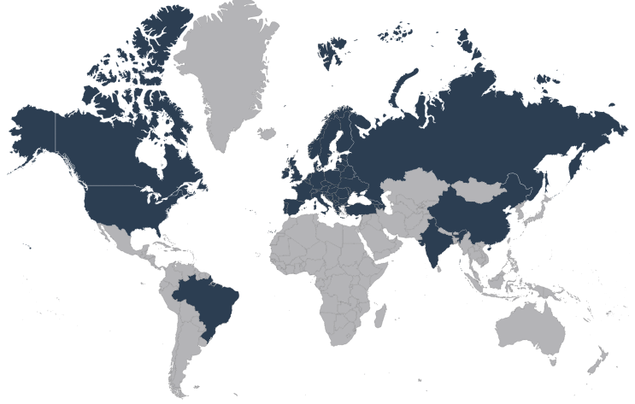
OpenSearch is global
Notes:
Sources are global
This is just the sources that CWIC enabled for OpenSearch!
INPE in Brazil
EUMETSAT and ESA in Europe.
CCMEO in Canada
ISRO in India
NASA, NOAA and USGS in the US
In the not too distant future you will be able to do that for AOE in China and ROSCOSMOS in Russia. Further out we will have Australia.

Slide 12
HOW CAN I USE IT?

Slide 13
Checklist
Get your OSDD
Construct interface / formulate search
Discover the data
Navigate through your results
Drill down on your results
Evaluate your results
Download your data
Notes:
If you know the OpenSearch specification and the extensions you care about then you can do this very easily.
Get the descriptor document
From that you can either construct a user interface for your web application or formulate a query for your web service
Execute a query
Navigate through your results using HATEOS and ATOM standards.
Use the search link of mime-type OSDD to drill down to granules using a granule-level OSDD. Repeat steps 2-4 (remember you can have a different query set at the granule level if you want, hence the OSDD). As a developer or user I don’t need to know anything about the provider of this data other than it’s OSDD. It could be the CWIC OpenSearch API or CMR’s or anything.
Use browse links to find the right data
Use download links to get your data

Slide 14
WHO USES THIS NOW?

Slide 15
Earthdata Search
CWICSmart
FEDEO Earth Observation Portal
Notes:
Earthdata Search is currently using IDN’s OpenSearch API to discover non-NASA/NASA affiliated collections from data providers such as INPE and ISRO.
CWICSmart is using both the IDN and CWIC OpenSearch APIs to allow collection and granule level discovery for the aforementioned providers
FEDEO in Europe is doing the same thing with their Earth Observation Portal

Slide 16
QUESTIONS?

Slide 17
This material is based upon work supported by the National Aeronautics and Space Administration under Contract Number NNG15HZ39C.

