Slide 1
Winter ESIP 2016 CMR + UMM Overview
Dan Pilone
dan@element84.com
The material is based upon work supported by the National Aeronautics and Space Administration under Contract Number NNG15HZ39C

Slide 2
Today’s Talks
CMR & UMM Overview
ECHO and GCMD Merger
CMR Transition and Client Collaboration
Earthdata Search and Global Open Search
NGAP: Compliance as a Service

Slide 3
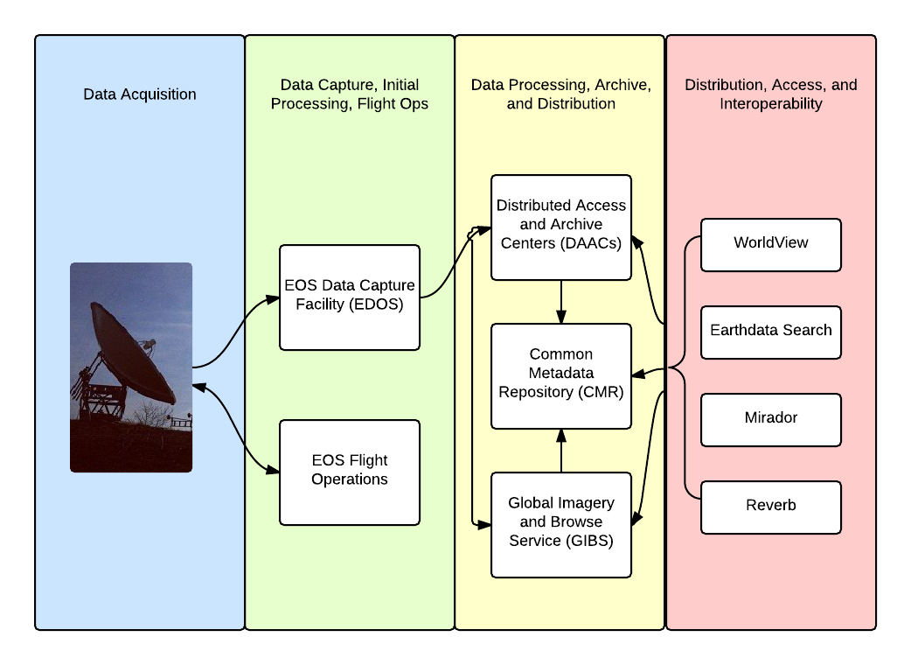
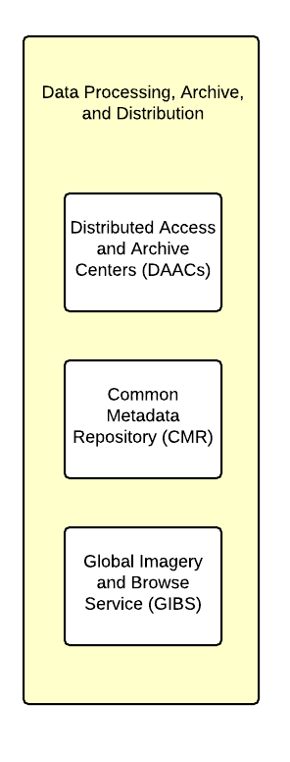
Notes:
NASA’S Earth Observing System (EOS) is a coordinated series of satellites for long term global observations.
NASA’s Earth Observing System Data and Information Systems (EOSDIS) is a multi-petabyte archive of environmental data that supports global climate change research by providing access to EOS and other Earth Science Data.

Slide 4
Key EOSDIS Metrics
Unique Data Products (Collections) | 6,861
Total Archive Volume | 12 PB
Average Daily Archive Growth | 8.5 TB/day
End User Average Daily Distribution Volume | 22 TB/day
Distinct Data and Service Users Per year | 1.7 M
End User Products Distributed per year | 839 M
Notes:
Size of the archive

Slide 5
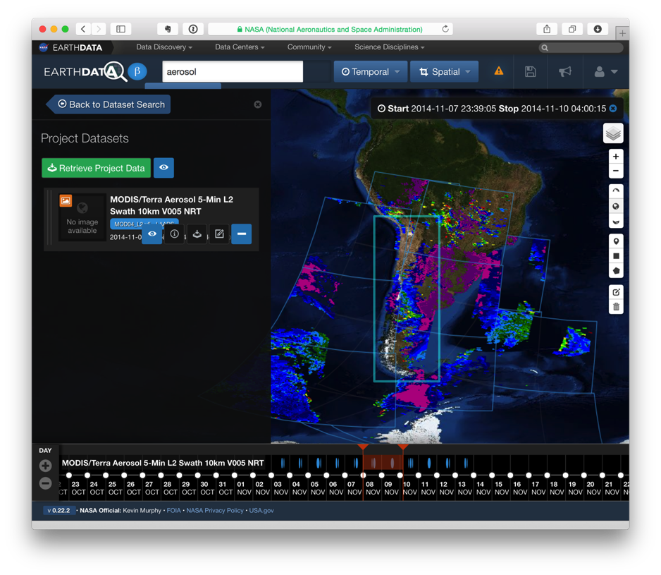
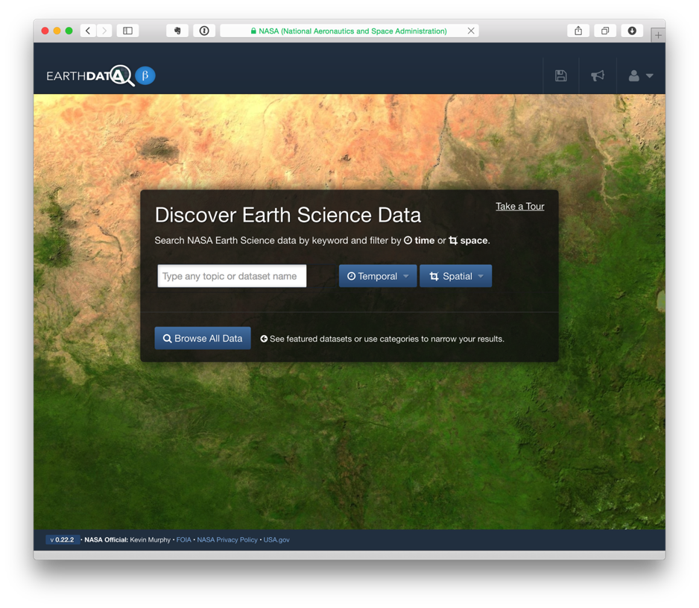
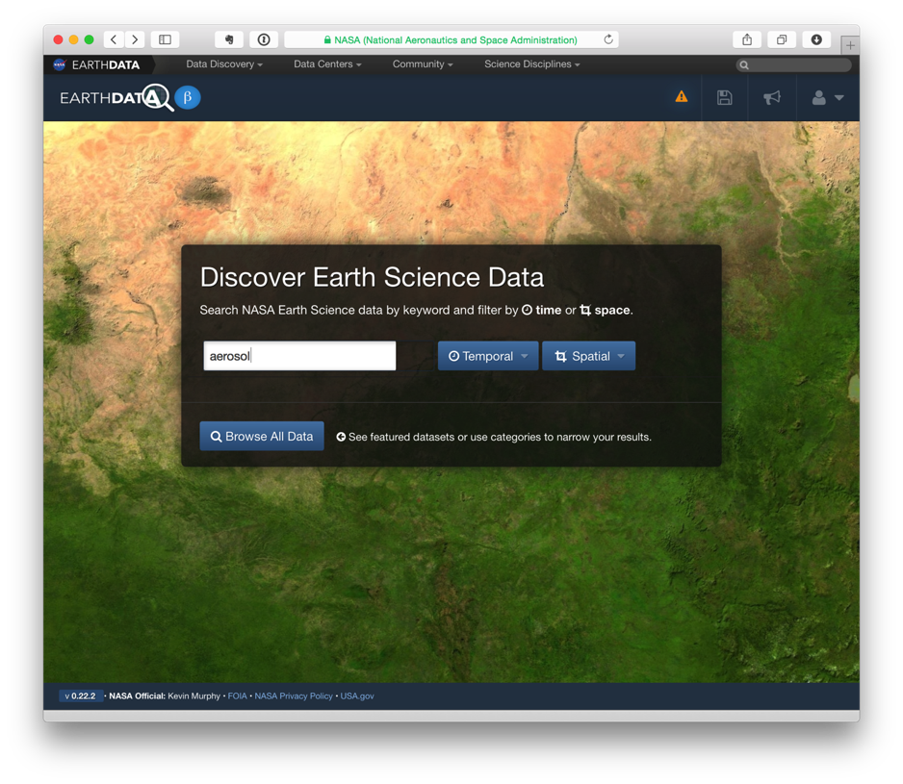
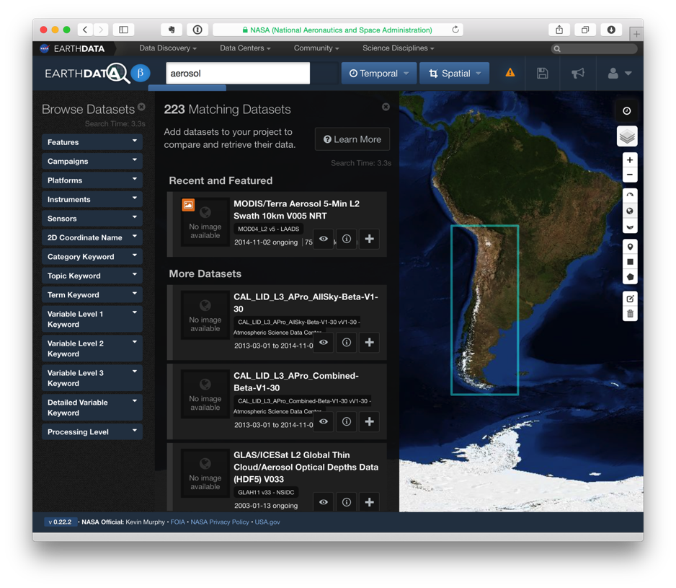
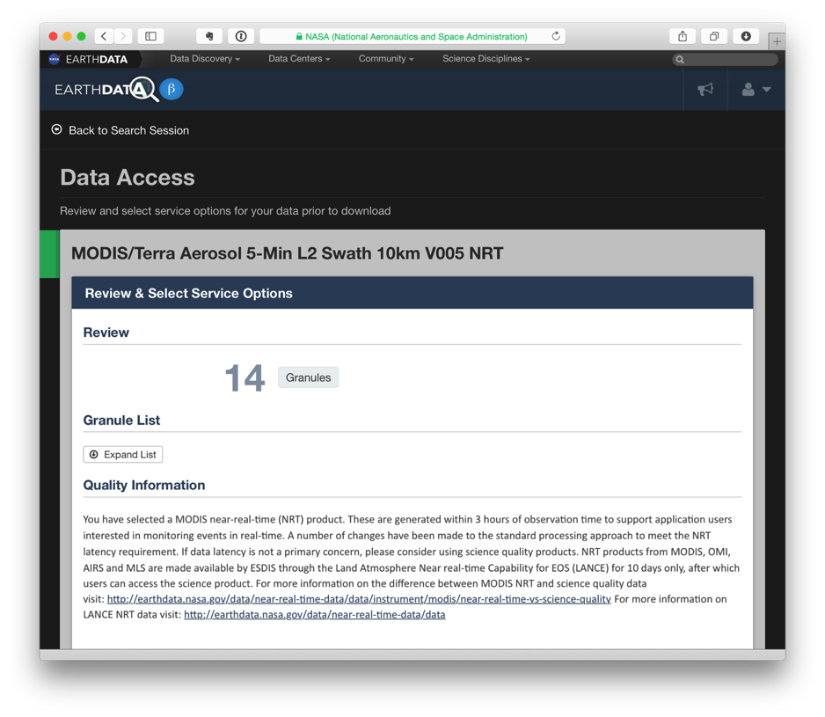
Notes:
Interaction from application to CMR, then GIBS, then CMR, then data
NASA kicked off an effort to really look at our metadata quality and usage

Slide 6
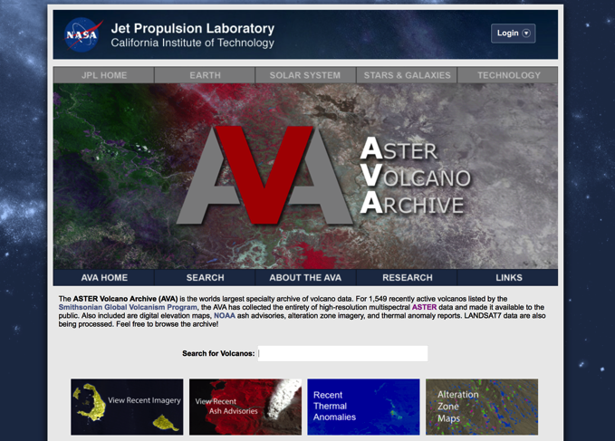
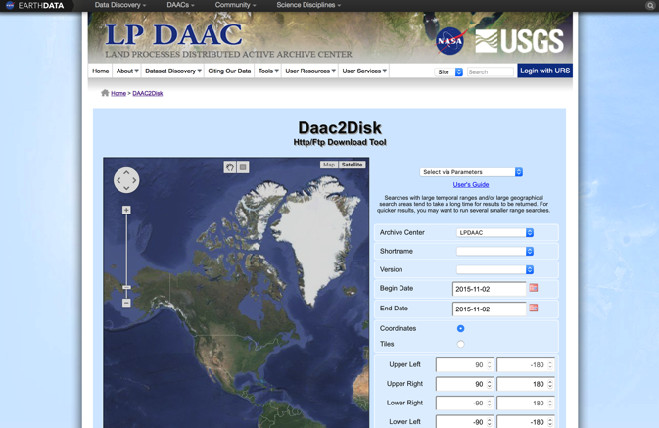
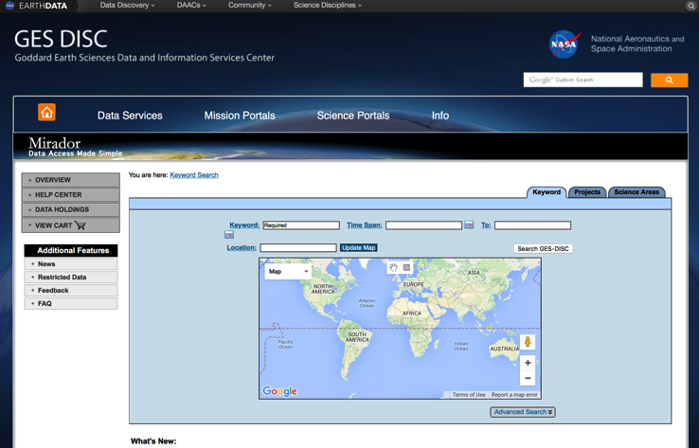
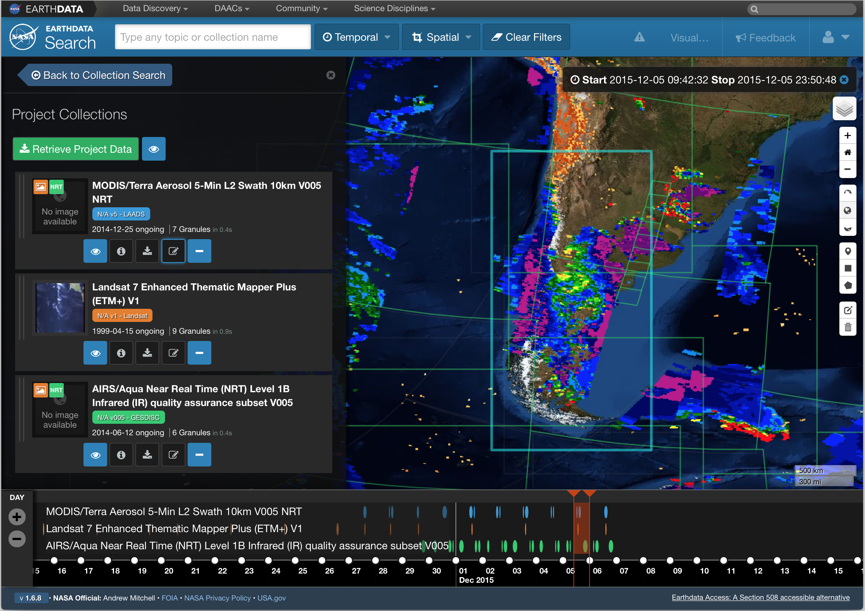
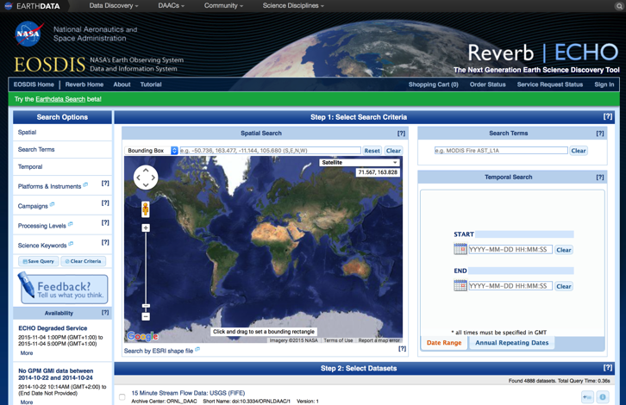
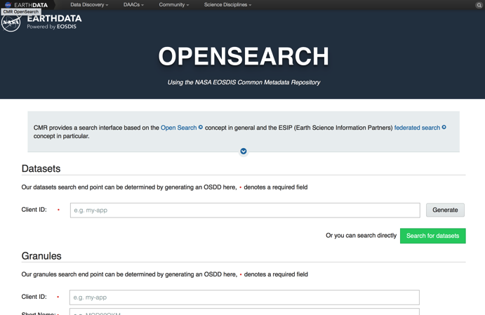
Notes:
We have existing applications – lots of them.
16 clients we track on a weekly basis then almost another 50% of traffic in “Other” - clients we don’t have any relationship with but user our services.

Slide 7
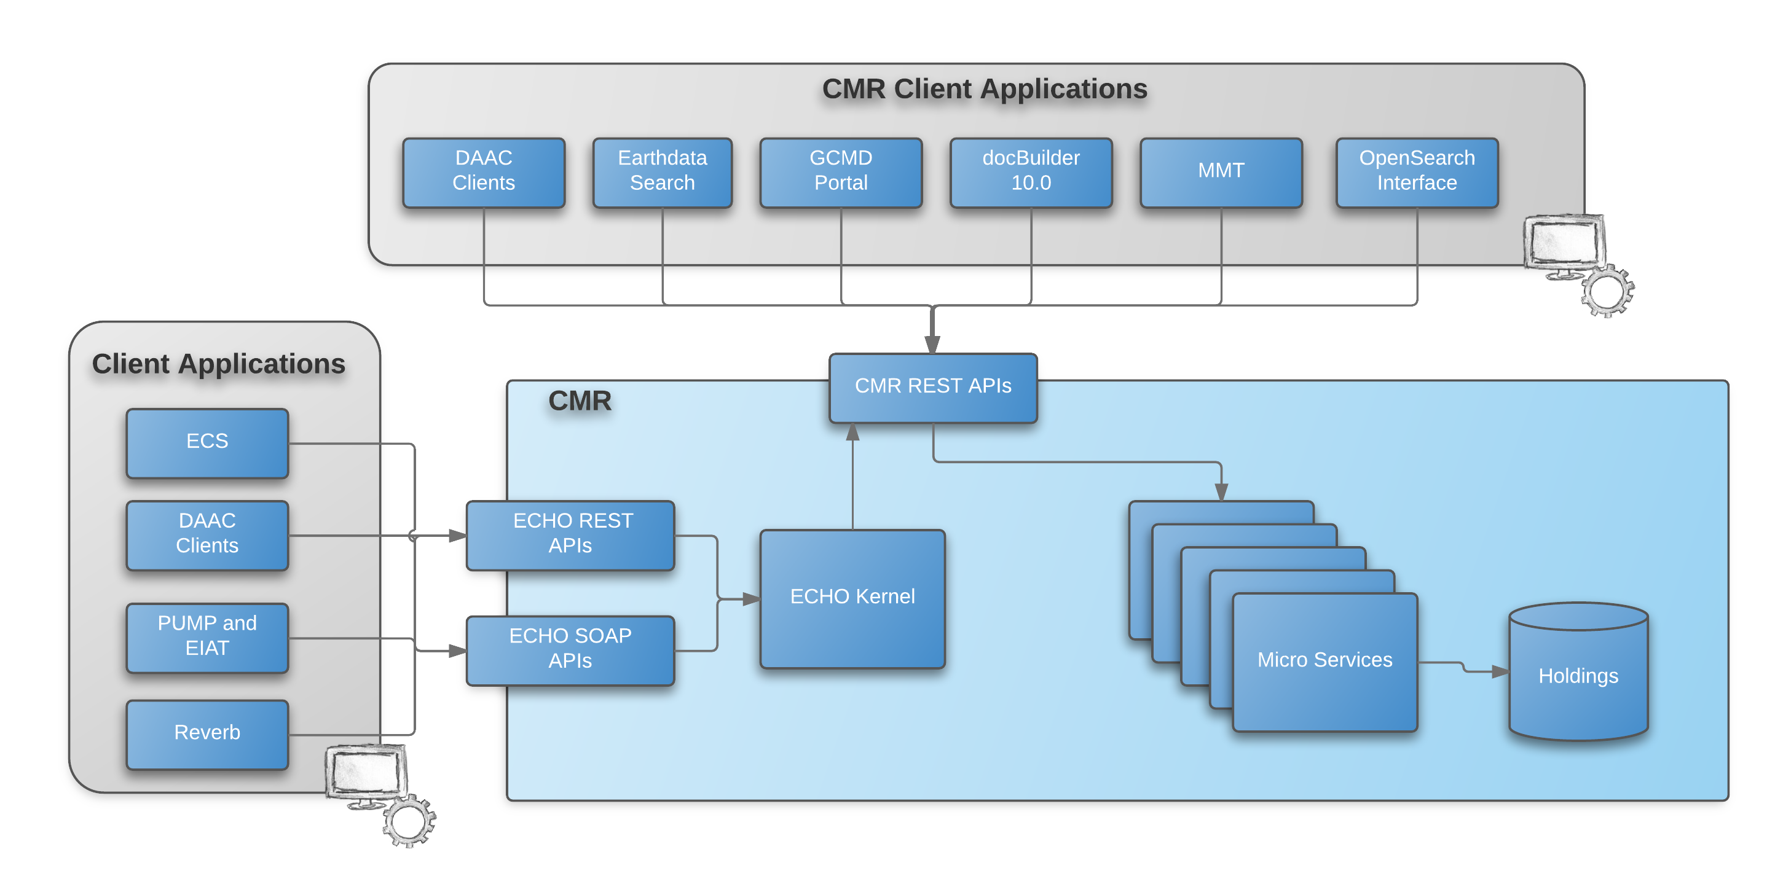
You are here…
Metadata
Metadata
Metadata
Metadata
Metadata

Slide 8
EOSDIS Metadata Challenges
Disparate Metadata Formats
Varying levels of Metadata Consistency & Completeness
Notes:
Three key challenges

Slide 9
ECHO10
GCMD SERF
ISO19115 MENDS
ESDIS Metrics System
ISO19115 SMAP
GCMD DIF
Notes:
Lots of existing data - ~30k collections, over 250M granules
It’s actually worse than that – if your data is in ECHO + GCMD, it has two different metadata records. If it’s been distributed, it actually has 3.
In addition to that, standards and interoperability is really important.

Slide 10
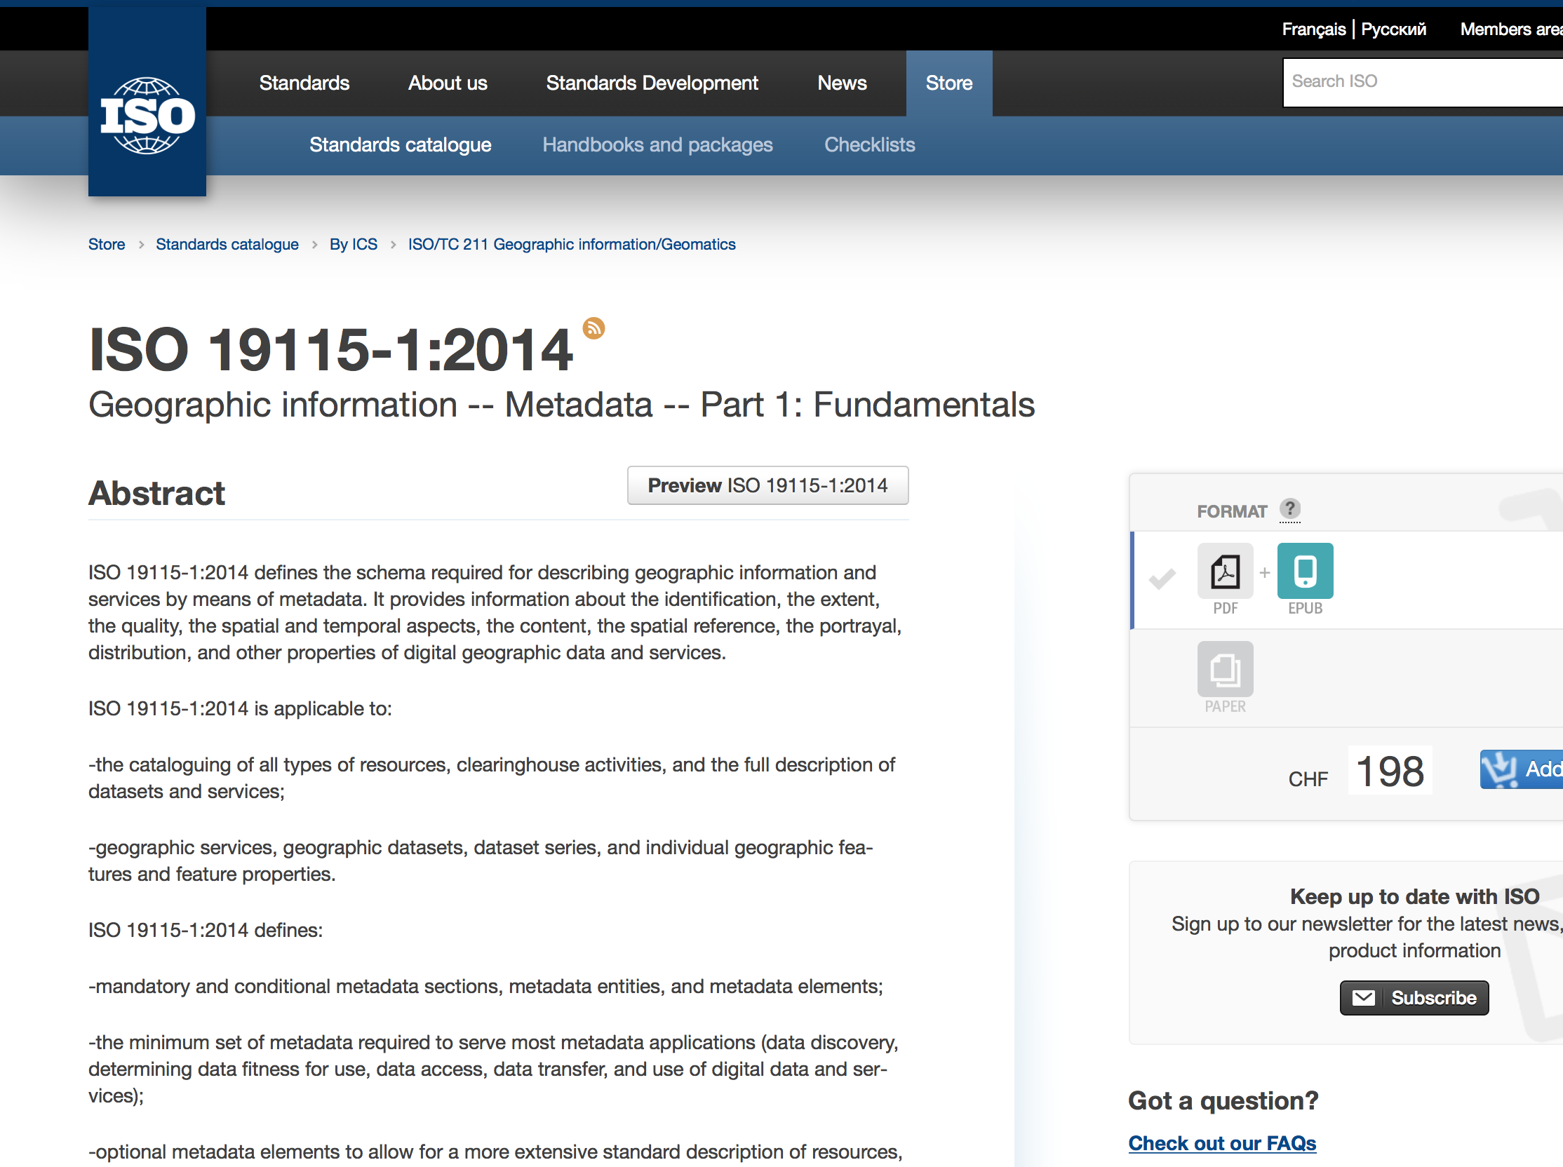
Notes:
A couple problems with this picture:
Lots of legacy systems
Lots of archived metadata
ISO19115 is verbose

Slide 11
Notes:
We have existing applications – lots of them.
They rely on metadata in one of the existing formats. Some of them we control, but lots we don’t since CMR is a public API.
Moving all metadata to ISO19115 would break them. We’ll need to continue to support legacy formats.

Slide 12
ECHO10
ISO19115
xslt
Notes:
Since ISO is a superset of ECHO, we can easily map into ISO. We could even get fancy and use an XSLT to do it. However, it’s not that simple…

Slide 13
Complete Graphs
7 Formats
http://en.wikipedia.org/wiki/File:Complete_graph_K7.svg
42 Translations
Notes:
So we don’t want to break our existing applications…but...
We don’t have just one format to map, we have 7.
But it gets worse. We have legacy systems that don’t speak ISO.
And… we have legacy data where the original PI may no longer be available.
And... we have a lot of archived metadata – metadata that would be translated only to be rearchived.

Slide 14
Yikes

Slide 15
Less Scary Alternatives
7 Formats
12 Translations

Slide 16
Unified Metadata Model
(UMM)
Science Metadata
Services Metadata
Parameter Metadata
Visualization Metadata
Future Metadata Profiles
Meta-Metadata
Notes:
Doesn’t care about format – says you have to have X, Y, Z and here’s where to find it
Multiple metadata profiles supported
Because people really like metadata -Meta-Metadata.
We are not creating another format.

Slide 17
Collections (UMM-C)
UMM-C
GCMD DIF Model
ECHO10 Collection Model
ESDIS Metrics Model
ISO19115
Notes:
Looked at existing collection formats / models to create ours

Slide 18
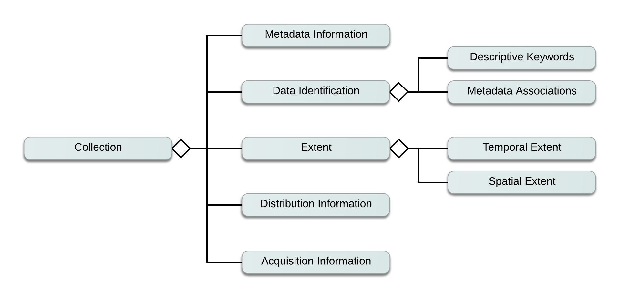
Notes:
Created a basic model – should look similar to ISO19115

Slide 19
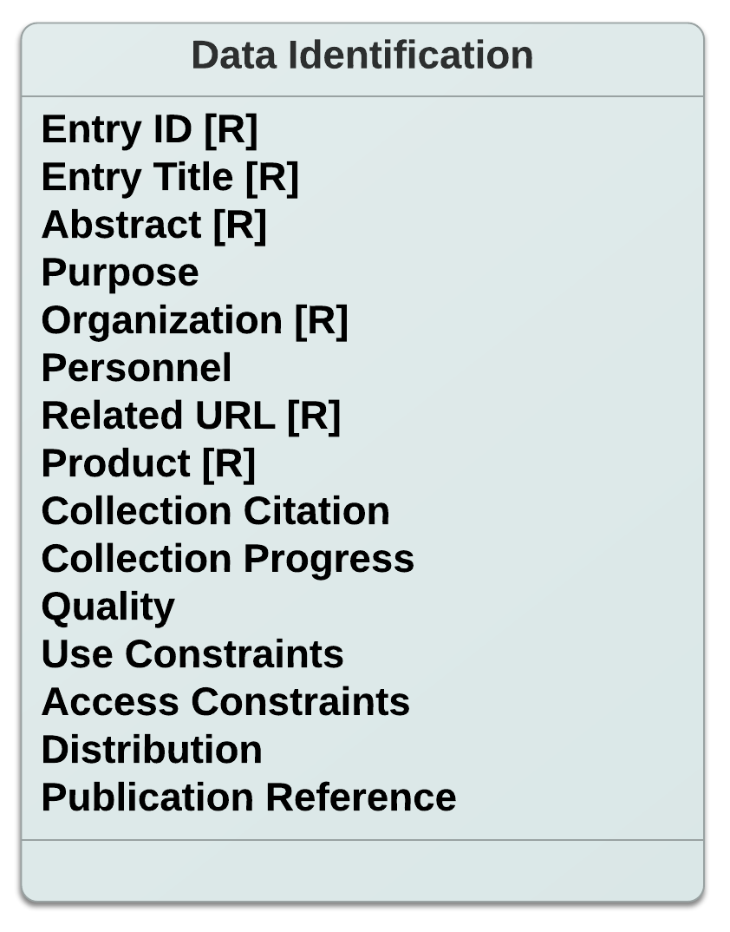

Slide 20
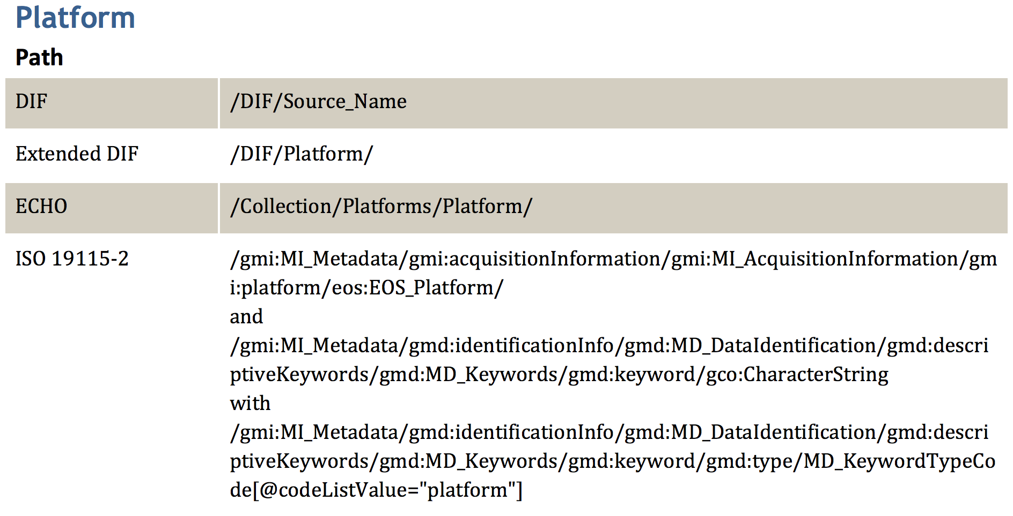
Sample UMM-C Crosswalk
Notes:
Shows mappings to various formats. This becomes the core of our implementation.

Slide 21
Metadata Model Status
Community
Input
Yearly ESO
Review
Workoff
Implementation
Post Documentation
UMM-Visualizations
UMM-Collections
UMM-Granules
UMM-Services
UMM
UMM-Parameters
https://wiki.earthdata.nasa.gov/display/CMR/CMR+Documents

Slide 22
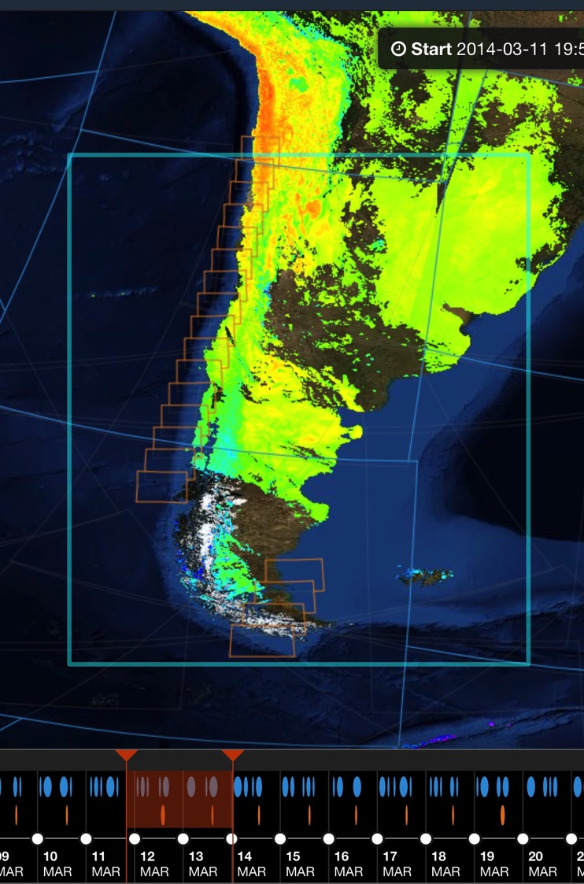
Interactive Data Discovery
Notes:
Back to why we’re doing this - we want interactive discovery and access…

Slide 23
Common Metadata Repository (CMR)
A single source of unified, high-quality, and reliable Earth Science metadata
< 1s search performance
Support ~1,000,000,000 geospatial items and scale
Fault tolerant and highly available
©iStock.com/AOosthuizen
Notes:
Built the CMR to support the UMM and meet our performance and scalability needs.

Slide 24
Scalable and Backward Compatible
*As of December 2015

Slide 25
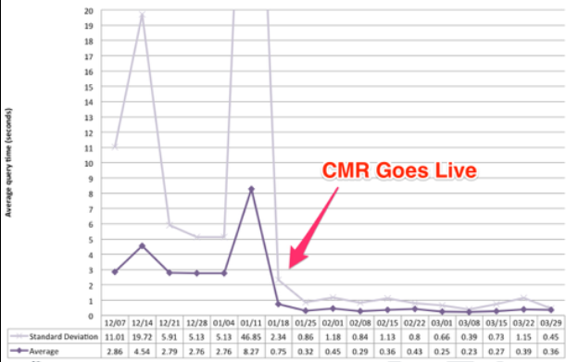
Granule Search Performance
Notes:
Performance is being met. 95% percentile for granule searches @ 700ms.

Slide 26
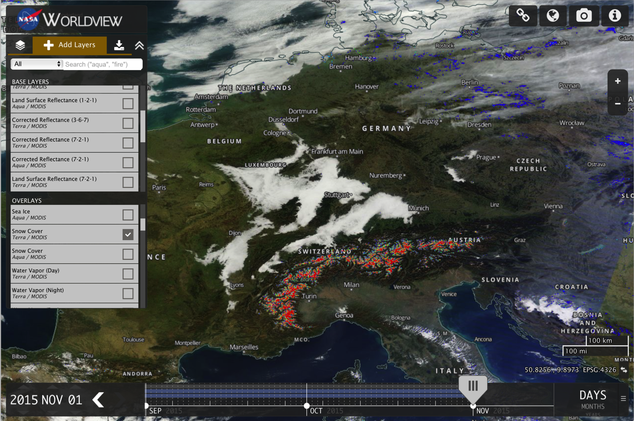
Notes:
But going back to our driver – are we enabling the kinds of applications we want to enable?

Slide 27
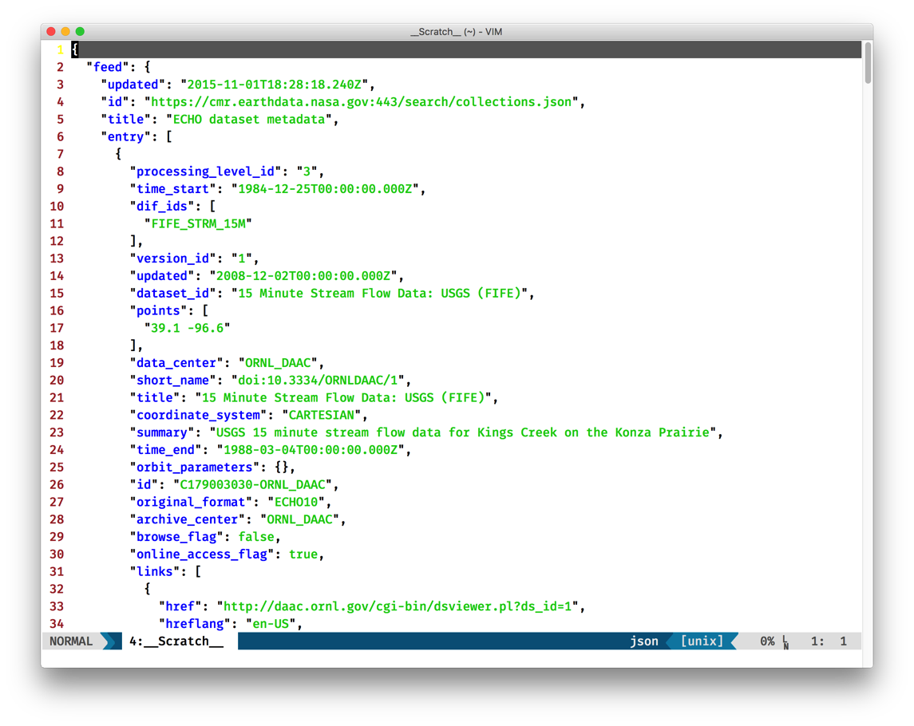
Web Friendly Metadata Formats
Notes:
Turns out our implementation of format transformation support with the UMM enables us to cost effectively add additional response formats.
For all of the good things ISO19115 offers, fast, easy parsing isn’t one of them.
Able to introduce lightweight JSON format for web applications

Slide 28
The echo and Gcmd merge
Dana Shum
Notes:
What’s next? Two related topics

Slide 29
CMR ECHO Transition and client collaboration
Jason Gilman

Slide 30
Earthdata search and global opensearch
Doug Newman

Slide 31
NGAP: compliance as a service
Andrew Pawloski

Slide 32
Looking forward
Notes:
What’s next? Two related topics

Slide 33
Improved Result Relevancy
Notes:
DAACs have a lot of expertise in this space – need to tap into it. User wants to do a time series study with Sea Ice, for example. User Services @ DAAC knows datasets to recommend.
How do we model and codify that expertise?

Slide 34
UMM-D and the Metadata Graph
Notes:
UMM provides us a lot of information through the metadata graph – think Linked Data.
Would like to leverage that…

Slide 35
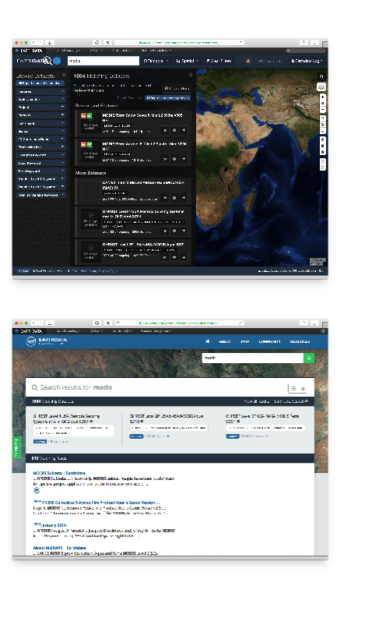
UMM-C
UMM-G
UMM-V
UMM-P
UMM-MM
Full Text Articles
Tagged Content
External Pages
CMR
Notes:
What if we fed everything to the CMR? We already talked about C, G, V, P… what if we had a UMM-D that let us feed raw content in and associate it with other elements?
Use that to feed applications...
Ultimately lets us...

Slide 36
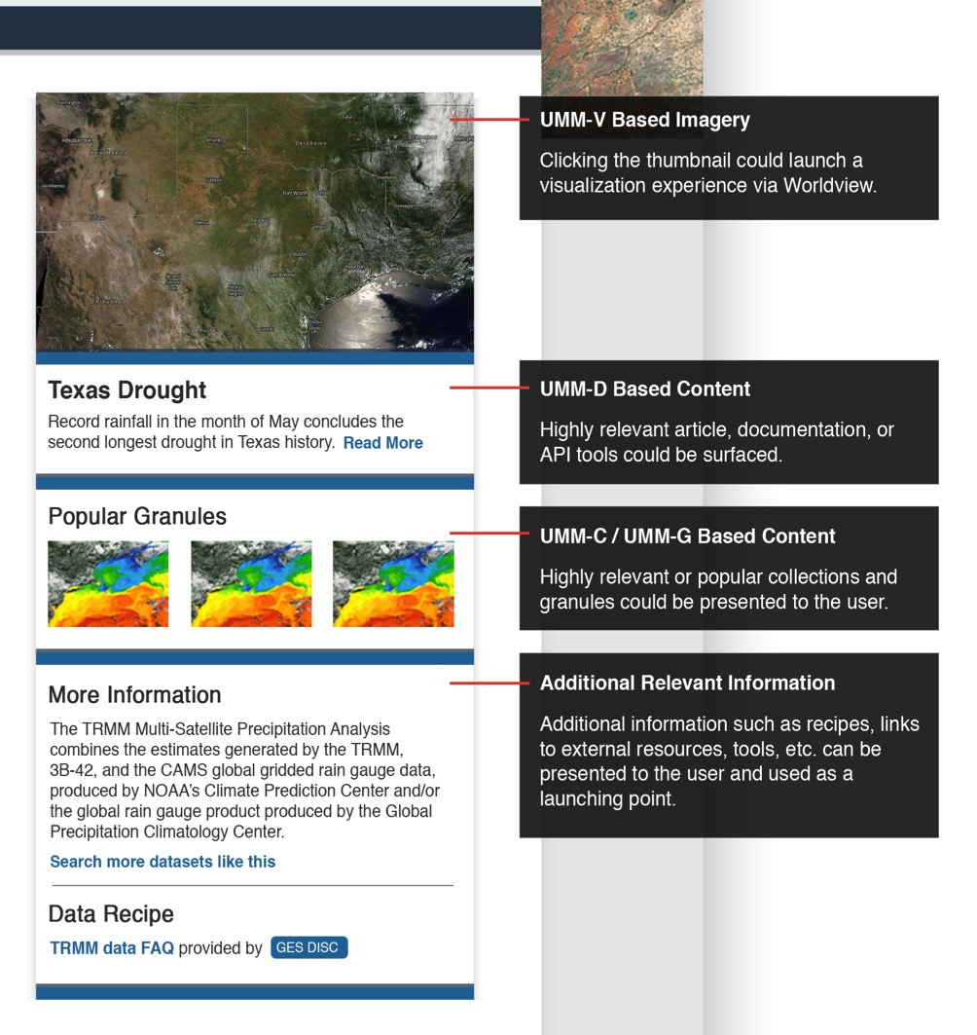
Notes:
Provide topic info sheets… like this.

Slide 37
Thank you!
Dan Pilone // dan@element84.com
https://earthdata.nasa.gov
Notes:
May want to steer to cmr.earthdata.nasa.gov also.

Slide 38
This material is based upon work supported by the National Aeronautics and Space Administration under Contract Number NNG15HZ39C.

