Slide 1
Share Data with OPeNDAP Hyrax: New Features and Improvements
July 2016
James Gallagher (OPeNDAP)
This work is supported by NASA/GSFC under Raytheon Co. contract number NNG15HZ39C and a Grant from the Australian National University.

Slide 2
Overview
Aggregation
Performance improvements
User-invoked aggregation
Authentication
End-to-end (web & programmatic clients)
Web-Service Protocols
W10n, WMS

Slide 3
Brief review of Aggregation
Combine discrete granules (e.g. files)
They are discrete usually because of the mechanics of collection or processing
Server aggregation frees users from having to understand the archive’s exact structure
Data type determines which aggregation techniques are appropriate
Regular data – e.g. level 3
Swath data – e.g. level 2

Slide 4
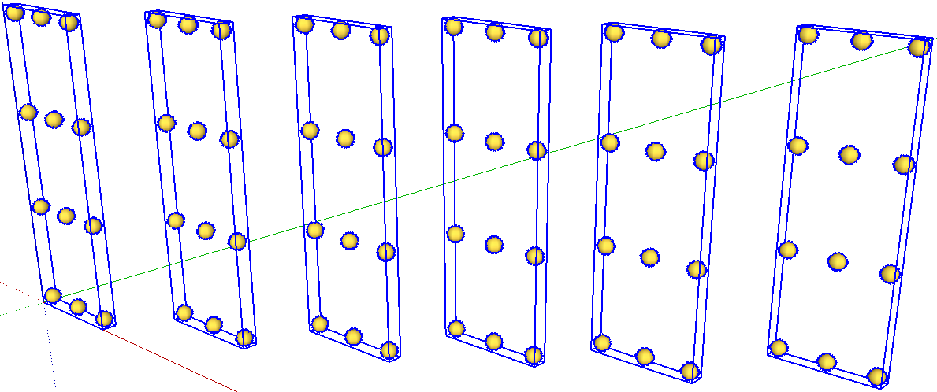
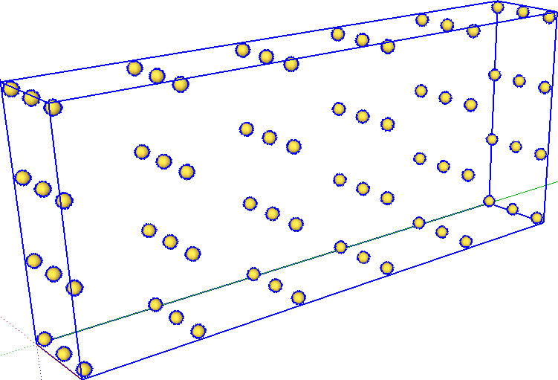
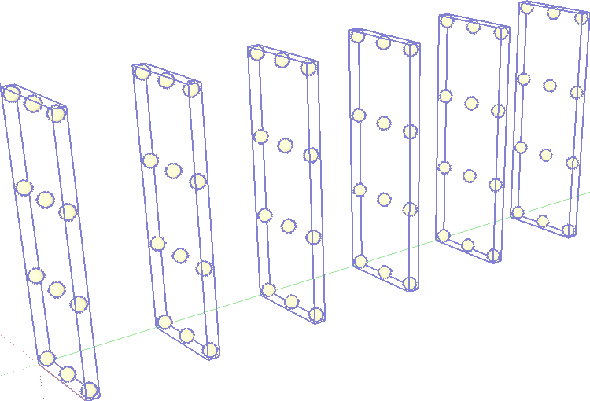
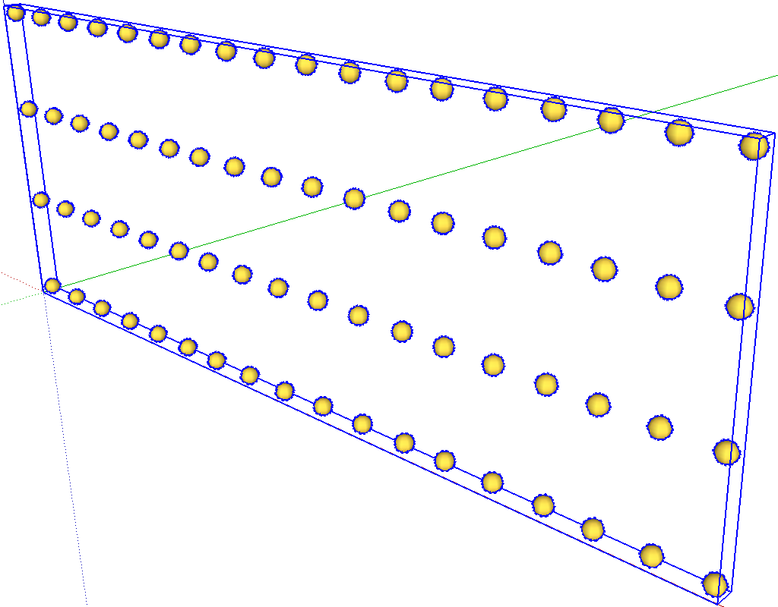
DAP Servers offer Virtual Aggregations of Identically Shaped Variables in different granules
Or*
Lengthening
An existing
dimension
Adding Some
New Dimension
*as specified
via NCML

Slide 5
Aggregation: performance
Test case*: Suppose a user were to ask for all of the data from a small aggregation – 120+ files of AIRX data:
The original server would leave the client hanging for ~26 minutes and then drop the connection… (because the network connection times out)
The new server will return all of the data (166GB) and begin to stream the results within fractions of seconds!
What if the hardware were made large enough so that the original software could complete?
The original server has an effective transfer rate of 5MB per second…
The new server has an effective transfer rate of 33MB per second*, a factor of 6.8 increase!
Server memory requirements were also reduced
The original server used memory (RAM) roughly equal to the response size…
The new server has a flat memory consumption that it equal to the smallest atomic unit accessible from the data store (e.g., array slab). For the test case above, the reduction is 4 orders of magnitude!
Key Points:
The server can now handle requests it simply could not before
This scales to very large requests – because the implementation uses pipelining to minimize data held in memory at any given time
* Tests run between machines in the Amazon cloud, see notes
Notes:
*These tests were run on AWS CentOS 6.6 machines (both m4.large and t2.medium machines in the US East region). The network transfers were made using a client (curl) also running in the AWS US East region and, thus, bandwidth of 33GB/s is available. Effective Transfer refers to the total time to send the response (or part of a response).

Slide 6
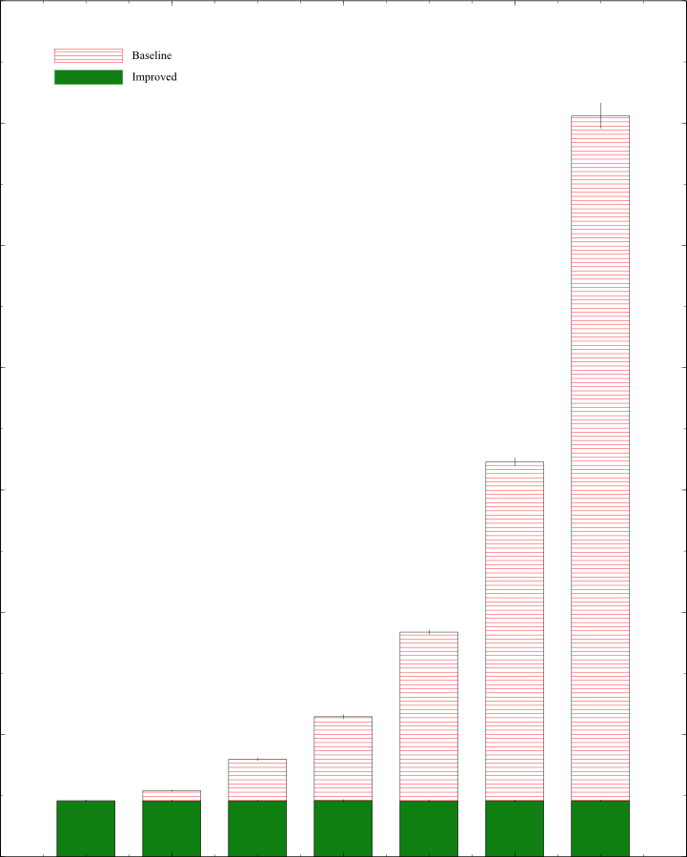
Quicker Initial Response
7
6
5
4
3
2
1
0
Baseline
Improved
Elapsed Time (seconds) to Start of Response
One Variable Selected from Increasing Numbers of Time Slices (Granules)
1 2 4 8 16 32 64
Number of Granules (multiple runs for each bar;
using the besstandalone test harness)

Slide 7
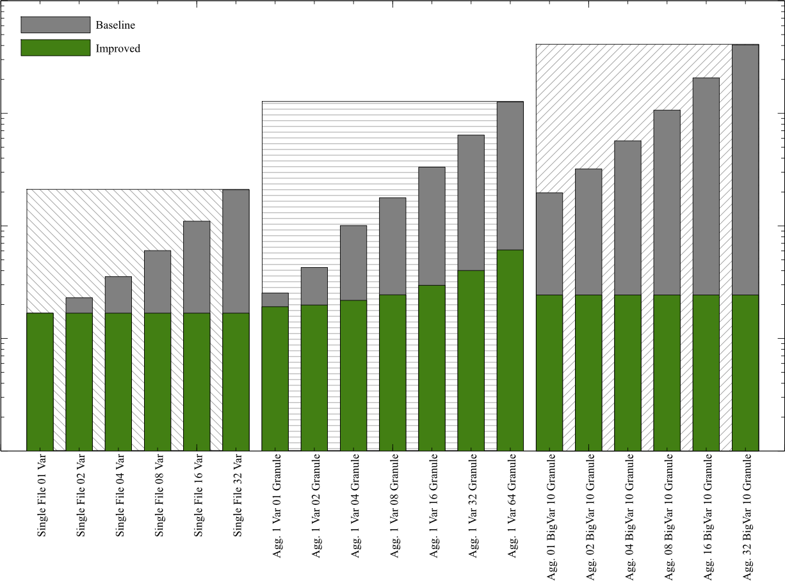
Less Server-Memory Use
10,000
Baseline
Improved
10 Granules, N Vars
One Variable, N Granules
Memory in (log) MB
1000
One File, N Vars
100
10
1
Test Scenarios

Slide 8
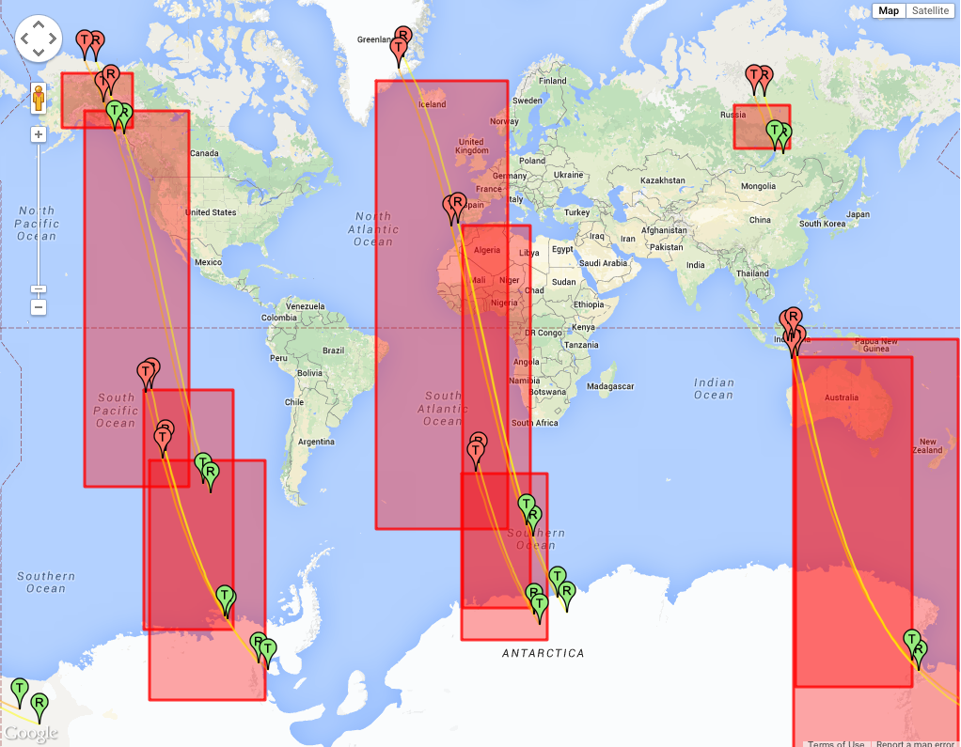
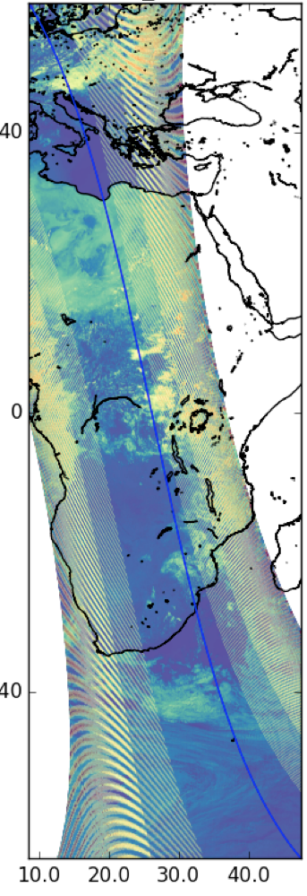
Aggregation of swath data …is also supported, differently
Simple aggregation techniques do not apply to swath data
Notes:
…because they are not uniform from granule to granule

Slide 9
Aggregation: user-driven
User-driven: The client provides a list of datasets to aggregate
Web service interface is easy to customize for differing clients
While intended for ‘Swath data,’ this can be used with any collection of datasets
Users may get data from thousands of files in a single operation (e.g., clicking a single link)
Con: Clients must know the granules they want

Slide 10
User-driven Aggregation Mechanisms
Two different response forms → different aggregation algorithms
Iterate over a set of granules applying a constraint to each, collecting discrete results in a single archive file
Iterate over a set of granules, transforming them to a table* and selecting a subset of those rows by value
*Actually DAP Sequence objects

Slide 11
User-driven Aggregation Interface Description
Implemented using a new web service that relies on POST so it can accept larger inputs than HTTP GET will allow.
It accepts a series of commands that describe the
Response format (e.g. files in a zip archive, CSV-encoded table)
Datasets, modified by their constraints, to aggregate

Slide 12
User-driven Aggregation Example
Users of NASA’s Earthdata Search Client* can receive single data responses from queries that involve many datasets.
Example operations
Get the server’s version
Get a simple aggregation, returned in an archive, values encoded in netCDF3 (other formats are supported).
Get an aggregation with array data transformed to a table, values encoded using CSV
*This feature was initially developed for EDSC
Notes:
Get the server version information: http://test.opendap.org/dap/aggregation/?&operation=version
Demo: Show and use request files from olfs/resources/aggregation/tests/demo/{README,short_names} (found at https://github.com/opendap/olfs). Use ”curl -X POST -d @d1_netcdf3_variable_subset.txt http://test.opendap.org/opendap/aggregation > d1.zip” to run the examples
Short_names/d1_netcdf3_variable_subset.txt – Subset HDF4 files, transform the result to netCDF and return them in a single archive
Same as #1 but with a bounding box
Return the same values, but in a CSV-encoded table

Slide 13
…Server Version
We can supply arguments using GET
The simplest ‘operation’ is ‘version’
Request:
http://test.opendap.org/dap/aggregation/?&operation=version
Returns:
Aggregation Interface Version: 1.1
<?xml version="1.0" encoding="UTF-8"?>
<response xmlns="http://xml.opendap.org/ns/bes/1.0#" reqID="[ajp-bio-…">
<showVersion>
<Administrator>support@opendap.org</Administrator>
<library name="bes">3.16.0</library>
<module name="dap-server/ascii">4.1.5</module>
<module name="csv_handler">1.1.2</module>
<library name="libdap">3.16.0</library>
…
</response>

Slide 14
… Returning an Archive
Use POST; multi-line input
Request:
&operation=netcdf3
&var=Latitude,Longitude,Optical_Depth_Land_And_Ocean
&file=/data/modis/MOD04_L2.A2015021.0020.051.NRT.hdf
&file=/data/modis/MOD04_L2.A2015021.0025.051.NRT.hdf
&file=/data/modis/MOD04_L2.A2015021.0030.051.NRT.hdf
Returns:
Archive: d1.zip
testing: MOD04_L2.A2015021.0020.051.NRT.hdf.nc OK
testing: MOD04_L2.A2015021.0025.051.NRT.hdf.nc OK
testing: MOD04_L2.A2015021.0030.051.NRT.hdf.nc OK
No errors detected in compressed data of d1.zip.
Notes:
To get these examples, clone https://github.com/opendap/olfs, then cd to resources/aggregation/tests/demo
edamame:demo jimg$ more short_names/d1_netcdf3_variable_subset.txt
&operation=netcdf3
&var=Latitude,Longitude,Optical_Depth_Land_And_Ocean
&file=/data/modis/MOD04_L2.A2015021.0020.051.NRT.hdf
&file=/data/modis/MOD04_L2.A2015021.0025.051.NRT.hdf
&file=/data/modis/MOD04_L2.A2015021.0030.051.NRT.hdf
edamame:demo jimg$ curl -X POST -d @short_names/d1_netcdf3_variable_subset.txt http://test.opendap.org/opendap/aggregation > d1.zip
% Total % Received % Xferd Average Speed Time Time Time Current
Dload Upload Total Spent Left Speed
100 552k 0 552k 100 226 305k 124 0:00:01 0:00:01 --:--:-- 305k
edamame:demo jimg$ unzip -t d1.zip
Archive: d1.zip
testing: MOD04_L2.A2015021.0020.051.NRT.hdf.nc OK
testing: MOD04_L2.A2015021.0025.051.NRT.hdf.nc OK
testing: MOD04_L2.A2015021.0030.051.NRT.hdf.nc OK
No errors detected in compressed data of d1.zip.

Slide 15
…Returning a Table
The request looks similar; the return type – CSV – requires different formatting
Request:
&operation=csv
&var=Latitude,Longitude,Image_Optical_Depth_Land_And_Ocean
&bbox="[49,Latitude,50][167,Longitude,170]"
&file=/data/modis/MOD04_L2.A2015021.0020.051.NRT.hdf
&file=/data/modis/MOD04_L2.A2015021.0025.051.NRT.hdf
&file=/data/modis/MOD04_L2.A2015021.0030.051.NRT.hdf
Returns:
Dataset: function_result_MOD04_L2.A2015021.0020.051.NRT.hdf
table.Latitude, table.Longitude, table.Image_Optical_Depth_Land_And_Ocean
49.98, 169.598, -9999
49.9312, 169.82, -9999
49.9878, 169.119, -9999
49.9423, 169.331, -9999
49.8952, 169.548, -9999
49.8464, 169.77, -9999 ...
Notes:
edamame:demo jimg$ more short_names/d3_csv_subset.txt
&operation=csv
&var=Latitude,Longitude,Image_Optical_Depth_Land_And_Ocean
&bbox="[49,Latitude,50][167,Longitude,170]"
&file=/data/modis/MOD04_L2.A2015021.0020.051.NRT.hdf
&file=/data/modis/MOD04_L2.A2015021.0025.051.NRT.hdf
&file=/data/modis/MOD04_L2.A2015021.0030.051.NRT.hdf
edamame:demo jimg$ curl -X POST -d @short_names/d3_csv_subset.txt http://test.opendap.org/opendap/aggregation > d3.csv
% Total % Received % Xferd Average Speed Time Time Time Current
Dload Upload Total Spent Left Speed
100 4141 0 3870 100 271 5150 360 --:--:-- --:--:-- --:--:-- 5153
edamame:demo jimg$ more d3.csv
Dataset: function_result_MOD04_L2.A2015021.0020.051.NRT.hdf
table.Latitude, table.Longitude, table.Image_Optical_Depth_Land_And_Ocean
49.98, 169.598, -9999
49.9312, 169.82, -9999
49.9878, 169.119, -9999
49.9423, 169.331, -9999
49.8952, 169.548, -9999
49.8464, 169.77, -9999
49.7958, 169.998, -9999
49.9897, 168.659, -9999
49.9471, 168.862, -9999
...

Slide 16
Aggregation – Summary
‘Regular’ aggregation performance improved by orders of magnitude
User-driven aggregation is a new feature
Regular aggregation – defined by data provider
User-driven aggregation – defined by user
User-driven aggregations work on a wide variety of data types

Slide 17
Overview
Aggregation
Performance improvements
User-invoked aggregation
Authentication
End-to-end (web & programmatic clients)
Web-Service Protocols
W10n, WMS

Slide 18
Authentication
Hyrax works with NASA’s Earthdata Login (OAuth2), LDAP and Shibboleth to provide user authentication
Hyrax + Earthdata Login supports both web and programmatic access
EarthData Login access will work for data analysis tools too.
LDAP does as well!
Shibboleth does not (easily)
Each of the three are ‘Single Sign On’ services:
One database of credentials → many data servers
Notes:
Hyrax supports LDAP and Shibboleth too
Hyrax Authentication configuration documentation: http://docs.opendap.org/index.php/Hyrax_-_User_Identification_(Authentication)

Slide 19
Authentication - Configuration
Apache modules provide the actual authentication – Advantage: robust code used by many sites
Hyrax + Authentication software stack:
Apache → Tomcat → Hyrax
Configure Apache httpd and Tomcat to work together
Configure Apache httpd to authenticate
Configuration information on the web
docs.opendap.org*

Slide 20
Authentication – Programmatic access
Programmatic clients: put username and password info in a .netrc file
This is better than asking users to install short-lived certificates (a process that they’d have to repeat often)
This enables automatic access to data
Processing done periodically
Batch jobs with many accesses
Notes:
Hyrax Authentication configuration documentation: http://docs.opendap.org/index.php/Hyrax_-_User_Identification_(Authentication)

Slide 21
Overview
Aggregation
Performance improvements
User-invoked aggregation
Authentication
End-to-end (web & programmatic clients)
Web-Service Protocols
w10n, WMS

Slide 22
Web Services
Hyrax ships with support for w10n and WMS
w10n - Webification
Use its JSON responses to build/control user interfaces
w10n supports navigating collections to get data
Its tree model extends into the granules, simplifying UI design & harmonizing data-storage schemes
WMS
Maps: WMS works well with geospatial data that can be shown as a ‘map’ (but not other data types)
Google Earth: WMS offers a bridge to other tools…

Slide 23
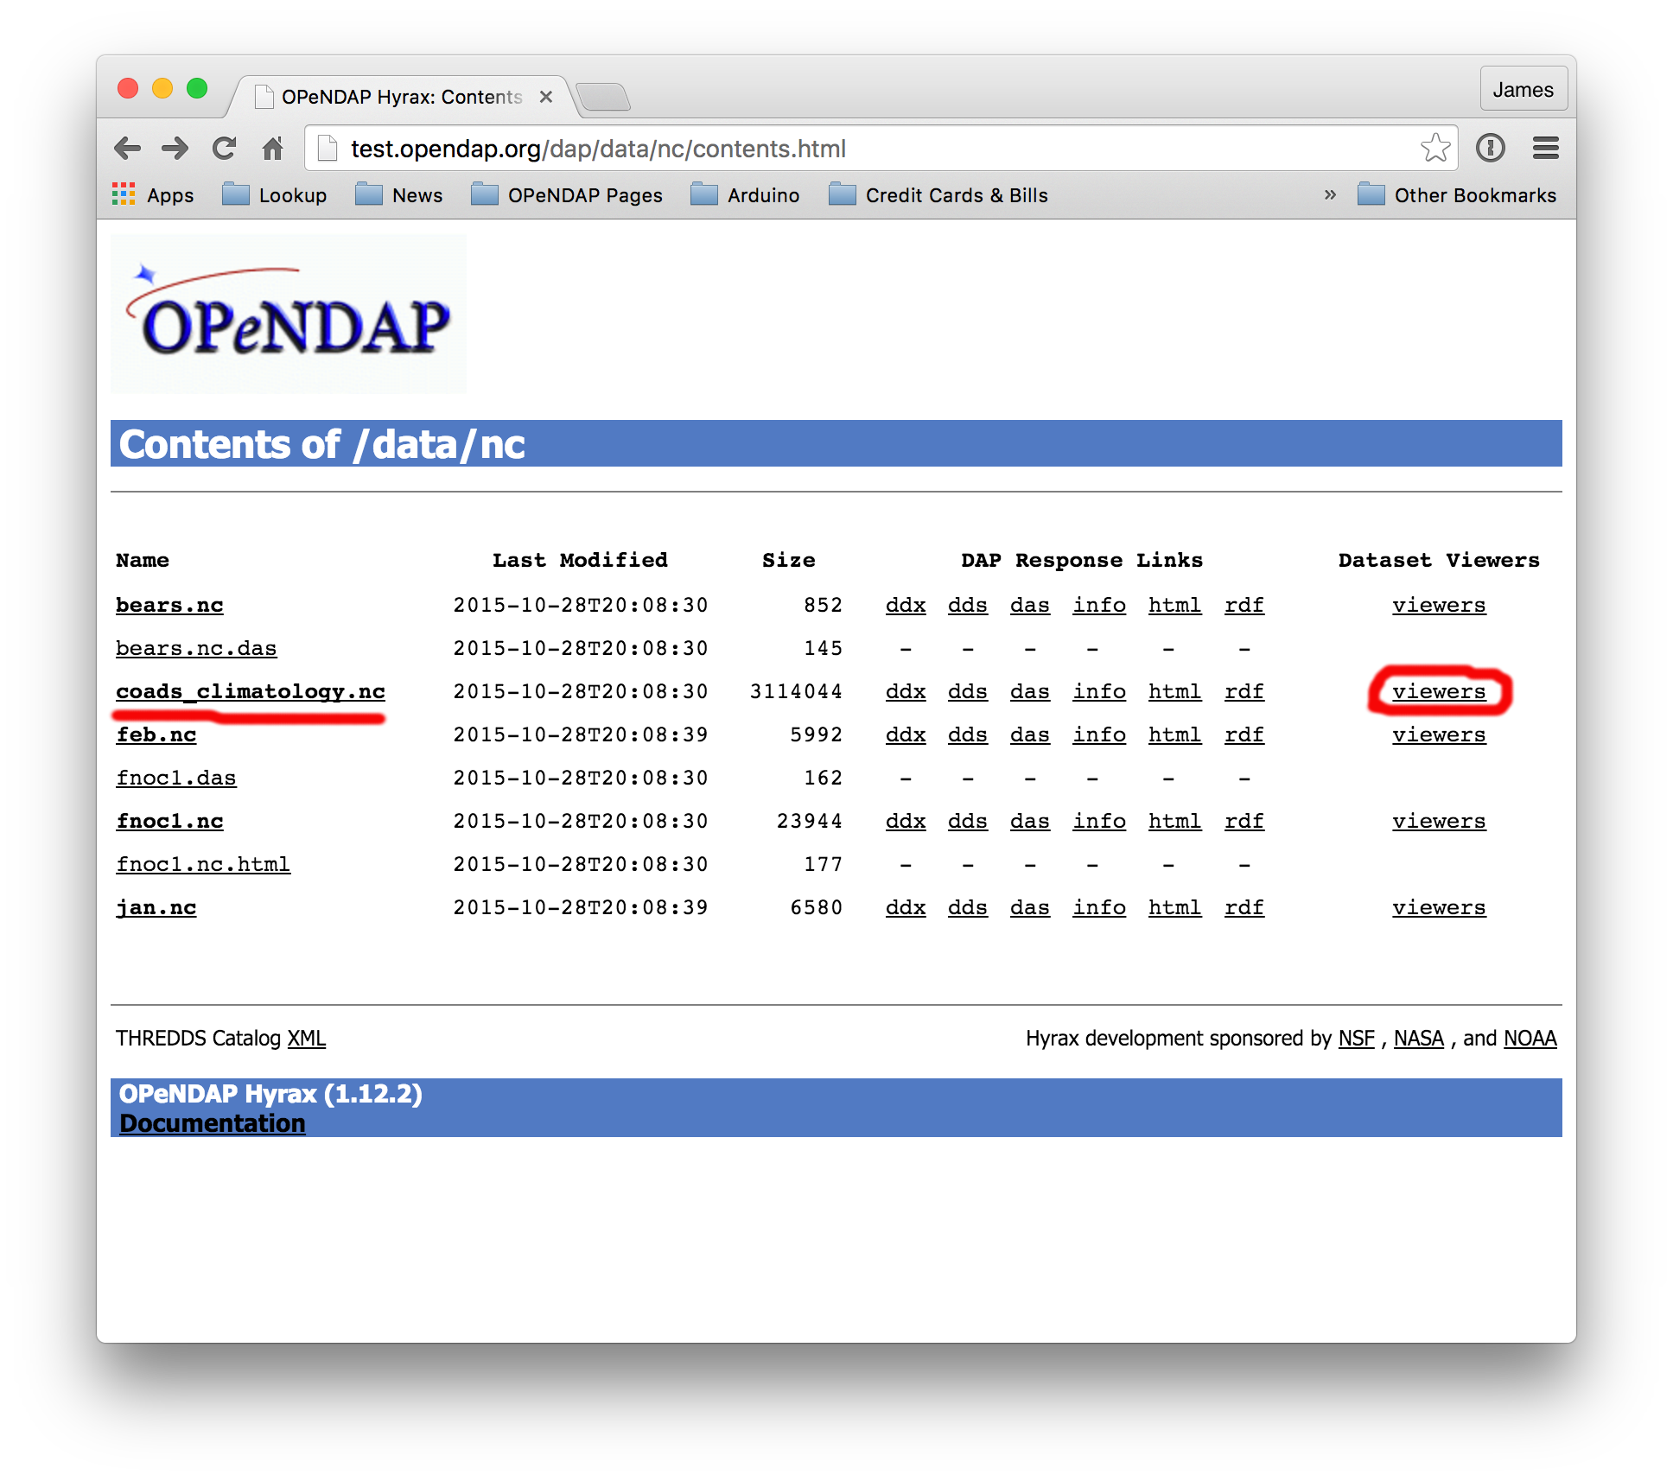

Slide 24
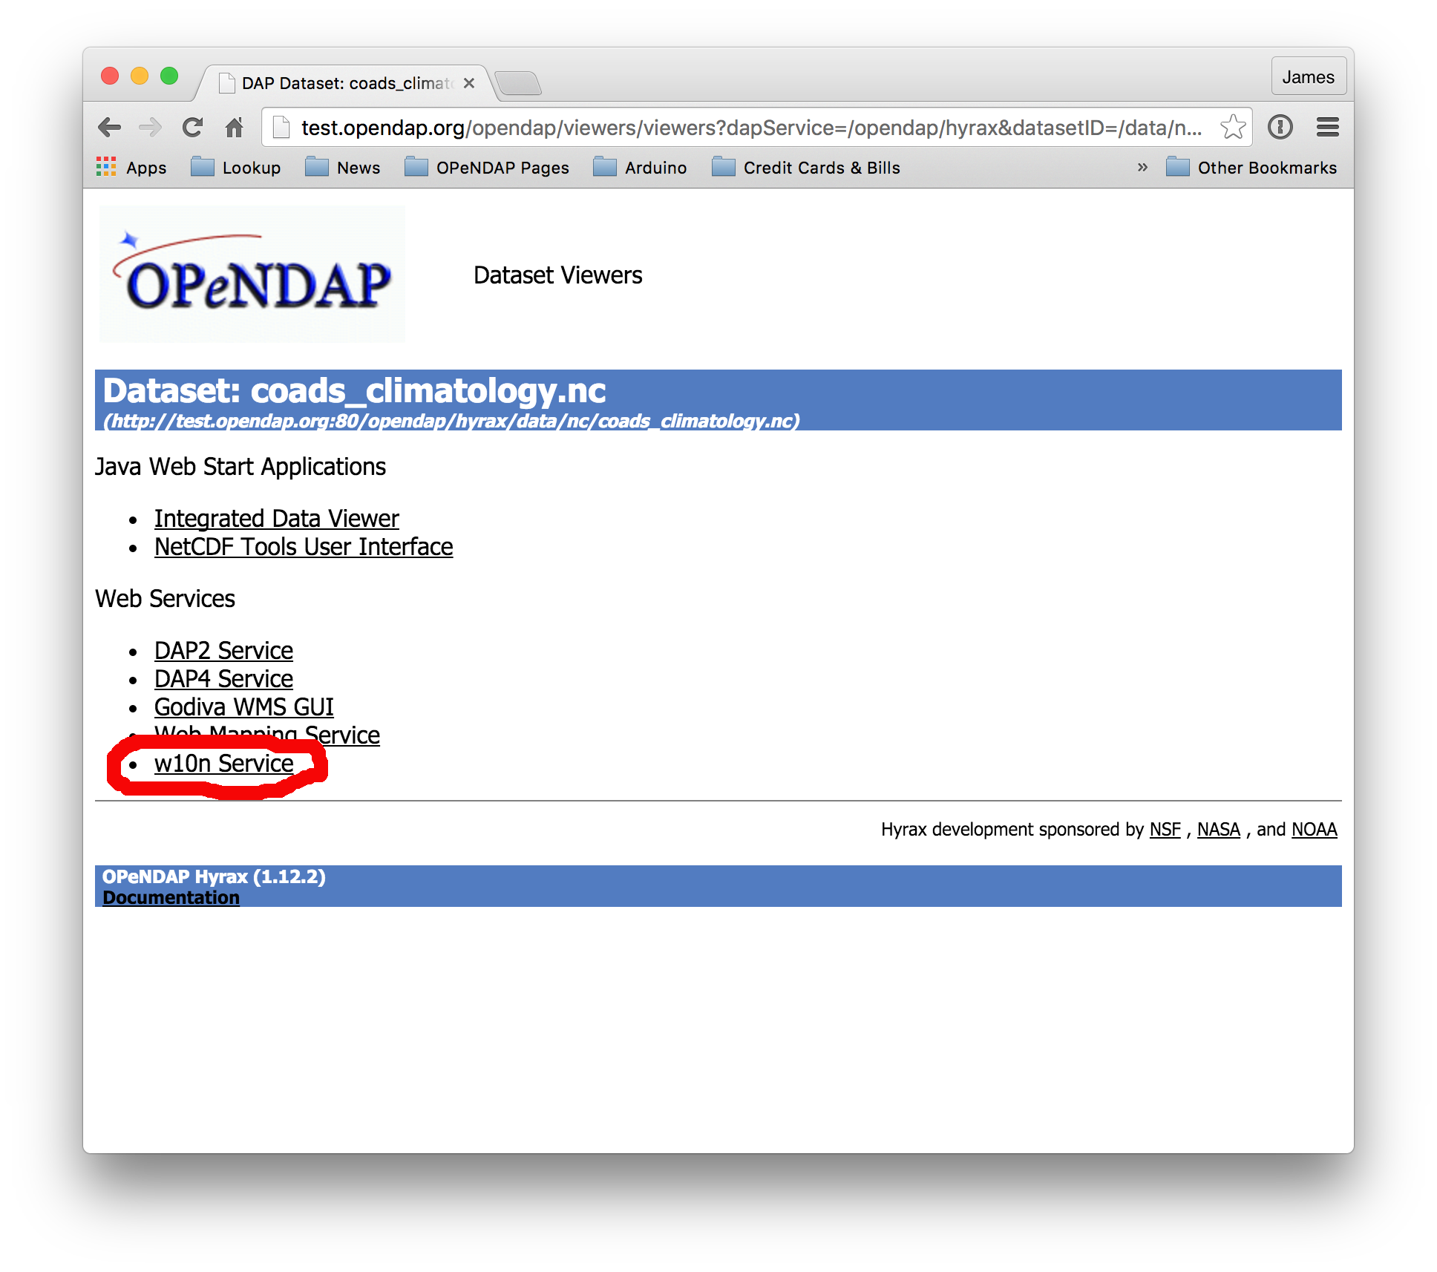

Slide 25
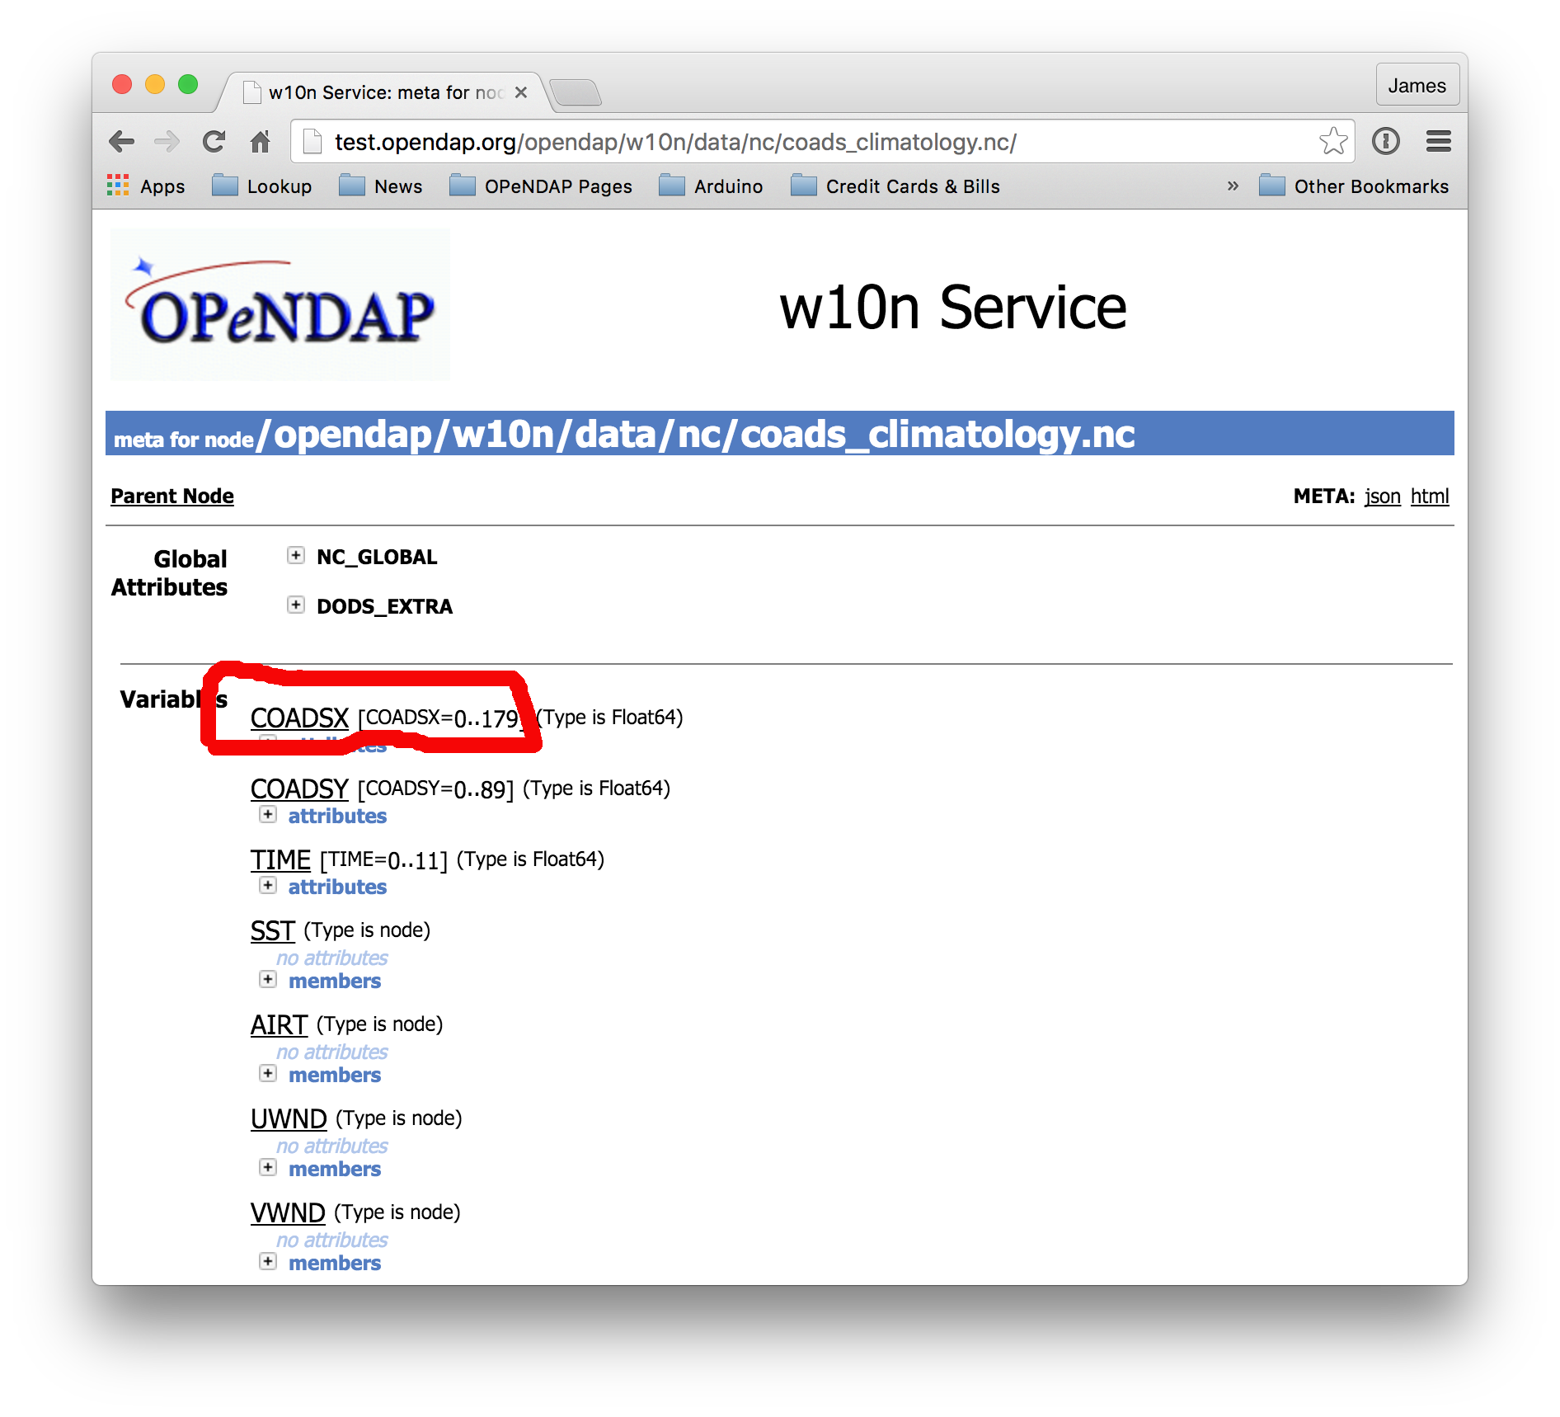

Slide 26
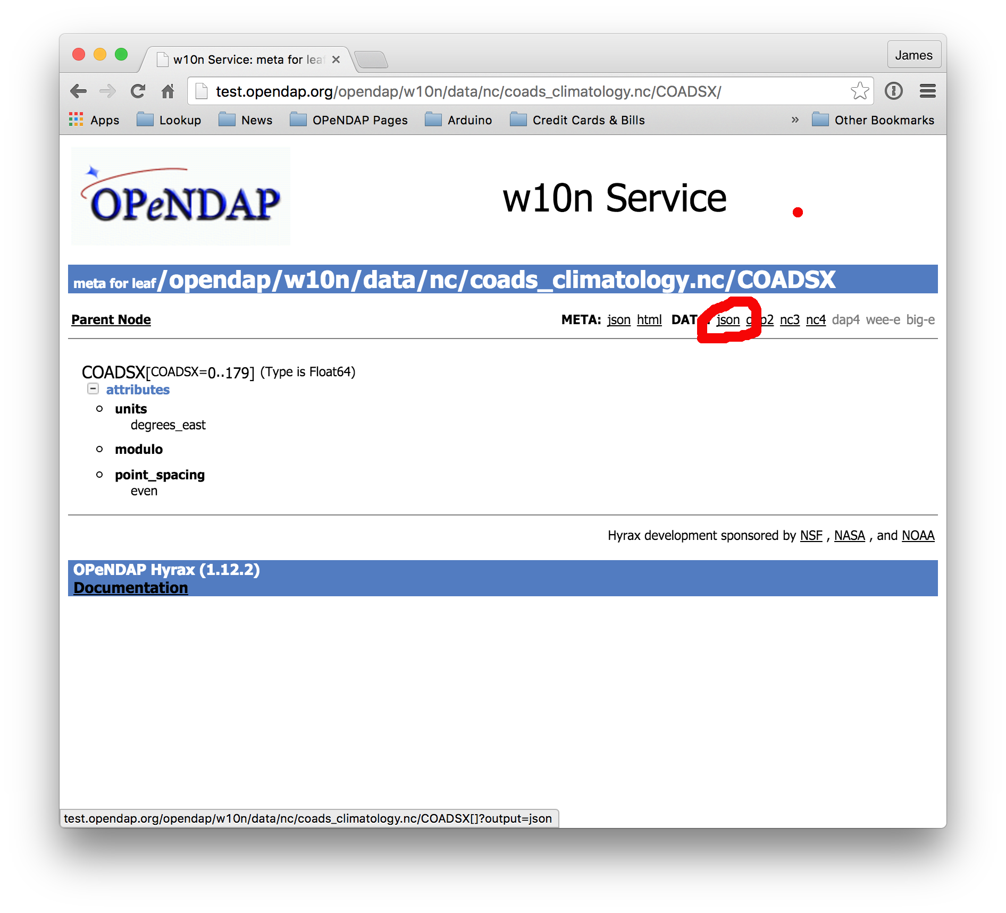

Slide 27
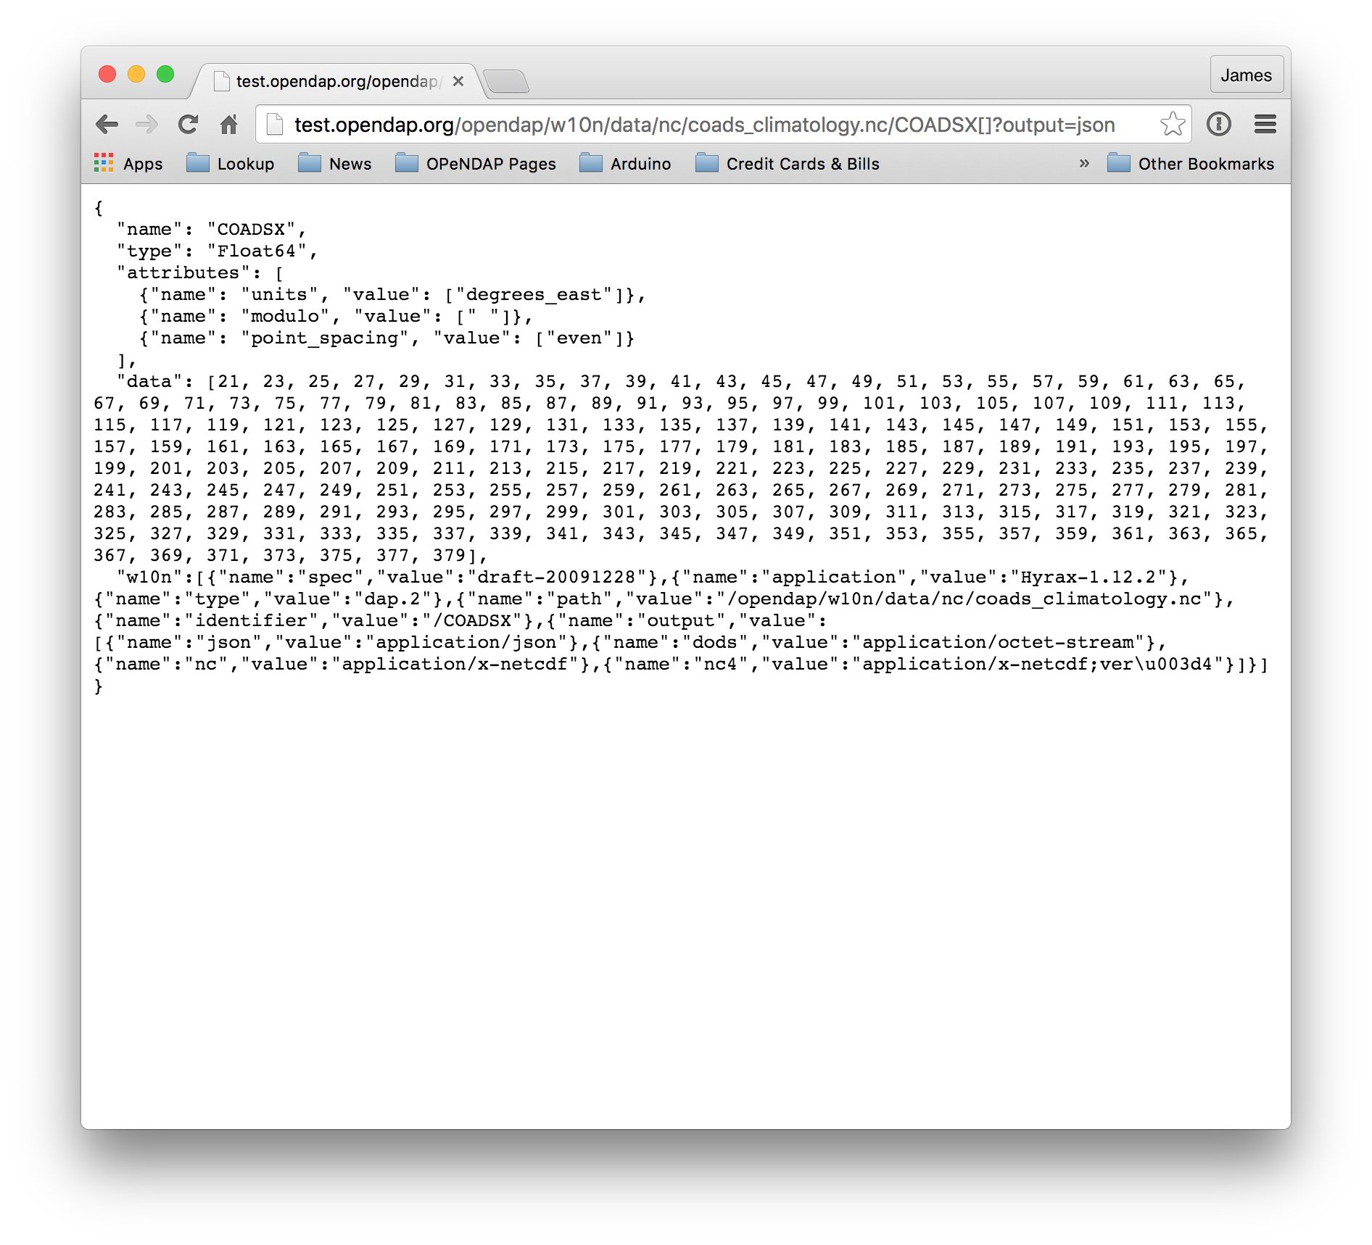

Slide 28
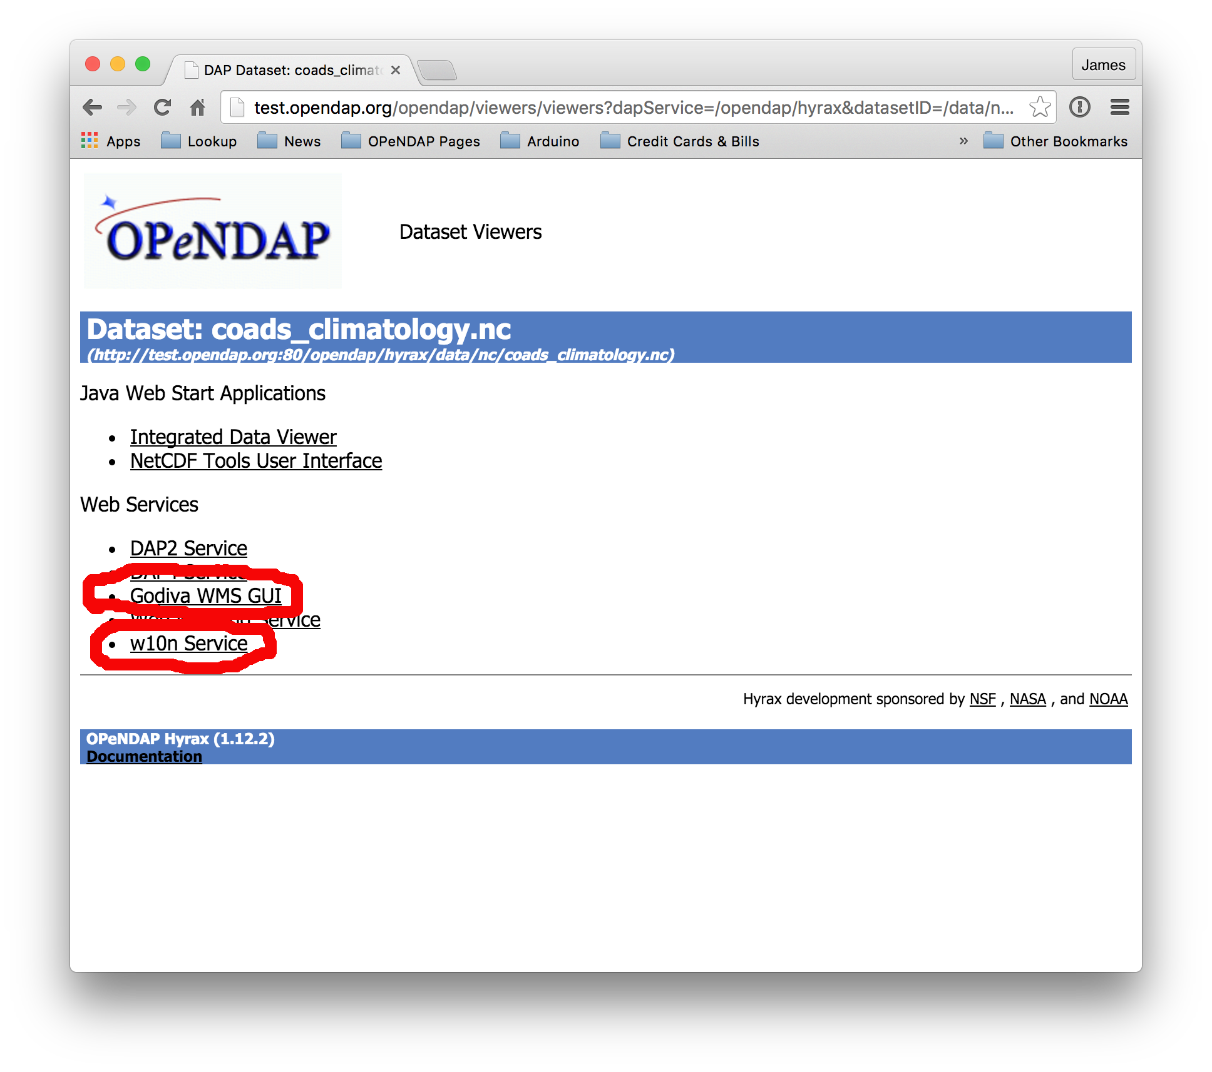

Slide 29
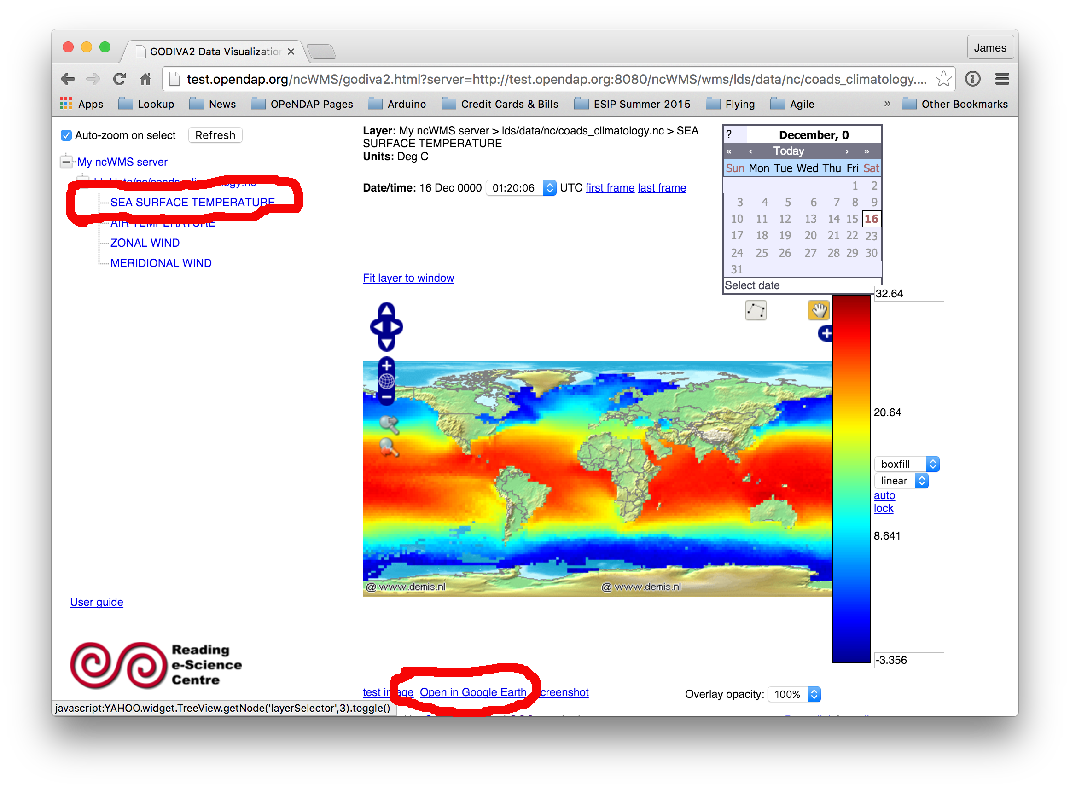

Slide 30
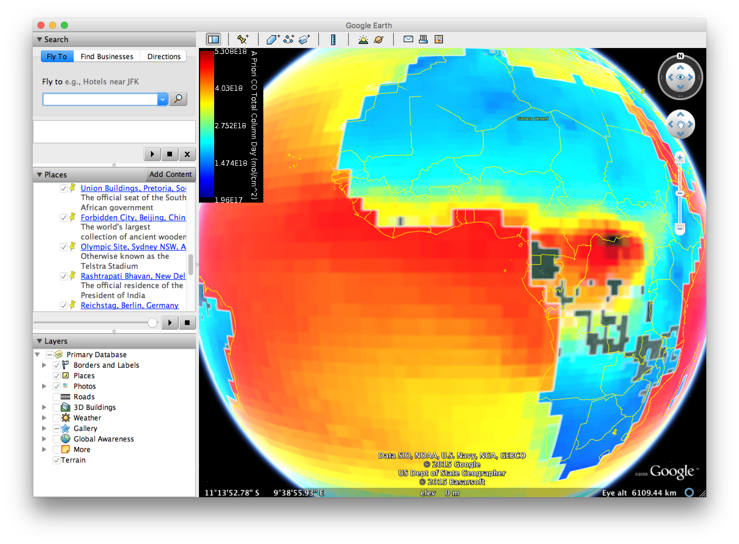

Slide 31
This work is supported by NASA/GSFC under Raytheon Co. contract number NNG15HZ39C

