Slide 1
Research data management using Globus
ESIP Summer Meeting 2015
Rachana Ananthakrishnan
University of Chicago
ranantha@uchicago.edu

Slide 2
Globus delivers …
… data transfer, sharing, publication, and discovery
… on storage chosen by you

Slide 3


Reliable, secure, high-performance file transfer and replication
“Fire-and-forget” transfers
Automatic fault recovery
Seamless security integration
Powerful GUI
and APIs
2
Globus
moves and replicates files
Data
Source
Data
Destination
1
User initiates transfer request
3
Globus
notifies user

Slide 4
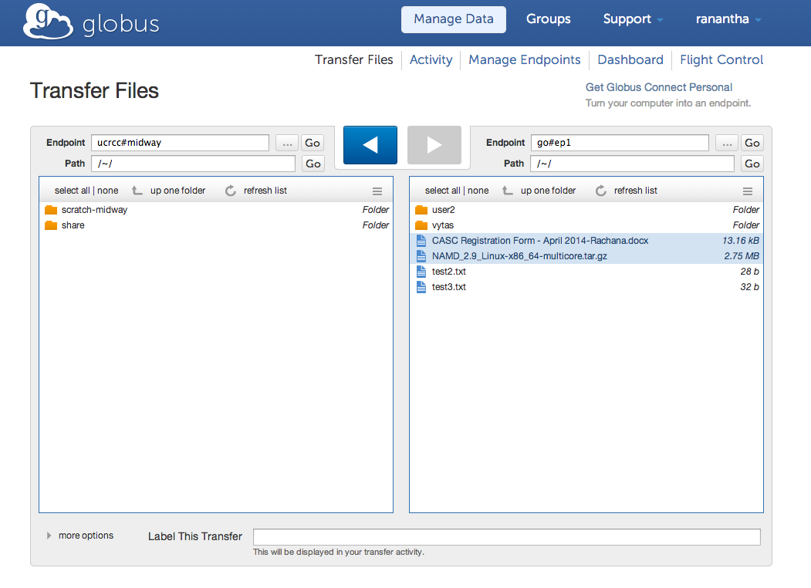
Transfer Files

Slide 5
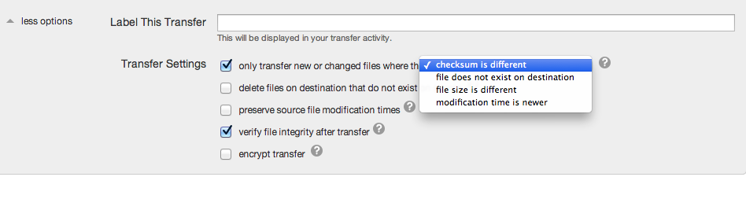
Transfer Options

Slide 6

Simple, secure sharing off existing storage systems
Easily share large data with any user or group
No cloud storage required
2
Globus tracks shared files; no need to move files to cloud storage!
Data
Source
1
User A selects file(s) to share, selects user or group, and sets permissions
3
User B logs in to Globus and accesses shared file

Slide 7
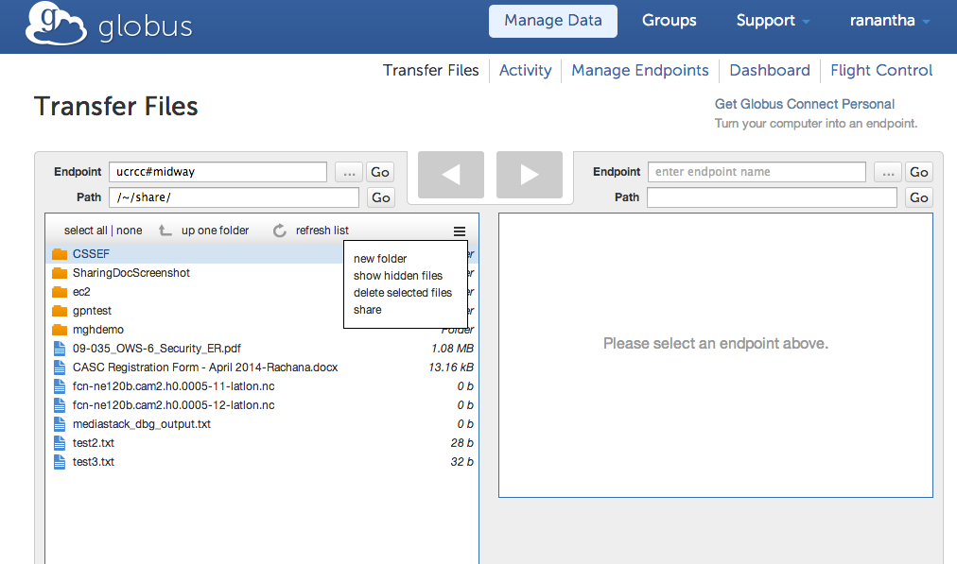
Share files/folders

Slide 8
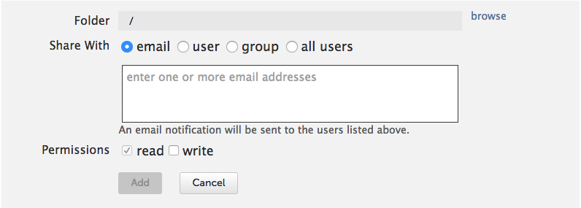
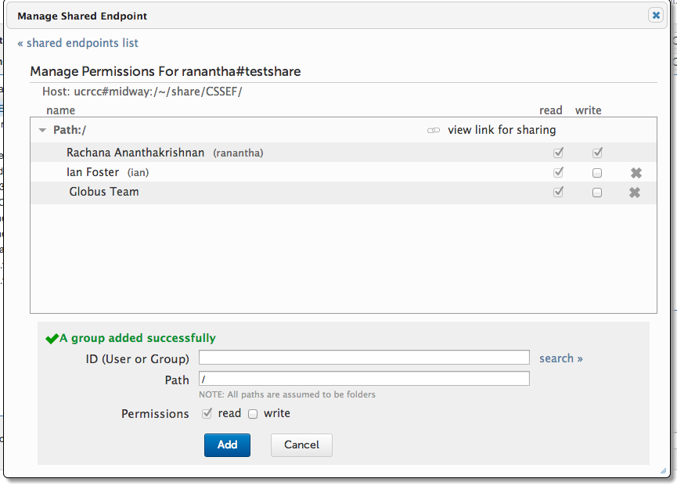
Manage permissions

Slide 9









Globus Platform-as-a-Service
Globus APIs
…
Globus Connect
Sharing Service
Transfer Service
Identity, Group, Profile Management Services
Globus Toolkit
Notes:
Highlight CI Connect; coming up in Rob Gardner’s talk
Highlight XSEDE’s planned adoption of user, group and profile management

Slide 10

Curated publication of data, with relevant metadata for discovery
Identify
Describe
Curate
Verify
Access
Preserve
Published
Data
Store
Metadata
2
Curator reviews and approves; data set published on campus or other storage
1
Researcher assembles data set; describes it using metadata (Dublin core and domain-specific)
3
Peers, public search and discover data sets; transfer using Globus

Slide 11
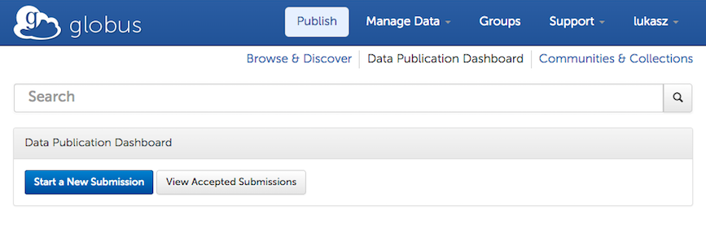
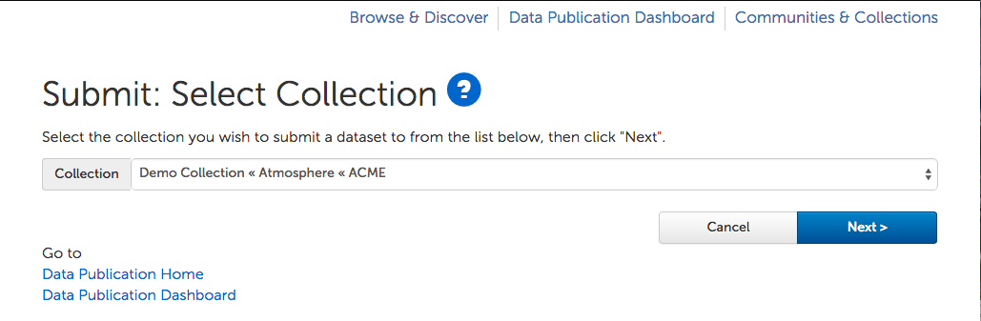
Choose a collection
A collection is created for each Case
Notes:
User chooses a collection to submit to.

Slide 12
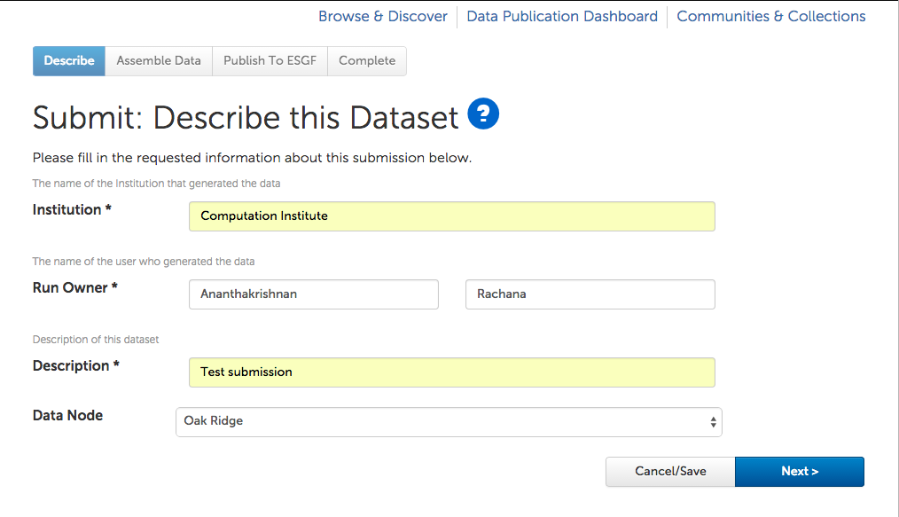
Add description
Metadata and ESGF node to store data
Notes:
Provides some basic metadata and chooses the ESGF data node to publish to.

Slide 13
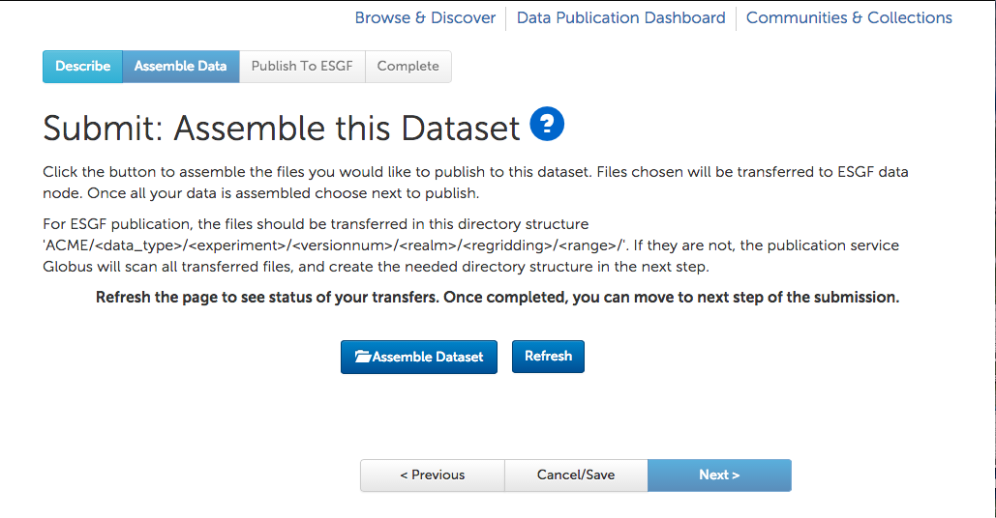
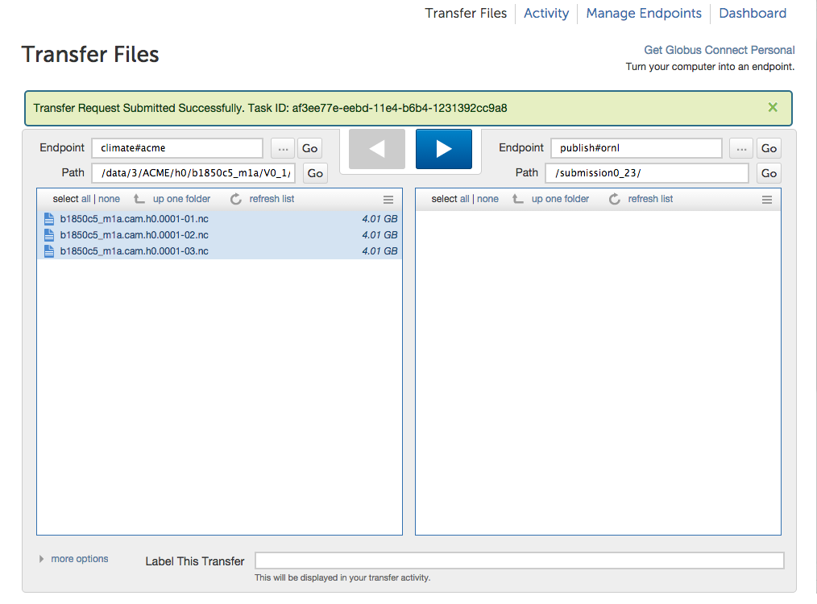
Assembles files to publish
Identify files to publish and transfer to ESGF data node
Notes:
Selects the files to publish from any of the endpoints in Globus, ALCF Mira, NERSC machines or ORNL machines all are endpoints. Data is moved to the ESGF data node (CADES for now) using Globus Transfer.

Slide 14
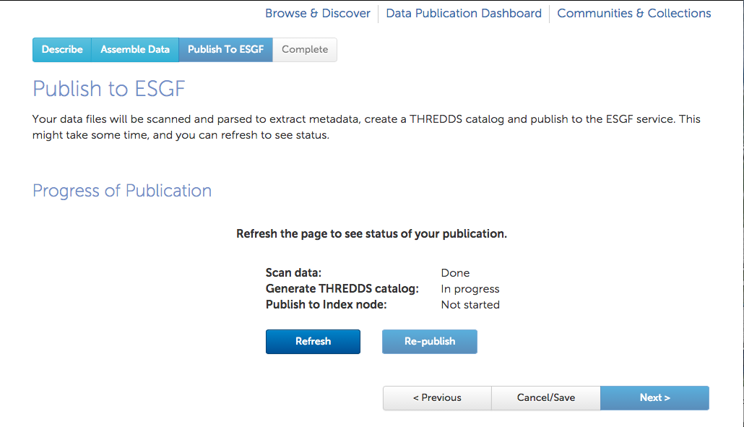
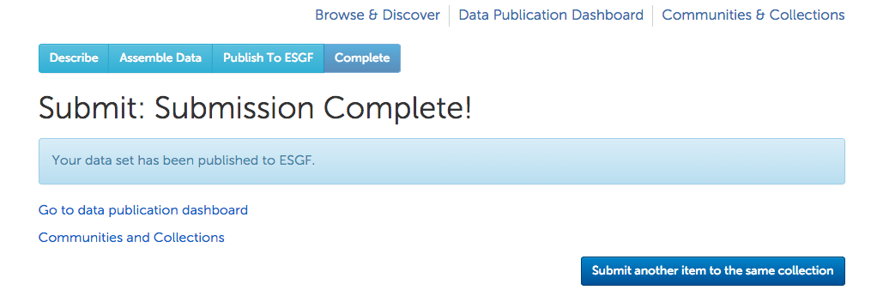
Status updates
Manage remote metadata extraction, generation of THREDDS catalogs and push to ESGF search index
Notes:
Publication is done in three steps: scan data, generate catalog and push to index node. Each step status can be seen here. We are working on adding notifications: user will be emailed when status changes or if any error is encountered.

Slide 15





Thank you to our sponsors!
U.S. DEPARTMENT OF
ENERGY

