Slide 1
The Utility of National Academy-Sponsored Decadal Surveys
Daniel N. Baker
Laboratory for Atmospheric and Space Physics
CU-Boulder

Slide 2
eGY Declaration
“Knowledge is the common wealth of humanity”
We have a shared responsibility to create and implement strategies to realize the full potential of digital information for present and future generations. In the 21st century and beyond, access to digital information and new technologies for information integration and knowledge discovery will influence the free and productive development of societies around the world. In the geosciences, as elsewhere, providing ready and open access to the vast and growing collections of cross-disciplinary digital information is the key to understanding and responding to complex Earth system phenomena that influence human survival.
Article 1: Data access
Article 2: Data release
Article 3: Data description
Article 4: Data persistence
Article 5: Data rescue
Article 6: Common standards and cooperation
Article 7: Capability building
Article 8: Education and public outreach

Slide 3
GOAL: Transform Information into Wisdom
There is an incredible amount of data being collected and information being generated.
What will be done with it?
Information
Knowledge
Wisdom
“Before you become too entranced with gorgeous gadgets and mesmerizing video displays,let me remind you that information is not knowledge, knowledge is not wisdom, and wisdom is not foresight. Each grows out of the other, and we need them all. "
Arthur C. Clarke

Slide 4

Decadal Survey Purpose & OSTP* Recommended Approach
“Decadal Survey benefits:
Community-based documents offering consensus of science opportunities to retain US scientific leadership
Provides well-respected source for priorities & scientific motivations to agencies, OMB, OSTP, & Congress”
“Most useful approach:
Frame discussion identifying key science questions
  Focus on what to do, not what to build
  Discuss science breadth & depth (e.g., impact on understanding fundamentals, related fields & interdisciplinary research)
Explain measurements & capabilities to answer questions
Discuss complementarity of initiatives, relative phasing, domestic & international context”
*From “The Role of NRC Decadal Surveys in Prioritizing Federal Funding for Science & Technology,” Jon Morse, Office of Science & Technology Policy (OSTP), NRC Workshop on Decadal Surveys, November 14-16, 2006

Slide 5
2013-2022 Survey’s Task Summary
5
Provide an overview of the science and a broad survey of the current state of knowledge in the field, including a discussion of the relationship between space- and ground-based science research and its connection to other scientific areas;
Identify the most compelling science challenges that have arisen from recent advances and accomplishments;
Identify the highest priority scientific targets for the interval 2013-2022 (having considered scientific value, urgency, cost category and risk, and technical readiness).
Develop an integrated research strategy that will present means to address these targets

Slide 6
Survey Organization
Steering Committee – Appointed by the NRC and responsible for the final report and its recommendations
  Nineteen members representing the broad solar and space physics community; includes representatives from the 3 study panels
Disciplinary Study Panels – Appointed by the NRC; provides written input to the steering committee and informs steering committee’s deliberations:
  Atmosphere-Ionosphere-Magnetosphere Interactions
  Solar Wind-Magnetosphere Interactions
  Solar and Heliospheric Physics
“National Capabilities” Working Groups – Informal groups drawn from drawn from survey members and from the community
  Address important cross-disciplinary issues and opportunities
6

Slide 7

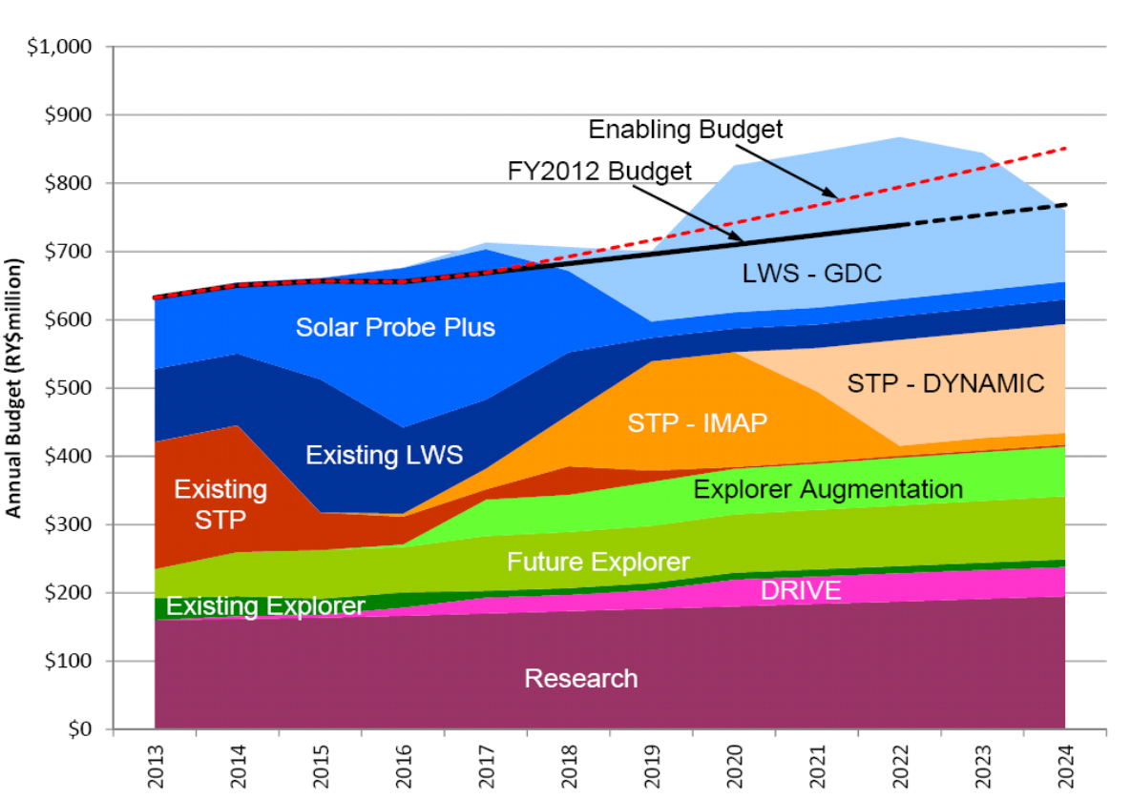

Slide 8
Advice: Define a tractable charter
Recommend an Earth Science focus (for now)
Base thinking on extensive work of NASA open data policies
Try to engage other agencies very broadly (NOAA, USGS, NSF, DOE, DoD, ?)
Bring together space-based, ground-based, purely science, operational systems, etc.
Include ‘meta-analysis’ of many (many!) prior studies and reports

Slide 9
Earth Data and Informatics Survey
What is the present state of data management, access, etc.?
What is the desired/required state for these themes?
What are the required actions? What order must actions be taken?
Provide strategic advice: Leave tactics to agencies (road maps, implementation plans, etc.)
Define notional plans (to give concreteness)
Consider reasonableness, feasibility, rough costs
Main thing: Define priorities and speak with one voice

Slide 10
Key Issues and Aspects
Assess the current status of the data and informatics realm
  Look closely at basic research aspects
  Consider the “applied” side of the field
  Evaluate where the greatest progress can be made; Where can progress occur soonest?
  Begin integrating best ideas from community (white papers, Working Groups, etc.)
  Establish disciplinary “game plan”

Slide 11
Survey Issues
Agencies – Get all the agencies you can involved and make them pay ($$): This will make them feel ownership of Survey.
Policy Maker Buy-In – Get Congress to ask for the survey report: This will make them much more interested and invested in the advice.
Promotion of the Results – Completing the Survey is just the beginning: The leadership must relentlessly advocate and continue to promote the advice and recommendations.
Get a hearing! – Get congressional staff to organize a hearing or set of hearings on Capital Hill: Make the agencies attend and answer pointed questions.
11

