Slide 1
The NEON approach to data ingest, curation, and sharing
Christine Laney (Data Products) - claney@neoninc.org
Mark Brundege (Cyberinfrastructure)
National Ecological Observatory Network

Slide 2
Intro to NEON
A continental-scale ecological observatory solely funded by the NSF that:
  Collects and provides data on the drivers/responses of ecological change across the continent over 30 years
  Supports standardized methods of data collection and high investment in QA/QC
  Serves as an infrastructure/backbone for other experiments
  Develops and provides educational resources to engage communities in working with scientific open data
Project Timeline
Notes:
A “science facility” is an observatory/organization that enables science by providing a community-wide resource. For example, the a large telescope that provides opportunities for many scientists to propose, collect and use data is also a facility.
NEON staff will collect, verify (through QA/QC procedures) and provide data to users through the NEON web portal. All data are available free and to anyone through the web portal.
Scientists can propose additional sensors, instruments, data collection, experiments, etc. that leverage NEON infrastructure (i.e., towers, sampling plots, airborne platform, etc.) to NSF to further their research goals.
Educational resources include Citizen Science programs, opportunities for undergraduate students to participate in internship or research experiences, a graduate student course, museum projects, online learning modules for students, and seminars/workshops to provide additional professional development/training related to NEON science, data, and educational programs.
Timeline
Design & Development=community workshops, design groups, development of proposal to NSF
Construction = build observatory infrastructure, data collection protocols, data delivery system, web portal and educational resources
Operations= collect and provide data, educational resources and infrastructure to users. NEON sites will move into Operations as they are completed during construction. Full Operations will not begin (with data from all sites) until the entire observatory is built, likely in late 2017.

Slide 3
Intro to NEON: A Continental-Scale Design
20 Ecoclimatic domains
20 Core sites: Located in unmanaged wildland conditions
40 Relocatable sites: Representative of human land management effects on ecosystems
36 Aquatic sites &10 colocated STREON sites: Measure changes in aquatic systems over time
3 Airborne Platforms: LiDAR, hyperspectral observations, imagery
Notes:
NEON statistically partitioned the continental US, Hawaii and Puerto Rico into 20 ecoclimatic domains that represent distinct regions of vegetation, landforms and ecosystem dynamics to capture the full range of US ecological and climatic diversity. NEON selected ecologically representative core sites within each domain considering logistical convenience and site accessibility. - See more at: http://www.neoninc.org/science-design/spatiotemporal-design#sthash.wsNOfYog.dpuf
A total of 72 sites are being built across 20 domains (approximately 3 terrestrial and 3 aquatic sites per domain)
60 terrestrial sites that include towers with atmospheric sensors, soil pits, organismal sampling plots
36 aquatic sites with sensors and organismal sampling (XX are co-located with terrestrial sites)
10 STREON sites (co-located with 10 aquatic sites)

Slide 4
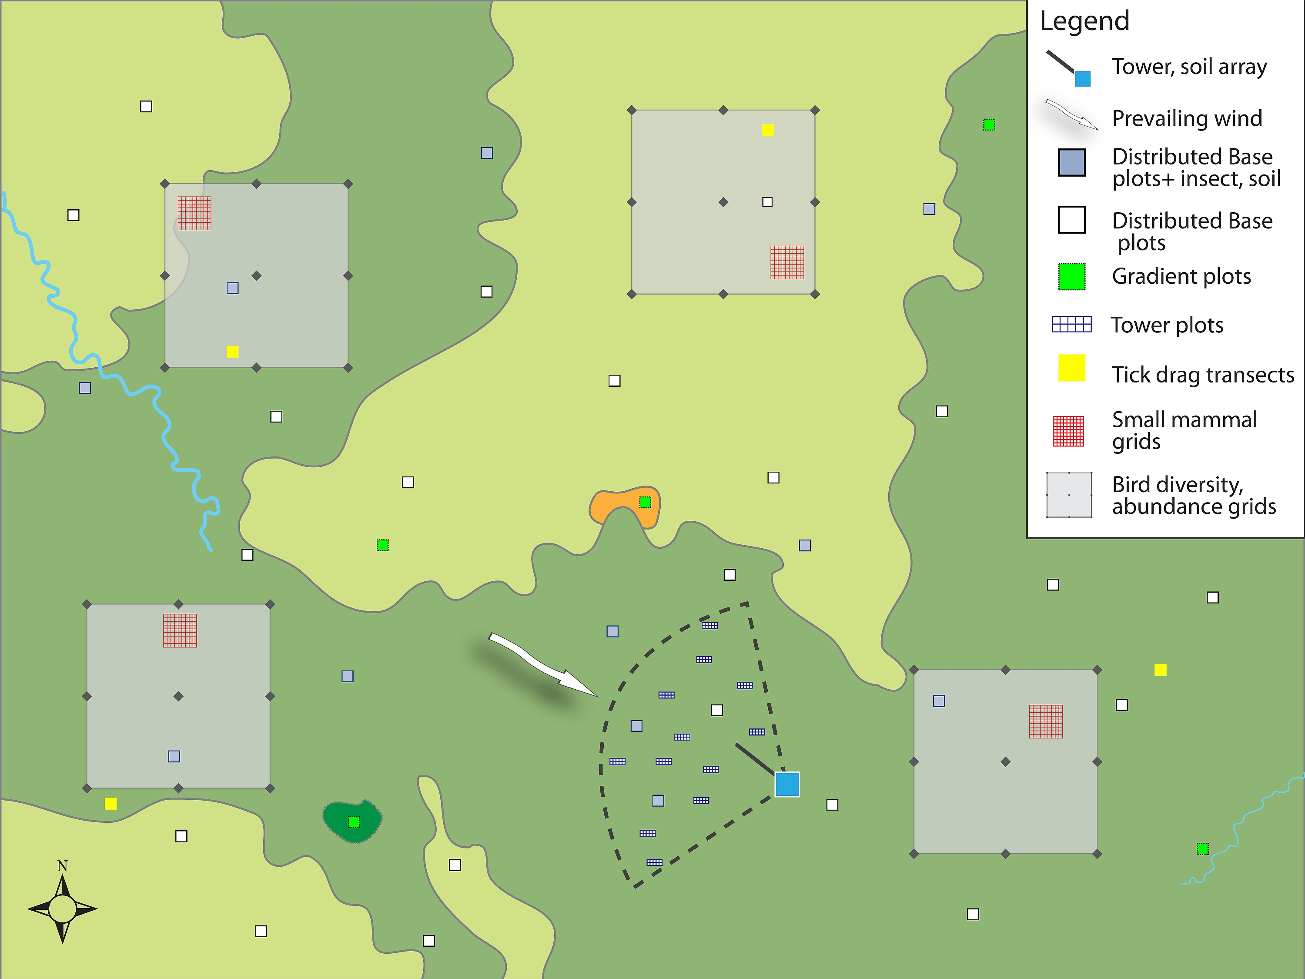
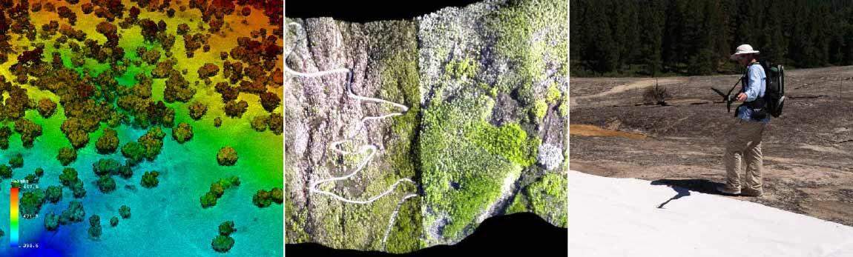
Generalized Terrestrial Sampling Scheme
4
Notes:
Bird, mammal, and tick sampling are more loosely tied to the biodiversity plot layout, with the goal to achieve spatial co-location among the different types of sampling units where possible.
Note that bird, mammal, and tick sampling units can be placed in order to capture habitat gradients of interest, or unique habitats on the landscape.

Slide 5
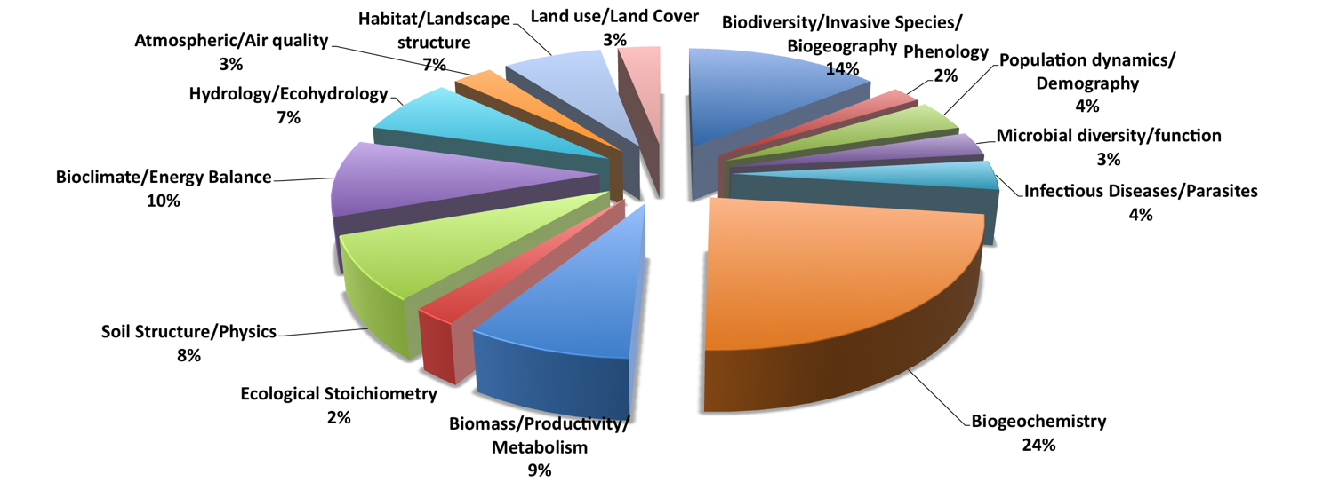
Data Heterogeneity
Current deployment: 17 core, 17 relocatable terrestrial, and 6 aquatic sites
Recent rapid addition of data products: 41 publicly available to date

Slide 6
Data product workflow
Processing: basic calibrated data will be processed using algorithms and models to produce synthetic data products that both specialist and non-specialist scientists can use to rapidly and effectively address ecological problems
Supporting trust: assignment of meaningful metadata & uncertainty measures
Enabling discovery: data portal, semantics

Slide 7
Supporting trust in the data
  Standardized Uncertainty Quantification for each subproduct: working with internal scientists and external collaborators.
  Documentation: Configuration-controlled and linked science designs, engineering documents, as-built documents, protocols, algorithms, etc. that are openly available via the data portal or by request
  Traceability:
  Science challenges → designs → implementation → data → data products
  Sample management and sharing via an asset tracking system
  Linkages between data products via a data product catalog
  Standardized Nomenclature & Metadata:
  Internal: unique ID, measurement, time, location, etc.
  External: Interoperability (LTER, DataONE, CZO, etc.)

Slide 8
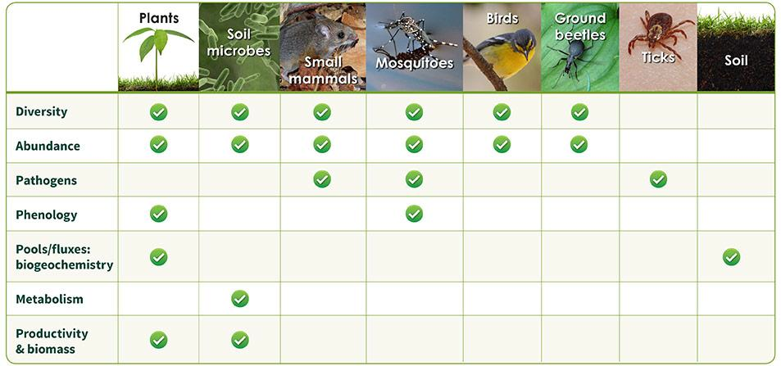
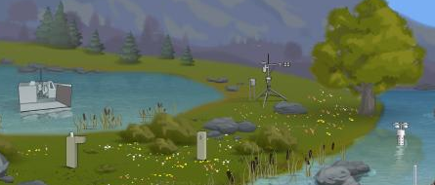
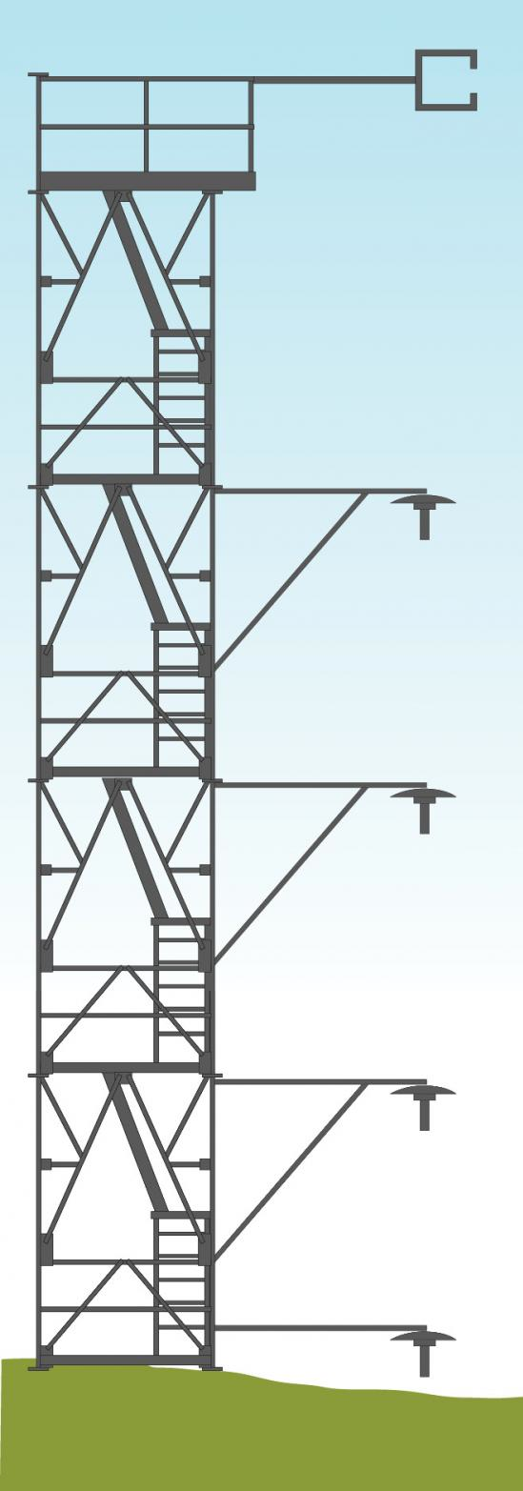
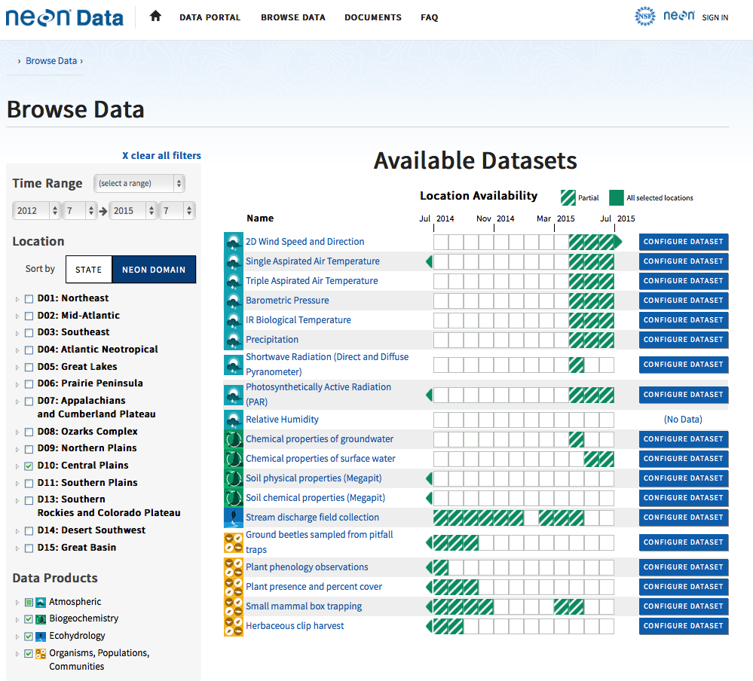
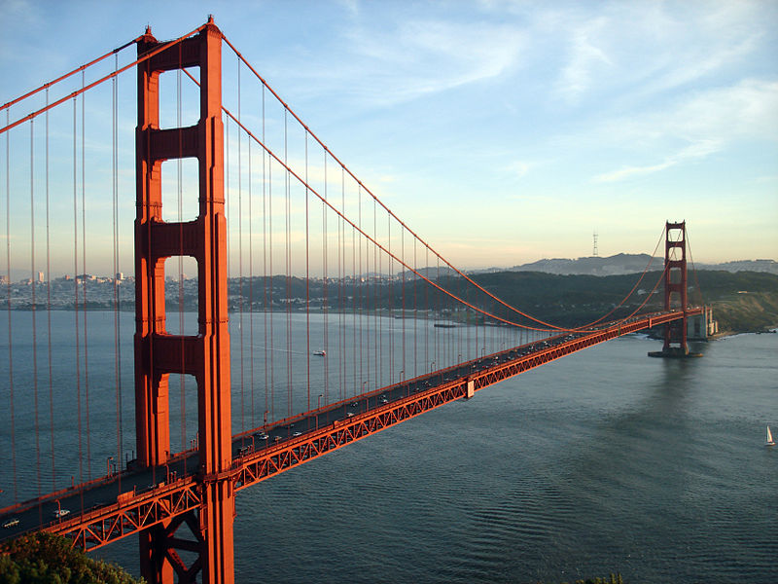
Data Ingest and Processing – Data Flow
Location controller
External Labs
WebUI or PDA
Queue
DRR (unpack messages)
DPMS (data transitions)
WebUI
Raw (L0) data
cdsExternalAPI
CDS server
QA/QC (L1) data
Queue
Lab ingest router
PDR (Oracle)
Golden Gate
Data Portal Database
Validator
© Rich Niewiroski Jr.
Notes:
DPMS: data processing management system
CDS: common data services – a data service layer
PDR: permanent data repository

Slide 9
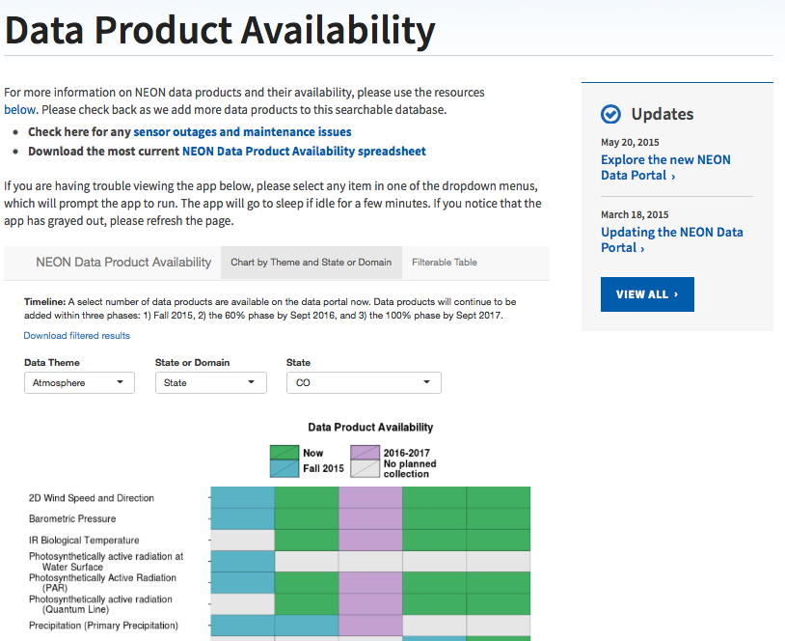
Data Product Availability Information
http://www.neoninc.org/data-resources/get-data/data-product-availability

Slide 10
NEON Data Portal – http://data.neoninc.org
(2.0 Launched May 2015)
NEON data should be accessible by anyone.
Our audience should be able to learn about NEON’s
Mission
Science designs
Data collection protocols
Processing practices
Data!
To do this, we need:
A user-friendly interface
Credible, traceable data
Robust data processing, storage, and querying systems.
Oracle database

Slide 11
NEON Data Portal – http://data.neoninc.org
Find a dataset by
Date range
Location (site by state or domain)
Data product by theme
Icons and graphics aid with identification of pertinent data
Custom configure the download

Slide 12
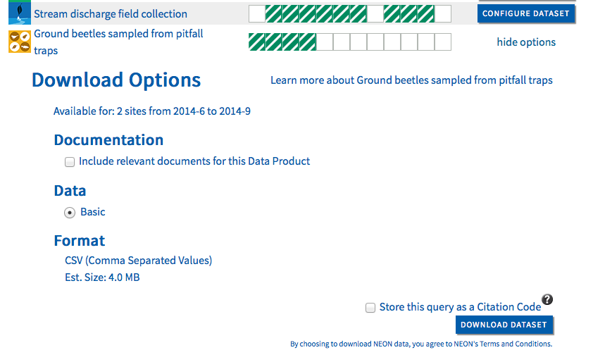
NEON Data Portal – http://data.neoninc.org
Learn more about the data product
Assess a data product by availability of data for:
Months
Sites
Parameters
Available documentation (protocols, algorithms)
Format
Estimated download size
Store a citation code to retrieve the query at a later date
DATA PACKAGE:
Unique citation code for query
Data files for chosen sites and time range
Variable definition file
Readme/manifest
Requested documentation
Data policy & citation info

Slide 13
A Few Future Plans
Adding more data products as sites continue to be built and commissioned.
Scoping for next iteration of data portal: Will be seeking community feedback via meetings and form at data.neoninc.org
Preparing for development of external API
Assess usability of data packages
Assess options for structured metadata
Report and track metrics
THANKS!

