Slide 1
On the Need for a Data Decadal Survey
Stanley C. Ahalt, Ph.D.
Director, RENCI Professor, UNC-Chapel Hill Dept. of Computer Science Director, Biomedical Informatics Core, UNC TraCS

Slide 2
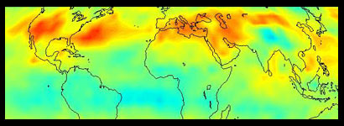
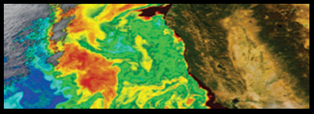
Data Decadal Survey
Do we need a Data Decadal Survey?
Emphatic answer is “Yes!”
There are three sets of reasons why:
Big data
Technological Trends
Sociological Trends

Slide 3
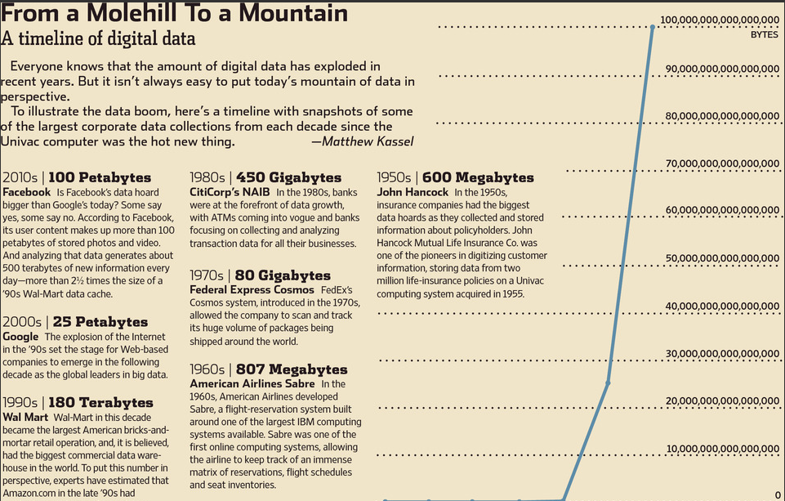
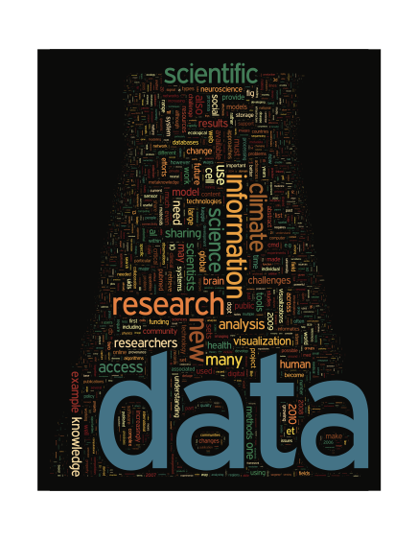
Here’s Why: Big Data
Shift from deductive to more inductive
Find patterns, then figure out why they’re there
Data, data everywhere, from all types of sources, levels
personal devices, sensors, genomic, molecular, citizen science, cheap satellites, Earth system
Notes:
Earth science is used to dealing with big data, think satellite systems collecting petabytes of data
However, these will be dwarfed by new sources of data that are on the horizon
Think
UAVs
Kickstarter campaigns creating Earth observing satellites
Relevance of molecular scale processes
Sensors everywhere on everything – sensors moving through space/time

Slide 4
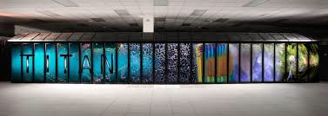
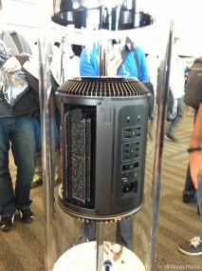
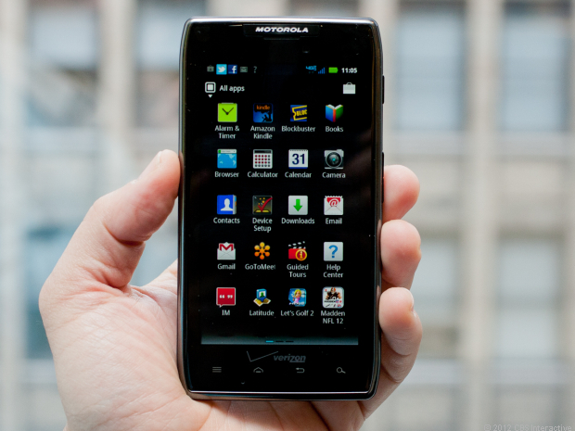
Here’s Why: Technological Trends
Compute power
64-bit architecture v. scientific precision, e.g.
Increasing importance of middleware
Software Defined Networks
Notes:
Keeps going up, generate more data, from cell phones to supercomputers
The fact that storage is so cheap, it actually creates problems
Unstructured data v. structured data
Middleware as a way to ease some of the data management, data integration, data use problems….middleware moving into storage controllers
Just because we can collect data with 64 bit precision, does that mean we should
Is it cheaper to store genetic material as opposed to the bits and bytes of a decoded genome (perhaps a bit of a stretch for this crowd, but gives an example of some of the trade offs)

Slide 5
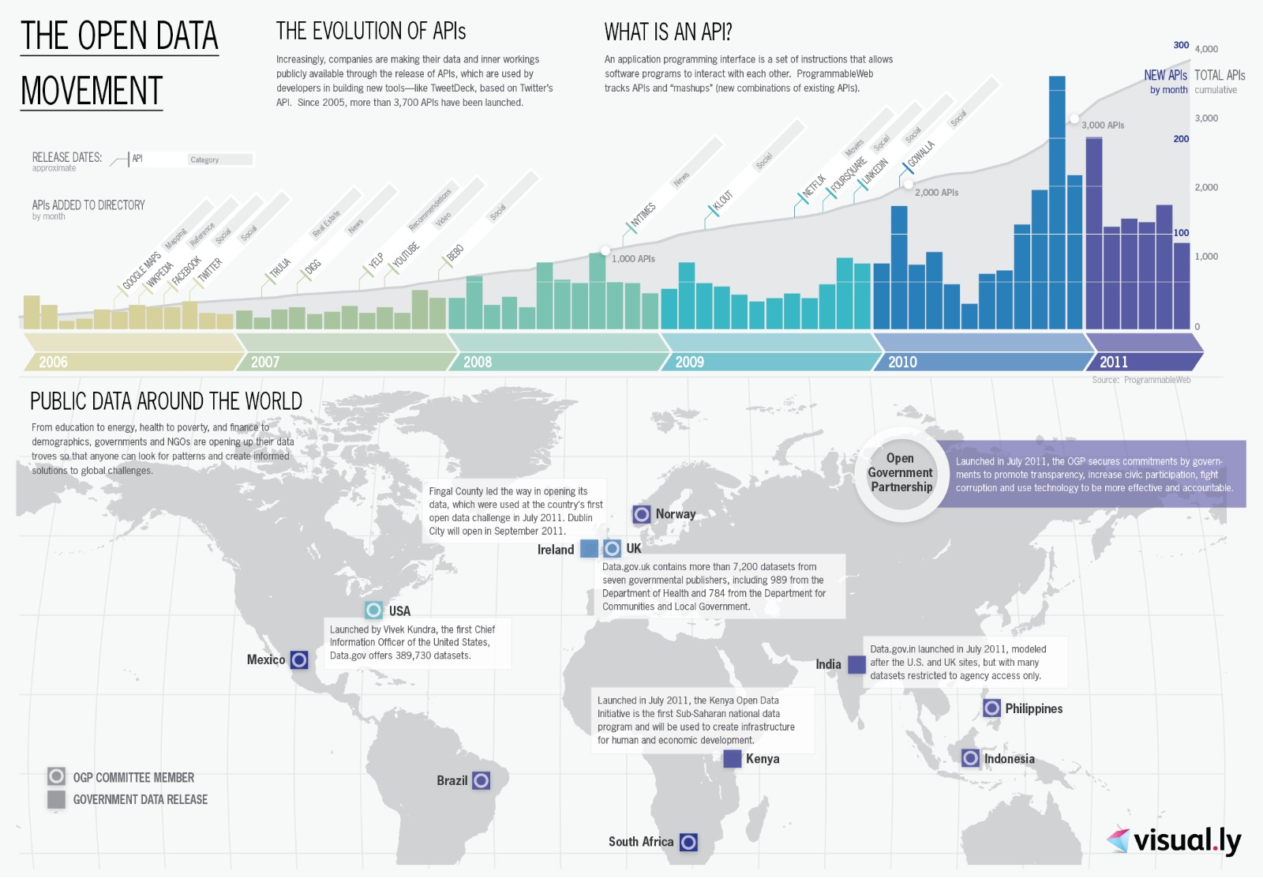
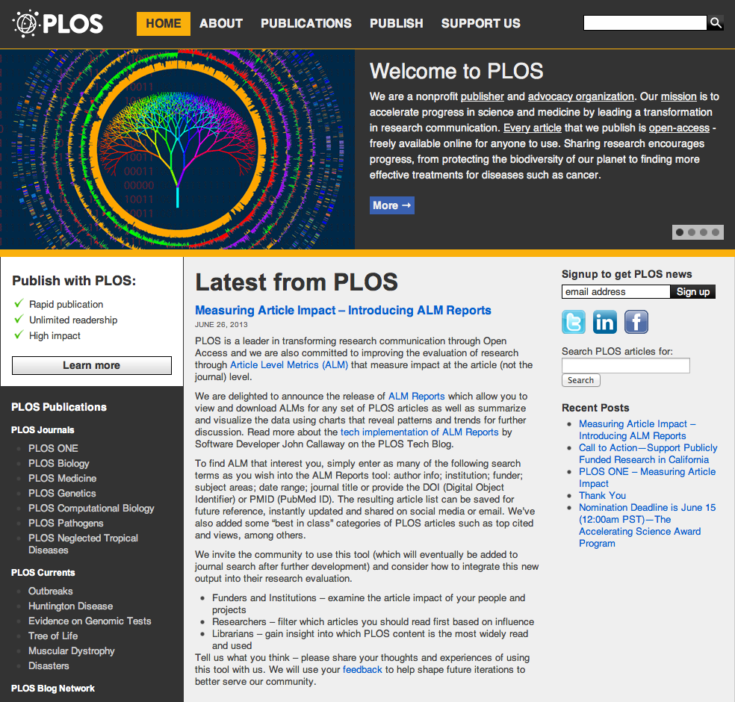
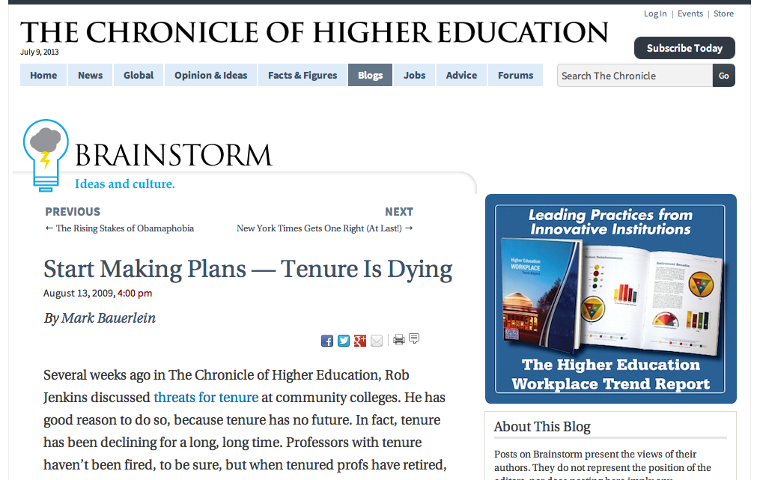
Here’s Why: Sociological Trends
Open Data
Open Publishing / Peer Review
Open Science
Crowdsourcing
Withering away of the tenure system?
Notes:
The way of science is changing, the very nature of the science enterprise is changing
As I indicated in the earlier slide, moving from inductive to deductive
Science shifting to a more open framework
Open science
Open publishing
Nature of peer review changing
Science continues to be even more collaborative
Transdisciplinary
Requires data from an array of sources

Slide 6
These issues raise a host of questions for US data-related agencies:
Are current methods for generating, maintaining, and using science data sustainable given the trends at play?
Do we have processes in place to deal effectively with the pace of change?
Will we have enough human capital to deal with these challenges?
How will we develop the next generation of data science experts and leaders?
How can issues of confidentiality and security be addressed?
What will be the impact of the White House open data push?
How can these challenges be addressed in an era of level funding?
What will Data [big D] Centers look like in 3 – 5 years? 10 years?
Notes:
These are the kinds of issues that need to be thought about emphatically, as soon as possible in a data decadal survey
Program management at the highest levels of the agencies need to think about and talk about these things
We are faced with unprecedented environment-related challenges that will require incredible new science that will need new data, data tools, and data science
Start with Earth science, but branch out to other disciplines in order to facilitate the required transdiciplinary science
We need to get out ahead of this as much as possible

Slide 7
More Questions and Issues
How do we:
Create strategies, practices, and scientific methods for understanding data?
Advance data science through collaborations among data scientists, software engineers, and scientists?
Holistic approach: Smaller projects can be highly innovative, but often result in targeted solutions applicable only to limited domains.
We need centers to study Data Science, as we created HPC centers.
These questions affect the science and technology that the US can do, which in turn affects US competitiveness, national security, etc.

