Slide 1
The Arctic Boreal Vulnerability Experiment and Big Data Analytics for Ecosystem Science
and
Data Management
Stephen D. Ambrose¹, Elizabeth Hoy,² Peter Griffith³
¹NASA CISTO Climate Model Data Services (CDS),
^{2, 3} NASA Carbon Cycle and Ecosystems Office
NASA, GSFC Greenbelt, Maryland
Notes:
Do we want to keep pictures?

Slide 2
Presentation Outline
Introduction
The ABoVE Campaign & Data Management
NASA’s High Performance Compute Capabilities – CISTO, NCCS, CDS and the ADAPT system
Data Sets for ABoVE
Analytics Examples
Summary

Slide 3
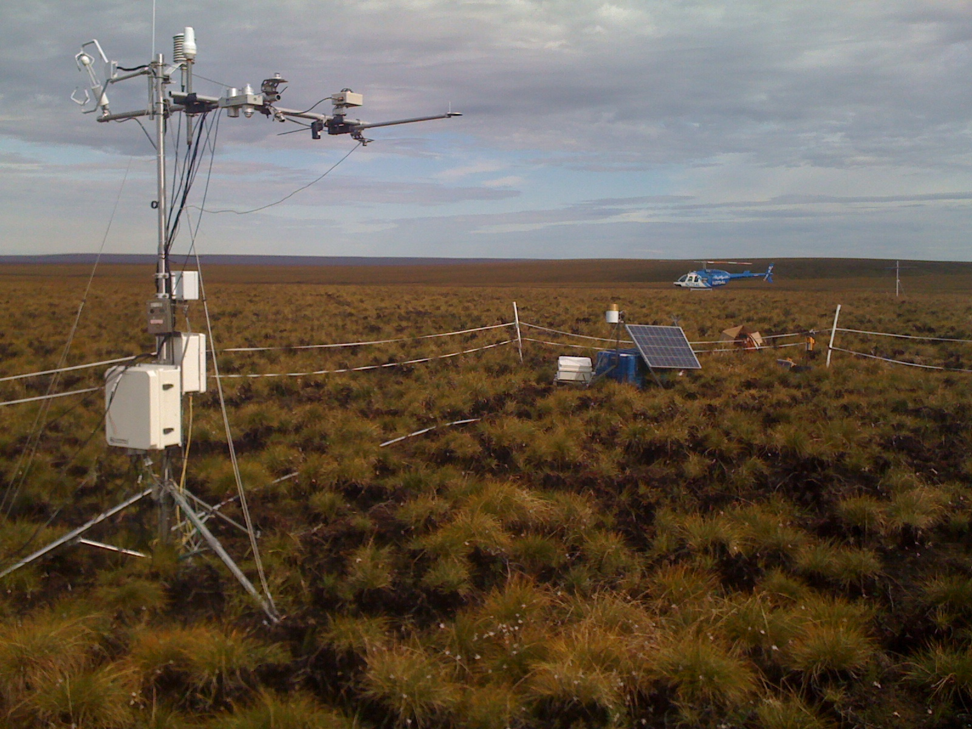
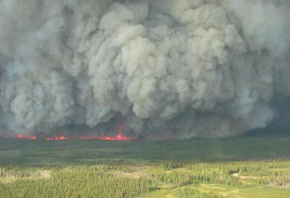
ABoVE is a large-scale NASA-led study of environmental change in arctic & boreal regions and the implications
for ecological systems and society
Our overarching Science Question is
How vulnerable or resilient are ecosystems and society to environmental change in the arctic and boreal region of western North America?
above.nasa.gov
Notes:
Photo credits:
Anatuvik tundra fire flux tower site, North Slope of Alaska (Scott Goetz)
Boreal forest fire, Northwest Territories (Dennis Quintilio)
Climate change in the Arctic and Boreal region is unfolding faster than anywhere else on Earth, resulting in reduced Arctic sea ice, thawing of permafrost soils, decomposition of long- frozen organic matter, widespread changes to lakes, rivers, coastlines, and alterations of ecosystem structure and function. NASA's Terrestrial Ecology Program is in the process of planning a major field campaign, the Arctic-Boreal Vulnerability Experiment (ABoVE), which will take place in Alaska and western Canada during the next 5 to 8 years. ABoVE will seek a better understanding of the vulnerability and resilience of ecosystems and society to this changing environment. http://above.nasa.gov

Slide 4
The Carbon Cycle & Ecosystems Office is responsible for implementation and management of ABoVE
Science team members work closely with the CCEO and rely upon our guidance for field operations and safety, communications with local and regional stakeholders and authorities, and utilization of ABoVE cyberinfrastructure.
The ABoVE Science Cloud combines high performance computing with emerging technologies, such as analytics, and data management tools for analyzing and processing geographic information to create an environment specifically designed for large-scale modeling, analysis of remote sensing data, copious disk storage for “big data” with integrated data management, and integration of core variables from in-situ networks.
Notes:
NASA has established an ABoVE implementation and management group within the Carbon Cycle and Ecosystems Office (CCEO) at the NASA Goddard Space Flight Center (GSFC). Field activities and operations to be conducted within the ABoVE Study Domain will be organized, coordinated, and supported through the efforts of the CCEO. Important aspects include coordination and support for field operations and logistics, safety and risk management, and interactions with local and regional stakeholders. The CCEO will provide cyberinfrastructure for data analysis and management (e.g., the ABoVE Science Cloud, see Section 2.2). The CCEO will assist ST members with permit applications to appropriate authorities. Depending on the needs of the selected ABoVE ST, the CCEO may also arrange for the collection of core variable data and installation of infrastructure at ABoVE field sites. The CCEO will be responsible for managing the airborne science campaigns.
Investigators should plan to work closely with the CCEO and rely upon guidance from its staff for field activities, communications with local and regional stakeholders and authorities, and utilization of ABoVE cyberinfrastructure.

Slide 5
The CCE Office will assist the Science Team throughout the Data Management Lifecycle.
Plan
Analyze
Collect
Traditional Project
Data Reuse
Other Data
Integrate
QA/QC
Discover
Analyze
Traditional Project
Archive
Publish
Preserve
Describe
Data Reuse
Closing the Data Life Cycle
Augmented from Rüegg et al 2014 in Front Ecol Environ
Notes:
Front Ecol Environ = Frontiers in Ecology and the Environment.
The practice of documenting and submitting datasets to data repositories is not new.

Slide 6
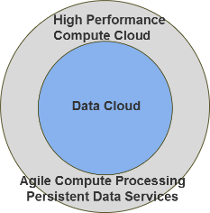
The ASC will surround these aspects of the data lifecycle.
Science Definition Team
Experiment Plan
CCE Office
NASA HQ
Call for Proposals
Plan
Selection of Funded Proposals/Scientists
Plan for the next Phase of ABoVE
Identify Conventions
CF Metadata, Ameriflux, GTN-P
Analytics
Collect
SensorML, Instrument Vendors, SmartPhone Apps
Other Data
Integrate
QA/QC
Model and Observational Data
ESRI, R, MatLab, Python, IDL
Discover
Analyze
Traditional Project
NASA DAACs
NSIDC
Governance
Publish
Preserve
Describe
Data Reuse
CCE Office
Closing the Data Life Cycle
Augmented from Rüegg et al 2014 in Front Ecol Environ
Notes:
Front Ecol Environ = Frontiers in Ecology and the Environment.
The practice of documenting and submitting datasets to data repositories is not new.

Slide 7
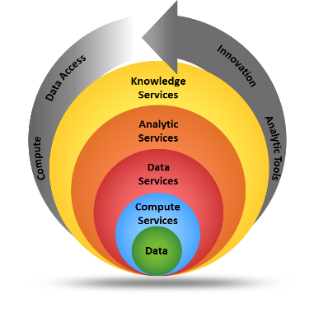
Background: CISTO Conceptual Service Layers
CISTO Conceptual Service Layers
Computational and Information Sciences and Technology Office’s (CISTO) Service Layers...
Brings together the tools, data storage and high-performance computing to for timely analysis over large-scale data sets, where the data resides, to ultimately produce societal benefits
Serving the Earth Science Community
7

Slide 8
NASA Center for Climate Simulation (NCCS)
CISTO Center provides an integrated high-end computing environment designed to support the specialized requirements of Climate and Weather modeling.
High-performance computing, data storage, and networking technologies
High-speed access to petabytes of Earth Science data
Collaborative data sharing and publication services
Advanced Data Analytics Platform (ADAPT) – High Performance Science Cloud
Current Primary Customers (NASA Climate Science)
Global Modeling and Assimilation Office (GMAO)
Goddard Institute for Space Studies (GISS)
High-Performance Science
http://www.nccs.nasa.gov
Located in Building 28 at Goddard

Slide 9
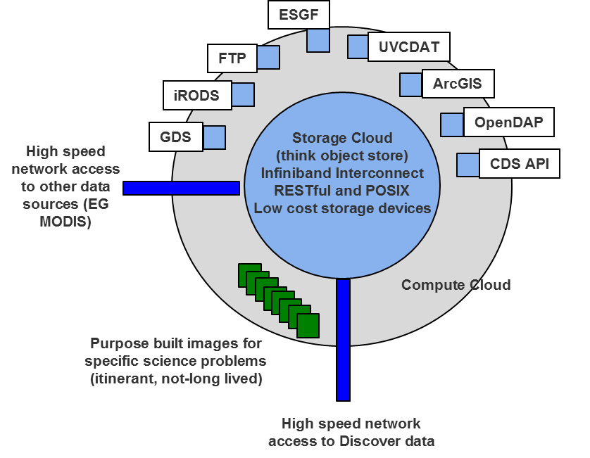
Advanced Data Analytics Platform (ADAPT) “High Performance Science Cloud”
High Performance Science Cloud is uniquely positioned to provide data processing and analytic services for NASA Science projects
Adjunct to the NCCS HPC environment
Lower barrier to entry for scientists
Customized run-time environments
Reusable HPC/Discover hardware
Expanded customer base
Scientist brings their analysis to the data
Extensible storage; build and expand as needed
Persistent data services build in virtual machines
Create purpose built VMs for specific science projects
Difference between a commodity cloud
Platform-as-a-Service that comes close to matching HPC levels of performance
Critical Node-to-node communication – high speed, low latency
Shared, high performance file system
Management and rapid provisioning of resources
High Performance Science Cloud
Conceptual Architecture

Slide 10
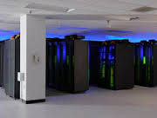
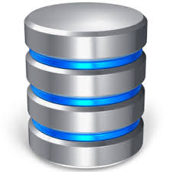
System Components/Configuration
Capability and Description
Configuration
Persistent Data Services
Virtual machines or containers deployed for web services, examples include ESGF, GDS, THREDDS, FTP, etc.
Nodes with 128 GB of RAM, 10 GbE, and FDR IB
Database
High available database nodes with solid state disk.
Nodes with 128 GB of RAM, 3.2 TB of Solid State Drive (SSD), 10 GbE, and FDR IB
Remote Visualization
Enable server side graphical processing and rendering of data.
Nodes with 128 GB of RAM, 10 GbE, FDR IB, and GPUs
High Performance Compute
More than 1,000 cores coupled via high speed Infiniband networks for elastic or itinerant computing requirements.
~100 nodes with 32 to 64 GB of RAM, and FDR IB
High-Speed/High-Capacity Storage
Petabytes of storage accessible to all the above capabilities over the high speed Infiniband network.
Storage nodes configured with a total of about 3 PB of RAW storage capacity
Notes:
FDR 14 data rate.. 14 Gb/s per lane
IB Infiniband

Slide 11
NASA Climate Model Data Services
Data Publication and Distribution Services
Data Publication Services
Protocol
Download
Subsetting
2D Visualization
Web Access
For downloading small files
HTTP
File Transfer Protocol (FTP)
Anonymous FTP supporting wget
FTP
GRads Data Server (GDS)
Data subsetting and analysis services
OPENDAP
Live Access Server (LAS)
Data subsetting and analysis services
OPENDAP
THREDDS Data Server (TDS)
subsetting , analysis, & visualization
OPENDAP
Earth System Grid Federation (ESGF)
Data access to IPPC CMIP data
OPENDAP
Web Map Service (WMS)
Data publication to IPPC CMIP Format
OPENDAP
11

Slide 12
ODISEA – Ontology-Driven Interactive Search Environment for ABoVE
ABoVE’s metadata search engine for project and data access
Built in house, it is derived from Langley’s Atmospheric Science Data Center ODISEES search engine for Earth Science
Finds and compares variables from heterogeneous data sets

Slide 13
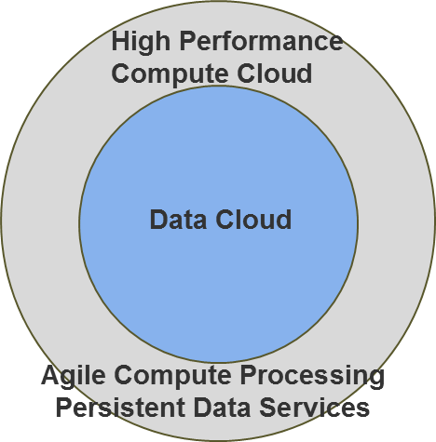
ABoVE Science Cloud
Solution for the ABoVE Computing and Storage Services Requirement is the innovative High Performance Science Cloud
Partnership between the CCE, CISTO, and NCCS
Provide compute, storage, data management, and data publication for the ABoVE campaign using the HPSC
Reduces technical overhead for ABoVE scientists
Allows scientists to focus on science in a optimized computing environment
The Conceptual Architecture to support analytics:
Data analysis platform collocating data, compute, data management, and data services
Ease of use for scientists; customized run-time environments; agile environment
Data storage surrounded by a compute cloud
Large amount of data storage
High performance compute capabilities
Very high speed interconnects

Slide 14
Staged / Common Data Sets in the ABoVE Science Cloud
Common datasets “Staged” for ABoVE investigators
Staged and available for direct use
Individual investigators don’t have to locate and download
Additional datasets can be added
Data Management services
Preliminary Staged datasets
Landsat, Surface reflectance, 123 TB
MODIS, Daily surface reflectance, 57 TB
NGA High Resolution Imagery, 447TB
MERRA, GEOS-5 reanalysis, 89 TB
ABoVE Core and Extended Domains
14
Notes:
Talk about how ABoVE investigators are just beginning to access the system, account setups underway… projects are funded and many will be starting to collect data.

Slide 15
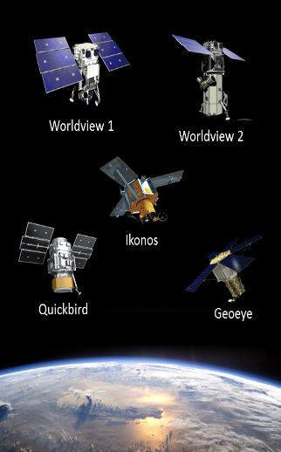
ABoVE Specific CDS Services: NGA/DigitalGlobe High Resolution Commercial Satellite Imagery
National Geospatial Agency (NGA) has licensed all DigitalGlobe ≥ 31 cm satellite imagery for US Federal use, i.e., NSF, NASA and NASA funded projects.
DigitalGlobe Satellite Fleet
Archive of 4.2 billion km² of data from 2000 to present
Data from six different satellites: Worldview-1, 2 and 3; Ikonos; Quickbird; and Geoeye-1
Access to NGA imagery (~3-4/ km²) at no cost to NASA
Satellite | Bands | Nadir Panchromatic Resolution (m) | Nadir Multispectral Resolution (m)
Ikonos | Pan, R, G, B, Near IR | 0.82 | 3.2
GeoEye | Pan, R, G, B, Near IR | 0.41 | 1.65
Quickbird | Pan, R, G, B, Near IR | 0.55 | 2.16
WorldView-1 | Panchromatic only | 0.5 | N/A
WorldView-2 | Pan, R, G, B, Near IR 1, Near IR 2, Coastal, Red Edge, Yellow | 0.46 | 1.85
WorldView-3 | Same as WV-2 plus 8 SWIR bands and 12 CAVIS bands | 0.31 | 1.24
Worldview 3
15
Notes:
WV3 – Accuracy for SWIR Nadir is 3.7m; Accuracy for CAVIS nadir is 30m

Slide 16
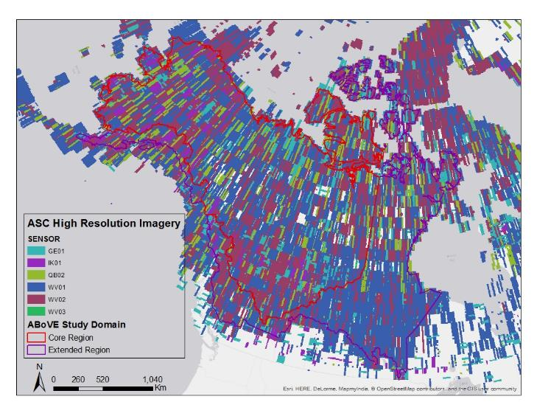
ABoVE Science Cloud DigitalGlobe Imagery: ABoVE Study Domain
Note: Imagery is included from all seasons and for years 1999-2015.
16
Notes:
These are footprints of the data that is available online on the ASC.

Slide 17
- Researchers will share their data using ABoVE’s cyberinfrastructure and/or partnering networks - Storage in the ASC will be tailored to meet Science Team needs - Using ORNL DAAC best practices will facilitate data integration
Other Sources of Data that will be used in the ABoVE Science Cloud
Notes:
Core Variables Listed in the ABoVE Concise Experiment Plan
Weather Station Records
Hydrometric Data (stream flow and water level) from streams and rivers from the U.S. Geological Survey and Environment Canada
Water Quality Data from the U.S. Geological Survey and Environment Canada
Borehole Temperature Data from the Thermal State of Permafrost monitoring network within the Global Terrestrial Network for Permafrost (GTN-P)
Active-Layer Thickness Data from the Circumpolar Active Layer Monitoring Network (CALM) within the Global Terrestrial Network for Permafrost (GTN-P)
CO2 and CH4 Eddy Covariance Flux Data from the AMERIFLUX Networks
Imiq - data portal and hydroclimate database at Univ of Alaska, Fairbanks.
Core Variables are measures of fundamentally important environmental characteristics that are
presently under sampled by monitoring networks in Arctic/boreal regions. The data from Core
Variable Sites located in the Research Areas along with those available from monitoring
networks are needed to address the Tier 2 science questions and objectives on how the drivers
of environmental change (e.g., weather station data) are controlling important ecosystem
processes and their interactions (fluxes of land/atmosphere fluxes, stream flow, and permafrost
dynamics) across the Study Domain (for a further discussion of Core Variables, see Section 4.2.1
below). The measurement of Core Variables would continue for the duration of the Intensive
Study Period. Finally, field data will be collected at some Investigator Sites for the refinement
and validation of products derived from remote sensing data (Remote Sensing Site) (Section
4.2.3).

Slide 18
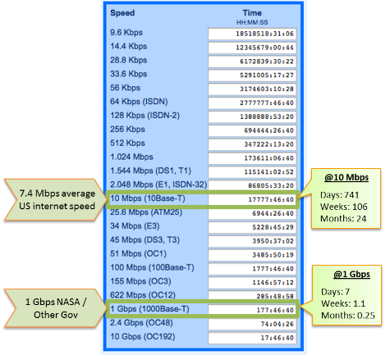
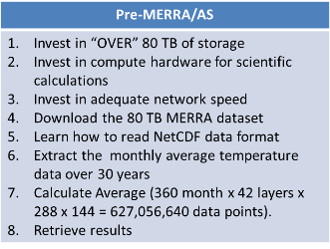
NASA’s Climate Analytics-as-a-Service “APPLICATION SERVICES” MERRA AS Functional Use Case
How an external NASA user calculates the global monthly temperature average over 42 layers of the atmosphere for the last 30 years
Example Download Times For 80TB
18
Notes:
MERRA – Modern Era Retrospective Analysis for Research and Applications

Slide 19
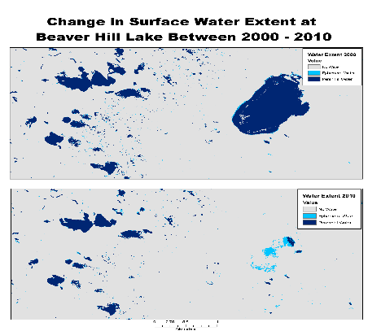
Analytics Application Support
Takes in large amounts of input and creates a small amount of output
Use large amounts of distributed observation and model data to generate science
Analysis applications are typically 100’s of lines of code
Python, IDL, Matlab, custom
Agile environment – users run in their own environments
Example
Decadal water predictions for the high northern latitudes for the past three decades (Mark Carroll)
Requires 100,000+ Landsat images and about 20 TB of storage
M. Carroll

Slide 20
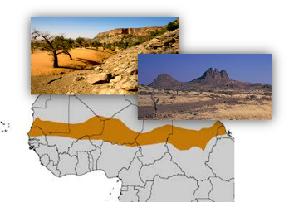
Projects: Estimated Biomass in South Sahara
Using NGA data to estimate tree and bush biomass over the entire arid and semi-arid zone on the south side of the Sahara
Project Summary:
Estimate carbon stored in trees and bushes in arid and semi-arid south Sahara
Establish carbon baseline for later research on expected CO2 fertilization of photosynthesis will first be manifested in the arid and semi-arid zones, because bushes and trees will use less water to grow, thus growing more
Replicate technique globally (i.e., Arctic where bushes and shrubs are moving into the tundra because of warmer conditions)
Proven successful method can be expanded for all arid and semi-arid areas of the planet if successful
Principal Investigator:
Compton J. Tucker, NASA Goddard Space Flight Center
Shadow
Tree Crown
NGA Imagery representing tree & shrub automated recognition
20
Notes:
Not ABoVE related but shows how the NGA data can be used in analytics

Slide 21
ABoVE Data Management at CISTO
Account Setup
User Data Upload
ABoVE
Users
NCCS/ABoVE User
Working Directory
Space
Curated
Peer Reviewed
Science Products
Data Backup
Until Data Reaches DAAC
ODISEA Data Discovery/Access System
ABoVE Curated Data Pool
Ready for DAAC’s
ADAPT Research Data and Product Access
ArcGIS Desktop and Portal
Satellite /Remote Sensing Image
Raster Data
Provided as Needed
Other Observation Datasets Provided as Needed
ABoVE P. I.
Phase 1 & 2 Products
Pre-ABoVE
Curated Products
DAAC Archive
Researchers
Policy Makers
Decision Makers
Applications
ArcGIS Server and Portal Access
Notes:
As a summary.. This talks about the users, storage, curation, arcgis tool, odisea, backup, DAAC’s and the total data management process for ABoVE.

Slide 22
Summary: Technical Infrastructure for ABoVE
CITSO’s 10 Year Commitment to Technical Solutions for Carbon Cycle & Ecosystems
ADAPT access (ASC), compute, storage, staged data, analytics, and technical Support
Data Management services/System Admin/User Support/Help Desk
Metadata, catalog, DOI, and science product transition to DAAC’s
ESRI ArcGIS Services for GIS (Server, Portal, Desktop)
On site access to NASA and NGA satellite imagery
Data search capability (ODISEA)
The ABoVE Science Cloud is a collaboration that promises to accelerate the pace of new Arctic science for researchers participating in the field campaign. Furthermore, by using the ABoVE Science Cloud as a shared and centralized resource, researchers reduce costs for their proposed work, making proposed research more competitive. (source: CCE Office)
22
Notes:
End with saying that other solicitations could use this model for their projects. Contact Mark McInerney for details and discussion.

Slide 23
Thank You
Questions?
23

