Slide 1
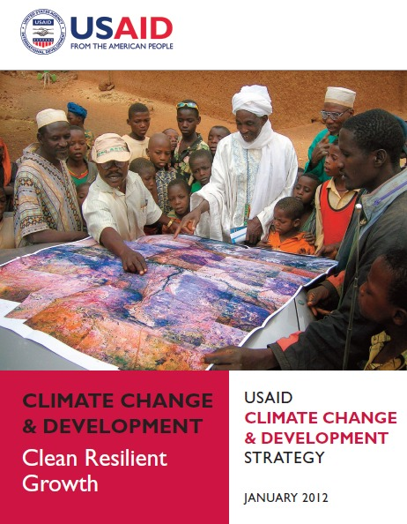
Global Climate Change: Earth Sciences Information Needs and Opportunities Kit Batten, Ph.D. USAID GCC Coordinator January 8, 2013

Slide 2
Overview:
NEEDS: Global climate change priority areas & information needs
EXAMPLES: How is data being used on the ground?
OPPORTUNITIES: How can earth science information providers engage with global climate change work?
Notes:
DATA and application needs

Slide 3
GROWING EMPHASIS ON:
The big picture…
Human impacts: Climate change matters for food, health, safety, economic growth
Adaptation & Mitigation: Climate data and knowledge can be used to manage change
Local data: Communities need scaled-down data to adapt
Interoperability: Communities & donors need data that connects with larger systems
Notes:
Within CC & Development work,
Beyond mitigation of GCC. Now we are already experiencing the impacts. How do we adapt? What information do we need in order to adapt? Not just modeling how to not exceed 2 degrees anymore
Interoperability:
Not reinventing the wheel in each jurisdiction
How do separately collected data sets talk to each other – standardizing data
Increasing power of observation and recommendations for action from larger data sets. We’re talking global scale here.

Slide 4
What are USAID climate change priorities?
USAID Climate Change and Development Strategy

Slide 5
USAID Climate Change and Development Strategy (2012-2016)
Overall goal: To help countries transition to climate-resilient, low-emission sustainable economic development
Mitigation (reducing emissions by shifting to clean energy & curbing emissions from land-use/land change)
Adaptation (building resilience to climate change for people, places & livelihoods with better info, planning & governance)
Integration (using climate practice across programs to ensure ALL USAID work is low-carbon & climate-resilient)

Slide 6
Helping partners & partner countries learn to:
USAID climate change activities
Access and use climate data & GIS services (to forecast trends and impacts in ALL sectors)
Build capacity for adaptation, carbon management and low-carbon activities
Engage in longer-term planning – 5 years-50 years or longer
Measure GHG performance across economic sectors (to engage in global talks & trade)
Practice good governance (adaptation/mitigation mean behavior change)
Notes:
**This includes ag, energy, tourism, transport, and many other sectors and activities
1-4 ALL require geo-data

Slide 7
Mitigation USAID supports a whole-of-government approach
Strategic Objective: Mitigation
EC-LEDS unites TWO familiar mitigation approaches:
Clean Energy (Result 1.1)
Establish a foundation for low carbon energy systems
Sustainable Landscapes (Result 1.2 )
Invest in land use practices that stop, slow, and reverse emissions from deforestation and degradation of forests and other landscapes
Notes:
**In both senses, USG and partner govts

Slide 8
Adaptation Increase resilience of people, places, and livelihoods
Strategic Objective: Adaptation
Result 2.1
Improve access to science and analysis for decision making
Result 2.2
Establish effective governance systems
Result 2.3
Identify and take actions that increase climate resilience

Slide 9
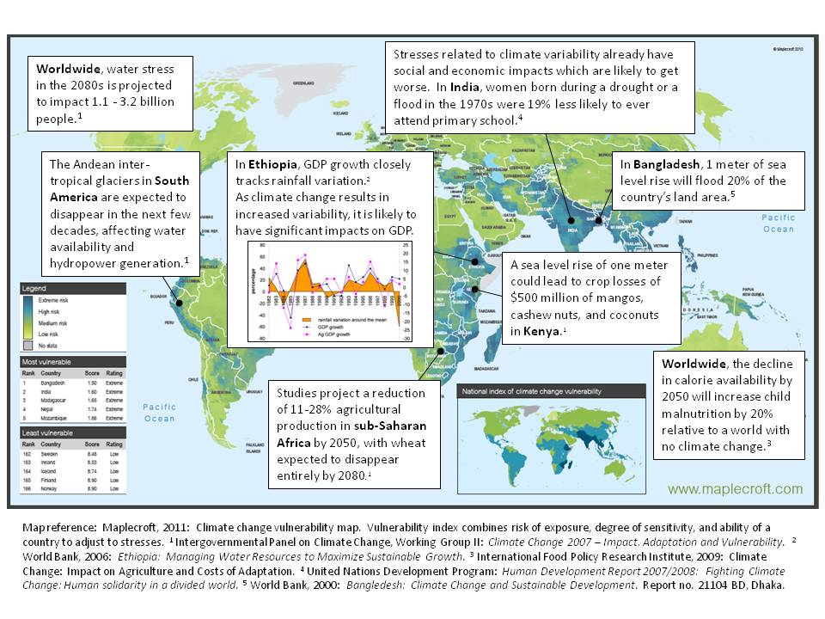
Anticipated human impacts
Notes:
Adaptation requires local, downscaled data. Because all impacts are local.
Drought & famine: Changes in rain & storm patterns are exacerbating droughts & famine in places like the Sahel, Ethiopia, Haiti. Shifting rainy seasons and higher temperatures can affect agriculture output (US 2012 drought losses were only estimated ~$5-10B – but global corn prices soared 12% y/y)
Intense storms & sea-level rise can threaten infrastructure, potentially costing tens of billions per storm (Sandy cost estimated at ~$30-50B; US aid package $9.7B)
Water supplies: Changing snowmelt/glacial melt can affect water resources (Hindu Kush snowmelt reaches up to 1.5 billion people downstream, from Afghanistan to China)

Slide 10
Integration To integrate climate change in USAID programming, policy dialogues, and internal operations – and thereby strengthen development outcomes
Strategic Objective: Integration
Result 3.1
Integrate climate change across USAID’s development portfolio
Result 3.2
Elevate the role of development climate change dialogues and policies.
Result 3.3
Lead by example through adoption of low emission and energy-saving operations

Slide 11
Integration & Key Development Sectors
Disaster preparedness & response: Need access to and capacity to use climate & weather data/data products
Food security: Must plan 5-yrs ahead – AND longer term
Health: Must prepare for changes in disease vectors, water-borne disease, heat-related illness, & water supplies
Sustainable economic growth: Need low-carbon, climate resilient economic growth & adaptation strategies
Gender, democracy & human rights, climate change hits poor and disenfranchised hardest – successful climate mitigation and adaptation strategies must be sensitive to these groups, not exacerbate existing inequalities
Global carbon markets, Need capacity to measure and report emissions

Slide 12
USAID Projects & Programs
FEWS NET & SERVIR

Slide 13
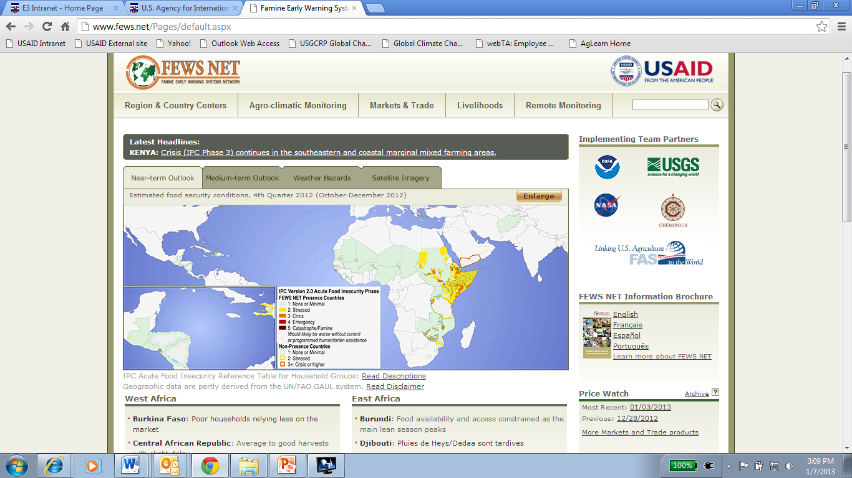
Notes:
(Famine Early Warning Systems Network)
FEWS NET reaches nearly 40 countries – mostly sub-Saharan Africa, also Central America, Haiti, Afghanistan, Tajikistan, Yemen.
This is the home page - FEWS NET is about data applications! – see the range of products beyond satellite data
FEWS NET offers climate monitoring, harvest monitoring on multiple scales (local to global) plus markets, trade & livelihoods data.
And risk ratings – see highlighted at risk regions in the Horn

Slide 14
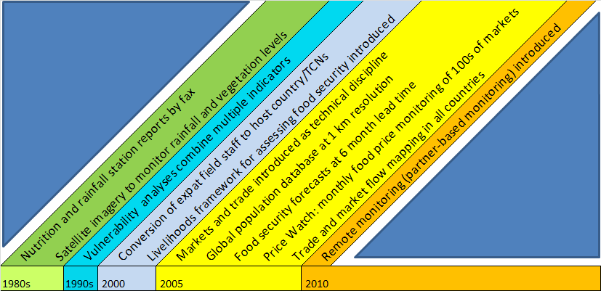
25 years of technical and strategic innovation…
FEWS
FEWS NET
Notes:
FEWS NET’s value is in its multiple & increasingly sophisticated applications
Satellite imagery first used in the 80s – not long after reports by fax
But note the rapid development of new products and applications - especially last decade
Today FEWS NET cross-references climate and weather data with market & price monitoring and population & livelihoods mapping

Slide 15
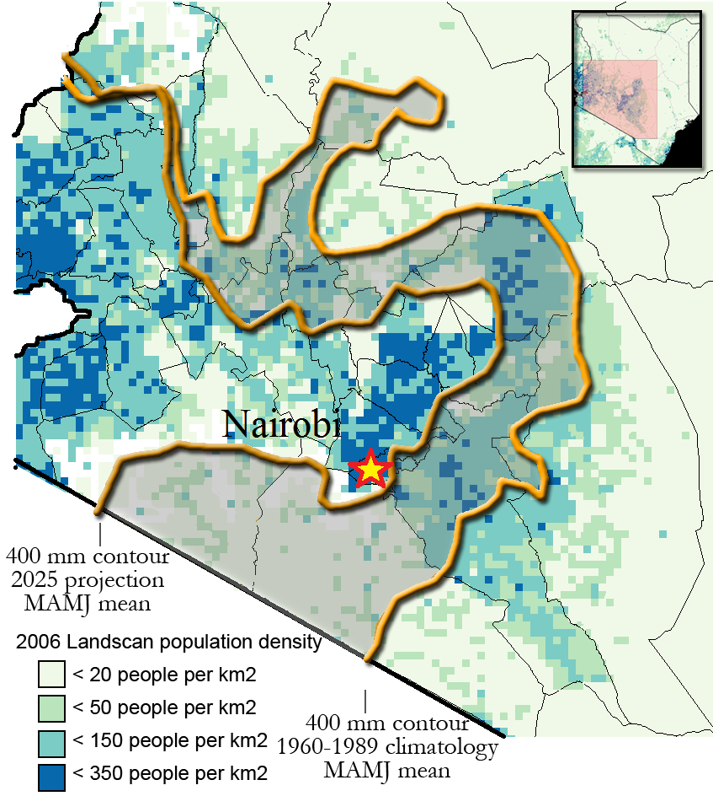
Problem: Global climate change data and patterns are not accurate at the national level…
Innovation: FEWS analyzes actual climate change data and patterns over last 30-50 years and projects trends forward to show 2025 impacts – generating scaled-down information useful to adaptation planning.
Kenya: Actual and projected agricultural areas being lost to CC
USAID/FEWS NET/USGS/UCSB
Notes:
This slide shows how FEWS NET uses SCALED DOWN data for Climate change.
FEWS analyzes actual climate change data and patterns over last 30-50 years and projects trends forward to show 2025 impacts
So FEWS generates scaled-down data that identifies where climate change is actually occurring in a way that’s useful for planning
Here we see that the area ok for ag (equated with at least 400 mm rain) in Kenya has shifted north-west and to higher elevations. Change from 1989 to what is projected in 2025
Another thing to note here is that the darker blue color represents higher population levels, so more of Kenya’s citizens will be vulnerable to GCC by 2025

Slide 16
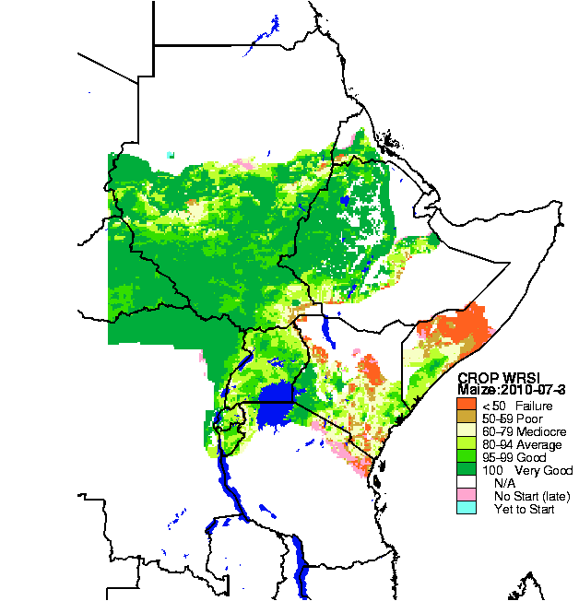
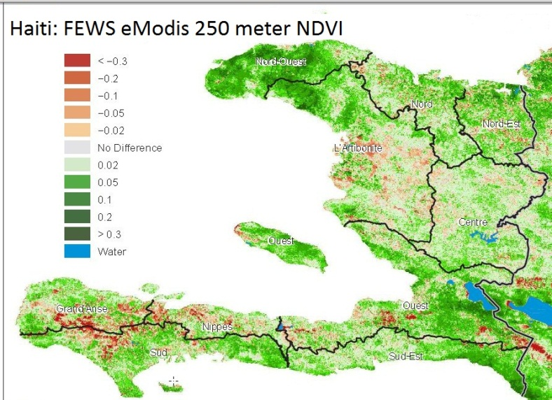
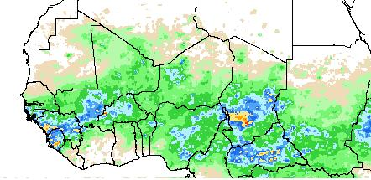
FEWS NET weather and crop monitoring products…
Very high resolution, almost real-time crop monitoring
Crop water requirements satisfaction index (WRSI)
Improved multiple-source rainfall estimation
Notes:
FEWS NET draws on multiple sources of data for targeted applications – see above weather, water & crop monitoring products
The Geospatial Water Requirements Satisfaction Index (WRSI) runs a crop-specific water balance model (this tool is currently being distributed by the Climate Hazards Group at the University of California, Santa Barbara)
This is a map of maize productivity in several east African countries. It’s in real time, according to existing rainfall. This is a model of phenological response of a given crop against available water supply
This type of map is used to forecast food shortages – see Somalia is in bad shape. Ethiopia doing ok. Kenya in between. This type of map helps distribute food aid to the tune of $1-$2B annually.
Real time data about plant biomass in Haiti. 2 years ago we were able to start getting 250m resolution compared to 7km resolution
Rainfall in Africa – now we have higher resolution satellite products from multiple sources of data
EMODUS allows us for express product delivery – these maps are generated on daily basis rather than weeks after the fact.

Slide 17
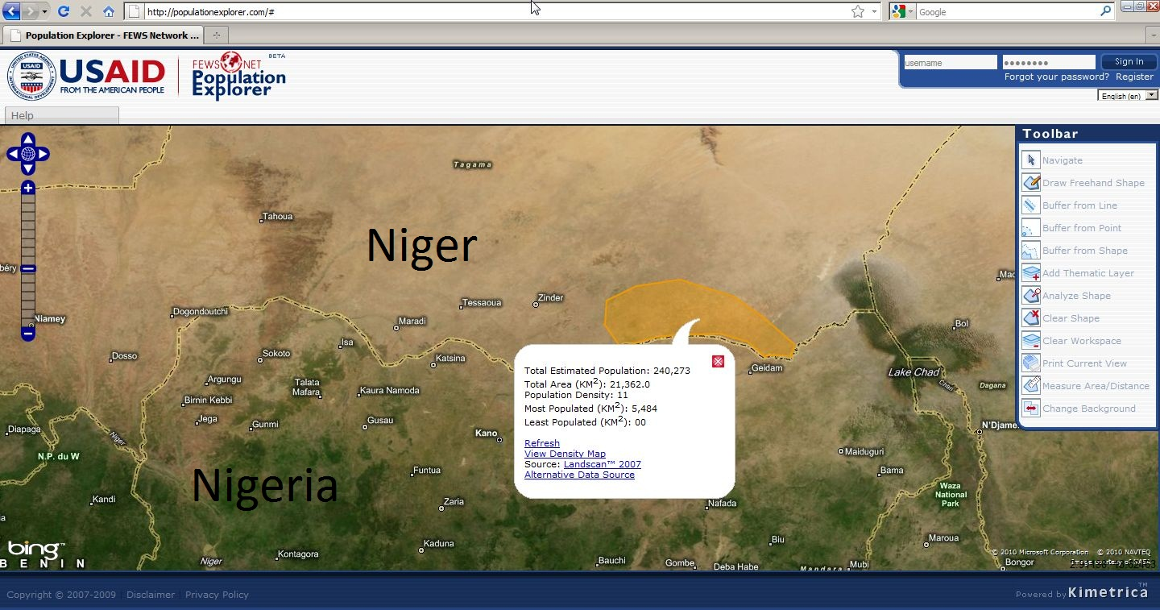
FEWS NET’s web-based population application
Notes:
And just to illustrate other products to give you a flavor…
Above, FEWS NET’s web-based population application gives the DoD’s Landscan (2011) satellite-based population estimate for every sq. kilometer on the globe.
Will start to incorporate this kind of data into food shortage predictions to make them even better starting soon.

Slide 18
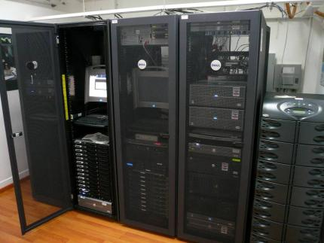
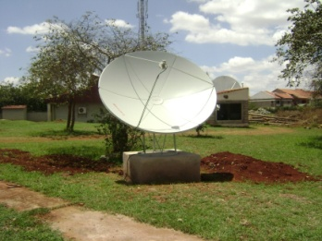
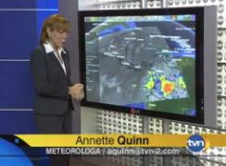
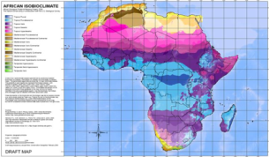
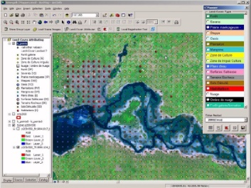
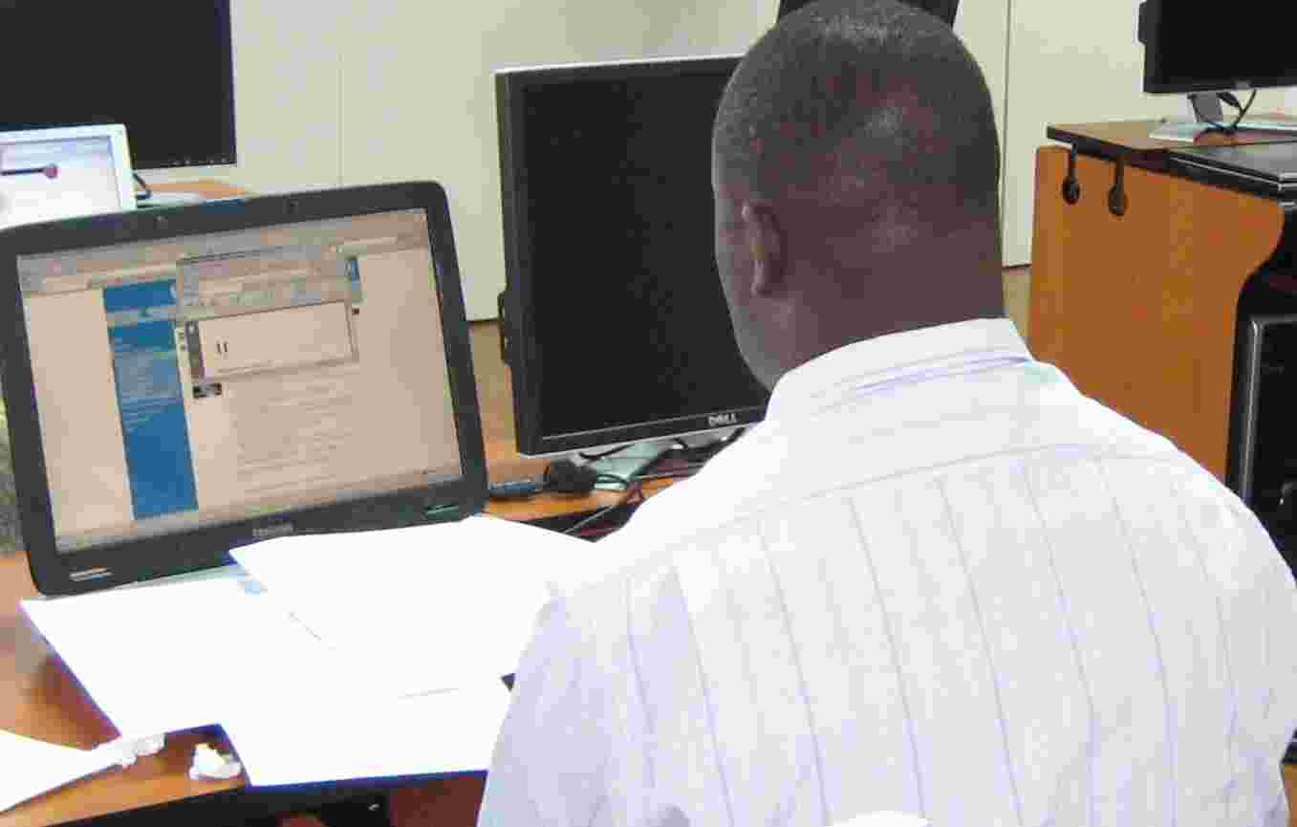
SERVIR Services
A common platform for:
Spatial analysis, monitoring, assessing extreme events
Sharing satellite & geospatial data
Disseminating products, decision-support tools
Geospatial technical support and map-making
Capacity building/training
Facilitating partnerships & collaboration
Notes:
Another model of delivering data for development is SERVIR
SERVIR builds this capability within regional institutions (hubs) which is unique – uses existing organizations to build expertise in regions
Partnership between USAID/NASA
Strengths in supply (NASA) – providing accress to and training on best available data and supplying decision support/applications.
Strengths in demand (USAID) – investing in better understanding users, their needs, capabilities, and what the market for these data products really is.
SERVIR program develops & uses a wide range of satellite & geospatial data applications
Wide range of applications includes fire mapping, flood mapping, ecosystem mapping, climate projections, predictive models and risk maps, and more

Slide 19
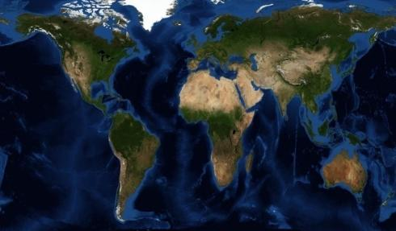
Current SERVIR Hubs: Coordination Office:
Notes:
SERVIR is global, with 3 hubs and plans to add more – a fast-growing program jointly funded by USAID, NASA and other partners
HQ in Huntsville, Alabama. HUBS in:
SERVIR-Mesoamerica is regional service providing analysis and visualization tools integrating satellite& geospatial data to support environmental monitoring
Africa Hub – or RCMRD = Regional Center for Mapping of Resources for Development
Himalaya Hub – or ICIMOD = International Centre for Integrated Mountain Development
Upcoming hub: SE Asia and looking for more expansion in the future.

Slide 20
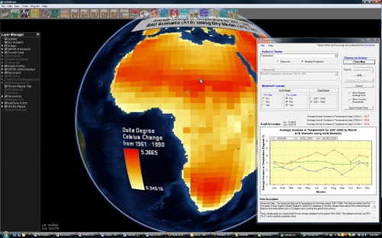
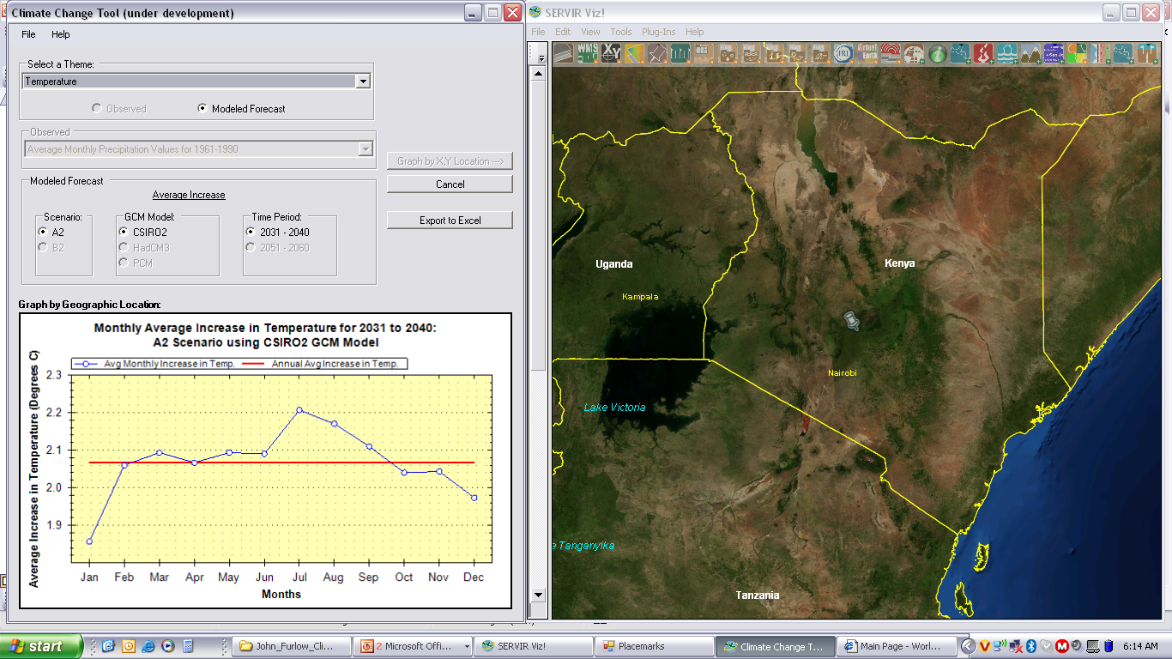
Mapping Climate Projections
Notes:
This is SERVIR VIZ Climate Mapper. Special user interface for projected climate data
Visualize and get access to future climate data. Not integrated with any data products yet, but is now used to visualize trends and provide access to the data.
Click on location on map
For the period 2030-2040, you can see the monthly projected average increase in temperature

Slide 21
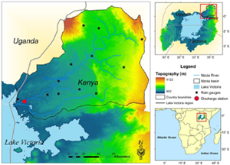
Predictive Models & Risk Maps
Flood Potential
Notes:
FEWSNET specific forecasts food security risk VERSUS SERVIR has a broader set of applications, often used to forecast risk of fire, floods, health threats, etc – as these slides illustrate
University of OK has developed a hydrologic model that has been calibrated for East Africa called CREST.
Using local streamflow monitor data, combined with TRMM (trim) satellite data (near real time rainfall info), they can provide a flood early warning to the MET dept and Ag ministry.

Slide 22
How Can Scientific Partners Get Engaged?
USAID Opportunities

Slide 23
CRSPs Collaborative Research Support Programs
Communities of U.S. universities that collaborate on long-term global food and agriculture research with developing country institutions http://crsps.net/
CRSP topics emerge through consultation between USAID and its BIFAD Board & the academic community
USAID funding via Washington and Missions; partners typically match 20-100% or more
USAID issues a request for applications from eligible universities. Other institutions can participate as partners under a lead proposal
Notes:
About 10 active CRSPs on topics like:
Livestock & Climate, Global Nutrition, Pest Management, Sustainable Natural Resources Management, Pulses & Grains, Horticulture, etc
CRSP topics emerge through consultation with academic community – no definite date when new CRSPs might be funded –
BIFAD (Board for International Food and Agricultural Development) a presidentially-appointed advisory council to USAID
http://crsps.net/

Slide 24
What is HESN?
The Higher Education Solutions Network is a constellation of 7 competitively selected American and international institutions and their partners convened to harness the intellectual power for development
Duke University
Makerere University- Uganda
University of California, Berkeley
Texas A&M University
The College of William & Mary
Massachusetts Institute of Technology
Michigan State University
Local Innovation & Evaluation
Food Security, Climate, Water
Innovation
Conflict & Development
Geospatial analysis and research
Resilience
Global Health & Innovation
Notes:
Launched in 2012, HESN is a network of seven new Development Labs to promote innovation
Berkeley, Duke, MIT, Michigan State, William & Mary, Texas A&M and Makerere in Uganda. www.usaid.gov/hesn
William & Mary in particular will focus on geospatial data and analysis www.usaid.gov/hesn/william-mary
MSU will focus on megatrends in climate, food & water http://www.usaid.gov/hesn/michigan-state

Slide 25
Initial Network awards
Seven awards, totaling approximately $26M per year
Beyond the 7 lead institutions, the network spans over 75 partners in academia, the private sector, NGOs, foundations and government partners
Notes:
The 7 lead institutions are working with USAID to develop and finalize the scope –

Slide 26
GDA-APS Global Development Alliance Grants
Smaller scale matching grants, up to $5 million from USAID
Each year, USAID issues a Global Development Alliance Annual Program Statement (GDA-APS) inviting proposals for public-private partnerships
Often private sector projects but open to academia
Best GDAs advance the partner’s core business interests and USAID development objectives
Applications for 2013 are due 31 January
Contact Kit Batten at kbatten@usaid.gov

Slide 27
Partnerships for Enhanced Engagement in Research
PEER began as a joint initiative with the National Science Foundation (NSF) to directly support developing country researchers collaborating with NSF-funded American Scientists
NSF
USAID
Congressional mandate is scientific research
Primary client is the US science community
Funding is allocated to US institutions
Merit review for research proposals is fundamental
Congressional mandate is foreign assistance
Primary clients are developing countries
Funding flows to foreign partner and/or US institution
Bureaus, regions, and missions need buy-in
MOU
Implementing Partner:
Notes:
Main goals of PEER
Advance quality research that will help address the challenges developing countries and the world faces
Who better to support in advancing research for development than those who know the problems best – the developing country researcher
And by leveraging NSF and their merit-review process though requiring collaborations with NSF-funded investigators, we are likely to have research outputs of high quality
Build research capacity in developing countries to create a more diverse and equal global research community and
Provide resources so that research programs can be built up with equipment, students, trainings, and other materials
Explore research questions important to their local community,
Contribute to the global dialogue on challenges the world faces in climate, clean energy, biodiversity conservation, food security and other important topics
Strengthening the collaborative network of researchers globally, particularly those involving developing country scientists
Want to provide support through the developing country scientists to existing collaborative projects but also new collaborations
Encourage developing country PI’s to look at NSF database to find matches
Proposals for workshops that will aim to build new collaborations are accepted
USAID will also plan workshops in gap areas that exist regionally, technically, etc.

Slide 28
PEER Science
2011: 1st Application Cycle
488 proposals from 63 countries
42 grants totaling approximately $5.5 million to support projects in 25 countries
Grants $30,000 to $50,000/year for 1-3 years
Selection based on technical merit and scientific feasibility, local and global development impact, and strength of collaboration
2012: 2nd Application Cycle – due December 2012
2013: 3rd Application Cycle – summer/fall
Research Topics:
Ecology, climate change, disaster mitigation, biodiversity, water supply natural resources, communication, etc.
Notes:
National Science Foundation funds a lot of domestic research at various universities, does not fund health.
PEER Science
Received 488 proposals from 63 different countries for first application deadline (November 30, 2011)
After completion of review process, 42 grants totaling approximately $5.5 million were awarded to support projects in 25 countries
These PEER Science grants leverage a total of more than $46 million in NSF awards supporting the projects of the U.S. partners involved
Current awards to be announced in May 2013
Detailed program requirements online at sites.nationalacademies.org/pga/dsc/peerscience/
28

Slide 29
We are excited by the opportunity to engage with the research community to provide the best knowledge and information to our global climate change programs… Thank you!

