Slide 1
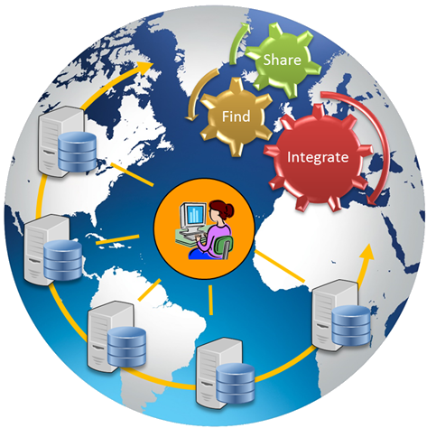
Community Inventory of EarthCube Resources for Geoscience Interoperability
Project Components,
Results, Issues
Ilya Zaslavsky
Raquel Calderon
chris condit
Jeffrey Grethe
amarnath Gupta
burak Ozyurt
Thomas Whitenack
David Valentine
Alice Giliarini
Aaron Gong
University of California San Diego
stephen Richard
Arizona Geological Survey
Kerstin lehnert, Leslie hsu
LDEO, Columbia University
Tanu Malik
University of Chicago
Luis bermudez
Open Geospatial Consortium
ESIP, Winter 2016

Slide 2
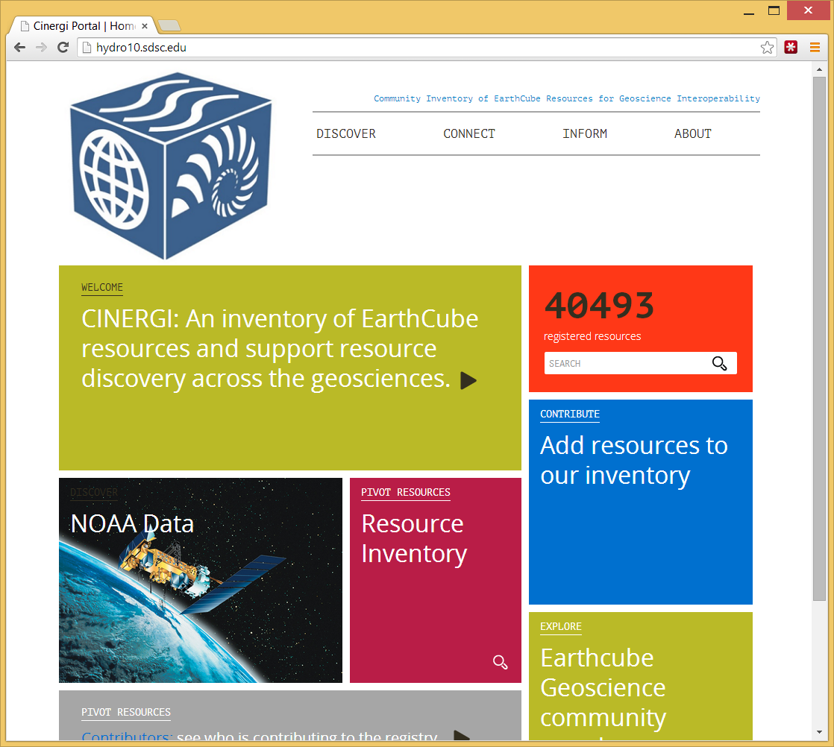
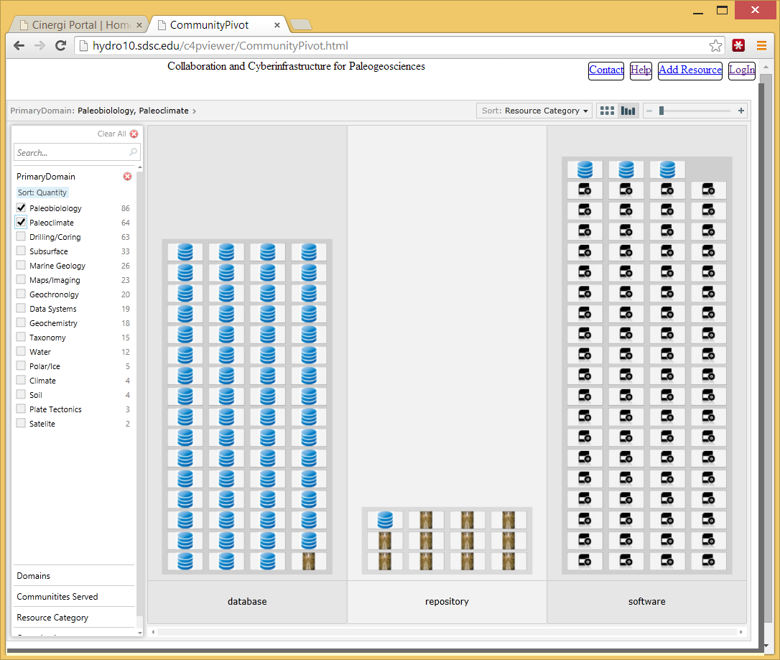
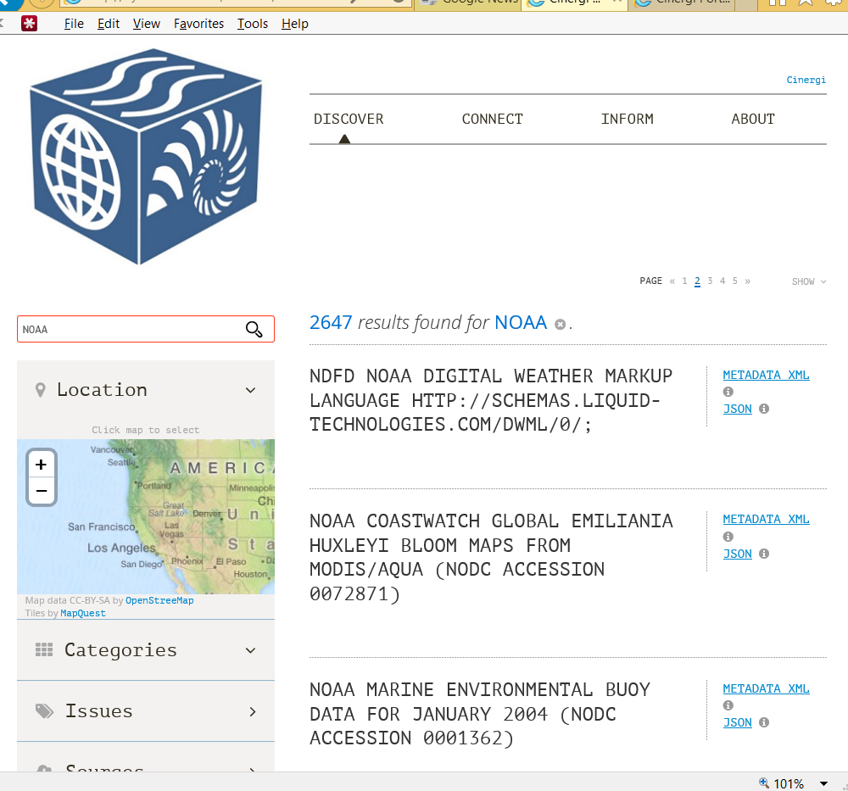
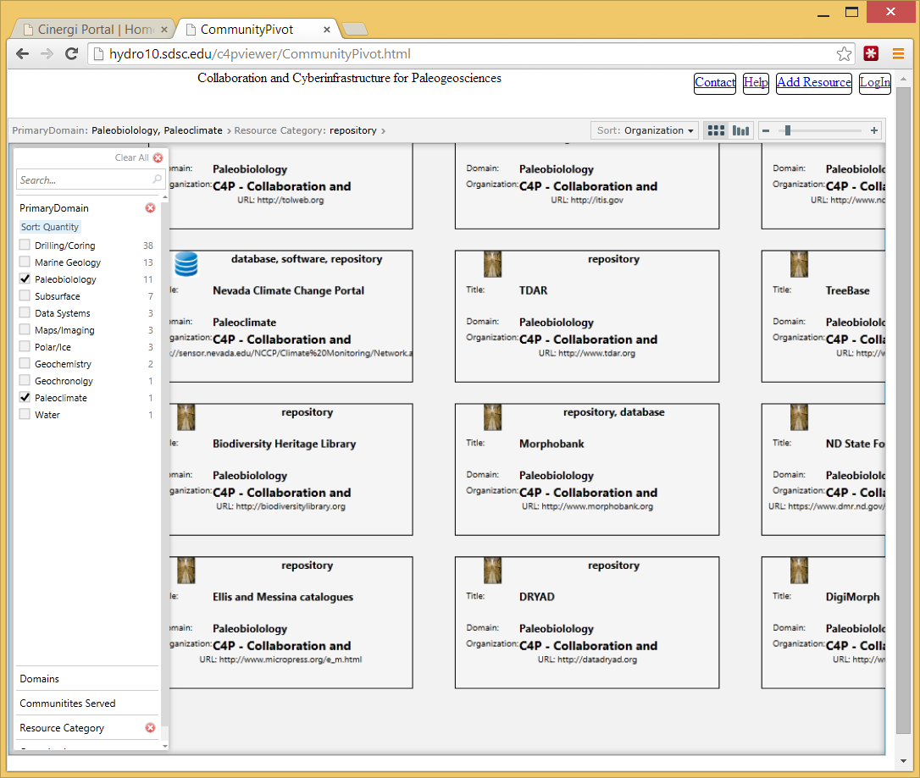
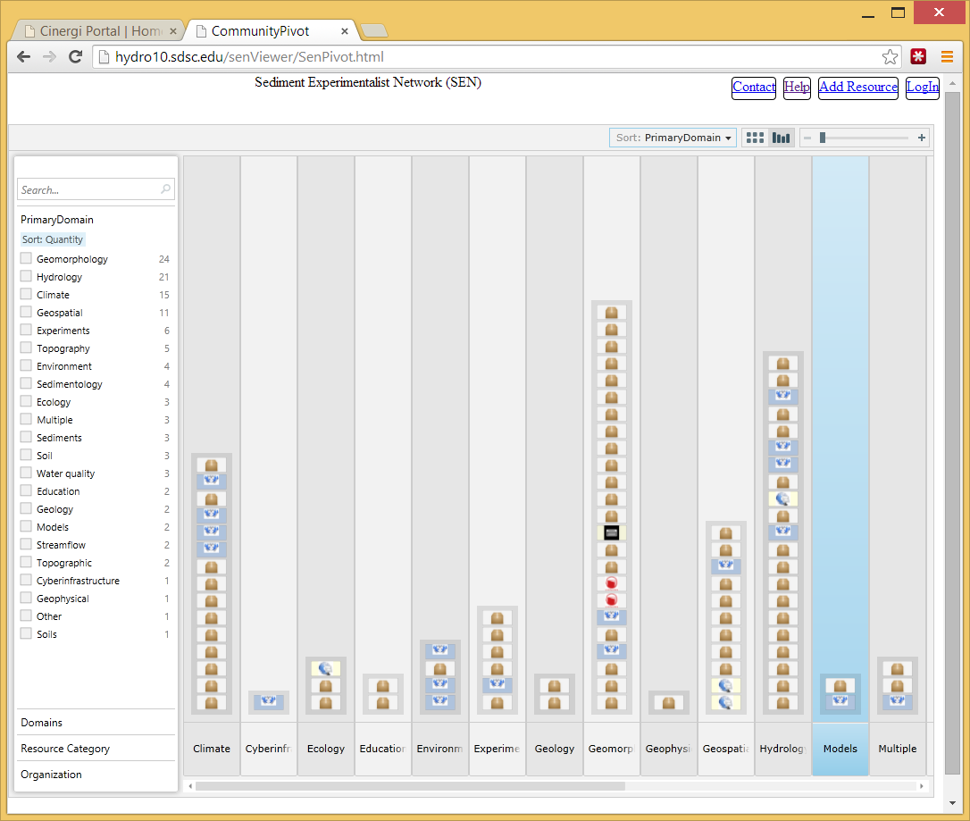
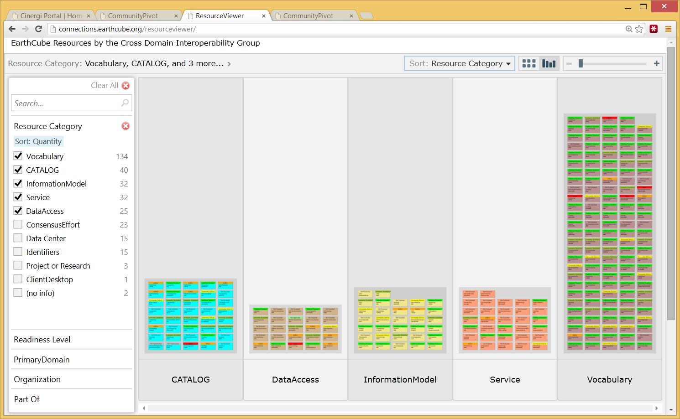
Metadata aggregation in CINERGI
Domain Inventories
CINERGI Metadata Pipeline
RCN (Research Coordination Networks)
Domain workshops
High-level assets
Catalogs

Slide 3
CINERGI metadata harvesting and content enhancement
Harvest adapters: description of information sources , allows connection and ingestion
Staging database: persist original harvested descriptions and updates from processing/curation
Document processing components: enhance content or presentation, update provenance record
Public access components: external interfaces to present content for users

Slide 4
Content enhancement components
Common enhancer API
Provenance recording: W3C PROV and Neo4J
Spatial enhancer (bounding boxes)
Keyword enhancer
Materials; Processes; Equipment; Methods; Features; Activities; Science Domains; Geologic age; Organizations; Resource types
GeoSciGraph API for semantic processing
Validation and provenance components

Slide 5
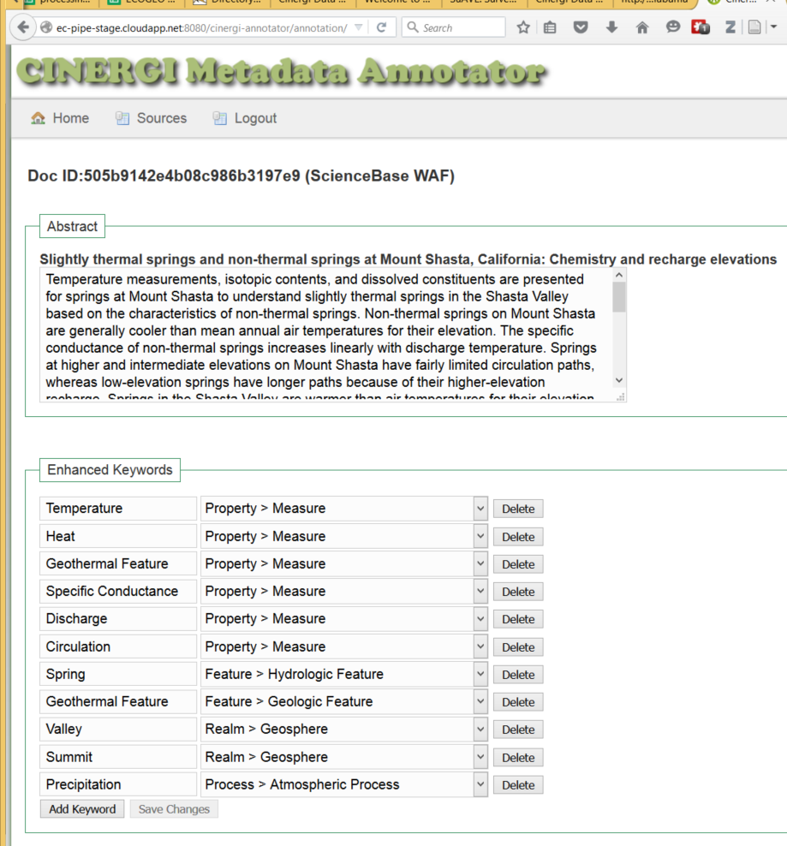
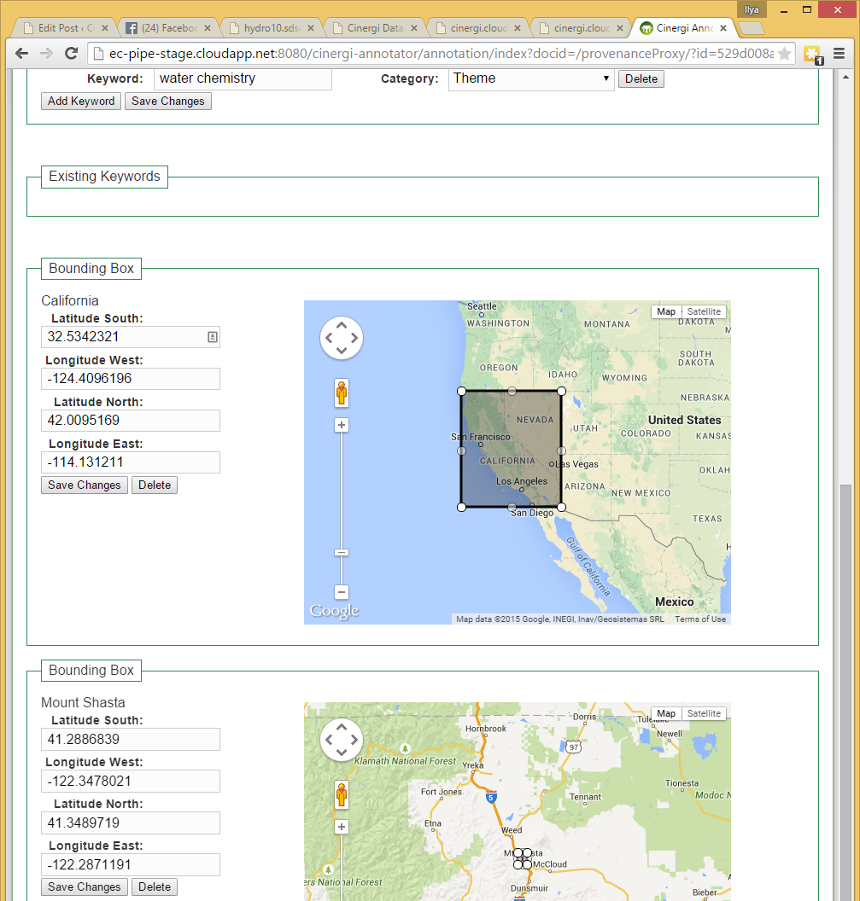
Manual Review of Keyword and Location Assignments for Machine Learning

Slide 6
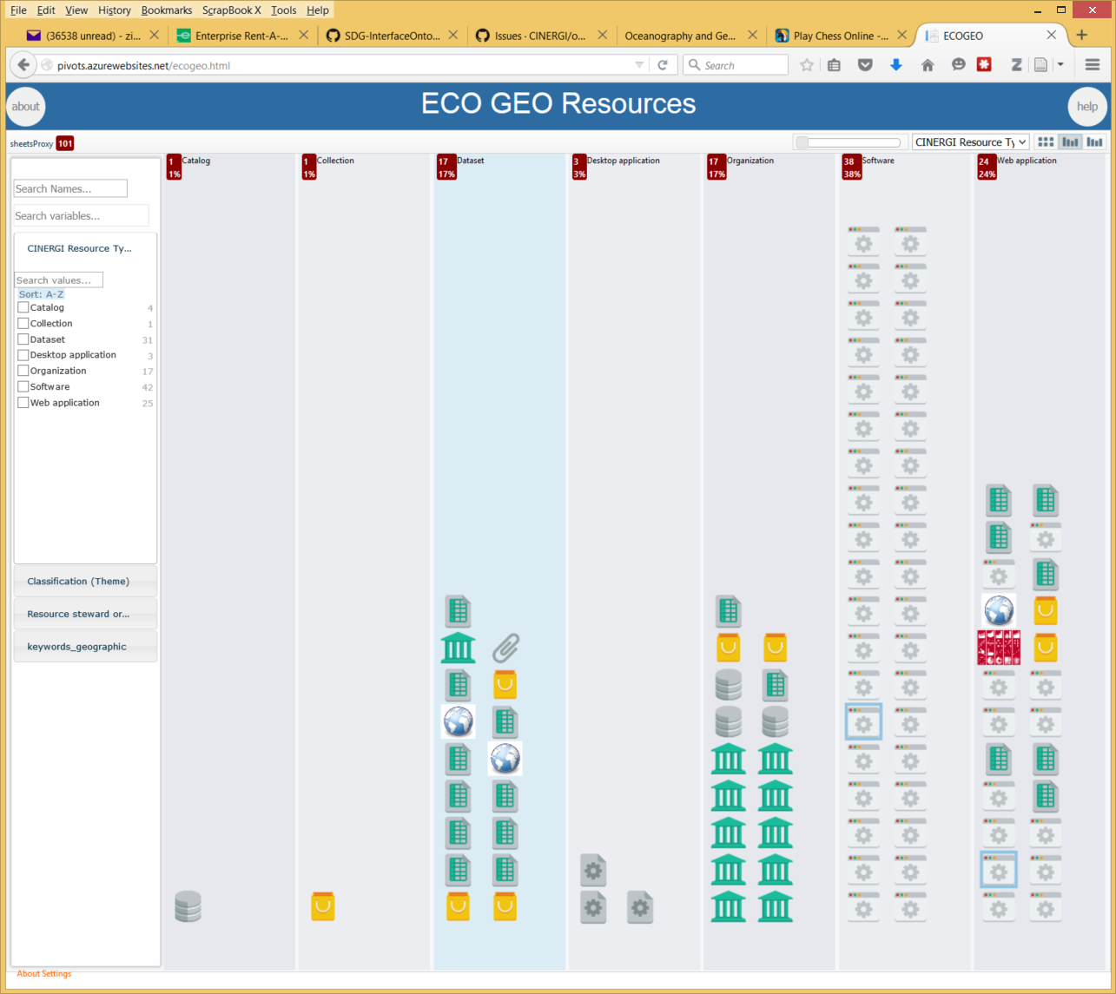
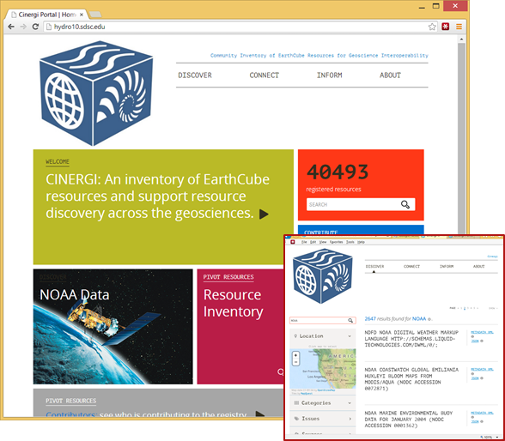
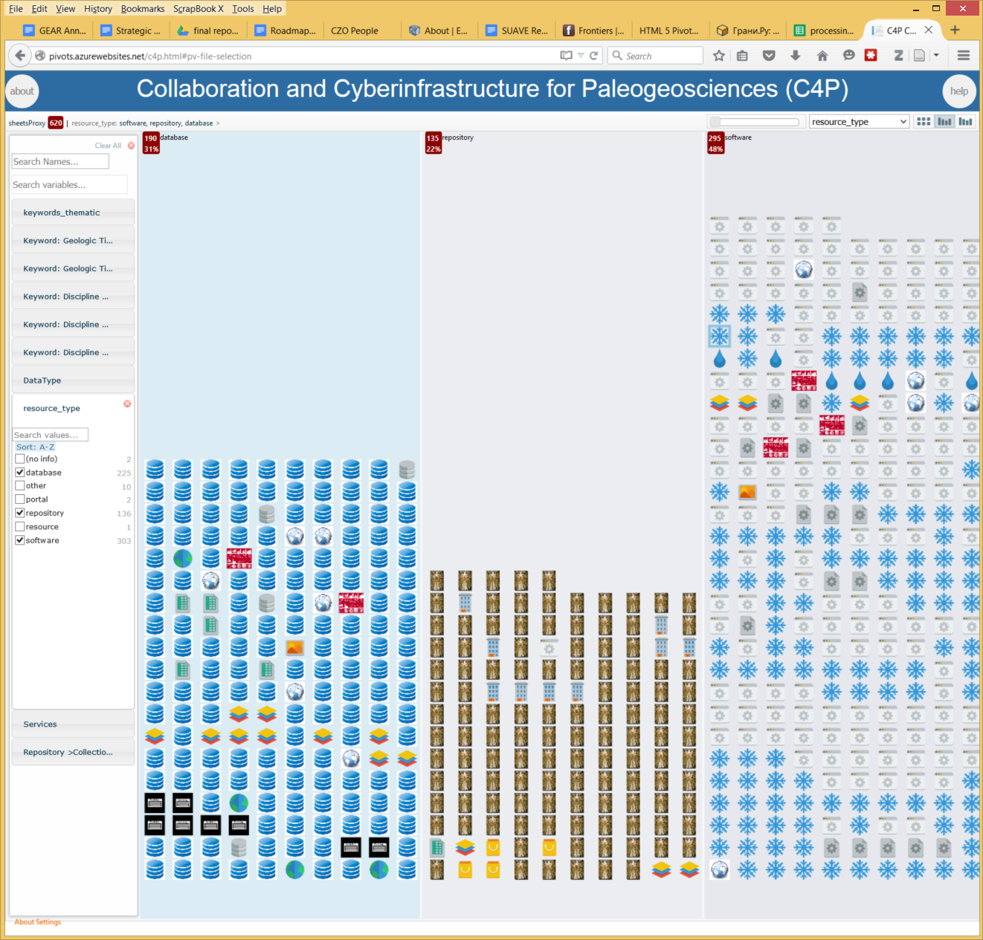
Working with geoscience communities
Resources from ECOGEO: “EarthCube Oceanography and Geobiology Environmental 'Omics”
pivots.azurewebsites.net/ecogeo.html
Resources assembled by the EarthCube paleogeoscience RCN
CINERGI Portal

Slide 7
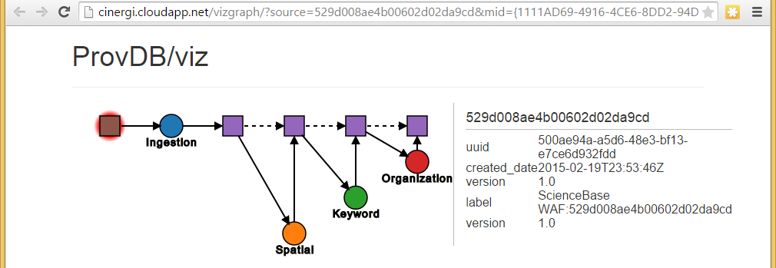
CINERGI Provenance
Resource harvested from a source, ingested into MongoDB, enhanced, and provenance recorded at each step in Neo4J
Versioning of Documents
Initial Source Document
Text description: how, why when, where
Enhancement
Activities

Slide 8
Interesting issues…
Scalability
Issues with Geoportal, Azure
Re-publishing linked data
ISO 19115? RDF? JSON-LD?
Semantic conflicts
Selecting which ontology IDs to use when conflicts
Our ability to detect concepts and assign keywords may not match ontology’s level of detail
Lots of tricks in the bridge ontology
Enabling faceting and search
Pre-defining upper facets; adjusting underlying ontology fragments for consistency (cinergiParent, cinergiFacet annotations)
Generating corpus of text to analyze (crawling, introspection)
Curating keyword assignments
Manual; Tool-Assisted; Community curation, Automated (Machine learning; Rules)
Adding usage metadata (eventually a facet?)
Communities may promote their own facets

Slide 9
Some very preliminary intermediate stats…
Source | harvested | published | faceted docs | total facets | facets/doc | #doc w/ facets | #doc w/out facets
Geoscience Australia | 6427 | 6426 | 5952 | 9523 | 1.60 | 4430 | 1996
NGDS Geoportal | 6536 | 5678 | 5254 | 10829 | 2.06 | 3912 | 1766
NOAA NGDC | 62 | 62 | 56 | 232 | 4.14 | 59 | 3
OpenTopography LiDAR Catalog | 176 | 176 | 164 | 589 | 3.59 | 168 | 8
Other Cinergi Curated Sources | 143 | 140 | 128 | 289 | 2.26 | 107 | 33
USGS ScienceBase | 53064 | 33532 | 30949 | 21736 | 0.70
U.S. Geoscience Information Network | 5866 | 1853 | 236 | 1150 | 4.87 | 223 | 36
USGS Coastal and Marine Geology Program | 149 | 149 | 143 | 32 | 0.22 | 18 | 131
data.gov | 27122 | 27115 | 24997 | 48664 | 1.95
 | 99545 | 75131 | 67879 | 93044 | 1.37

Slide 10
CINERGI’s role in EarthCube
If your data facility does manual metadata curation: explore CINERGI pipeline and see if automatic metadata enhancement is useful; examine metadata provenance for your records, help us train the system
If you organize a domain community: consider setting up and using a CINERGI community resource viewer
If you maintain a domain catalog:
consider interfacing it with CINERGI
Have interesting discovery use cases: contribute use cases from your domain, see what we need to add to CINERGI to support them (eg additional vocabularies, data repositories, harvest adapters…)
Contribute to and help curate existing inventories, esp. high-level resources, functional components
this will be used in EC architecture development

