Slide 1
Geoportal
Server
January 4, 2012
Christine White, Esri

Slide 2
A long time ago in a galaxy far, far away....
Geoportal
Server
became a viable tool many
others desired. Soon it was
A NEW HOPE
What began as a project
for the federal government
clear that the tool should be free
and open. This is the continuing story.

Slide 3
(Sidenote: Space-ial Data Infrastructure?)

Slide 4
Universe of challenges
How to comply with Open Government directives to share data?
Technical and administrative challenges to sharing?
How to discover data?
How to distribute authoritative datasets?
Metadata…

Slide 5
Geoportal Server Completes the SDI Platform
Inventory and Catalog
Search and Discovery
Providers
Access and Distribution
Consumers

Slide 6
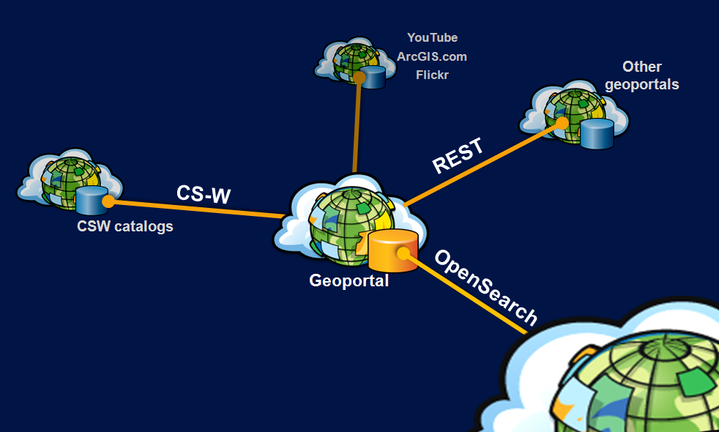
Creating connections across the data life cycle

Slide 7
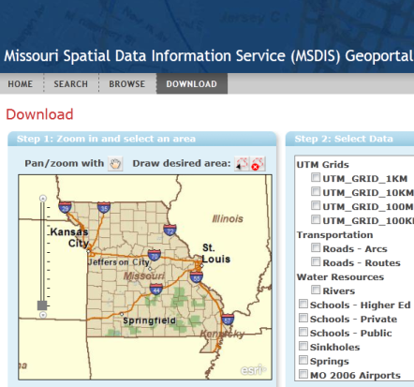
2005-2010

Slide 8
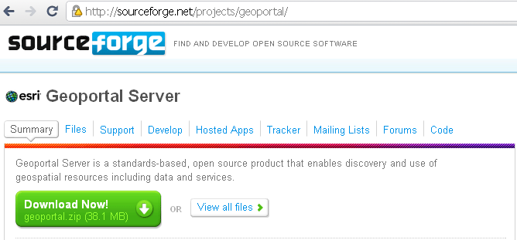
October 2010: “Esri Geoportal Server”
http://esriurl.com/geoportalserver
Apache 2.0 license

Slide 9
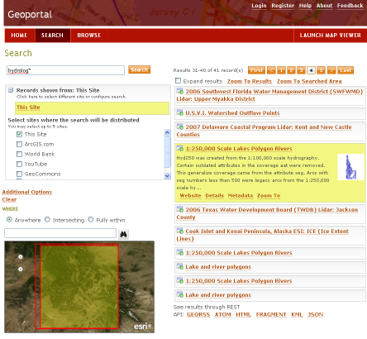
No-cost system setup
Apache Directory Server for authentication
Geoportal Server application
Flex-based map viewer with Geoportal search widget
Tomcat or GlassFish to serve web application
PostgreSQL database, metadata indexed by Lucene
OpenStreetMap, WMS, or ArcGIS Services for basemap

Slide 10
Popular Features (e.g., why do folks choose this tool?)
Open Source, yet supported and tested with other Esri products
Support for multiple metadata standards
Support for standards-based discovery protocols
Highly customizable web interface
Federated search
Accessible documentation

Slide 11
Version 1.2 (released Dec. 21)
Support for MySQL db
Use WMS, WMTS, or OSM for Search map
Ability to set an initial extent on Search map
CSV format for search results
Native publishing support for ISO 19115-2
Schematron validation
Harvest THREDDS
Collections

Slide 12
Links
Download Esri Geoportal Server
http://esriurl.com/geoportal
Public beta site
http://gptogc.esri.com/geoportal
Questions
cwhite@esri.com

