Slide 1


Elements of a Data Management Plan:
Identifying the materials to be created
Data Management Plans
Ruth Duerr
National Snow and Ice Data Center
Version 1.0
February 2013
Copyright 2013 Ruth Duerr
Notes:
Introduction: Slide 1
This is the Federation of Earth Science Information Partners Data Management for Scientists Short Course, Section: Data Management Plans - Elements of a Data Management Plan; Module: Identifying the Materials to be Created.
This training module is part of the Federation of Earth Science Information Partners (or ESIP Federation's) Data Management for Scientists Short Course. The subject of this module is "Identifying the Materials to be Created". The module was authored by Ruth Duerr from the National Snow and Ice Data Center at the University of Colorado in Boulder. Besides the ESIP Federation, sponsors of this Data Management for Scientists Short Course are the Data Conservancy and the United States National Oceanic and Atmospheric Administration (NOAA).

Slide 2
Overview
Your data management plan needs to discuss the type(s) of data produced during your research
Notes:
Slide 2: Overview
As discussed in the module “Data Management Plans: Elements of a Data Management Plan”, your data management plan needs to discuss the type or types of data that will be produced over the course of your research.

Slide 3
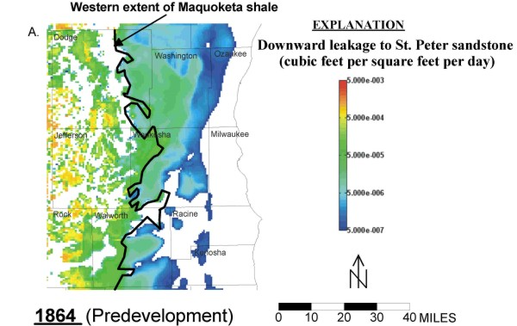
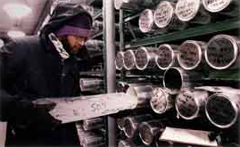


What is data? (1 of 3)
Some types of data are obvious
Data about samples
Model output
Photo by Scott Bauer
Data from laboratory experiments
Remotely sensed data
Data from field experiments
Notes:
Slide 3: What is data? (1 of 3)
Thinking about the type of your research data naturally leads to the question “What counts as data?” The answer to that question is not straightforward. Some types of data are obvious.
For example, the output of a computer model counts as data such as the image on the slide illustrating an historical model of freshwater recharge into an aquifer.
Measurements made during a field experiment are obviously considered data such as the one shown of a friend and colleague, Mark Parsons, setting up a weather station during the 2011 Arctic Observing Network (Snownet) project in Alaska.
Output from an experiment counts as data such as that conducted at the United States Geological Survey lab depicted in the center image.
Measurements taken from a sample also count as data; in this case, measurements from an ice core stored at the National Ice Core Lab in Colorado.
All sorts of remote sensing data count too.

Slide 4
What is data? (2 of 3)
Other types of data may not be so obvious:
Blueprints
Multimedia Files
Documents
Software
Course Materials
Notes:
Slide 4: What is data? (2 of 3)
Other types of information that may be considered as data may not be so obvious.
For example, if you are building an instrument or observatory or some sort of facility, your blueprints and other materials may count as data.
If you are developing software as part of your project, it may count as data. For example, the center image shows a form for a web application developed to help people advertise their data holdings by simply filling out the form and saving it to a publicly accessible web site. For this project, the web application source code counted as data, and is publicly available on gitHub.
A project that produces other forms of documentation or multimedia materials may well count those files as data.
Even course materials, curricula, or other training materials may be considered data.

Slide 5
What is data? (3 of 3)
Your program manager, the solicitation you are responding to, or your community may dictate this!
Notes:
Slide 5: What is data? (3 of 3)
So, how do you know exactly what counts as data? You need to talk to your program manager, read the solicitation, and become aware of standards for data within your community. That’s the only way to tell for sure.

Slide 6
For example:
For NASA’s Earth Science program data “includes observation data, metadata, products, information, algorithms including scientific source code, documentation, models, images, and research results”
For NSF “What constitutes such data will be determined by the community of interest through the process of peer review and program management. This may include, but is not limited to: data, publications, samples, physical collections, software and models.”
Notes:
Slide 6: For example
Guidance on what constitutes data varies from agency to agency. We’ve included the high level statements of guidance from both the National Aeronautics and Space Administration, NASA, and NSF, the National Science Foundation. You can see the statements are not identical, which makes sense given the different missions of each agency. Your best bet is to familiarize yourself with the guidance from your funding agency.

Slide 7
Resources
Data & Information Policy – NASA Science, http://science.nasa.gov/earth-science/earth-science-data/data-information-policy/, accessed 2/29/2012
US NSF – About, http://www.nsf.gov/bfa/dias/policy/dmpfaqs.jsp#1, accessed 2/29/2012
NOAA Administrative Order 212-15: http://www.corporateservices.noaa.gov/ames/administrative_orders/chapter_212/212-15.html
USGS National Climate Change and Wildlife Science Center guidance: https://nccwsc.usgs.gov/?q=content/data-policies-and-guidance
NIH Data Sharing Policy and Implementation Guidance:
http://grants1.nih.gov/grants/policy/data_sharing/data_sharing_guidance.htm
Notes:
Slide 7: Resources
We’ve included some additional resources that you might find helpful should you need more information about some of the topics we’ve covered in this module. To help you get started, we’ve included links to the high level guidance from many of the agencies that deal with Earth Science or human health data in the United States.

Slide 8
Other Relevant Modules
Data Management: Elements of a Data Management Plan
  For a high level overview of the content of a Data Management Plan
Data Management: Elements of a Data Management Plan
  Organization and Standards
    For details of another section of a Data Management Plan
Notes:
Slide 8: Other Relevant Modules
The modules of the ESIP Data Management for Scientists Short Course have been designed to complement and supplement each other. In light of this plan, we think you may find the following modules relevant as you seek to gain a better understanding of what should be included in a data management plan:
For a high level overview of the contents of a data management plan, see Data Management Plans: Elements of a Plan.
For more information on developing another specific element of a Data Management Plan, see
Data Management Plans: Elements of Plan: Organization and Standards

Slide 9
Recommended Citations
Duerr, R. 2013. “Data Management Plans - Elements of a Data Management Plan: Identifying the Materials to be Created.” In Data Management for Scientists Short Course, edited by Ruth Duerr and Nancy J. Hoebelheinrich, Federation of Earth Science Information Partners: ESIP Commons. doi:10.7269/P35D8PSC
Copyright 2013 Ruth Duerr
Notes:
Slide 9: Recommended Citation
This module is available under a Creative Commons Attribution 3.0 license that allows you to share and adapt the work as long as you cite the work according to the citation provided.
Thank you very much for your interest in the ESIP Federation’s Data Management for Scientists Short Course.

