Slide 1
Can Data be Organized for Science and Reuse?
Ted Habermann,
Aleksandar Jelenak
The HDF Group
thabermann@hdfgroup.org
Svetlana Shasharina,
David Fillmore
Tech-X Corporation
IN54A-05
Notes:
The Data Life Cycle is an important general concept for thinking about data collection, management, and preservation practices across the geophysical scientific data community. The cycle generally spans the scientific process from ideation, through experimental design, observation collection, data analysis and visualization, publication, archive, distributions and eventual reuse. During the cycle, the data may change through new analyses, presentations, and responsible parties, but, historically, the format and organization of the data have generally remained the same. Data collected as a time series at a point remains as a time series and data collected/calculated as grids remains as grids. BIP is BIP and BSQ is BSQ. In fact, in many large data centers, the native format remains sacrosanct and, in the scientific community, reformatting is avoided because of fear of losing information or introducing data quality problems and irreproducible results.
This traditional approach has worked well in areas where data are collected and used for a single purpose throughout the life cycle and domains where comparisons across different data sets are rare and problematic due to conflicting data organizational structures or incomplete documentation. This is not the world we live in today. Reuse for unexpected purposes and data (and model) comparisons are becoming increasingly common (e.g. climate model / observation comparisons). Data sets are preserved for future global investigators that may be unaware of the original project or purpose of the data. Also, it is becoming more common for data to be restructured and reformatted for particular problem or to support a flexible web service. Unfortunately, many of these efforts do not preserve the metadata that, hopefully, accompanies the data in the original format.
In this presentation we will discuss alternative approaches to data management that will facilitate data reuse across teams and disciplines.

Slide 2
Data Organizations
ESDIS
Data As Collected / Calculated
Format: HDF4, GRIB, …
Conventions: HDF-EOS, ~HDF-EOS
File Structure: 1 file / time step
Metadata: With granules
Optimized: Synoptic (lat/lon)
Service: WCS
P₁
P₂
P₃
time
P₁
P₂
P₃
lat
lon
metadata
ESGF
Data Reorganized
Format: netCDF3, HDF4, HDF5
Conventions: CF
File Structure: 1 file / parameter
Metadata: With granules
Optimized: Synoptic (lat/lon)
Service: WCS
P₁
P₂
P₃
time
lat
lon
lon
lon

Slide 3
Data Organizations
metadata ???
Data Rods
Format: Custom binary
Conventions: None
File Structure: 1 file / pixel
Metadata; ???
Optimized: Time Series Views
Service: WFS, SOS
time
P₁
3D Chunking / Compression
Format: HDF5
Conventions: HDF-EOS, CF,
GDAL
File Structure: 1 file or 1 / chunk
Metadata: All in table
Optimized: Multiple Views
Service: WCS, WFS, SOS
metadata
-- -- --- - ---
-- -- --- - ---
-- -- --- - ---
-- -- --- - ---
-- -- --- - ---
-- -- --- - ---
-- -- --- - ---
-- -- --- - ---
-- -- --- - ---
-- -- --- - ---
-- -- --- - ---
-- -- --- - ---
-- -- --- - ---
-- -- --- - ---
-- -- --- - ---
-- -- --- - ---
time
P₁
lat
lon

Slide 4
Go Small – Object Store
metadata
-- -- --- - ---
-- -- --- - ---
-- -- --- - ---
-- -- --- - ---
-- -- --- - ---
-- -- --- - ---
-- -- --- - ---
-- -- --- - ---
-- -- --- - ---
-- -- --- - ---
-- -- --- - ---
-- -- --- - ---
-- -- --- - ---
-- -- --- - ---
-- -- --- - ---
-- -- --- - ---
metadata
-- -- --- - ---
-- -- --- - ---
-- -- --- - ---
-- -- --- - ---
-- -- --- - ---
-- -- --- - ---
-- -- --- - ---
-- -- --- - ---
-- -- --- - ---
-- -- --- - ---
-- -- --- - ---
-- -- --- - ---
-- -- --- - ---
-- -- --- - ---
-- -- --- - ---
-- -- --- - ---

Slide 5
HDF4Maps - Arrays
<h4:Array name="localDirection" path="/Swath" nDimensions="4" id="ID_A44">
<h4:arrayData fastestVaryingDimensionIndex="3"> <h4:byteStreamSet> <h4:byteStream offset="159790" nBytes="27648"/> <h4:byteStream offset="727378" nBytes="27648"/> <h4:byteStream offset="1229156" nBytes="27648"/> <h4:byteStream offset="1730934" nBytes="27648"/> </h4:byteStreamSet> </h4:arrayData>
<!-- value(s) for verification localDirection[0,0,0,0]=48.724838 localDirection[993,0,0,0]=48.749168 localDirection[0,26,0,0]=48.418507 localDirection[993,26,0,0]=48.443016 localDirection[0,0,1,0]=30.902325 localDirection[993,26,1,0]=34.908806 localDirection[0,0,0,1]=34.543011 -->
</h4:Array>

Slide 6
HDF4Maps - Chunks
<h4:Array name="BRDF_Albedo_Quality" path="/MOD_Grid_BRDF/Data Fields" nDimensions="2" id="ID_A1">
<h4:arrayData compressionType="deflate" deflate_level="8">
<h4:chunks>
<h4:chunkDimensionSizes>100 1200</h4:chunkDimensionSizes> <h4:byteStream offset="35858" nBytes="192" chunkPositionInArray="[0,0]"/> <h4:byteStream offset="41697" nBytes="146" chunkPositionInArray="[100,0]"/> <h4:byteStream offset="55267" nBytes="206" chunkPositionInArray="[200,0]"/> <h4:byteStream offset="57350" nBytes="199" chunkPositionInArray="[300,0]"/> </h4:chunks>
</h4:arrayData>
<!-- value(s) for verification BRDF_Albedo_Quality[0,0]=255 BRDF_Albedo_Quality[1199,0]=255 BRDF_Albedo_Quality[0,1199]=255 -->
</h4:Array>

Slide 7
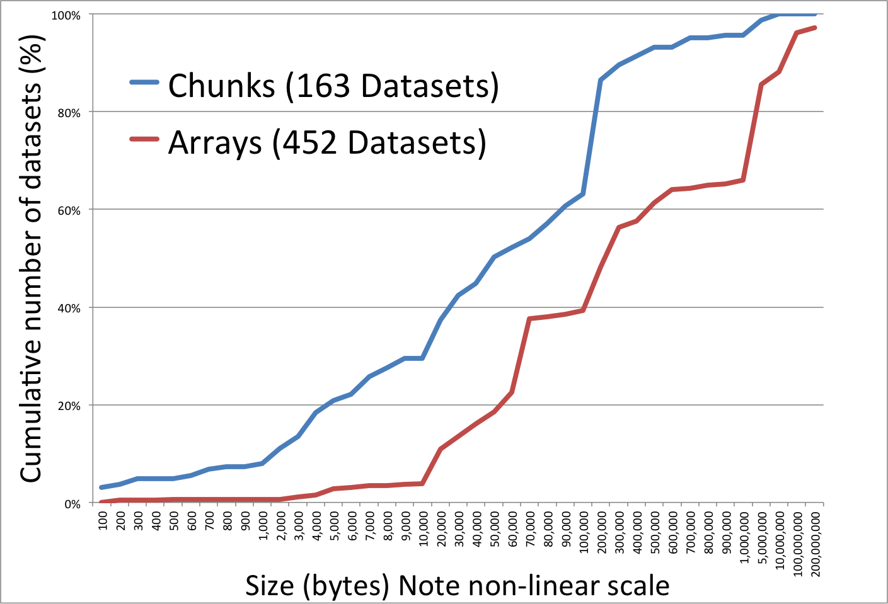
byteStream Sizes

Slide 8
Metadata Levels & Interoperability
Collection
ECHO
Data.Gov
CSDGM &
Extensions
DIF
CSW, WCS, WMS, WFS, SOS
ISO 19115, 19115-2, 19139, 19115-1, 19115-3
Core Metadata
ncISO / ACDD
Discovery Only
Discovery Only
ISOInHDF
HDF-EOS
NUG / CF
Granules

Slide 9
Data Organization Spectrum
P₁
P₂
P₃
metadata
-- -- --- - ---
-- -- --- - ---
-- -- --- - ---
-- -- --- - ---
-- -- --- - ---
-- -- --- - ---
-- -- --- - ---
-- -- --- - ---
-- -- --- - ---
-- -- --- - ---
-- -- --- - ---
-- -- --- - ---
-- -- --- - ---
-- -- --- - ---
-- -- --- - ---
-- -- --- - ---
P₁
P₂
P₃
Chunks
Time Series
Maps

Slide 10
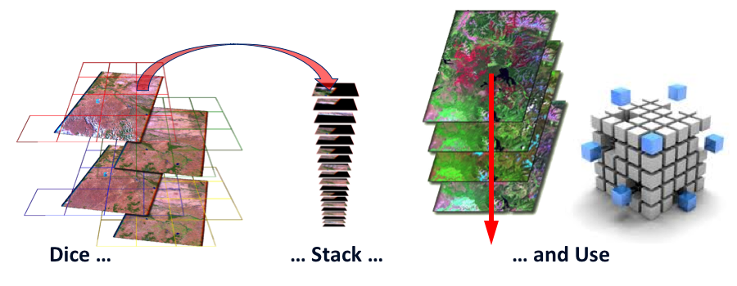
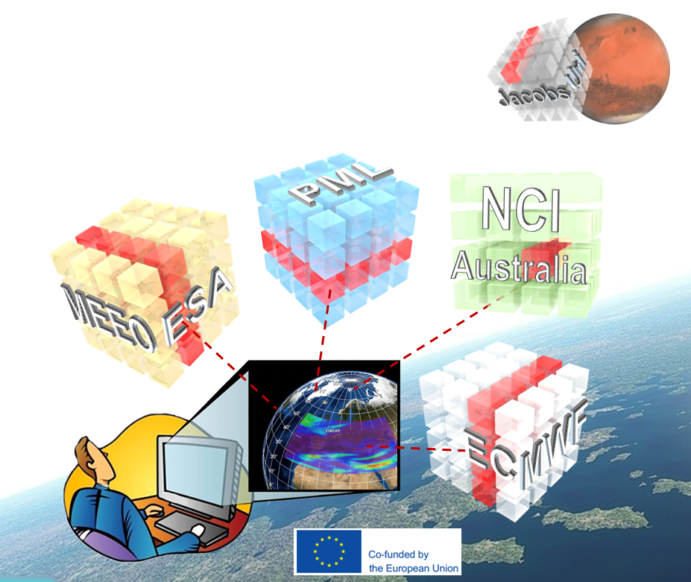
Go Big
Australian Data Cube
Raster Data Management System (Rasdaman)

Slide 11
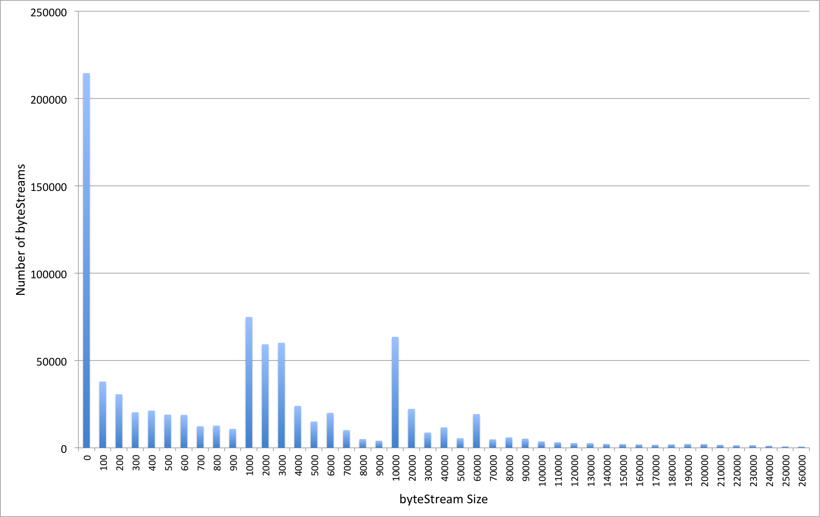
Lots of objects
624 files
853995 objects
~1400/file

Slide 12
Evolving Backends - Persistent API’s
S
T
A
B
I
L
I
T
Y
Existing Analysis, Visualization Applications
New Cloud Applications
HDF5 Library (C, Fortran, Java, Python)
Virtual Object Layer
Local Files
Chunked
Cloud
metadata
metadata
-- -- --- - ---
-- -- --- - ---
-- -- --- - ---
-- -- --- - ---
-- -- --- - ---
-- -- --- - ---
-- -- --- - ---
-- -- --- - ---
-- -- --- - ---
-- -- --- - ---
-- -- --- - ---
-- -- --- - ---
-- -- --- - ---
-- -- --- - ---
-- -- --- - ---
-- -- --- - ---
time
lat
lon
Data Migration / Evolution

Slide 13
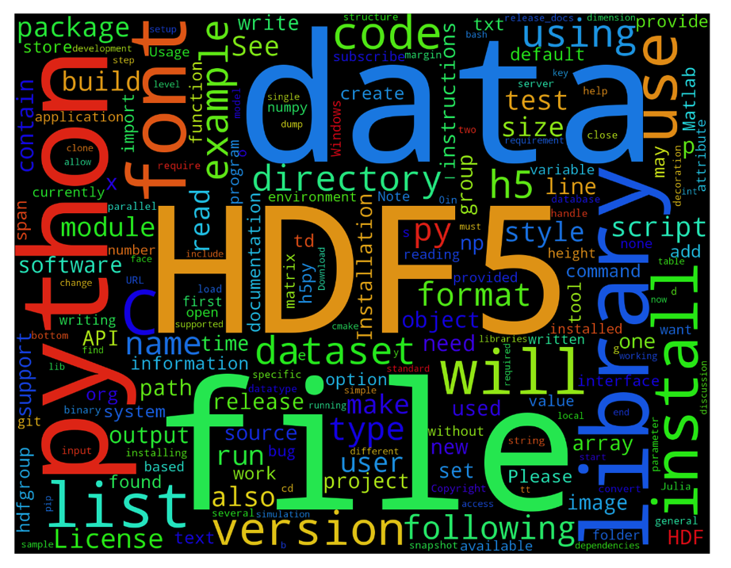
HDF API is already ubiquitous
Thousands of C, C++ and Fortran Applications in all disciplines
Over 450 github projects using HDF
Over 100 pypy modules using h5py

Slide 14
Acknowledgements
This work was partially supported by NASA Advanced Information System Technology.
Any opinions, findings, conclusions, or recommendations expressed in this material are those of the author and do not necessarily reflect the views of NASA or The HDF Group.

